Slide 1



ICSE’15 Technical Briefing:
The Art and Science of
Analyzing Software Data:
Quantitative methods
Tim Menzies : NcState, USA
Leandro Minku : U. Birmingham, UK
Fayola Peters : Lero, UL, Ireland
http:// unbox.org/open/
trunk/doc/15/icse/techbrief

Slide 2
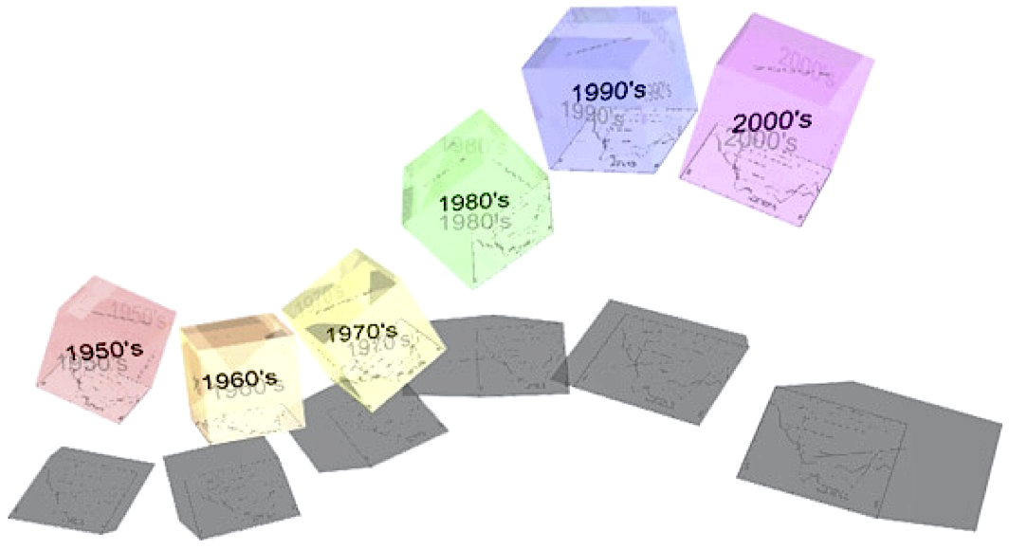
What’s next?
2023 ?
2033 ?
• Statistics
• Operations research
  • Machine Learning
    • Data mining
      • Predictive Analytics
      • Business Intelligence
        • Data Science
          • Big Data
          • Smart Data
            • ???
Seek core principles that may
last for longer that just your next
application.

Slide 3



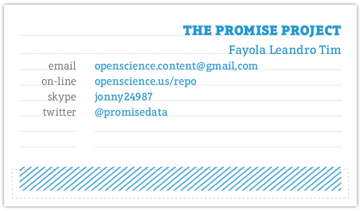
Who we are…
Tim Menzies
North Carolina State, USA
tim.menzies@gmail.com
Leandro L. Minku
The University of Birmingham, UK
L.L.Minku@cs.bham.ac.uk
Fayola Peters
LERO, University of Limerick, Ireland,
fayolapeters@gmail.com
Card carry members of
“the PROMISE project”

Slide 4
1. Introduction
2. Sharing data
3. Privacy and Sharing
4. Sharing models
5. Summary

Slide 5
1. Introduction
2. Sharing data
3. Privacy and Sharing
4. Sharing models
5. Summary
1a. Analyzing software: why?
1b. The PROMISE project

Slide 6
1a. Analyzing software: why?
In the 21st century, too much data:
  Impossible to browse all available software project
  E.g. PROMISE repository of SE data
    grown to 200+ projects standard projects
    250,000+ spreadsheets
  And a dozen other open-source repositories:
    E.g. see next page
    E.g Feb 2015
      Mozilla Firefox : 1.1 million bug reports,
      GitHub host 14+ million projects.

Slide 7
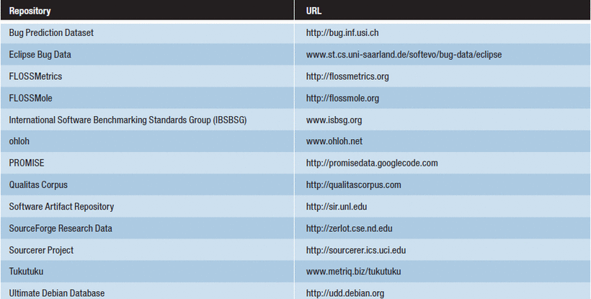
1a. Analyzing software: why?

Slide 8
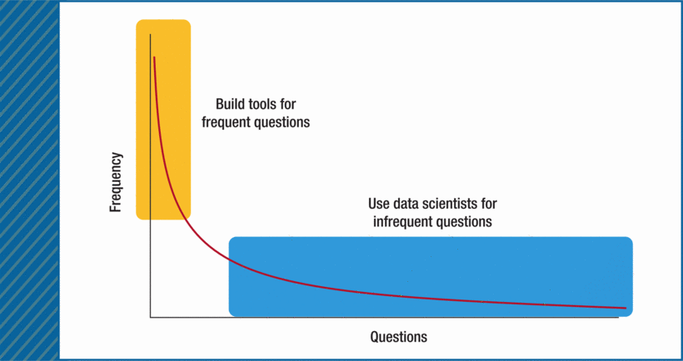
1a. Analyzing software: why?
Software engineering is so diverse;
What works there does not here;
Need cost effective methods for finding best local lessons;
Every development team needs a team of data scientists.

Slide 9
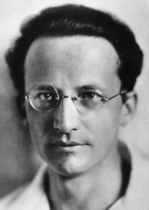
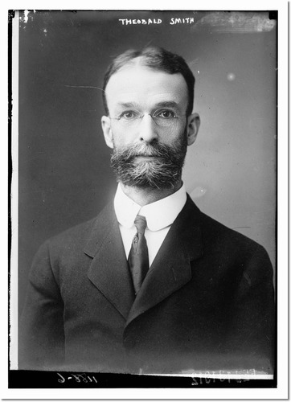
1b. The PROMISE Project
If you cannot- in the long run- tell everyone what you have been doing, your doing has been worthless.
  Erwin Schrodinger
  Nobel Prize winner in physics
  1887 -- 1961
Research has deserted the individual and entered the group. The individual worker find the problem too large, not too difficult. (They) must learn to work with others.
  Theobald Smith
  American pathologist and microbiologist
  1859 -- 1934

Slide 10
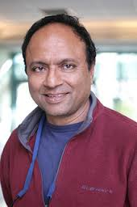
If it works, try to make it better
1b. The PROMISE Project
“The following is my valiant attempt to capture the difference (between PROMISE and MSR)”
“To misquote George Box, I hope my model is more useful than it is wrong:
  For the most part, the MSR community was mostly concerned with the initial collection of data sets from software projects.
  Meanwhile, the PROMISE community emphasized the analysis of the data after it was collected.”
“The PROMISE people routinely posted all their data on a public repository
  their new papers would re-analyze old data, in an attempt to improve that analysis.
  In fact, I used to joke “PROMISE. Australian for repeatability” (apologies to the Fosters Brewing company). “
Dr. Prem Devanbu
UC Davis
General chair, MSR’14

Slide 11

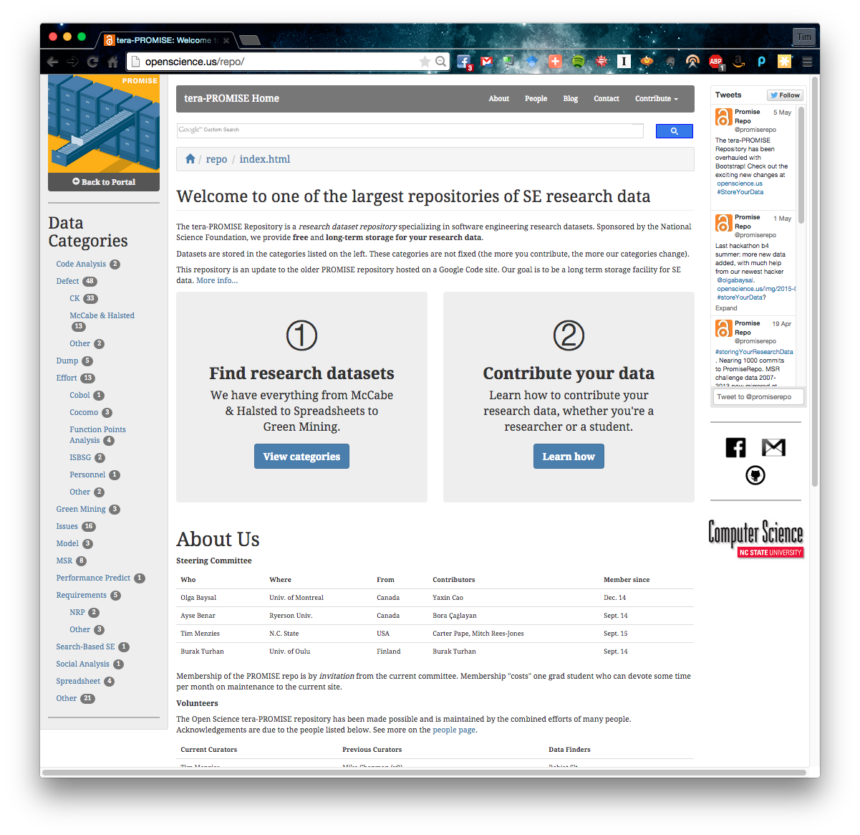
1b. The PROMISE Project
Serve all our data, on-line
The PROMISE repo
openscience.us/repo
#storingYourResearchData
URL
  openscience.us/repo
  Data from 100s of projects
  E.g. EUSE:
    250,000K+ spreadsheets
Oldest continuous
repository of SE data
  For other repos, see
  Table 1 of goo.gl/UFZgnd

Slide 12


1b. The PROMISE Project
Challenges
Initial, naïve, view:
  Collect enough data …
  … and the truth will emerge
Reality:
  The more data we collected …
  … the more variance we observed
  Its like the microscope zoomed in
    to smash the slide
So now we routinely slice the data
  Find local lessons in local regions.

Slide 13



1b. The PROMISE Project
Our summary. And other related books
The MSR
community
and others
Perspective on
Data Science
for Software
Engineering
Tim Menzies
Laurie Williams
Thomas
Zimmermann
2014
2015
2016

Slide 14
1b. The PROMISE Project
This briefing
Selected lessons from
“Sharing Data and Models”

Slide 15
1. Introduction
2. Sharing data
3. Privacy and Sharing
4. Sharing models
5. Summary
Step 1: Throw most of it away
Step 2: Share the rest

Slide 16
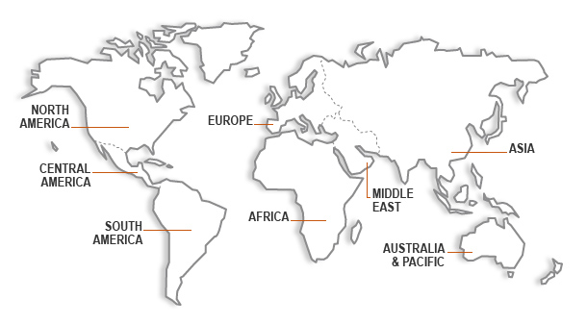


Transferring lessons learned:
Turkish Toasters to NASA Space Ships
Burak Turhan, Tim Menzies, Ayşe B. Bener, and Justin Di Stefano. 2009. On the relative value of cross-company and within-company data for defect prediction. Empirical Softw. Engg. 14, 5 (October 2009),

Slide 17
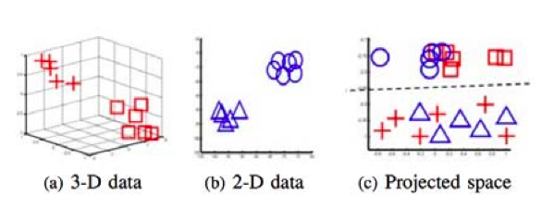
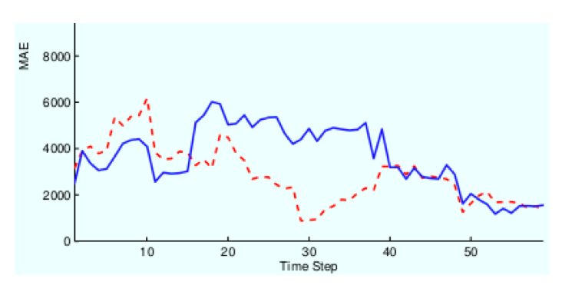
Q: How to transfer data between projects?
A: Be very cruel to the data
Ignore most of the data
relevancy filtering: Turhan ESEj’09; Peters TSE’13, Peters ICSE’15
variance filtering: Kocaguneli TSE’12,TSE’13
performance similarities: He ESEM’13
Contort the data
spectral learning (working in PCA
space or some other rotation)
Menzies, TSE’13; Nam, ICSE’13
Build a bickering committee
Ensembles Minku, PROMISE’12

Slide 18
Q: How to share data?
A: Carve most of it away
Column
pruning
Row
pruning
Range
pruning
irrelevancy removal
better predictions
outliers,
privacy,
anomaly detection, incremental learning,
handling missing values,
cross-company learning
noise reduction
explanation
optimization

Slide 19
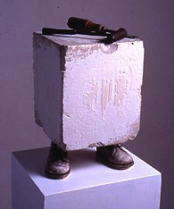
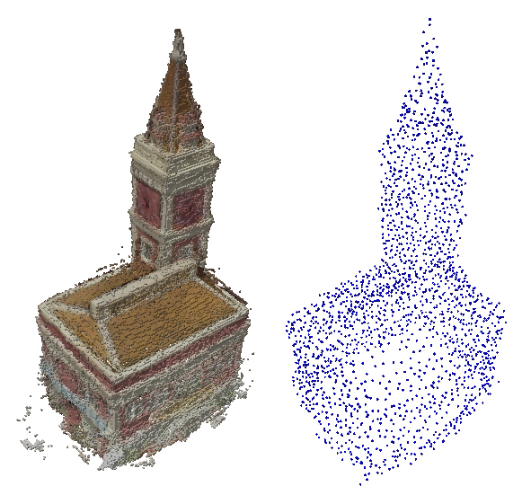
Data mining = data carving
Michelangelo
Someone else
Every block of stone has a statue inside it and it is the task of the sculptor to discover it.
Every Some stone databases have statue models inside and it is the task of the sculptor data scientist to go look.

Slide 20
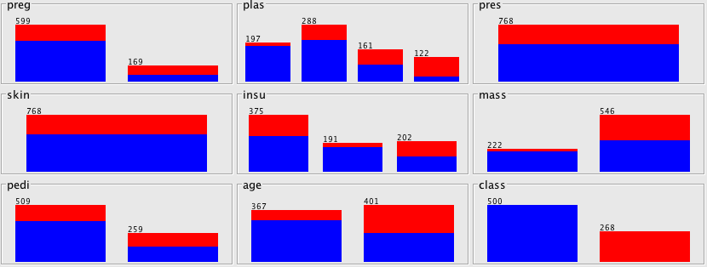
Data mining = Data Carving
How to mine:
  Find the cr*p
  Cut the cr*p;
  Goto step1
Eg. Discretization
  Numerics divided
    where class frequencies most change
  If not division,
    then no information in that attribute
E.g. Classes = (notDiabetic, isDiabetic)
  Baseline distribution = (5: 3)
Mass:
Most change
From raw

Slide 21
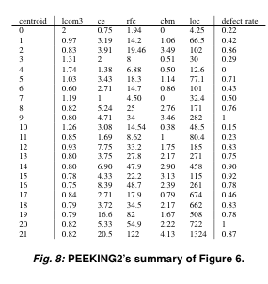
BTW, works for rows as well as columns
Models are reported from repeated signals,
  So R rows of data must contain repeats
  Otherwise, no model
Replace all repeats with one exemplar
  Cluster data
  Replace each cluster with
  its middle point
e.g.
Before: 322 rows * 24 columns
After : 21 cluster * 5 columns
For defect prediction, no information loss

Slide 22
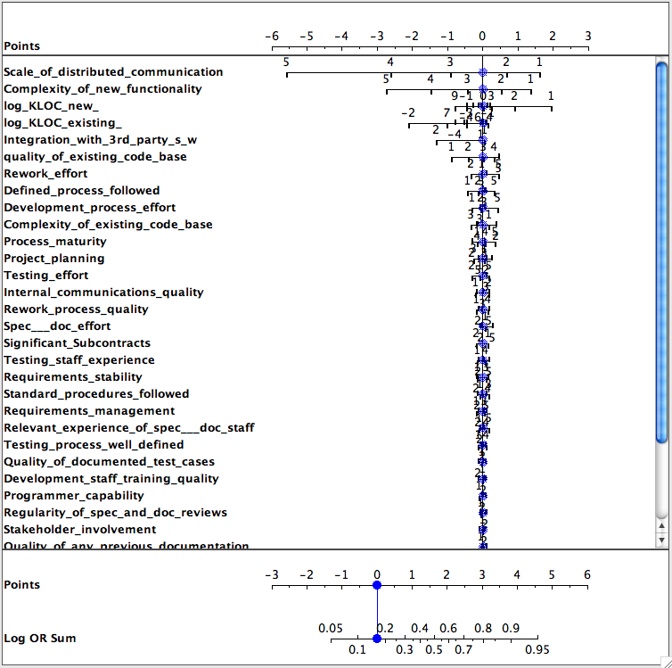
And What About Range Pruning?
Classes x,y
  Fx, Fy
    frequency of discretized ranges in x,y
  Log Odds Ratio
    log(Fx/Fy )
    Is zero if no difference in x,y
E.g. Data from Norman Fenton’s Bayes nets discussing software defects = yes, no
Do most ranges contribute to determination of defects?
Restrict discussion to just most powerful ranges

Slide 23
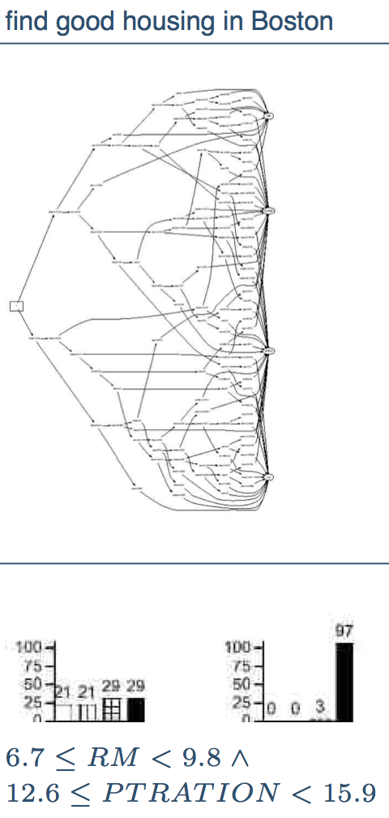
Learning from
“powerful” ranges
Explanation
Generate tiny models
  Sort all ranges by their power
WHICH
  Select any pair (favoring those with most power)
  Combine pair, compute its power
  Sort back into the ranges
  Goto 1
Initially:
  stack contains single ranges
Subsequently
  stack sets of ranges
Decision tree
learning on
14 features
WHICH
Tim Menzies, Zach Milton, Burak Turhan, Bojan Cukic, Yue Jiang, Ayse Basar Bener: Defect prediction from static code features: current results, limitations, new approaches. Autom. Softw. Eng. 17(4): 375-407 (2010)

Slide 24
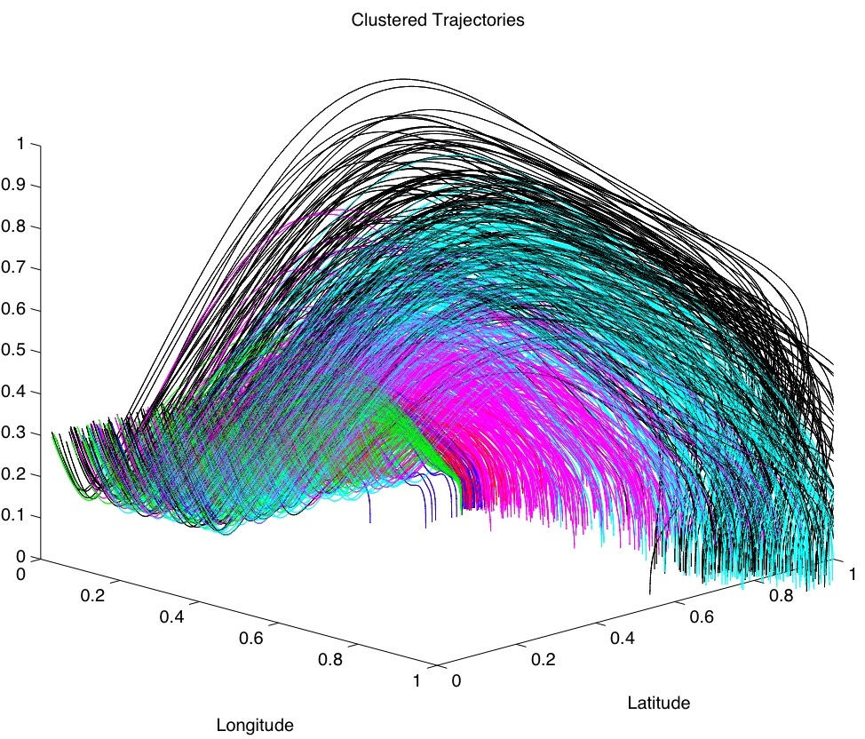
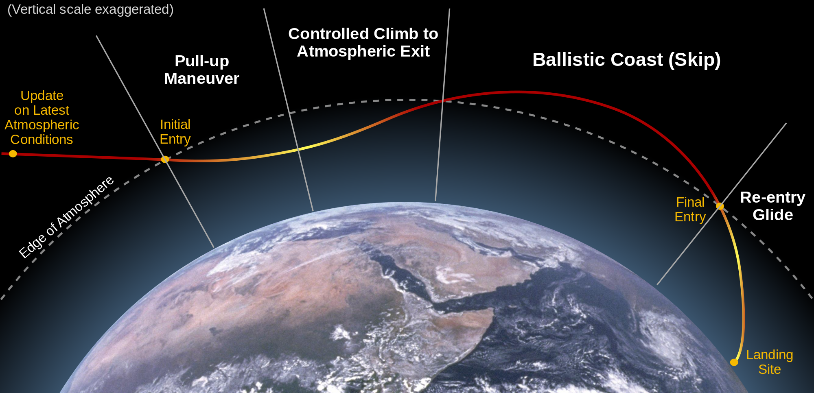
Skip re-entry
My optimizers vs state of the art numeric optimizers
My tools: ran 40 times faster
  Generated better solutions
Powerful succinct explanation tool
Automatically Finding the Control Variables for Complex System Behavior Gregory Gay, Tim Menzies, Misty Davies, and Karen Gundy-Burlet Journal - Automated Software Engineering, 2010 [PDF]

Slide 25

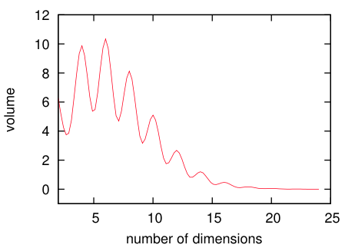
We prune and model works?
So why so few key variables?
Cause otherwise, no model
Models = summaries of repeated similar structures in data
  No examples of that structure? Then no model
Volume n-dimensional sphere V_{n} = V_{n-2} 2 r²/n
  V_{n} shrinks for r=1, when n > 2
So as complexity grows
  Space for similar things shrinks
Models are either low
dimensional
  Or not supportable (no data)

Slide 26
Applications of pruning
Anomaly detection
Incremental learning
Missing values
Pass around the reduced data set
“Alien”: new data is too “far away” from the reduced data
“Too far”: e.g. 10%
of separation most
distance pair
Pass around the reduced data set
Add if anomalous:
  For defect data, cache does not grow beyond 3% of total data
  E.g. LACE2, Peters, ICSE15
For effort estimation
  Reasoning by analogy on all data with missing “lines of code” measures
  Hurts estimation
But after row pruning (using a reverse nearest neighbor technique)
  Good estimates, even without size
  Why? Other features “stand in” for the missing size features

Slide 27
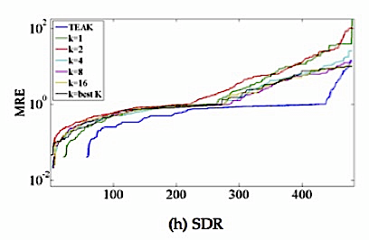
Other applications of pruning
Noise reduction
Cross-company learning
Explanation
Hierachical cluster
Throw away sub-trees with highest variance
Cluster again
TEAK, IEEE TSE 2012,
  Exploiting the Essential Assumptions of Analogy-Based Effort Estimation
Don’t’ learn from all data
Just from training data in same cluster
Works even when data comes from multiple companies
  EMSE journal, 2009, relative value of cross-company and within-company data
Just show samples in the cluster nearest user’s concerns
Or, list all clusters by their average properties and say “you are here, your competitors are there.

Slide 28
But Why Prune at All?
Why not use all the data?
The original vision
of PROMISE
Software projects
are different
With enough data, our knowledge will stabilize
But the more data we collected …
  … the more variance we observed
Its like the microscope zoomed in
  to smash the slide
They change from place to place.
They change from time to time.
My lessons may not apply to you
Your lessons may not even apply to you (tomorrow).
Locality, locality, locality

Slide 29
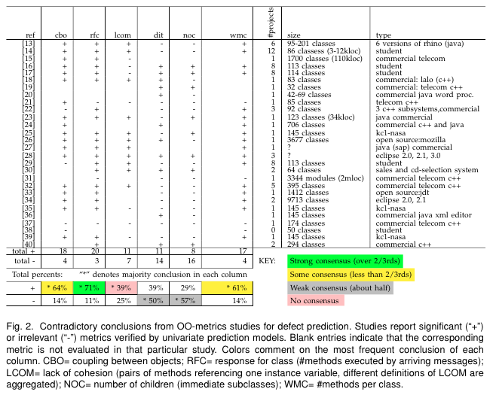
Example conclusion instability
Are all these studies wrong?

Slide 30
The uncarved block
Michelangelo
Someone else
Every block of stone has a statue inside it and it is the task of the sculptor to discover it.
Every Some stone databases have statue models inside and it is the task of the sculptor data scientist to go look.

Slide 31
1. Introduction
2. Sharing data
3. Privacy and Sharing
4. Sharing models
5. Summary
Step 1: Throw most of it away
Step 2: Share the rest

Slide 32
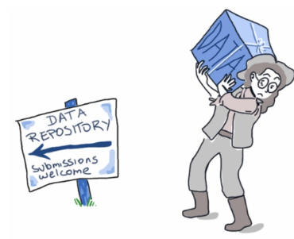
Why We Care
  Sebastian Elbaum et al. 2014
  Sharing industrial datasets with the research community is extremely valuable, but also extremely challenging as it needs to balance the usefulness of the dataset with the industry’s concerns for privacy and competition.
S. Elbaum, A. Mclaughlin, and J. Penix, “The google dataset of testing results,” june 2014. [Online].
Available: https://code.google.com/p/google-shared-dataset-of-test-suite-results

Slide 33
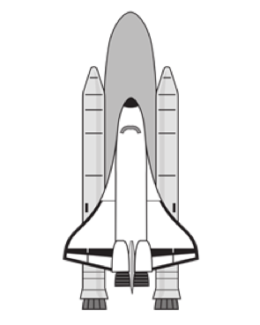
Consider NASA Contractors
NASA’s software contractors
Subject to competitive bidding every 2 years,
Unwilling to share data that would lead to sensitive attribute disclosure
  e.g. actual software development times

Slide 34

Sensitive Attribute Disclosure
A privacy threat.
Occurs when a target is associated with information about their sensitive attributes
  e.g. software code complexity or actual software development times.
B. C. M. Fung, R. Chen, and P. S. Yu, “Privacy-Preserving Data Publishing: A Survey on Recent Developments,” Computing, vol. V, no. 4, pp. 1–53, 2010.
J. Brickell and V. Shmatikov, “The cost of privacy: destruction of data-mining utility in anonymized data publishing,” in Proceeding of the 14th ACM SIGKDD international conference on Knowledge discovery and data mining, ser. KDD ’08.

Slide 35
Software Defect Prediction
For improving inspection efficiency
But wait! I don’t have enough data.
Local data not always available [Zimmermann et al. 2009]
  companies too small;
  product in first release, no past data;
  no time for data collection;
  new technology can make all data irrelevant. [Kitchenham et al. 2007]
T. Zimmermann, N. Nagappan, H. Gall, E. Giger, and B. Murphy, “Cross-project defect prediction: a large scale experiment on data vs. domain vs. process.” in ESEC/SIGSOFT FSE’09, 2009, pp. 91–100.
Kitchenham, Barbara A., Emilia Mendes, and Guilherme H. Travassos. "Cross versus within-company cost estimation studies: A systematic review." Software Engineering, IEEE Transactions on 33.5 (2007): 316-329

Slide 36
Cross Project Defect Prediction
Use of data from other sources to build defect predictors for target data.
Initial results (Zimmermann et al. 2009).
T. Zimmermann, N. Nagappan, H. Gall, E. Giger, and B. Murphy, “Cross-project defect prediction: a large scale experiment on data vs. domain vs. process.” in ESEC/SIGSOFT FSE’09, 2009, pp. 91–100.

Slide 37
Cross Project Defect Prediction
Reason for initial results: Data distribution between source data and target data are different. [Nam et al. 2013]
Other results have more promising outcome (Turhan et al. 2009, He et al. 2012,2013, Nam et al. 2013).
Use of data from other sources to build defect predictors for target data.
  This raises privacy concerns
J. Nam, S. J. Pan, and S. Kim, “Transfer defect learning,” in ICSE’13. IEEE Press Piscataway, NJ, USA, 2013, pp. 802–811.
B. Turhan, T. Menzies, A. B. Bener, and J. Di Stefano, “On the relative value of cross-company and within-company data for defect prediction,” Empirical Software Engineering, vol. 14, pp. 540–578, 2009.
He, Zhimin, et al. "An investigation on the feasibility of cross-project defect prediction." Automated Software Engineering 19.2 (2012): 167-199.
He, Zhimin, et al. "Learning from open-source projects: An empirical study on defect prediction." Empirical Software Engineering and Measurement, 2013 ACM/IEEE International Symposium on. IEEE, 2013.

Slide 38
What We Want
Features |  | Algorithm
Privacy | Low sensitive attribute disclosure. | ?
Utility | Strong defect predictors. | ?
Cost | Low memory requirements. | ?
 | Fast runtime. | ?
By using a privacy framework such as LACE2, you will be able to share an obfuscated version of your data while having a high level of privacy and maintaining the usefulness of the data.
Intuition for LACE2: Software code reuse.
  Don’t share what others have shared.
  In a set of programs, 32% were comprised of reused code (not including libraries). [Selby 2005]
R. Selby, “Enabling reuse-based software development of large-scale systems,” Software Engineering, IEEE Transactions on, vol. 31, no. 6, pp. 495–510, June 2005.

Slide 39
LACE2: Data Minimization
a | b | c | d | class
r1 | r1 | r1 | r2 | yes
r1 | r2 | r3 | r2 | yes
r1 | r3 | r3 | r3 | yes
r4 | r4 | r4 | r4 | no
r1 | r5 | r5 | r2 | no
r6 | r6 | r6 | r2 | no
CLIFF: "a=r1" is powerful for selection for class=yes, i.e. more common in "yes" than "no".
P(yes|r1) =
like(yes|r1)²
like(yes|r1) + like(no|r1)
Step 1: For each class find ranks of all values;
Step 2: Multiply ranks of each row;
Step 3: Select the most powerful rows of each class.
F. Peters and T. Menzies, “Privacy and utility for defect prediction: Experiments with morph,” in Proceedings of the 2012 International Conference on Software Engineering, ser. ICSE 2012. Piscataway, NJ, USA: IEEE Press, 2012, pp. 189–199.
F. Peters, T. Menzies, L. Gong, and H. Zhang, “Balancing privacy and utility in cross-company defect prediction,” Software Engineering, IEEE Transactions on, vol. 39, no. 8, pp. 1054–1068, Aug 2013.

Slide 40
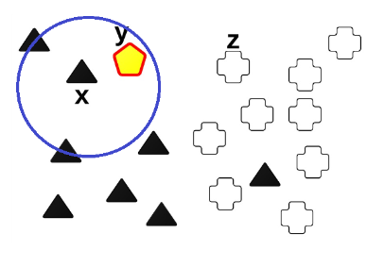

LACE2: Obfuscation
MORPH: Mutate the survivors no more than half the distance to their nearest unlike neighbor.
x is original instance;
z is nearest unlike neighbor of x;
y resulting MORPHed instance;
r is random.
F. Peters and T. Menzies, “Privacy and utility for defect prediction: Experiments with morph,” in Proceedings of the 2012 International Conference on Software Engineering, ser. ICSE 2012. Piscataway, NJ, USA: IEEE Press, 2012, pp. 189–199.
F. Peters, T. Menzies, L. Gong, and H. Zhang, “Balancing privacy and utility in cross-company defect prediction,” Software Engineering, IEEE Transactions on, vol. 39, no. 8, pp. 1054–1068, Aug 2013.

Slide 41
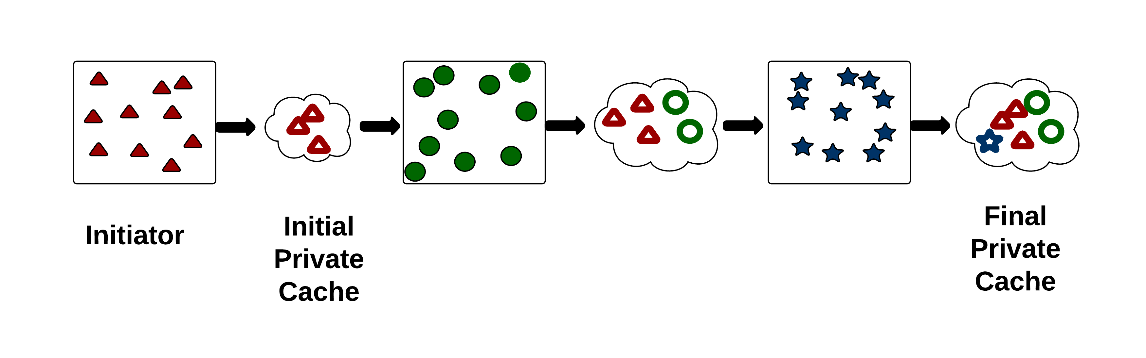
LACE2: Group Sharing
Intuition for LACE2: Software code reuse.
  Don’t share what others have shared.
  In a set of programs, 32% were comprised of reused code (not including libraries). [Selby 2005]
LACE2 : Learn from N software projects
  from multiple data owners
As you learn, play “pass the parcel”
  The cache of reduced data
Each data owner only adds its “leaders” to the passed cache
  Morphing as they go
Each data owner determines “leader” according to distance
  separation = distance (d) of farthest 2 instances
  d = separation/10
Duda, Richard O., Peter E. Hart, and David G. Stork. Pattern classification. John Wiley & Sons, 2012.
R. Selby, “Enabling reuse-based software development of large-scale systems,” Software Engineering, IEEE Transactions on, vol. 31, no. 6, pp. 495–510, June 2005.

Slide 42
LACE2: Sensitive Attribute Disclosure
Occurs when a target is associated with information about their sensitive attributes, (e.g. software code complexity).
  Measured as Increased Privacy Ratio (IPR)
  100 % = zero sensitive attribute disclosure
  0% = total sensitive attribute disclosure
Queries | Original | Obfuscated | Breach
Q1 | 0 | 0 | yes
Q2 | 0 | 1 | no
Q3 | 1 | 1 | yes
 |  |  | no=1/3
 |  |  | IPR=33%
F. Peters and T. Menzies, “Privacy and utility for defect prediction: Experiments with morph,” in Proceedings of the 2012 International Conference on Software Engineering, ser. ICSE 2012. Piscataway, NJ, USA: IEEE Press, 2012, pp. 189–199.
F. Peters, T. Menzies, L. Gong, and H. Zhang, “Balancing privacy and utility in cross-company defect prediction,” Software Engineering, IEEE Transactions on, vol. 39, no. 8, pp. 1054–1068, Aug 2013.

Slide 43
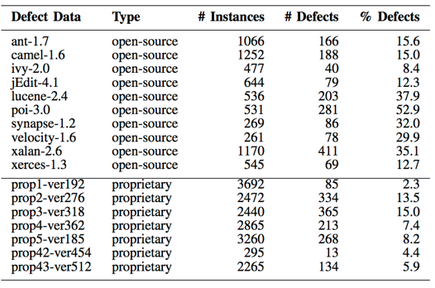
Data

Slide 44
Results: Privacy IPRs
Median IPRs over 10 runs.
The higher the better.
  100 % = zero sensitive attribute disclosure
  0% = total sensitive attribute disclosure
7 proprietary data sets
RQ1: Does LACE2 offer more privacy than LACE1?

Slide 45
Results: Privacy IPRs
RQ1: Does LACE2 offer more privacy than LACE1?

Slide 46
Result Summary
Features |  | Algorithm
Privacy | Low sensitive attribute disclosure. | yes
Utility | Strong defect predictors. | ?
Cost | Low memory requirements*. | ?
 | Fast runtime. | ?
* Don’t share what others have shared.

Slide 47
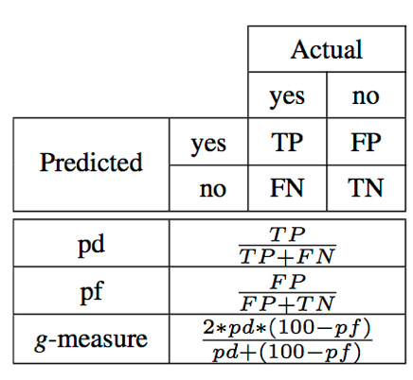
Performance Measures
TP (True Positive): defect-prone classes that are classiﬁed correctly;
FN (False Negative): defect-prone classes that are wrongly classiﬁed to be defect-free;
TN (True Negative): defect-free classes that are classiﬁed correctly;
FP (False Positive): defect-free classes that are wrongly classiﬁed to be defect-prone.

Slide 48
Results: Defect Prediction
Median pds relatively higher for LACE2 for 6/10 data sets
Five local pd results are less than 50%
  For ant-1.7, camel-1.6, ivy-2.0, jEdit-4.1 and xerces-1.3.
RQ2: Does LACE2 offer more useful defect predictors than LACE1 and local?

Slide 49
Results: Defect Prediction
RQ2: Does LACE2 offer more useful defect predictors than LACE1 and local?

Slide 50
Results: Defect Prediction
Consequence of high pds for LACE2
  Higher pfs (lower is best) than local and LACE1.
Pfs for local, LACE1 and LACE2
Data | local | LACE1 | LACE2
jEdit-4.1 | 5.7 | 23.4 | 41.7
ivy-2.0 | 6.9 | 31.9 | 46.3
xerces-1.3 | 8.0 | 27.1 | 33.7
ant-1.7 | 8.4 | 34.3 | 36.8
camel-1.6 | 11.2 | 28.2 | 37.6
lucene-2.4 | 16.2 | 24.0 | 31.1
xalan-2.6 | 16.2 | 28.1 | 27.3
velocity-1.6.1 | 19.1 | 22.7 | 30.3
synapse-1.2 | 21.2 | 40.2 | 55.7
poi-3.0 | 23.6 | 16.4 | 23.8

Slide 51
Results: Defect Prediction
Consequence of high pds for LACE2
  Increasing pfs (lower is best)
Pfs for local, LACE1 and LACE2
Data | local | LACE1 | LACE2
jEdit-4.1 | 5.7 | 23.4 | 41.7
ivy-2.0 | 6.9 | 31.9 | 46.3
xerces-1.3 | 8.0 | 27.1 | 33.7
ant-1.7 | 8.4 | 34.3 | 36.8
camel-1.6 | 11.2 | 28.2 | 37.6
lucene-2.4 | 16.2 | 24.0 | 31.1
xalan-2.6 | 16.2 | 28.1 | 27.3
velocity-1.6.1 | 19.1 | 22.7 | 30.3
synapse-1.2 | 21.2 | 40.2 | 55.7
poi-3.0 | 23.6 | 16.4 | 23.8
LACE2 Median pf = 36% (not abnormally large)
Median pf in TSE2013 = 28%

Slide 52
Result Summary
Features |  | Algorithm
Privacy | Low sensitive attribute disclosure. | yes
Utility | Strong defect predictors. | yes
Cost | Low memory requirements*. | ?
 | Fast runtime. | ?
* Don’t share what others have shared.

Slide 53
Results: Memory
RQ3: Are system costs of LACE2 (memory) worse than LACE1?

Slide 54
Result Summary
Features |  | Algorithm
Privacy | Low sensitive attribute disclosure. | yes
Utility | Strong defect predictors. | yes
Cost | Low memory requirements*. | yes
 | Fast runtime. | ?
* Don’t share what others have shared.

Slide 55
Results: Runtime
RQ3: Are system costs of LACE2 (runtime) worse than LACE1?

Slide 56
Result Summary
Features |  | Algorithm
Privacy | Low sensitive attribute disclosure. | yes
Utility | Strong defect predictors. | yes
Cost | Low memory requirements. | yes
 | Fast runtime. | yes
LACE2 provides more privacy than LACE1.
  Less data used.
No loss of predictive efficacy due to the sharing method of LACE2.
  Don’t share what others have shared.
LACE2’s sharing method, does not take more resources than LACE1.
By using LACE2, you will be able to share an obfuscated version of your data while having a high level of privacy and maintaining the usefulness of the data.

Slide 57
1. Introduction
2. Sharing data
3. Privacy and Sharing
4. Sharing models
5. Summary
4a. Bagging
4b. Comba
4c. DCL
4e. Multi-objective ensembles

Slide 58
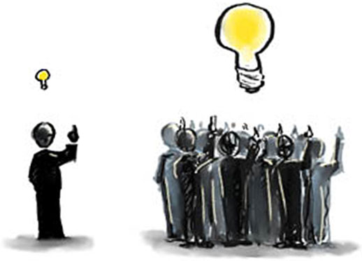
Ensembles
Artificially generated experts, possibly with slightly different views on how to solve a problem.

Slide 59
Ensembles
Sets of learning machines grouped together with the aim of improving predictive performance.
B₁
B₂
B_{N}
...
Base learners
estimation₁
estimation₂
estimation_{N}
E.g.: ensemble estimation = Σ w_{i} estimation_{i}
T. Dietterich. Ensemble Methods in Machine Learning. Proceedings of the First International Workshop in Multiple Classifier Systems. 2000.

Slide 60
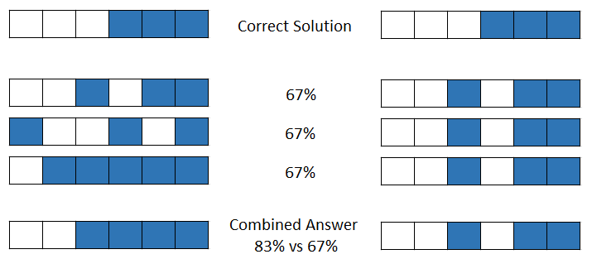
Ensemble Diversity
One of the keys: diversity, i.e., different base learners make different mistakes on the same instances.
Notes:
Intuitive idea: correct predictions of some may compensate errors of others.

Slide 61
Ensemble Versatility
Diversity can be used to address different issues when estimating software data.
Models of the same environment
Models with different goals
Models of different environments
Models of different environments
Notes:
Using different models of the same environment to achieve more stable performance ranking across data sets.
Models representing different objectives to improve on more than one objective/performance measure.
Models of different environments to help each other in improving a given environment and reducing the number of WC data required for learning.

Slide 62
Ensemble Versatility
Diversity can be used to increase stability across data sets.
Models of the same environment
Models with different goals
Models of different environments

Slide 63
Bagging Ensembles of Regression Trees
Ensemble
Training data
(completed projects)
RT1
RT2
RTN
...
Sample uniformly with replacement
Regression Trees (RTs)
Functional Size
Regression Trees (RTs):
  Local methods.
  Divide projects according to attribute value.
  Most impactful attributes are in higher levels.
  Attributes with insignificant impact are not used.
  E.g., REPTrees.
< 253
>= 253
Functional Size
Effort = 5376
< 151
>= 151
Effort = 1086
Effort = 2798
L. Breiman. Bagging Predictors. Machine Learning 24(2):123-140, 1996.

Slide 64

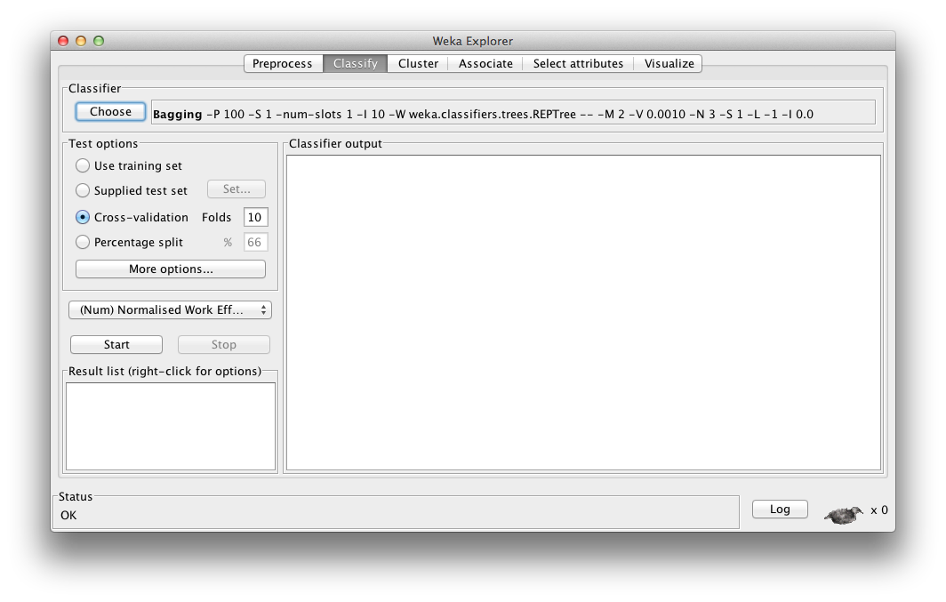
WEKA
  Weka: classifiers – meta – bagging
  classifiers – trees – REPTree

Slide 65
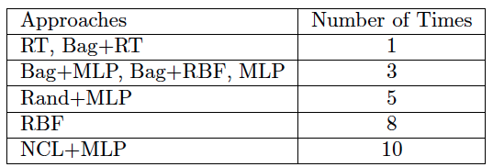
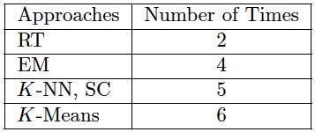
Increasing Performance Rank Stability Across Data Sets
Study with 13 data sets from PROMISE and ISBSG repositories.
Bag+RTs:
  Obtained the highest rank across data set in terms of Mean Absolute Error (MAE).
  Rarely performed considerably worse (>0.1SA, SA = 1 – MAE / MAE_{rguess}) than the best approach:
L. Minku, X. Yao. Ensembles and Locality: Insight on Improving Software Effort Estimation. Information and Software Technology 55(8):1512-1528, 2013.

Slide 66
Comba
Solo-methods: preprocessing + learning algorithm
Sa
Sb
Sc
Sz
...
Rank solo-methods based on win, loss, win-loss
And sort according to losses
training
Sc
Sa
Sk
Sx
...
Select top ranked models with few rank changes
Training data
(completed projects)
Ensemble
S1
S2
SN
...
Kocaguneli, E., Menzies, T. and Keung, J. On the Value of Ensemble Effort Estimation. IEEE Transactions on Software Engineering, 8(6):1403 – 1416, 2012.

Slide 67
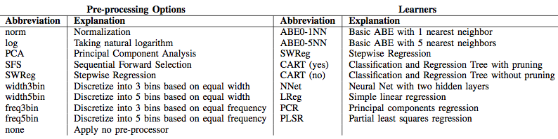







Comba
Experimenting with:
90 solo-methods, 20 public data sets, 7 error measures
Kocaguneli, E., Menzies, T. and Keung, J. On the Value of Ensemble Effort Estimation. IEEE Transactions on Software Engineering, 8(6):1403 – 1416, 2012.

Slide 68
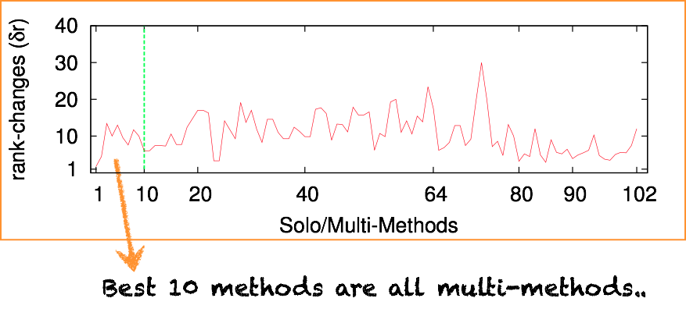
Increasing Rank Stability Across Data Sets
Combine top 2,4,8,13 solo-methods via mean, median and IRWM
Re-rank solo and multi-methods together according to #losses
The first ranked multi-method had very low rank-changes.

Slide 69
Ensemble Versatility
Diversity can be used to increase performance on different measures.
Models of the same environment
Models with different goals
Models of different environments
Models of different environments
Notes:
Using different models of the same environment to achieve more stable performance ranking across data sets.
Models representing different objectives to improve on more than one objective/performance measure.
Models of different environments to help each other in improving a given environment and reducing the number of WC data required for learning.

Slide 70
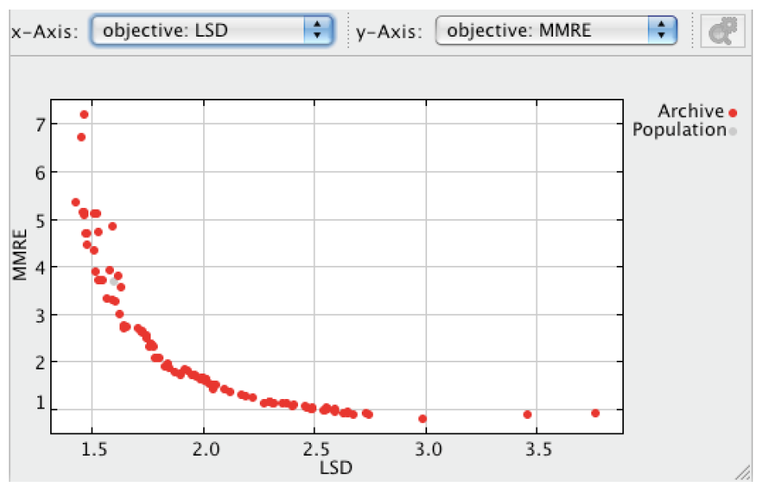
Multi-Objective Ensemble
There are different measures/metrics of performance for evaluating SEE models.
  E.g.: MAE, standard deviation, PRED, etc.
Different measures capture different quality features.
    There is no agreed single measure.
    A model doing well for a certain measure may not do so well for another.

Slide 71
Multi-Objective Ensembles
We can view SEE as a multi-objective learning problem.
A multi-objective approach (e.g. Multi-Objective Evolutionary Algorithm (MOEA)) can be used to:
  Better understand the relationship among measures.
  Create ensembles that do well for a set of measures, in particular for larger data sets (>=60).
L. Minku, X. Yao. Software Effort Estimation as a Multi-objective Learning Problem. ACM Transactions on Software Engineering and Methodology, 22(4):35, 2013.

Slide 72
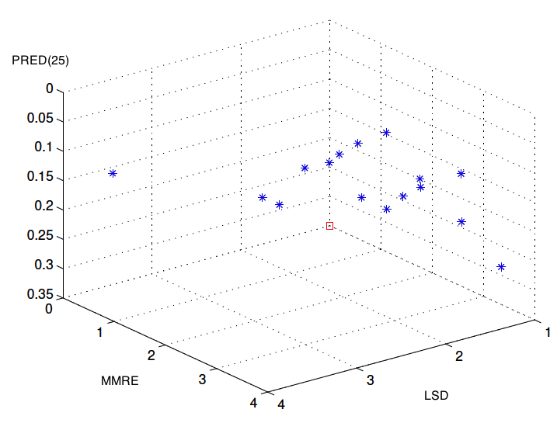
Multi-Objective Ensembles
Training data
(completed projects)
Multi-objective evolutionary algorithm creates nondominated models with several different trade-offs.
Ensemble
The model with the best performance in terms of each particular measure can be picked to form an ensemble with a good trade-off.
B1
B2
B3
L. Minku, X. Yao. Software Effort Estimation as a Multi-objective Learning Problem. ACM Transactions on Software Engineering and Methodology, 22(4):35, 2013.

Slide 73
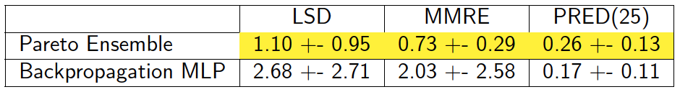
Improving Performance on Different Measures
Sample result: Pareto ensemble of MLPs (ISBSG):
Important:
    Using performance measures that behave differently from each other (low correlation) provide better results than using performance measures that are highly correlated.
      More diversity.
    This can even improve results in terms of other measure not used for training.
L. Minku, X. Yao. An Analysis of Multi-objective Evolutionary Algorithms for Training Ensemble Models Based on Different Performance Measures in Software Effort Estimation. PROMISE, 10p, 2013.

Slide 74
Ensemble Versatility
Diversity can be used to deal with changes and transfer knowledge.
Models of the same environment
Models with different goals
Models of different environments
Models of different environments
Notes:
Using different models of the same environment to achieve more stable performance ranking across data sets.
Models representing different objectives to improve on more than one objective/performance measure.
Models of different environments to help each other in improving a given environment and reducing the number of WC data required for learning.

Slide 75
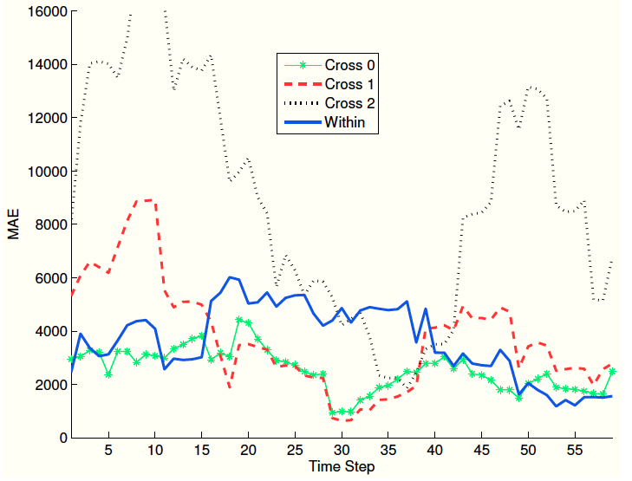
Companies’ Changing Environments
Companies are not static entities – they can change with time (concept drift).
Companies can start behaving more or less similarly to other companies.
How to know when a model from another company is helpful?
How to improve performance throughout time?
Predicting effort for a single company from ISBSG based on its projects and other companies' projects.

Slide 76
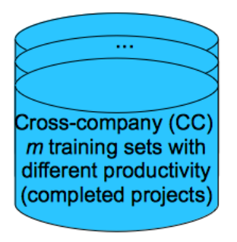

Dynamic Cross-Company Learning (DCL)
DCL learns a weight to reflect the suitability of CC models.
CC Model
1
CC Model
2
CC Model
M
...
w₁
w₂
w_{M}
Within-company (WC)
incoming training
data (completed projects arriving with time)
For each new training project
If model is not a winner, multiply its weight by β (0 < β < 1)
WC Model
w
L. Minku, X. Yao. Can Cross-company Data Improve Performance in Software Effort Estimation? PROMISE, p. 69-78, 2012.

Slide 77
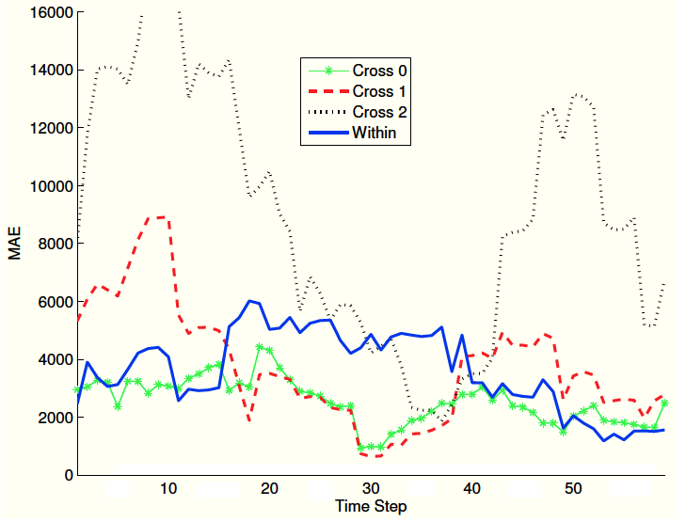
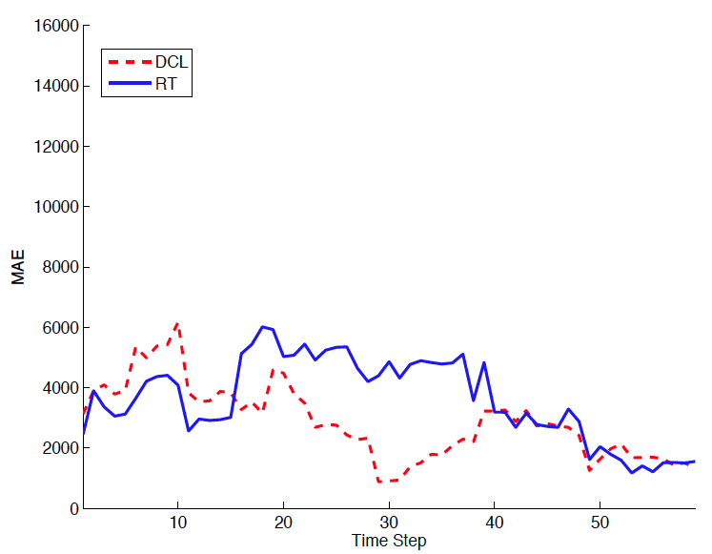
Improving Performance Throughout Time
  DCL adapts to changes by using CC models.
  DCL manages to use CC models to improve performance over WC models.
Sample Result
Predicting effort for a single company from ISBSG based on its projects and other companies' projects.

Slide 78
Dynamic Cross-Company Mapped Model Learning (Dycom)
How to use CC models even when they are not directly helpful?
CC Model
1
CC Model
2
CC Model
M
...
Map 1
Map 2
Map M
w₁
w₂
w_{M}
Within-company (WC)
incoming training
data (completed projects arriving with time)
WC Model
Dycom learns functions to map CC models to the WC context.
w
L. Minku, X. Yao. How to Make Best Use of Cross-Company Data in Software Effort Estimation? ICSE, p. 446-456, 2014.

Slide 79
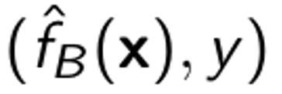

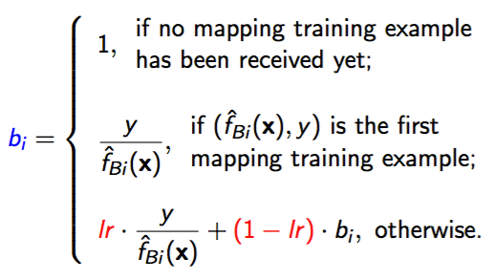
Learning Mapping Function
train
where lr is a smoothing factor that allows tuning the emphasis on more recent examples.
L. Minku, X. Yao. How to Make Best Use of Cross-Company Data in Software Effort Estimation? ICSE, p. 446-456, 2014.

Slide 80
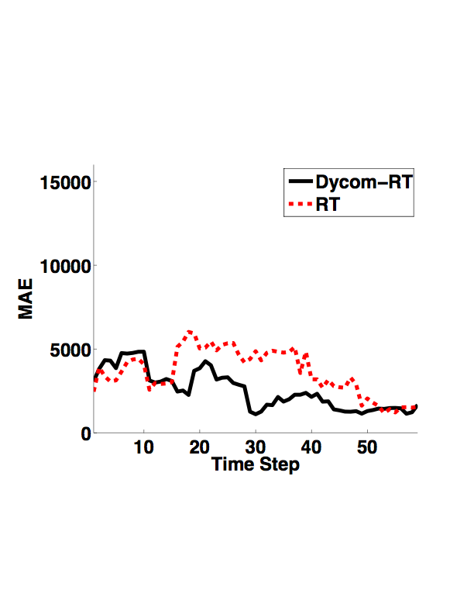
Reducing the Number of Required WC Training Examples
Sample Result
Dycom can achieve similar / better performance while using only 10% of WC data.

Slide 81
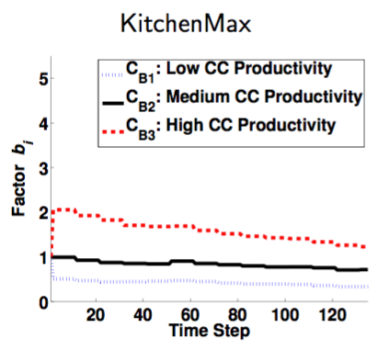

Dycom Insights
Relationship between effort of different companies for the same projects.
Initially, our company needs initially 2x effort than company red.
Later, it needs only 1.2x effort.

Slide 82
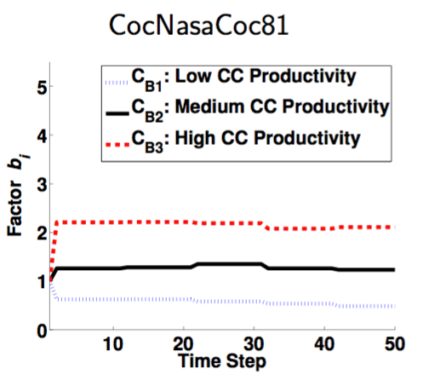
Dycom Insights
Our company needs 2x effort than company red.
How to improve our company?
Notes:
This allows not only to improve performance and reduce the number of WC data required for the learning, but also leads to insights on how to improve a company's productivity. For instance, if we plot these functions that map CC models into the WC context, we can vizualise the relationship between the productivity of these companies. That, together with an analysis of the data from these companies + knowledge from the software manager, can lead to insights on how to improve a company's productivity.

Slide 83
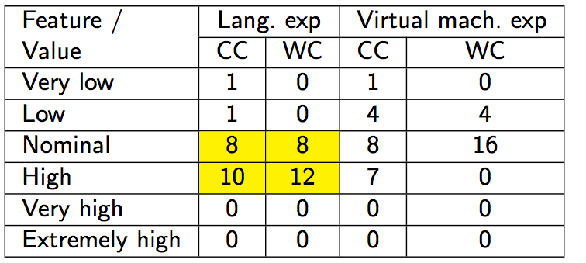
Analysing Project Data
Number of projects with each feature value for the 20 CC projects from the medium productivity CC section and the first 20 WC projects:
Both the company and the medium CC section frequently use employees
with high programming language experience.

Slide 84
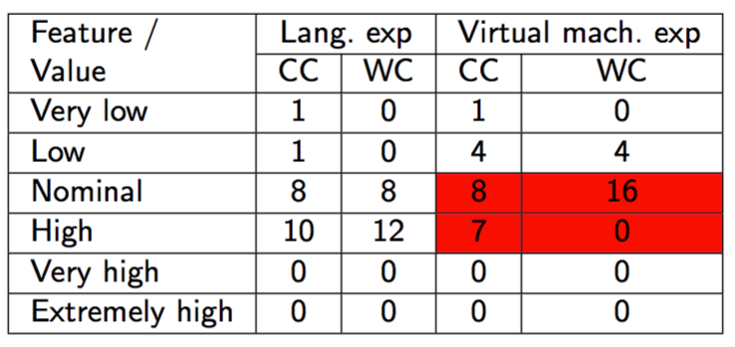
Analysing Project Data
Number of projects with each feature value for the 20 CC projects from the medium productivity CC section and the first 20 WC projects:
Medium CC section uses more employees with high virtual machine experience. So, this is more likely to be a problem for the company. Sensitivity analysis and project manager knowledge could help to confirm that.

Slide 85
Ensemble Versatility
Diversity can be used to address different issues when estimating software data.
Increase stability across data sets.
Increase performance on different measures.
Models of the same environment
Models with different goals
Models of different environments
Models of different environments
Deal with changes and transfer knowledge.
Notes:
Using different models of the same environment to achieve more stable performance ranking across data sets.
Models representing different objectives to improve on more than one objective/performance measure.
Models of different environments to help each other in improving a given environment and reducing the number of WC data required for learning.

Slide 86
1. Introduction
2. Sharing data
3. Privacy and Sharing
4. Sharing models
5. Summary
6a. The past
6b. The future

Slide 87

The past
Focused on minimizing the obfuscation data of software projects.
  Accomplished for individual data owners as well as data owners who would want to share data collaboratively.
  Results were promising.

Slide 88

The future
Privacy
  Next step : focus on end user privacy
    when using software apps that need personal info to function.
Model-based reasoning
  Gaining more insights from models.
  Considering temporal aspects of software data.
  Taking goals into account in decision-support tools.

Slide 89


End of our tale

Slide 90
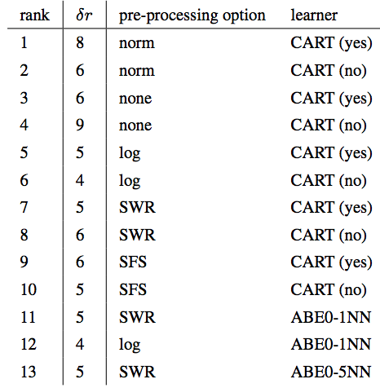

Building Comba
Rank methods according to win, loss and win – loss
δr is the max. rank change
Sort methods acc. to loss and observe δr values
Top 13 methods were CART & ABE methods (1NN, 5NN) using different preprocessing methods.

Slide 91

Performance Measures
Notes:
This slide is here just as a backup. It won’t be presented.

Slide 92

Mapping Training Examples
L. Minku, X. Yao. How to Make Best Use of Cross-Company Data in Software Effort Estimation? ICSE, p. 446-456, 2014.

Slide 93

Reducing the Number of Required WC Training Examples
Dycom’s MAE (and SA), StdDev, RMSE, Corr and LSD were always similar or better than RT’s (Wilcoxon tests with Holm-Bonferroni corrections).

