Slide 1



ICSE’15 Technical Briefing:
The Art and Science of
Analyzing Software Data
Part1: Qualitative methods
Christian Bird : Microsoft, USA
Tim Menzies : North Carolina State, USA
Thomas Zimmermann : Microsoft, USA

Slide 2



Who we are…
Christian Bird
Microsoft Research, USA
Christian.Bird@microsoft.com
Tim Menzies
North Carolina State, USA
tim@menzies.us
Thomas Zimmermann
Microsoft Research, USA
tzimmer@microsoft.com

Slide 3
Topics (in this tutorial)
0) In a nutshell
(executive summary of this presentation)
1) Organization Issues:
(Menzies)
Rule #1: Talk to the users
Rule #2: Know your domain
Rule #3: Suspect your data
Rule #4: Data science is cyclic
2) Qualitative methods
(Bird + Zimmermann)
Discovering information needs
On the role of surveys and interviews in data analysis

Slide 4
What can we share?
Two software project managers meet
  What can they learn from each other?
They can share
  Data
  Models
  Methods
    techniques for turning data into models
  Insight into the domain
The standard mistake
  Generally assumed that models can be shared, without modification.
  Yeah, right…

Slide 5
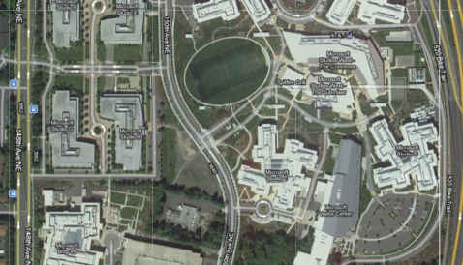
SE research = sparse sample of a very diverse set of activities
And they are all different.
Microsoft research,
Redmond, Building 99
Other studios,
many other projects

Slide 6
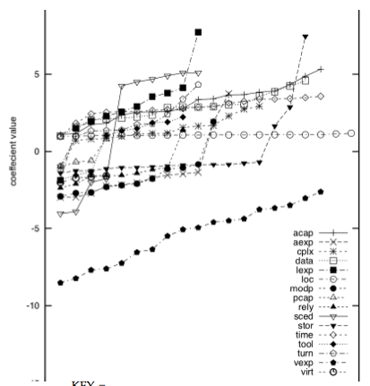
Models may not move
(effort estimation)
20 * 66% samples of
data from NASA
Linear regression on
each sample to learn
effort = a*LOC^{b} *Σ_{i}β_{i}x_{i}
Back select to remove
useless x_{i}
Result?
  Wide β_{i} variance
* T. Menzies, A.Butcher, D.Cok, A.Marcus, L.Layman, F.Shull, B.Turhan, T.Zimmermann, "Local vs. Global Lessons for Defect Prediction and Effort Estimation," IEEE TSE pre-print 2012. http://menzies.us/pdf/12gense.pdf

Slide 7
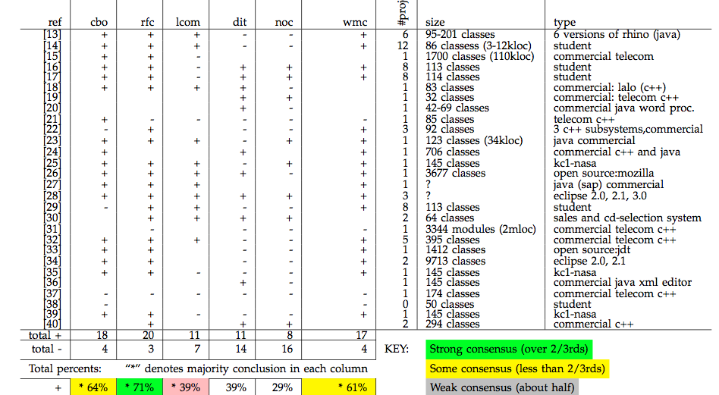
Models may not move
(defect prediction)
* T. Menzies, A.Butcher, D.Cok, A.Marcus, L.Layman, F.Shull, B.Turhan, T.Zimmermann, "Local vs. Global Lessons for Defect Prediction and Effort Estimation," IEEE TSE pre-print 2012. http://menzies.us/pdf/12gense.pdf

Slide 8
Oh woe is me
No generality in SE?
Nothing we can learn from each other?
Forever doomed to never make a conclusion?
  Always, laboriously, tediously, slowly, learning specific lessons that hold only for specific projects?
No: 3 things we might want to share
  Models, methods, data
If no general models, then
  Share methods
    general methods for quickly turning local data into local models.
  Share data
    Find and transfer relevant data from other projects to us

Slide 9
The rest of this tutorial
Data science
  How to share data
  How to share methods
Maybe one day, in the future,
  after we’ve shared enough data and methods
  We’ll be able to report general models
  ICSE 2020?
But first,
  Some general notes on data mining

Slide 10
The great myth
Let’s face it:
  Humans are a pest
  And experts doubly so.
“The notion of ‘user’ cannot be precisely defined and therefore has no place in CS and SE”
  Edsger Dijkstra, ICSE’4, 1979
http://en.wikipedia.org/wiki/List_of_cognitive_biases
96 Decision-making, belief and behavioral biases
  Attentional bias – paying more attention to emotionally dominant stimuli in one's environment and to neglect relevant data
23 Social biases
  Worse-than-average effect – believing we are worse than others at tasks which are difficult
52 Memory errors and biases
  Illusory correlation – inaccurately remembering a relationship between two event

Slide 11
The great myth
Wouldn’t it be wonderful if we did not have to listen to them
  The dream of olde worlde machine learning
    Circa 1980s
  Dispense with live experts and resurrect dead ones.
But any successful learner needs biases
  Ways to know what’s important
    What’s dull
    What can be ignored
  No bias? Can’t ignore anything
    No summarization
    No generalization
    No way to predict the future

Slide 12

Expert data scientists spend more time with users than algorithms
Christian Bird, data miner,
Msoft research, Redmond
A successful “Bird”
session:
Knowledge engineers enter with sample data
Users take over the spreadsheet
Run many ad hoc queries
In such meetings, users often…
  demolish the model
  offer more data
  demand you come back next week with something better
Microsoft Research, Redmond
  Assesses learners by “engagement”

Slide 13
Also: Users control budgets
Why talk to users?
  Cause they own the wallet
As the Mercury astronauts used to say
  No bucks, no Buck Rodgers
We need to give users a sense of comfort that we know what we are doing
  That they are part of the process
  That we understand their problem and processes
  Else, budget = $0

Slide 14
The Inductive
Engineering Manifesto
Users before algorithms:
  Mining algorithms are only useful in industry if users fund their use in real-world applications.
Data science
  Understanding user goals to inductively generate the models that most matter to the user.
T. Menzies, C. Bird, T. Zimmermann, W. Schulte, and E. Kocaganeli.
The inductive software engineering manifesto. (MALETS '11).

Slide 15
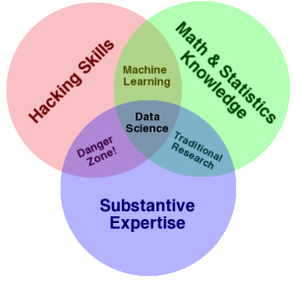
Algorithms is only part of the story
Dumb data miners miss important domains semantics
An ounce of domain knowledge is worth a ton to algorithms.
Math and statistics only gets you machine learning,
Science is about discovery and building knowledge, which requires some motivating questions about the world
The culture of academia, does not reward researchers for understanding domains.
Drew Conway, The Data Science Venn Diagram, 2009,
http://www.dataists.com/2010/09/the-data-science-venn-diagram/

Slide 16
Case Study #1: NASA
NASA’s Software Engineering Lab, 1990s
  Gave free access to all comers to their data
  But you had to come to get it (to Learn the domain)
  Otherwise: mistakes
E.g. one class of software module with far more errors that anything else.
  Dumb data mining algorithms: might learn that this kind of module in inherently more data prone
Smart data scientists might question “what kind of programmer work that module”
  A: we always give that stuff to our beginners as a learning exercise
* F. Shull, M. Mendonsa, V. Basili, J. Carver, J. Maldonado, S. Fabbri, G. Travassos, and M. Ferreira, "Knowledge-Sharing Issues in Experimental Software Engineering", EMSE 9(1): 111-137, March 2004.

Slide 17
Case Study #2: Microsoft
Distributed vs centralized development
Who owns the files?
  Who owns the files with most bugs
Result #1 (which was wrong)
  A very small number of people produce most of the core changes to a “certain Microsoft product”.
  Kind of an uber-programmer result
  I.e. given thousands of programmers working on a project
    Most are just re-arrange deck chairs
    TO improve software process, ignore the drones and focus mostly on the queen bees
WRONG:
  Microsoft does much auto-generation of intermediary build files.
  And only a small number of people are responsible for the builds
  And that core build team “owns” those auto-generated files
  Skewed the results. Send us down the wrong direction
Needed to spend weeks/months understanding build practices
  BEFORE doing the defect studies
* E. Kocaganeli, T. Zimmermann, C.Bird, N.Nagappan, T.Menzies. Distributed Development
Considered Harmful?. ICSE 2013 SEIP Track, San Francisco, CA, USA, May 2013.

Slide 18
You go mining with the data you have—not the data you might want
In the usual case, you cannot control data collection.
  For example, data mining at NASA 1999 – 2008
    Information collected from layers of sub-contractors and sub-sub-contractors.
    Any communication to data owners had to be mediated by up to a dozen account managers, all of whom had much higher priority tasks to perform.
Hence, we caution that usually you must:
  Live with the data you have or dream of accessing at some later time.

Slide 19
Rinse before use
Data quality tests (*)
  Linear time checks for (e.g.) repeated rows
Column and row pruning for tabular data
  Bad columns contain noise, irrelevancies
  Bad rows contain confusing outliers
  Repeated results:
    Signal is a small nugget within the whole data
    R rows and C cols can be pruned back to R/5 and C^{0.5}
    Without losing signal
* M. Shepperd, Q. Song, Z. Sun, C. Mair,
"Data Quality: Some Comments on the NASA Software Defect Data Sets," IEEE TSE, 2013, pre-prints

Slide 20
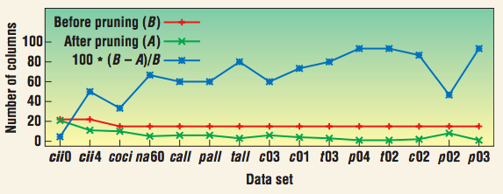
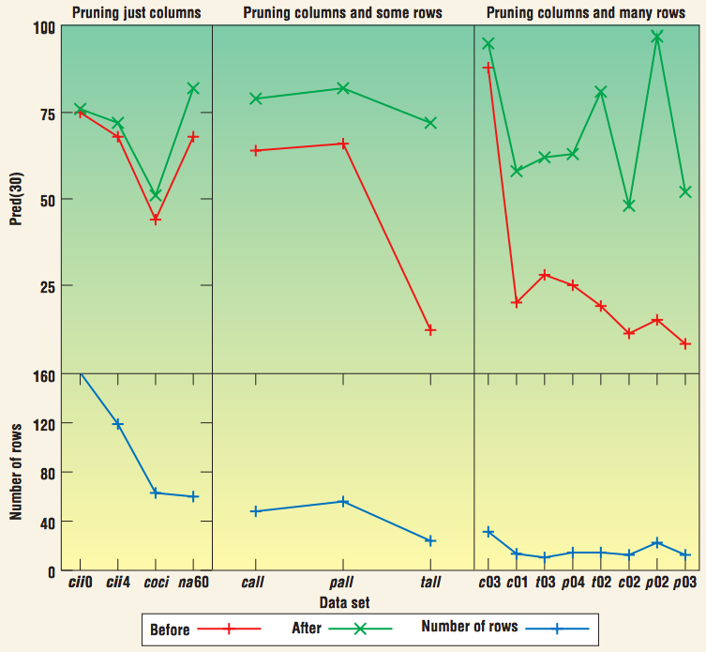
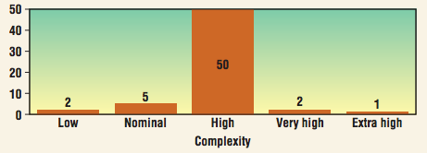
e.g. NASA effort data
The more features we
remove for smaller
projects the better
the predictions.
Nasa data: most
Projects highly complex
i.e. no information in saying
“complex”

Slide 21
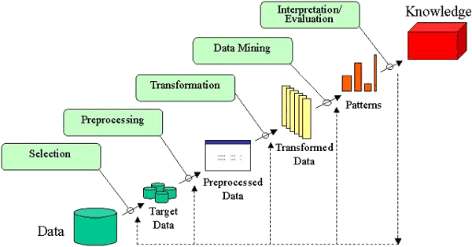
Do it again, and again, and again, and …
In any industrial application, data science is repeated multiples time to either answer an extra user question, make some enhancement and/or bug fix to the method, or to deploy it to a different set of users.

Slide 22
Thou shall not click
For serious data science studies,
  to ensure repeatability,
  the entire analysis should be automated
  using some high level scripting language;
    e.g. R-script, Matlab, Bash, ….

Slide 23
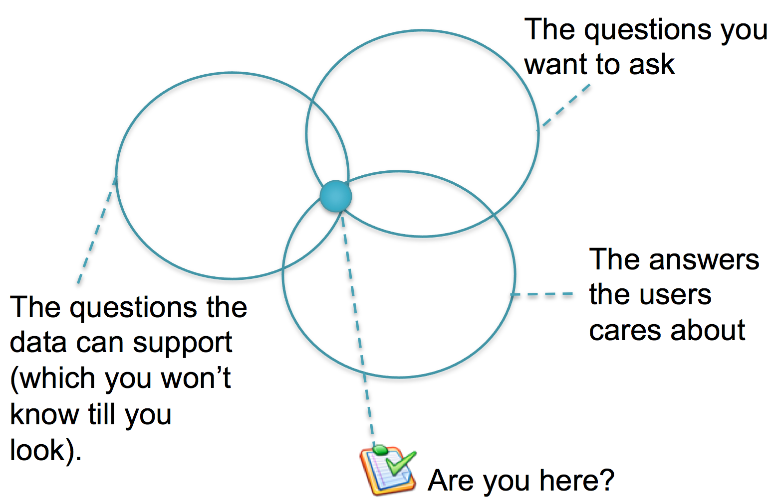
The feedback process

Slide 24
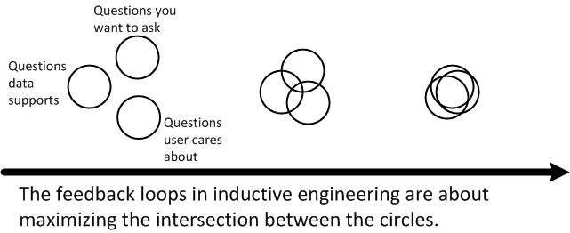
The feedback process

Slide 25
In this section
Why qualitative analysis?
Surveys as a lightweight tool for data collection
Two of my most successful surveys
  Example: What makes a good bug report?
  Example: Which bugs get fixed/reassigned/reopened?
What makes a good survey?
Analyzing survey data
  Likert scale data
  Open-ended questions
  Card sorting
  Inter-rater agreement

Slide 26
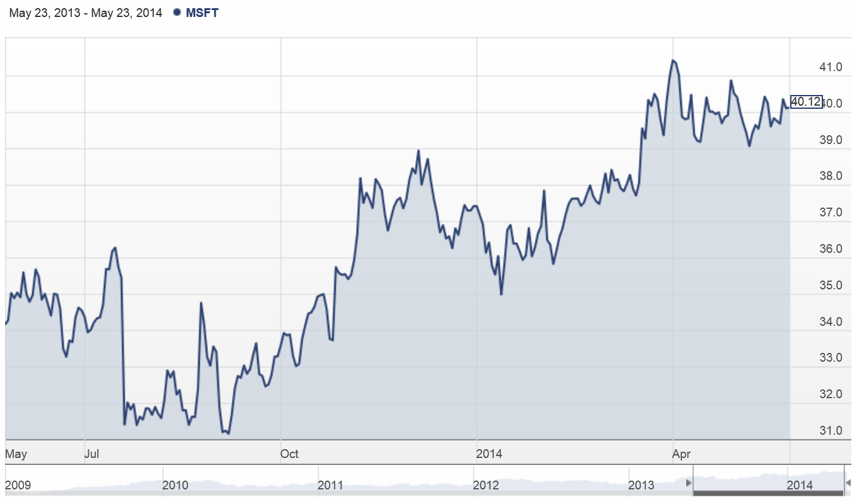
Measurement alone doesn’t tell you much…

Slide 27
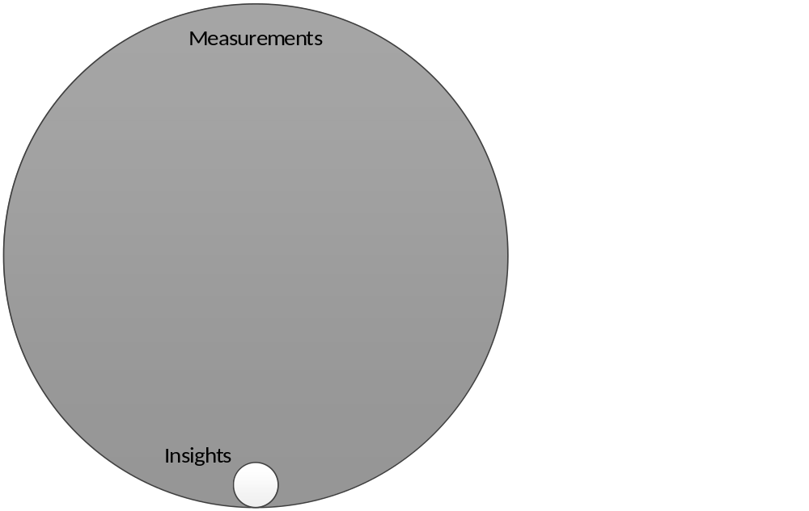
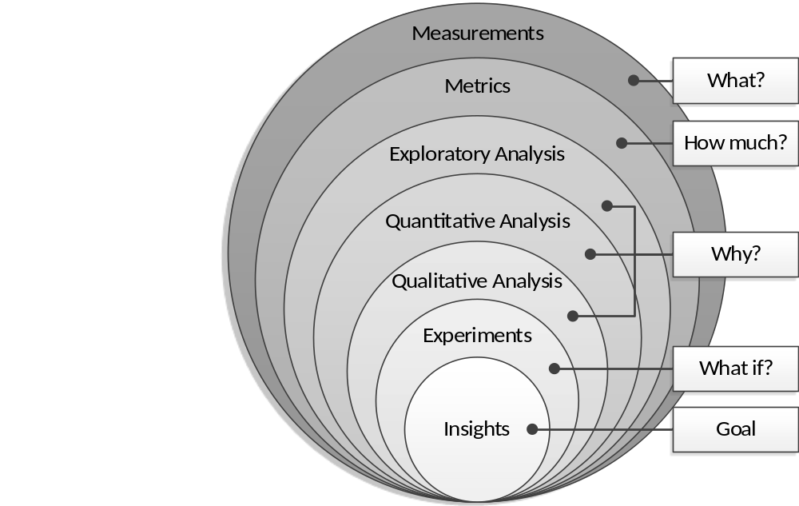
Qualitative analysis can help you to answer the “Why?” question
Raymond P. L. Buse, Thomas Zimmermann: Information needs
for software development analytics. ICSE 2012: 987-996

Slide 28
Surveys are a lightweight way to get more insight into the “Why?”
Surveys allow collection of quantitative + qualitative data (open ended questions)
Identify a population + sample
Send out web-based questionnaire
Survey tools:
  Qualtrics, SurveyGizmo, SurveyMonkey
  Custom built tools for more complex questionaires

Slide 29

Two of my most successful surveys are about bug reports
Notes:
And actually there is one thing that caught my attention. In the first editions of this book, it came with a BUG TRACKER.

Slide 30
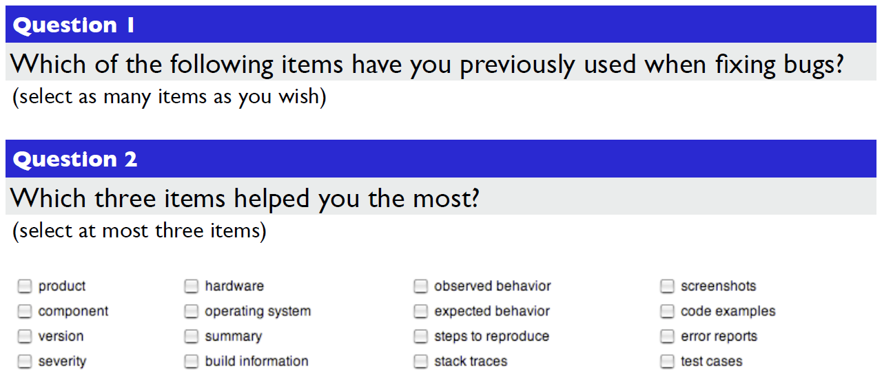
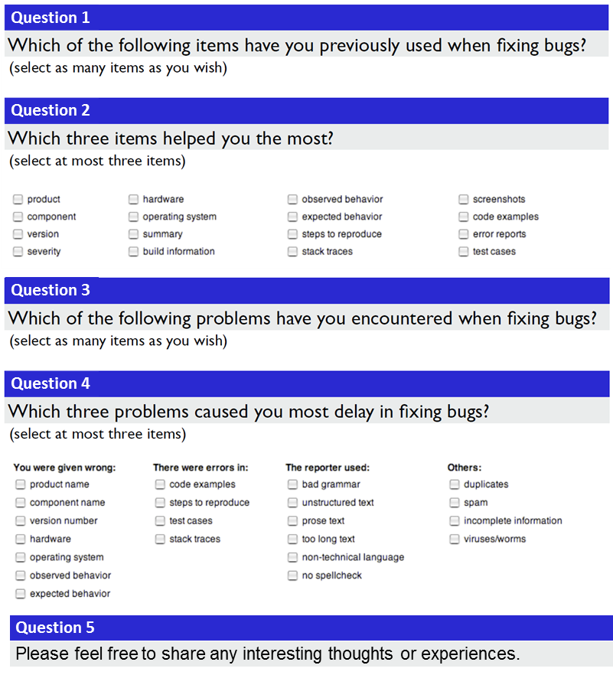
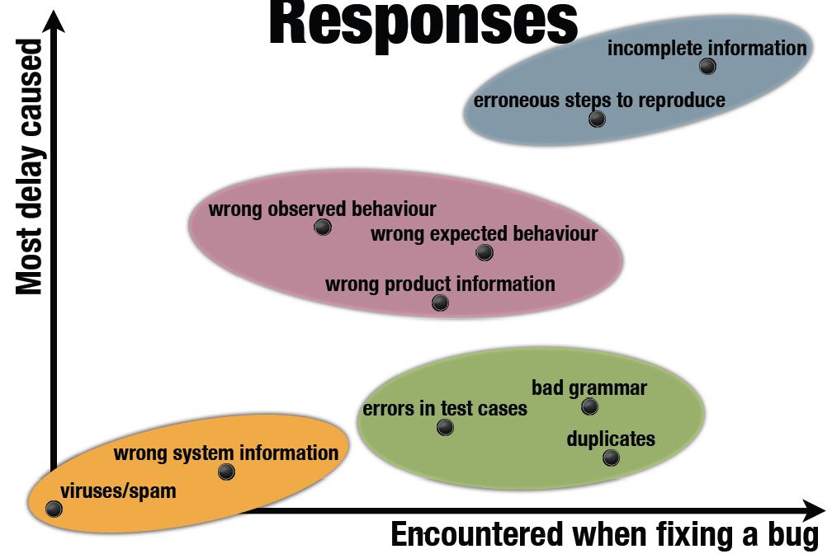
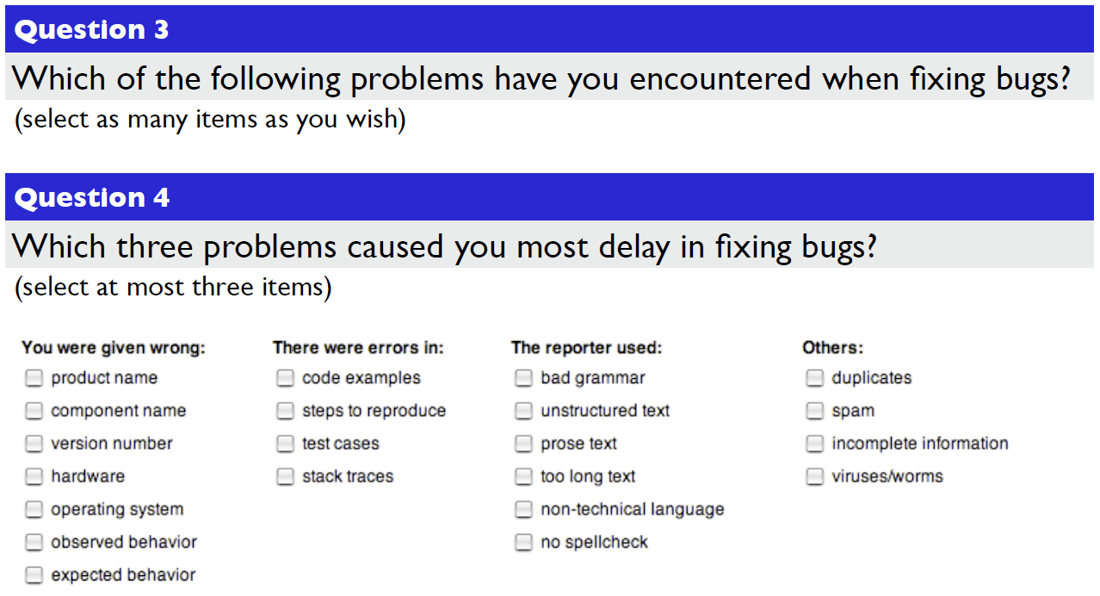
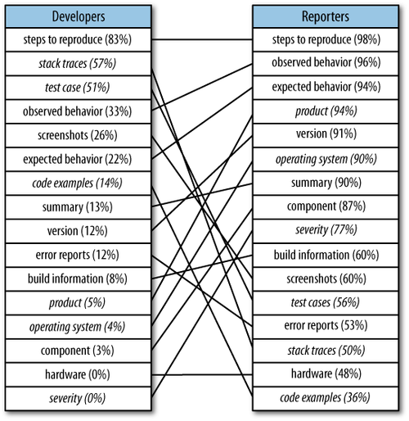
What makes a good bug report?
Question 1
Question 2
Question 3
Question 4
Question 5
Please feel free to share any interesting thoughts or experiences.
T. Zimmermann et al.: What Makes a Good Bug Report? IEEE Trans. Software Eng. 36(5): 618-643 (2010)

Slide 31
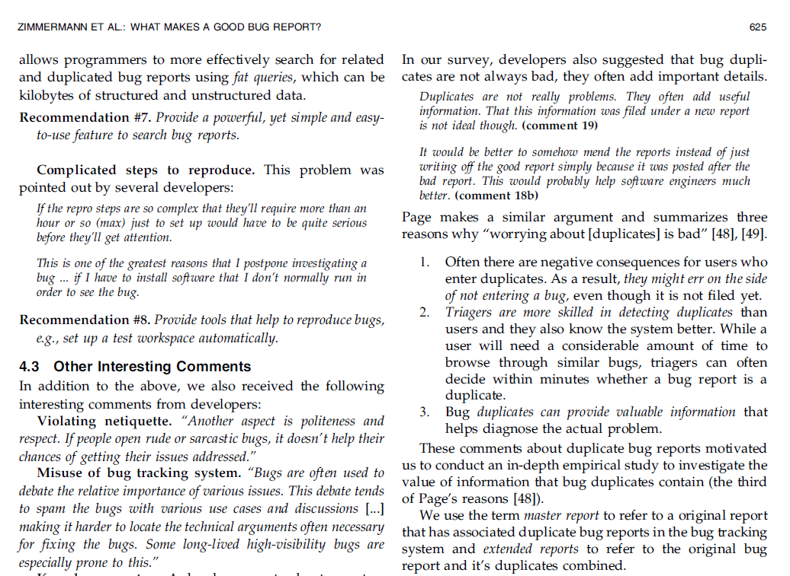
Well crafted open-ended questions in surveys can be a great source of additional insight.

Slide 32
Which bugs are fixed?
In your experience, how do the following factors affect the chances of whether a bug will get successfully resolved as FIXED?
  7-point Likert scale (Significant/Moderate/Slight increase, No effect, Significant/Moderate/Slight decrease)
Sent to 1,773 Microsoft employees
  Employees who opened OR were assigned to OR resolved most Windows Vista bugs
  358 responded (20%)
Combined with quantitative analysis of bug reports

Slide 33
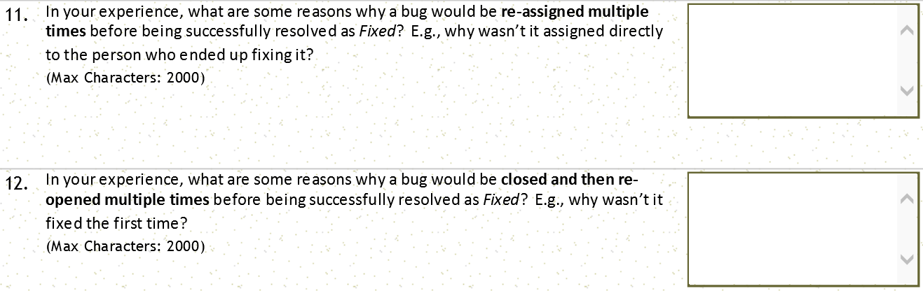
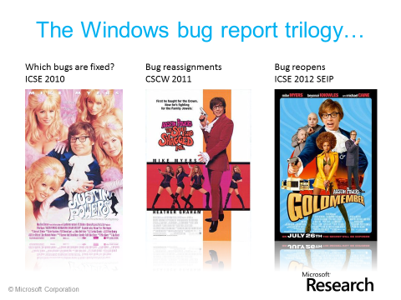
Philip J. Guo, Thomas Zimmermann, Nachiappan Nagappan, Brendan Murphy: Characterizing and predicting which bugs get fixed: an empirical study of Microsoft Windows. ICSE (1) 2010: 495-504
Philip J. Guo, Thomas Zimmermann, Nachiappan Nagappan, Brendan Murphy: "Not my bug!" and other reasons for software bug report reassignments. CSCW 2011: 395-404
Thomas Zimmermann, Nachiappan Nagappan, Philip J. Guo, Brendan Murphy: Characterizing and predicting which bugs get reopened. ICSE 2012: 1074-1083

Slide 34
What makes a good survey?
Open discussion.

Slide 35
My (incomplete) advice for survey design
Keep the survey short. 5 minutes – 10 minutes
Be accurate about the survey length
Questions should be easy to understand
Anonymous vs. non-anonymous
Provide incentive for participants
  Raffle of gift certificates
Timely topic increases response rates
Personalize the invitation emails
If possible, use only one page for the survey

Slide 36
Example of an email invite
Subject: MS Research Survey on Bug Fixes
Hi FIRSTNAME,
I’m with the Empirical Software Engineering group at MSR, and
we’re looking at ways to improve the bug fixing experience at
Microsoft. We’re conducting a survey that will take about 15-20
minutes to complete. The questions are about how you choose bug
fixes, how you communicate when doing so, and the activities that
surround bug fixing. Your responses will be completely anonymous.
If you’re willing to participate, please visit the survey: http://url
There is also a drawing for one of two $50.00 Amazon gift cards at
the bottom of the page.
Thanks very much,
Emerson
Who are you?
Why are you
doing this?
Details on the
survey
Incentive for people
to participate
Edward Smith, Robert Loftin, Emerson Murphy-Hill, Christian Bird, Thomas Zimmermann. Improving Developer Participation Rates in Surveys. CHASE 2013

Slide 37
Analyzing survey data
Statistical analysis
  Likert items: interval-scale vs. ordinal data
  Often transformed into binary, e.g.,
  Strongly Agree and Agree vs the rest
  Often non-parametric tests are used such as
  chi-squared test, Mann–Whitney test, Wilcoxon signed-rank test, or Kruskal–Wallis test
  Logistic regression
Barbara A. Kitchenham, Shari L. Pfleeger. Personal Opinion Surveys. In Guide to Advanced Empirical Software Engineering, 2008, pp 63-92. Springer

Slide 38
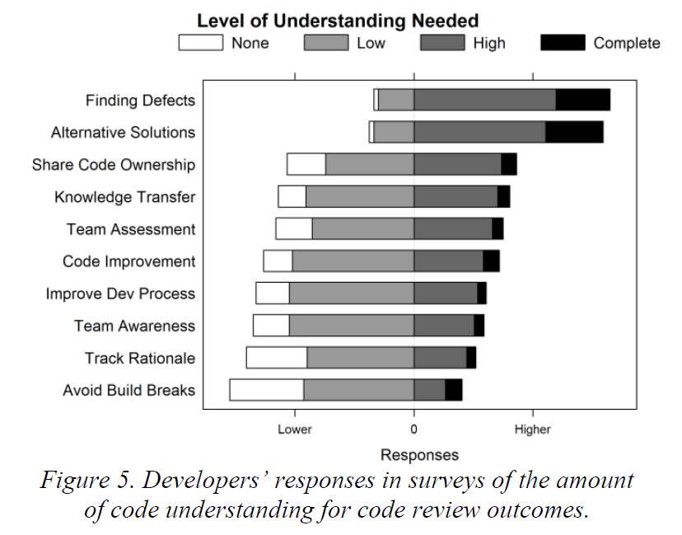
Visualizing Likert responses
This example is taken from: Alberto Bacchelli, Christian Bird: Expectations, outcomes, and challenges of modern code review. ICSE 2013: 712-721
Resources: Look at the “After” Picture in http://statistical-research.com/plotting-likert-scales/
There are more before/after examples here http://www.datarevelations.com/category/visualizing-survey-data-and-likert-scales
Here’s some R code for stacked Likert bars http://statistical-research.com/plotting-likert-scales/

Slide 39
Analyzing survey data
Coding of responses
  Taking the open-end responses and categorizing them into groups (codes) to facilitate quantitative analysis or to identify common themes
  Example:
  What tools are you using in software development?
  Codes could be the different types of tools, e.g., version control, bug database, IDE, etc.
Tools for coding qualitative data:
  Atlas.TI
  Excel, OneNote
  Qualyzer, http://qualyzer.bitbucket.org/
  Saturate (web-based), http://www.saturateapp.com/

Slide 40
Analyzing survey data
Inter-rater agreement
  Coding is a subjective activity
  Increase reliability by using multiple raters for entire data or a subset of the data
  Cohen’s Kappa or Fleiss’ Kappa can be used to measure the agreement between multiple raters.
  “We measured inter-rater agreement for the first author’s categorization on a simple random sample of 100 cards with a closed card sort and two additional raters (third and fourth author); the Fleiss’ Kappa value among the three raters was 0.655, which can be considered a substantial agreement [19].”
  (from Breu @CSCW 2010)
[19] J. Landis and G. G. Koch. The measurement of observer agreement
for categorical data. Biometrics, 33(1):159–174, 1977.

Slide 41
Analyzing survey data
Card sorting
  widely used to create mental models and derive taxonomies from data and to deduce a higher level of abstraction and identify common themes.
  in the preparation phase, we create cards for each response written by the respondents (Mail Merge feature in Word);
  in the execution phase, cards are sorted into meaningful groups with a descriptive title;
  in the analysis phase, abstract hierarchies are formed in order to deduce general categories and themes.
Open card sorts have no predefined groups;
  groups emerge and evolve during the sorting process
Closed card sort have predefined groups,
  typically used when the themes are known in advance.
Mail Merge for Email: http://office.microsoft.com/en-us/word-help/use-word-mail-merge-for-email-HA102809788.aspx

Slide 42
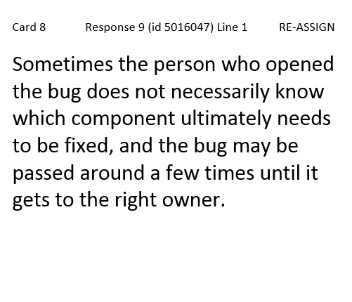
Example of a card for a card sort
Have an ID for each card.
Same length of ID is better.
Put a reference to the survey response
Print in large font, the larger
the better (this is 19 pt.)
After the mail merge you can reduce the font size for cards that don’t fit
We usually do 6-up or 4-up on a letter page.

Slide 43
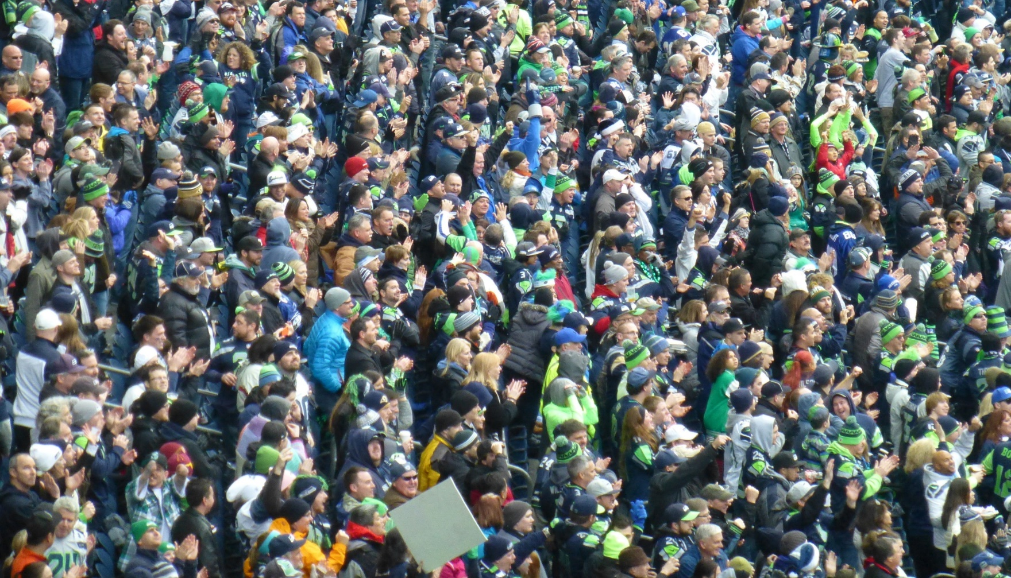
One more example
http://aka.ms/145Questions
Andrew Begel, Thomas Zimmermann. Analyze This! 145 Questions for Data Scientists
in Software Engineering. ICSE 2014

Slide 44
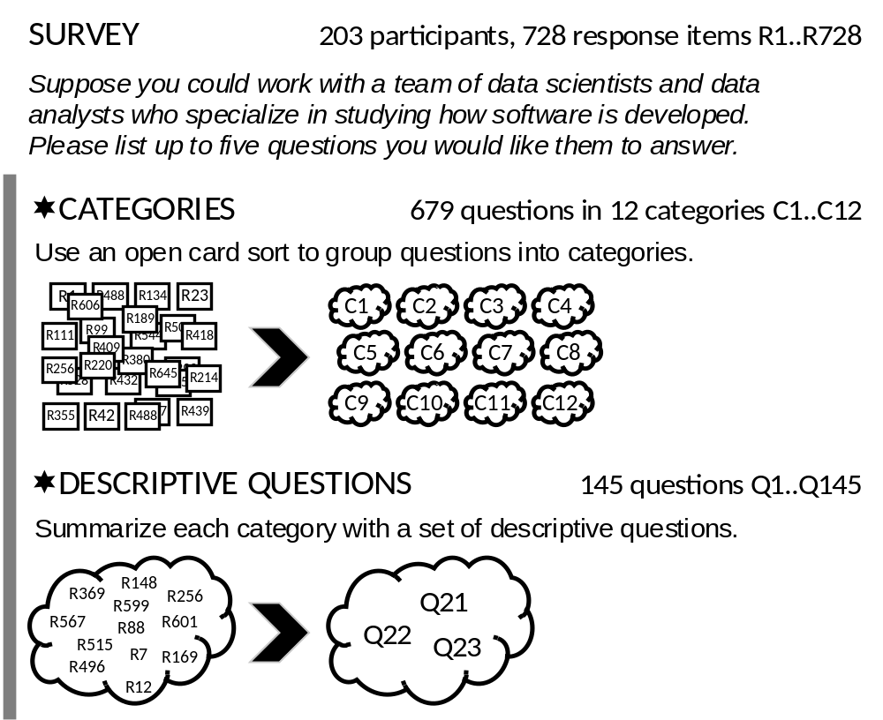
❶

Slide 45
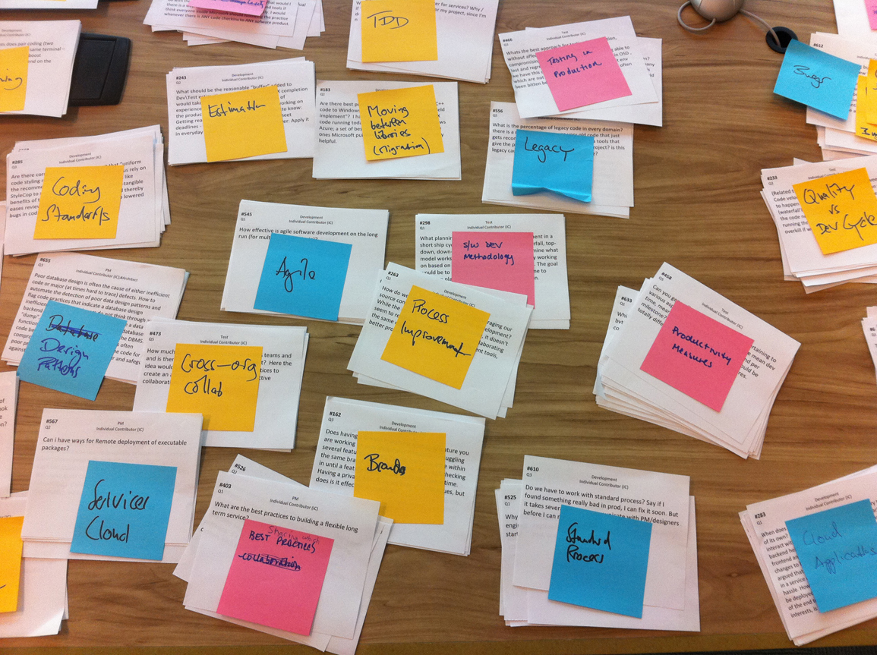

Slide 46

raw questions (that were provided by respondents)
“How does the quality of software change over time – does software age?
I would use this to plan the replacement of components.”
“How do security vulnerabilities correlate to age / complexity / code churn / etc. of a code base? Identify areas to focus on for in-depth security review or re-architecting.”
“What will the cost of maintaining a body of code or particular solution be? Software is rarely a fire and forget proposition but usually has a fairly predictable lifecycle. We rarely examine the long term cost of projects and the burden we place on ourselves and SE as we move forward.”

Slide 47
raw questions (that were provided by respondents)
“How does the quality of software change over time – does software age?
I would use this to plan the replacement of components.”
“How do security vulnerabilities correlate to age / complexity / code churn / etc. of a code base? Identify areas to focus on for in-depth security review or re-architecting.”
“What will the cost of maintaining a body of code or particular solution be? Software is rarely a fire and forget proposition but usually has a fairly predictable lifecycle. We rarely examine the long term cost of projects and the burden we place on ourselves and SE as we move forward.”
descriptive question (that we distilled)
How does the age of code affect its quality, complexity, maintainability, and security?

Slide 48
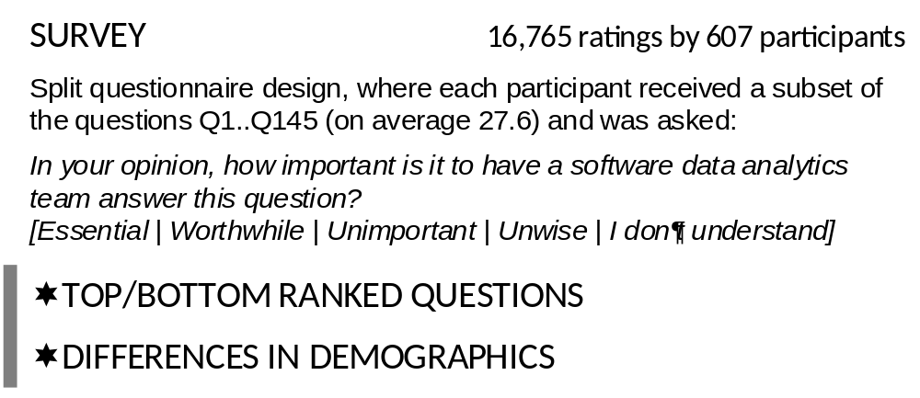
❷
Discipline: Development, Testing, Program Management
Region: Asia, Europe, North America, Other
Number of Full-Time Employees
Current Role: Manager, Individual Contributor
Years as Manager
Has Management Experience: yes, no.
Years at Microsoft
Notes:
The asymmetric survey response scale was inspired by a model for product development and customer satisfaction created by Professor Noriaki Kano [31]. It measures three aspects: must have (Essential), nice to have (Worthwhile), and detraction (Unwise).

Slide 49
Why conduct interviews?
Collect historical data that is not recorded anywhere else
Elicit opinions and impressions
Richer detail
Triangulate with other data collection techniques
Clarify things that have happened (especially following an observation)
J. Aranda and G. Venolia. The Secret Life of Bugs: Going Past the Errors and Omissions in Software Repositories. ICSE 2009

Slide 50
Types of interviews
Structured – Exact set of questions, often quantitative in nature, uses and interview script
Semi-Structured – High level questions, usually qualitative, uses an interview guide
Unstructured – High level list of topics, exploratory in nature, often a conversation, used in ethnographies and case studies.
Notes:
Structured interviews require adherence to a very particular set of rules. Each question that is outlined should be read word for word by the researcher without any deviation from the protocol. Structured interviews are the type used most often by quantitative researchers. The style is most useful when looking for very specific information. The benefits are that it keeps the data concise and reduces researcher bias.
Semi-Structured - "Semi-structured interviews are a bit more relaxed than structured interviews. While researchers using this type are still expected to cover every question in the protocol, they have some wiggle room to explore participant responses by asking for clarification or additional information. Interviewers also have the freedom to be more friendly and sociable. Semi-structured interviews are most often used in qualitative studies. The style is most useful when one is investigating a topic that is very personal to participants. Benefits include the ability to gain rapport and participants' trust, as well as a deeper understanding of responses. Data sets obtained using this style will larger than those with structured interviews."
Unstructured - "Unstructured interviews have the most relaxed rules of the three. In this type, researchers need only a checklist of topics to be covered during the interview. There is no order and no script. The interaction between the participant and the researcher is more like a conversation than an interview. Unstructured interviews are most often used in ethnographies and case studies (types of qualitative studies). They are best used when researchers want to find as much information as possible about their topic. The benefit is that unstructured interviews often uncover information that would not have been exposed using structured or semi-structured interviews. The researcher and participant are not limited by the protocol. Data sets collected using unstructured interviews will be larger than the rest."

Slide 51
Interview Workflow
Select Subjects
Contact & Schedule
Conduct Interview
Write Notes & Discuss
Transcribe
Code
Report
Collect Background Info
Decide Goals & Questions

Slide 52
Preparation: Interview Guide
Contains an organized list of high level questions.
ONLY A GUIDE!
Questions can be skipped, asked out of order, followed up on, etc.
Helps with pacing and to make sure core areas are covered.

Slide 53
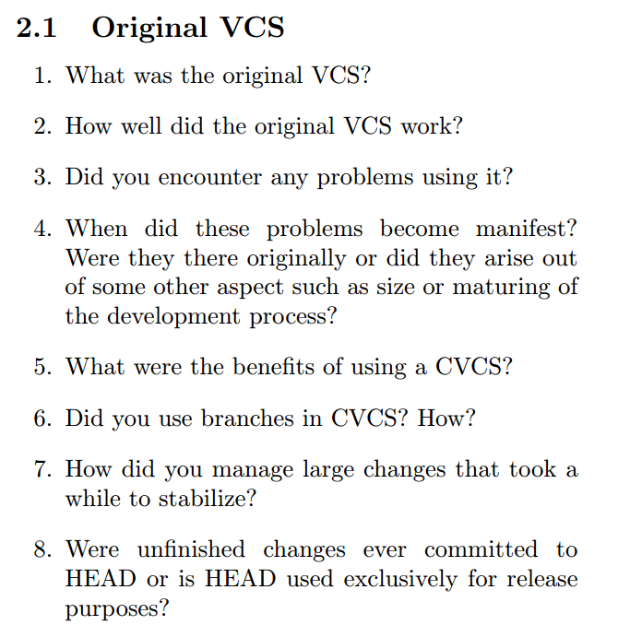
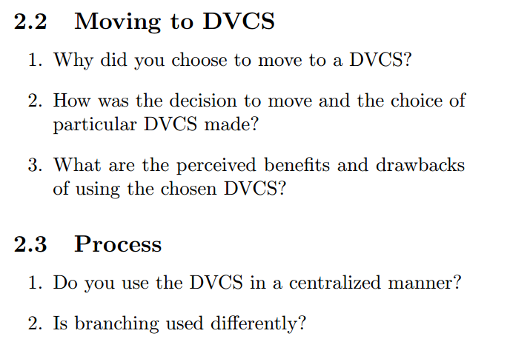
E. Barr, C. Bird, P. Rigby, A. Hindle, D. German, and P. Devanbu. Cohesive and Isolated Development with Branches. FASE 2012

Slide 54
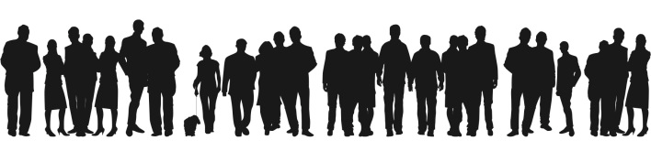
Preparation: Identify Subjects
You can’t interview everyone!
Doesn’t have to be a random sample, but you can still try to achieve coverage.
Don’t be afraid to add/remove people as you go
Notes:
10 interviews is A LOT of work.

Slide 55
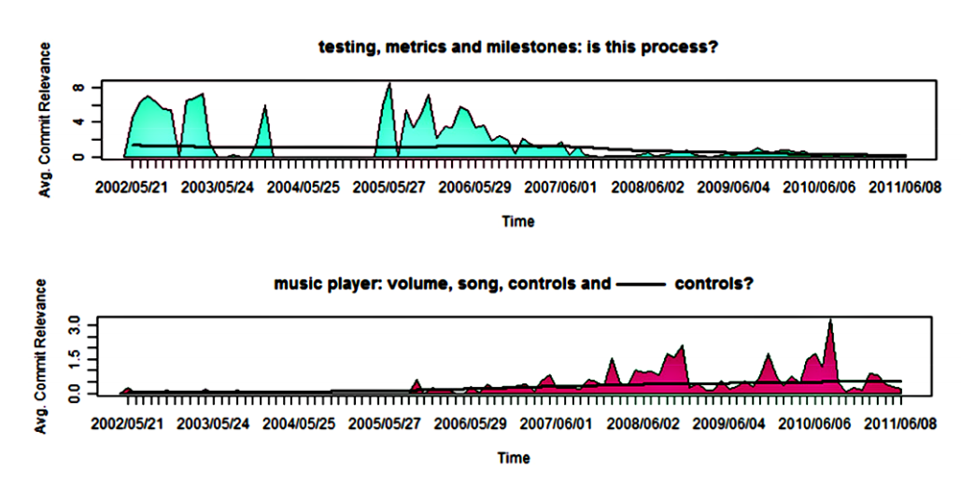
Preparation: Data collection
Some interviews may require interviewee-specific preparation.
A. Hindle, C. Bird, T. Zimmermann, N. Nagappan. Relating Requirements to Implementation via Topic Analysis: Do Topics Extracted From Requirements Make Sense to Managers and Developers? ICSM 2012

Slide 56
Preparation: Contacting
Introduce yourself.
Tell them what your goal is.
How can it benefit them?
How long will it take?
Do they need any preparation?
Why did you select them in particular?

Slide 57
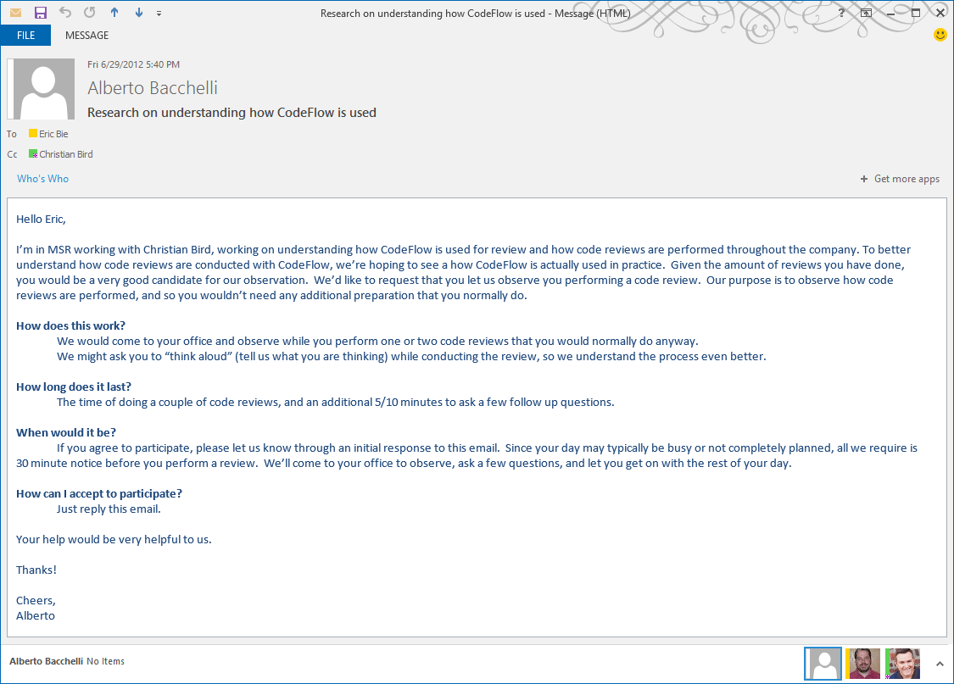
A. Bacchelli and C. Bird. Expectations, Outcomes, and Challenges of Modern Code Review. ICSE 2013 2012

Slide 58
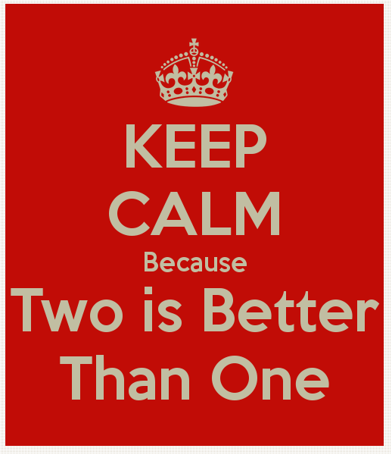
During: Two people is best
Tend to ask more questions == more info
Less “down time”
One writes, one talks
Discuss afterwards
Three or more can be threatening

Slide 59
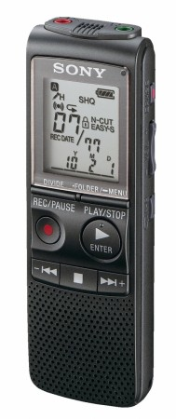
During: General Tips
Ask to record. Still take notes (What if it didn’t record!)
You want to listen to them, don’t make them listen to you!
Face to face is best, even if online.
Be aware of time.

Slide 60
After
Write down post-interview notes. Thoughts, impressions, discussion with co-interviewer, follow-ups.
Do you need to continue interviewing? (saturation)
Do you need to modify your guide?
Do you need to transcribe?

Slide 61
Analysis: transcription
Verbatim == time consuming or expensive and error prone. (but still may be worth it)
Partial transcription: capture the main idea in 10-30 second chunks.
Notes:
Paying for transcription is expensive and often the transcribers don’t understand technical jargon

Slide 62
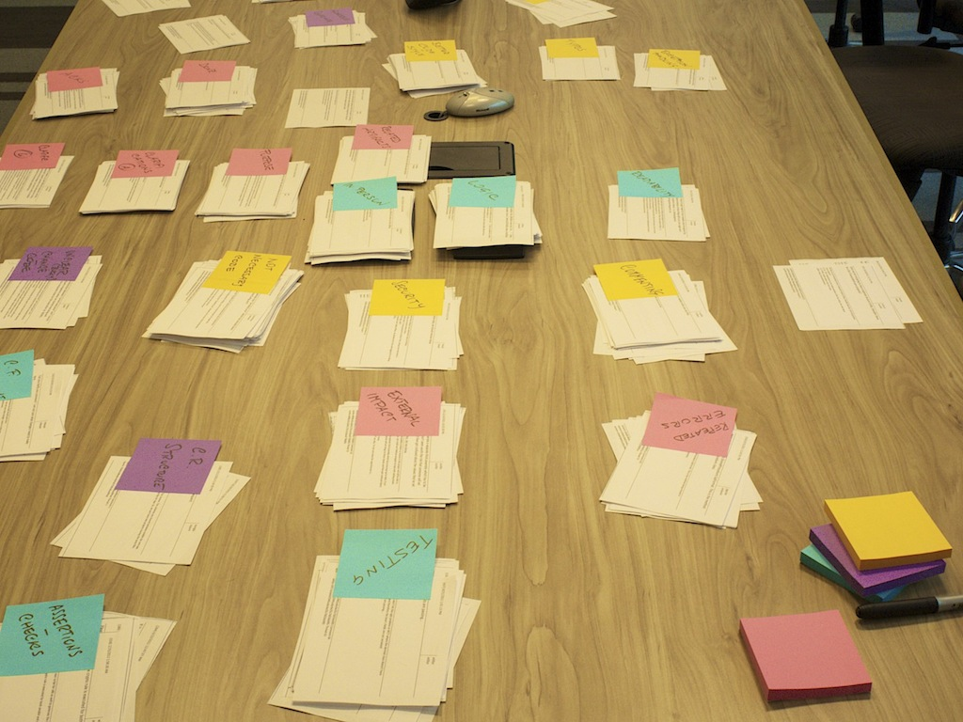
Card Sorting

Slide 63
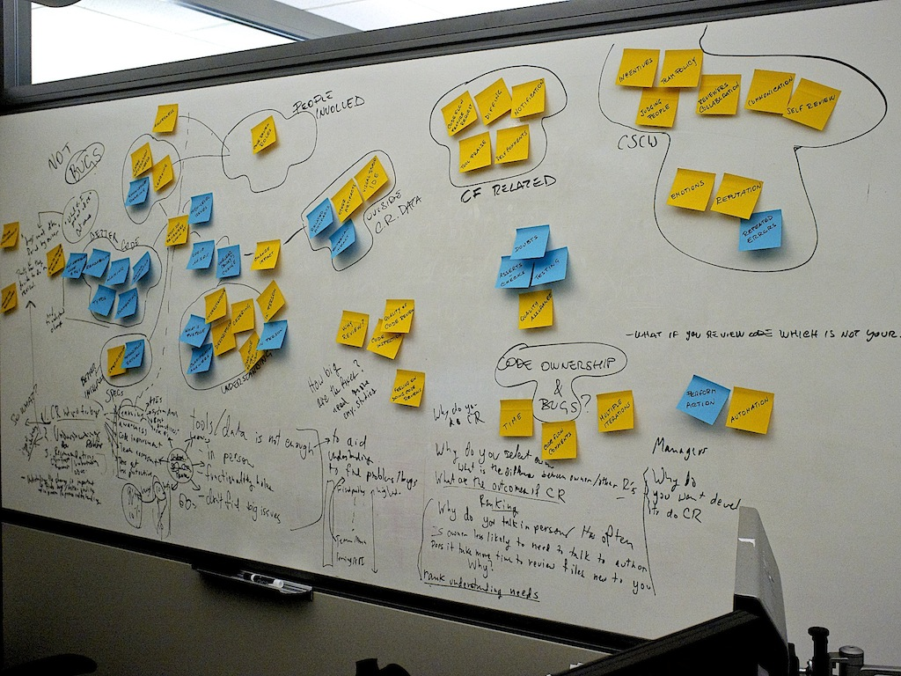
Affinity Diagram
Notes:
a lot of interesting topics
narrow down to something actionable and interesting, not only from an academic point of view, but for Microsoft, too. We focused on a part of the left side

Slide 64
Reporting
At least, include:
Number of interviewees, how selected, how recruited, their roles
Duration and location of interviews
Describe or provide interview guide and/or any artifacts used

Slide 65
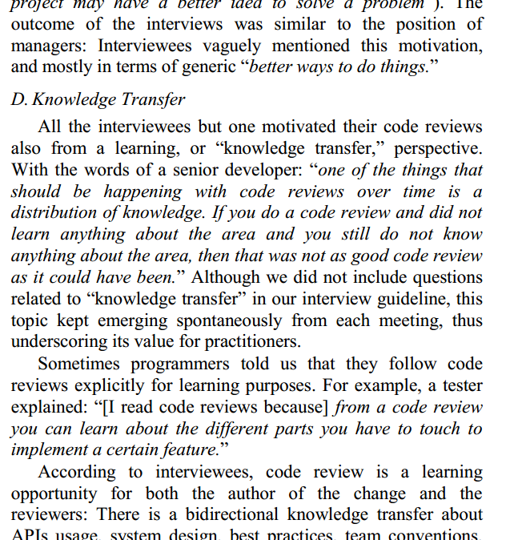
Quotes
can provide richness and insight and is engaging
Don’t cherry pick. Select representative quotes that capture general sentiment.

Slide 66
Additional References
Hove and Anda. "Experiences from conducting semi-structured interviews in empirical software engineering research." Software Metrics, 2005. 11th IEEE International Symposium. IEEE, 2005.
Seaman, C. "Qualitative Methods in Empirical Studies of Software Engineering". IEEE Transactions on Software Engineering, 1999. 25 (4), 557-572

