Slide 1



ICSE’15 Technical Briefing:
The Art and Science of
Analyzing Software Data
Part2: Quantitative methods
Tim Menzies : NcState, USA
Leandro Minku : U. Birmingham, UK
Fayola Peters : Lero, Ireland

Slide 2
NOTE TO REVIEWERS
THESE SLIDES ARE INCOMPLETE.
To be added (before icse’15)
  Background notes on data mining methods (from a recent chapter by Menzies on recommender systems)
  New notes on landmark results
    Estimating software project effort using analogies M Shepperd, C Schofield Software Engineering, IEEE Transactions on 23 (11), 736-743, 1997
    Less is More: Temporal fault predictive performance over multiple Hadoop releases HARMAN, M.; ISLAM, S.; JIA, Y.; MINKU, L.; SARRO, F.; SRIVISUT, K.; Symposium on Search-Based Software Engineering (SSBSE'14), 6p., 2014
    On the value of ensemble effort estimation E Kocaguneli, T Menzies, J Keung IEEE Transactions on Software Engineering 38 (6), 1403-1416, 2012
    Ensembles and locality: Insight on improving software effort estimation LL Minku, X Yao Information and Software Technology 55 (8), 1512-1528, 2013
  Updates on our prior work
    [4] How to make best use of cross-company data in software effort estimation? LL Minku, X Yao ICSE, 446-456, 2014
    [5] Transfer learning in effort estimation, E Kocaguneli, T Menzies, E Mendes Empirical Software Engineering, 2014

Slide 3



Who we are…
Tim Menzies
North Carolina State, USA
tim@menzies.us
Leandro L. Minku
The University of Birmingham
L.L.Minku@cs.bham.ac.uk
Fayola Peters
LERO, University of Limerick, Ireland,
fayolapeters@gmail.com

Slide 4
Topics (in this tutorial)
A (brief) survey of quantitative data mining methods
Landmark results
Issues of Ethics, Privacy algorithms
4) Open Issues, new solutions
Instabilities;
Envy;
Ensembles

Slide 5
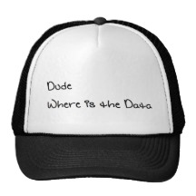
How to Solve Lack or Scarcity of Local Data
Notes:
Burak

Slide 6
What are my options?
Isn’t local (within) data better?
  It may not be available
  It may be scarce
  Tedious data collection effort
  Too slow to collect
GLOBAL
LOCAL
The verdict with global (cross) data?
Effort estimation¹:
  No clear winners, either way
Defect Prediction²:
  Can use global data as a stop gap
¹ Barbara A. Kitchenham, Emilia Mendes, Guilherme Horta Travassos: Cross versus Within-Company Cost Estimation Studies: A Systematic Review. IEEE Trans. Software Eng. 33(5): 316-329 (2007)
² B. Turhan, T. Menzies, A. Bener and J. Distefano, “On the relative value of cross-company and within-company data for defect prediction”, Empirical Software Engineering Journal, Vol.14/5, pp.540-578, 2009.

Slide 7
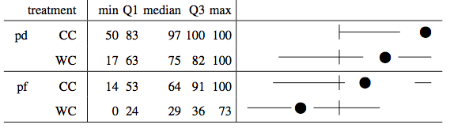
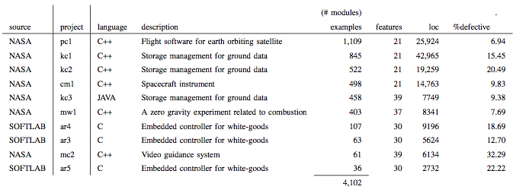
Comparing options
For NASA data
  Seven test sets from 10% of each source
Treatment CC (using global)
  Train on the 6 other data sets
Treatment WC (using local)
  Train on the remaining 90% of the local data

Slide 8

NN-Filtering
Step 1: Calculate the pairwise Euclidean distances between the local (test) set and the candidate (global) training set.
Step 2: For each test datum, pick its k nearest neighbors from global set.
Step 3: Pick unique instances from the union of those selected across all local set to construct the final training set
Now, train your favorite model on the filtered training set!
B. Turhan, A. Bener, and T. Menzies, “Nearest Neighbor Sampling for Cross Company Defect Predictors”, in Proceedings of the 1st International Workshop on Defects in Large Software Systems (DEFECTS 2008), pp. 26, 2008.

Slide 9
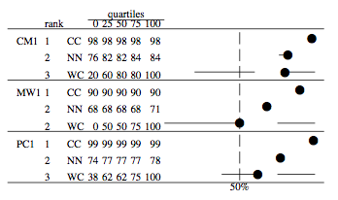
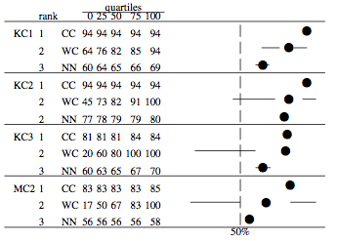
More Comparisons: PD
For NASA data
  Seven test sets from 10% of each source
Treatment CC (using global)
  Train on the 6 other data sets
Treatment WC (using local)
  Train on the remaining 90% of the local data
Treatment NN (using global+NN)
  Initialize train set with 6 other data sets,
  Prune the train set to just the 10 nearest neighbors (Euclidean)
  of the test set (discarding repeats)
B. Turhan, T. Menzies, A. Bener and J. Distefano, “On the relative value of cross-company and within-company data for defect prediction”, Empirical Software Engineering Journal, Vol.14/5, pp.540-578, 2009.

Slide 10
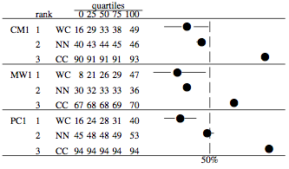
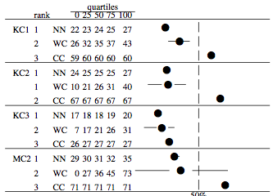
More Comparisons: PF
For NASA data
  Seven test sets from 10% of each source
Treatment CC (using global)
  Train on the 6 other data sets
Treatment WC (using local)
  Train on the remaining 90% of the local data
Treatment NN (using global+NN)
  Initialize train set with 6 other data sets,
  Prune the train set to just the 10 nearest neighbors (Euclidean)
  of the test set (discarding repeats)
B. Turhan, T. Menzies, A. Bener and J. Distefano, “On the relative value of cross-company and within-company data for defect prediction”, Empirical Software Engineering Journal, Vol.14/5, pp.540-578, 2009.

Slide 11
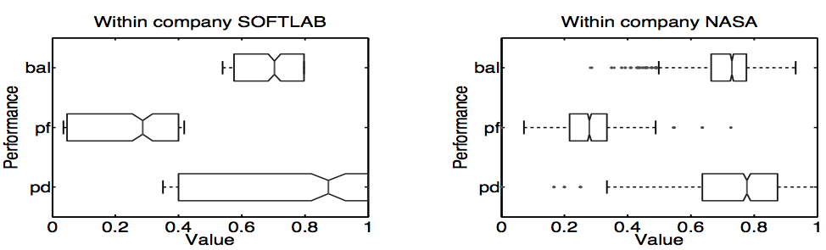
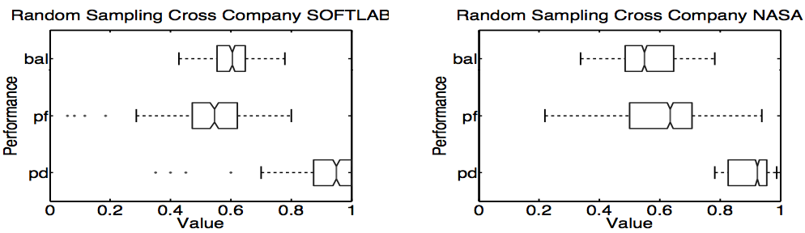
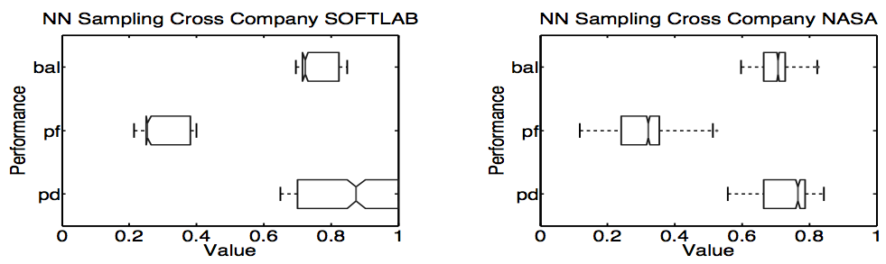
External Validity
For SOFTLAB data
  Three test sets from embedded systems
Treatment CC (using global)
  Train on the seven NASA data sets
Treatment WC (using local)
  Train on the remaining two local test data
Treatment NN (using global+NN)
  Initialize train set with 7 NASA data sets,
  Prune the train set to just the 10 nearest neighbors (Euclidean)
  of the test set (discarding repeats)
B. Turhan, T. Menzies, A. Bener and J. Distefano, “On the relative value of cross-company and within-company data for defect prediction”, Empirical Software Engineering Journal, Vol.14/5, pp.540-578, 2009.

Slide 12
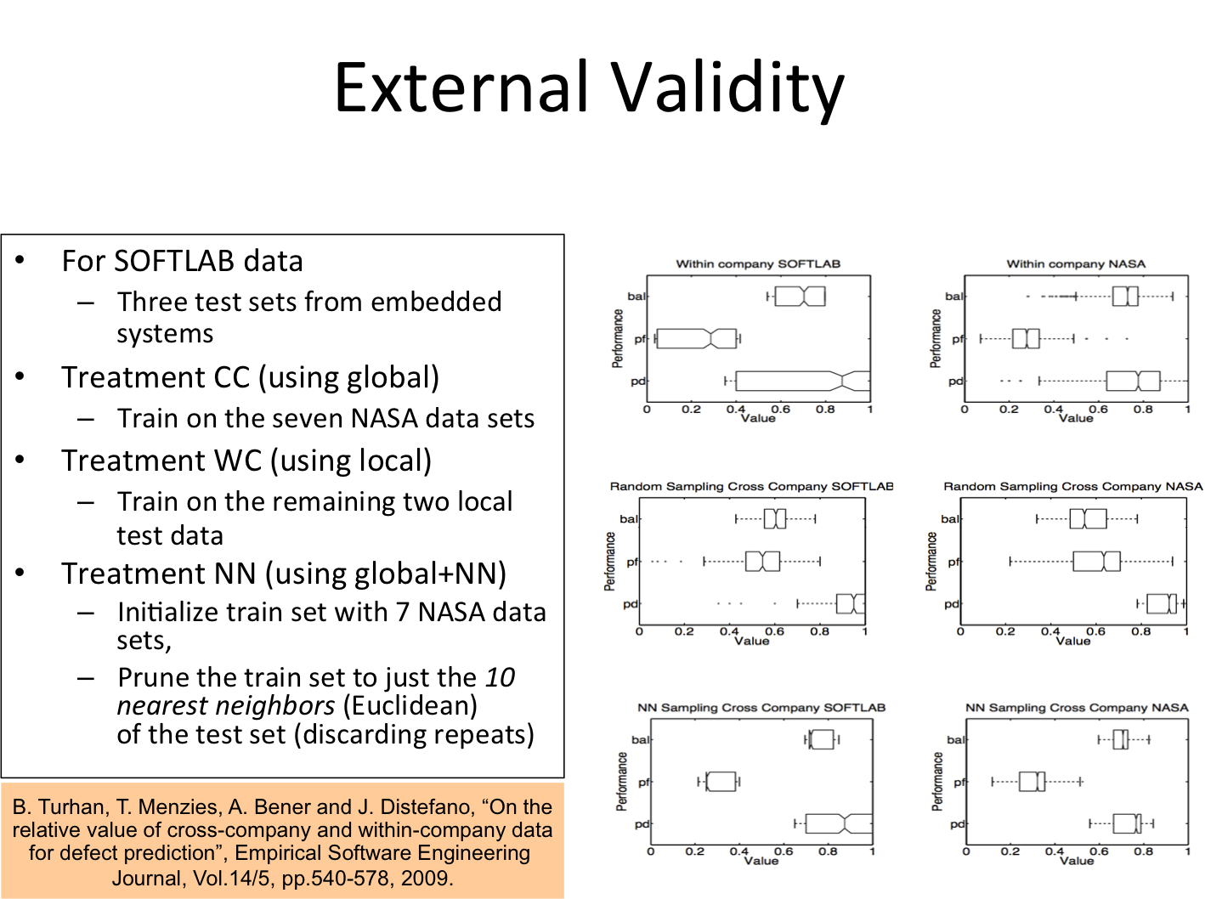



Slide 13
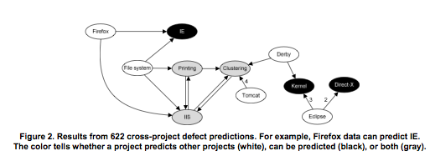
Warning!

Slide 14
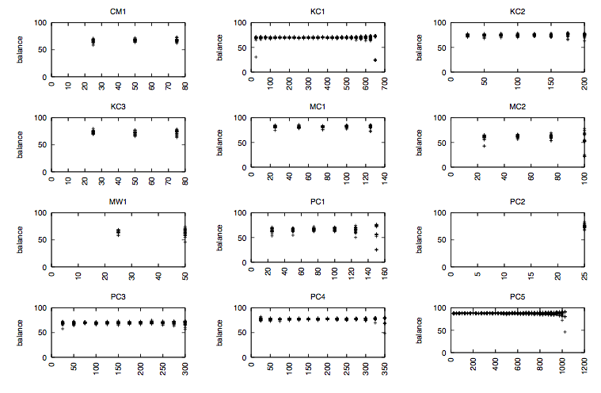
“Theories can be learned from a very small sample of available data”
Microsampling
Given N defective modules:
  M = {25, 50, 75, ...} <= N
  Select M defective and M defect-free modules.
  Learn theories on 2M instances
Undersampling: M=N
8/12 datasets -> M = 25
1/12 datasets -> M = 75
3/12 datasets -> M = {200, 575, 1025}
T. Menzies, B. Turhan, A. Bener, G. Gay, B. Cukic, Y. Jiang, “Implications of Ceiling Effects in Defect Predictors”, in Proceedings of the 4th International Workshop on Predictor Models in Software Engineering (PROMISE 2008), pp. 47-54, 2008.

Slide 15
How about mixing local and global?
Is it feasible to use additional data from other projects:
  (Case 1) When there is limited local project history, i.e. no prior releases
  (Case 2) When there is existing local project history, i.e. many releases over some period
For 73 versions of 41 projects
  Reserve test sets from 10% of each project
  Additional test sets if the project has multiple releases
Treatment WP (using local)
  Train on 10%..90% of the local data
  Train on the previous releases
Treatment WP+CP (using global)
  Enrich training sets above with NN-filtered data from all other projects
Case 1: WP(10%) + CP is as good as WP(90%)
Case 2: WP+CP is significantly better than WP (with small effect size)
B. Turhan, A. T. Mısırlı, A. Bener, “Empirical Evaluation of The Effects of Mixed Project Data on Learning Defect Predictors”, (in print) Journal of Information and Software Technology, 2013

Slide 16

Is Data Sharing Worth the Risk to Individual Privacy
What would William Weld say?
Former Governor Massachusetts.
Victim of re-identification privacy breach.
Led to sensitive attribute disclosure of his medical records.

Slide 17

Is Data Sharing Worth the Risk to Individual Privacy
What about NASA contractors?
Subject to competitive bidding every 2 years.
Unwilling to share data
that would lead to
sensitive attribute disclosure.
e.g. actual software development times

Slide 18
When To Share – How To Share
So far we cannot guarantee
100% privacy.
What we have is a directive
as to whether data is private
and useful enough to share...
We have a lot of privacy
algorithms geared toward
minimizing risk.
Old School
K-anonymity
L-diversity
T-closeness
The degree of risk to the
data sharing entity must
not exceed the benefits of sharing.
But What About Maximizing Benefits (Utility)?

Slide 19
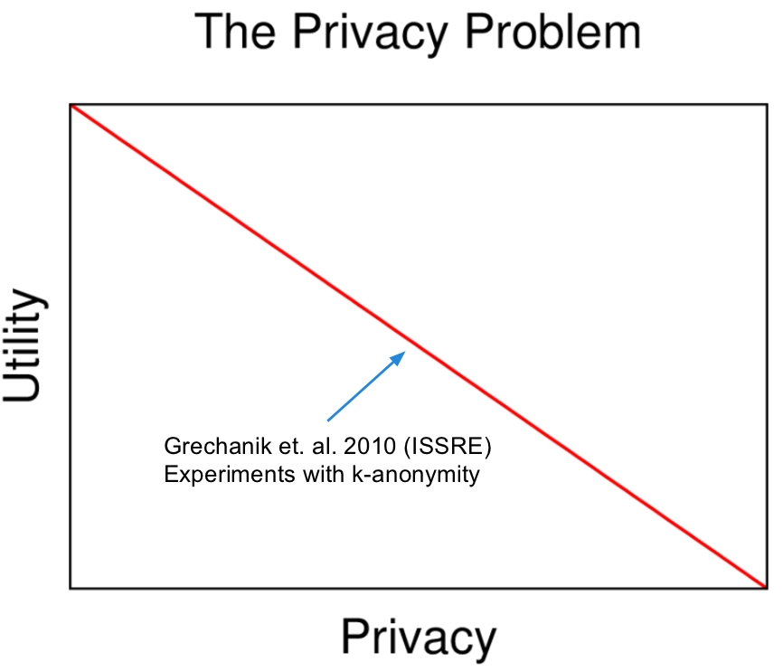

Slide 20

Balancing Privacy and Utility
or...
Minimize risk of privacy disclosure while maximizing utility.
= CLIFF + MORPH
Instance Selection with CLIFF
Small random moves with MORPH
F. Peters, T. Menzies, L. Gong, H. Zhang, "Balancing Privacy and Utility in Cross-Company Defect Prediction," IEEE Transactions on Software Engineering, 24 Jan. 2013. IEEE computer Society Digital Library. IEEE Computer Society

Slide 21
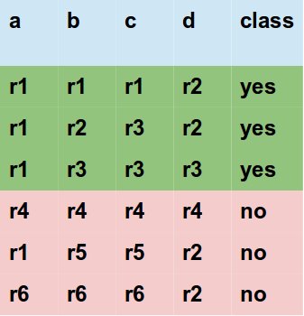
CLIFF
Don't share all the data.
F. Peters, T. Menzies, L. Gong, H. Zhang, "Balancing Privacy and Utility in Cross-Company Defect Prediction," IEEE Transactions on Software Engineering, 24 Jan. 2013. IEEE computer Society Digital Library. IEEE Computer Society

Slide 22
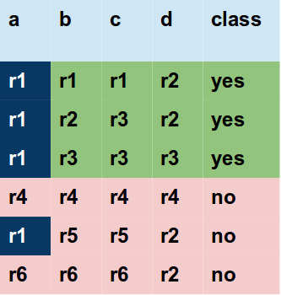
CLIFF
Don't share all the data.
"a=r1"
powerful for selection for class=yes
more common in "yes" than "no"
CLIFF
step1:
for each class find ranks of all values
F. Peters, T. Menzies, L. Gong, H. Zhang, "Balancing Privacy and Utility in Cross-Company Defect Prediction," IEEE Transactions on Software Engineering, 24 Jan. 2013. IEEE computer Society Digital Library. IEEE Computer Society

Slide 23
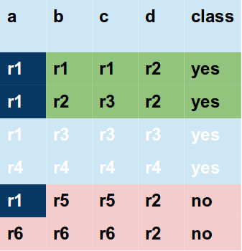
CLIFF
Don't share all the data.
"a=r1"
powerful for selection for class=yes
more common in "yes" than "no"
CLIFF
step2:
multiply ranks of each row
F. Peters, T. Menzies, L. Gong, H. Zhang, "Balancing Privacy and Utility in Cross-Company Defect Prediction," IEEE Transactions on Software Engineering, 24 Jan. 2013. IEEE computer Society Digital Library. IEEE Computer Society

Slide 24
CLIFF
Don't share all the data.
CLIFF
step3: select the most powerful
rows of each class
Note linear time
Can reduce N rows to 0.1N
So an O(N2) NUN algorithm now
takes time O(0.01)
Scalability
F. Peters, T. Menzies, L. Gong, H. Zhang, "Balancing Privacy and Utility in Cross-Company Defect Prediction," IEEE Transactions on Software Engineering, 24 Jan. 2013. IEEE computer Society Digital Library. IEEE Computer Society

Slide 25
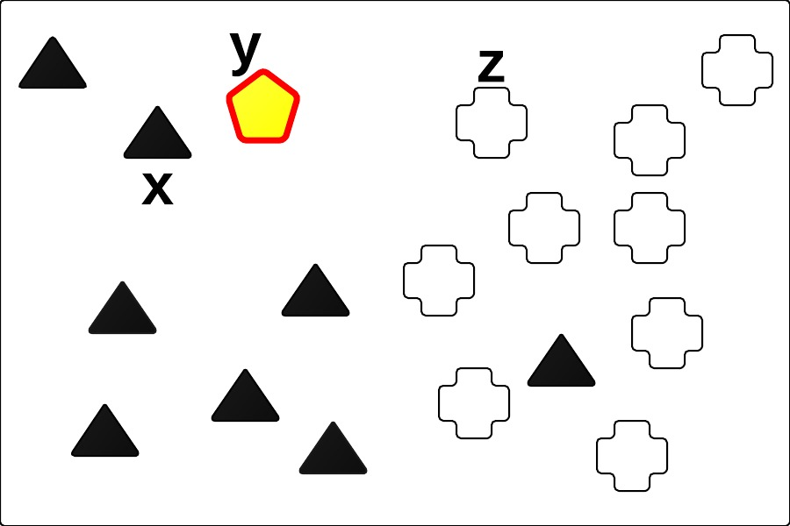
MORPH
Push the CLIFF data from their original position.
y = x ± (x − z) ∗ r
x ∈ D, the original instance
z ∈ D the NUN of x
y the resulting MORPHed
instance
F. Peters and T. Menzies, “Privacy and utility for defect prediction: Experiments with morph,” in Software Engineering (ICSE), 2012 34th
International Conference on, june 2012, pp. 189 –199.
F. Peters, T. Menzies, L. Gong, H. Zhang, "Balancing Privacy and Utility in Cross-Company Defect Prediction,"
IEEE Transactions on Software Engineering, 24 Jan. 2013. IEEE computer Society Digital Library. IEEE Computer Society

Slide 26
Case Study: Cross-Company Defect Prediction (CCDP)
Sharing Required.
- Company B has little or no data to build a defect model;
- Company B uses data from Company A to build defect models;
Zimmermann et al.
Local data not always available
companies too small
product in first release, so no past data.
Kitchenham et al.
no time for collection
new technology can make all data irrelevant
T. Zimmermann, N. Nagappan, H. Gall, E. Giger, and B. Murphy, “Cross-project defect prediction: a large scale experiment on data vs. domain vs. process.”
in ESEC/SIGSOFT FSE’09,2009
B. A. Kitchenham, E. Mendes, and G. H. Travassos, “Cross versus within-company cost estimation studies: A systematic review,”
IEEE Transactions on Software Engineering, vol. 33, pp. 316–329, 2007

Slide 27

CCDP
Better with data filtering
Initial results with cross-company defect prediction
- negative(Zimmerman FSE '09)
- or inconclusive (Kitchenham TSE '07)
More recent work show better results
- Turhan et al. 2009 (The Burak Filter)
B. Turhan, T. Menzies, A. Bener, and J. Di Stefano, “On the relative value of cross-company and within-company data for defect prediction,”
Empirical Software Engineering, vol. 14, pp. 540–578, 2009.
F. Peters, T. Menzies, and A. Marcus, “Better Cross Company Defect Prediction,” Mining Software Repositories (MSR), 2013 10th IEEE Working Conference on, (to appear)

Slide 28
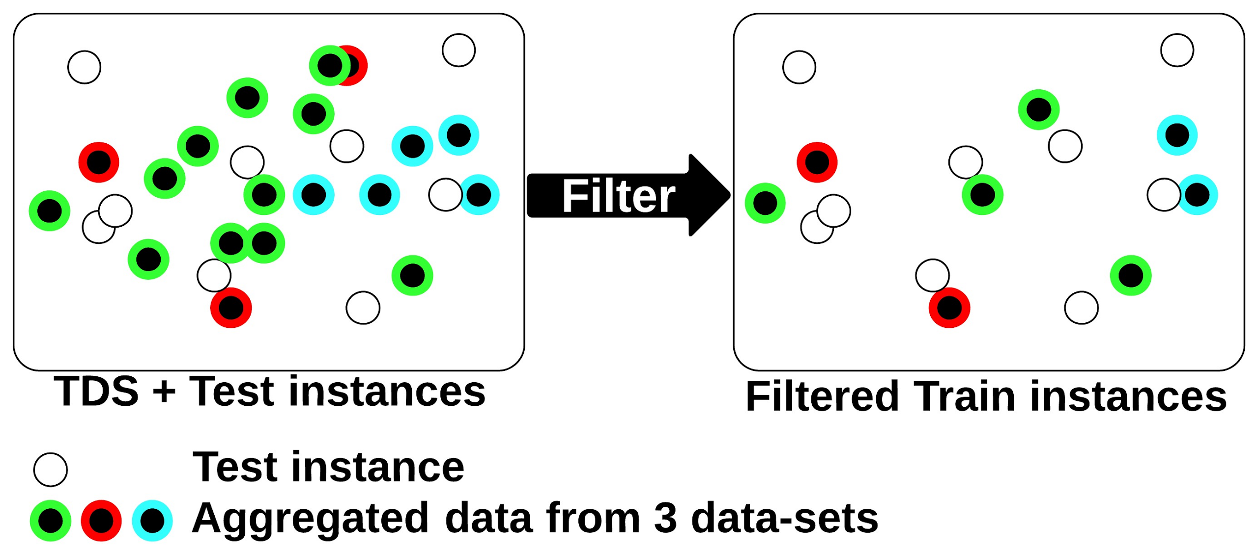
CCDP
Better with data filtering

Slide 29


Making Data Private for CCDP
Terms
Here is how we look at the data
Non-Sensitive Attribute (NSA)
Sensitive Attribute
Class Attribute

Slide 30
Measuring the Risk
IPR = Increased Privacy Ratio
Queries | Original | Privatized | Privacy Breach
Q1 | 0 | 0 | yes
Q2 | 0 | 1 | no
Q3 | 1 | 1 | yes
 |  |  | yes = 2/3 IPR = 1- 2/3 = 0.33
F. Peters, T. Menzies, L. Gong, H. Zhang, "Balancing Privacy and Utility in Cross-Company Defect Prediction," IEEE Transactions on Software Engineering, 24 Jan. 2013. IEEE computer Society Digital Library. IEEE Computer Society

Slide 31
Measuring the Utility
The g-measure
Probability of detection (pd)
Probability of False alarm (pf)
 |  | Actual
 |  | yes | no
Predicted | yes | TP | FP
 | no | FN | TN
pd |  | TP/(TP+FN)
pf |  | FP/(FP+TN)
g-measure |  | 2*pd*(1-pf)/(pd+(1-pf))
F. Peters, T. Menzies, L. Gong, H. Zhang, "Balancing Privacy and Utility in Cross-Company Defect Prediction," IEEE Transactions on Software Engineering, 24 Jan. 2013. IEEE computer Society Digital Library. IEEE Computer Society

Slide 32
Making Data Private for CCDP
Comparing CLIFF+MORPH to Data Swapping and K-anonymity
Data Swapping (s10, s20, s40)
A standard perturbation
technique used for privacy
To implement...
For each NSA a certain percent of the values are swapped with any other value in that NSA.
For our experiments, these percentages are 10, 20 and 40.
k-anonymity (k2, k4)
The Datafly Algorithm.
To implement...
Make a generalization hierarchy.
Replace values in the NSA according to the hierarchy.
Continue until there are k or fewer distinct instances and suppress them.
K. Taneja, M. Grechanik, R. Ghani, and T. Xie, “Testing software in age of data privacy: a balancing act,” in Proceedings of the 19th ACM SIGSOFT symposium and the 13th European conference on Foundations of software engineering, ser. ESEC/FSE ’11. New York, NY, USA: ACM, 2011, pp. 201–211.
L. Sweeney, “Achieving k-anonymity privacy protection using generalization and suppression,” Int. J. Uncertain. Fuzziness Knowl.-Based Syst., vol. 10, no. 5, pp. 571–588, Oct. 2002.

Slide 33
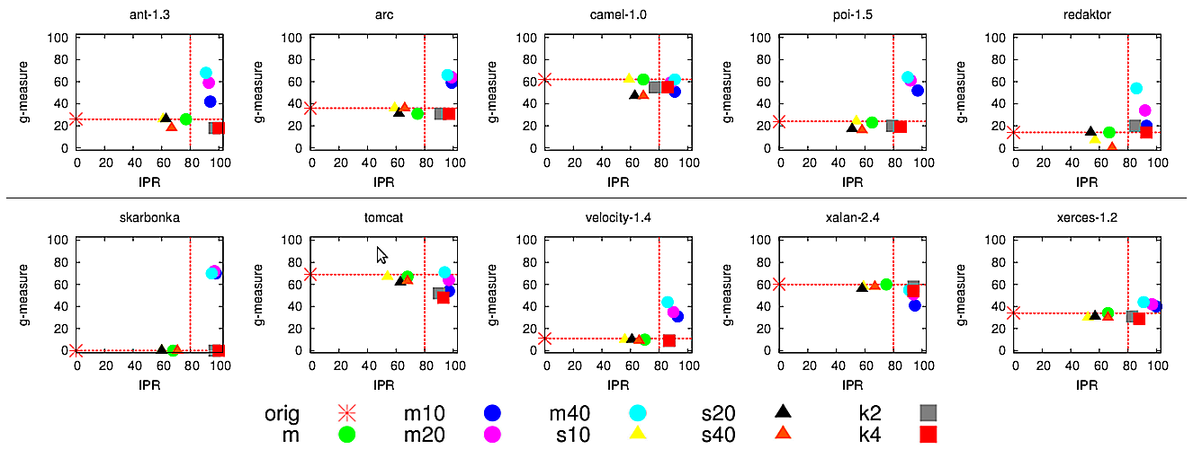
Making Data Private for CCDP
Comparing CLIFF+MORPH to Data Swapping and K-anonymity
F. Peters, T. Menzies, L. Gong, H. Zhang, "Balancing Privacy and Utility in Cross-Company Defect Prediction," IEEE Transactions on Software Engineering, 24 Jan. 2013. IEEE computer Society Digital Library. IEEE Computer Society

Slide 34
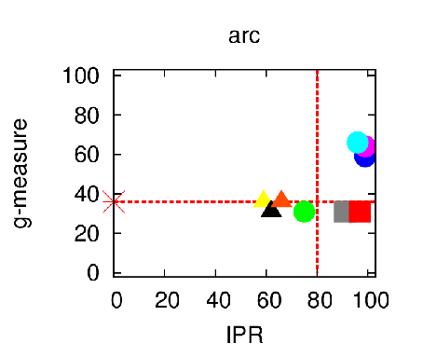
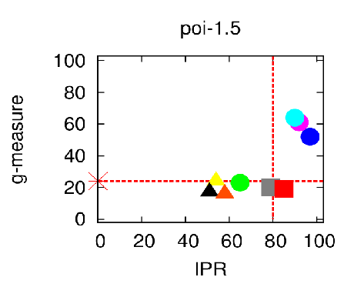
Making Data Private for CCDP
Comparing CLIFF+MORPH to Data Swapping and K-anonymity
F. Peters, T. Menzies, L. Gong, H. Zhang, "Balancing Privacy and Utility in Cross-Company Defect Prediction," IEEE Transactions on Software Engineering, 24 Jan. 2013. IEEE computer Society Digital Library. IEEE Computer Society

Slide 35
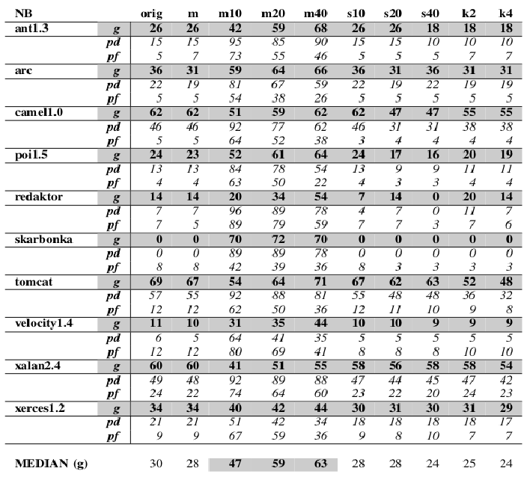
Making Data Private for CCDP
F. Peters, T. Menzies, L. Gong, H. Zhang, "Balancing Privacy and Utility in Cross-Company Defect Prediction," IEEE Transactions on Software Engineering, 24 Jan. 2013. IEEE computer Society Digital Library. IEEE Computer Society

Slide 36
Problems of SE Models
Instability is the problem of not being able to elicit same/similar results under changing conditions
  E.g. data set, performance measure etc.
We will look at instability in 2 areas
  Instability in Effort Estimation
  Instability in Process
Notes:
Tim, Ekrem

Slide 37
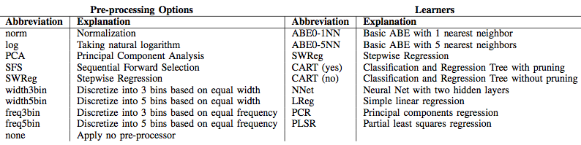
Problems of SE Models/
Instability in Effort
There is no agreed upon best estimation method [1]
Methods change ranking w.r.t. conditions such as data sets, error measures [2]
Experimenting with: 90 solo-methods, 20 public data sets, 7 error measures
[1] M. Jorgensen and M. Shepperd, “A systematic review of software development cost estimation studies,” IEEE Trans. Softw. Eng., vol. 33, no. 1, pp. 33–53, 2007.
[2] I. Myrtveit, E. Stensrud, and M. Shepperd, “Reliability and validity in comparative studies of software prediction models,” IEEE Trans. Softw. Eng., vol. 31, no. 5, pp. 380–391, May 2005.

Slide 38
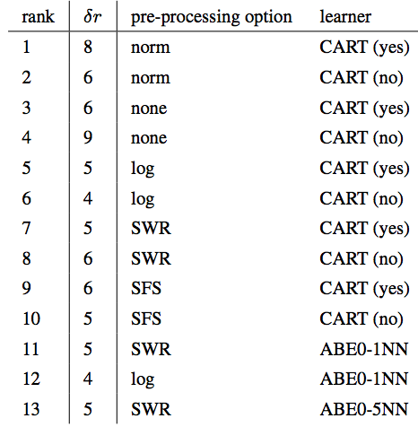
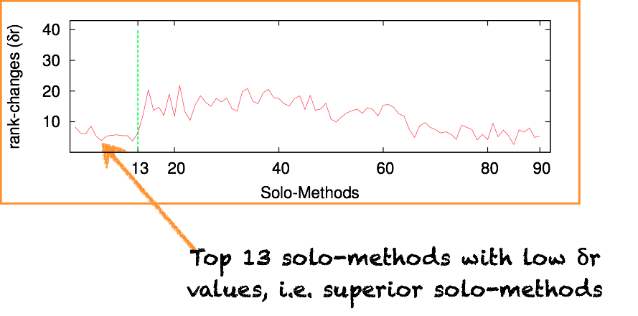
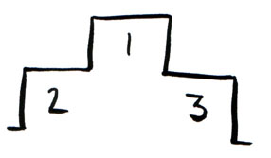
Problems of SE Models/
Instability in Effort
1. Rank methods acc. to win, loss and win-loss values
2. δr is the max. rank change
3. Sort methods acc. to loss and observe δr values

Slide 39

Problems of SE Models/
Instability in Effort
Top 13 methods are CART & ABE methods (1NN, 5NN)
Assembling solo-methods may be a good idea
We have a set of superior methods to recommend
But the previous evidence of assembling multiple methods in SEE is discouraging
Baker et al. [1], Kocaguneli et al. [2], Khoshgoftaar et al. [3] failed to outperform solo-methods
[1] D. Baker, “A hybrid approach to expert and model-based effort esti- mation,” Master’s thesis, Lane Department of Computer Science and Electrical Engineering, West Virginia University, 2007, available from https://eidr.wvu.edu/etd/documentdata.eTD?documentid=5443.
[2] E. Kocaguneli, Y. Kultur, and A. Bener, “Combining multiple learners induced on multiple datasets for software effort prediction,” in Interna- tional Symposium on Software Reliability Engineering (ISSRE), 2009, student Paper.
[3] T. M. Khoshgoftaar, P. Rebours, and N. Seliya, “Software quality analysis by combining multiple projects and learners,” Software Quality Control, vol. 17, no. 1, pp. 25–49, 2009.

Slide 40
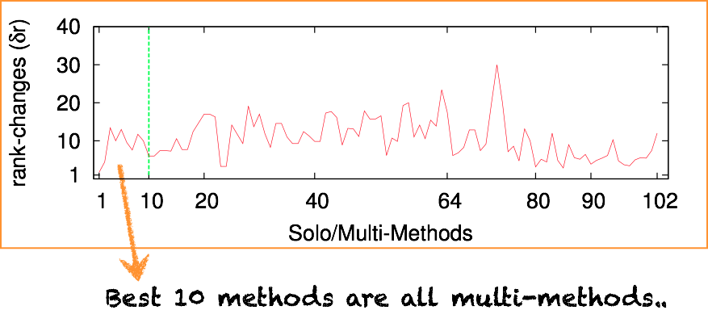
Problems of SE Models/
Instability in Effort
Combine top 2,4,8,13 solo-methods via mean, median and IRWM
Re-rank solo and multi-methods together

Slide 41

Problems of SE Models/
Instability in Process: Dataset Shift/Concept Drift
Candela JQ, Sugiyama M, Schwaighofer A, Lawrence ND (eds) (2009) Dataset shift in machine learning. The MIT Press, Cambridge, MA
Notes:
Burak

Slide 42

Instability in Process: Dataset Shift
Candela JQ, Sugiyama M, Schwaighofer A, Lawrence ND (eds) (2009) Dataset shift in machine learning. The MIT Press, Cambridge, MA
Notes:
Burak

Slide 43
Dataset Shift: Covariate Shift
p(X_{train}) ≠ p(X_{test})
Consider a size-based effort estimation model
  Effective for projects within the traditional operational boundaries of a company
What if a change with impact on products’ size:
  new business domains
  change in technologies
  change in development techniques
Size
B. Turhan, “On the Dataset Shift Problem in Software Engineering Prediction Models”, Empirical Software Engineering Journal, Vol.17/1-2, pp.62-74, 2012.

Slide 44
Dataset Shift: Prior Probability Shift
p(Y_{train}) ≠ p(Y_{test})
Now, consider a defect prediction model…
… and again, what if defect characteristics change:
  Process improvement
  More QA resources
  Increased experience over time
  Basically you improve over time!
kLOC
B. Turhan, “On the Dataset Shift Problem in Software Engineering Prediction Models”, Empirical Software Engineering Journal, Vol.17/1-2, pp.62-74, 2012.

Slide 45

Dataset Shift: Usual Suspects
Sample Selection Bias
& Imbalanced Data
B. Turhan, “On the Dataset Shift Problem in Software Engineering Prediction Models”, Empirical Software Engineering Journal, Vol.17/1-2, pp.62-74, 2012.

Slide 46
Dataset Shift: Usual Suspects
Sample Selection Bias
& Imbalanced Data
B. Turhan, “On the Dataset Shift Problem in Software Engineering Prediction Models”, Empirical Software Engineering Journal, Vol.17/1-2, pp.62-74, 2012.

Slide 47
Dataset Shift
Domain shift
Source Component Shift
Be consistent in the way you measure concepts for model training and testing!
*: “…the metrics based assessment of a software system and measures taken to improve its design differ considerably from tool to tool.”
a.k.a. Data Heterogeneity
Ex: ISBSG contains data from 6000+ projects from 30+ countries.
Where do the training data come from?
vs.
Where do the test data come from?
* Rüdiger Lincke, Jonas Lundberg, and Welf Löwe. “Comparing software metrics tools”, ISSTA '08
B. Turhan, “On the Dataset Shift Problem in Software Engineering Prediction Models”, Empirical Software Engineering Journal, Vol.17/1-2, pp.62-74, 2012.

Slide 48
Managing Dataset Shift
Sampling
Imbalanced Data
Prior Probability Shift
Domain Shift
Covariate Shift
Source Component Shift
Cost Curves
Outlier ‘Detection’
Stratification
RelevancyFiltering
Instance Weighting
Mixture Models
B. Turhan, “On the Dataset Shift Problem in Software Engineering Prediction Models”, Empirical Software Engineering Journal, Vol.17/1-2, pp.62-74, 2012.

Slide 49

Envy =
The WisDOM Of the COWs
Seek the fence where the grass is greener on the other side.
  Learn from there
  Test on here
Cluster to find “here” and “there”

Slide 50
Data = multi-dimensional vectors
@attribute recordnumber real
@attribute projectname {de,erb,gal,X,hst,slp,spl,Y}
@attribute cat2 {Avionics, application_ground, avionicsmonitoring, … }
@attribute center {1,2,3,4,5,6}
@attribute year real
@attribute mode {embedded,organic,semidetached}
@attribute rely {vl,l,n,h,vh,xh}
@attribute data {vl,l,n,h,vh,xh}
…
@attribute equivphyskloc real
@attribute act_effort real
@data
1,de,avionicsmonitoring,g,2,1979,semidetached,h,l,h,n,n,l,l,n,n,n,n,h,h,n,l,25.9,117.6
2,de,avionicsmonitoring,g,2,1979,semidetached,h,l,h,n,n,l,l,n,n,n,n,h,h,n,l,24.6,117.6
3,de,avionicsmonitoring,g,2,1979,semidetached,h,l,h,n,n,l,l,n,n,n,n,h,h,n,l,7.7,31.2
4,de,avionicsmonitoring,g,2,1979,semidetached,h,l,h,n,n,l,l,n,n,n,n,h,h,n,l,8.2,36
5,de,avionicsmonitoring,g,2,1979,semidetached,h,l,h,n,n,l,l,n,n,n,n,h,h,n,l,9.7,25.2
6,de,avionicsmonitoring,g,2,1979,semidetached,h,l,h,n,n,l,l,n,n,n,n,h,h,n,l,2.2,8.4
….

Slide 51
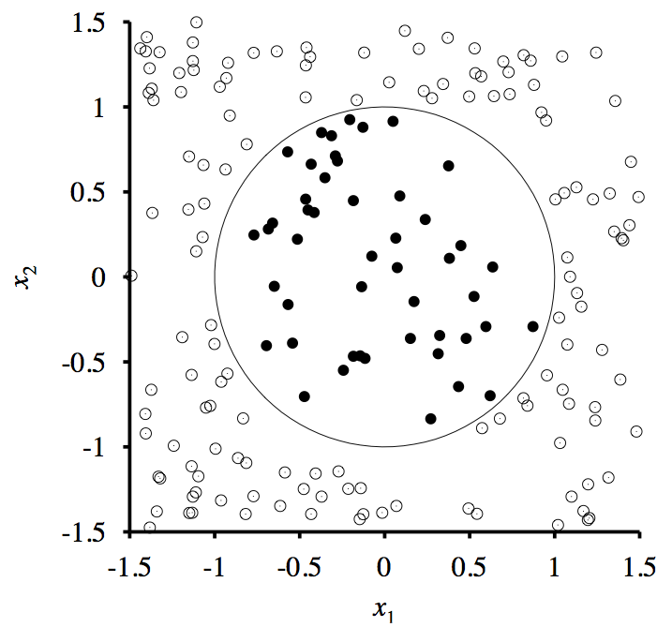
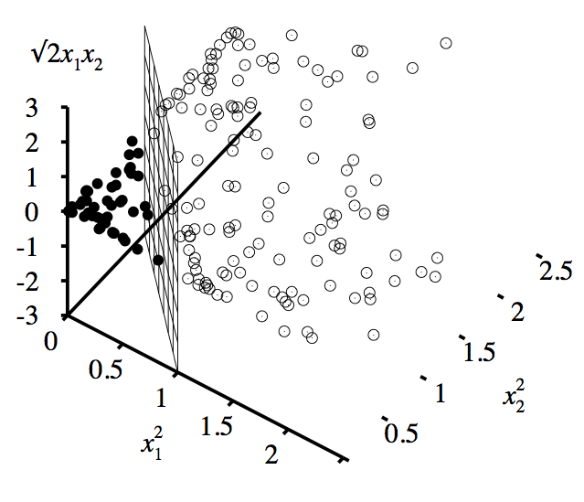
CAUTION: data may not divide neatly on raw dimensions
The best description for SE projects may be synthesize dimensions extracted from the raw dimensions

Slide 52
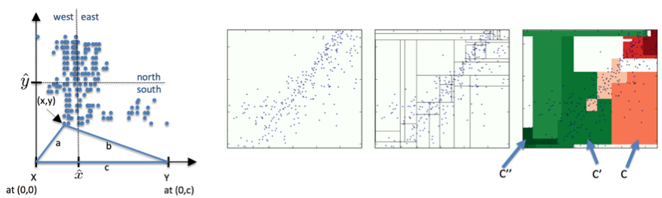
Fastmap
Fastmap: Faloutsos [1995]
O(2N) generation of axis of large variability
  Pick any point W;
  Find X furthest from W,
  Find Y furthest from Y.
c = dist(X,Y)
All points have distance a,b to (X,Y)
  x = (a² + c² − b²)/2c
  y= sqrt(a² – x²)
Find median(x), median(y)
Recurse on four quadrants

Slide 53
Hierarchical partitioning
Grow
Prune
Find two orthogonal dimensions
Find median(x), median(y)
Recurse on four quadrants
Combine quadtree leaves
with similar densities
Score each cluster by median
score of class variable

Slide 54
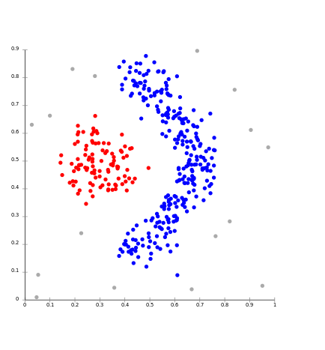
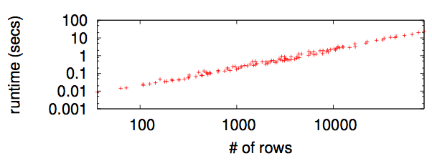
Q: why cluster Via FASTMAP?
A1: Circular methods (e.g. k-means) assume round clusters.
  But density-based clustering allows clusters to be any shape
A2: No need to pre-set the number of clusters
A3: cause other methods
(e.g. PCA) are much slower
  Fastmap is the O(2N)
  Unoptimized Python:

Slide 55
  Learning via “envy”

Slide 56
Envy =
The WisDOM Of the COWs
Seek the fence where the grass is greener on the other side.
  Learn from there
  Test on here
Cluster to find “here” and “there”

Slide 57
Hierarchical partitioning
Grow
Prune
Find two orthogonal dimensions
Find median(x), median(y)
Recurse on four quadrants
Combine quadtree leaves
with similar densities
Score each cluster by median
score of class variable

Slide 58
Hierarchical partitioning
Grow
Prune
Find two orthogonal dimensions
Find median(x), median(y)
Recurse on four quadrants
Combine quadtree leaves
with similar densities
Score each cluster by median
score of class variable
This cluster envies its neighbor with better score and max
abs(score(this) - score(neighbor))
Where is grass greenest?

Slide 59
Q: How to learn rules from neighboring clusters
A: it doesn’t really matter
  Many competent rule learners
But to evaluate global vs local rules:
  Use the same rule learner for local vs global rule learning
This study uses WHICH (Menzies [2010])
  Customizable scoring operator
  Faster termination
  Generates very small rules (good for explanation)

Slide 60
Data from http://promisedata.googlecode.com
Distributions have percentiles:
Effort reduction =
{ NasaCoc, China } :
COCOMO or function points
Defect reduction =
{lucene,xalan jedit,synapse,etc } : CK metrics(OO)
Clusters have untreated class distribution.
Rules select a subset of the examples:
  generate a treated class distribution
Treated with rules
learned from all data
Treated with rules learned
from neighboring cluster

Slide 61
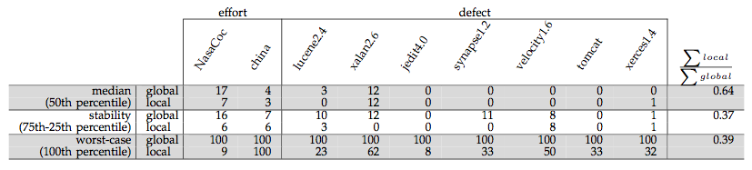
By any measure,
Local BETTER THAN GLOBAL
Lower median efforts/defects (50th percentile)
Greater stability (75th – 25th percentile)
Decreased worst case (100th percentile)

Slide 62
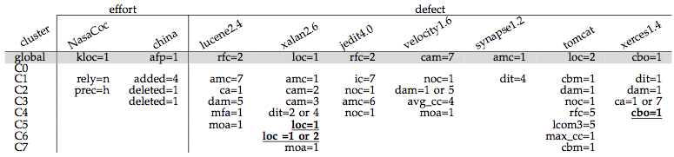
Rules learned in each cluster
What works best “here” does not work “there”
  Misguided to try and tame conclusion instability
  Inherent in the data
Can’t tame conclusion instability.
  Instead, you can exploit it
  Learn local lessons that do better than overly generalized global theories

Slide 63
Solutions to SE Model Problems/
Ensembles of Learning Machines*
Sets of learning machines grouped together.
Aim: to improve predictive performance.
B₁
B₂
B_{N}
...
Base learners
estimation₁
estimation₂
estimation_{N}
E.g.: ensemble estimation = Σ w_{i} estimation_{i}
* T. Dietterich. Ensemble Methods in Machine Learning. Proceedings of the First International Workshop in Multiple Classifier Systems. 2000.

Slide 64
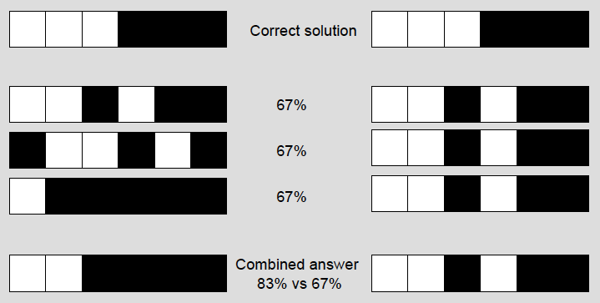
Solutions to SE Model Problems/
Ensembles of Learning Machines
One of the keys:
  Diverse* ensemble: “base learners” make different errors on the same instances.
* G. Brown, J. Wyatt, R. Harris, X. Yao. Diversity Creation Methods: A Survey and Categorisation. Journal of Information Fusion 6(1): 5-20, 2005.

Slide 65
Solutions to SE Model Problems/
Ensembles of Learning Machines
One of the keys:
  Diverse ensemble: “base learners” make different errors on the same instances.
Three different types of ensembles that have been applied for software effort estimation will be presented in the next slides.
Different ensemble approaches can be seen as different ways to generate diversity among base learners!

Slide 66
Solutions to SE Model Problems/
Static Ensembles
An existing training set is used for creating/training the ensemble.
Ensemble
Training data
(completed projects)
training
B₁
B₂
B_{N}
...

Slide 67
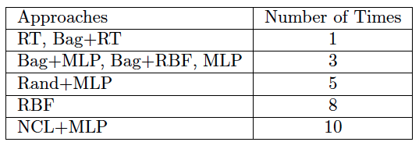
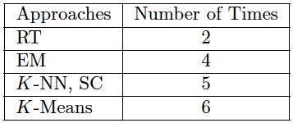
Solutions to SE Model Problems/
Static Ensembles
Bagging ensembles of Regression Trees (Bag+RTs)*
  Study with 13 data sets from PROMISE and ISBSG repositories.
  Bag+RTs:
    Obtained the highest rank across data set in terms of Mean Absolute Error (MAE).
    Rarely performed considerably worse (>0.1SA, SA = 1 – MAE / MAE_{rguess}) than the best approach:
* L. Minku, X. Yao. Ensembles and Locality: Insight on Improving Software Effort Estimation. Information and Software Technology, Special Issue on Best Papers from PROMISE 2011, 2012 (in press), http://dx.doi.org/10.1016/j.infsof.2012.09.012.

Slide 68
Solutions to SE Model Problems/
Static Ensembles
Bagging* ensembles of regression trees
Ensemble
Training data
(completed projects)
RT₁
RT₂
RT_{N}
...
Sample uniformly with replacement
* L. Breiman. Bagging Predictors. Machine Learning 24(2):123-140, 1996.

Slide 69
Solutions to SE Model Problems/
Static Ensembles
Bagging ensembles of regression trees
Regression trees:
Estimation by analogy.
Divide projects according to attribute value.
Most impactful attributes are in higher levels.
Attributes with insignificant impact are not used.
E.g., REPTrees*.
Functional Size
< 253
>= 253
Functional Size
Effort = 5376
< 151
>= 151
Effort = 1086
Effort = 2798
* M. Hall, E. Frank, G. Holmes, B. Pfahringer, P. Reutemann, I. H. Witten.
The WEKA Data Mining Software: An Update. SIGKDD Explorations 11(1), 2009.
http://www.cs.waikato.ac.nz/ml/weka.

Slide 70

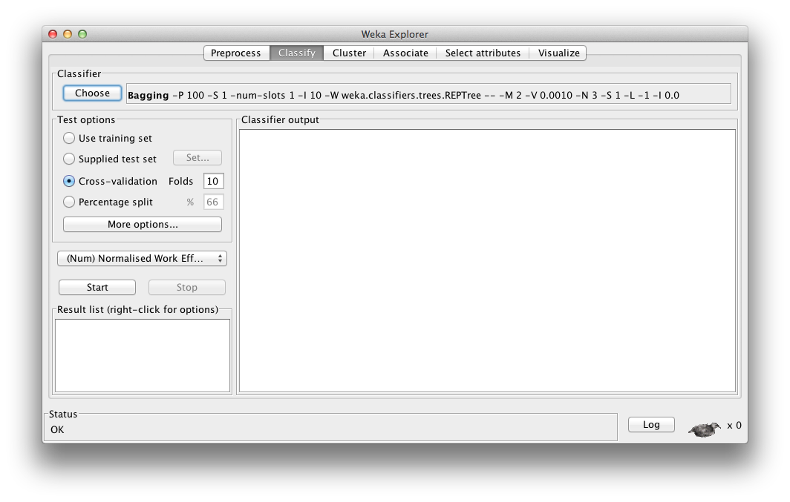
Solutions to SE Model Problems/
Static Ensembles
Bagging ensembles of regression trees
  Weka: classifiers – meta – bagging
    classifiers – trees – REPTree

Slide 71
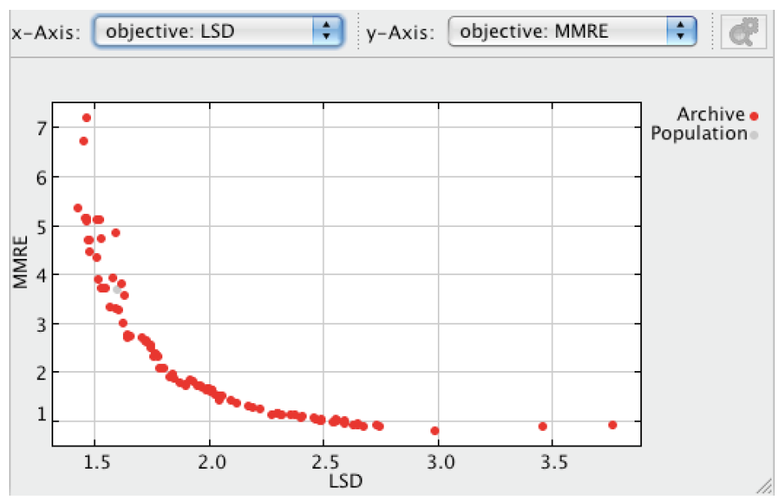
Solutions to SE Model Problems/
Static Ensembles
Multiple-objective Pareto ensembles
  There are different measures/metrics of performance for evaluating SEE models.
  Different measures capture different quality features of the models.
    E.g.: MAE, standard deviation, PRED, etc.
    There is no agreed single measure.
    A model doing well for a certain measure may not do so well for another.
Multilayer Perceptron (MLP) models created using Cocomo81.

Slide 72
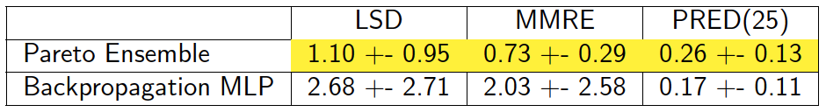
Solutions to SE Model Problems/
Static Ensembles
Multi-objective Pareto ensembles*
  We can view SEE as a multi-objective learning problem.
  A multi-objective approach (e.g. Multi-Objective Evolutionary Algorithm (MOEA)) can be used to:
    Better understand the relationship among measures.
    Create ensembles that do well for a set of measures, in particular for larger data sets (>=60).
  Sample result: Pareto ensemble of MLPs (ISBSG):
* L. Minku, X. Yao. Software Effort Estimation as a Multi-objective Learning Problem. ACM Transactions on Software Engineering and Methodology, 2012 (accepted). Author's final version:
http://www.cs.bham.ac.uk/~minkull/publications/MinkuYaoTOSEM12.pdf.

Slide 73
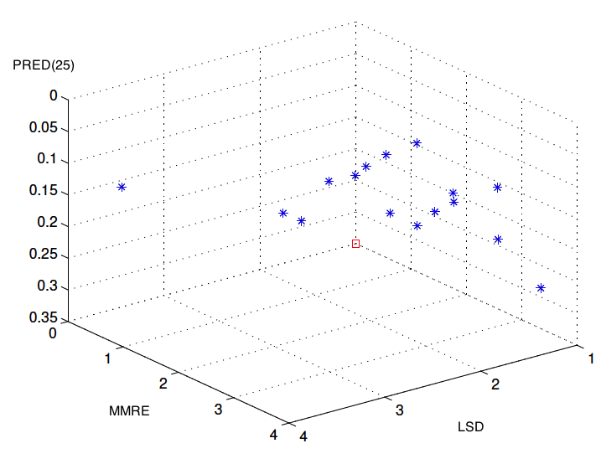
Solutions to SE Model Problems/
Static Ensembles
Multi-objective Pareto ensembles
Training data
(completed projects)
Multi-objective evolutionary algorithm creates nondominated models with several different trade-offs.
The model with the best performance in terms of each particular measure can be picked to form an ensemble with a good trade-off.
Ensemble
B1
B2
B3

Slide 74
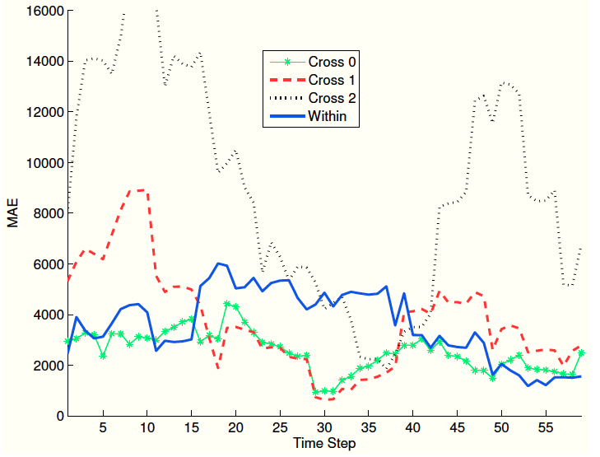
Solutions to SE Model Problems/
Dynamic Adaptive Ensembles
Companies are not static entities – they can change with time (data set shift / concept drift*).
  Models need to learn new information and adapt to changes.
  Companies can start behaving more or less similarly to other companies.
Predicting effort for a single company from ISBSG based on its projects and other companies' projects.
* L. Minku, A. White, X. Yao. The Impact of Diversity on On-line Ensemble Learning in the Presence of Concept Drift. IEEE Transactions on Knowledge and Data Engineering, 22(5):730-742, 2010.

Slide 75
Solutions to SE Model Problems/
Dynamic Adaptive Ensembles
Dynamic Cross-company Learning (DCL)*
Cross-company
Training Set 1
(completed projects)
...
Cross-company
Training Set 1
(completed projects)
CC
model m
CC
model 1
Cross-company (CC)
m training sets with
different productivity
(completed projects)
CC model 1
CC model m
...
...
w1
...
wm
w₁
w_{m}
WC
model 1
Dynamic weights control how much a certain model contributes to predictions:
  At each time step, “loser” models have weight multiplied by Beta.
Models trained with “very different” projects from the one to be predicted can be filtered out.
Within-company (WC) training data
(projects arriving with time)
w_{m+1}
* L. Minku, X. Yao. Can Cross-company Data Improve Performance in Software Effort Estimation? Proceedings of the 8th International Conference on Predictive Models in Software Engineering, p. 69-78, 2012. http://dx.doi.org/10.1145/2365324.2365334.

Slide 76
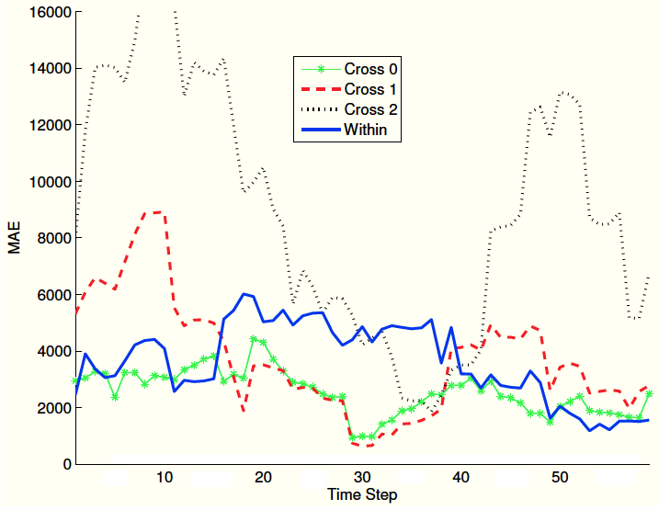
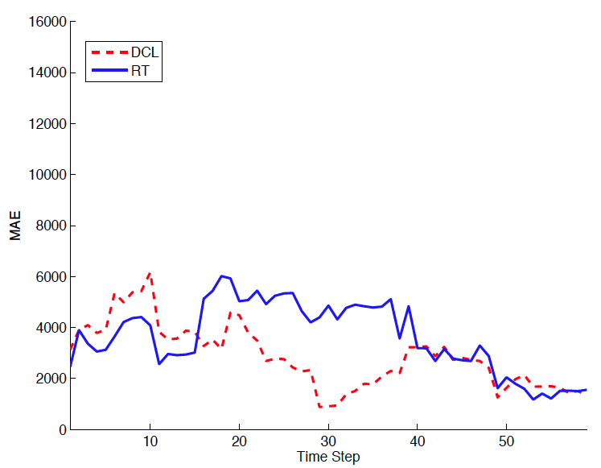
Solutions to SE Model Problems/
Dynamic Adaptive Ensembles
Dynamic Cross-company Learning (DCL)
  DCL uses new completed projects that arrive with time.
  DCL determines when CC data is useful.
  DCL adapts to changes by using CC data.
Predicting effort for a single company from ISBSG based on its projects and other companies' projects.

Slide 77
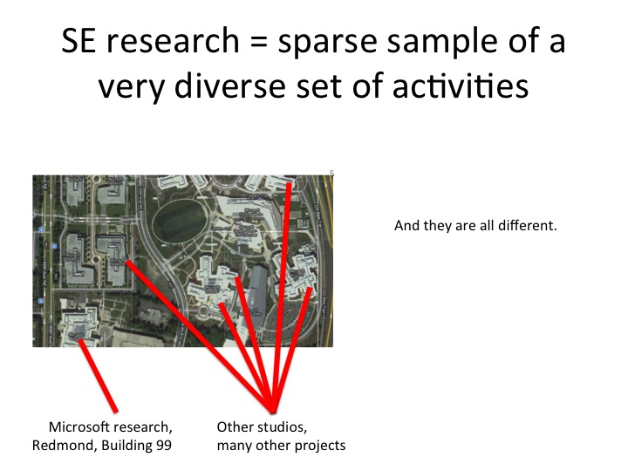
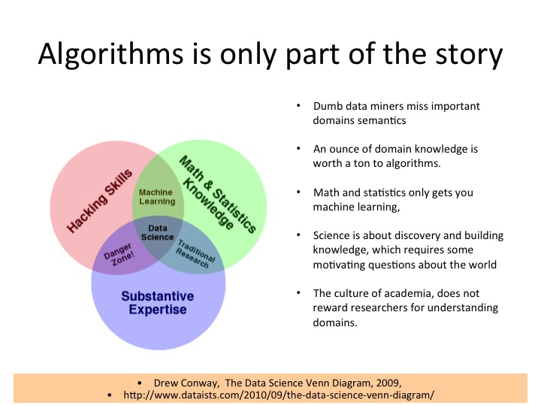
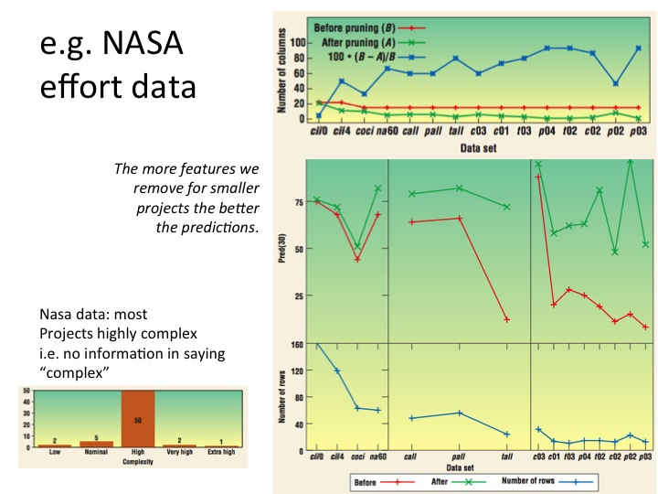
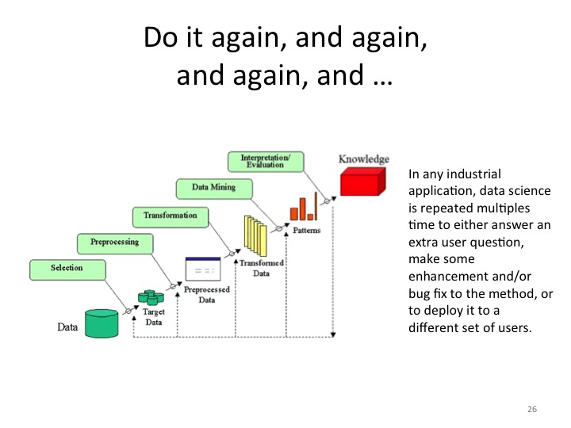
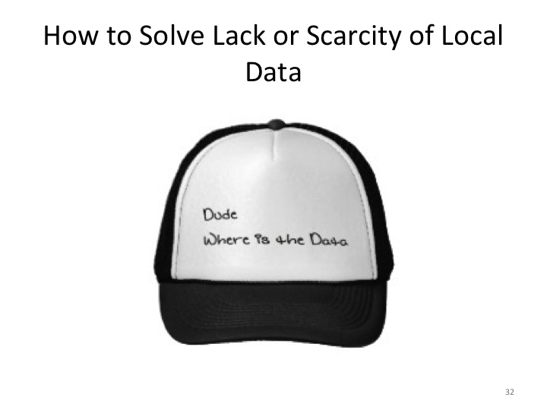







What have we covered?
Organizational Issues
Data Issues
Model Issues

Slide 78


