Slide 1
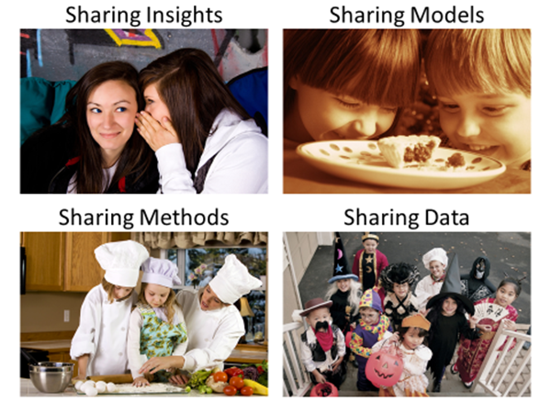
What can we learn
from each other?

Slide 2
What can we learn
from each other?

Slide 3
How to share methods?
Write!
Read!
To really understand something..
… try and explain it to someone else
  MSR
  PROMISE
  ICSE
  FSE
  ASE
  EMSE
  TSE
  …
But how else can we better share methods?

Slide 4
How to share methods?
Related questions:
  How to train newcomers?
  How to certify (say) a masters program in data science?
  If you are hiring, what core competencies should you expect in applications?
But how else can we better share methods?

Slide 5
What can we learn
from each other?

Slide 6
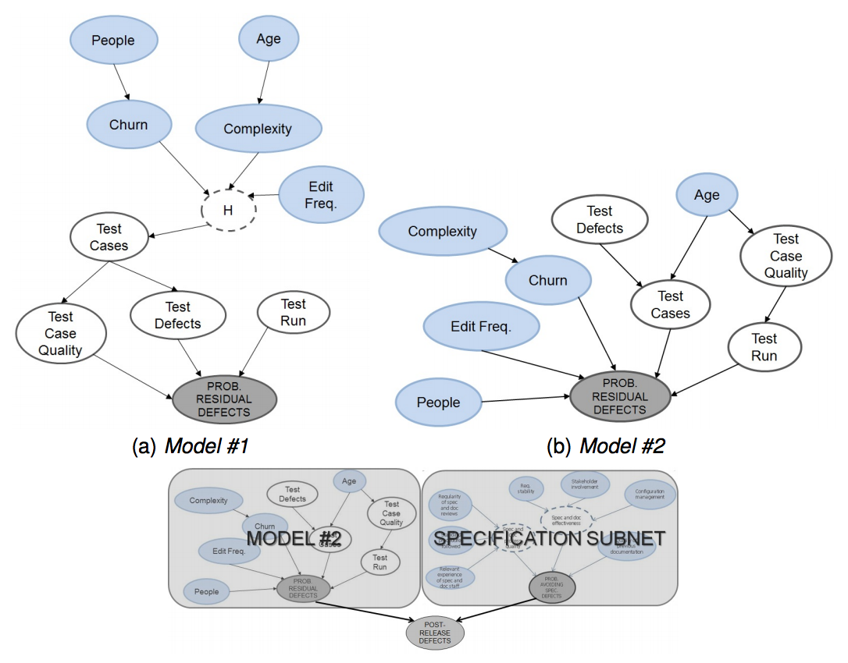
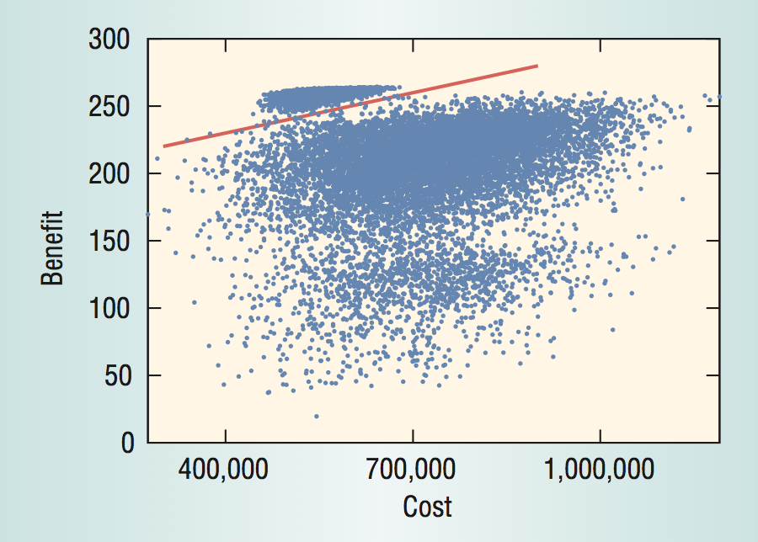
How to represent models?
Bayes nets
Less is more
(contrast set learning)
New = old + now
Graphical form, visualizable
Updatable
Difference between N things
  Is smaller than that the things
Useful for learning ..
  What to do
  What not to do
  Link modeling to optimization
Tosun Misirli, A.; Basar Bener, A., "Bayesian Networks For Evidence-Based Decision-Making in IEEE TSE, pre-print
Tim Menzies and Ying Hu. 2003. Data Mining for Very Busy People. Computer 36, 11 (November 2003), 22-29.

Slide 7
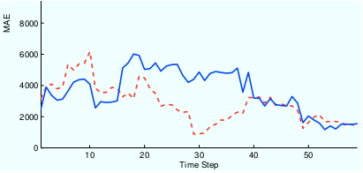
How to share models?
Incremental adaption
Ensemble learning
Update N variants of the current model as new data arrives
For estimation, use the M<N models scoring best
Build N different opinions
Vote across the committee
Ensemble out-performs solos
But how else can we better share models?
Re-learn when each
new record arrives
New: listen to N-variants
L. L. Minku and X. Yao. Ensembles and locality: Insight on improving software effort estimation. Information and Software Technology (IST), 55(8):1512–1528, 2013.
Kocaguneli, E.; Menzies, T.; Keung, J.W., "On the Value of Ensemble Effort Estimation," IEEE TSE, 38(6) pp.1403,1416, Nov.-Dec. 2012

Slide 8
What can we learn
from each other?
d

Slide 9
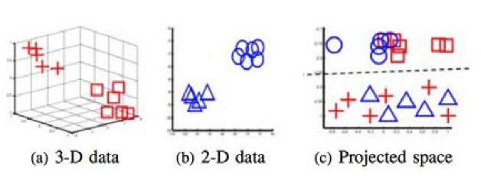
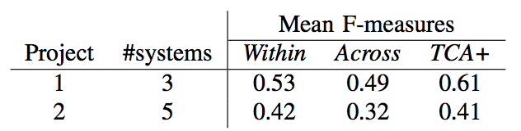
How to share data?
Transfer learning
Relevancy filtering
Map terms in old and new language to a new set of dimensions
TEAK:
  prune regions of noisy instances;
  cluster the rest
For new examples,
  only use data in nearest cluster
Finds useful data from projects either
  decades-old
  or geographically remote
Nam, Pan and Kim, "Transfer Defect Learning"
ICSE’13 San Francisco, May 18-26, 2013
Kocaguneli, Menzies, Mendes, Transfer learning in effort estimation, Empirical Software Engineering, March 2014

Slide 10
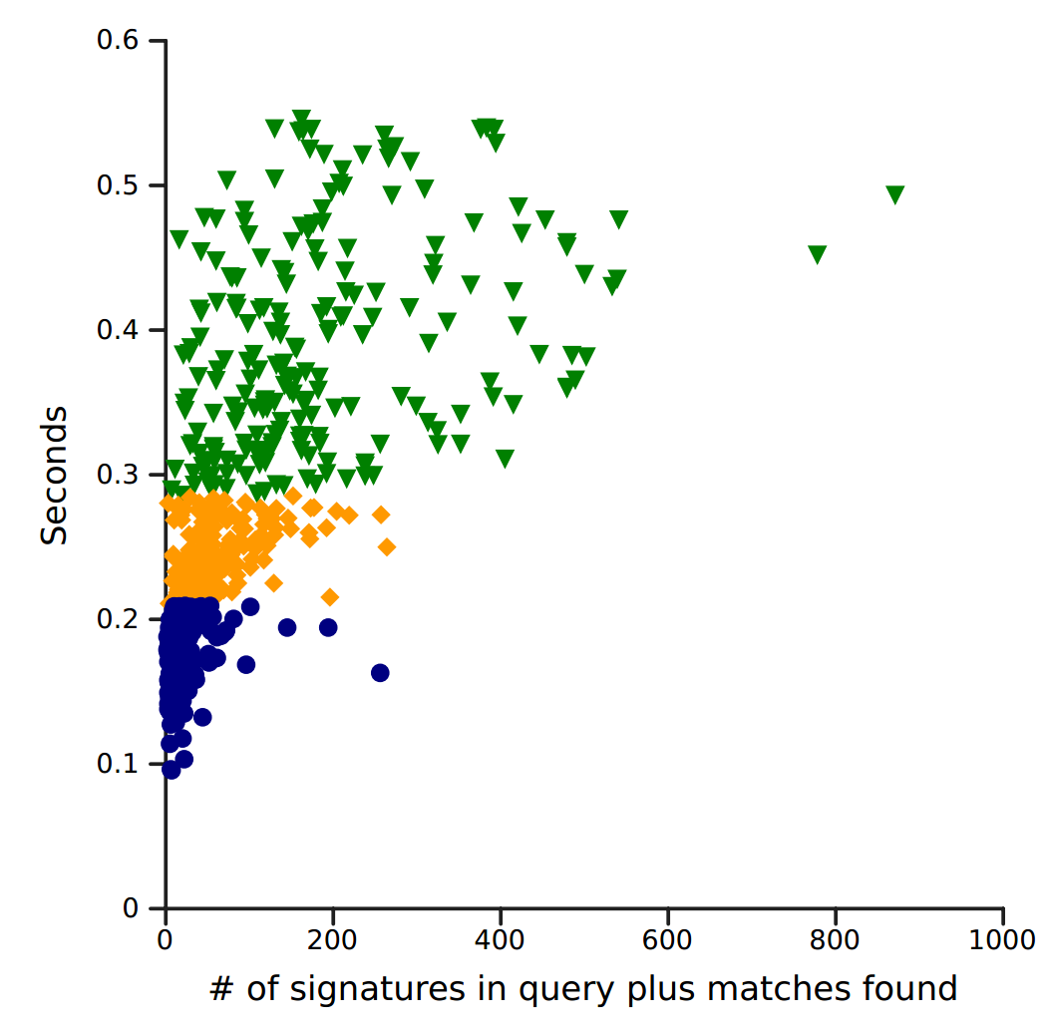
Handling Suspect Data
Dealing with "holes" in the data
Effectiveness of quick & dirty techniques to narrow a big search space
"Software Bertillonage: Determining the Provenance of Software Development Artifacts", by Julius Davies, Daniel M. German, Michael W. Godfrey, and Abram Hindle, Empirical Software Engineering, 18(6), December 2013.

Slide 11
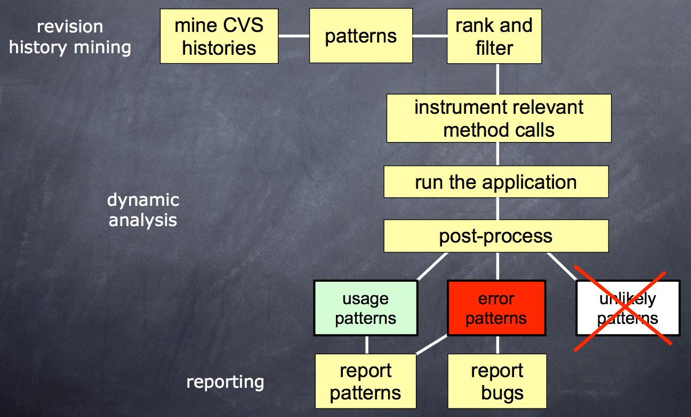
And sometimes, data breeds data
Sum greater than parts
E.g. Mining and correlating different types of artifacts
  e.g., bugs and design/architecture (anti)patterns
  E.g. Learning common error patters
Visualizations
Benjamin Livshits and Thomas Zimmermann. 2005. DynaMine: finding common error patterns by mining software revision histories. SIGSOFT Softw. Eng. Notes 30, 5 (September 2005), 296-305.
J Garcia, I Ivkovic, N Medvidovic. A comparative analysis of software architecture recovery techniques. 28th IEEE/ACM International Conference on Automated Software Engineering (ASE), 2013.
Jian-Guang Lou, Qiang Fu, Shengqi Yang, Ye Xu, and Jiang Li, Mining Invariants from Console Logs for System Problem Detection, in Proceedings of the 2010 USENIX Annual Technical Conference, USENIX, June 2010.

Slide 12
How to share data?
SE data compression
Privacy preserving data mining
Most SE data can be greatly compressed
  without losing its signal
  median: 90% to 98% %&
Share less, preserve privacy
Store less, visualize faster
Compress data by X%,
  now, 100-X is private ^*
More space between data
  Elbow room to mutate/obfuscate data*
But how else can we better share data?
% Vasil Papakroni, Data Carving: Identifying and Removing Irrelevancies in the Data by Masters thesis, WVU, 2013 http://goo.gl/i6caq7
^ Boyang Li, Mark Grechanik, and Denys Poshyvanyk. Sanitizing And Minimizing DBS For Software Application Test Outsourcing. ICST14
& Kocaguneli, Menzies, Keung, Cok, Madachy: Active Learning and Effort Estimation IEEE TSE. 39(8): 1040-1053 (2013)
* Peters, Menzies, Gong, Zhang, "Balancing Privacy and Utility in Cross-Company Defect Prediction,” IEEE TSE, 39(8) Aug., 2013

Slide 13
What can we learn
from each other?

Slide 14

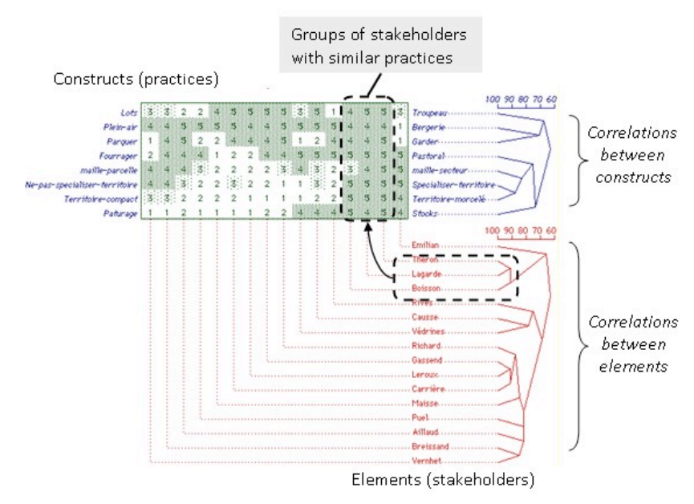
How to share insight?
Open issue
We don’t even know how to measure “insight”
But how to share it?
  Elevators?
  Number of times the users invite you back?
  Number of issues visited and retired in a meeting?
  Number of hypotheses rejected?
  Repertory grids?
Nathalie GIRARD . Categorizing stakeholders’ practices with repertory grids for sustainable development, Management, 16(1), 31-48, 2013

Slide 15
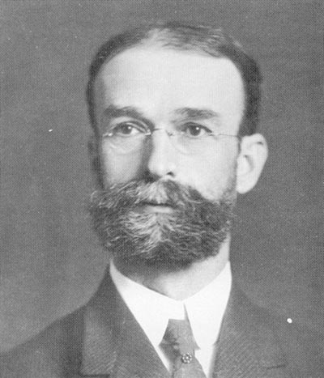
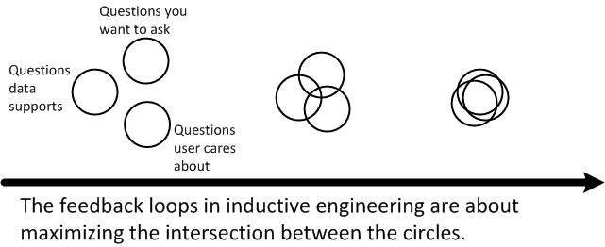
Q: How to share insight
A: Do it again and again and again…
Insight is a cyclic process
“A conclusion is simply the place
where you got tired of thinking.” : Dan Chaon
Experience is adaptive and accumulative.
  And data science is “just” how we report our experiences.
For an individual to find better conclusions:
  Just keep looking
For a community to find better conclusions
  Discuss more, share more
  Theobald Smith
  (American
  pathologist and microbiologist).
  “Research has
  deserted the individual and entered the group.
  “The individual worker find the problem too large, not too difficult.
  “(They) must learn to work with others. “

Slide 16
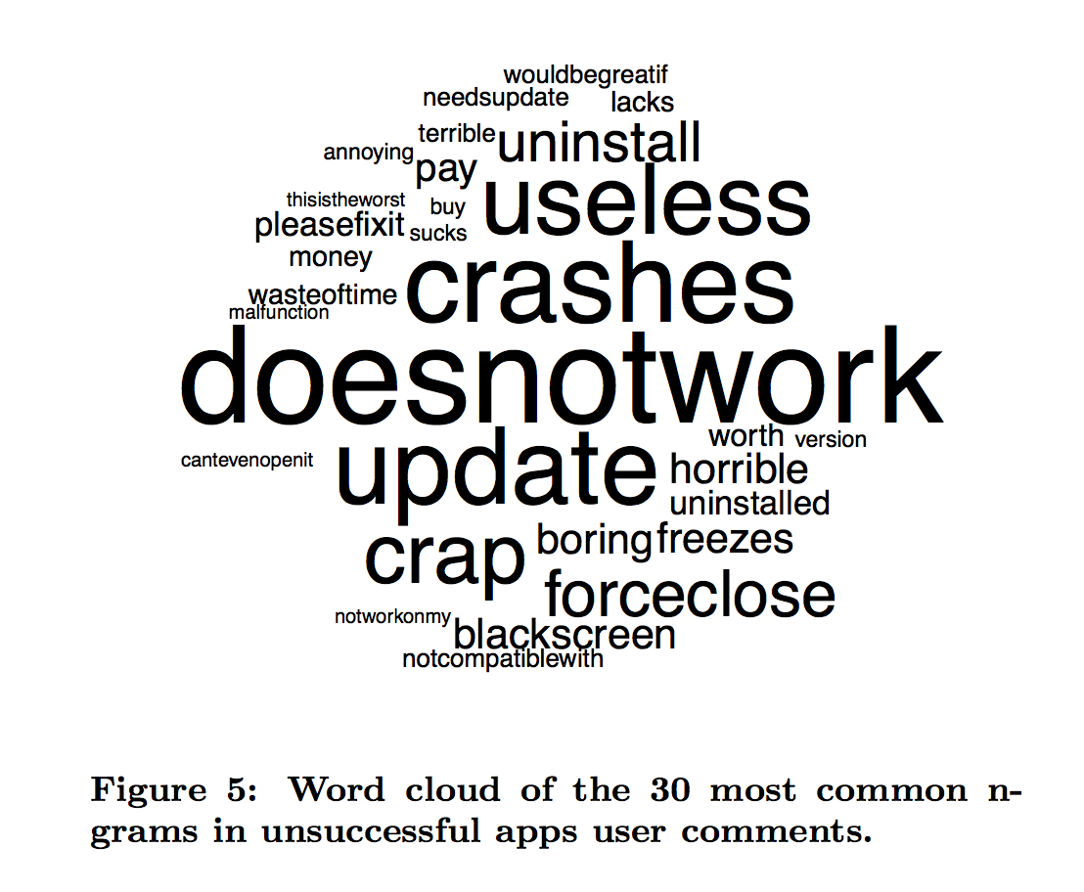
Learning to ask the right questions
actionable mining,
tools for analytics,
domain specific analytics (mobile data, personal data, etc),
programming by examples for analytics.
Kim, M.; Zimmermann, T.; Nagappan, N., "An Empirical Study of Refactoring Challenges and Benefits at Microsoft," IEEE TSE, pre-print 2014
Linares-Vásquez, M., Bavota, G., Bernal-Cárdenas, C., Di Penta, M., Oliveto, R., and Poshyvanyk, D., "API Change and Fault Proneness: A Threat to Success of Android Apps",

Slide 17
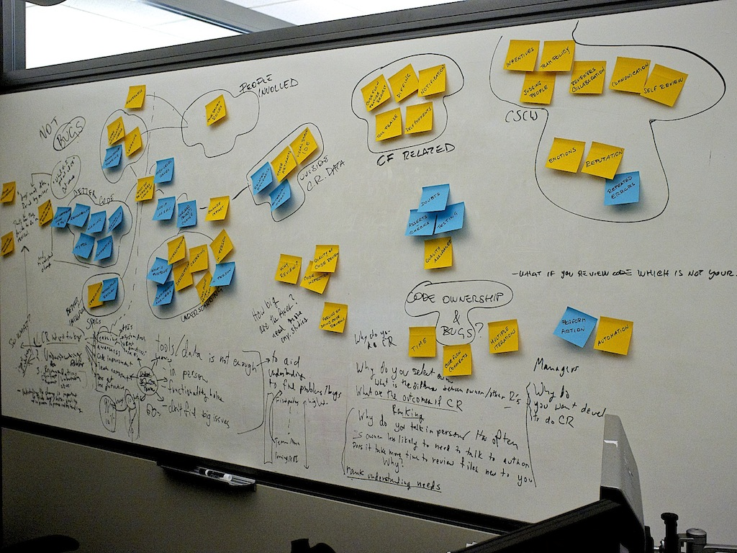
Q: How to share insights
A: Step1- find them
One tool is card sorting.
Labor intensive, but insightful
E.g. we routinely use cross-val to verify data mining results , which is a statement on how well the part predicts for new future data.
Yet two-thirds of the information needs for Software Developers are for insights into the past and present.
 | Past | Present | Future
Exploration (find) | Trends | Alerts | Forecasts
Analysis (explain) | Summarize | Overlays | Goals
Experiment (what-if) | Model | Bench marks | Simulate
Andrew Begel and Thomas Zimmermann, Analyze This! 145 Questions for Data Scientists in Software Engineering, ICSE’14
Alberto Bacchelli and Christian Bird, Expectations, Outcomes, and Challenges of Modern Code Review, in Proceedings of the International Conference on Software Engineering, IEEE, May 2013
Raymond P.L. Buse, Thomas Zimmermann. Information Needs for Software Development Analytics. ICSE 2012 SEIP.

Slide 18
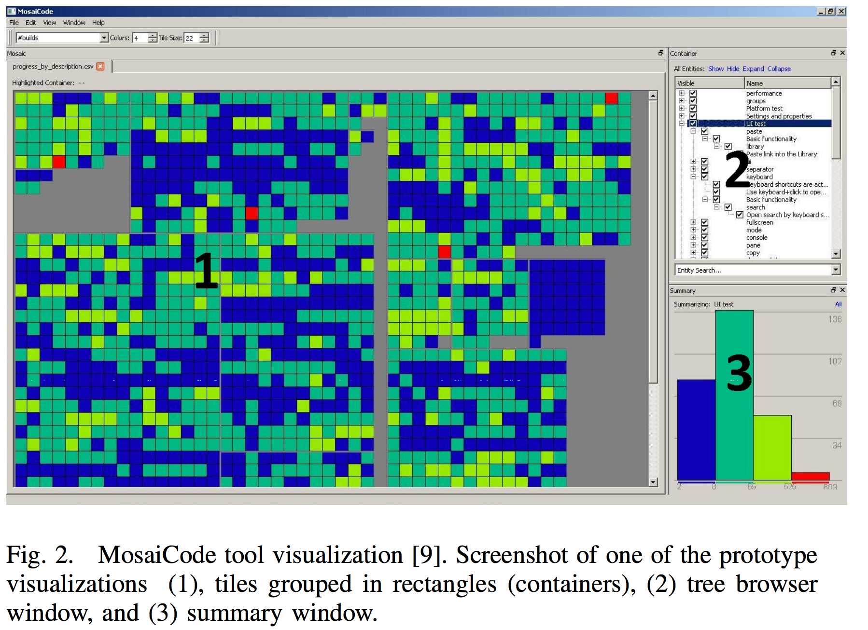
Finding insights (more)
Interpretation of data,
Visualization
  To (e.g.) avoid (sub-) optimization based on data,
But how to capture/aggregate diverse aspects of software quality?
Engström, E., M. Mäntylä, P. Runeson, and M. Borg (2014). Supporting Regression Test Scoping with Visual Analytics, IEEE International Conference on Software Testing, Verification, and Validation, pp.283–292.
Diversity in Software Engineering Research http://research.microsoft.com/apps/pubs/default.aspx?id=193433
(Collecting a Heap of Shapes) http://research.microsoft.com/apps/pubs/default.aspx?id=196194
Wagner et al. The Quamocao Quality Modeling and Assessment Approach , ICSE’12
An Industrial Case Study on the Risk of Software Changes, E. Shihab, A. E. Hassan, B. Adams and J. Jiang, In FSE'12, Nov. 2012

Slide 19
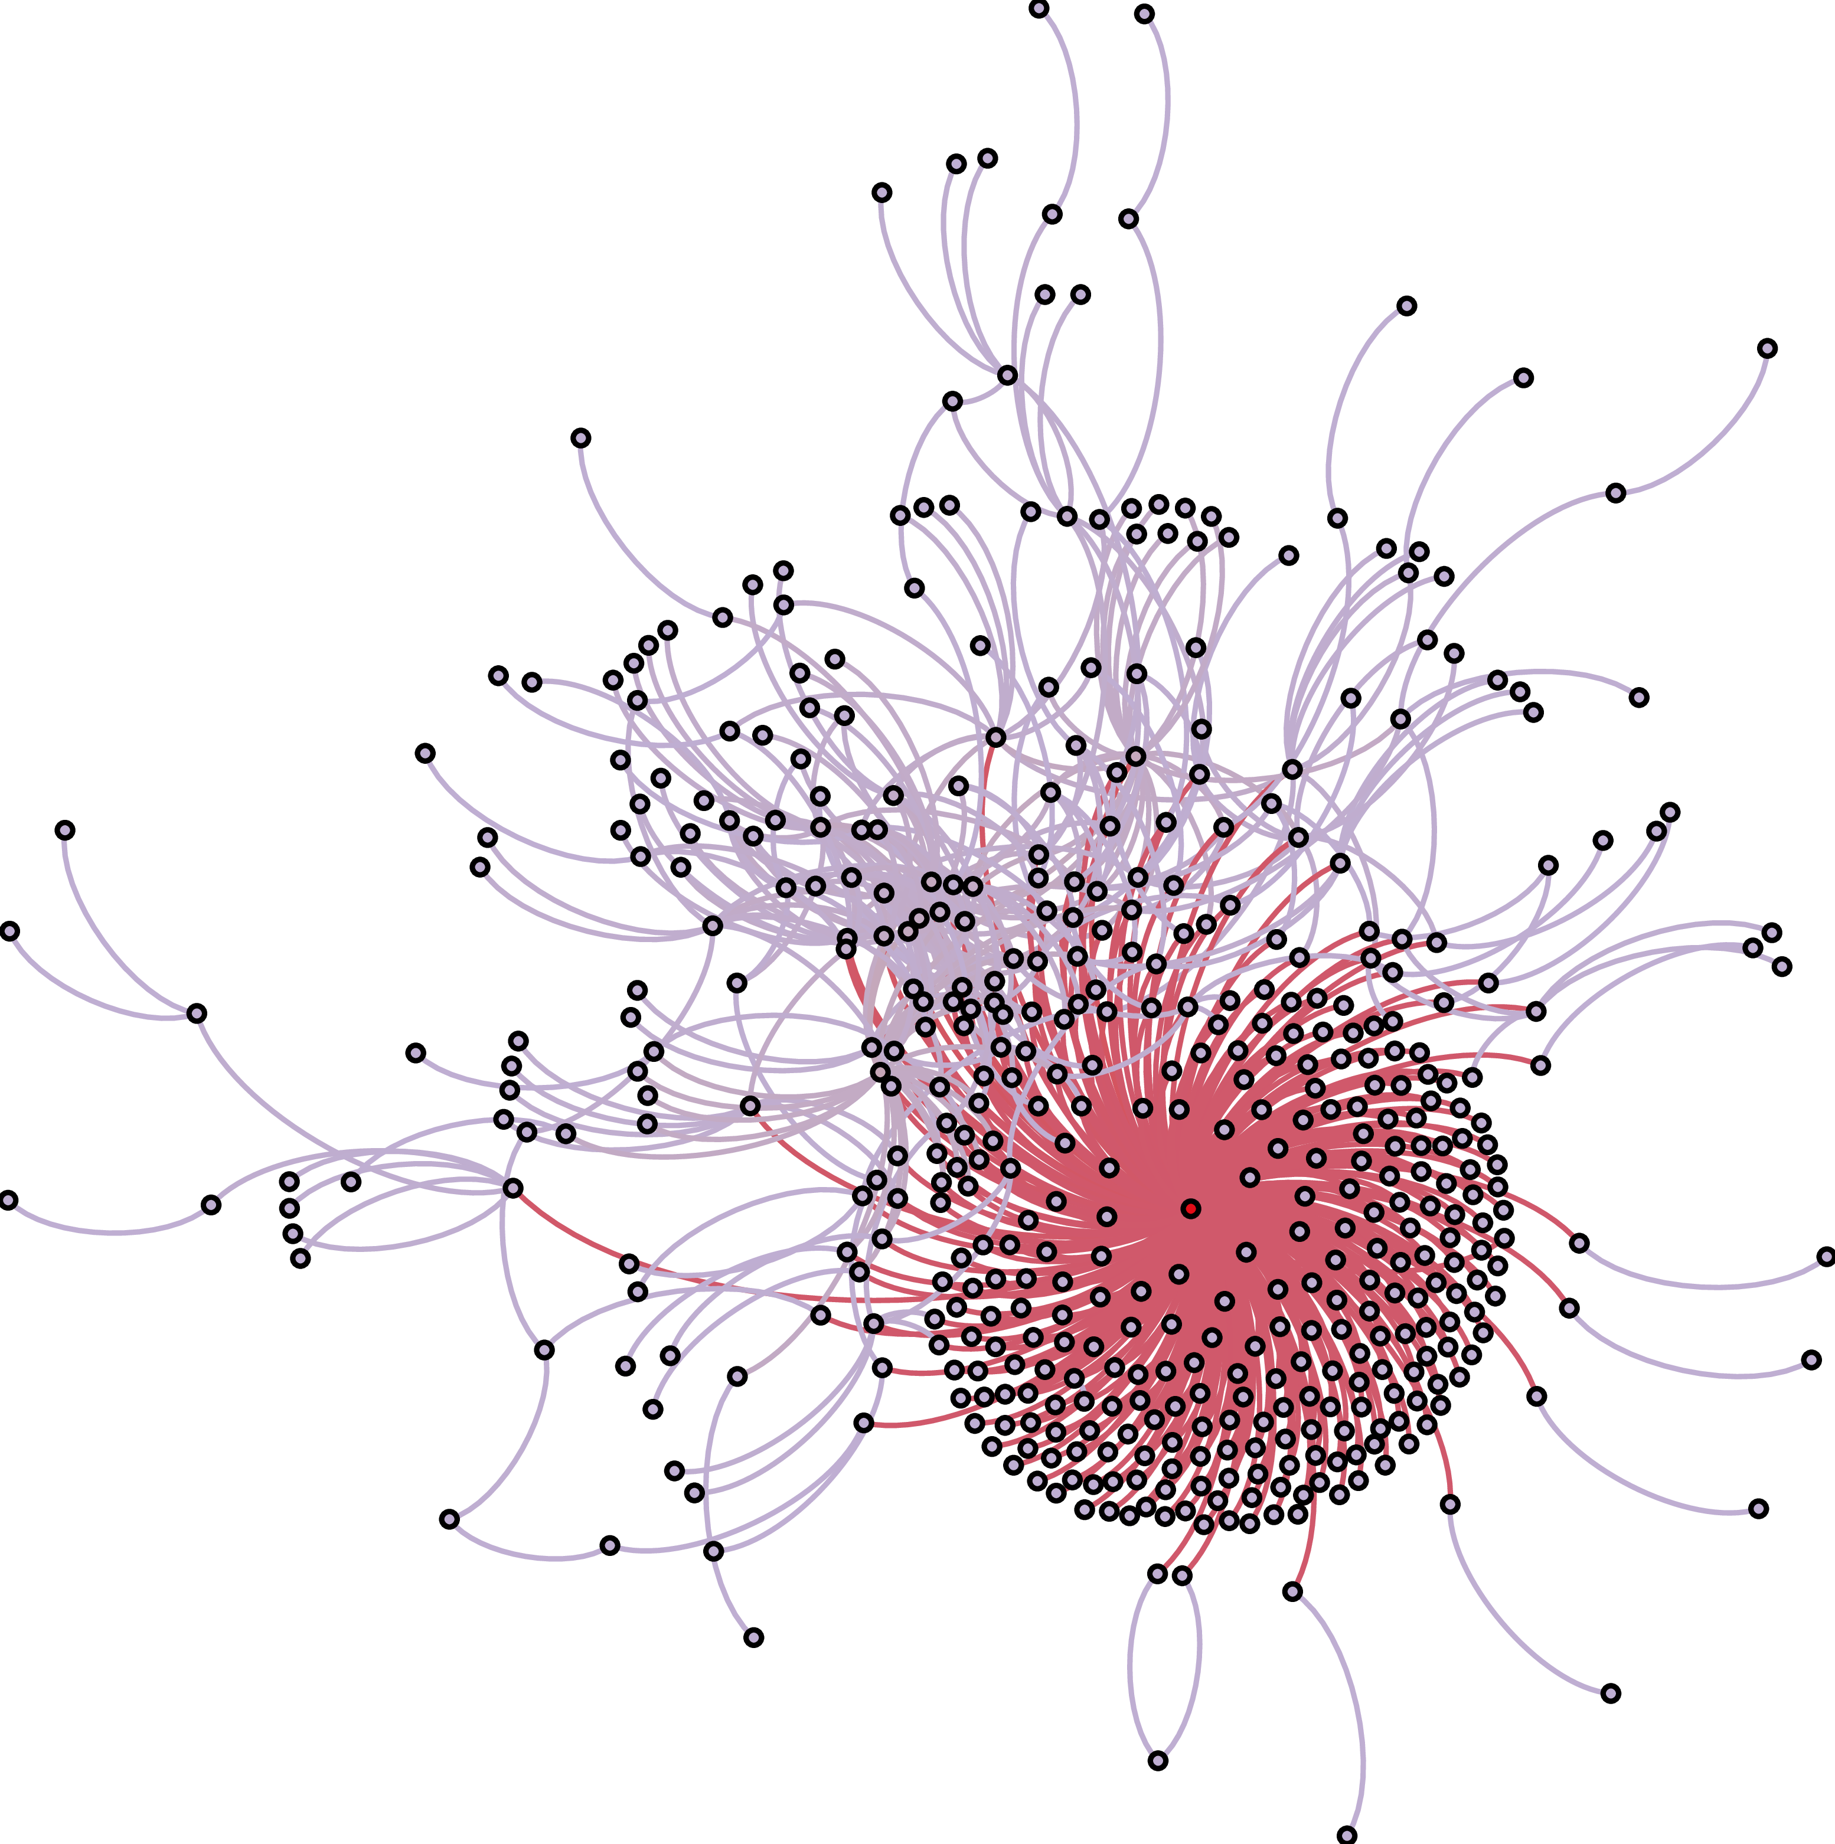
Building big insight from little parts
How to go from simple predictions to explanations and theory formation?
How to make analysis generalizable and repeatable?
Qualitative data analysis methods
Falsifiability of results
Patrick Wagstrom, Corey Jergensen, Anita Sarma: A network of rails: a graph dataset of ruby on rails and associated projects. MSR 2013: 229-232
Walid Maalej and Martin P. Robillard. Patterns of Knowledge in API Reference Documentation. IEEE Transactions on Software Engineering, 39(9):1264-1282, September 2013. http://www.cs.mcgill.ca/~martin/papers/tse2013a.pdf
Categorizing bugs with social networks: A case study on four open source software communities, ICSE’13, Zanetti, Marcelo Serrano; Scholtes, Ingo; Tessone, Claudio Juan; Schweitzer, Frank

Slide 20
What can we learn
from each other?

Slide 21
Words for a fledgling Manifesto?
Vilfredo Pareto
  “Give me the fruitful error any time, full of seeds, bursting with its own corrections. You can keep your sterile truth for yourself.”
Susan Sontag:
  ““The only interesting answers are those which destroy the questions. “
Martin H. Fischer
  “A machine has value only as it produces more than it consumes, so check your value to the community.”
Tim Menzies
  “More conversations, less conclusions.”

Slide 22
What can we learn
from each other?

Slide 23
Our schedule
Day 1:
  Find (any) initial common ground
  Breakout groups to explore a shared question
    How to share insights, models, methods, data about software?
Day 2,3:
  Review, reassess, reevaluate, re-task
Day 4:
  Lets write a manifesto
Day 5:
  Some report writing tasks.

