Slide 1
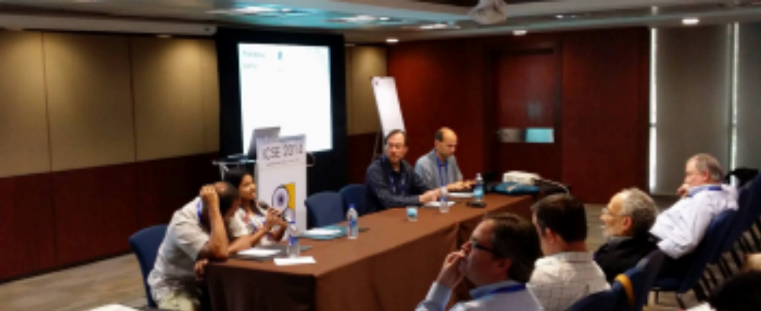
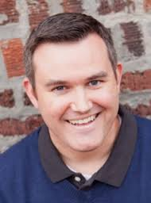
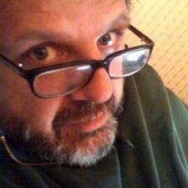
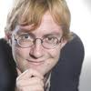
Comments, panel session: ICSE’14:
“After the gold rush”
tim.menzies@gmail.com
Dagstuhl workshop on SA
June 23, 2014
Organized by….
Da bird
Da Men
Da Mann

Slide 2

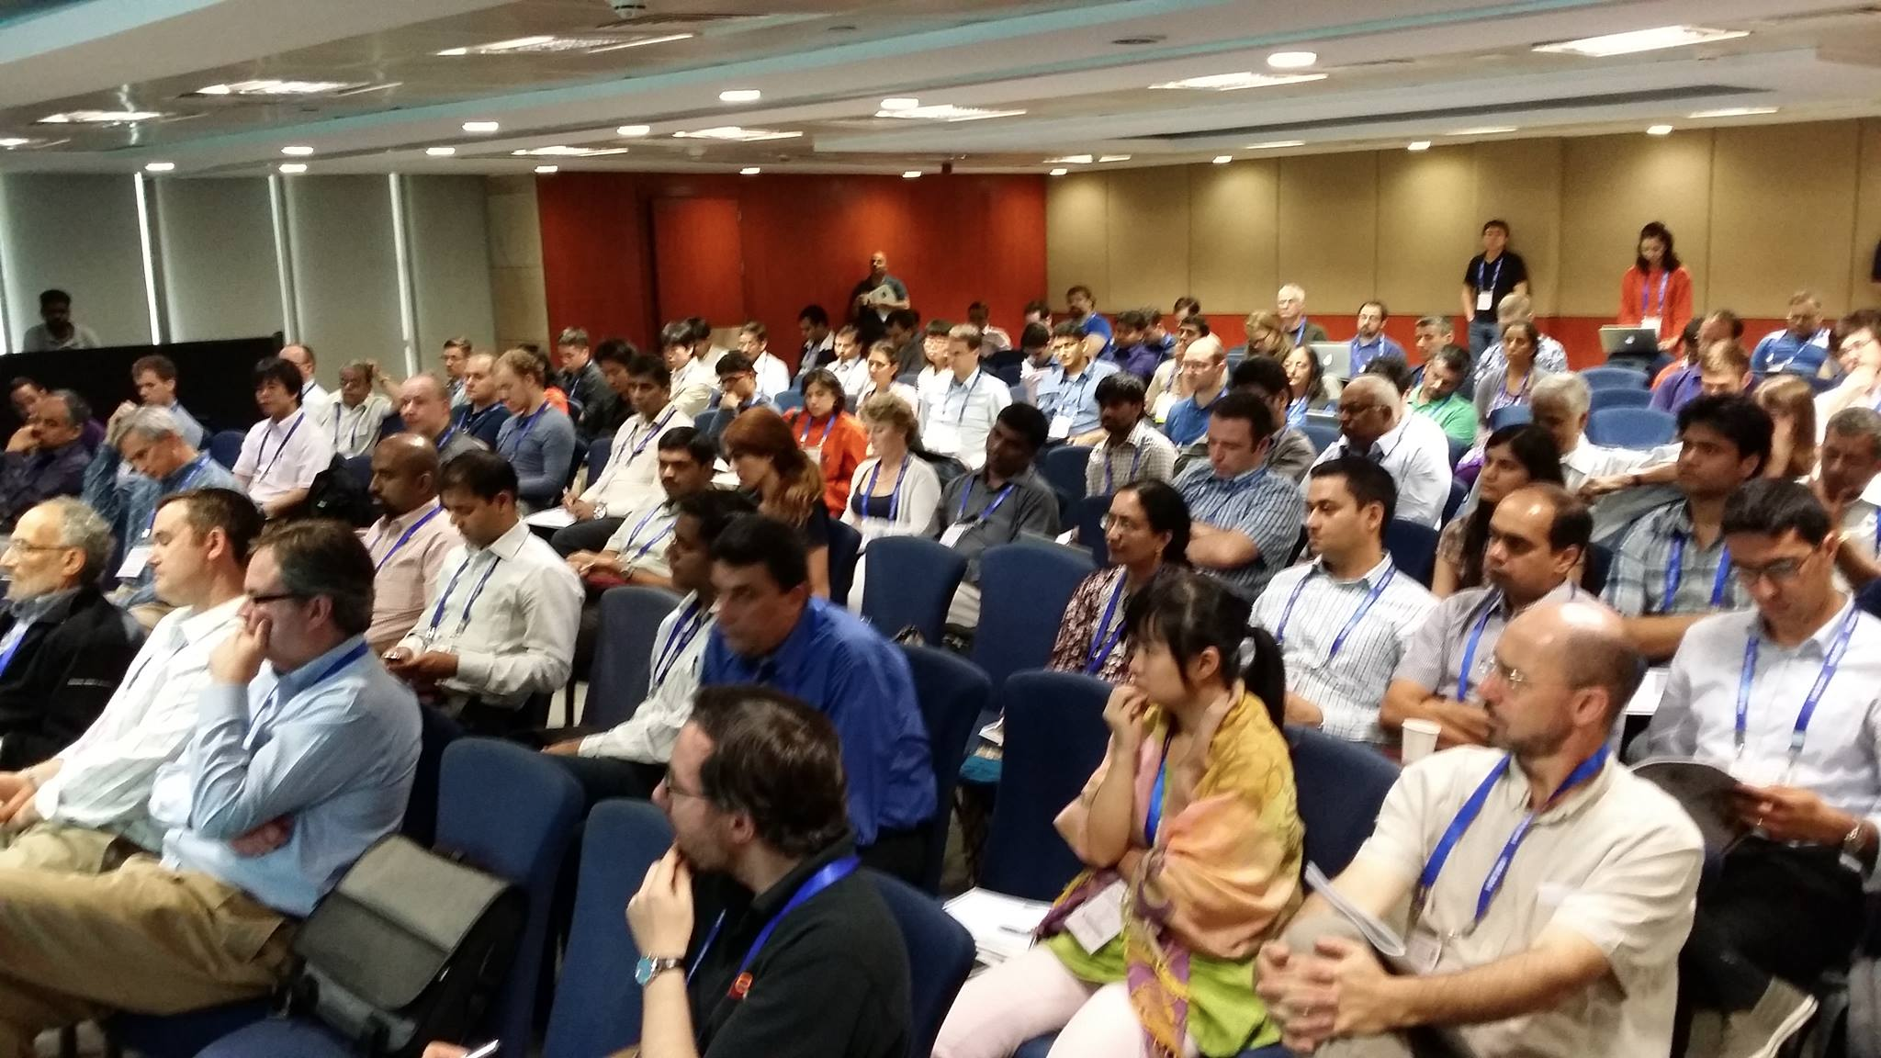
Welcome to the Wild West
Gold rush:
  To extract nuggets of insight.
Too many inexperienced “cowboys”:
  No use of best or safe practices.
“Goldfish bowl” panel:
  Best practices, what not to do

Slide 3
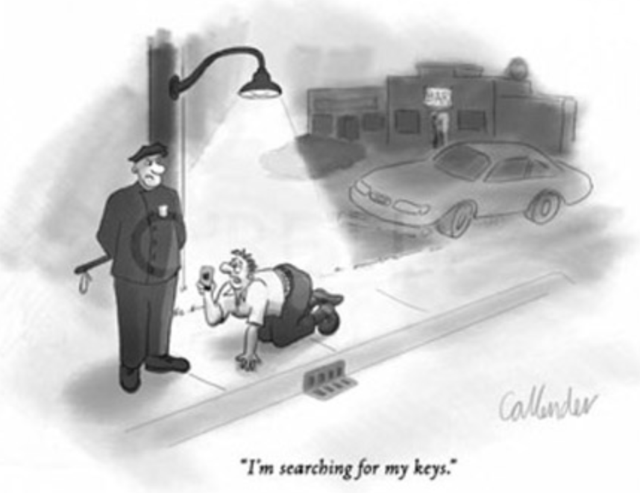
Street light effect
Moral #1:
  look at the real data, not just the conveniently available data
“Before we collect the data, need to redefine the right data to collect.”
“Garbage in, garbage out”
“Before analyzing terabytes of data, reflect some on user goals.”
“I’m looking for my keys.”

Slide 4
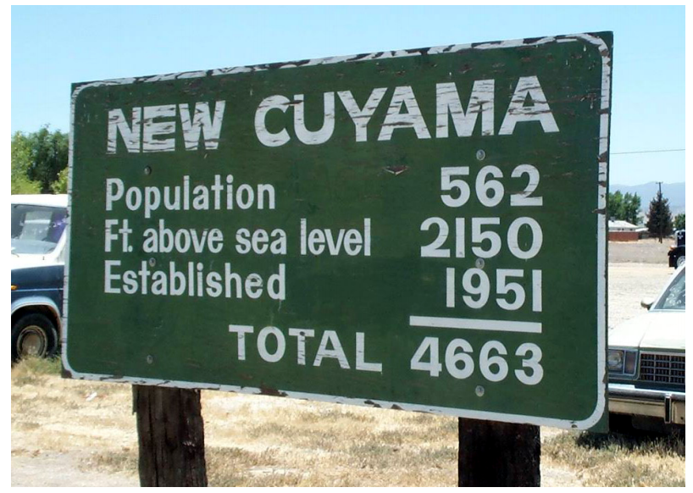
Can we reason about data, without detailed background knowledge?
Traditional view:
  GQM
  Traditional science:
    Define data to collected
    Collect
    Infer
“Newer” view:
  Operational science (Mockus, keynote, MSR, 2014)
    Find data
    Reason about it
    Prone to “streetlight effect”

Slide 5
Empiricists : Rationalists
Observation : use of background knowledge
  Mockus : Basili
  Norvig : Chomsky
  Locke : Leibnitz
  Aristotle : Plato
  Newton : Descartes
    Ike said:
      “I make no hypotheses.”
      “I feign no hypotheses.”

Slide 6
Working in the light
Moral #2:
  “before we rush to the new, lets reflect on what we can learn from what we can see right now. “
“Too fast, too early to expect actionable data for some specific area. “
“Building models on what we have before pushing ahead.”
“Need to invest more in data science infrastructure”
“I’m exploring the data
without pre-conceived biases.”

Slide 7
Full disclosure: Menzies is not rational (he’s an empiricist)
Wikipedia lists of human cognitive biases
Accidental
discoveries
100+ entries
  The way we routinely get it wrong, every day.
America
Penicillin
Anesthesia
Big bang radiation
Internal pacemakers
Microwave ovens
X-rays
Safety glass
Plastics (non-conductive heat resistant polymer)
Vulcanised rubber
Viagra

Slide 8
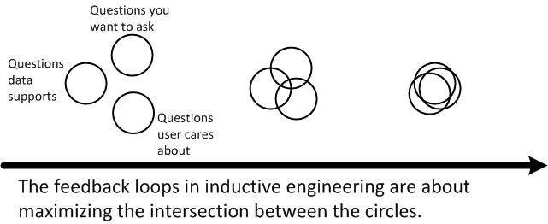
All (current) conclusions are wrong
Prone to revisions
To find better conclusions …
By subsequent analysis
Any current models is
  Wrong, but useful
Timm’s Law:
  Less conclusions, More conversations
Just keep looking
For a community to find better conclusions
  Discuss more, share more

Slide 9
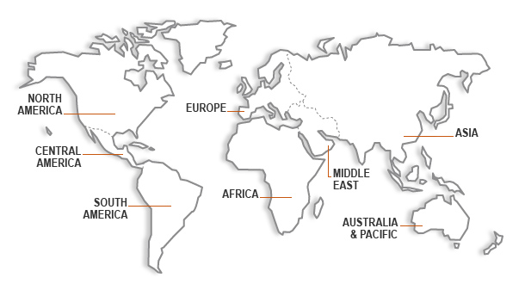

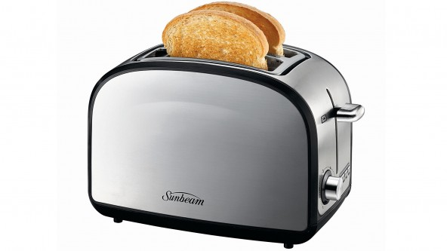
Between Turkish Toasters
AND NASA Space Ships

Slide 10
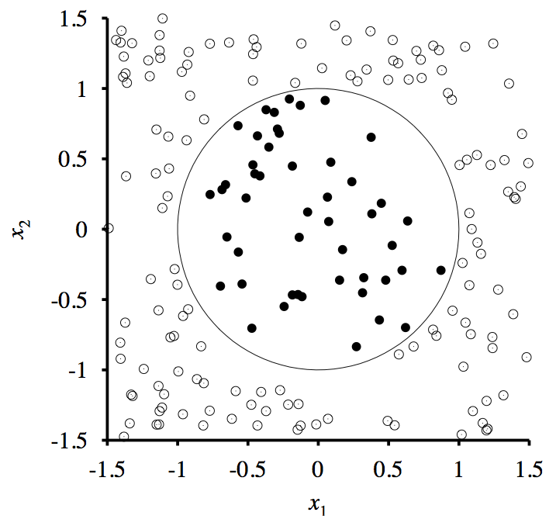
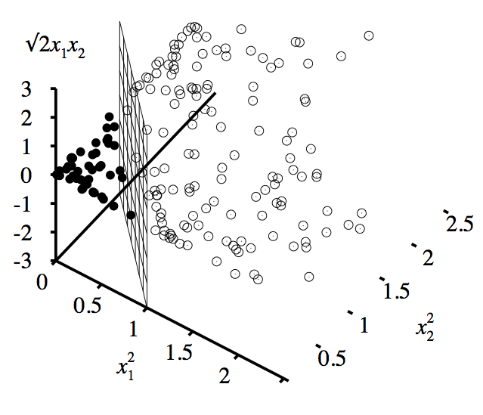
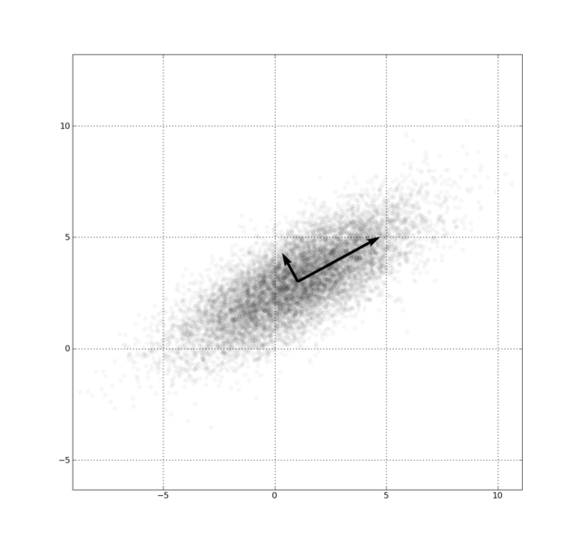
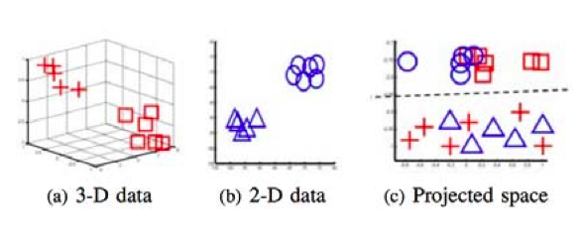
Raw dimensions less informative than underlying dimensions

Slide 11
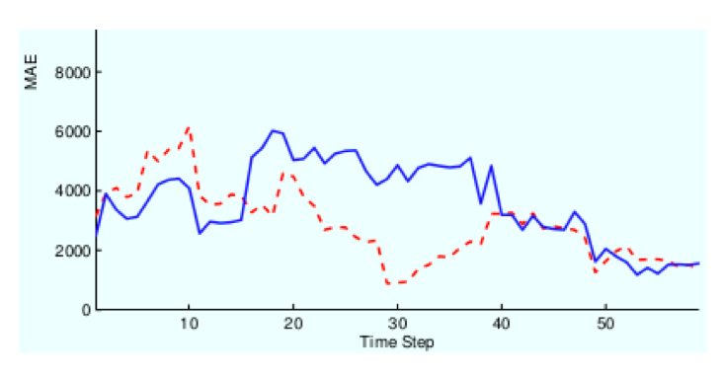
Q: How to TRANSFER
Lessons Learned?
Ignore most of the data
relevancy filtering: Turhan ESEj’09; Peters TSE’13
variance filtering: Kocaguneli TSE’12,TSE’13
performance similarities: He ESEM’13
Contort the data
spectral learning (working in PCA
space or some other rotation)
Menzies, TSE’13; Nam, ICSE’13
Build a bickering committee
Ensembles Minku, PROMISE’12

Slide 12
A little bit of this, a little bit of that
Moral #3:
  “My Father’s house has many rooms.”
“False dichotomy between these two approaches. Really need to bridge these two modes.“
“Not the scientific method but scientific methods (plural).”
“Aha! Bus tracks! I can follow these to the bus stop and not drive home drunk.”

