Slide 1



ICSE’14 Workshop Keynote Address: Emerging Trends in Software Metrics (WeTSOM’14)
What Metrics Matter?
(And the answer may surprise you)
tim.menzies@gmail.com
http://bit.ly/icse14metrics

Slide 2


Coming soon to an Amazon near you
Late 2014
Late 2015

Slide 3
This talk is in two parts
Part1: a little history
(my unhappiness with past “results”)
Part2: a new view

Slide 4

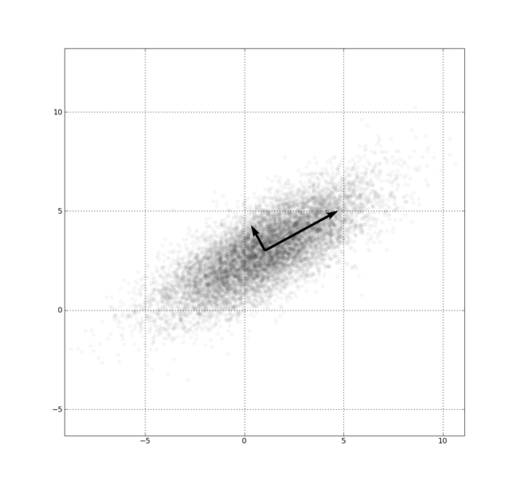
Data about software projects is not stored in metrc1, metric2,…
But is shared between them
in some shared, underlying,
shape.
Not every project has the
same underlying simple shape
  Many projects have different,
  albeit simple, shapes
We can exploit that shape,
to great effect:
  For better local predictions
  For transferring lessons learned
  For privacy-preserving data mining

Slide 5
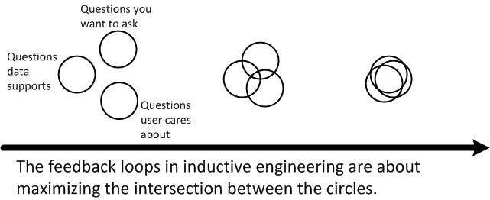
So, what metrics to collect?
Whatever you can get, quickly, cheaply:
  Then model within the reduced dimensions
  Then cycle back to the users, for sanity, for clarity, for questions for the next round of analysis

Slide 6
Part1:
Ye Olde “results”
(from the 1990s)

Slide 7

Along time ago…
In a century far, far away…
We thought the “right name” was inherently power
  Stranger in a Strange Land (Heinlien)
  Wizard of Earthsea (LeGuin)
  Snow Crash (Stephenson)
Sapir-Whorf hypothesis:
  The right words let you think better
And we need such power
  to avoid the lies and illusions of a cruel and confusing world.

Slide 8
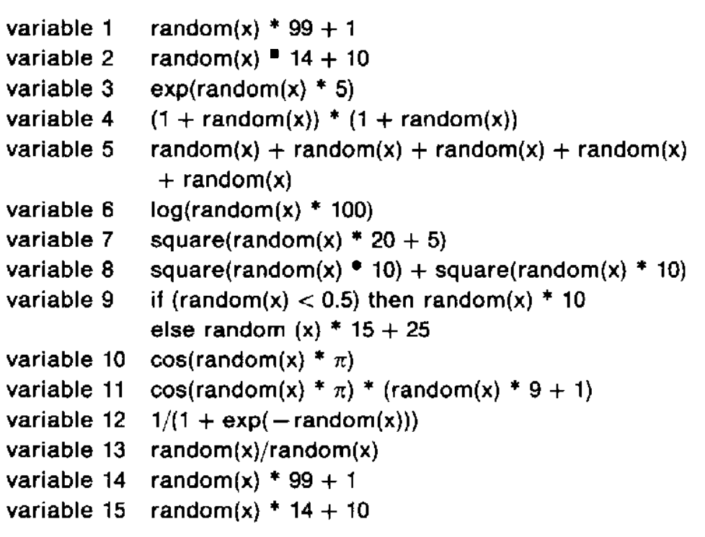
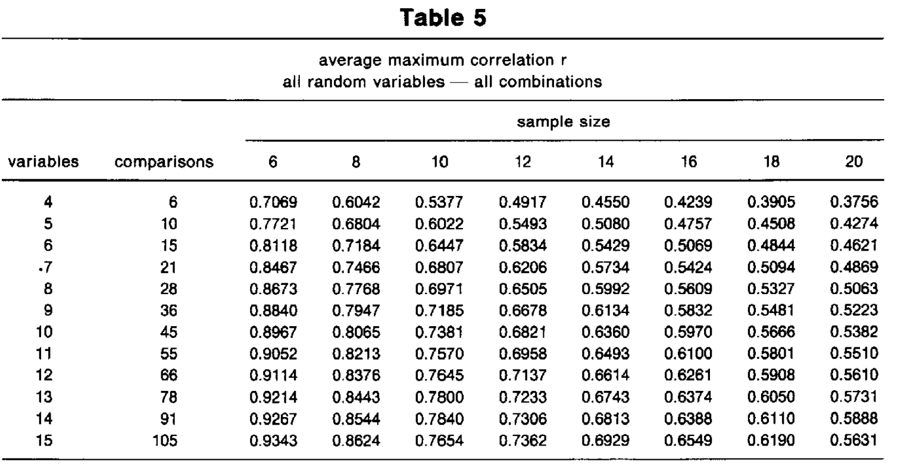
Shotgun correlations
Courtney, R.E.; Gustafson, D.A., "Shotgun correlations in software measures," Software Engineering Journal , vol.8, no.1, pp.5,13, Jan 1993

Slide 9
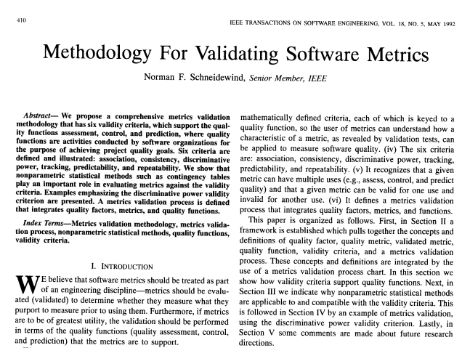
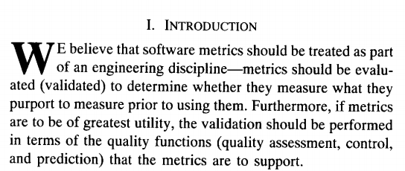
Norman F. Schneidewind. 1992. Methodology for Validating Software Metrics. IEEE Trans. Softw. Eng. 18, 5 (May 1992), 410-422.

Slide 10
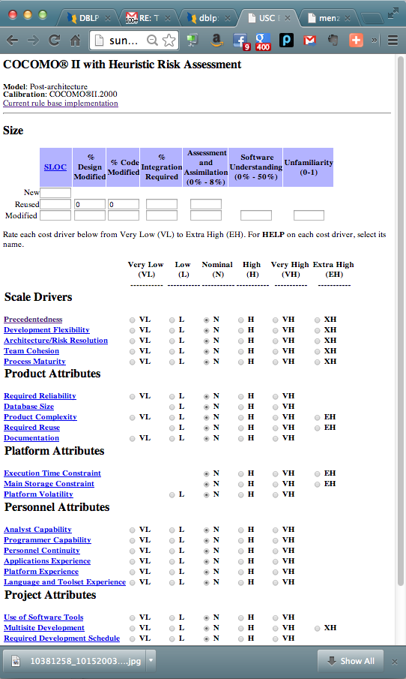

The 1990’s obsession:
What metrics to collect?

Slide 11
How to Design a
Metrics Repository (mid-1990s)
RA-1 : process-centric [1]
TAME resource model: resource-centric [2]
Harrison model : product centric [3]
[1] Ramakishanan et al, Building an effective measure systems, TR96, SD, Monash, 1996
[2] Jeffrey, Basili, Validating the TAME resource model, ICSE’88
[3] W. Harrison, Towards Well-Defined Shareable Product Data, Workshop SE : Future Directions, 1992

Slide 12
Battle lines were drawn
Blood was split
And again
It is shown that a collection of nine properties suggested by E.J. Weyuker is inadequate for determining the quality of a software complexity measure.
A complexity measure which satisfies all nine of the properties, but which has absolutely no practical utility in measuring the complexity of a program is presented.
It is concluded that satisfying all of the nine properties is a necessary, but not sufficient, condition for a good complexity measure.
Measurement theory is used to highlight both weaknesses and strengths of software metrics work, including work on metrics validation.
We identify a problem with the well-known Weyuker properties, but also show that a criticism of these properties by Cherniavsky and Smith is invalid.
We show that the search for general software complexity measures is doomed to failure.
John C. Cherniavsky and Carl H. Smith. 1991. On Weyuker's Axioms for Software Complexity Measures. IEEE Trans. Softw. Eng. 17, 6 (June 1991), 636-638
Software measurement: A Necessary Scientific Basis, Norman Fenton, IEEE TSE 30(3), 1994

Slide 13
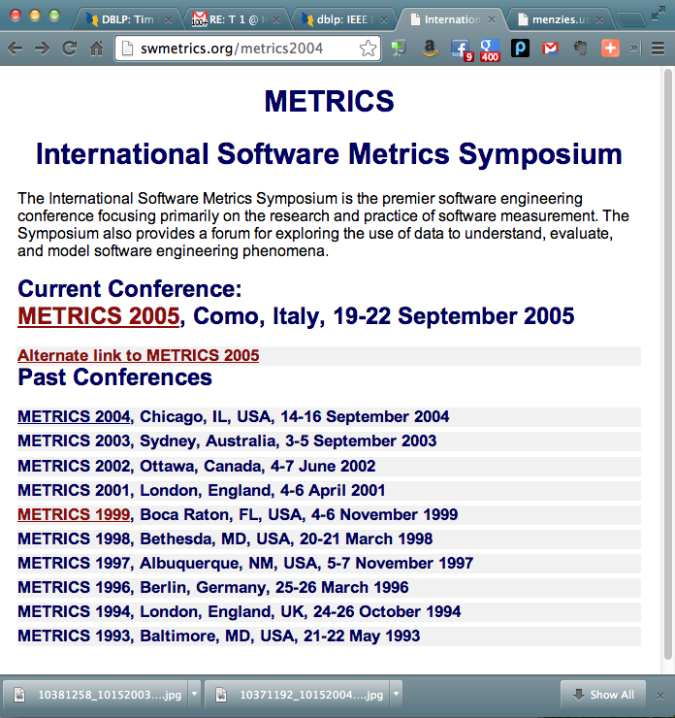
And the eventual winner?
No one
When the dust settled, no one really cared.
Norman Fenton abandoned, renounced, his prior work on metrics.
The IEEE Metrics conference got cancelled
  subsumed by EMSE
  R.I.P.

Slide 14
Part2:
A new view

Slide 15
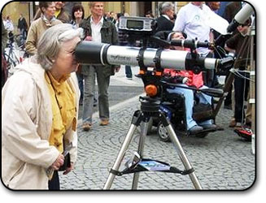
Looking in the wrong direction?
SE project data = surface features of an underlying effect
Stop fussing on surface details (mere metrics)
Go beneath the surface

Slide 16
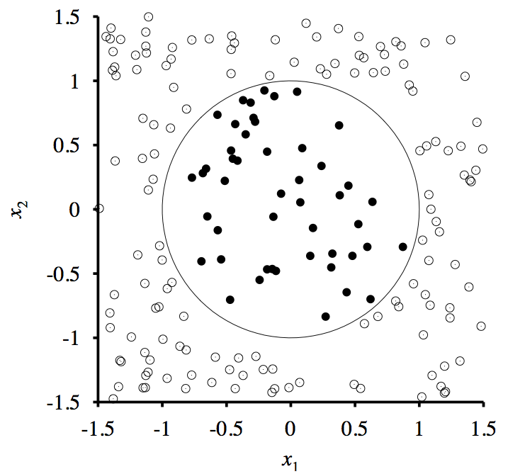
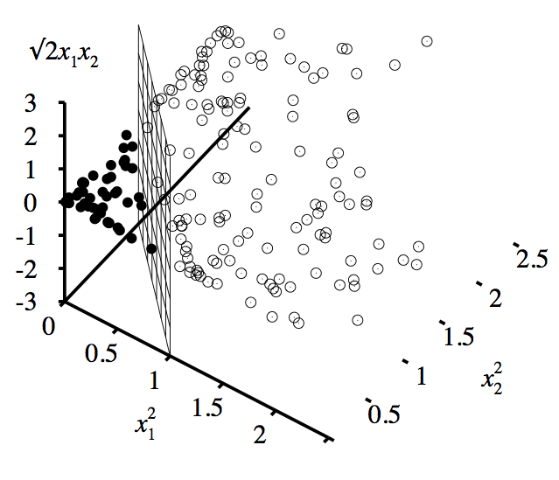
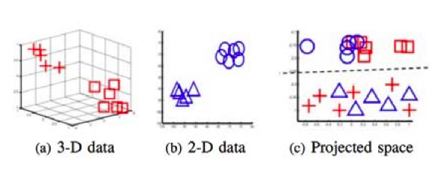
Reflect LESS on raw dimensions

Slide 17
Reflect MORE on INTRINSIC dimensions
Levina and Bickel report that it is possible to simplify seemingly complex data:
  “... the only reason any methods work in very high dimensions is that, in fact, the data are not truly high-dimensional. Rather, they are embedded in a high-dimensional space, but can be efficiently summarized in a space of a much lower dimension ... “
Elizaveta Levina and Peter J. Bickel. Maximum likelihood estimation of intrinsic dimension. In NIPS, 2004.

Slide 18

If SE data compresses in this way then….
In compressed space, many measures tightly associated
  Does not matter exactly what you collect
  Since they will map the same structures
So collect what you can :
  As fast as you can
  Then model within the reduced dimensions
The “7M” Hypothesis:
  Menzies mentions that many measures
  mean much the same thing

Slide 19
How to test for 7M
Specifics do not matter
But general shape does
Examples :
  Instability in “what matters most”
  Intrinsic dimensionality
  Active learning
  Transfer learning
  Filtering and wrapping
  Privacy algorithms

Slide 20
How to test for 7M
Specifics do not matter
But general shape does
Examples :
  Instability in “what matters most”
  Intrinsic dimensionality
  Transfer learning
  Filtering and wrapping
  Privacy algorithms
  Active learning

Slide 21
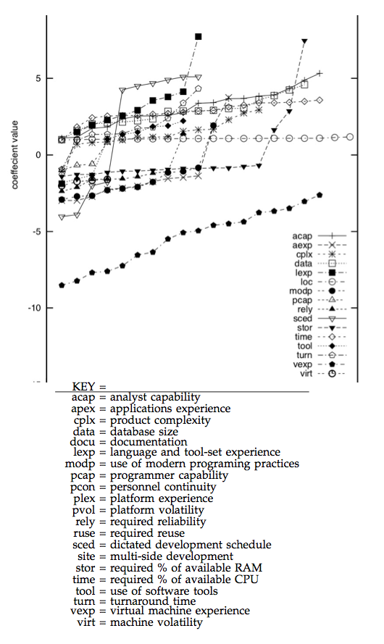
Raw dimensions problematic
(for effort estimation)
Conclusion instability
Learning effort =
b0 + b1*x1+b2*x3+
20 times * 66% of the data
  Record the learned“b” values
NASA93 (effort data)

Slide 22
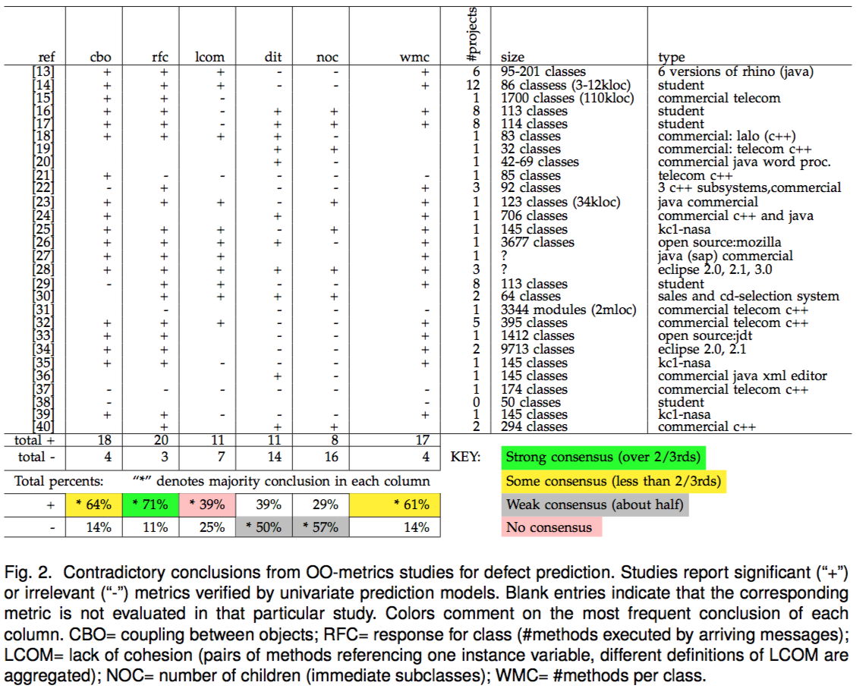
Raw dimensions problematic
(for defect prediction)
Tim Menzies, Andrew Butcher, David R. Cok, Andrian Marcus, Lucas Layman, Forrest Shull, Burak Turhan, Thomas Zimmermann: Local versus Global Lessons for Defect Prediction and Effort Estimation. IEEE Trans. Software Eng. 39(6): 822-834 (2013)

Slide 23
By the way, same instabilities for social metrics
Results from Helix repo
Results for AT&T
Many classes
are “write once”
  A few OO classes are “rewrite many”
Defect defectors that take into account this developer social interaction
  perform very well indeed
  Near optimum
Studied patterns of programmer interaction with the code
Not a major influence
on defects
Lumpe, Vasa, Menzies, Rush, Turhan, Learning better inspection optimization policies International Journal of Software Engineering and Knowledge Engineering 22(05), 621-644, 2012
Weyuker, Ostrand, Bell. 2008. Do too many cooks spoil the broth? Using the number of developers to enhance defect prediction models. Empirical Softw. Eng. 13, 5 (October 2008), 539-559

Slide 24
How to test for 7M
Specifics do not matter
But general shape does
Examples :
  Instability in “what matters most”
  Intrinsic dimensionality
  Active learning
  Transfer learning
  Filtering and wrapping
  Privacy algorithms

Slide 25
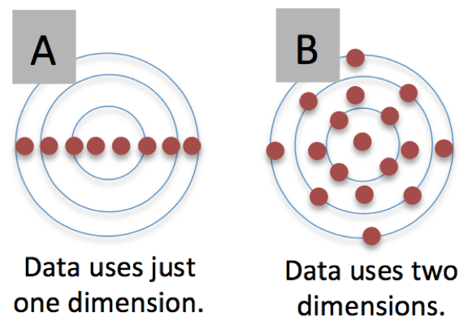
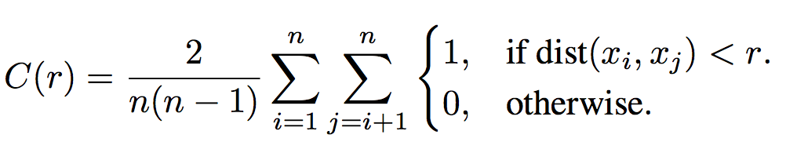
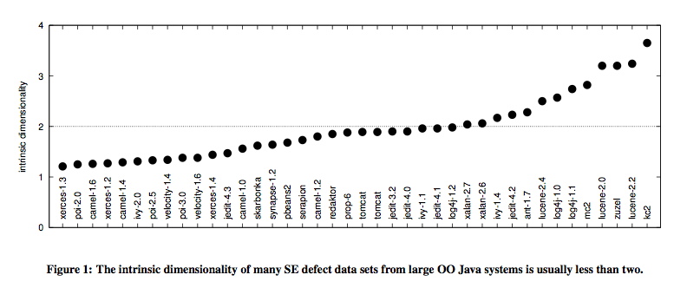
Intrinsic dimensionality (in theory)
Elizaveta Levina and Peter J. Bickel. Maximum likelihood estimation of intrinsic dimension. In NIPS, 2004.

Slide 26
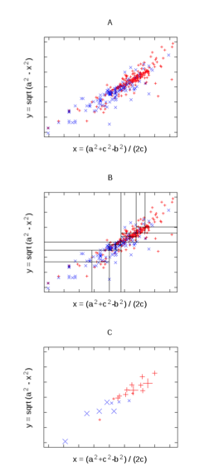
Intrinsic dimensionality (in practice)
Defect projects, open source JAVA projects
TRAIN:
  Project 21 features onto two synthesized
    using FASTMAP
    X= First PCA component
    Y= right angles to X
  Recursively divide two dimensions (at median)
    Stopping a SQRT(N)
  In each grid, replace N projects with median centroid
TEST:
  Estimate = interpolate between 2 near centroids
For 10 data sets, 5*5 cross-val
  Performs no worse, and sometimes better, than Random forests, NaiveBayes
Conclusion:
  21 dimensions can map to two without loss of signal
Vasil Papakroni, Data Carving: Identifying and Removing Irrelevancies in the Data by Masters thesis, WVU, 2013 http://goo.gl/i6caq7

Slide 27
How to test for 7M
Specifics do not matter
But general shape does
Examples :
  Instability in “what matters most”
  Intrinsic dimensionality
  Active learning
  Transfer learning
  Filtering and wrapping
  Privacy algorithms

Slide 28
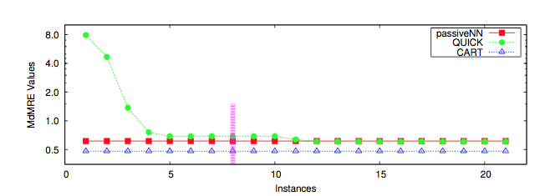
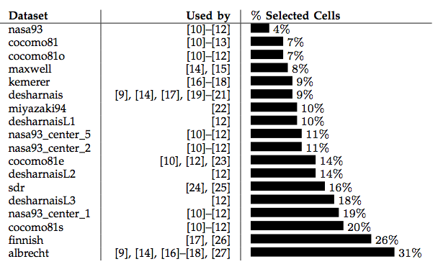
Active learning in effort estimation
If difficult to find actual project effort, ask that for fewest projects
Put aside a hold-out set
Prune columns that are most often other column’s nearest neighbors
Sort rows by how often they are other people’s nearest neighbor
For first “I” rows in sort
  Train (then test on hold out)
  Stop when no performance gain after N new rows
Ekrem Kocaguneli, Tim Menzies, Jacky Keung, David R. Cok, Raymond J. Madachy: Active Learning and Effort Estimation: Finding the Essential Content of Software Effort Estimation Data. IEEE Trans. Software Eng. 39(8): 1040-1053 (2013)

Slide 29
How to test for 7M
Specifics do not matter
But general shape does
Examples :
  Instability in “what matters most”
  Intrinsic dimensionality
  Active learning
  Transfer learning
  Filtering and wrapping
  Privacy algorithms

Slide 30
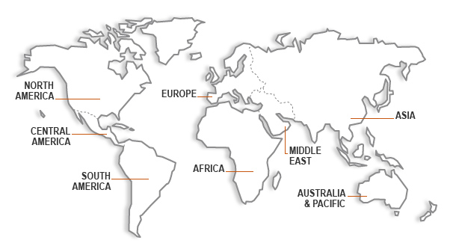

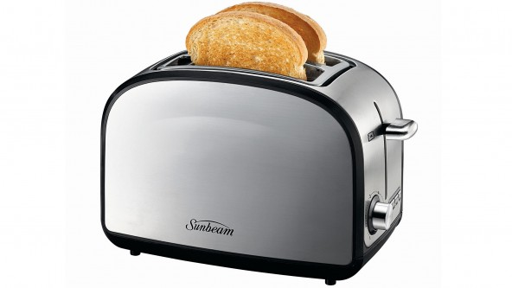
Between Turkish Toasters
AND NASA Space Ships

Slide 31
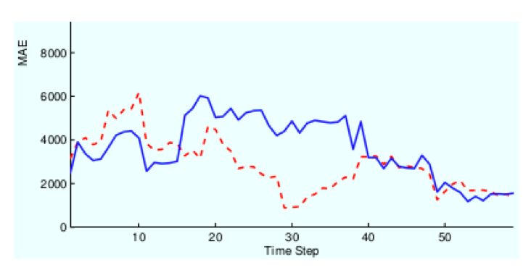
Q: How to TRANSFER
Lessons Learned?
Ignore most of the data
relevancy filtering: Turhan ESEj’09; Peters TSE’13
variance filtering: Kocaguneli TSE’12,TSE’13
performance similarities: He ESEM’13
Contort the data
spectral learning (working in PCA
space or some other rotation)
Menzies, TSE’13; Nam, ICSE’13
Build a bickering committee
Ensembles Minku, PROMISE’12

Slide 32
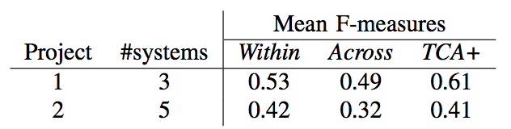
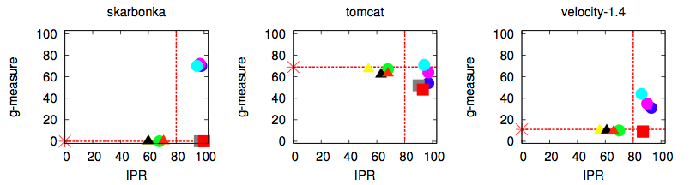
BTW, Sometimes, TRANFER better than LOCAL
Minku:PROMISE’12
Nam:ICSE’13
Peters:TSE’13

Slide 33
How to test for 7M
Specifics do not matter
But general shape does
Examples :
  Instability in “what matters most”
  Intrinsic dimensionality
  Active learning
  Transfer learning
  Filtering and wrapping
  Privacy algorithms

Slide 34
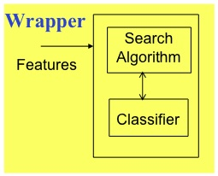
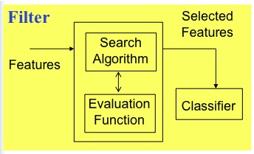
Some technology: feature selectors
Wrappers
Filters
Slow: O(2^{N}) for N features
Selection biased by target learner
Faster (some even linear time)
Selection may confuse target
M.A. Hall and G. Holmes, Benchmarking Attribute Selection Techniques for Discrete Class Data Mining, IEEE Transactions On Knowledge And Data Engineering 15)6) 1437-1447. 2--3

Slide 35
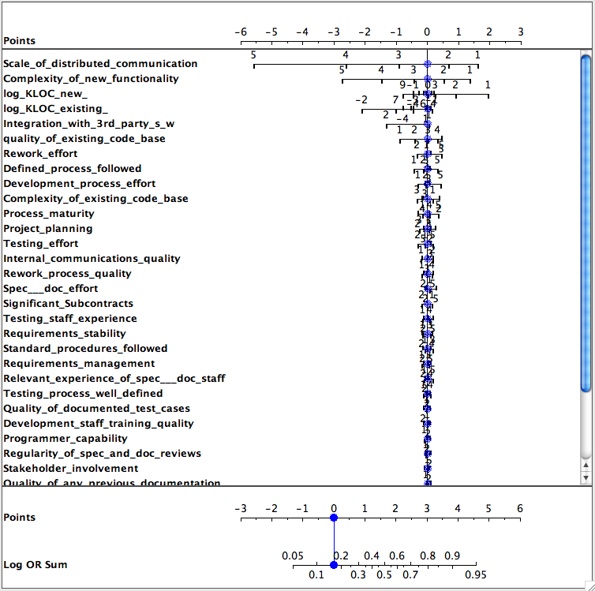
Filter results
Data from Norman Fenton’s Bayes nets discussing software defects = yes, no
Give classes x,y
  Fx, Fy
    frequency of discretized ranges in x,y
  Log Odds Ratio [1]
    log(Fx/Fy )
    Is zero if no difference in x,y
Most variables do not contribute to determination of defects
Martin Možina, Janez Demšar, Michael Kattan, and Blaž Zupan. 2004. Nomograms for visualization of naive Bayesian classifier. In Proceedings of the 8th European Conference on Principles and Practice of Knowledge Discovery in Databases (PKDD '04),

Slide 36
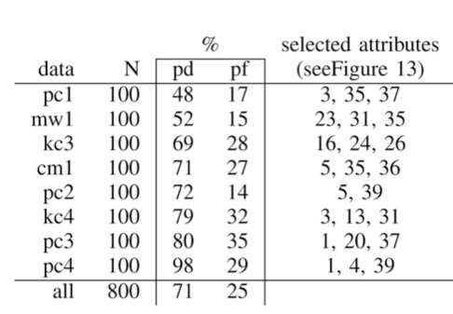
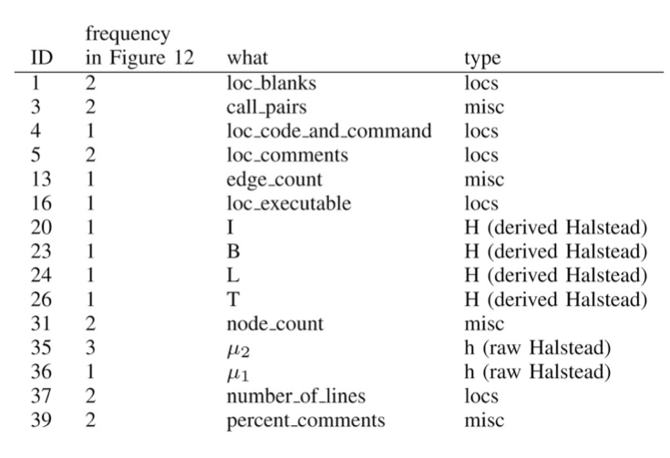
Filter results (more)
Defect prediction, NASA data
Baseline= learn defect model on all data (McCabes + Halstead +
LOC measures)
Filter = sort columns on “info gain”
Experiment = use the first N items in the sort, stopping when recall, false alarm, same as baseline
Tim Menzies, Jeremy Greenwald, Art Frank: Data Mining Static Code Attributes to Learn Defect Predictors. IEEE Trans. Software Eng. 33(1): 2-13 (2007)

Slide 37
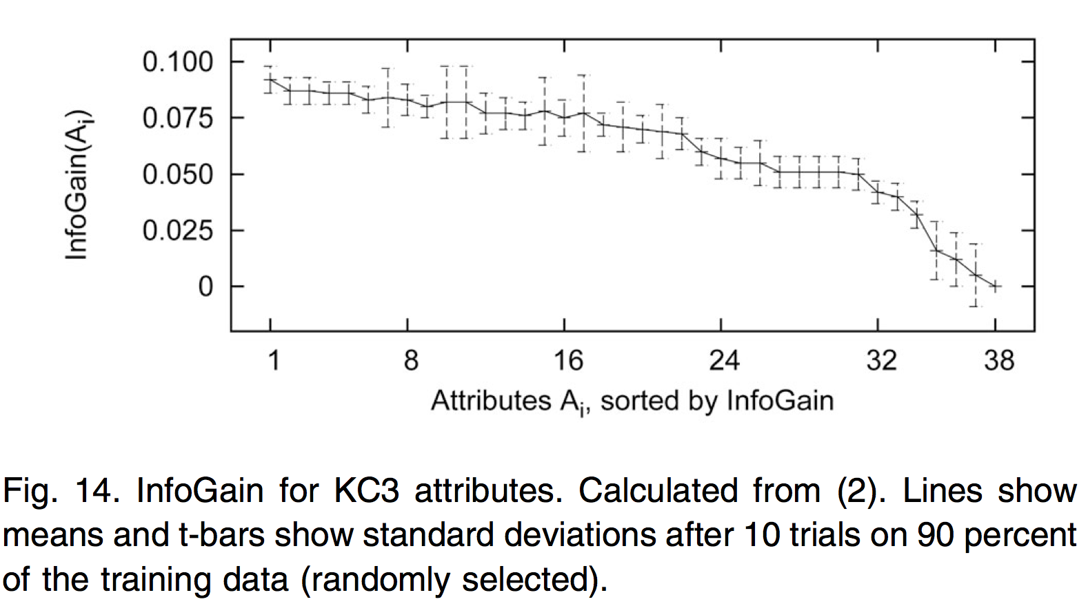
Filter results on defect data: many different features equally as good for prediction
Consistent with this data “pinging” a much lower dimensional space
Tim Menzies, Jeremy Greenwald, Art Frank: Data Mining Static Code Attributes to Learn Defect Predictors. IEEE Trans. Software Eng. 33(1): 2-13 (2007)

Slide 38
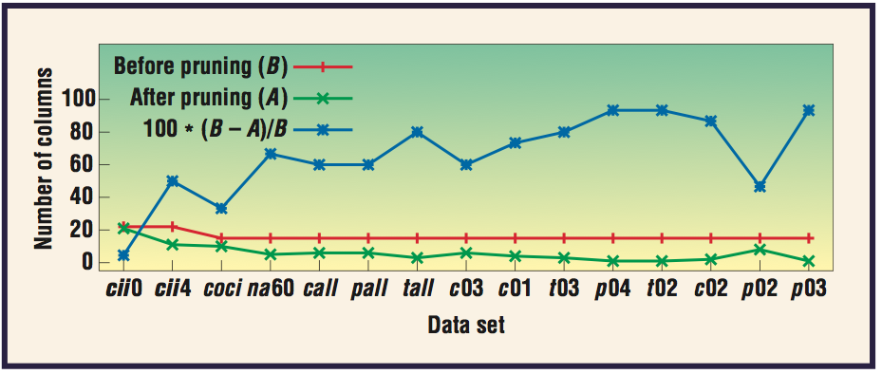
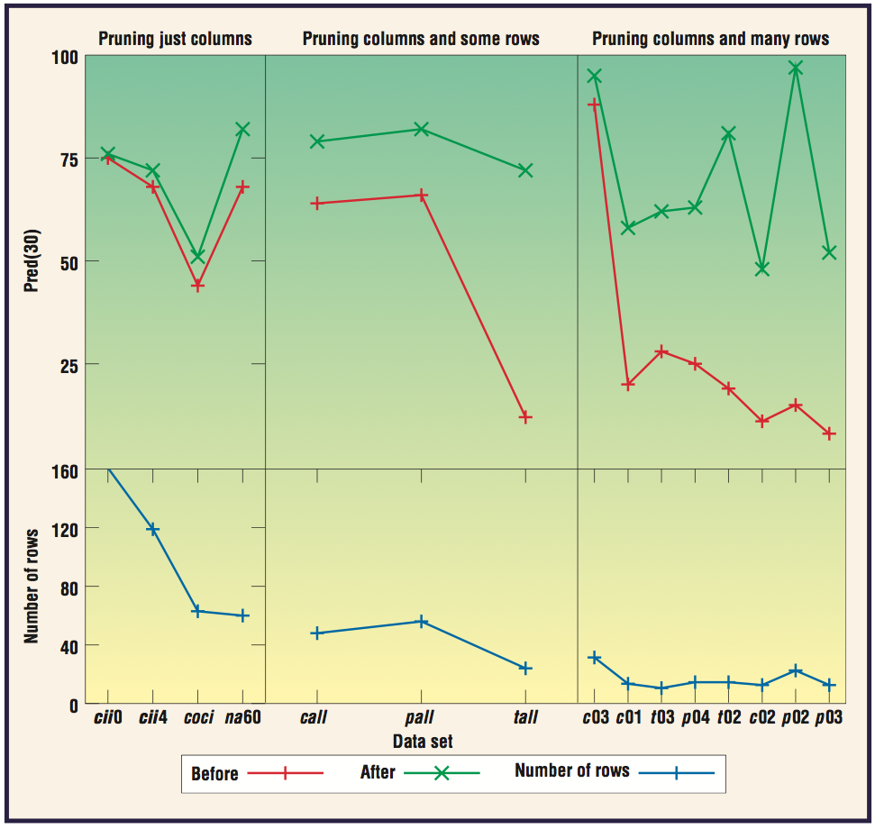
Some Wrapper results: effort estimation,
NASA data
X = f (a,b,c,..)
X’s variance comes
from a,b,c
If less a,b,c
  then less confusion
  about X
E.g effort estimation
Pred(30) = %estimates within 30% of actual
Zhihao Chen, Tim Menzies, Daniel Port, Barry Boehm, Finding the Right Data for Software Cost Modelling, IEEE Software, Nov, 2005

Slide 39
How to test for 7M
Specifics do not matter
But general shape does
Examples :
  Instability in “what matters most”
  Intrinsic dimensionality
  Active learning
  Transfer learning
  Filtering and wrapping
  Privacy algorithms

Slide 40
Peter’s Power Principle
(for row and column pruning)
Filtering via range “power”
Pruning
Divide data with N rows into
  one region for classes x,y,etc
For each region x, of size nx
    px = nx/N
    py (of everything else) =(N-nx )/N
Let Fx and Fy be frequency of range r in (1) region x and (2) everywhere else
  Do the Bayesian thing:
    a = Fx * px
    b= Fy * py
Power of range r for predicting x is:
  POW[r,x] = a²/(a+b)
Column pruning
  Sort columns by power of column (POC)
    POC = max POW value in that column
Row pruning
  Sort rows by power of row (POR)
  If row is classified as x
    POR =
    Prod( POW[r,x] for r in row )
Keep 20% most powerful
rows and columns:
  0.2 * 0.2 = 0.04
  i.e. 4% of the original data
Fayola Peters Tim Menzies, Liang Gong, Hongyu Zhang, Balancing Privacy and Utility in Cross-Company Defect Prediction, 39(8) 1054-1068, 2013

Slide 41
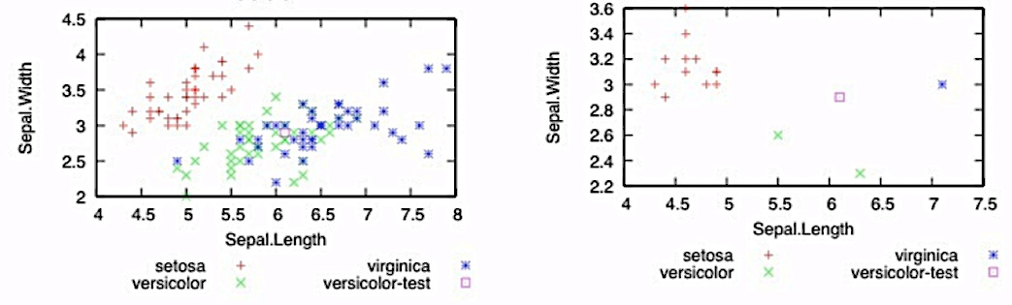
Q: What does that look like?
A: Empty out the “billiard table”
This is a privacy algorithm:
  CLIFF: prune X% of rows, we are 100-X% private
  MORPH: mutate the survivors no more than half the distance to their nearest unlike neighbor
  One of the few known privacy algorithms that does not damage data mining efficacy
before
after
Fayola Peters Tim Menzies, Liang Gong, Hongyu Zhang, Balancing Privacy and Utility in Cross-Company Defect Prediction, 39(8) 1054-1068, 2013

Slide 42
Advanced privacy methods
Incremental learning
Privacy-preserving
Cross-company Learning
Pass around the reduced data set
“Alien”: new data is too “far away” from the reduced data
  “Too far”: 10% of separation most distance pair
If anomalous, add to cache
  For defect data, cache does not grow beyond 3% of total data
LACE : Learn from N software projects
  Mixtures of open+closed source projects
As you learn, play “pass the parcel”
  The cache of reduced data
Each company only adds its “aliens” to the passed cache
  Morphing as they goes
Each company has full control of privacy
Generated very good defect predictors
ASE’14: submitted
Peters, Ph.D. thesis, WVU,
September 2014, in progress.

Slide 43
Summary &
Conclusions

Slide 44
Underlying dimensions more interesting than raw dimensions
We can ignore most of the data
  And still find the signal
  Filters, active learning
  Sometimes even enhancing the signal
    Wrappers
We can significantly and usefully contort the data
  And still get our signal
  E.g. transfer learning, privacy

Slide 45
Data about software projects is not stored in metrc1, metric2,…
But is shared between them
in some shared, underlying,
shape.
Not every project has the
same underlying simple shape
  Many projects have different,
  albeit simple, shapes
We can exploit that shape,
to great effect:
  For better local predictions
  For transferring lessons learned
  For privacy-preserving data mining

Slide 46
We were looking in the wrong direction
SE project data = surface features of an underlying effect
Stop fussing on surface details (mere metrics)
Go beneath the surface

Slide 47
Reflect LESS on raw dimensions

Slide 48
Reflect MORE on INTRINSIC dimensions
Levina and Bickel report that it is possible to simplify seemingly complex data:
  “... the only reason any methods work in very high dimensions is that, in fact, the data are not truly high-dimensional. Rather, they are embedded in a high-dimensional space, but can be efficiently summarized in a space of a much lower dimension ... “
Elizaveta Levina and Peter J. Bickel. Maximum likelihood estimation of intrinsic dimension. In NIPS, 2004.

Slide 49
If SE data compresses in this way then….
The “7M” Hypothesis:
  Menzies mentions that many measures
  mean much the same thing
In compressed space, many measures tightly associated
  Does not matter exactly what you collect
  Since they will map the same structures

Slide 50

So, what metrics to collect?
Whatever you can get, quickly, cheaply:
  Then model within the reduced dimensions
  Then cycle back to the users, for sanity, for clarity, for questions for the next round of analysis

Slide 51


Slide 53

Should we
Study L-system?
Speculation

Slide 54
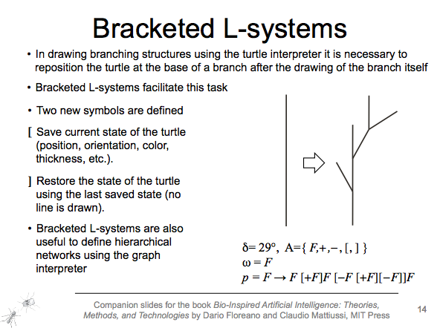

Slide 55
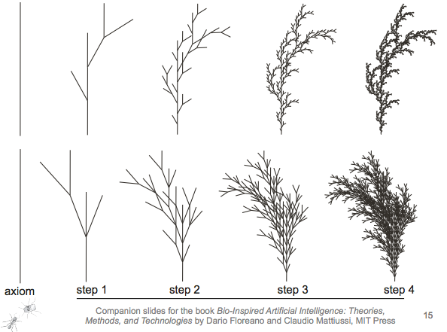

Slide 56
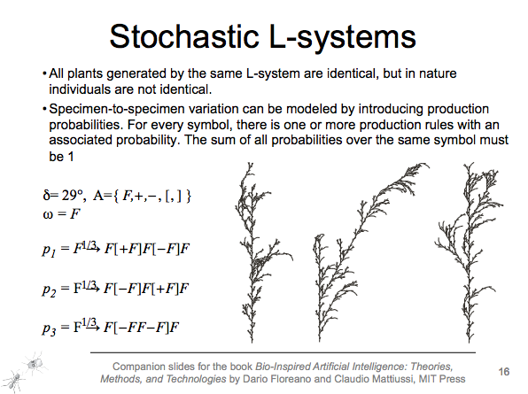

Slide 57
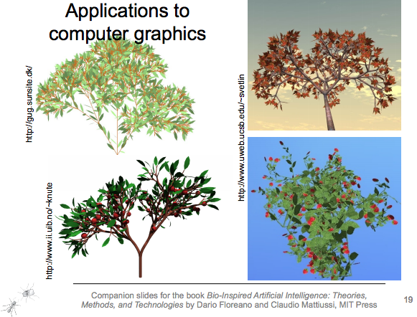

Slide 58


Slide 59

End of my tale

