Slide 1


Data Mining
tim.menzies@gmail.com

Slide 2
Know thy tools
Stop treating data miners as black boxes.
Looking inside is (1) fun, (2) easy, (3) needed.

Slide 3
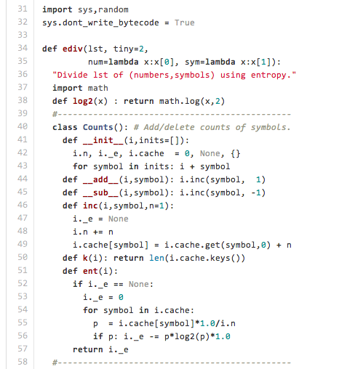
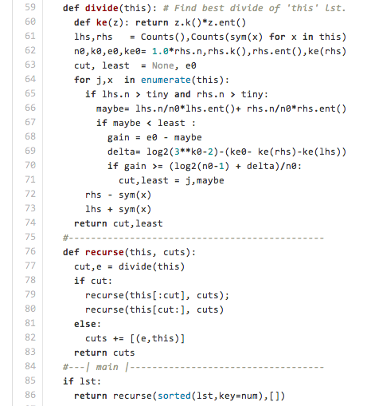
INFOGAIN: (the Fayyad and Irani MDL discretizer) in 55 lines https://raw.githubusercontent.com/timm/axe/master/old/ediv.py
Input: [ (1,X), (2,X), (3,X), (4,X), (11,Y), (12,Y), (13,Y), (14,Y) ]
Output: 1, 11 dsfdsdssdsdsddsdsdsfsdfsdsdfsdsdf
E = Σ –p*log₂(p)

Slide 4
Know thy tools
Stop treating data miners as black boxes.
Looking inside is (1) fun, (2) easy, (3) needed.

Slide 5
Know thy tools
Stop treating data miners as black boxes.
Looking inside is (1) fun, (2) easy, (3) needed.

Slide 6

It doesn't matter what you do but does matter who does it!
Martin Shepperd, Brunel University, West London, UK
http://crest.cs.ucl.ac.uk/?id=3695

Slide 7
Systematic Review
Conducted by Tracy Hall and David Bowes
  T. Hall, S. Beecham, D. Bowes, D. Gray, and S. Counsell. “A systematic literature review on fault prediction performance in software engineering”, Accepted for publication in TSE (download from BURA).
Located 208 relevant primary studies
Due to reporting requirements used 18 studies that contain 194 results
  binary classifiers, confusion matrix, context details

Slide 8
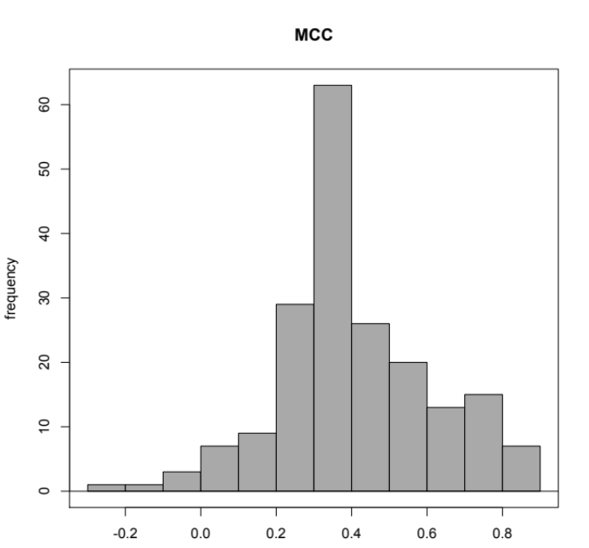
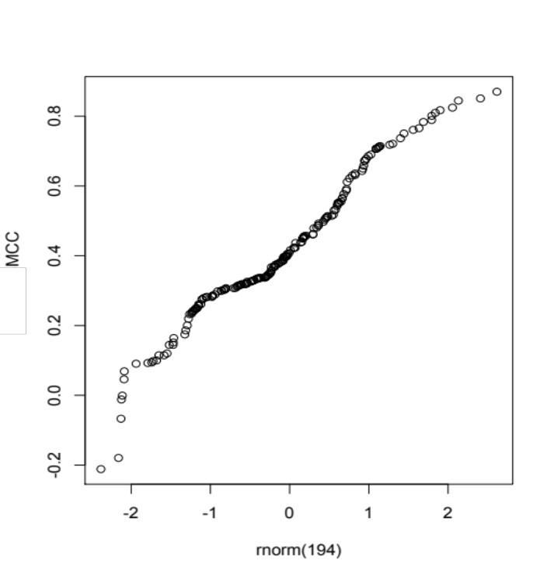
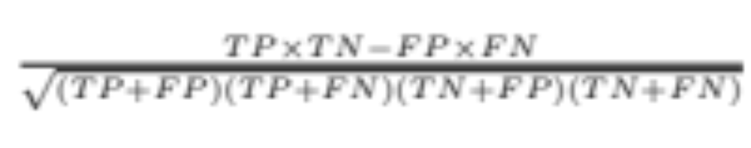
Matthews correlation coefficient

Slide 9
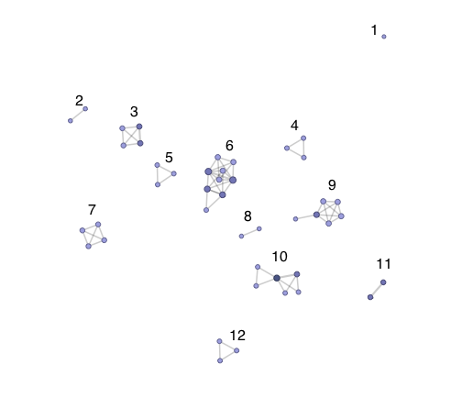
(iv) Research Group

Slide 10
ANOVA Results
Factor % of var
Author group 61%
Metric family 3%
Author/metric 9%
Everything else 8% (but not significant)
Residuals 19%

Slide 11
Final word
We cannot ignore the fact that the main determinant of a validation study result is which research group undertakes it.

Slide 12
Know thy tools
Stop treating data miners as black boxes.
Looking inside is (1) fun, (2) easy, (3) needed.

