Slide 1



Analyzing Software Data:
After the Gold Rush
Tim Menzies, NcState, USA
Thomas Zimmermann : Microsoft Research
Christian Bird: Microsoft Research
#icse14
#gold

Slide 2
Welcome to the Wild West
Volume and types of data related to SE:
  growing at unprecedented rate
Gold rush:
  researchers attempt to mine raw data and extract nuggets of insight.
Too many inexperienced “cowboys”:
  hastily generated models
  No use of best or safe practices..

Slide 3

Today’s topic:
Better SE data science
Definition
Today’s task
The analysis of software project data…
  … for anyone involved in software…
Aim:
  empowering individuals and teams to gain and share insight from their data…
  … to make better decisions.
Interactive panel
  For skilled practitioners and academics
Goals:
  Broadcast their insights
  Document the issues of newcomers in this field.

Slide 4
WhY?

Slide 5


Forthcoming reports on data science in SE
Late 2014
Late 2015

Slide 6
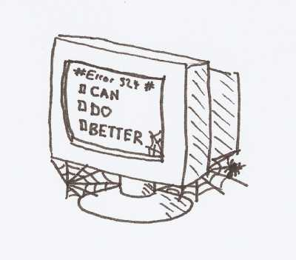
Must do better
No single best “right” way
  But many wrong ways.
For the methods we use, we must
  understand and share
  strengths and drawbacks

Slide 7
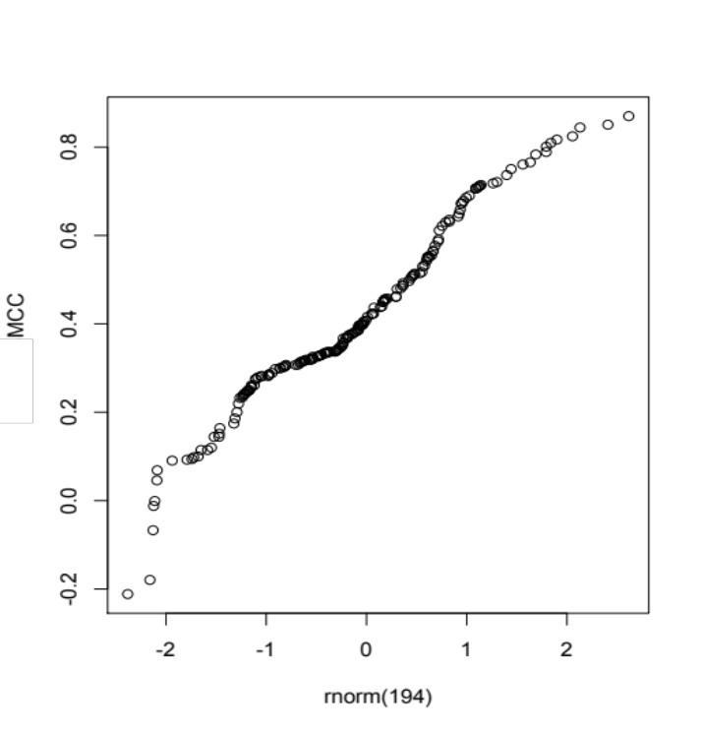
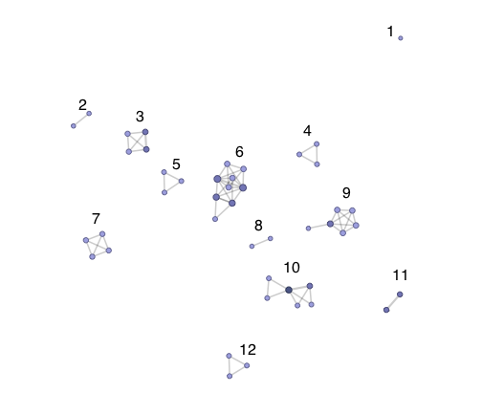
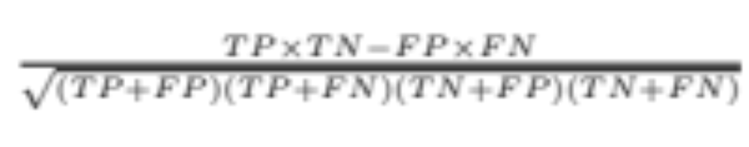
Performance scores seen in Hall et al, TSE 2013, systematic review on defect predictions
Performance scores
Research Groups

Slide 8
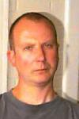
Analysis by Martin Shepperd http://crest.cs.ucl.ac.uk/?id=3695
Factor % of var
Author group 61%
Metric family 3%
Author/metric 9%
Everything else 8%
(but not
significant)
Residuals 19%
“We cannot ignore the fact that the main determinant of a validation study result is which research group undertakes it.”

Slide 9
HOW?

Slide 10
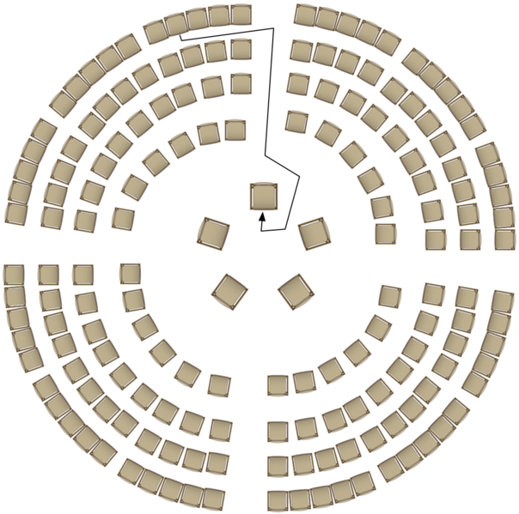
Fishbowl panel
One panel chair is always left empty.
At any time:
  A member of the audience can, at any time, occupy the empty chair (“join the fishbowl”).
    Sign our guest book!
  An existing member of the fishbowl must voluntarily leave.
Discussion continues
  Panelists frequently enter and leave the fishbowl.
  Speak for 2 mins, max

Slide 11
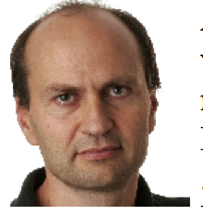
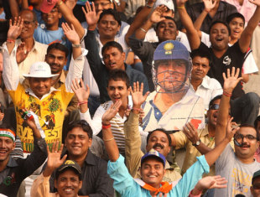
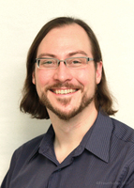
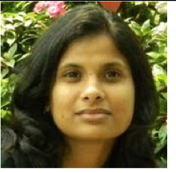
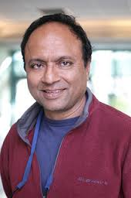
Our panelists
1) Audris Mockus:
U. Tennessee
2) Forrest Shull:
SEI
5) You!
3) Vibha S Sinha:
IBM, India
4) Prem Devanbu:
UC Davies

