Slide 1



ICSE’14 Tutorial:
The Art and Science of
Analyzing Software Data
http://bit.ly/icsetut14
Tim Menzies : North Carolina State, USA
Christian Bird : Microsoft, USA
Thomas Zimmermann : Microsoft, USA
Leandro Minku : The University of Birmingham
Burak Turhan : University of Oulu

Slide 2





Who are we?
Burak Turhan
University of Oulu
turhanb@computer.org
Christian Bird
Microsoft Research, USA
Christian.Bird@microsoft.com
Leandro L. Minku
The University of Birmingham
L.L.Minku@cs.bham.ac.uk
Thomas Zimmermann
Microsoft Research, USA
tzimmer@microsoft.com
Tim Menzies
North Carolina State, USA
tim@menzies.us

Slide 3
Roadmap
0) In a nutshell [9:00]
(Menzies + Zimmermann)
1) Organization Issues [9:15]
(Menzies)
Rule #1: Talk to the users
Rule #2: Know your domain
Rule #3: Suspect your data
Rule #4: Data science is cyclic
2) Qualitative methods [9:45]
(Bird + Zimmermann)
Discovering information needs
On the role of surveys and interviews in data analysis
Break [10:30]
3) Quantitative Methods [11:00]
(Turhan)
Do we need all the data?
  row + column + range pruning
How to keep your data private
4) Open Issues, new solutions [11:45] (Minku)
Instabilities;
Envy;
Ensembles

Slide 4


For more…
Late 2014
Late 2015

Slide 5
Roadmap
0) In a nutshell [9:00]
(Menzies + Zimmermann)
1) Organization Issues [9:15]
(Menzies)
Rule #1: Talk to the users
Rule #2: Know your domain
Rule #3: Suspect your data
Rule #4: Data science is cyclic
2) Qualitative methods [9:45]
(Bird + Zimmermann)
Discovering information needs
On the role of surveys and interviews in data analysis
Break [10:30]
3) Quantitative Methods [11:00]
(Turhan)
Do we need all the data?
  row + column + range pruning
How to keep your data private
4) Open Issues, new solutions [11:45] (Minku)
Instabilities;
Envy;
Ensembles

Slide 6

Definition:
SE Data Science
The analysis of software project data…
  … for anyone involved in software…
  … with the aim of empowering individuals and teams to gain and share insight from their data…
  … to make better decisions.

Slide 7
Q: Why Study Data Science?
A: So Much Data, so Little Time
As of late 2012,
  Mozilla Firefox had 800,000 bug reports,
  Platforms such as Sourceforge.net and GitHub hosted 324,000 and 11.2 million projects, respectively.
The PROMISE repository of software engineering data has 100+ projects (http://promisedata.googlecode.com)
  And PROMISE is just one of 12+ open source repositories
To handle this data,
  practitioners and researchers have turned to data science

Slide 8
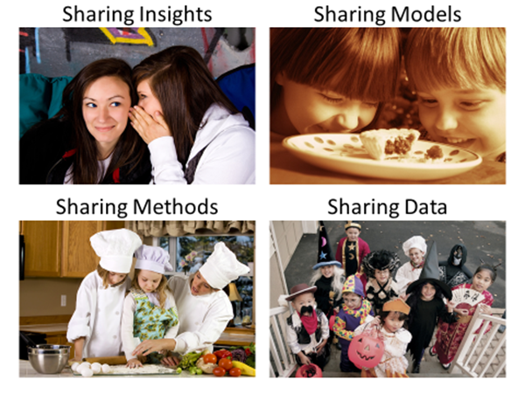
What can we learn
from each other?

Slide 9

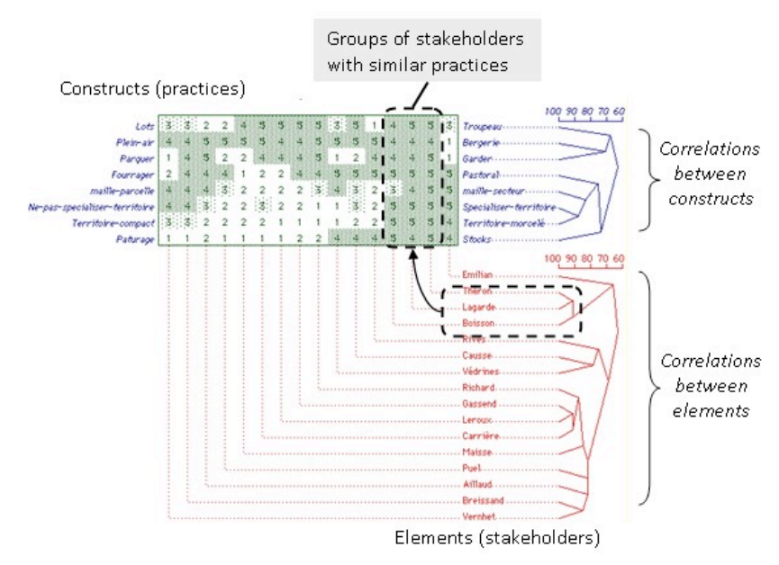
How to share insight?
Open issue
We don’t even know how to measure “insight”
  Elevators
  Number of times the users invite you back?
  Number of issues visited and retired in a meeting?
  Number of hypotheses rejected?
  Repertory grids?
Nathalie GIRARD . Categorizing stakeholders’ practices with repertory grids for sustainable development, Management, 16(1), 31-48, 2013

Slide 10
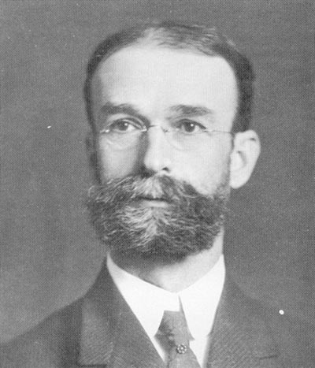
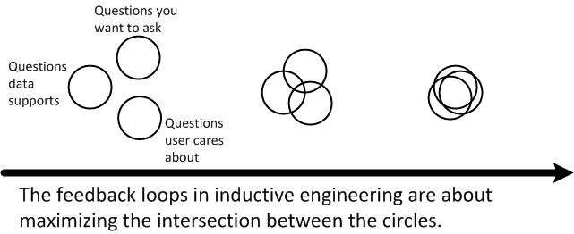
“A conclusion is simply the place where you got tired of thinking.” : Dan Chaon
Insight is a cyclic process
Experience is adaptive and accumulative.
  And data science is “just” how we report our experiences.
For an individual to find better conclusions:
  Just keep looking
For a community to find better conclusions
  Discuss more, share more
  Theobald Smith
  (American
  pathologist and microbiologist).
  “Research has
  deserted the individual and entered the group.
  “The individual worker find the problem too large, not too difficult.
  “(They) must learn to work with others. “

Slide 11
How to share methods?
Write!
Read!
To really understand something..
… try and explain it to someone else
  MSR
  PROMISE
  ICSE
  FSE
  ASE
  EMSE
  TSE
  …
But how else can we better share methods?

Slide 12
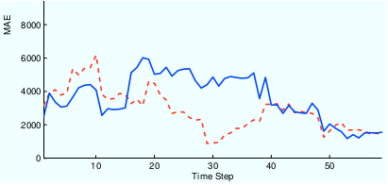
How to share models?
Incremental adaption
Ensemble learning
Update N variants of the current model as new data arrives
For estimation, use the M<N models scoring best
Build N different opinions
Vote across the committee
Ensemble out-performs solos
But how else can we better share models?
Re-learn when each
new record arrives
New: listen to N-variants
L. L. Minku and X. Yao. Ensembles and locality: Insight on improving software effort estimation. Information and Software Technology (IST), 55(8):1512–1528, 2013.
Kocaguneli, E.; Menzies, T.; Keung, J.W., "On the Value of Ensemble Effort Estimation," IEEE TSE, 38(6) pp.1403,1416, Nov.-Dec. 2012

Slide 13
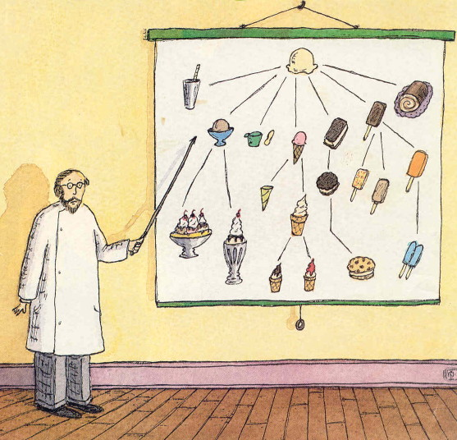
How to share data? (maybe not)
Shared data schemas
Semantic net
Everyone has same schema
  Yeah, that’ll work
Mapping via ontologies
Work in progress

Slide 14
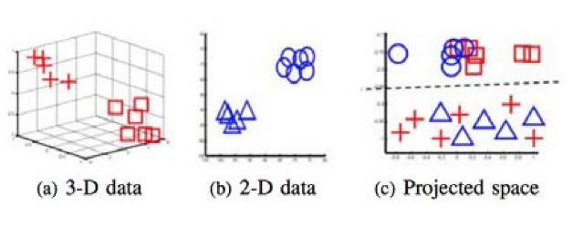
How to share data?
Transfer learning
Relevancy filtering
Map terms in old and new language to a new set of dimensions
TEAK:
  prune regions of noisy instances;
  cluster the rest
For new examples,
  only use data in nearest cluster
Finds useful data from projects either
  decades-old
  or geographically remote
Nam, Pan and Kim, "Transfer Defect Learning" ICS’13 San Francisco, May 18-26, 2013
Kocaguneli, Menzies, Mendes, Transfer learning in effort estimation, Empirical Software Engineering, March 2014

Slide 15
How to share data?
SE data compression
Privacy preserving data mining
Most SE data can be greatly compressed
  without losing its signal
  median: 90% to 98% %&
Share less, preserve privacy
Store less, visualize faster
Compress data by X%,
  now, 100-X is private ^*
More space between data
  Elbow room to mutate/obfuscate data*
But how else can we better share data?
% Vasil Papakroni, Data Carving: Identifying and Removing Irrelevancies in the Data by Masters thesis, WVU, 2013 http://goo.gl/i6caq7
^ Boyang Li, Mark Grechanik, and Denys Poshyvanyk. Sanitizing And Minimizing DBS For Software Application Test Outsourcing. ICST14
& Kocaguneli, Menzies, Keung, Cok, Madachy: Active Learning and Effort Estimation IEEE TSE. 39(8): 1040-1053 (2013)
* Peters, Menzies, Gong, Zhang, "Balancing Privacy and Utility in Cross-Company Defect Prediction,” IEEE TSE, 39(8) Aug., 2013

Slide 16
Topics (in this talk)
0) In a nutshell [9:00]
(Menzies + Zimmermann)
1) Organization Issues: [9:15]
(Menzies)
Rule #1: Talk to the users
Rule #2: Know your domain
Rule #3: Suspect your data
Rule #4: Data science is cyclic
2) Qualitative methods [9:45]
(Bird + Zimmermann)
Discovering information needs
On the role of surveys and interviews in data analysis
Break [10:30]
3) Quantitative Methods [11:00]
(Turhan)
Do we need all the data?
  Relevancy filtering + Teak
How to keep your data private
4) Open Issues, new solutions [11:45] (Minku)
Instabilities;
Envy;
Ensembles

Slide 17
Talk to the users
Rule #1

Slide 18
From The Inductive
Engineering Manifesto
Users before algorithms:
  Mining algorithms are only useful in industry if users fund their use in real-world applications.
Data science
  Understanding user goals to inductively generate the models that most matter to the user.
T. Menzies, C. Bird, T. Zimmermann, W. Schulte, and E. Kocaganeli.
The inductive software engineering manifesto. (MALETS '11).

Slide 19
Users = The folks funding the work
Wouldn’t it be wonderful if we did not have to listen to them
  The dream of olde worlde machine learning
    Circa 1980s
  “Dispense with live experts and resurrect dead ones.”
But any successful learner needs biases
  Ways to know what’s important
    What’s dull
    What can be ignored
  No bias? Can’t ignore anything
    No summarization
    No generalization
    No way to predict the future

Slide 20
Expert data scientists spend more time with users than algorithms
User Engagement meetings
A successful
“engagement” session:
Knowledge engineers enter with sample data
Users take over the spreadsheet
Run many ad hoc queries
In such meetings, users often…
  demolish the model
  offer more data
  demand you come back next week with something better

Slide 21
Know Your domain
Rule #2

Slide 22
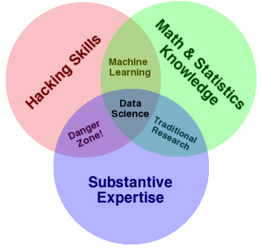
Algorithms is only part of the story
Dumb data miners miss important domains semantics
An ounce of domain knowledge is worth a ton to algorithms.
Math and statistics only gets you machine learning,
Science is about discovery and building knowledge, which requires some motivating questions about the world
The culture of academia, does not reward researchers for understanding domains.
Drew Conway, The Data Science Venn Diagram, 2009, http://www.dataists.com/2010/09/the-data-science-venn-diagram/

Slide 23
Case Study #1: NASA
NASA’s Software Engineering Lab, 1990s
  Gave free access to all comers to their data
  But you had to come to get it (to Learn the domain)
  Otherwise: mistakes
E.g. one class of software module with far more errors that anything else.
  Dumb data mining algorithms: might learn that this kind of module in inherently more data prone
Smart data scientists might question “what kind of programmer work that module”
  A: we always give that stuff to our beginners as a learning exercise
F. Shull, M. Mendonsa, V. Basili, J. Carver, J. Maldonado, S. Fabbri, G. Travassos, and M. Ferreira, "Knowledge-Sharing Issues in Experimental Software Engineering", EMSE 9(1): 111-137, March 2004.

Slide 24
Case Study #2: Microsoft
Distributed vs centralized development
Who owns the files?
  Who owns the files with most bugs
Result #1 (which was wrong)
  A very small number of people produce most of the core changes to a “certain Microsoft product”.
  Kind of an uber-programmer result
  I.e. given thousands of programmers working on a project
    Most are just re-arrange deck chairs
    TO improve software process, ignore the drones and focus mostly on the queen bees
WRONG:
  Microsoft does much auto-generation of intermediary build files.
  And only a small number of people are responsible for the builds
  And that core build team “owns” those auto-generated files
  Skewed the results. Send us down the wrong direction
Needed to spend weeks/months understanding build practices
  BEFORE doing the defect studies
E. Kocaganeli, T. Zimmermann, C.Bird, N.Nagappan, T.Menzies. Distributed Development
Considered Harmful?. ICSE 2013 SEIP Track, San Francisco, CA, USA, May 2013.

Slide 25
Suspect your data
Rule #3

Slide 26
You go mining with the data you have—not the data you might want
In the usual case, you cannot control data collection.
  For example, data mining at NASA 1999 – 2008
    Information collected from layers of sub-contractors and sub-sub-contractors.
    Any communication to data owners had to be mediated by up to a dozen account managers, all of whom had much higher priority tasks to perform.
Hence, we caution that usually you must:
  Live with the data you have or dream of accessing at some later time.

Slide 27
Rinse before use
Data quality tests [1]
  Linear time checks for (e.g.) repeated rows
Column and row pruning for tabular data [2,3]
  Bad columns contain noise, irrelevancies
  Bad rows contain confusing outliers
  Repeated results:
    Signal is a small nugget within the whole data
    R rows and C cols can be pruned back to R/5 and C^{0.5}
    Without losing signal
[1] Shepperd, M.; Qinbao Song; Zhongbin Sun; Mair, C., "Data Quality: Some Comments on the NASA Software Defect Datasets”, IEEE TSE 39(9) pp.1208,1215, Sept. 2013
[2] Kocaguneli, Menzies, Keung, Cok, Madachy: Active Learning and Effort Estimation IEEE TSE. 39(8): 1040-1053 (2013)
[3] Jiang, Cukic, Menzies, Lin, Incremental Development of Fault Prediction Models, IJSEKE journal, 23(1), 1399-1425 2013

Slide 28
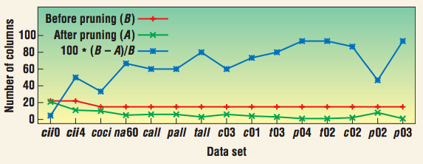
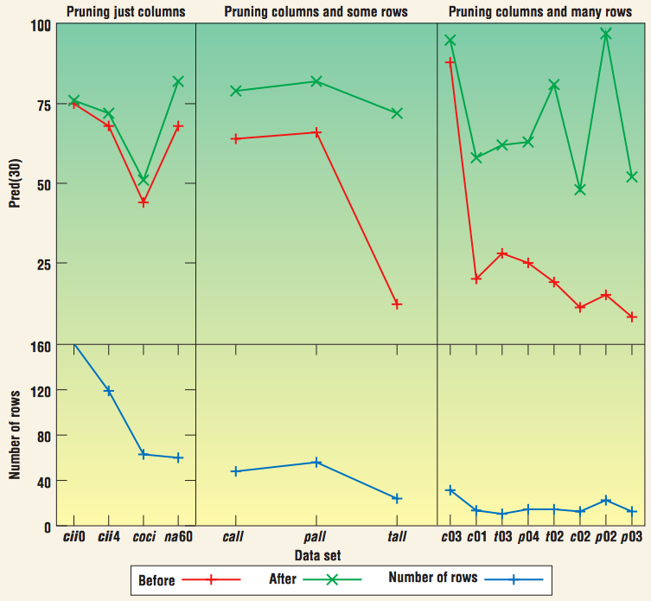
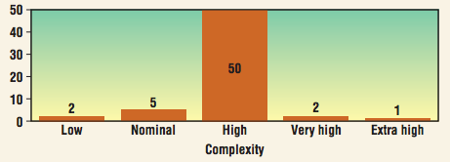
e.g. NASA effort data
The more features we
remove for smaller
projects the better
the predictions.
Nasa data: most
Projects highly complex
i.e. no information in saying
“complex”
Zhihao Chen, Barry W. Boehm, Tim Menzies, Daniel Port: Finding the Right Data for Software Cost Modeling. IEEE Software 22(6): 38-46 (2005)

Slide 29
Data mining is cyclic
Rule #4

Slide 30
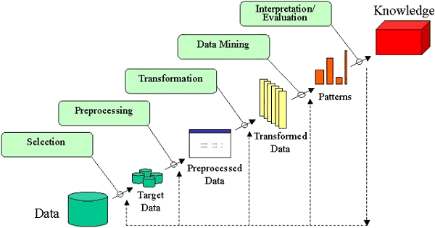
Do it again, and again, and again, and …
In any industrial application, data science is repeated multiples time to either answer an extra user question, make some enhancement and/or bug fix to the method, or to deploy it to a different set of users.
U. Fayyad, G. Piatetsky-Shapiro, and P. Smyth. From data mining to knowledge discovery in databases. AI Magazine, [33] pages 37–54, Fall 1996.

Slide 31
Thou shall not click
For serious data science studies,
  to ensure repeatability,
  the entire analysis should be automated
  using some high level scripting language;
    e.g. R-script, Matlab, Bash, ….

Slide 32
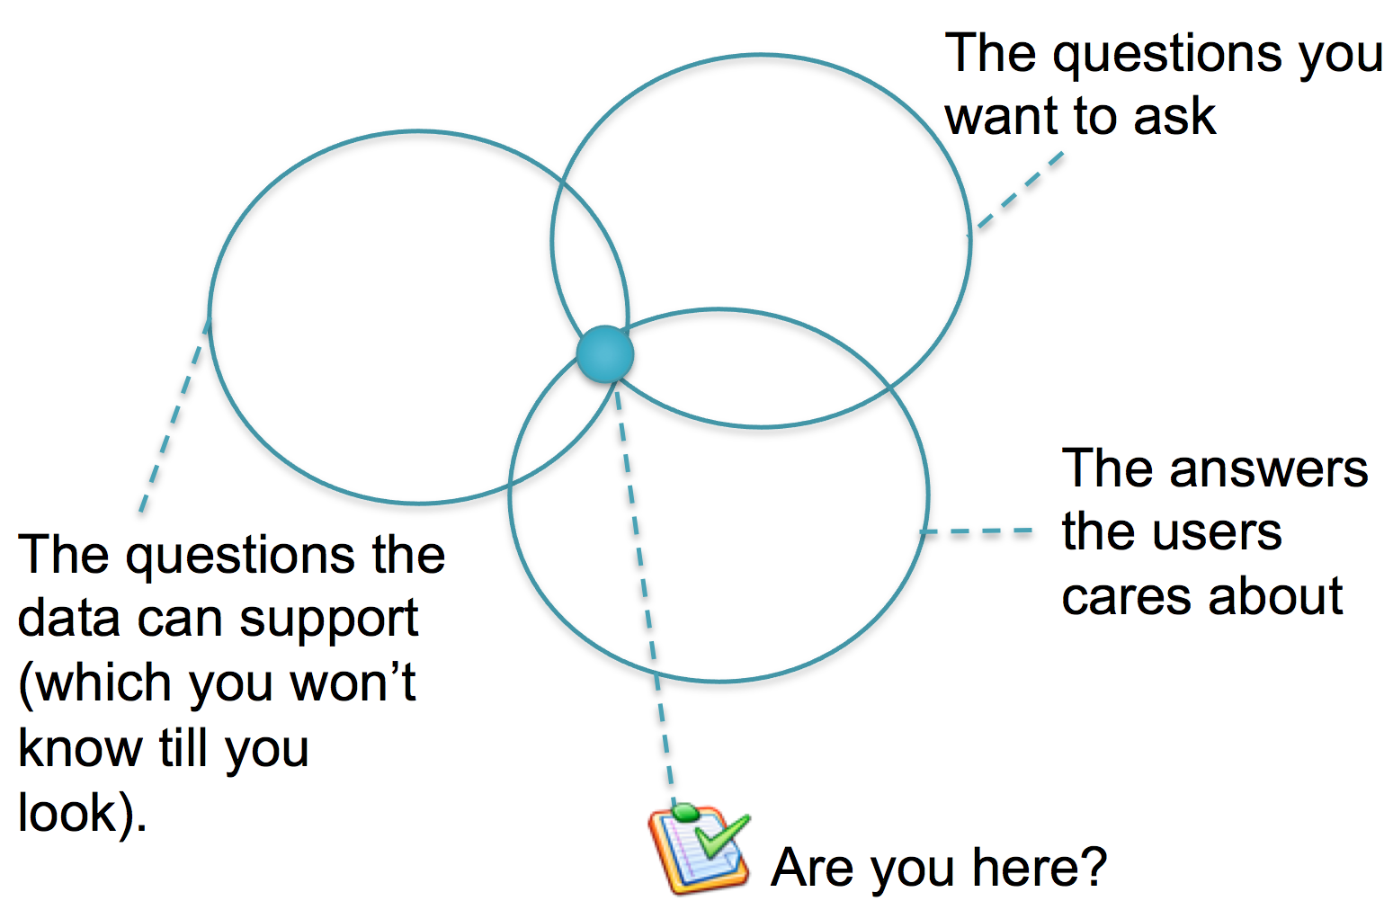
The feedback process

Slide 33
The feedback process

Slide 34
The other Rules
Rule #5,6,7,8….
T. Menzies, C. Bird, T. Zimmermann, W. Schulte, and E. Kocaganeli.
The inductive software engineering manifesto. (MALETS '11).

Slide 35
Roadmap
0) In a nutshell [9:00]
(Menzies + Zimmermann)
1) Organization Issues: [9:15]
(Menzies)
Rule #1: Talk to the users
Rule #2: Know your domain
Rule #3: Suspect your data
Rule #4: Data science is cyclic
2) Qualitative methods [9:45]
(Bird + Zimmermann)
Discovering information needs
On the role of surveys and interviews in data analysis
Break [10:30]
3) Quantitative Methods [11:00]
(Turhan)
Do we need all the data?
  row + column + range pruning
How to keep your data private
4) Open Issues, new solutions [11:45] (Minku)
Instabilities;
Envy;
Ensembles

Slide 36
In this section
Why qualitative analysis?
Surveys as a lightweight tool for data collection
Two of my most successful surveys
  Example: What makes a good bug report?
  Example: Which bugs get fixed/reassigned/reopened?
What makes a good survey?
Analyzing survey data
  Likert scale data
  Open-ended questions
  Card sorting
  Inter-rater agreement

Slide 37
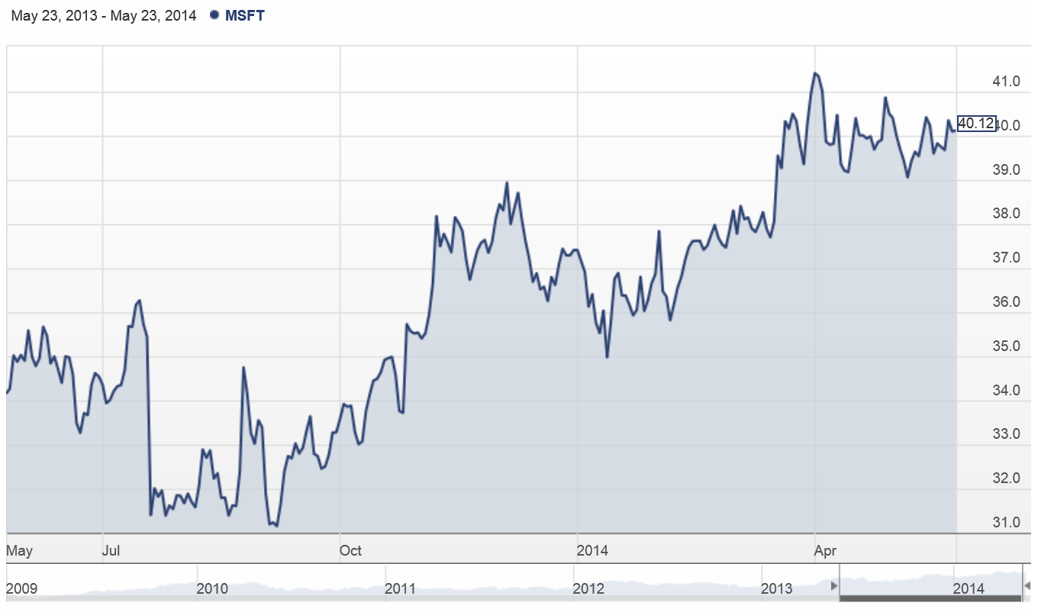
Measurement alone doesn’t tell you much…

Slide 38
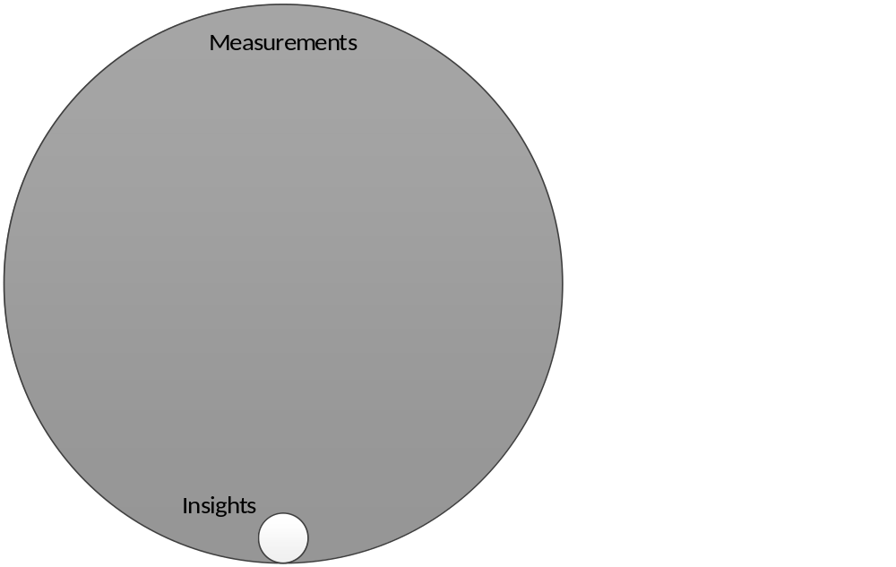
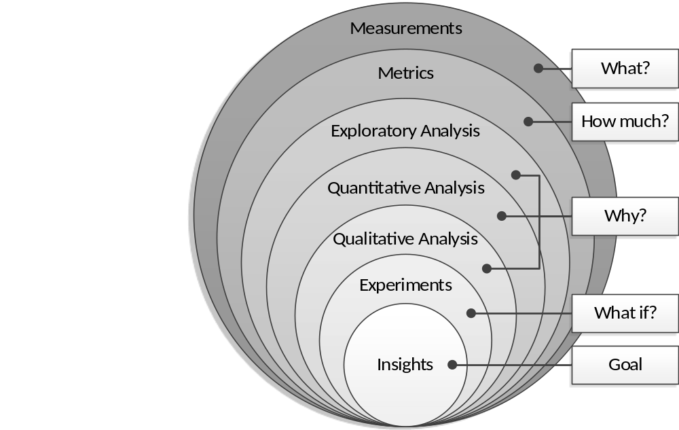
Qualitative analysis can help you to answer the “Why?” question
Raymond P. L. Buse, Thomas Zimmermann: Information needs
for software development analytics. ICSE 2012: 987-996

Slide 39
Surveys are a lightweight way to get more insight into the “Why?”
Surveys allow collection of quantitative + qualitative data (open ended questions)
Identify a population + sample
Send out web-based questionnaire
Survey tools:
  Qualtrics, SurveyGizmo, SurveyMonkey
  Custom built tools for more complex questionaires

Slide 40

Two of my most successful surveys are about bug reports
Notes:
And actually there is one thing that caught my attention. In the first editions of this book, it came with a BUG TRACKER.

Slide 41
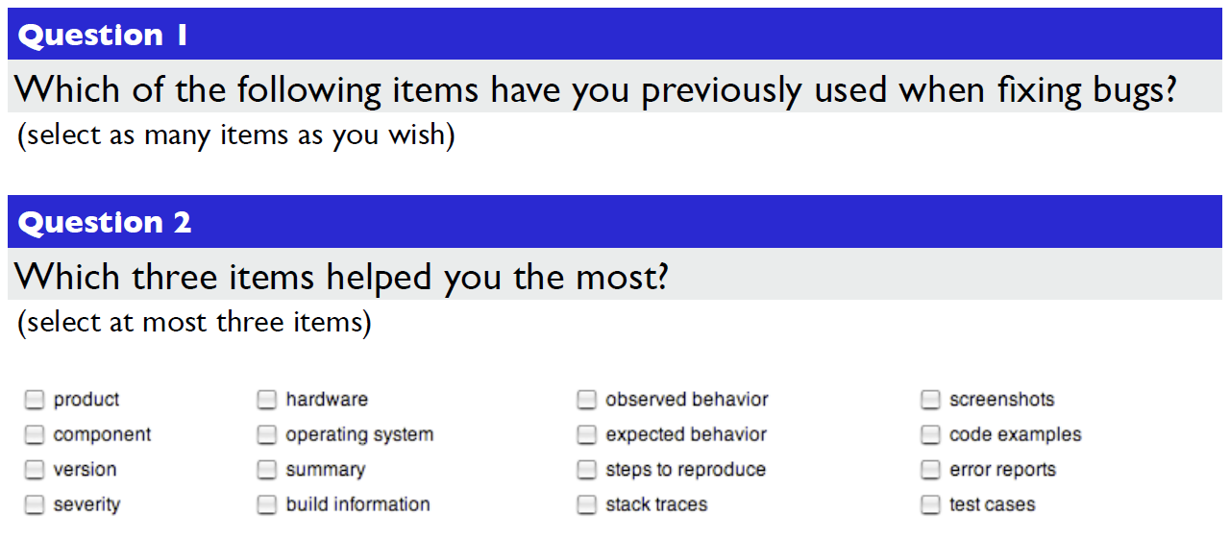
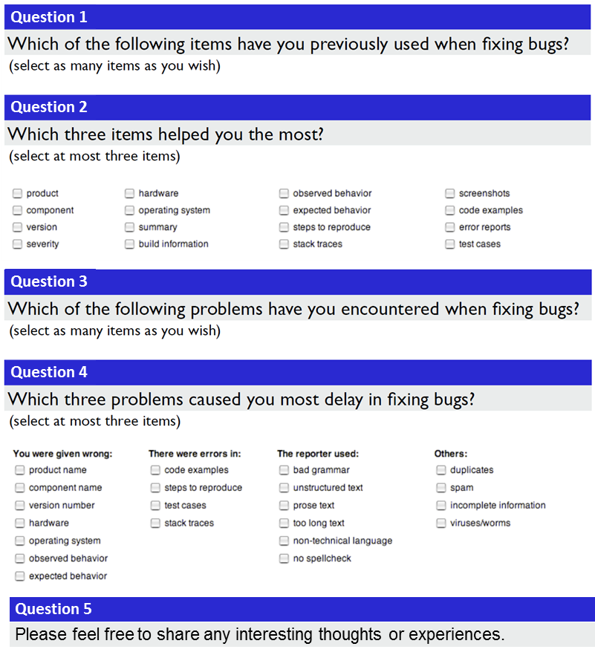
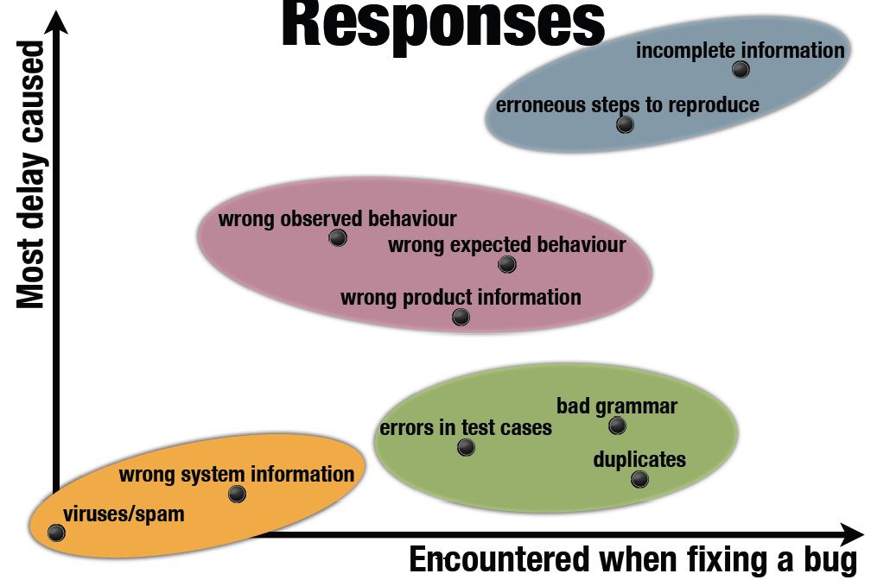
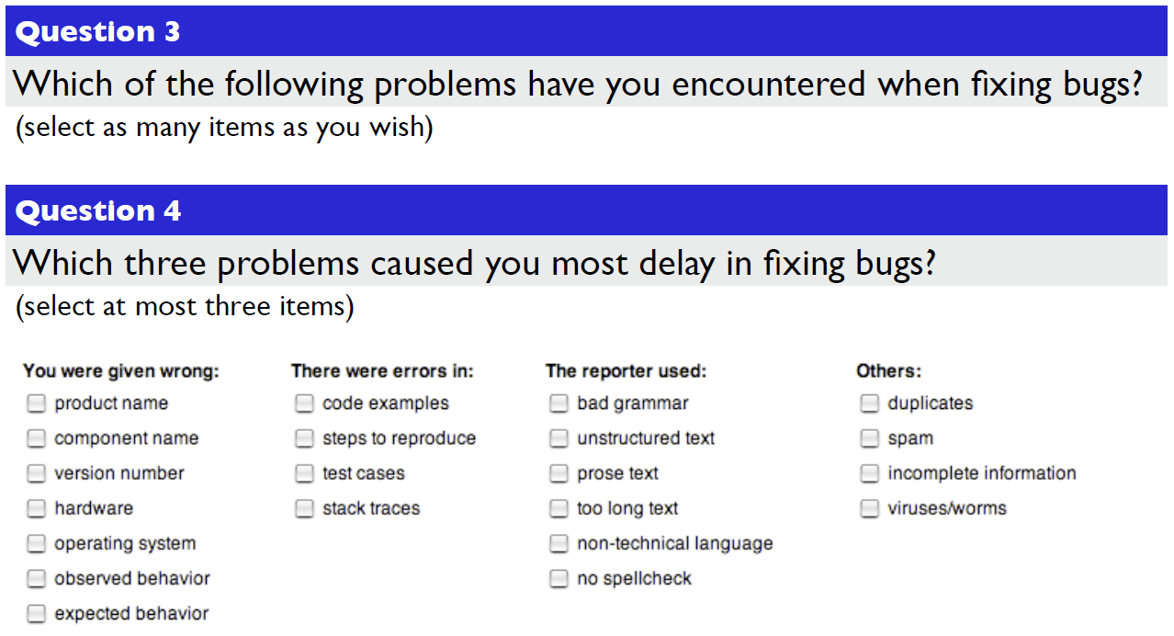
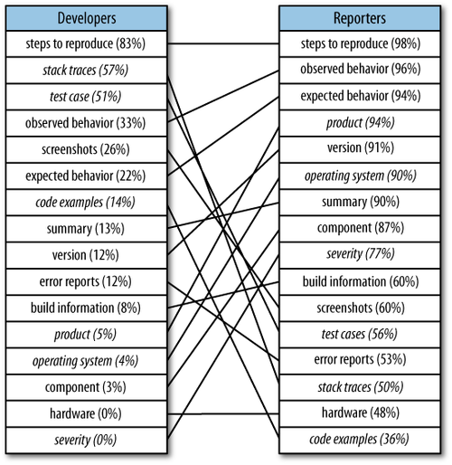
What makes a good bug report?
Question 1
Question 2
Question 3
Question 4
Question 5
Please feel free to share any interesting thoughts or experiences.
T. Zimmermann et al.: What Makes a Good Bug Report? IEEE Trans. Software Eng. 36(5): 618-643 (2010)

Slide 42
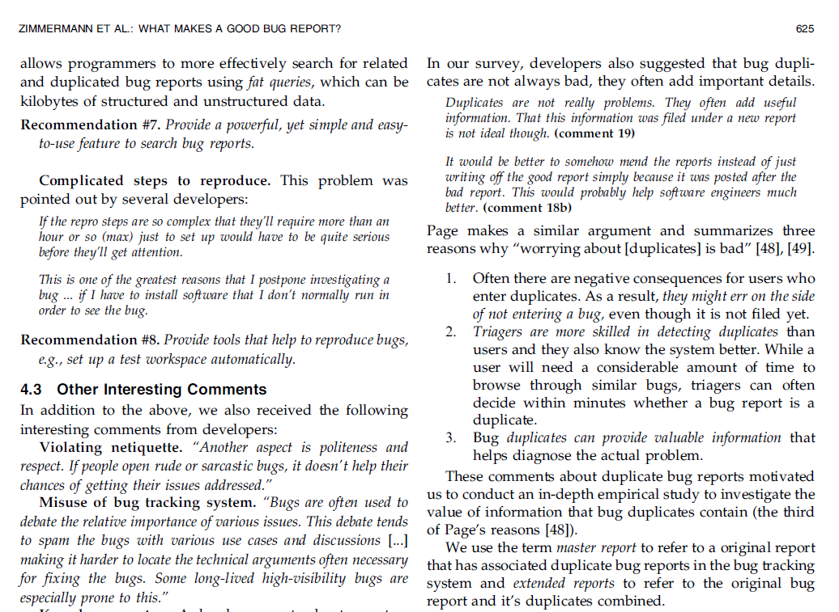
Well crafted open-ended questions in surveys can be a great source of additional insight.

Slide 43
Which bugs are fixed?
In your experience, how do the following factors affect the chances of whether a bug will get successfully resolved as FIXED?
  7-point Likert scale (Significant/Moderate/Slight increase, No effect, Significant/Moderate/Slight decrease)
Sent to 1,773 Microsoft employees
  Employees who opened OR were assigned to OR resolved most Windows Vista bugs
  358 responded (20%)
Combined with quantitative analysis of bug reports

Slide 44
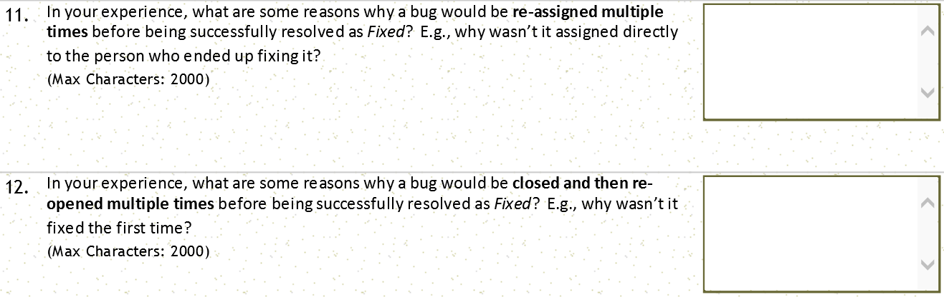
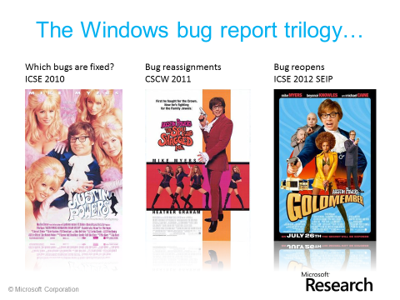
Philip J. Guo, Thomas Zimmermann, Nachiappan Nagappan, Brendan Murphy: Characterizing and predicting which bugs get fixed: an empirical study of Microsoft Windows. ICSE (1) 2010: 495-504
Philip J. Guo, Thomas Zimmermann, Nachiappan Nagappan, Brendan Murphy: "Not my bug!" and other reasons for software bug report reassignments. CSCW 2011: 395-404
Thomas Zimmermann, Nachiappan Nagappan, Philip J. Guo, Brendan Murphy: Characterizing and predicting which bugs get reopened. ICSE 2012: 1074-1083

Slide 45
What makes a good survey?
Open discussion.

Slide 46
My (incomplete) advice for survey design
Keep the survey short. 5 minutes – 10 minutes
Be accurate about the survey length
Questions should be easy to understand
Anonymous vs. non-anonymous
Provide incentive for participants
  Raffle of gift certificates
Timely topic increases response rates
Personalize the invitation emails
If possible, use only one page for the survey

Slide 47
Example of an email invite
Subject: MS Research Survey on Bug Fixes
Hi FIRSTNAME,
I’m with the Empirical Software Engineering group at MSR, and
we’re looking at ways to improve the bug fixing experience at
Microsoft. We’re conducting a survey that will take about 15-20
minutes to complete. The questions are about how you choose bug
fixes, how you communicate when doing so, and the activities that
surround bug fixing. Your responses will be completely anonymous.
If you’re willing to participate, please visit the survey: http://url
There is also a drawing for one of two $50.00 Amazon gift cards at
the bottom of the page.
Thanks very much,
Emerson
Who are you?
Why are you
doing this?
Details on the
survey
Incentive for people
to participate
Edward Smith, Robert Loftin, Emerson Murphy-Hill, Christian Bird, Thomas Zimmermann. Improving Developer Participation Rates in Surveys. CHASE 2013

Slide 48
Analyzing survey data
Statistical analysis
  Likert items: interval-scale vs. ordinal data
  Often transformed into binary, e.g.,
  Strongly Agree and Agree vs the rest
  Often non-parametric tests are used such as
  chi-squared test, Mann–Whitney test, Wilcoxon signed-rank test, or Kruskal–Wallis test
  Logistic regression
Barbara A. Kitchenham, Shari L. Pfleeger. Personal Opinion Surveys. In Guide to Advanced Empirical Software Engineering, 2008, pp 63-92. Springer

Slide 49
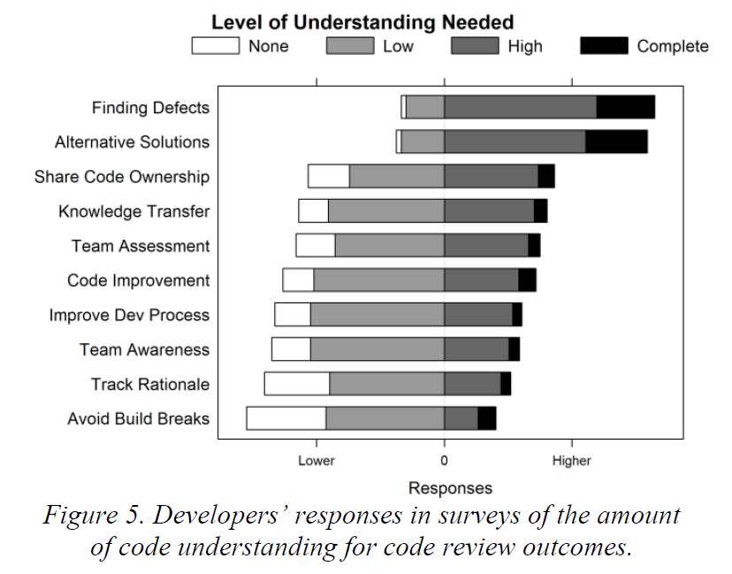
Visualizing Likert responses
This example is taken from: Alberto Bacchelli, Christian Bird: Expectations, outcomes, and challenges of modern code review. ICSE 2013: 712-721
Resources: Look at the “After” Picture in http://statistical-research.com/plotting-likert-scales/
There are more before/after examples here http://www.datarevelations.com/category/visualizing-survey-data-and-likert-scales
Here’s some R code for stacked Likert bars http://statistical-research.com/plotting-likert-scales/

Slide 50
Analyzing survey data
Coding of responses
  Taking the open-end responses and categorizing them into groups (codes) to facilitate quantitative analysis or to identify common themes
  Example:
  What tools are you using in software development?
  Codes could be the different types of tools, e.g., version control, bug database, IDE, etc.
Tools for coding qualitative data:
  Atlas.TI
  Excel, OneNote
  Qualyzer, http://qualyzer.bitbucket.org/
  Saturate (web-based), http://www.saturateapp.com/

Slide 51
Analyzing survey data
Inter-rater agreement
  Coding is a subjective activity
  Increase reliability by using multiple raters for entire data or a subset of the data
  Cohen’s Kappa or Fleiss’ Kappa can be used to measure the agreement between multiple raters.
  “We measured inter-rater agreement for the first author’s categorization on a simple random sample of 100 cards with a closed card sort and two additional raters (third and fourth author); the Fleiss’ Kappa value among the three raters was 0.655, which can be considered a substantial agreement [19].”
  (from Breu @CSCW 2010)
[19] J. Landis and G. G. Koch. The measurement of observer agreement
for categorical data. Biometrics, 33(1):159–174, 1977.

Slide 52
Analyzing survey data
Card sorting
  widely used to create mental models and derive taxonomies from data and to deduce a higher level of abstraction and identify common themes.
  in the preparation phase, we create cards for each response written by the respondents (Mail Merge feature in Word);
  in the execution phase, cards are sorted into meaningful groups with a descriptive title;
  in the analysis phase, abstract hierarchies are formed in order to deduce general categories and themes.
Open card sorts have no predefined groups;
  groups emerge and evolve during the sorting process
Closed card sort have predefined groups,
  typically used when the themes are known in advance.
Mail Merge for Email: http://office.microsoft.com/en-us/word-help/use-word-mail-merge-for-email-HA102809788.aspx

Slide 53
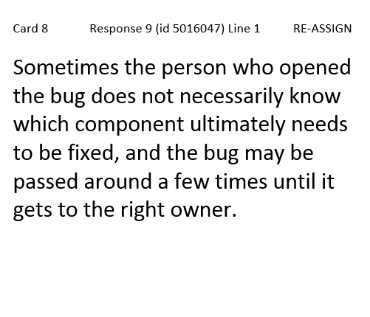
Example of a card for a card sort
Have an ID for each card.
Same length of ID is better.
Put a reference to the survey response
Print in large font, the larger
the better (this is 19 pt.)
After the mail merge you can reduce the font size for cards that don’t fit
We usually do 6-up or 4-up on a letter page.

Slide 54
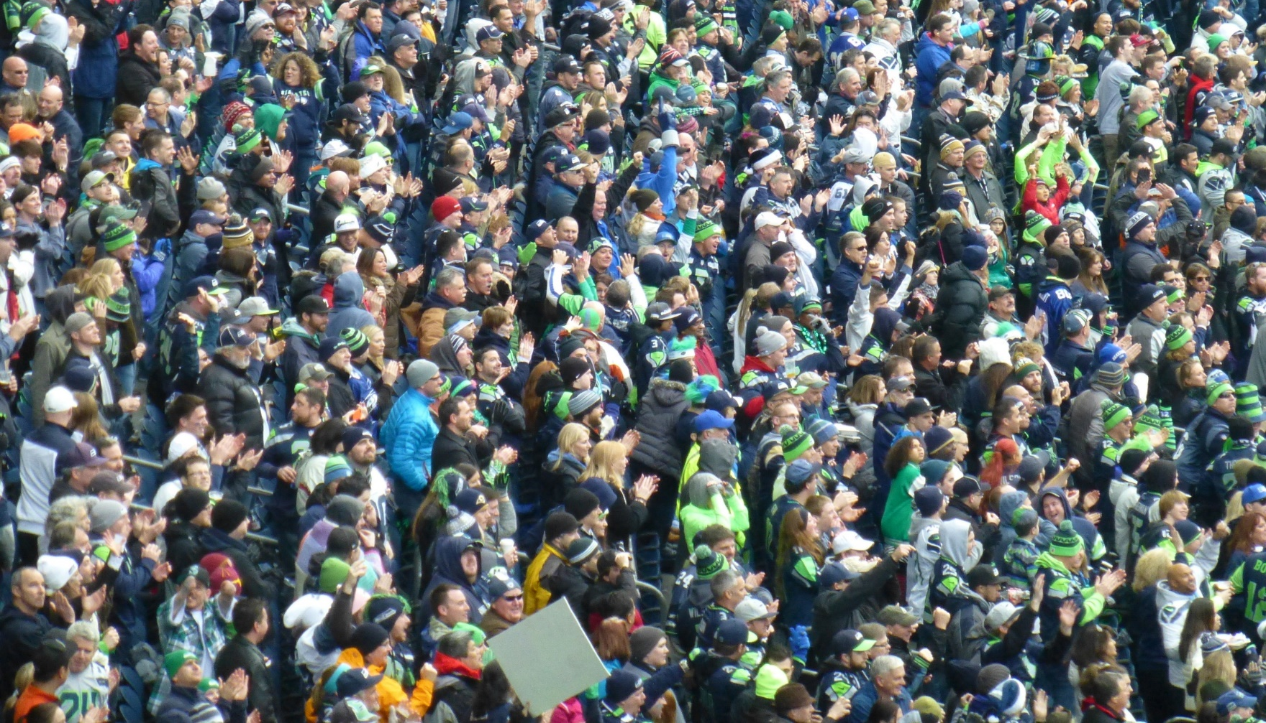
One more example
http://aka.ms/145Questions
Andrew Begel, Thomas Zimmermann. Analyze This! 145 Questions for Data Scientists
in Software Engineering. ICSE 2014

Slide 55
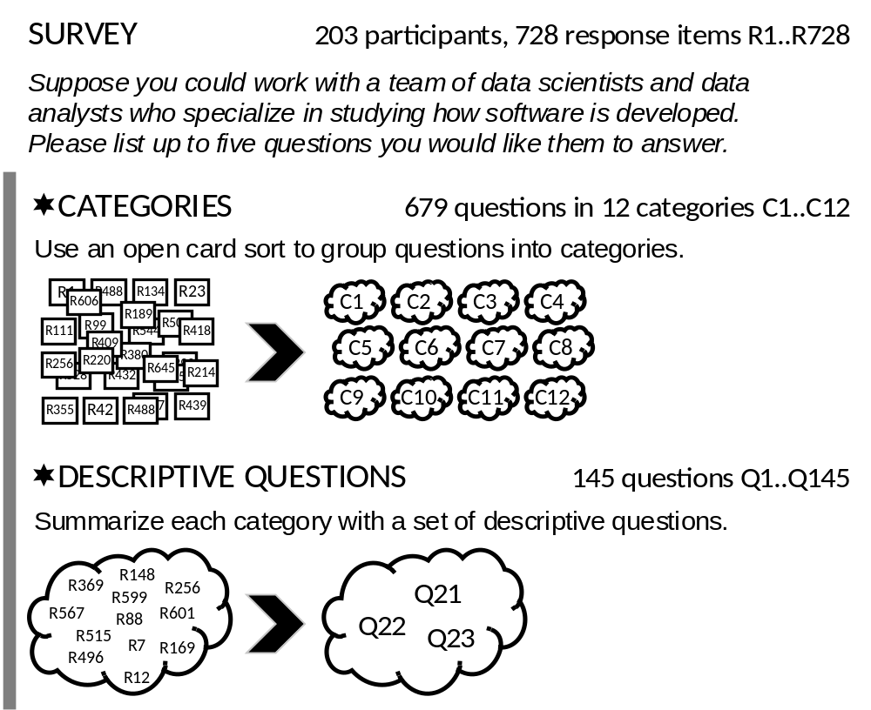
❶

Slide 56
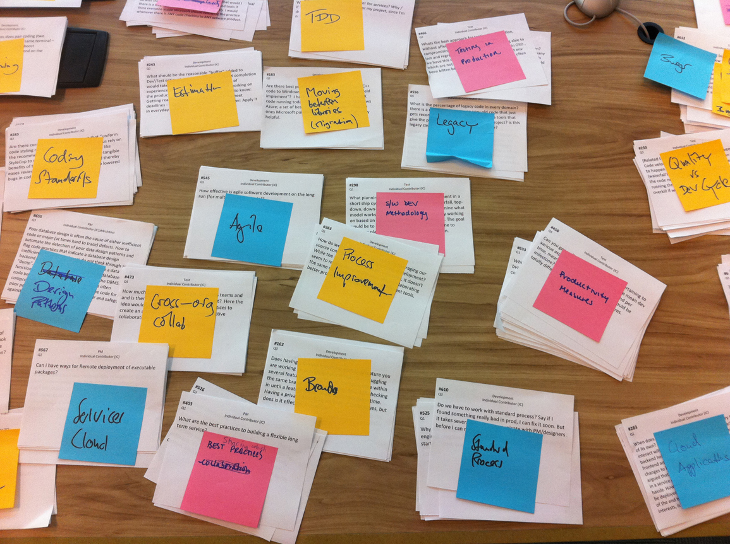

Slide 57

raw questions (that were provided by respondents)
“How does the quality of software change over time – does software age?
I would use this to plan the replacement of components.”
“How do security vulnerabilities correlate to age / complexity / code churn / etc. of a code base? Identify areas to focus on for in-depth security review or re-architecting.”
“What will the cost of maintaining a body of code or particular solution be? Software is rarely a fire and forget proposition but usually has a fairly predictable lifecycle. We rarely examine the long term cost of projects and the burden we place on ourselves and SE as we move forward.”

Slide 58
raw questions (that were provided by respondents)
“How does the quality of software change over time – does software age?
I would use this to plan the replacement of components.”
“How do security vulnerabilities correlate to age / complexity / code churn / etc. of a code base? Identify areas to focus on for in-depth security review or re-architecting.”
“What will the cost of maintaining a body of code or particular solution be? Software is rarely a fire and forget proposition but usually has a fairly predictable lifecycle. We rarely examine the long term cost of projects and the burden we place on ourselves and SE as we move forward.”
descriptive question (that we distilled)
How does the age of code affect its quality, complexity, maintainability, and security?

Slide 59
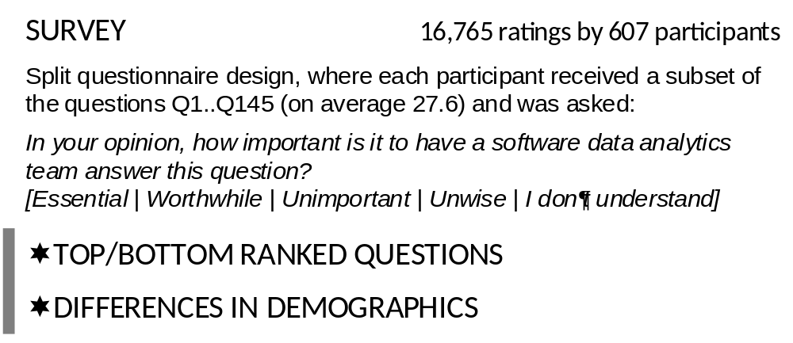
❷
Discipline: Development, Testing, Program Management
Region: Asia, Europe, North America, Other
Number of Full-Time Employees
Current Role: Manager, Individual Contributor
Years as Manager
Has Management Experience: yes, no.
Years at Microsoft
Notes:
The asymmetric survey response scale was inspired by a model for product development and customer satisfaction created by Professor Noriaki Kano [31]. It measures three aspects: must have (Essential), nice to have (Worthwhile), and detraction (Unwise).

Slide 60
Why conduct interviews?
Collect historical data that is not recorded anywhere else
Elicit opinions and impressions
Richer detail
Triangulate with other data collection techniques
Clarify things that have happened (especially following an observation)
J. Aranda and G. Venolia. The Secret Life of Bugs: Going Past the Errors and Omissions in Software Repositories. ICSE 2009

Slide 61
Types of interviews
Structured – Exact set of questions, often quantitative in nature, uses and interview script
Semi-Structured – High level questions, usually qualitative, uses an interview guide
Unstructured – High level list of topics, exploratory in nature, often a conversation, used in ethnographies and case studies.
Notes:
Structured interviews require adherence to a very particular set of rules. Each question that is outlined should be read word for word by the researcher without any deviation from the protocol. Structured interviews are the type used most often by quantitative researchers. The style is most useful when looking for very specific information. The benefits are that it keeps the data concise and reduces researcher bias.
Semi-Structured - "Semi-structured interviews are a bit more relaxed than structured interviews. While researchers using this type are still expected to cover every question in the protocol, they have some wiggle room to explore participant responses by asking for clarification or additional information. Interviewers also have the freedom to be more friendly and sociable. Semi-structured interviews are most often used in qualitative studies. The style is most useful when one is investigating a topic that is very personal to participants. Benefits include the ability to gain rapport and participants' trust, as well as a deeper understanding of responses. Data sets obtained using this style will larger than those with structured interviews."
Unstructured - "Unstructured interviews have the most relaxed rules of the three. In this type, researchers need only a checklist of topics to be covered during the interview. There is no order and no script. The interaction between the participant and the researcher is more like a conversation than an interview. Unstructured interviews are most often used in ethnographies and case studies (types of qualitative studies). They are best used when researchers want to find as much information as possible about their topic. The benefit is that unstructured interviews often uncover information that would not have been exposed using structured or semi-structured interviews. The researcher and participant are not limited by the protocol. Data sets collected using unstructured interviews will be larger than the rest."

Slide 62
Interview Workflow
Select Subjects
Contact & Schedule
Conduct Interview
Write Notes & Discuss
Transcribe
Code
Report
Collect Background Info
Decide Goals & Questions

Slide 63
Preparation: Interview Guide
Contains an organized list of high level questions.
ONLY A GUIDE!
Questions can be skipped, asked out of order, followed up on, etc.
Helps with pacing and to make sure core areas are covered.

Slide 64
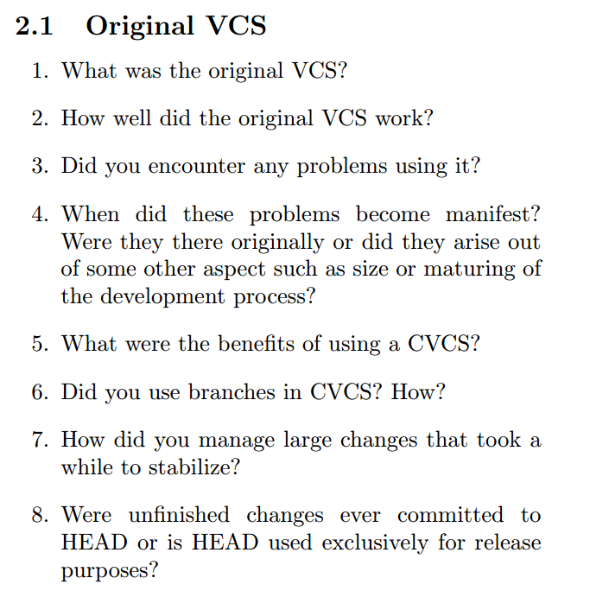
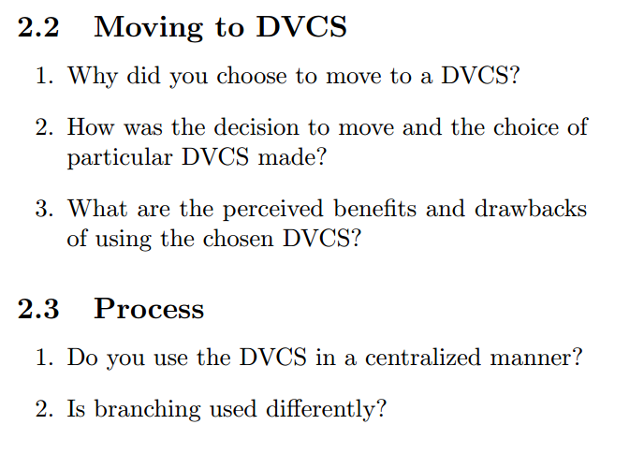
E. Barr, C. Bird, P. Rigby, A. Hindle, D. German, and P. Devanbu. Cohesive and Isolated Development with Branches. FASE 2012

Slide 65
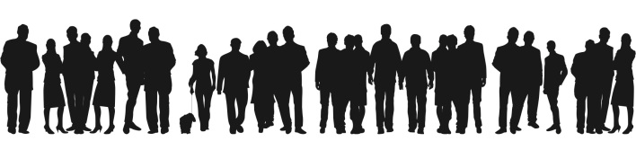
Preparation: Identify Subjects
You can’t interview everyone!
Doesn’t have to be a random sample, but you can still try to achieve coverage.
Don’t be afraid to add/remove people as you go
Notes:
10 interviews is A LOT of work.

Slide 66
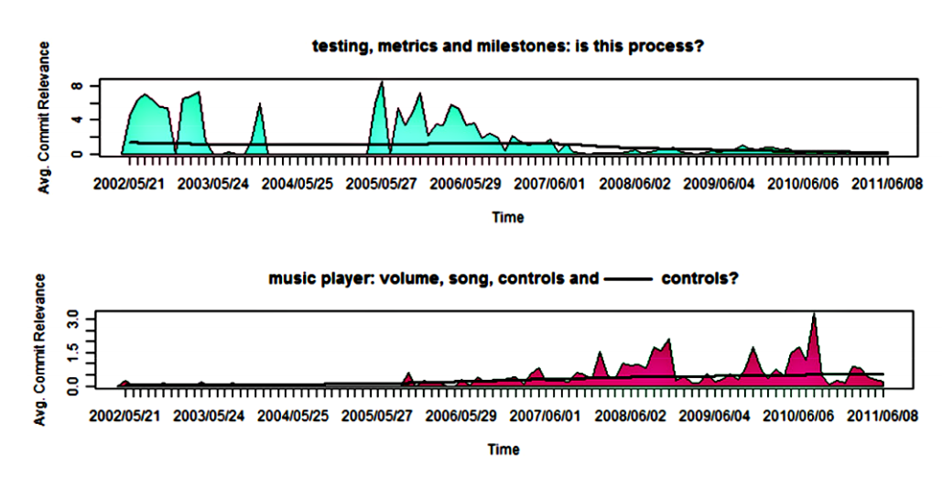
Preparation: Data collection
Some interviews may require interviewee-specific preparation.
A. Hindle, C. Bird, T. Zimmermann, N. Nagappan. Relating Requirements to Implementation via Topic Analysis: Do Topics Extracted From Requirements Make Sense to Managers and Developers? ICSM 2012

Slide 67
Preparation: Contacting
Introduce yourself.
Tell them what your goal is.
How can it benefit them?
How long will it take?
Do they need any preparation?
Why did you select them in particular?

Slide 68
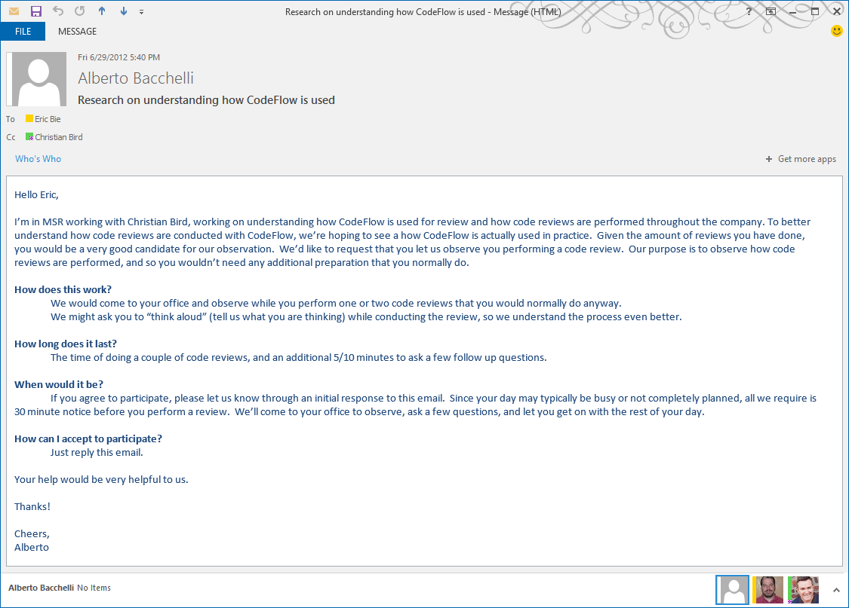
A. Bacchelli and C. Bird. Expectations, Outcomes, and Challenges of Modern Code Review. ICSE 2013 2012

Slide 69
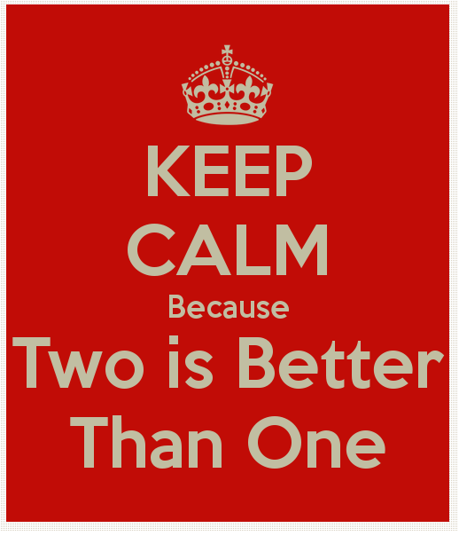
During: Two people is best
Tend to ask more questions == more info
Less “down time”
One writes, one talks
Discuss afterwards
Three or more can be threatening

Slide 70
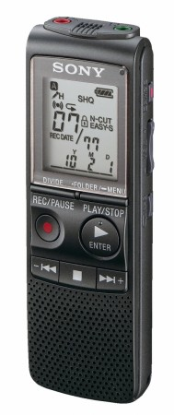
During: General Tips
Ask to record. Still take notes (What if it didn’t record!)
You want to listen to them, don’t make them listen to you!
Face to face is best, even if online.
Be aware of time.

Slide 71
After
Write down post-interview notes. Thoughts, impressions, discussion with co-interviewer, follow-ups.
Do you need to continue interviewing? (saturation)
Do you need to modify your guide?
Do you need to transcribe?

Slide 72
Analysis: transcription
Verbatim == time consuming or expensive and error prone. (but still may be worth it)
Partial transcription: capture the main idea in 10-30 second chunks.
Notes:
Paying for transcription is expensive and often the transcribers don’t understand technical jargon

Slide 73
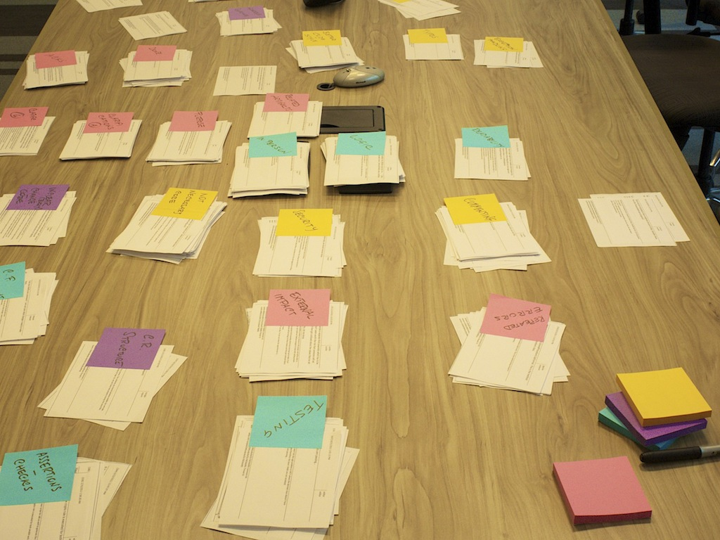
Card Sorting

Slide 74
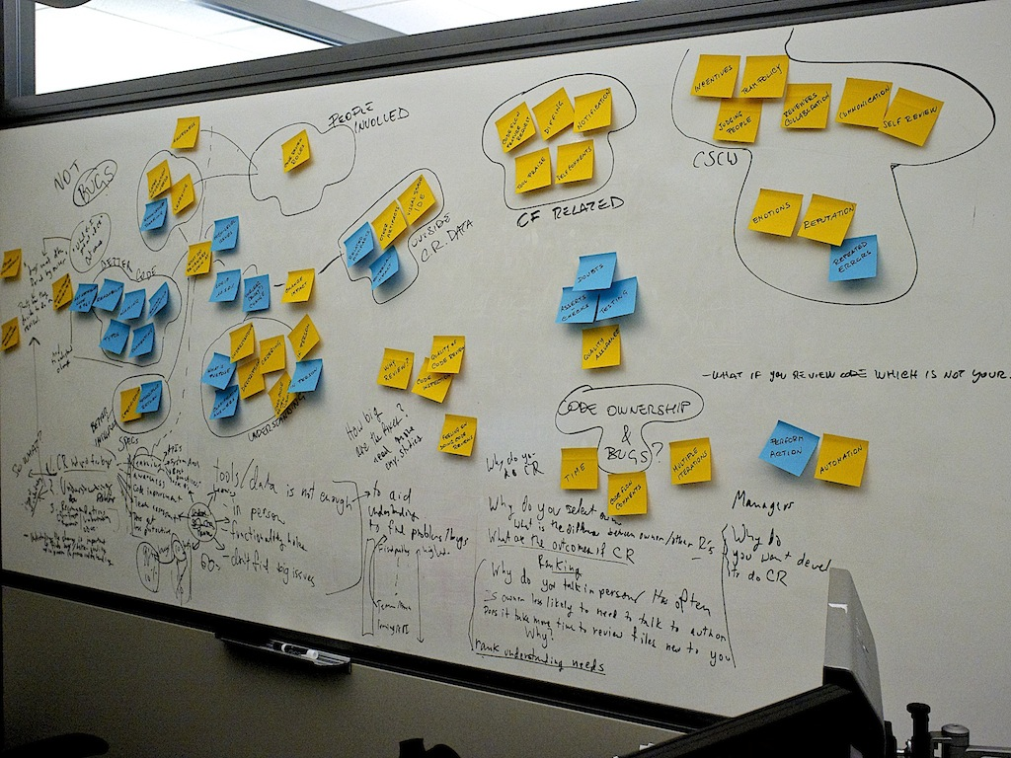
Affinity Diagram
Notes:
a lot of interesting topics
narrow down to something actionable and interesting, not only from an academic point of view, but for Microsoft, too. We focused on a part of the left side

Slide 75
Reporting
At least, include:
Number of interviewees, how selected, how recruited, their roles
Duration and location of interviews
Describe or provide interview guide and/or any artifacts used

Slide 76
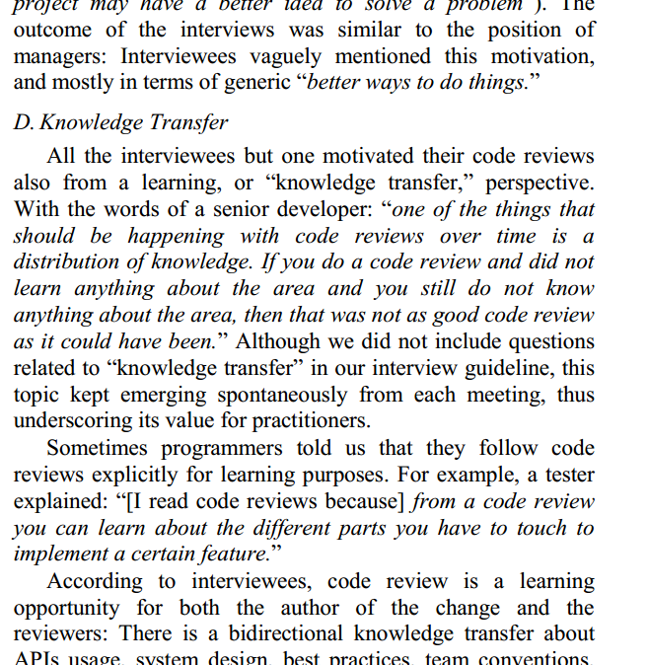
Quotes
can provide richness and insight and is engaging
Don’t cherry pick. Select representative quotes that capture general sentiment.

Slide 77
Additional References
Hove and Anda. "Experiences from conducting semi-structured interviews in empirical software engineering research." Software Metrics, 2005. 11th IEEE International Symposium. IEEE, 2005.
Seaman, C. "Qualitative Methods in Empirical Studies of Software Engineering". IEEE Transactions on Software Engineering, 1999. 25 (4), 557-572

Slide 78
Roadmap
0) In a nutshell [9:00]
(Menzies + Zimmermann)
1) Organization Issues: [9:15]
(Menzies)
Rule #1: Talk to the users
Rule #2: Know your domain
Rule #3: Suspect your data
Rule #4: Data science is cyclic
2) Qualitative methods [9:45]
(Bird + Zimmermann)
Discovering information needs
On the role of surveys and interviews in data analysis
Break [10:30]
3) Quantitative Methods [11:00]
(Turhan)
Do we need all the data?
  row + column + range pruning
How to keep your data private
4) Open Issues, new solutions [11:45] (Minku)
Instabilities;
Envy;
Ensembles

Slide 79
In this section
Very fast tour of automatic data mining methods
This will be fast
  30 mins
This will get pretty geeky
  For more details, see Chapter 13 “Data Mining, Under the Hood”
Late 2014

Slide 80

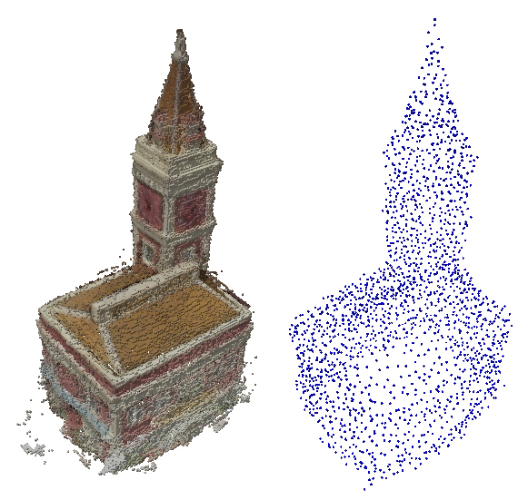
The uncarved block
Michelangelo
Someone else
Every block of stone has a statue inside it and it is the task of the sculptor to discover it.
Every Some stone databases have statue models inside and it is the task of the sculptor data scientist to go look.

Slide 81
Data mining
= Data Carving
How to mine:
  Find the crap
  Cut the crap;
  Goto step1
E.g Cohen pruning:
  Prune away small differences in
  numerics: E.g. 0.5 * stddev
E.g Discretization pruning:
  prune numerics back to a handful of bins
  E.g. age = “alive” if < 120 else “dead”
  Known to significantly improve
  Bayesian learners
James Dougherty, Ron Kohavi, Mehran Sahami: Supervised and Unsupervised Discretization of Continuous Features. ICML 1995: 194-202

Slide 82
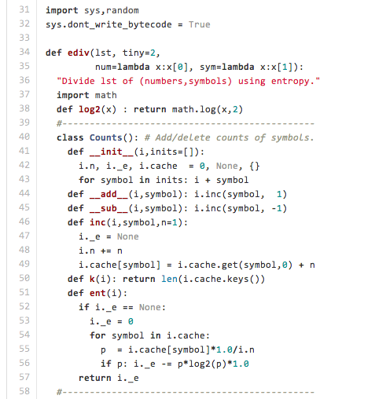
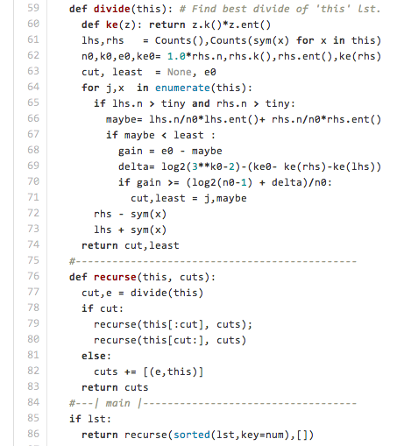
INFOGAIN: (the Fayyad and Irani MDL discretizer) in 55 lines https://raw.githubusercontent.com/timm/axe/master/old/ediv.py
Input: [ (1,X), (2,X), (3,X), (4,X), (11,Y), (12,Y), (13,Y), (14,Y) ]
Output: 1, 11 dsfdsdssdsdsddsdsdsfsdfsdsdfsdsdf
E = Σ –p*log₂(p)

Slide 83
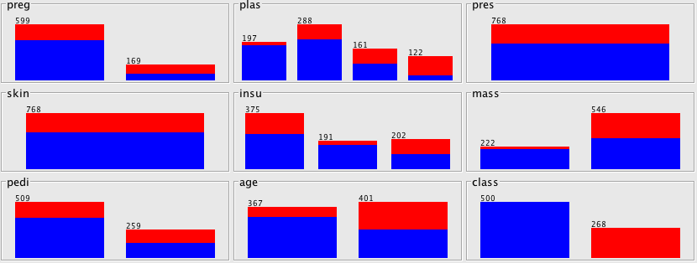
Example output of INFOGAIN: data set = diabetes.arff
Classes = (notDiabetic, isDiabetic)
Baseline distribution = (5: 3)
Numerics divided
  at points where class frequencies most change
If not division,
  then no information on that attribute regarding those classes

Slide 84
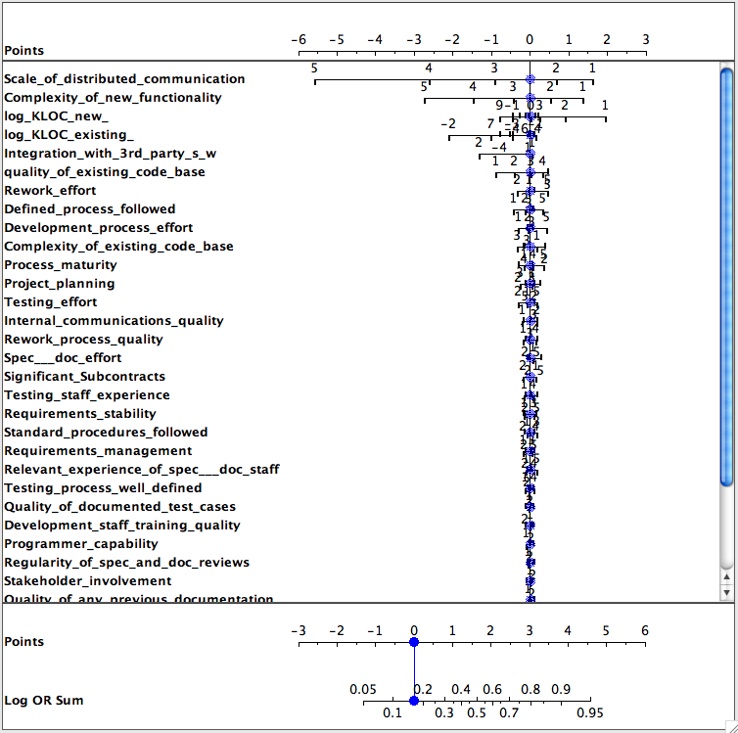
By Why
Prune?
Give classes x,y
  Fx, Fy
    frequency of discretized ranges in x,y
  Log Odds Ratio
    log(Fx/Fy )
    Is zero if no difference in x,y
E.g. Data from Norman Fenton’s Bayes nets discussing software defects = yes, no
Most variables do not contribute to determination of defects

Slide 85
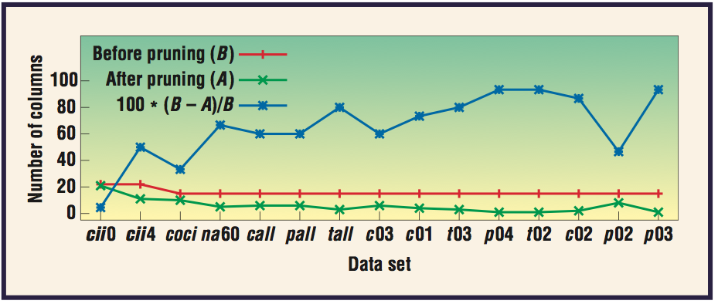
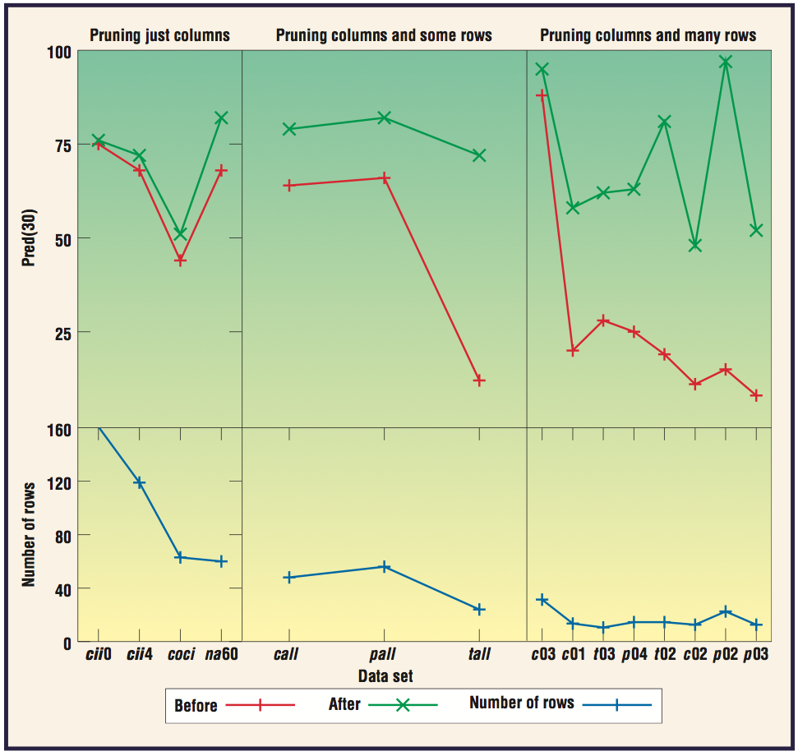
But Why
Prune? (again)
X = f (a,b,c,..)
X’s variance comes
from a,b,c
If less a,b,c
  then less confusion
  about X
E.g effort estimation
Pred(30) = %estimates within 30% of actual
Zhihao Chen, Tim Menzies, Daniel Port, Barry Boehm, Finding the Right Data for Software Cost Modelling, IEEE Software, Nov, 2005

Slide 86
From column pruning to row pruning
(Prune the rows in a table back to just the prototypes)
Why prune?
  Remove outliers
  And other reasons….
Column and row pruning are similar tasks
  Both change the size of cells in data
Pruning is like playing an accordion with the ranges.
  Squeezing in or wheezing out
  Makes that range cover more or less rows and/or columns
So we can use column pruning for row pruning
Q: Why is that interesting?
A: We have linear time column pruners
  So maybe we can have linear time row pruners?
U. Lipowezky. Selection of the optimal prototype subset for 1-nn classification. Pattern Recognition Letters, 19:907–918, 1998

Slide 87
Combining column and row pruning
O(N log(N) )
Collect range “power”
Pruning
Divide data with N rows into
  one region for classes x,y,etc
For each region x, of size nx
    px = nx/N
    py (of everything else) =(N-nx )/N
Let Fx and Fy be frequency of range r in (1) region x and (2) everywhere else
Do the Bayesian thing:
    a = Fx * px
    b= Fy * py
Power of range r for predicting x is:
  POW[r,x] = a²/(a+b)
Column pruning
  Sort columns by power of column (POC)
    POC = max POW value in that column
Row pruning
  Sort rows by power of row (POR)
  If row is classified as x
    POR =
    Prod( POW[r,x] for r in row )
Keep 20% most powerful
rows and columns:
  0.2 * 0.2 = 0.04
  i.e. 4% of the original data

Slide 88
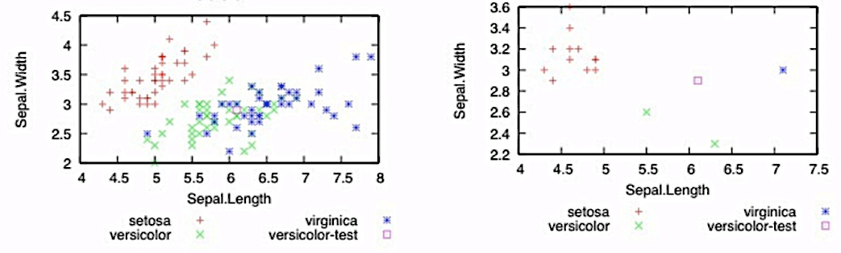
Q: What does that look like?
A: Empty out the “billard table”
This is a privacy algorithm:
  CLIFF: prune X% of rows, we are 100-X% private
  MORPH: mutate the survivors no more than half the distance to their nearest unlike neighbor
  One of the few known privacy algorithms that does not damage data mining efficacy
before
after
Fayola Peters Tim Menzies, Liang Gong, Hongyu Zhang, Balancing Privacy and Utility in Cross-Company Defect Prediction, 39(8) 1054-1068, 2013

Slide 89
Applications of row pruning
(other than outliers, privacy)
Anomaly detection
Incremental learning
Missing values
Pass around the reduced data set
“Alien”: new data is too “far away” from the reduced data
“Too far”: 10% of separation most distance pair
Pass around the reduced data set
If anomalous, add to cache
  For defect data, cache does not grow beyond 3% of total data
  (under review, ASE’14)
For effort estimation
  Reasoning by analogy on all data with missing “lines of code” measures
  Hurts estimation
But after row pruning (using a reverse nearest neighbor technique)
  Good estimates, even without size
  Why? Other features “stand in” for the missing size features
Ekrem Kocaguneli, Tim Menzies, Jairus Hihn, Byeong Ho Kang: Size doesn't matter?: on the value of software size features for effort estimation. PROMISE 2012: 89-98

Slide 90
Applications of row pruning
(other than outliers, privacy, anomaly detection, incremental learning, handling missing values)
Cross-company learning
Method #1: 2009
Cross-company learning
Method #2: 2014
First report successful SE cross-company data mining experiment
Software of whitegood’s manufacturers (Turkey) and NASA (USA)
Combine all data
  high recall, but terrible false alarms
  Relevancy filtering:
    For each test item,
    Collect 10 nearest training items
  Good recall and false alarms
So Turkish toasters can predict for NASA space systems
LACE
  Uses incremental learning approach from last slide
Learn from N software projects
  Mixtures of open+closed source projects
As you learn, play “pass the parcel”
  The cache of reduced data
Each company only adds its “aliens” to the passed cache
  Morphing as they goes
Each company has full control of privacy
Burak Turhan, Tim Menzies, Ayse Basar Bener, Justin S. Di Stefano: On the relative value of cross-company and within-company data for defect prediction. Empirical Software Engineering 14(5): 540-578 (2009)
Peters, Ph.D. thesis, WVU, September 2014, in progress.

Slide 91
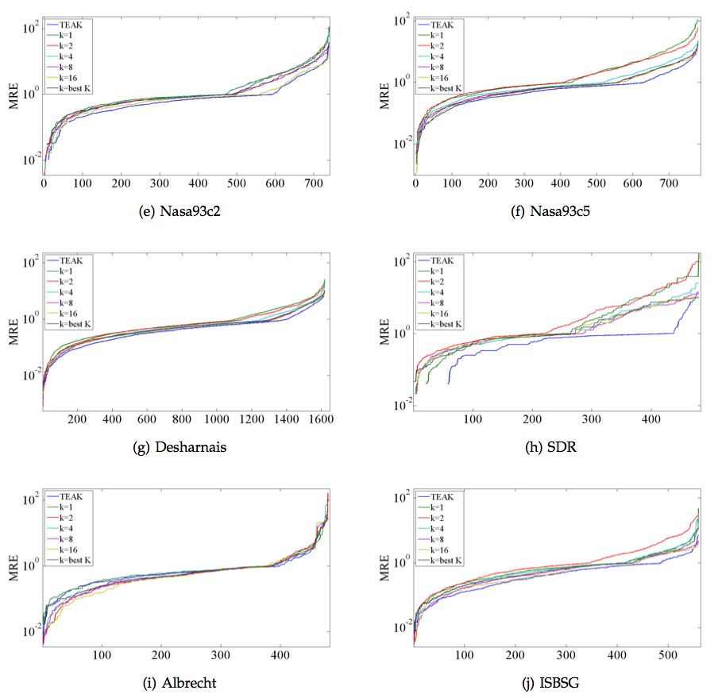
Applications of row pruning
(other than outliers, privacy, anomaly detection, incremental learning, handling missing values, cross-company learning)
Noise reduction (with TEAK)
Row pruning via “variance”
Recursively divide data
  into tree of clusters
Find variance of estimates in all sub-trees
  Prune sub-trees with high variance
  Vsub > rand() ⁹ * maxVar
Use remaining for estimation
Orders of magnitude less error
On right hand side, effort estimation
  20 repeats
  Leave-one-out
  TEAK vs k=1,2,4,8 nearest neighbor
In other results:
  better than linear regression, neural nets
Ekrem Kocaguneli, Tim Menzies, Ayse Bener, Jacky W. Keung: Exploiting the Essential Assumptions of Analogy-Based Effort Estimation. IEEE Trans. Software Eng. 38(2): 425-438 (2012)

Slide 92
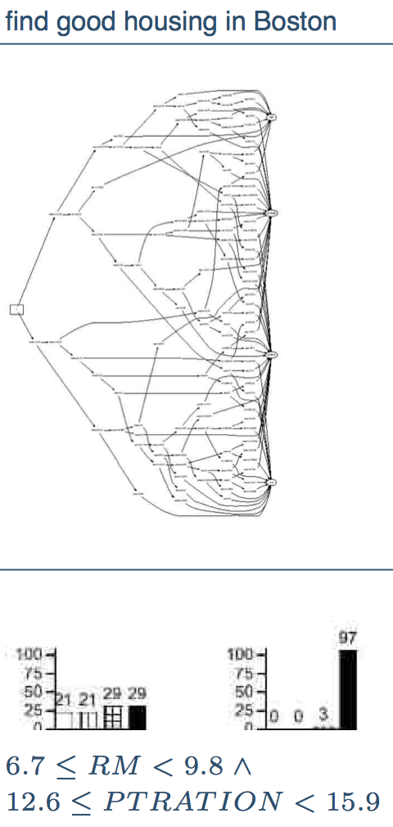
Applications of range pruning
Explanation
Generate tiny models
  Sort all ranges by their power
WHICH
  Select any pair (favoring those with most power)
  Combine pair, compute its power
  Sort back into the ranges
  Goto 1
Initially:
  stack contains single ranges
Subsequently
  stack sets of ranges
Decision tree
learning on
14 features
WHICH
Tim Menzies, Zach Milton, Burak Turhan, Bojan Cukic, Yue Jiang, Ayse Basar Bener: Defect prediction from static code features: current results, limitations, new approaches. Autom. Softw. Eng. 17(4): 375-407 (2010)

Slide 93

Explanation is easier since we are
explorer smaller parts of the data
So would inference also be faster?

Slide 94

Applications of range pruning
Optimization (eg1):
Learning defect predictors
Optimization (eg2):
Reasoning via analogy
If just explore the ranges that survive row and column pruning
Then is inference is faster
E.g. how long between WHICH’s search of the ranges stops finding better ranges?
Any nearest neighbor method runs faster
with row/column pruning
Fewer rows to search
Fewer columns to compare
Optimization (eg3):
Learning software policies to control hardware
Model-based SE
Learning software policies to control hardware
Method1: an earlier version of WHICH
Method2: standard optimizers
Runtimes, Method1/Method2
  for three different NASA problems:
  Method1 is 310, 46, 33 times faster
Tim Menzies, Zach Milton, Burak Turhan, Bojan Cukic, Yue Jiang, Ayse Basar Bener: Defect prediction from static code features: current results, limitations, new approaches. Autom. Softw. Eng. 17(4): 375-407 (2010)
Gregory Gay, Tim Menzies, Misty Davies, Karen Gundy-Burlet: Automatically finding the control variables for complex system behavior. Autom. Softw. Eng. 17(4): 439-468 (2010)

Slide 95
The uncarved block
Michelangelo
Someone else
Every block of stone has a statue inside it and it is the task of the sculptor to discover it.
Every Some stone databases have statue models inside and it is the task of the sculptor data scientist to go look.

Slide 96
Carving = Pruning =
A very good thing to do
Column
pruning
Row
pruning
Range
pruning
irrelevancy removal
better predictions
outliers,
privacy,
anomaly detection, incremental learning,
handling missing values,
cross-company learning
noise reduction
explanation
optimization

Slide 97
Roadmap
0) In a nutshell [9:00]
(Menzies + Zimmermann)
1) Organization Issues: [9:15]
(Menzies)
Rule #1: Talk to the users
Rule #2: Know your domain
Rule #3: Suspect your data
Rule #4: Data science is cyclic
2) Qualitative methods [9:45]
(Bird + Zimmermann)
Discovering information needs
On the role of surveys and interviews in data analysis
Break [10:30]
3) Quantitative Methods [11:00]
(Turhan)
Do we need all the data?
  row + column + range pruning
How to keep your data private
4) Open Issues, new solutions [11:45] (Minku)
Instabilities;
Envy;
Ensembles

Slide 98
Roadmap
0) In a nutshell [9:00]
(Menzies + Zimmermann)
1) Organization Issues: [9:15]
(Menzies)
Rule #1: Talk to the users
Rule #2: Know your domain
Rule #3: Suspect your data
Rule #4: Data science is cyclic
2) Qualitative methods [9:45]
(Bird + Zimmermann)
Discovering information needs
On the role of surveys and interviews in data analysis
Break [10:30]
3) Quantitative Methods [11:00]
(Turhan)
Do we need all the data?
  row + column + range pruning
How to keep your data private
4) Open Issues, new solutions [11:45] (Minku)
Instabilities;
Envy;
Ensembles

Slide 99
Conclusion Instability
There are several examples of conclusion instability in SE model studies.
Conclusion is some empirical preference relation P(M2) < P(M1).
Instability is the problem of not being able to elicit same/similar results under changing conditions.
  E.g. data set, performance measure, etc.

Slide 100
Two Examples of Conclusion Instability
Mair, C., Shepperd, M. The consistency of empirical comparisons of regression and analogy-based software project cost prediction. In: Intl. Symp. on Empirical Software Engineering, 10p., 2005.
Kitchenham, B., Mendes, E., Travassos, G.H.: Cross versus within-company cost estimation studies: A systematic review. IEEE Trans. Softw. Eng., 33(5), 316–329, 2007.
Regression vs Analogy-based SEE
  7 studies favoured regression, 4 were indifferent, and 9 favoured analogy.
Cross vs within-company SEE
  3 studies found CC = WC, 4 found CC to be worse.

Slide 101

Why does Conclusion Instability Occur?
Models and predictive performance can vary considerably depending on:
  Source data – the best model for a data set depends on this data set.
of 90 prediction systems
Menzies, T., Shepperd, M. Special Issue on Repeatable Results in Software Engineering Prediction. Empirical Software Engineering, 17(1-2):1-17, 2012.

Slide 102
Why does Conclusion Instability Occur?
Menzies, T., Shepperd, M. Special Issue on Repeatable Results in Software Engineering Prediction. Empirical Software Engineering, 17(1-2):1-17, 2012.
  Preprocessing techniques – in those 90 predictors, k-NN jumped from rank 12 to rank 62, just by switching from three bins to logging.
    Discretisation (e.g., bins)
    Feature selection (e.g., correlation-based)
    Instance selection (e.g., outliers removal)
    Handling missing data (e.g., k-NN imputation)
    Transformation of data (e.g., log)

Slide 103

Why does Conclusion Instability Occur?
  Performance measures
    MAE (depends on project size),
    MMRE (biased),
    PRED(N) (biased),
    LSD (less interpretable),
    etc.
L. Minku, X. Yao. Software Effort Estimation as a Multi-objective Learning Problem. ACM Transactions on Software Engineering and Methodology, 22(4):35, 2013.

Slide 104
Why does Conclusion Instability Occur?
  Train/test sampling
  Parameter tuning
  Etc
Menzies, T., Shepperd, M. Special Issue on Repeatable Results in Software Engineering Prediction. Empirical Software Engineering, 17(1-2):1-17, 2012.
Song, L., Minku, L. X. Yao. The Impact of Parameter Tuning on Software Effort Estimation Using Learning Machines, PROMISE, 10p., 2013.
It is important to report a detailed experimental setup in papers.

Slide 105

Concept Drift / Dataset Shift
Not only a predictor's performance can vary depending on the data set, but also the data from a company can change with time.
Notes:
Burak

Slide 106
Concept Drift / Dataset Shift
Minku, L.L., White, A.P. and Yao, X. The Impact of Diversity on On-line Ensemble Learning in the Presence of Concept Drift., IEEE Transactions on Knowledge and Data Engineering, 22(5):730-742, 2010.
Concept drift / dataset shift is a change in the underlying distribution of the problem.
  The characteristics of the data can change with time.
  Test data can be different from training data.

Slide 107
Concept Drift – Unconditional Pdf
p(X_{train}) ≠ p(X_{test})
Consider a size-based effort estimation model.
A change can influence products’ size:
  new business domains
  change in technologies
  change in development techniques
True underlying function does not necessarily change.
Size
B. Turhan, On the Dataset Shift Problem in Software Engineering Prediction Models, Empirical Software Engineering Journal, 17(1-2): 62-74, 2012.

Slide 108
Concept Drift – Posterior Probability
p(Y_{train}|X) ≠ p(Y_{test}|X)
Now, consider a defect prediction model based on kLOC.
Defect characteristics may change:
  Process improvement
  More quality assurance resources
  Increased experience over time
  New employees being hired
kLOC
B. Turhan, On the Dataset Shift Problem in Software Engineering Prediction Models, Empirical Software Engineering Journal, 17(1-2): 62-74, 2012.
Minku, L.L., White, A.P. and Yao, X. The Impact of Diversity on On-line Ensemble Learning in the Presence of Concept Drift., IEEE Transactions on Knowledge and Data Engineering, 22(5):730-742, 2010.

Slide 109
Concept Drift / Dataset Shift
Concept drifts may affect the ability of a given model to predict new instances / projects.
We need predictive models and techniques able to deal with concept drifts.

Slide 110
Roadmap
0) In a nutshell [9:00]
(Menzies + Zimmermann)
1) Organization Issues: [9:15]
(Menzies)
Rule #1: Talk to the users
Rule #2: Know your domain
Rule #3: Suspect your data
Rule #4: Data science is cyclic
2) Qualitative methods [9:45]
(Bird + Zimmermann)
Discovering information needs
On the role of surveys and interviews in data analysis
Break [10:30]
3) Quantitative Methods [11:00]
(Turhan)
Do we need all the data?
  row + column + range pruning
How to keep your data private
4) Open Issues, new solutions [11:45] (Minku)
Instabilities;
Envy;
Ensembles

Slide 111

Envy =
The WisDOM Of the COWs
Seek the fence where the grass is greener on the other side.
  Eat from there.
Cluster to find “here” and “there”.
Seek the neighboring cluster with best score.
  Learn from there.
  Test on here.

Slide 112

Hierarchical partitioning
Grow
Prune
  Use Fastmap to find an axis of large variability.
  Find an orthogonal dimension to it
Find median(x), median(y)
Recurse on four quadrants
Combine quadtree leaves
with similar densities
Score each cluster by median
score of class variable
Menzies, T., Butcher, A., Cok, D., Marcus, A., Layman, L., Shull, F., Turhan, B., Zimmermann, T. Local versus Global Lessons for Defect Prediction and Effort Estimation. IEEE Trans. On Soft. Engineering, 39(6):822-834, 2013.
Faloutsos, C., Lin, K.-I. Fastmap: A Fast Algorithm for Indexing, Data-Mining and Visualization of Traditional and Multimedia Datasets, Intl. Conf. Management of Data, p. 163-174, 1995.

Slide 113
Hierarchical partitioning
Grow
Prune
Find two orthogonal dimensions
Find median(x), median(y)
Recurse on four quadrants
Combine quadtree leaves
with similar densities
Score each cluster by median
score of class variable
This cluster envies its neighbor with better score and max
abs(score(this) - score(neighbor))
Where is grass greenest?

Slide 114
  Learning via “envy”
Use some learning algorithm to learn rules from neighboring clusters where the grass is greenest.
  This study uses WHICH
    Customizable scoring operator
    Faster termination
    Generates very small rules (good for explanation)
    If Rk then prediction
Apply rules.
Menzies, T., Butcher, A., Cok, D., Marcus, A., Layman, L., Shull, F., Turhan, B., Zimmermann, T. Local versus Global Lessons for Defect Prediction and Effort Estimation. IEEE Trans. On Soft. Engineering, 39(6):822-834, 2013.

Slide 115

By any measure,
Local BETTER THAN GLOBAL
Sample result:
  Rules to identify projects that minimise effort/defect.
    Lessons on how to reduce effort/defects.
Lower median efforts/defects (50th percentile)
Greater stability (75th – 25th percentile)
Decreased worst case (100th percentile)

Slide 116

Rules learned in each cluster
What works best “here” does not work “there”
  Misguided to try and tame conclusion instability
  Inherent in the data
Can’t tame conclusion instability.
  Instead, you can exploit it
  Learn local lessons that do better than overly generalized global theories

Slide 117
Roadmap
0) In a nutshell [9:00]
(Menzies + Zimmermann)
1) Organization Issues: [9:15]
(Menzies)
Rule #1: Talk to the users
Rule #2: Know your domain
Rule #3: Suspect your data
Rule #4: Data science is cyclic
2) Qualitative methods [9:45]
(Bird + Zimmermann)
Discovering information needs
On the role of surveys and interviews in data analysis
Break [10:30]
3) Quantitative Methods [11:00]
(Turhan)
Do we need all the data?
  row + column + range pruning
How to keep your data private
4) Open Issues, new solutions [11:45] (Minku)
Instabilities;
Envy;
Ensembles

Slide 118
Ensembles of Learning Machines
Sets of learning machines grouped together.
Aim: to improve predictive performance.
B1
B2
BN
...
Base learners
estimation1
estimation2
estimationN
E.g.: ensemble estimation = Σ wi estimationi
T. Dietterich. Ensemble Methods in Machine Learning. Proceedings of the First International Workshop in Multiple Classifier Systems. 2000.

Slide 119

Ensembles of Learning Machines
One of the keys:
  Diverse ensemble: “base learners” make different errors on the same instances.
G. Brown, J. Wyatt, R. Harris, X. Yao. Diversity Creation Methods: A Survey and Categorisation. Journal of Information Fusion 6(1): 5-20, 2005.

Slide 120
Ensembles of Learning Machines
One of the keys:
  Diverse ensemble: “base learners” make different errors on the same instances.
Versatile tools:
  Can be used to create solutions to different SE model problems.
Next:
  Some examples of ensembles in the context of SEE will be shown.
Different ensemble approaches can be seen as different ways to generate diversity among base learners!
G. Brown, J. Wyatt, R. Harris, X. Yao. Diversity Creation Methods: A Survey and Categorisation. Journal of Information Fusion 6(1): 5-20, 2005.

Slide 121
Creating Ensembles
Existing training data are used for creating/training the ensemble.
Ensemble
Training data
(completed projects)
training
B₁
B₂
B_{N}
...

Slide 122
Bagging Ensembles of Regression Trees
Ensemble
Training data
(completed projects)
RT1
RT2
RTN
...
Sample uniformly with replacement
L. Breiman. Bagging Predictors. Machine Learning 24(2):123-140, 1996.

Slide 123
Regression Trees
Regression trees:
  Estimation by analogy.
  Divide projects according to attribute value.
  Most impactful attributes are in higher levels.
  Attributes with insignificant impact are not used.
  E.g., REPTrees.
Functional Size
< 253
>= 253
Functional Size
Effort = 5376
< 151
>= 151
Effort = 1086
Effort = 2798
M. Hall, E. Frank, G. Holmes, B. Pfahringer, P. Reutemann, I. H. Witten.
The WEKA Data Mining Software: An Update. SIGKDD Explorations 11(1), 2009. http://www.cs.waikato.ac.nz/ml/weka.

Slide 124


WEKA
  Weka: classifiers – meta – bagging
  classifiers – trees – REPTree

Slide 125


Bagging Ensembles of Regression Trees (Bag+RTs)
  Study with 13 data sets from PROMISE and ISBSG repositories.
  Bag+RTs:
    Obtained the highest rank across data set in terms of Mean Absolute Error (MAE).
    Rarely performed considerably worse (>0.1SA, SA = 1 – MAE / MAE_{rguess}) than the best approach:
L. Minku, X. Yao. Ensembles and Locality: Insight on Improving Software Effort Estimation. Information and Software Technology, Special Issue on Best Papers from PROMISE 2011, 2012 (in press), http://dx.doi.org/10.1016/j.infsof.2012.09.012.

Slide 126
Multi-Method Ensembles
Solo-methods: preprocessing + learning algorithm
Sa
Sb
Sc
Sz
...
Rank solo-methods based on win, loss, win-loss
And sort according to losses
training
Sc
Sa
Sk
Sx
...
Select top ranked models with few rank changes
Training data
(completed projects)
Ensemble
S1
S2
SN
...
Kocaguneli, E., Menzies, T. and Keung, J. On the Value of Ensemble Effort Estimation. IEEE Transactions on Software Engineering, 8(6):1403 – 1416, 2012.

Slide 127

Multi-Method Ensembles
Experimenting with: 90 solo-methods, 20 public data sets, 7 error measures
Kocaguneli, E., Menzies, T. and Keung, J. On the Value of Ensemble Effort Estimation. IEEE Transactions on Software Engineering, 8(6):1403 – 1416, 2012.

Slide 128



Multi-Method Ensembles
1. Rank methods acc. to win, loss and win-loss values
2. δr is the max. rank change
3. Sort methods acc. to loss and observe δr values
Top 13 methods were CART & ABE methods (1NN, 5NN) using different preprocessing methods.

Slide 129


Multi-Method Ensembles
Combine top 2,4,8,13 solo-methods via mean, median and IRWM
Re-rank solo and multi-methods together
129
The first ranked multi-method had very low rank-changes.

Slide 130

Multi-objective Ensembles
There are different measures/metrics of performance for evaluating SEE models.
Different measures capture different quality features of the models.
    E.g.: MAE, standard deviation, PRED, etc.
    There is no agreed single measure.
    A model doing well for a certain measure may not do so well for another.
Multilayer Perceptron (MLP) models created using Cocomo81.

Slide 131
Multi-objective Ensembles
  We can view SEE as a multi-objective learning problem.
  A multi-objective approach (e.g. Multi-Objective Evolutionary Algorithm (MOEA)) can be used to:
    Better understand the relationship among measures.
    Create ensembles that do well for a set of measures, in particular for larger data sets (>=60).
L. Minku, X. Yao. Software Effort Estimation as a Multi-objective Learning Problem. ACM Transactions on Software Engineering and Methodology, 22(4):35, 2013.

Slide 132

Multi-objective Ensembles
Training data
(completed projects)
Multi-objective evolutionary algorithm creates nondominated models with several different trade-offs.
The model with the best performance in terms of each particular measure can be picked to form an ensemble with a good trade-off.
Ensemble
B1
B2
B3
L. Minku, X. Yao. Software Effort Estimation as a Multi-objective Learning Problem. ACM Transactions on Software Engineering and Methodology, 22(4):35, 2013.

Slide 133

Multi-Objective Ensembles
Sample result: Pareto ensemble of MLPs (ISBSG):
Important:
    Using performance measures that behave differently from each other (low correlation) provide better results than using performance measures that are highly correlated.
      More diversity.
    This can even improve results in terms of other measure not used for training.
L. Minku, X. Yao. Software Effort Estimation as a Multi-objective Learning Problem. ACM Transactions on Software Engineering and Methodology, 22(4):35, 2013.
L. Minku, X. Yao. An Analysis of Multi-objective Evolutionary Algorithms for Training Ensemble Models Based on Different Performance Measures in Software Effort Estimation. PROMISE, 10p, 2013.

Slide 134

Dynamic Adaptive Ensembles
Companies are not static entities – they can change with time (concept drift).
  Models need to learn new information and adapt to changes.
  Companies can start behaving more or less similarly to other companies.
Predicting effort for a single company from ISBSG based on its projects and other companies' projects.

Slide 135
Dynamic Adaptive Ensembles
Dynamic Cross-company Learning (DCL)*
Cross-company
Training Set 1
(completed projects)
...
Cross-company
Training Set 1
(completed projects)
CC
model m
CC
model 1
Cross-company (CC)
m training sets with
different productivity
(completed projects)
CC model 1
CC model m
...
...
w1
...
wm
w₁
w_{m}
WC
model 1
Dynamic weights control how much a certain model contributes to predictions:
  At each time step, “loser” models have weight multiplied by Beta.
Models trained with “very different” projects from the one to be predicted can be filtered out.
Within-company (WC) training data
(projects arriving with time)
w_{m+1}
L. Minku, X. Yao. Can Cross-company Data Improve Performance in Software Effort Estimation? Proceedings of the 8th International Conference on Predictive Models in Software Engineering, p. 69-78, 2012.

Slide 136


Dynamic Adaptive Ensembles
Dynamic Cross-company Learning (DCL)
  DCL uses new completed projects that arrive with time.
  DCL determines when CC data is useful.
  DCL adapts to changes by using CC data.
  DCL manages to use CC data to improve performance over WC models.
Predicting effort for a single company from ISBSG based on its projects and other companies' projects.

Slide 137
Mapping the CC Context to the WC context
L. Minku, X. Yao. How to Make Best Use of Cross-Company Data in Software Effort Estimation? ICSE 2014.
Presentation on 3rd June -- afternoon

Slide 138
Roadmap
0) In a nutshell [9:00]
(Menzies + Zimmermann)
1) Organization Issues [9:15]
(Menzies)
Rule #1: Talk to the users
Rule #2: Know your domain
Rule #3: Suspect your data
Rule #4: Data science is cyclic
2) Qualitative methods [9:45]
(Bird + Zimmermann)
Discovering information needs
On the role of surveys and interviews in data analysis
Break [10:30]
3) Quantitative Methods [11:00]
(Turhan)
Do we need all the data?
  row + column + range pruning
How to keep your data private
4) Open Issues, new solutions [11:45] (Minku)
Instabilities;
Envy;
Ensembles

Slide 139
For more…
Late 2014
Late 2015

Slide 140


End of our tale

