Slide 1
Ten (er, 12)
Years OF
SE in the USA
tim@menzies.us, LCSEE, WVU, USA

Slide 2
Background
1995: phd@ai.unsw
1998 .. 2006:
  NASA’s Software Independent V&V Lab
  SE research chair
    Evaluated &monitored research proposals/progress for the National Software Assurance Program Program
What did I learn and unlearn about SE research?
  Objects, patterns, programming languages, formal methods, data mining, teaching SE,…
  Implications for CS/SE cirriculum

Slide 3
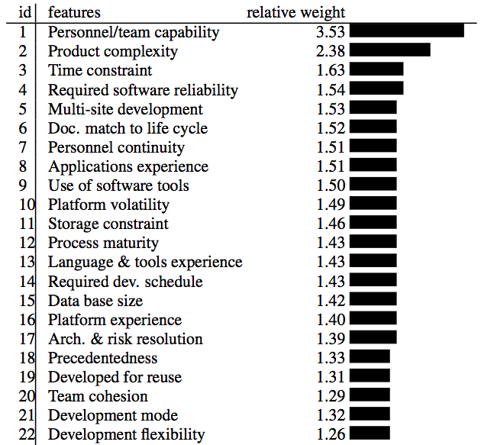
Programming languages
Before: it really matters
Now: it really doesn’t
Email from a hacker friend in a silicon valley start up
  Today was spent refactoring some RUBY…. Luckily was rescued by a PROLOG problem with came up… then back to RUBY and finally diverted by a problem with the C code.
Source: Boehm 2000. Regression results from 161 projects.

Slide 4
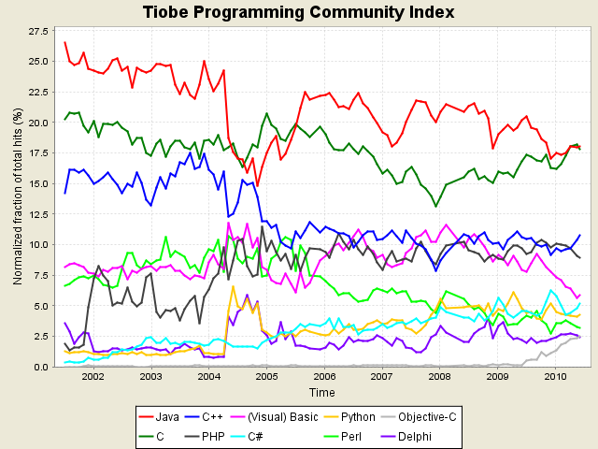
Programming languages (more)
The TIOBE index
  No majority best language
  Most popular languages on the wane
  Rising number of new languages
Email from a hacker friend in a silicon valley start up
  Today was spent refactoring some RUBY…. Luckily was rescued by a PROLOG problem with came up… then back to RUBY and finally diverted by a problem with the C code.

