Slide 1

Empirical Software Engineering, Version 2.0
Tim Menzies, WVU, USA
Forrest Shull, Fraunhofer CESE, USA
ICSE, Hawaii,
May 2011

Slide 2
Outline
Empirical SE v2.0: What is it?
EMSE 1.0 marked by:
  Case studies
  Experiments
  Literature studies
EMSE 2.0 is incorporating:
  Better pattern detection in big and rich datasets
  A recognition of value propositions
  Aggregating studies for more robust results
  Infrastructure and repositories that facilitate collaboration
A vision for where we are headed
References & resources
  Download these slides: http://tinyurl.com/emse2

Slide 3


About us
Shull:
  EIC IEEE Software
  Ed board, Journal of Emp SE
  Program Co-chair, ESEM11
  Division Director, Fraunhofer CESE
Menzies:
  Ed board, Journal of Emp SE, Automated Software Engineering
  Co-founder, PROMISE series on repeatable SE
  Program Co-chair, PROMISE’11, ASE’12
  Former research chair @ NASA
Both: curators of large repositories of SE data
  Shull, NSF-funded CeBase 2001- 2005
  Menzies, PROMISE, 2006-2011
    If you publish, offer data used in that pub
    http://promisedata.org/data

Slide 4
EMSE v2.0
What is it?

Slide 5
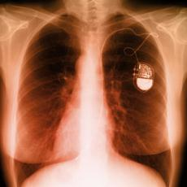
Software is everywhere
Software controls everything
  Our computers, our cars,
  our planes, our factories
  Even in pacemakers
    that control the beating of our hearts
Software engineering (SE)
  Provide engineering processes
  Which deliver artifacts of predictable quality
  Within the required time frame.
Empirical SE (EMSE)
  Strives to find the patterns of success
    And the patterns of failure
  Seen in real-world data from software projects.

Slide 6
EMSE: What is it?
Field of research that
  Focuses on using studies of all kinds to accumulate knowledge about software engineering
  Uses methods such as experiments, case studies, surveys, statistical analysis
    In short, gathering observable, empirical and measurable evidence
  Is based on applying the scientific method to software engineering
The legacy of EMSE has been to make SE more of a truly “engineering” field
  But we’re not there yet.

Slide 7
What’s the difference?
SE research v1.0
SE research v2.0
Literature reviews
  Read everyone else’s work
Case studies
  Watch, don’t touch
Experiments
  Vary a few conditions in a project
Simple analysis
  A little ANOVA, regression, maybe a t-test
Data generators
  Case studies
  Experiments
Data analysis
  10,000 of possible
  data miners
Crowd-sourcing
  10,000 of possible analysts

Slide 8
Our theme
Empirical Software Engineering 1.0 has had successes
  Important and rigorous studies
  Increasing penetration in CS research
But it has been slow
  Practices become adopted or obsolete without us
  Recent trends are exacerbating the problem
  Are we losing the chance to impact practice?
EMSE 2.0 needs to shorten the feedback loop:
  Good results
  When they can be most useful

Slide 9
EMSE version 2.0: what’s different?
I study my data | I let you study my data
I study data from other sites | They collect it; others study it

Slide 10
SE version 2.0: what’s different?
e.g. NASA’s MDP
program publishing NASA project data
Traditional
SE version 1.0
I study my data | You study my data
I study their data | We study everyone else’s data
SE version 2.0:
groups contributing data to a shared repo that others use
e.g. vendors studying
data collected from many client site
e.g. PROMISE
e.g. SIR

Slide 11
SE version 2.0: what’s different?
Traditional
SE version 1.0
I study my data | I let you study my data
I study data from other sites | They collect it; others study it
SE version 2.0

Slide 12
SE version 2.0: what’s different?
Traditional
SE version 1.0
I study my data | I let you study my data
I study data from other sites | They collect it; others study it
SE version 2.0
Conclusions
From one project

Slide 13
SE version 2.0: what’s different?
Traditional
SE version 1.0
I study my data | I let you study my data
I study data from other sites | They collect it; others study it
SE version 2.0
Conclusions
From one project
Data aggregated across multiple projects

Slide 14
SE version 2.0: what’s different?
Traditional
SE version 1.0
Crowd sourcing
I study my data | I let you study my data
I study data from other sites | They collect it; others study it
SE version 2.0
Conclusions
From one project
Data aggregated across multiple projects

Slide 15
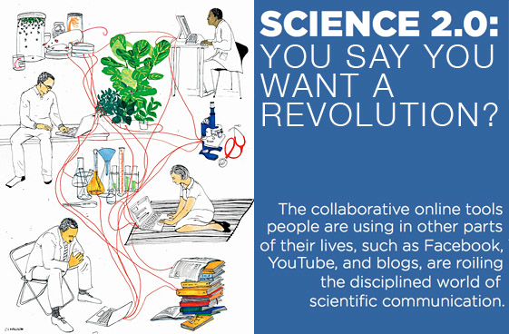
Science 2.0

Slide 16
Ben Shneiderman
Science 2.0
[Sheniderman08]:
  The growth of the World Wide Web ...
  continues to reorder whole disciplines and industries. ...
  It is time for researchers in science to take network collaboration to the next phase
    and reap the potential intellectual and societal payoffs.

Slide 17
EMSE1.0
Case Studies

Slide 18
Outline
Empirical SE v2.0: What is it?
EMSE 1.0 marked by:
  Case studies
  Experiments
  Literature studies
EMSE 2.0 is incorporating:
  Better pattern detection in big and rich datasets
  A recognition of value propositions
  Aggregating studies for more robust results
  Infrastructure and repositories that facilitate collaboration
A vision for where we are headed
References & resources
  Download these slides: http://tinyurl.com/emse2

Slide 19
Case studies
Watch, don’t touch
Observations of a working project
[Perry04]
  A defined, scientific, method for posing research questions, collecting data, analyzing the data, and presenting the results.
  Each of these steps is planned from the outset of the study and do not come about through serendipity.
    So a case study is not an “experience report”
  Case studies are well-suited to “how” and “why” questions

Slide 20
[Easterbrook07]
Exploratory case studies
  used as initial investigations of some phenomena to derive new hypotheses and build theories,
Confirmatory case studies
  used to test existing theories.
  Important for refuting theories:
  a detailed case study of a real situation in which a theory fails may be more convincing than ‘failed’ experiments in the lab.
  The detailed insights obtained from confirmatory case studies can also be useful for choosing between rival theories.

Slide 21
Case studies (assessment)
Used when researcher does not have control over variables and there is a focus on contemporary events.
The generality of conclusions from case studies needs to be carefully assessed.
Can be slow to conduct (fast pace of change in modern SE)
Also, in EMSE 2.0, no control on data collection.
  Must adjust questions to the data

Slide 22

Adjusting questions to data
The questions you
want to ask
The answers anyone else cares about
The questions the data can support (which, BTW, you won’t know till you look).
Are you here?

Slide 23
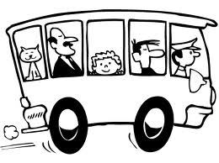
That old joke
Version 1.0
Version 2.0
One night, I meet a drunk searching the street.
”Can’t find my keys”, he said. .
"Are you sure you lost your keys here?" I asked.
"No" the drunk replies "I lost them in the alley but there's no light there."
As before, then…
  “A ha!” shouted the drunk.
  “Found the keys?” I asked
  “Better! Bus tracks to the bus stop!”
So he did not drive home drunk
Moral: its best not to give misguided people their first goals

Slide 24
EMSE1.0
Experiments

Slide 25
Outline
Empirical SE v2.0: What is it?
EMSE 1.0 marked by:
  Case studies
  Experiments
  Literature studies
EMSE 2.0 is incorporating:
  Better pattern detection in big and rich datasets
  A recognition of value propositions
  Aggregating studies for more robust results
  Infrastructure and repositories that facilitate collaboration
A vision for where we are headed
References & resources
  Download these slides: http://tinyurl.com/emse2

Slide 26
TIMM: 3 slides on experiments
Audris Mockus recent TSE paper
Forrest: what’s your best experiment on, say, inspections

Slide 27
Experiments (assessment)
Need to control
Expensive
If so controlled (e.g. uni groups) are the results representative?

Slide 28
EMSE1.0
Literature Studies

Slide 29
Outline
Empirical SE v2.0: What is it?
EMSE 1.0 marked by:
  Case studies
  Experiments
  Literature studies
EMSE 2.0 is incorporating:
  Better pattern detection in big and rich datasets
  A recognition of value propositions
  Aggregating studies for more robust results
  Infrastructure and repositories that facilitate collaboration
A vision for where we are headed
References & resources
  Download these slides: http://tinyurl.com/emse2

Slide 30
TIMM:
Structured reviews
Recent examples
Shepperd’s paper on “are they any good”
Budgen: is evidence-based SE mature enough to set practice and policy

Slide 31
EMSE 2.0 pattern detection in big and rich datasets

Slide 32
Outline
Empirical SE v2.0: What is it?
EMSE 1.0 marked by:
  Case studies
  Experiments
  Literature studies
EMSE 2.0 is incorporating:
  Better pattern detection in big and rich datasets
  A recognition of value propositions
  Aggregating studies for more robust results
  Infrastructure and repositories that facilitate collaboration
A vision for where we are headed
References & resources
  Download these slides: http://tinyurl.com/emse2

Slide 33
So many applications of data mining to SE
Process data
  Input: Developer skills, platform stability
  Output: effort estimation
  E.g. [Boehm09,Shepperd97,Koc11]
Social data
  Input: e.g. which tester do you most respect?
  Output: predictions of what bugs gets fixed first
  E.g. [Guo10]
Product data
  Input: static code descriptions
  Output: defect predictors
  E.g. [Bell07,Me07]
Trace data
  Input: what calls what?
  Output: call sequences that lead to a core dump
  E.g. [Thumm09]
Usage data
  Input: what is everyone using?
  Output: recommendations on where to browse next
  E.g. [Ado05]
Any textual form
  Input: text of any artifact
  Output: e.g. connections between concepts
  E.g. [Ma03]

Slide 34

Of course, DM gets it wrong, sometimes
Heh, nobody’s perfect
E.g. look at all the mistakes people make:
  Wikipidea: list of cognitive biases
  38 decision
  making biases
  30 biases in probability
  18 social biases
  10 memory biases
At least with DM, can repeat the analysis, audit the conclusion.
Create agent communities, each with novel insights and limitations
  Data miners working with humans
  See more together than separately
  Partnership

Slide 35
Need for adaptive agents
No general rules in SE
  Zimmermann FSE, 2009
But general methods to find the local rules
Issues:
  How quickly can we learn the local models?
  How to check when local models start failing?
  How to repair local models?
An adaptive agent watching a stream of data, learning and relearning as appropriate

Slide 36
Data Mining
PROs:
  Enables analyses to scale-up to size and speed that could never be done manually
CONs:
  Analysis without intelligence can give uninteresting, unactionable results…
  Patterns have a poor track record regarding utility outside their home context

Slide 37
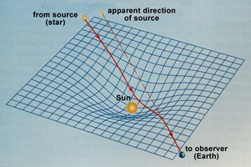
Should we use laws that we can’t explain?
Gravity
1846, rival astronomers John Adams (in England) and Urbain Leverrier (in France) raced to ﬁnd a previously unseen planet that was disturbing the orbit of Uranus.
Neptune was ﬁrst sighted by Adams, then Leverrier, after both men pointed their telescopes at the precise point in the sky indicated by Newton’s equations.
But for 100s of years, there was no explanation for gravity
Not till relativity and space-time curvature
  1600s till 1900s

Slide 38
Five types of theories
(Gregor ’06)
Lists of what is: taxonomies, ontologies
Explainers: e.g. case studies on historical data
  No test on data not used in the analysis
Predictors
  And may not don’t explain why
  (Neural nets, Naïve Bayes)
Explain & predict
    Learn a model: Decision tree learners, linear regression
    Apply the model to predict
    Browse the model to explain the predictions
Convincing models: on some domain-specific criteria
  E.g. “goto considered harmful”
Post-singularity,
expect these

Slide 39
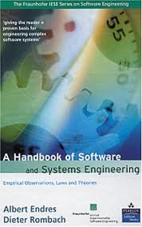
Three kinds of statements
(Endres & Rombach’03)
Observations: what you see
Laws:
  predict observation B given observation A
Theories:
  explanations of laws
Laws predict repeatable observations
Theories explain laws
Laws are either hypotheses (tentatively accepted) or conjectures (guesses)
100+ laws
  No theories

Slide 40
Research into defect prediction
Useful to (say) organize testing resources
  Assumes that you don’t have the resources to test everything 100% rigorously
If something looks like its going to be bad
  Allocate more resources to it
Method: data mining on logs of prior defects
  What predicts for defects?

Slide 41
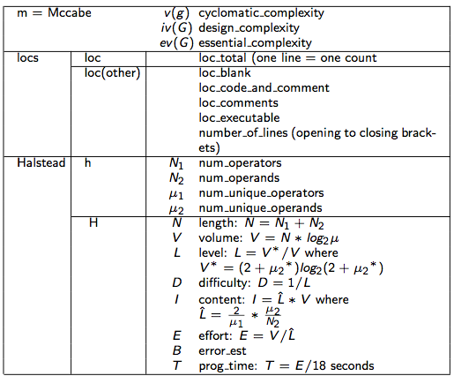
Which of these most predict for software defects?

Slide 42
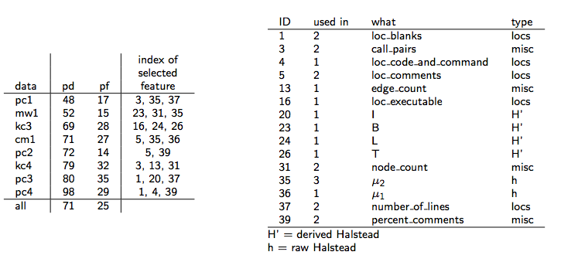
No common pattern
pd, pf = prob.detection, prob.falseAlarm
Data sets = pc1, mw1m kc3,cm1, pc2, kc4, pc4,pc4
Learner = Naïve Bayes
Attribute selection = WRAPPER

Slide 43
Managing Software Development Projects
Take a project described by
  Task complexity
  Skill of the analysts
  Schedule pressure
  Etc
Assume partial partial control of some of these features
Find changes that most
  Reduce development time
  Reduce defects
  Reduce required staff
Method: AI search algorithms
  Model-based, instance-based

Slide 44
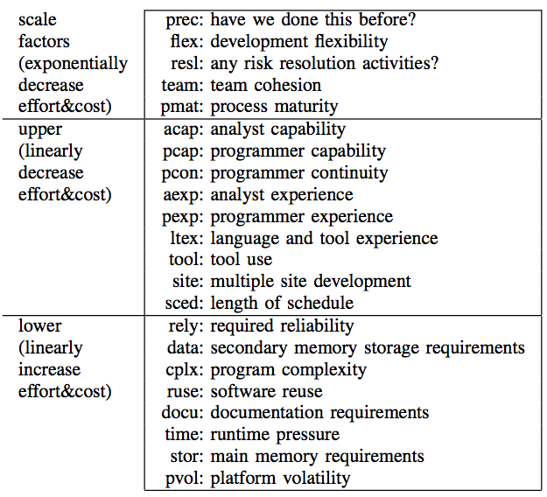
Which of these most predict for software development problems?

Slide 45
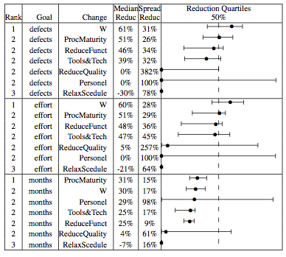
Instance-based planner to reduce defects, effort, months
NASA data
W :
  instance-based planner
Other:
  standard changes
Median = 50th %
Spread = (75-25)^{th} %
Reduction
= (init-final)/init

Slide 46
But again, no common pattern
 |  | acap | apex | ltex | ltex | plex | pmat | pmat | sced | sced | stor | time | tool | # of
cases | query | 3 | 3 | 3 | 4 | 3 | 3 | 4 | 2 | 3 | 3 | 3 | 3 | Changes
nasa93 | ground |  |  |  |  | 100% | 55% |  |  |  | 85% |  |  | 3
nasa93 | flight |  |  |  |  | 95% | 70% |  |  |  | 100% |  |  | 3
nasa93 | osp | 95% | 90% |  |  |  |  |  |  |  |  |  | 100% | 3
nasa93 | osp2 |  |  |  | 100% |  |  | 80% | 85% |  |  |  |  | 3
coc81 | flight |  |  |  |  |  | 60% |  |  |  |  | 65% |  | 2
coc81 | osp2 |  |  | 55% | 55% |  | 65% |  |  | 100% |  |  |  | 4
coc81 | ground |  |  |  |  |  | 80% |  |  |  |  | 100% |  | 2
coc81 | osp |  |  |  |  |  | 65% |  |  | 65% |  |  |  | 2
Overall: |  | 12% | 11% | 7% | 19% | 24% | 49% | 10% | 11% | 21% | 23% | 21% | 13%
20 repeats over 2:1 split to train:test
Learner = the “W” instance-based planner
Only shows ranges found in > 50% of the repeats

Slide 47
In all these SE experiments
Can generate useful predictions
  Defect prediction
  Software process planning
But no general pattern
  Performance, but no insight
  These AI tools “just” work
  And we don’t understand why

Slide 48
EMSE2.0
Value Propositions

Slide 49
Outline
Empirical SE v2.0: What is it?
EMSE 1.0 marked by:
  Case studies
  Experiments
  Literature studies
EMSE 2.0 is incorporating:
  Better pattern detection in big and rich datasets
  A recognition of value propositions
  Aggregating studies for more robust results
  Infrastructure and repositories that facilitate collaboration
A vision for where we are headed
References & resources
  Download these slides: http://tinyurl.com/emse2

Slide 50
VBSE
VBSE: Creating a decision-making framework that evaluates an objective function under a set of constraints [check Mary Shaw’s definition]
Reflects a recognition that satisfactory research solutions are driven by business context
  The “optimal” approach for a team that wants to minimize time to market and one that wants to maximize safety will look very different
VBSE provides important mechanisms to:
  Relate research results to business drivers
  Communicate results back to practitioners

Slide 51
VBSE
VBSE applies techniques from finance and economics to evaluate software engineering decisions
  Provide some examples – e.g. Decision trees?

Slide 52
VBSE
Example results [see book by Biffl et al for a good sampling]
  Boehm’s “sweet spot” analysis of how much testing is enough
  Erdogmus’ evaluation of iterative development benefits
  Mary Shaw / Shawn Butler results on security valuation

Slide 53
Related Work:
GQM+Strategies ™
Need to translate technical <-> business measures
  Sometimes, still need to overcome the “software as cost center” mentality
    Helps to compute ROI, measure how software costs affect the bottom line and provide business value (e.g. growth of users due to new functionality)
  Always, have a need to communicate how technical decisions are aligned with business goals
    E.g., “get a good project to market first” and “deliver near-perfect quality” are both viable business strategies, and have a huge impact on the technical org.
  Doing these mappings is hard!

Slide 54
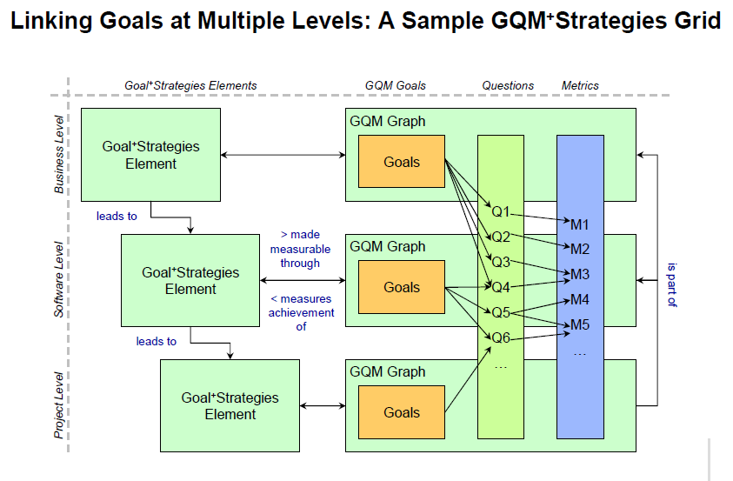
Related Work: GQM+Strategies ™

Slide 55
This is hard!

Slide 56
VBSE
PROs
  Recognition that technical decisions can’t be divorced from business context
  Recognition that there are few if any one-size-fits-all answers
CONs
  ?

Slide 57
EMSE2.0
Aggregating Across Studies

Slide 58
Approaches to Aggregating Studies
Critical mass of
quant. data
Meta-analysis
Define topic of interest
Broaden scope;
Reason about results
using vote counting
Systematic review
Some quant &
qual data
Minimal
data
Find exemplary study;
Advocate for more data

Slide 59
Systematic Review
An explicit protocol documents:
  Inclusion / exclusion criteria
  Data sources
  Data extraction
  List of pubs found
These protocols aim to address:
  Repeatability - Expandability
  Completeness - Expense
Appendices describing systematic review details for all topics discussed here
  Online at http://www.computer.org/portal/site/software/
  Click on “web extra bonus material”

Slide 60
Meta-analysis Example:
Study of pair programming, Dyba et al.
Systematic review of literature:
  15 studies over 10 years
Enough data to conduct a true meta-analysis
  Normalized according to
  (mean value for pairs – mean value for individuals) normalized by standard deviation
    0.5 => mean of the pairs is half a standard deviation larger than the mean of the individuals.
  Each study assigned a weight inversely proportional to the variance
Source: Dybå, T., Arisholm, E., Sjøberg, D. I. K., Hannay, J., and Shull, F., “Are Two Heads Better than One? On the Effectiveness of Pair Programming,” IEEE Software, vol. 24, no. 6, pp. 12-15, November/December 2007.

Slide 61
Meta-analysis example results
Effect size and 95% CI
Relative
weight
Effects on:
Quality: Agreement among studies that PP leads to a medium-sized increase in quality.
Duration: Overall, PP has a medium-sized reduction of the time to deliver the finished product, although studies are mixed.
Effort: There’s a medium-sized negative effect, shown by all but one study.
23,24
22,85
Quality
18,64
9,80
7,95
4,73
4,53
2,81
2,33
2,02
1,09
33,33
15,24
11,83
Duration
10,97
8,66
6,09
6,01
2,87
2,51
1,65
0,84
47,66
Effort
21,17
15,73
4,46
4,04
3,88
3,07
-2,00
-1,00
0,00
1,00
2,00
Favors solo programming
Favors pair programming
Source: Dybå, T., Arisholm, E., Sjøberg, D. I. K., Hannay, J., and Shull, F., “Are Two Heads Better than One? On the Effectiveness of Pair Programming,” IEEE Software, vol. 24, no. 6, pp. 12-15, November/December 2007.

Slide 62
Vote counting and manual aggregation (1)
Study of reqts elicitation techniques, Dieste et al.
Systematic review of literature, w/ quality rating of studies to remove less trustable ones.
Results:
  30 studies over 20 years of research
Data:
  A sparse matrix of
    43 different techniques
    50 variables
  Converted to a denser matrix of
    7 types of techniques (interviews, questionnaires, contrived techniques, …)
    8 types of variables (time spent, number of reqts elicited, quality of reqts, …)
Source: Dieste, O., Juristo, N., and Shull, F. “Understanding the Customer: What Do We Know about Requirements Elicitation?” IEEE Software, vol. 25, no. 2, pp. 11-13, March/April 2008.

Slide 63
Vote counting and manual aggregation (1)
Selected findings include:
  Regardless of experience, interviews with some structure are more effective than completely unstructured ones.
  Sorting techniques are less effective than interviews.
  Introspective techniques (e.g. protocol analysis) are less effective than other types.
  Interviews were not always the most efficient techniques.
  To elicit specialized types of knowledge, complement interviews with techniques that produce specialized models
Source: Dieste, O., Juristo, N., and Shull, F. “Understanding the Customer: What Do We Know about Requirements Elicitation?” IEEE Software, vol. 25, no. 2, pp. 11-13, March/April 2008.

Slide 64
Vote counting and manual aggregation (2):
Study of website trust (Miller et al.) &
Study of developer motivation (Hall et al.)
Two studies, similar in terms of methodology:
  Review literature
  Understand which studies identified the same factors as influencing the dependent variable (coding)
  Construct a model of “most influential” factors & their interactions
Study on: Trust in e-commerce sites
  114 studies found => 28 relevant
Study on: Motivation of software developers
  519 papers => 92 relevant studies

Slide 65
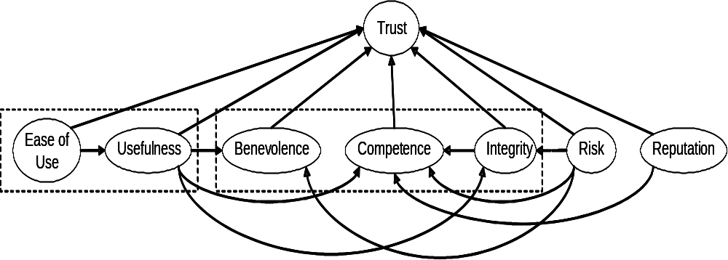
Vote counting and manual aggregation (2):
Factors in website trust
TAM
BCI

Slide 66
Vote counting and manual aggregation (2):
Factors in developer motivation

Slide 67
Dealing with a Lack of Data:
Study of MBT, Travassos et al.
Systematic review of the literature to understand the depth of evidence for one specific practice, Model-Based Testing
Results:
  202 realistic candidates => 85 relevant papers
  71 distinct approaches (!)
  Small minority of papers relied on experimentation or experience to demonstrate why the approaches were beneficial – interesting insight as to state of the practice

Slide 68
Dealing with a Lack of Data:
Study of MBT, Travassos et al.
Type of evidence | Number of papers
 | UML-based | Non-UML | Total | Percent
Speculation | 17 | 6 | 23 | 27
Example | 22 | 16 | 38 | 45
Proof of concept | 5 | 8 | 13 | 15
Experience report | 0 | 4 | 4 | 5
Experimentation | 3 | 4 | 7 | 8
Total | 47 | 38 | 85 | 100

Slide 69
Aggregating across Studies
PROs:
  Can yield more robust, more “interesting” results not tethered to a specific context
  Helps identify basic principles in SE
CONs:
  Exacerbates the problem with getting empirical results when they can most be relevant to developers
  Can take a lot of work, yet produce unclear results

Slide 70
EMSE2.0
Data & Knowledge Sharing

Slide 71
Data / Experiment Repositories
Rationale for why we would do this:
  Make the cost of replication lower – enable more data to be collected on an issue
  Provide more detail about experiment that was done – assist in better replications

Slide 72
Data / Experiment Repositories
Issues related to replications:
  Keep too much the same and you run the risk of repeating biases and errors
  Vary too much and its not clear the same issue is really being tested

Slide 73
Data / Experiment Repositories
Examples of ESE repositories
  CeBASE: Fraunhofer, UMD, USC
    Data on inspections, COTS, …
  PROMISE: WVU
    Data on defects, …
  SIR: UNL
    Data on testing…

Slide 74
Some Info on PROMISE?

Slide 75
Data / Experiment Repositories
Lessons Learned about ESE repositories
From PROMISE – It’s useful to have an annual conference to discuss.
From PROMISE – Not being hypothesis-driven is a blessing and a curse. Lowers the barrier of entry.
From PROMISE and CEBASE – The server architecture is not trivial! Survivability of the data is important. (Maybe something like Dreamweaver can do this now – Also automatically updates the links if I move the content around.)
From CEBASE – Can’t predefine context. Can’t pre-limit hypotheses.

Slide 76
Data / Experiment Repositories
PROs:
  Enable reuse and cheaper experiments => more data
  Allow studies to build upon each other’s results
  Make more and larger datasets publicly available for re-analysis
  …
CONs:
  Not free: Somebody has to maintain them. Maintenance != research

Slide 77
Future Visions:
Where does empirical SE research go next?

Slide 78
Direct Connections to Data Sources

Slide 79
Visual Wiki (“Viki”) concept

Slide 80
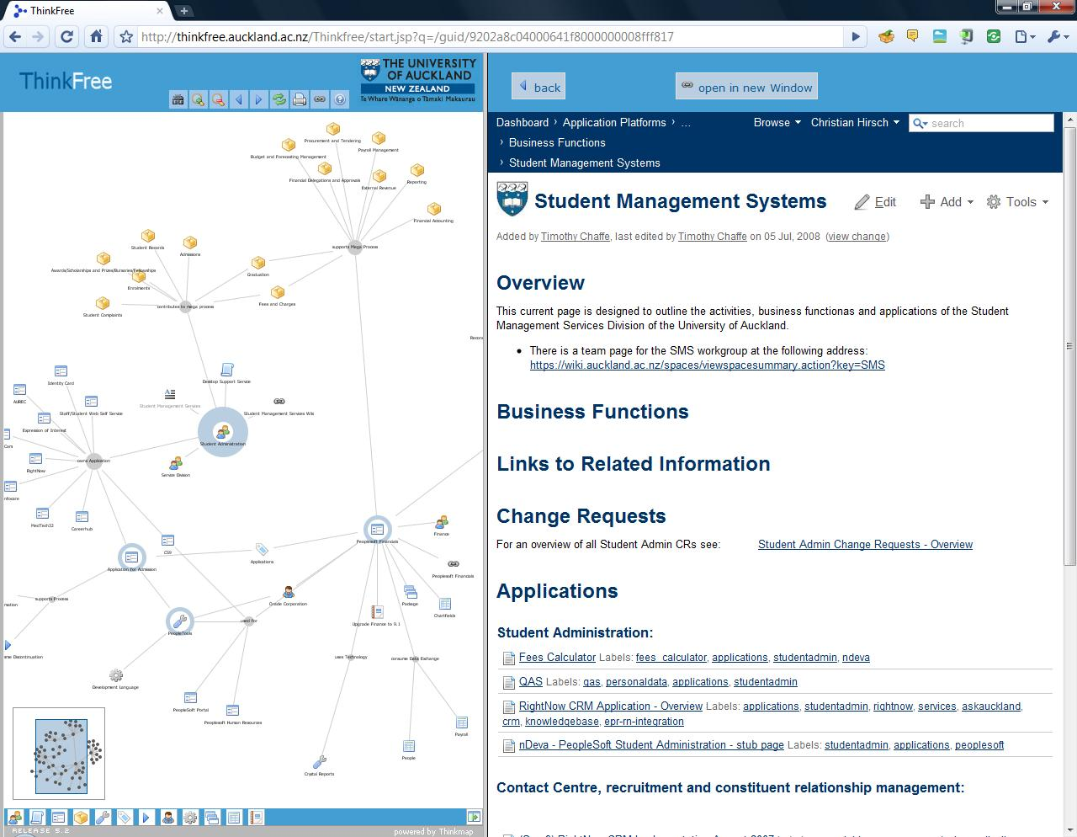
Enterprise Artifacts example
Add documents; organize; search; navigate
Edit properties, documents, add links, extract links

Slide 81
Various Vikis
Bottom left: business process descriptions

Slide 82
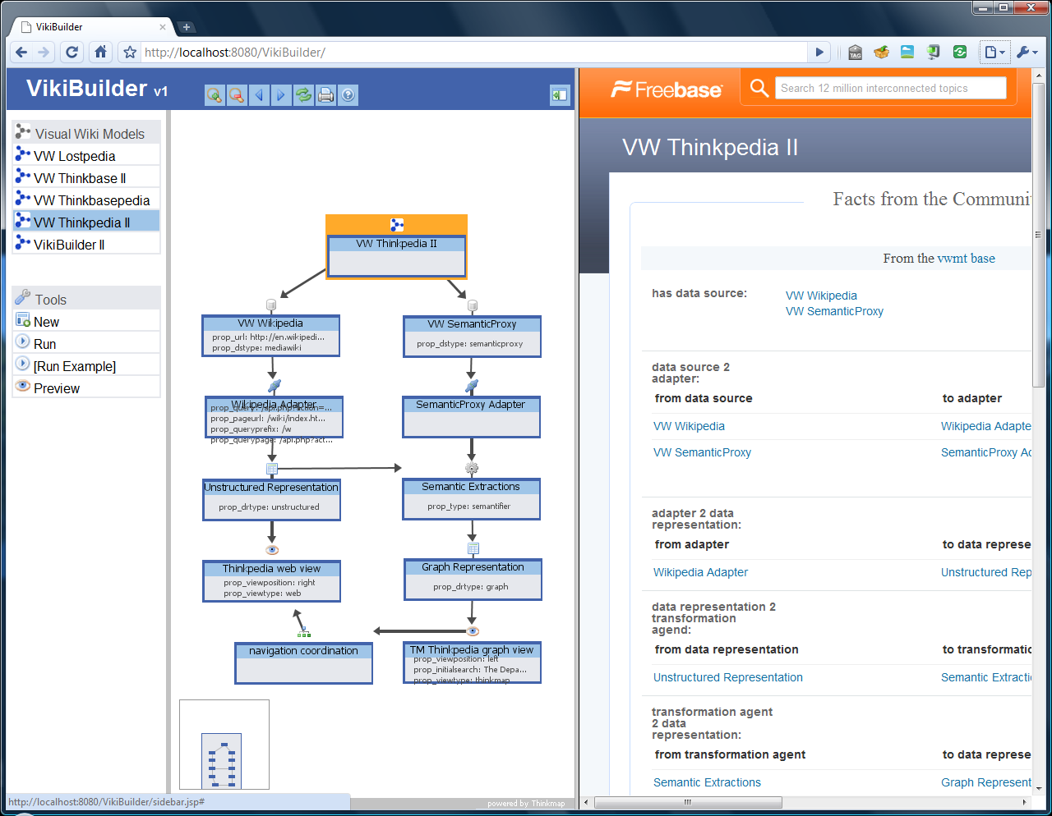
VikiBuilder – generating Vikis

Slide 83
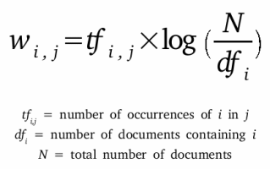
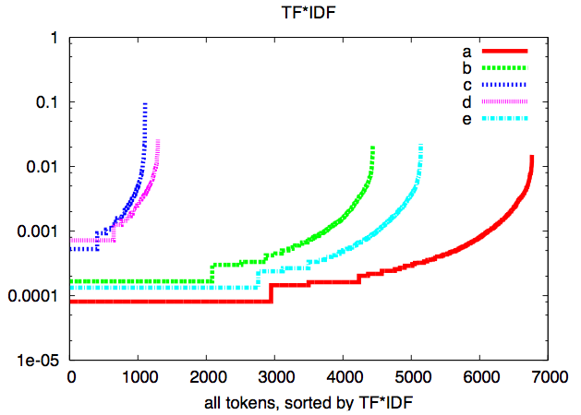
Text mining
Key issue: dimensionality reduction
In some domains, can be done in linear time
Use standard data miners, applied to top 100 terms in each corpus

Slide 84
Faster Scientific Publishing

Slide 85
“Letters,” not “Pubs”?
New publishing model we described in CRI proposal

Slide 86
Dealing with Privacy

Slide 87
Better Schemes for Privacy Protection
How to share data without giving away too much?
Talk about data mining across trusted enclaves, etc.?

Slide 88
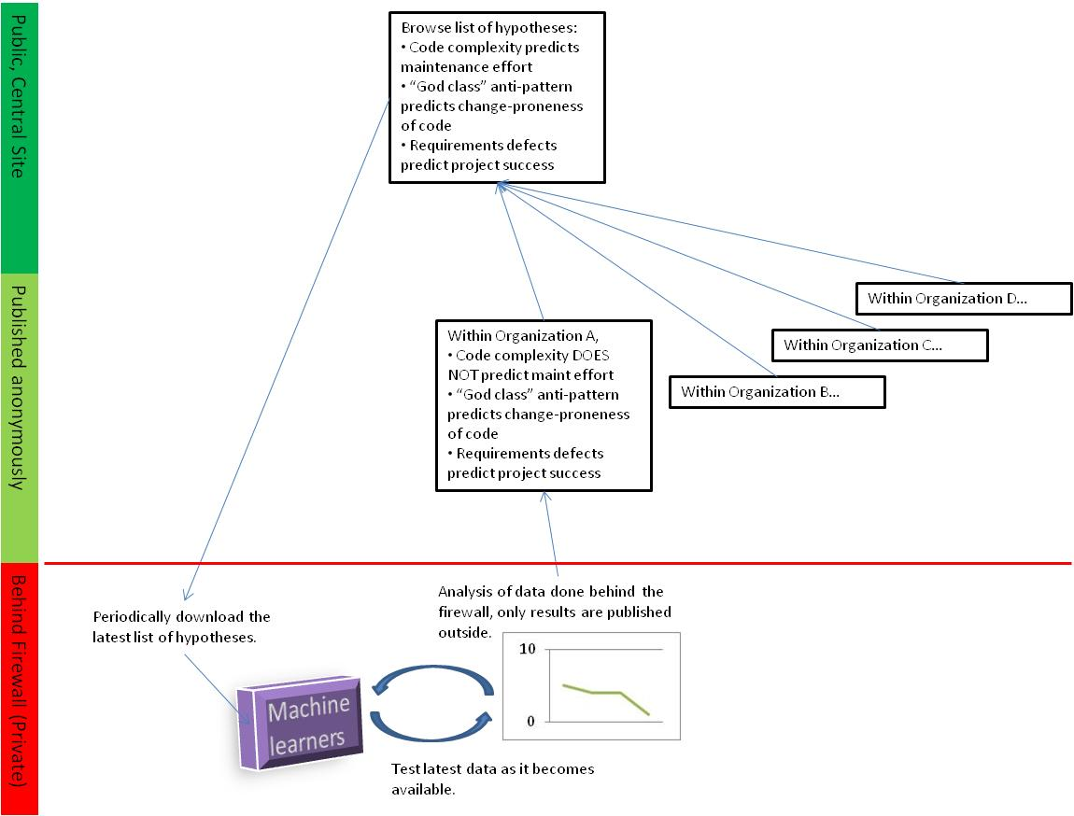
Coming Soon: PI in a Box?

Slide 89
Questions?
Comments?

Slide 90
Resources for EMSE
Claes Wohlin’s textbook
Shull, Singer, and Sjoberg
ISERN – support community; bibliography, …
EMSE Journal
ESEM

Slide 91
Details

Slide 92
Agents for adaptive business intelligence
Quality
(e.g.
PRED(30))
mode #2
mode #1
learn
mode #3
learn
break
down
break
down
learn
Data collected over time
Q1: How to learn faster?
  Technology: active learning: reflect on examples to date to ask most informative next question
Q2: How to recognize breakdown?
  Technology: bayesian anomaly detection
  Focusing on frequency counts of contrast sets

Slide 93
Agents for adaptive business intelligence
Quality
(e.g.
PRED(30))
mode #2
mode #1
learn
mode #3
learn
break
down
break
down
learn
Data collected over time
Q3: How to classify a mode?
  Recognize if you’ve arrived at a mode seen before
  Technology: Bayes classifier
Q4: How to make predictions?
  Using the norms of a mode, report expected behavior
  Technology: table look-up of data inside Bayes classifier

Slide 94
Agents for adaptive business intelligence
Quality
(e.g.
PRED(30))
mode #2
mode #1
learn
mode #3
learn
break
down
break
down
learn
Data collected over time
Q5: What went wrong? (diagnosis)
  Delta between current and prior, better, mode
Q6: What to do? (planning)
  Delta between current and other, better, mode
Technology: contrast set learning

Slide 95
Agents for adaptive business intelligence
Quality
(e.g.
PRED(30))
mode #2
mode #1
learn
mode #3
learn
break
down
break
down
learn
Data collected over time
Q7: How to understand a mode (explanation)
  Presentation of essential features of a mode
Technology: contrast set learning

Slide 96
And so…

Slide 97
We seek industrial partners
That will place textual versions of their products in a wiki
That will offer joins of those products to quality measures
That will suffer us interviewing their managers, from time to time, to learn the control points.
(Note: 1,2 can be behind your firewalls.)

Slide 98
In return, we offer
Agents for
  automatic, adaptive, business intelligence
  that tunes itself to your local domain

Slide 99
References & Resources

Slide 100
References
[Ado05]
  "Toward the Next Generation of Recommender Systems: A Survey of the State-of-the-Art and Possible Extensions". Gediminas Adomavicius and Alexander Tuzhilin. 2005. IEEE Trans. on Knowl. and Data Eng. 17, 6 (June 2005), 734-749.
[Bell06]
  “Looking for bugs in all the right places”, Robert M. Bell, Thomas J. Ostrand, Elaine J. Weyuker:. ISSTA 2006
[Boehm00]
  “Software Cost Estimation with COCOMO II” Barry W. Boehm, Chris Abts, A. Winsor Brown, Sunita Chulani, Bradford K. Clark, Ellis Horowitz, Ray Madachy, Donald J. Reifer, and Bert Steece. 2000. Prentice Hall
[Easterbrook07]
  “Selecting Empirical Methods for Software Engineering Research” Steve Easterbrook, Janice Singer, Margaret-Anne Storey, Daniela Damian, in [Shull07]
[Guo10]
  “Characterizing and predicting which bugs get ﬁxed: An empirical study of Microsoft Windows” P. J. Guo, T. Zimmermann, N. Nagappan, and M. Brendan. In Proceedings of the 32nd International Conference on Software Engineering, pages 495–504, May 2010.
[Koc11]
  "Exploiting the Essential Assumptions of Analogy-Based Effort Estimation”, Ekrem Kocaguneli, Tim Menzies, Ayse Bener, Jacky W. Keung, IEEE Transactions on Software Engineering, 2011, to appear
[Ma03]
  “Recovering documentation-to-source-code traceability links using latent semantic indexing”. Andrian Marcus and Jonathan I. Maletic. In Proceedings of the 25th International Conference on Software Engineering (ICSE '03), 2003
[Me07]
  "Data Mining Static Code Attributes to Learn Defect Predictors" by Tim Menzies and Jeremy Greenwald and Art Frank. IEEE Transactions on Software Engineering January 2007

Slide 101
References (more)
[Perry04]
  “Case Studies for Software Engineers”, Dewayne E. Perry, Susan Elliott Sim, Steve M. Easterbrook. ICSE’04 tutorial. http://goo.gl/3Iqlv
[Shepperd07]
  “Software project economics: a roadmap”. Martin Shepperd. 2007. 2007 Future of Software Engineering (FOSE '07).
[Shnediderman08]
  “Science 2.0”, Ben Shneiderman. Science, 319(7):1349–1350, March 2008
[Shull07]
  “Guide to Advanced Empirical Software Engineering” Forrest Shull, Janice Singer, Dag I.K. Sjoberg (eds),, Springer-Verlag, 2007
[Thumm09]
  Mining exception-handling rules as sequence association rules. Suresh Thummalapenta and Tao Xie. In ICSE ’09: Proceedings of the 31st International Conference on Software Engineering, pages 496– 506, Washington, DC, USA, 2009. IEEE Computer Society.

Slide 102
Resources
Download these slides from
  http://tinyurl.com/emse2

Slide 103
Extras

Slide 104
Extras

Slide 105
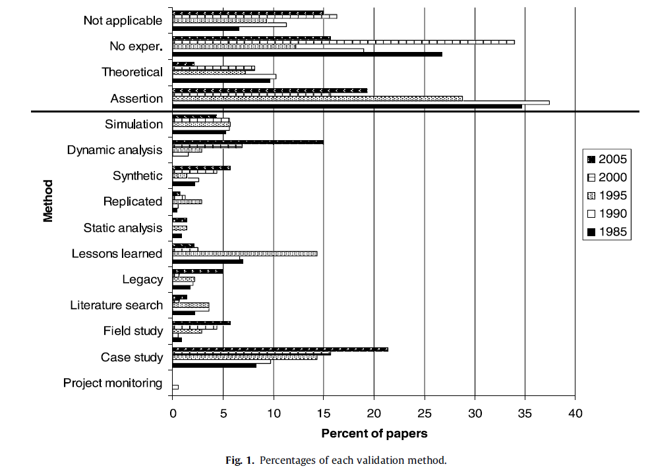
EMSE: What is it?
Source: Zelkowitz, M.V., An update to experimental models for validating computer technology, J. Syst. Software (2008), doi:10.1016/j.jss.2008.06.040

Slide 106
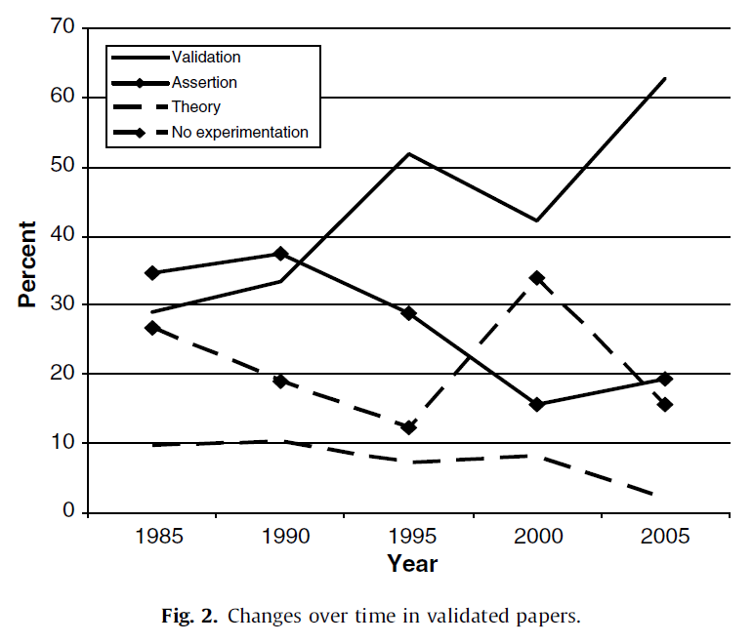
EMSE: Why Should I Care?
Zelkowitz’ data:
  Strong trend over time that an increasing % of software engineering papers have an empirical component
Source: Zelkowitz, M.V., An update to experimental models for validating computer technology, J. Syst. Software (2008), doi:10.1016/j.jss.2008.06.040

Slide 107
Agents for adaptive business intelligence
Quality
(e.g.
PRED(30))
mode #2
mode #1
learn
mode #3
learn
break
down
break
down
learn
Data collected over time

Slide 108
Agents for adaptive business intelligence
Quality
(e.g.
PRED(30))
mode #2
mode #1
learn
mode #3
learn
break
down
break
down
learn
Data collected over time
What is different here?
  Not “apply data mining to build a predictor”
  But add monitor and repair tools to recognize and handle the breakdown of old predictors
  Trust = data mining + monitor + repair

Slide 109
If crowd sourcing
Quality
(e.g.
PRED(30))
mode #2
mode #1
Company#1
mode #3
Quality
(e.g.
PRED(30))
mode #5
Company #2
mode #4
mode #6
Quality
(e.g.
PRED(30))
mode #8
mode #7
Company #3
mode #9
With DM, we could recognize that e.g. 1=4=7
i.e. when some “new” situation has happened before
So we’d know what experience base to exploit

Slide 110
Research Questions.
How to handle….
Anonymization
  Make data public, without revealing private data
Volume of data
  Especially if working from “raw” project artifacts
  Especially if crowd sourcing
Explanation : of complex patterns
Noise: from dad data collection
Mode recognition
  Is when new is stuff is new, or a a repeat of old stuff
Trust : you did not collect the data
  Must surround the learners with assessment agents
    Anomaly detectors
    Repair

Slide 111
Prototypes
Bits and pieces

Slide 112
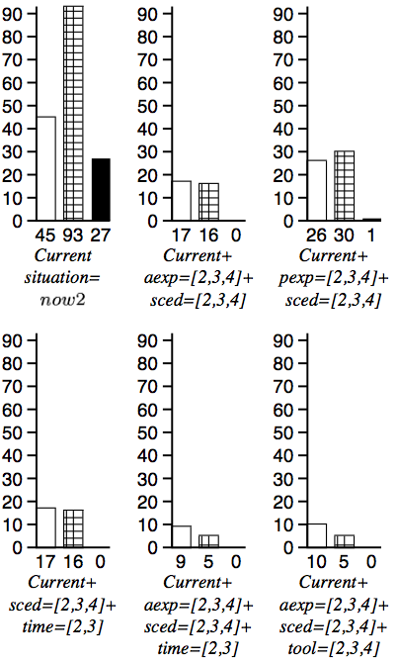
Contrast set learning
Minimal contrast set learning = diagnosis &planning
A decision tree with weighted leaves
  Treatment = decisions that prune branches
    Culls bad weights
    Keeps good weights
E.g. Simulator + C4.5 + 10-way
  10 * 1000 node trees
  TAR1: tiny rules: decision on 4 ranges
Why so small?
  Higher decisions prune more branches
    touch fewer nodes

Slide 113
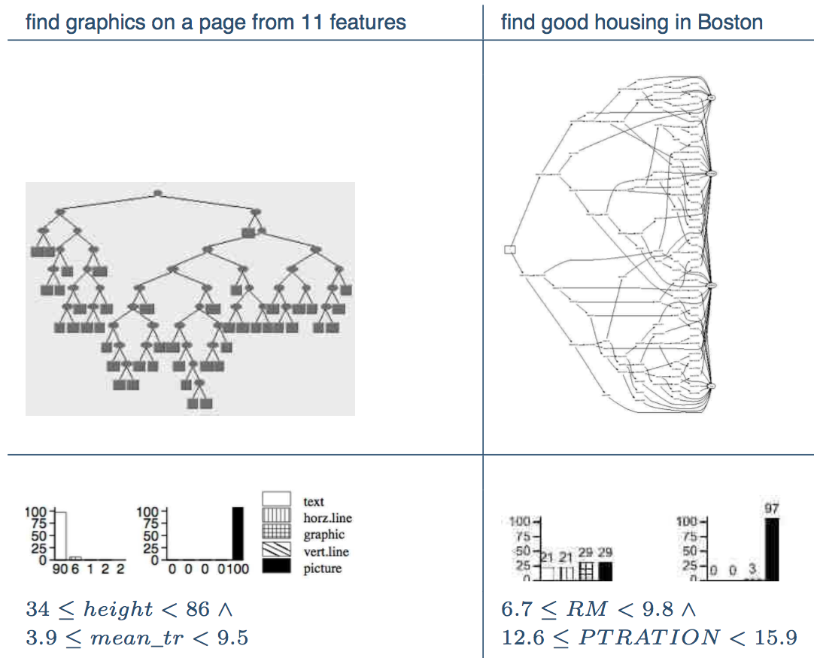
Contrast Set Learning ➔
Succinct Explanations

Slide 114
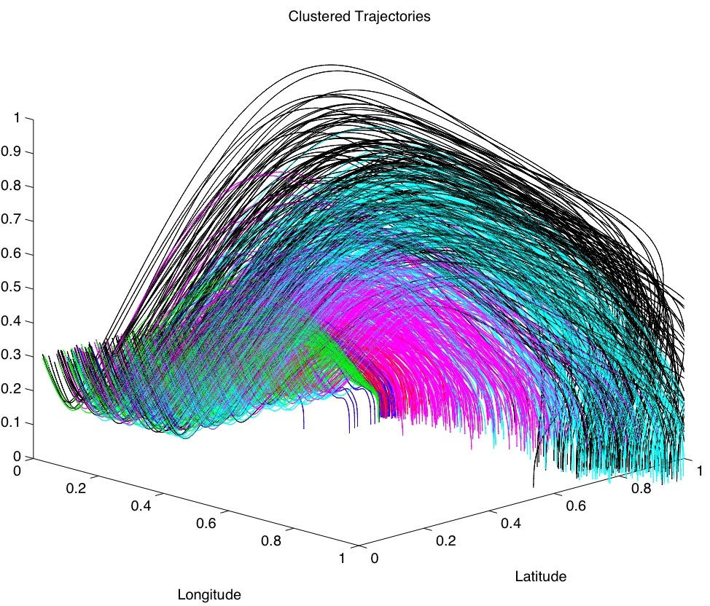
Contrast Set Learning
(10 years later)
No longer a post-processor to a decision tree learner
  TAR3: Branch pruning operators applied directly to discretized data
Summer’09
  Shoot ‘em up at NASA AMES
  State-of-the-art numerical optimizer
  TAR3
    Ran 40 times faster
    Generated better solutions
Powerful succinct explanation tool

Slide 115
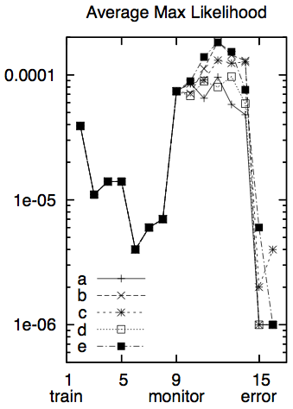
Contrast Set Learning ➔ Anomaly Detection
Recognize when old ideas
are now out-dated
SAWTOOTH:
  read data in “eras” of 100 instances
  Classify all examples as “seen it”
SAWTOOTH1:
  Report average likelihood of examples belong to “seen it”
  Alert if that likelihood drops
SAWTOOTH2:
  Back-end to TAR3
  Track frequency of contrast sets
  Some uniformity between contrast sets and anomaly detection

Slide 116
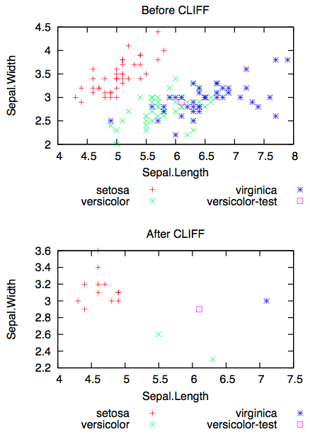
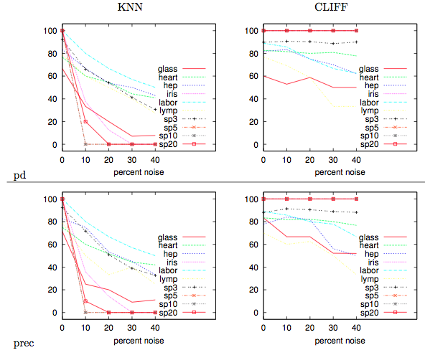
Contrast sets ➔ noise management
CLIFF: post-processor to TAR3
  Linear time instance selector
Finds the attribute ranges that change classification
Delete all instances that lack the “power ranges”

Slide 117
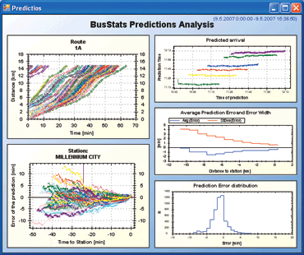


The (Industrial) State of the Art
If data collected, then usually forgotten
Dashboards : visualizations for feature
extraction; intelligence left the user
MapReduce, Hadoop et. al : systems
support for massive, parallel execution.
  http://hadoop.apache.org
  Implements the bus, but no bus drivers
Many SE data mining publications
  e.g. Bird, Nagappan, Zimmermann
  and last slide
  But, no agents that recognize when
  old models are no longer relevant,
  Or to repair old models using new data

Slide 118
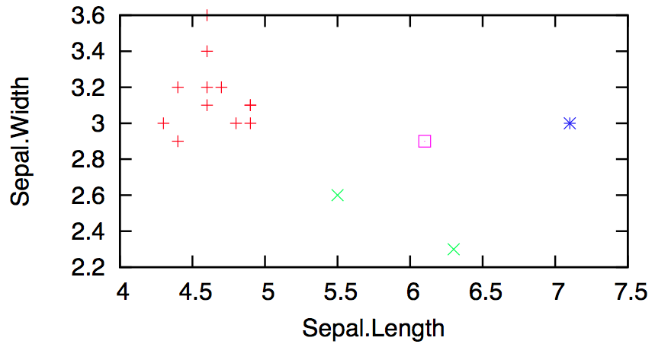
Contrast Sets ➔ CLIFF ➔
Active Learning
Many examples, too few labels
Reduce the time required for business users to offer judgment on business cases
Explore the reduced space generated by CLIFF.
    Randomly ample the instances half-way between different classes
Fast (in the reduced space)

Slide 119
Contrast sets ➔ CLIFF ➔ Statistical databases
Anonymize the data: Preserving its distributions
For KNN, that means keep the boundaries between classes
  Which we get from CLIFF
Also, CLIFF empties out the instance space
  Leaving us space to synthesize new instances

