Slide 1

Empirical Software Engineering, Version 2.0
Tim Menzies, WVU, USA
Forrest Shull, Fraunhofer CESE, USA
ICSE, Hawaii,
May 2011

Slide 2
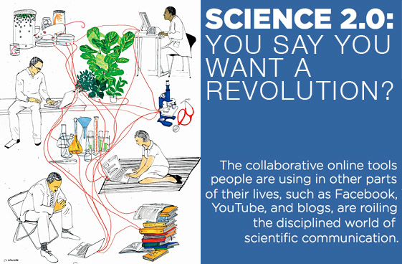
Science 2.0

Slide 3
Our theme
Empirical Software Engineering 1.0 has had successes
  Important and rigorous studies
  Increasing penetration in CS research
But it has been slow
  Practices become adopted or obsolete without us
  Recent trends are exacerbating the problem
  Are we losing the chance to impact practice?
Empirical software engineering version 2.0 needs to shorten the feedback loop:
  Good results
  When they can be most useful

Slide 4
Outline
Empirical SE v2.0: What is it?
EMSE 1.0 marked by:
  Case studies
  Experiments
  Literature studies
EMSE 2.0 is incorporating:
  Better pattern detection in big and rich datasets
  A recognition of value propositions
  Aggregating studies for more robust results
  Infrastructure and repositories that facilitate collaboration
A vision for where we are headed
References & resources
  Download these slides: http://tinyurl.com/emse2

Slide 5


About us
Shull:
  EIC IEEE Software
  Ed board, Journal of Emp SE
  Program Co-chair, ESEM11
  Division Director, Fraunhofer CESE
Menzies:
  Ed board, Journal of Emp SE, Automated Software Engineering
  Co-founder, PROMISE series on repeatable SE
  Program Co-chair, PROMISE’11, ASE’12
  Former research chair @ NASA
Both: curators of large repositories of SE data
  Shull, NSF-funded CeBase 2001- 2005
  Menzies, PROMISE, 2006-2011
    If you publish, offer data used in that pub
    http://promisedata.org/data

Slide 6
EMSE v2.0
What is it?

Slide 7
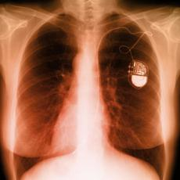
Software is everywhere
Software controls everything
  Our computers, our cars,
  our planes, our factories
  Even in pacemakers
    that control the beating of our hearts
Software engineering (SE)
  Provide engineering processes
  Which deliver artifacts of predictable quality
  Within the required time frame.
Empirical SE (EMSE)
  Strives to find the patterns of success
    And the patterns of failure
  Seen in real-world data from software projects.

Slide 8
EMSE: What is it?
Field of research that
  Focuses on using studies of all kinds to accumulate knowledge about software engineering
  Uses methods such as experiments, case studies, surveys, statistical analysis
    In short, gathering observable, empirical and measurable evidence
  Is based on applying the scientific method to software engineering
The legacy of EMSE has been to make SE more of a truly “engineering” field
  But we’re not there yet.

Slide 9
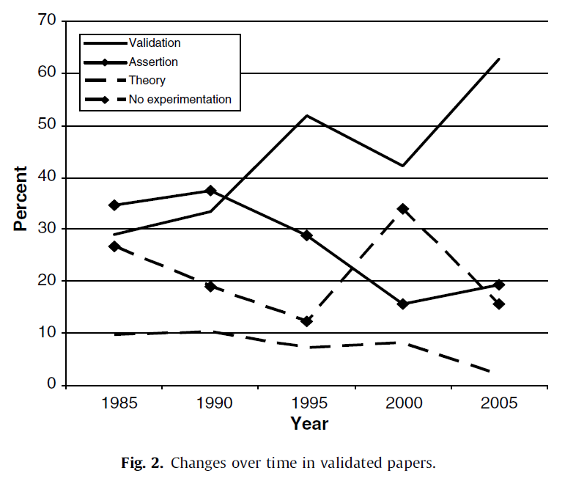
EMSE: Why Should I Care?
[Zelkowitz08]:
  Strong trend over time that an increasing % of software engineering papers have an empirical component

Slide 10
What’s the difference?
SE research v1.0
SE research v2.0
Literature reviews
  Read everyone else’s work
Case studies
  Watch, don’t touch
Experiments
  Vary a few conditions in a project
Simple analysis
  A little ANOVA, regression, maybe a t-test
Data generators
  Case studies
  Experiments
Data analysis
  10,000 of possible
  data miners
Crowd-sourcing
  10,000 of possible analysts

Slide 11
EMSE version 2.0: what’s new?
The way we get data
  More data
    Thanks you WWW
  Different kinds of data
    Text mining, program comprehension
      Structures inferred from unstructured data
Who collects the data
Who analyzes the data

Slide 12
EMSE version 2.0: what’s new?
e.g. NASA’s MDP
program publishing NASA project data
Traditional
SE version 1.0
I study my data | I let you study my data
I study data from other sites | They collect it; others study it
SE version 2.0:
groups contributing data to a shared repo that others use
e.g. vendors studying
data collected from many client site
e.g. PROMISE
e.g. SIR

Slide 13
EMSE version 2.0: what’s new?
Traditional
SE version 1.0
Crowd sourcing
I study my data | I let you study my data
I study data from other sites | They collect it; others study it
SE version 2.0
Conclusions
From one project
Data aggregated across multiple projects

Slide 14
EMSE1.0
Case Studies
Do we need both slides 19 & 20?
(Ditto for every section break.
Can we delete 19?
Tim: I actually like the section breaks.
Its very edward tufte. Cogniive map
Of the talk. The old
Franhoufer slides did something
Similar: LHS roadmap for the entire
talk

Slide 15
Outline
Empirical SE v2.0: What is it?
EMSE 1.0 marked by:
  Case studies
  Experiments
  Literature studies
EMSE 2.0 is incorporating:
  Better pattern detection in big and rich datasets
  A recognition of value propositions
  Aggregating studies for more robust results
  Infrastructure and repositories that facilitate collaboration
A vision for where we are headed
References & resources
  Download these slides: http://tinyurl.com/emse2

Slide 16
Case studies
[Easterbrook07]
Exploratory case studies
  used as initial investigations of some phenomena to derive new hypotheses and build theories,
Confirmatory case studies
  used to test existing theories.
  Important for refuting theories:
  a detailed case study of a real situation in which a theory fails may be more convincing than ‘failed’ experiments in the lab.
  The detailed insights obtained from confirmatory case studies can also be useful for choosing between rival theories.

Slide 17
Case studies (assessment)
Used when researcher does not have control over variables and there is a focus on contemporary events.
The generality of conclusions from case studies needs to be carefully assessed.
Can be slow to conduct (fast pace of change in modern SE)
Also, in EMSE 2.0, no control on data collection.
  Must adjust questions to the data

Slide 18

Adjusting questions to data
The questions you
want to ask
The answers anyone else cares about
The questions the data can support (which, BTW, you won’t know till you look).
Are you here?

Slide 19

That old joke
Version 1.0
Version 2.0
One night, I meet a drunk searching the street.
”Can’t find my keys”, he said. .
"Are you sure you lost your keys here?" I asked.
"No" the drunk replies "I lost them in the alley but there's no light there.”
Moral (v1.0):
  Pick your goals,
  Then pick your data
As before, then…
  “A ha!” shouted the drunk.
  “Found the keys?” I asked
  “Better! Tire tracks to bus stop!”
  So he did not drive home drunk
Moral (v2.0):
  Study your data,
  Then revise your goals

Slide 20
EMSE1.0
Experiments

Slide 21
Outline
Empirical SE v2.0: What is it?
EMSE 1.0 marked by:
  Case studies
  Experiments
  Literature studies
EMSE 2.0 is incorporating:
  Better pattern detection in big and rich datasets
  A recognition of value propositions
  Aggregating studies for more robust results
  Infrastructure and repositories that facilitate collaboration
A vision for where we are headed
References & resources
  Download these slides: http://tinyurl.com/emse2

Slide 22
Example Experiment
Design (from [Basili96])
Group A
Group B
Training
Training
Review (usual)
(NASA DOC A)
Review (usual)
(NASA DOC B)
T
I
M
E
Review (usual)
(GENERIC DOC A)
Review (usual)
(GENERIC DOC B)
Training (PBR)
Training (PBR)
Review (PBR)
(GENERIC DOC B)
Review (PBR)
(GENERIC DOC A)
Review (PBR)
(NASA DOC B)
Review (PBR)
(NASA DOC A)

Slide 23
Example Experiment Results (from [Basili96])
Team effectiveness results

Slide 24
Experiments (assessment)
Need to control
Expensive
If so controlled (e.g. uni groups) are the results representative?

Slide 25
EMSE1.0
Literature Studies

Slide 26
Outline
Empirical SE v2.0: What is it?
EMSE 1.0 marked by:
  Case studies
  Experiments
  Literature studies
EMSE 2.0 is incorporating:
  Better pattern detection in big and rich datasets
  A recognition of value propositions
  Aggregating studies for more robust results
  Infrastructure and repositories that facilitate collaboration
A vision for where we are headed
References & resources
  Download these slides: http://tinyurl.com/emse2

Slide 27
A Family of Studies
Can we replace the next four slides
With just one or two?
(PVB95)
SBC+
02
MDM+
05
PVB98
S03
S04
Reqts
(BGL+
96)
CDL+
97
S98
RRT00
LMC+
04
LAS+00
Des
TSFB
99
MST01
CMA+
03
SBB87
B97
LEH00b
S03
S04
BS87
Code
Other
ZBS99

Slide 28
A Family of Studies
Studies:
in industry;
in classroom.
(PVB95)
SBC+
02
MDM+
05
PVB98
S03
S04
Reqts
(BGL+
96)
CDL+
97
S98
RRT00
LMC+
04
LAS+00
Des
TSFB
99
MST01
CMA+
03
SBB87
B97
LEH00b
S03
S04
BS87
Code
Other
ZBS99

Slide 29
A Family of Studies
Empirical data helps build maturity and move into industry, e.g:
Tried/evolved in the classroom;
Shown to be feasible with industry;
Show to improve industry.
(PVB95)
SBC+
02
MDM+
05
PVB98
S03
S04
Reqts
(BGL+
96)
CDL+
97
S98
RRT00
LMC+
04
LAS+00
Des
TSFB
99
MST01
CMA+
03
SBB87
B97
LEH00b
S03
S04
BS87
Code
Other
ZBS99

Slide 30
A Family of Studies
Empirical data helps build maturity and move into industry, e.g:
Tried/evolved in the classroom;
Shown to be feasible with industry;
Show to improve industry.
(PVB95)
SBC+
02
MDM+
05
PVB98
S03
S04
Reqts
(BGL+
96)
CDL+
97
S98
RRT00
LMC+
04
LAS+00
Des
TSFB
99
MST01
CMA+
03
SBB87
B97
LEH00b
S03
S04
BS87
Code
Other
ZBS99

Slide 31
A Family of Studies
(PVB95)
SBC+
02
MDM+
05
PVB98
S03
S04
Reqts
(BGL+
96)
CDL+
97
S98
RRT00
LMC+
04
LAS+00
Des
Empirical data helps build maturity and move into industry, e.g:
Tried/evolved in the classroom;
Shown to be feasible with industry;
Show to improve industry.
TSFB
99
MST01
CMA+
03
SBB87
B97
LEH00b
S03
S04
BS87
Code
Other
ZBS99

Slide 32
Literature Reviews
(assessment)
Pro
Con
Much faster than case studies or experiments
So much research:
  Foolish to ignore it
  A fool learns from their own mistakes
  The wise learn from someone else’s
  What has been learned from all that work?
  EBSE = Evidence-based SE
      Justify current practice w.r.t. current publications
    [Budgen09]:
      They ask: “Is Evidence Based Software Engineering mature enough for Practice & Policy?”
      Their answer: no!

Slide 33
EMSE 2.0 pattern detection in big and rich datasets

Slide 34
Outline
Empirical SE v2.0: What is it?
EMSE 1.0 marked by:
  Case studies
  Experiments
  Literature studies
EMSE 2.0 is incorporating:
  Better pattern detection in big and rich datasets
  A recognition of value propositions
  Aggregating studies for more robust results
  Infrastructure and repositories that facilitate collaboration
A vision for where we are headed
References & resources
  Download these slides: http://tinyurl.com/emse2

Slide 35
Data mining
What
How, why
Diamonds in the dust
  Finding patterns in (lots of) data
Synonyms
  Machine learning
  Business intelligence
  Predictive analytics
The art of the approximate scalable analysis
  Bigger is better
Combines statistics, AI, visualization, ….
Used for… anything
  The review of current beliefs w.r.t. new data is the hallmark of human rationality.
  It is irrational NOT to data mine.

Slide 36
Some Sample Data Mining Technologies [Wu08]
Learning trees:
  C4.5 : for discrete classes
  CART: for continuous classes
Clustering:
  K-means (small),
  EM (statistical)
  canopy (large)
For complex data : SVM = support vector machines
AdaBoost:
  how to make a learner, better
Apriori
  Association rule learning
  People who buy this also buy that
Naive Bayes
  (simple, scalable)
k-th nearest neighbors
  Reasoning by analogy
  Very useful when data is sparse
And many, many others
as well

Slide 37
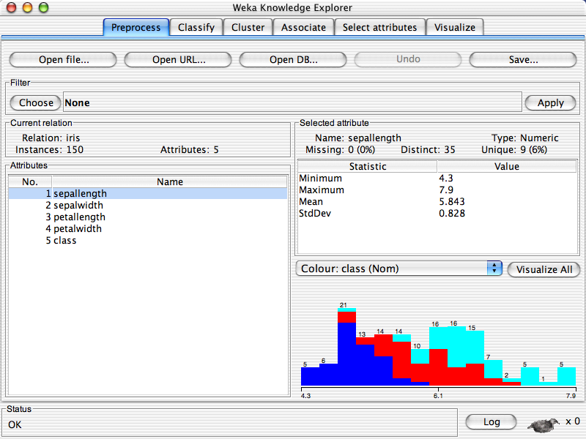
Many, many tools
“R”
RapidMiner
Orange
Matlab
(not free)
Weka ➔

Slide 38
Sample applications of Data Mining in SE
Process data
  Input: Developer skills, platform stability
  Output: effort estimation
  E.g. [Boehm09,Shepperd97,Koc11]
Social data
  Input: e.g. which tester do you most respect?
  Output: predictions of what bugs gets fixed first
  E.g. [Guo10]
Product data
  Input: static code descriptions
  Output: defect predictors
  E.g. [Bell07,Me07]
Trace data
  Input: what calls what?
  Output: call sequences that lead to a core dump
  E.g. [Thumm09]
Usage data
  Input: what is everyone using?
  Output: recommendations on where to browse next
  E.g. [Ado05]
Any textual form
  Input: text of any artifact
  Output: e.g. connections between concepts
  E.g. [Ma03]

Slide 39
Data Mining
pros
cons
Ready availability to many toolkits
Broader range of applications than traditional statistics
Enables analyses to scale-up to size and speed that could never be done manually
Analysis is now automatable, repeatable auditable
More and more university graduates trained in data mining technologies
  Requires data
    Not always available at all sites
  Analysis unguided by domain knowledge can yield results that are
      uninteresting,
      un-actionable
      Or just plain weird (alien messages)
  Conclusion instability
      Patterns have a poor track record regarding utility outside their home context

Slide 40
EMSE2.0
Value Propositions

Slide 41
Outline
Empirical SE v2.0: What is it?
EMSE 1.0 marked by:
  Case studies
  Experiments
  Literature studies
EMSE 2.0 is incorporating:
  Better pattern detection in big and rich datasets
  A recognition of value propositions
  Aggregating studies for more robust results
  Infrastructure and repositories that facilitate collaboration
A vision for where we are headed
References & resources
  Download these slides: http://tinyurl.com/emse2

Slide 42

Question: Is bias a problem?

Slide 43
Answer: perhaps not
[Boehm03] : VBSE
  Value-based software engineering
    Creating a decision-making framework that evaluates an function under a set of constraints [check Mary Shaw’s definition]
    Satisfactory research solutions driven by business context
[Basili94] : GQM
  Goal-question-metric
  Bias data collection according to overall goal of the research

Slide 44
“Values” bias the search for models
Sources of bias
Bias = good
Search bias
  Nearly infinite space of possible models
    all subsets of (all attributes * all ranges)
  Use bias to guide the search towards most effective options
Evaluation bias
  Generated models are assessed by business criteria
  Bad models do not comment on the business case
No bias?
  No way to prune possible models
No pruning?
  No summarization
No summarization?
  No model that can predict the future
So bias makes us blind
  To certain factors
  Buts lets us see (predict) the future

Slide 45
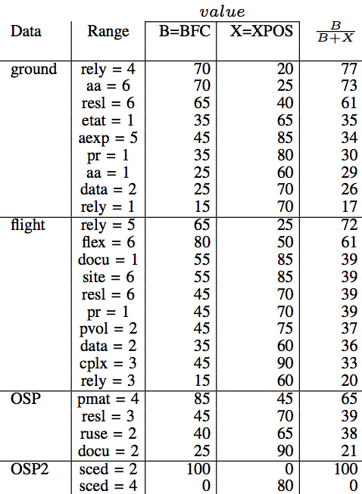
[Green09]: Effects of bias
Data miners searching for best treatments to 4 projects
  NASA ground & flight systems
  Guidance systems: OSP & OSP2
2 bias
  BFC= better faster cheaper
    Less bugs and less cost and less time
  XPOS= reduce exposure to competition
    Get it to market quickly, with not too many bugs
20 runs:
  how many times did different ranges get selected by the two biases
Results:
  Different biases = different treatments
Implications
  Can’t talk about “best” way to improve a project unless you also define “best”

Slide 46
VBSE
Pro
Cos
Recognition that technical decisions can’t be divorced from business context
Recognition that there are few if any one-size-fits-all answers
Makes analysis less general
Increases analysis work
  Must be repeated whenever the business bias (a.k.a. value proposition) is changed
Despite the cons
  There is no way to avoid understanding the local business case
  Unless you want to build models no one cares about

Slide 47
VBSE
Can we dump the next five slides?
VBSE applies techniques from finance and economics to evaluate software engineering decisions
  Provide some examples – e.g. Decision trees?

Slide 48
VBSE
Example results [see book by Biffl et al for a good sampling]
  Boehm’s “sweet spot” analysis of how much testing is enough
  Erdogmus’ evaluation of iterative development benefits
  Mary Shaw / Shawn Butler results on security valuation

Slide 49
Related Work:
GQM+Strategies ™
Need to translate technical <-> business measures
  Sometimes, still need to overcome the “software as cost center” mentality
    Helps to compute ROI, measure how software costs affect the bottom line and provide business value (e.g. growth of users due to new functionality)
  Always, have a need to communicate how technical decisions are aligned with business goals
    E.g., “get a good project to market first” and “deliver near-perfect quality” are both viable business strategies, and have a huge impact on the technical org.
  Doing these mappings is hard!

Slide 50
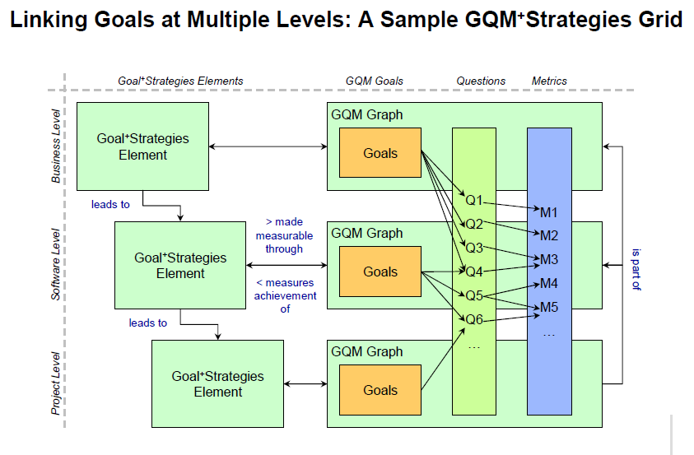
Related Work: GQM+Strategies ™

Slide 51
This is hard!

Slide 52
EMSE2.0
Aggregating Across Studies

Slide 53
Outline
Empirical SE v2.0: What is it?
EMSE 1.0 marked by:
  Case studies
  Experiments
  Literature studies
EMSE 2.0 is incorporating:
  Better pattern detection in big and rich datasets
  A recognition of value propositions
  Aggregating studies for more robust results
  Infrastructure and repositories that facilitate collaboration
A vision for where we are headed
References & resources
  Download these slides: http://tinyurl.com/emse2

Slide 54
Aggregating data from multiple studies
V1.0
V2.0
Hard, slow
Plagued by “conclusion instability”
  What works here, does not work there.
E.g. [Kitch07] (effort estimation)
E.g. [Zimmerman09] (defect prediction)
  600+ defect models built from project1,
    applied to project2
  In only 4% of those projects
    Did project1’s predictors work for project2
Better selection of training data
  Less “conclusion instability”
More data
  Easier to aggregate via “meta-studies”

Slide 55
Better selection of training data
For items in the test set
  Build a special training set, just from projects closest to the test set item
Results:
  Cross-company data works as well as local data
  [Turhan09]: defect prediction
  [Koc10, Koc11,Koc11a]: effort estimation
Implications
  Can generate estimates faster, without local data collection
  Shared repositories are useful.

Slide 56
Building Knowledge Systematically
Sorry forrest, but I just don’t believe the next 3 slides at all
Define topic
Identify search parameters
Literature survey
Interviews
Polls
Expert opinion?
Filtering
Content extraction
Forms of evidence
Sources to include
Key variables
Key measures
Find evidence
Analyze evidence
Integrate evidence
Problem 1: There are insufficient studies
available on many topics to base conclusions on only the most rigorous sources.
Problem 2: Users expecting relevant results cannot always wait until this point for all topics.
Standardize & document
Handle discrepancies
Abstract conclusions

Slide 57
Approaches to Aggregation
Critical mass of
quant. data
Meta-analysis
Define topic of interest
Broaden scope;
Reason about results
using vote counting
Systematic review
Some quant &
qual data
Minimal
data
Find exemplary study;
Advocate for more data

Slide 58
Systematic Review
An explicit protocol documents:
  Inclusion / exclusion criteria
  Data sources
  Data extraction
  List of pubs found
These protocols aim to address:
  Repeatability - Expandability
  Completeness - Expense
Appendices describing systematic review details for all topics discussed here
  Online at http://www.computer.org/portal/site/software/
  Click on “web extra bonus material”

Slide 59
Meta-analysis Example:
[Dbya07]: pair programming,
Systematic review of literature:
  15 studies over 10 years
Enough data to conduct a true meta-analysis
  Normalized according to
  (mean value for pairs – mean value for individuals) normalized by standard deviation
    0.5 => mean of the pairs is half a standard deviation larger than the mean of the individuals.
  Each study assigned a weight inversely proportional to the variance

Slide 60
Meta-analysis example results
Effect size and 95% CI
Relative
weight
Effects on:
Quality: Agreement among studies that PP leads to a medium-sized increase in quality.
Duration: Overall, PP has a medium-sized reduction of the time to deliver the finished product, although studies are mixed.
Effort: There’s a medium-sized negative effect, shown by all but one study.
23,24
22,85
Quality
18,64
9,80
7,95
4,73
4,53
2,81
2,33
2,02
1,09
33,33
15,24
11,83
Duration
10,97
8,66
6,09
6,01
2,87
2,51
1,65
0,84
47,66
Effort
21,17
15,73
4,46
4,04
3,88
3,07
-2,00
-1,00
0,00
1,00
2,00
Favors solo programming
Favors pair programming

Slide 61
Vote counting and manual aggregation (1)
Study of reqts elicitation techniques, Dieste et al.
I’d like to prune the next 6 slides. Not cause they are bad. But the main point has been made in the last 2 slides. Perhas add them as references at the end and list them back on p62?
Systematic review of literature, w/ quality rating of studies to remove less trustable ones.
Results:
  30 studies over 20 years of research
Data:
  A sparse matrix of
    43 different techniques
    50 variables
  Converted to a denser matrix of
    7 types of techniques (interviews, questionnaires, contrived techniques, …)
    8 types of variables (time spent, number of reqts elicited, quality of reqts, …)
Source: Dieste, O., Juristo, N., and Shull, F. “Understanding the Customer: What Do We Know about Requirements Elicitation?” IEEE Software, vol. 25, no. 2, pp. 11-13, March/April 2008.

Slide 62
Vote counting and manual aggregation (1)
Selected findings include:
  Regardless of experience, interviews with some structure are more effective than completely unstructured ones.
  Sorting techniques are less effective than interviews.
  Introspective techniques (e.g. protocol analysis) are less effective than other types.
  Interviews were not always the most efficient techniques.
  To elicit specialized types of knowledge, complement interviews with techniques that produce specialized models
Source: Dieste, O., Juristo, N., and Shull, F. “Understanding the Customer: What Do We Know about Requirements Elicitation?” IEEE Software, vol. 25, no. 2, pp. 11-13, March/April 2008.

Slide 63
Vote counting and manual aggregation (2):
Study of developer motivation (Hall et al.)
Methodology:
  Review literature
  Understand which studies identified the same factors as influencing the dependent variable (coding)
  Construct a model of “most influential” factors & their interactions
Study on: Trust in e-commerce sites
  114 studies found => 28 relevant
Study on: Motivation of software developers
  519 papers => 92 relevant studies

Slide 64
Vote counting and manual aggregation (2):
Factors in developer motivation

Slide 65
Dealing with a Lack of Data:
Study of MBT, Travassos et al.
Systematic review of the literature to understand the depth of evidence for one specific practice, Model-Based Testing
Results:
  202 realistic candidates => 85 relevant papers
  71 distinct approaches (!)
  Small minority of papers relied on experimentation or experience to demonstrate why the approaches were beneficial – interesting insight as to state of the practice

Slide 66
Dealing with a Lack of Data:
Study of MBT, Travassos et al.
Type of evidence | Number of papers
 | UML-based | Non-UML | Total | Percent
Speculation | 17 | 6 | 23 | 27
Example | 22 | 16 | 38 | 45
Proof of concept | 5 | 8 | 13 | 15
Experience report | 0 | 4 | 4 | 5
Experimentation | 3 | 4 | 7 | 8
Total | 47 | 38 | 85 | 100

Slide 67
Aggregating across Studies
Pro
Con
Faster predictions at a local site
  Don’t have to wait for local data collection
  Can make predictions using imported data
Can yield more robust, more “interesting” results not tethered to a specific context
Helps identify basic principles in SE (image of timm having heart attack).
  Imported data has to be pruned or weighted
  Exacerbates the problem with getting empirical results when they can most be relevant to developers
  Can take a lot of work, yet produce unclear results

Slide 68
EMSE2.0
Data & Knowledge Sharing

Slide 69
Outline
Empirical SE v2.0: What is it?
EMSE 1.0 marked by:
  Case studies
  Experiments
  Literature studies
EMSE 2.0 is incorporating:
  Better pattern detection in big and rich datasets
  A recognition of value propositions
  Aggregating studies for more robust results
  Infrastructure and repositories that facilitate collaboration
A vision for where we are headed
References & resources
  Download these slides: http://tinyurl.com/emse2

Slide 70
Data / Experiment Repositories
Rationale for why we would do this:
  Make the cost of replication lower – enable more data to be collected on an issue
  Provide more detail about experiment that was done – assist in better replications
Issues related to replications:
  Keep too much the same and you run the risk of repeating biases and errors
  Vary too much and its not clear the same issue is really being tested

Slide 71
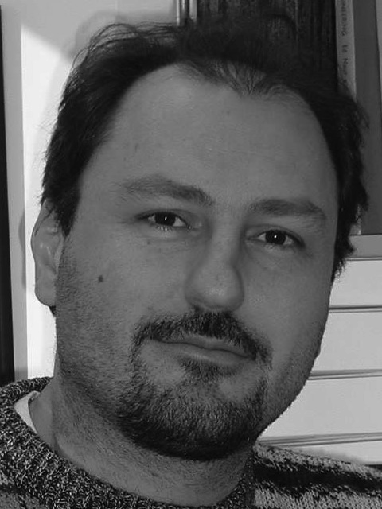
In theory: repositories won’t work
Before
Now
Why would organizations place effort into sharing data?
  What ROI?
Why would a researcher give away the core resource used in their publications?
  The data
Corporate
confidentiality
will prevent
data collection.
  Lionel Briand,
  2006, on the
  PROMISE repo
  “You will
  never get
  any data”.
Given cross-company aggregation
  We gain more together than apart
Reputations can be built in the open source data world
  E.g. everyone quotes the first paper that donates/ first analyzes the data
PROMISE repo 2011:
  140 data sets
  Terminating Ph.D. students, donating their project data

Slide 72
Data / Experiment Repositories
Examples of ESE repositories
  CeBASE: Fraunhofer, UMD, USC
    Data on inspections, COTS, …
  SIR: UNL : http://sir.unl.edu/portal/
    Software artifacts (many testing related)
  PROMISE: WVU http://promisedata.org/data

Slide 73
Repositories : lessons learned
From PROMISE :
  Need a reward structure for academics
    Annual conference, journal special issue
  Not being hypothesis-driven is a blessing and a curse.
      Lowers the barrier of entry.
      Increases the diversity of the data)
From CEBASE –
  Can’t predefine context.
  Can’t pre-limit hypotheses.
From PROMISE & CEBASE :
  server architecture is not trivial!
  Survivability of the data is important.
    CeBASE data is now lost
    (Maybe something like Dreamweaver can do this now – Also automatically updates the links if I move the content around.)

Slide 74
Data / Experiment Repositories
Pro
Com
  Enable reuse and cheaper experiments => more data
  Allow studies to build upon each other’s results
  Make more and larger datasets publicly available for re-analysis
  Not free:
    Somebody has to maintain them.
    Maintenance != research
  Need more than just a database
    Need social institutions around the data

Slide 75
Future Visions:
Where does empirical SE research go next?

Slide 76
Outline
Empirical SE v2.0: What is it?
EMSE 1.0 marked by:
  Case studies
  Experiments
  Literature studies
EMSE 2.0 is incorporating:
  Better pattern detection in big and rich datasets
  A recognition of value propositions
  Aggregating studies for more robust results
  Infrastructure and repositories that facilitate collaboration
A vision for where we are headed
References & resources
  Download these slides: http://tinyurl.com/emse2

Slide 77
How will this change SE?
Continual monitoring all artifacts associated with a project (emails, diagrams, video chats, etc etc)
  E.g. University
  of Auckland’s
  visual wikis

Slide 78
Agents for adaptive business intelligence
Quality
(e.g.
PRED(30))
mode #2
mode #1
learn
mode #3
learn
break
down
break
down
learn
Data collected over time
How to learn faster?
  Technology: active learning: reflect on examples to date to ask most informative next question
How to recognize breakdown?
  Technology: anomaly detection

Slide 79
Faster publication methods
Not 20 pages articles
  But 4 page “letters”
  For background, can refer to other papers, without including details
Review cycles in days,
  Not months
“Papers” will include executable code and data packages
  So reviewers can repeat the experiments as part of the review process

Slide 80
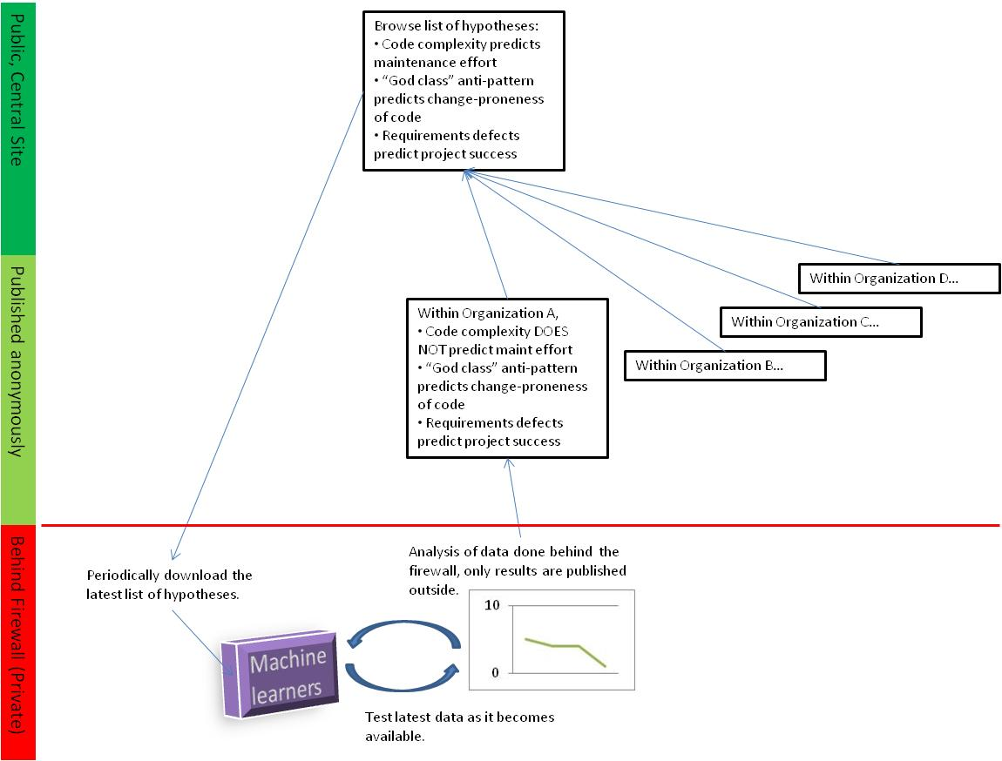
Coming Soon: PI in a Box?
This figure hard to read

Slide 81
Questions?
Comments?

Slide 82
References & Resources

Slide 83
Outline
Empirical SE v2.0: What is it?
EMSE 1.0 marked by:
  Case studies
  Experiments
  Literature studies
EMSE 2.0 is incorporating:
  Better pattern detection in big and rich datasets
  A recognition of value propositions
  Aggregating studies for more robust results
  Infrastructure and repositories that facilitate collaboration
A vision for where we are headed
References & resources
  Download these slides: http://tinyurl.com/emse2

Slide 84
References
[Ado05]
  "Toward the Next Generation of Recommender Systems: A Survey of the State-of-the-Art and Possible Extensions". Gediminas Adomavicius and Alexander Tuzhilin. 2005. IEEE Trans. on Knowl. and Data Eng. 17, 6 (June 2005), 734-749.
[Basili94]
  V. Basili, G. Caldiera, and H.D. Rombach, “Goal Question Metric Approach,” Encyclopedia of Software Engineering, pp. 528-532, John Wiley & Sons, Inc., 1994.brendan:
[Basili96]
“The empirical investigation of perspective-based reading,” Basili V. R., Green, S., Laitenberger, O., Lanubile, F., Shull, F., Sorumgaard, S., and Zelkowitz, M. V., Empirical Software Engineering: An International Journal, vol. 1, no. 2, pp. 133-164, 1996.
[Bell06]
  “Looking for bugs in all the right places”, Robert M. Bell, Thomas J. Ostrand, Elaine J. Weyuker:. ISSTA 2006
[Boehm00]
  “Software Cost Estimation with COCOMO II” Barry W. Boehm, Chris Abts, A. Winsor Brown, Sunita Chulani, Bradford K. Clark, Ellis Horowitz, Ray Madachy, Donald J. Reifer, and Bert Steece. 2000. Prentice Hall
[Boehm03]
  Barry Boehm. 2003. Value-based software engineering. SIGSOFT Softw. Eng. Notes 28, 2 (March 2003), 4-.
[Budgen09]
  B. K. D. Budgen, P. Brereton, “Is evidence based software engineering mature enough for practice & policy?” in 33rd Annual IEEE Software Engineering Workshop 2009 (SEW-33), Skvde, Sweden, 2009
[Dbya07]
  “Are Two Heads Better than One? On the Effectiveness of Pair Programming,” Dybå, T., Arisholm, E., Sjøberg, D. I. K., Hannay, J., and Shull, F., IEEE Software, vol. 24, no. 6, pp. 12-15, November/December 2007.

Slide 85
References (more)
[Easterbrook07]
  “Selecting Empirical Methods for Software Engineering Research” Steve Easterbrook, Janice Singer, Margaret-Anne Storey, Daniela Damian, in [Shull07]
[Green09]
  Understanding the Value of Software Engineering Technologies Phillip Green II, Tim Menzies, Steven Williams, Oussama El-Rawas
[Guo10]
  “Characterizing and predicting which bugs get ﬁxed: An empirical study of Microsoft Windows” P. J. Guo, T. Zimmermann, N. Nagappan, and M. Brendan. In Proceedings of the 32nd International Conference on Software Engineering, pages 495–504, May 2010.
[Kitch07]
  “ Cross versus within-company cost estimation studies: A systematic review,” B. Kitchenham, E. Mendes, and G. H. Travassos, IEEE Trans. Softw. Eng., vol. 33, no. 5, pp. 316–329, 2007
[Koc10]
  "When to Use Data from Other Projects for Effort Estimation" by Ekrem Kocaguneli and Gregory Gay and Tim Menzies and Ye Yang and Jacky W. Keung. IEEE ASE10 2010 . Available from http://menzies.us/pdf/10other.pdf
[Koc11]
  "Exploiting the Essential Assumptions of Analogy-Based Effort Estimation”, Ekrem Kocaguneli, Tim Menzies, Ayse Bener, Jacky W. Keung, IEEE Transactions on Software Engineering, 2011, to appear
[Koc11b]
  How to Find Relevant Data for Effort Estimation? Ekrem Kocaguneli, Tim Menzies, ESEM 2011

Slide 86
References (more)
[Ma03]
  “Recovering documentation-to-source-code traceability links using latent semantic indexing”. Andrian Marcus and Jonathan I. Maletic. In Proceedings of the 25th International Conference on Software Engineering (ICSE '03), 2003
[Me07]
  "Data Mining Static Code Attributes to Learn Defect Predictors" by Tim Menzies and Jeremy Greenwald and Art Frank. IEEE Transactions on Software Engineering January 2007
[Perry04]
  “Case Studies for Software Engineers”, Dewayne E. Perry, Susan Elliott Sim, Steve M. Easterbrook. ICSE’04 tutorial. http://goo.gl/3Iqlv
[Shepperd07]
  “Software project economics: a roadmap”. Martin Shepperd. 2007. 2007 Future of Software Engineering (FOSE '07).
[Shnediderman08]
  “Science 2.0”, Ben Shneiderman. Science, 319(7):1349–1350, March 2008
[Shull07]
  “Guide to Advanced Empirical Software Engineering” Forrest Shull, Janice Singer, Dag I.K. Sjoberg (eds),, Springer-Verlag, 2007
[Thumm09]
  Mining exception-handling rules as sequence association rules. Suresh Thummalapenta and Tao Xie. In ICSE ’09: Proceedings of the 31st International Conference on Software Engineering, pages 496– 506, Washington, DC, USA, 2009. IEEE Computer Society.

Slide 87
References (more)
[Wu08]
  Top 10 Algorithms in Data Mining, , Xindong Wu, Vipin Kumar, J. Ross Quinlan, Joydeep Ghosh, Qiang Yang, Hiroshi Motoda, Geoffrey J. McLachlan, Angus Ng, Bing Liu, Philip S. Yu, Zhi-Hua Zhou, Michael Steinbach, David J. Hand and Dan Steinberg, Knowledge and Information Systems, 14(2008), 1: 1-37.
[Zelkowitx08]
  “An update to experimental models for validating computer technology”, J. Syst. Software (2008), doi:10.1016/j.jss.2008.06.040
[Zimmermann09]
  “Cross-project defect prediction,” T. Zimmermann, N. Nagappan, H. Gall, E. Giger, and B. Murphy in ESEC/FSE’09, August 2009.

Slide 88
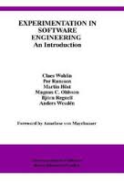

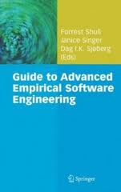
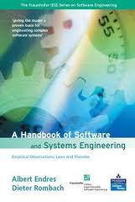
Resources for EMSE
Claes Wohlin’s textbook
Shull, Singer, and Sjoberg
ISERN – support community; bibliography, …
EMSE Journal
ESEM

