Slide 2
Extras

Slide 3
Extras

Slide 4
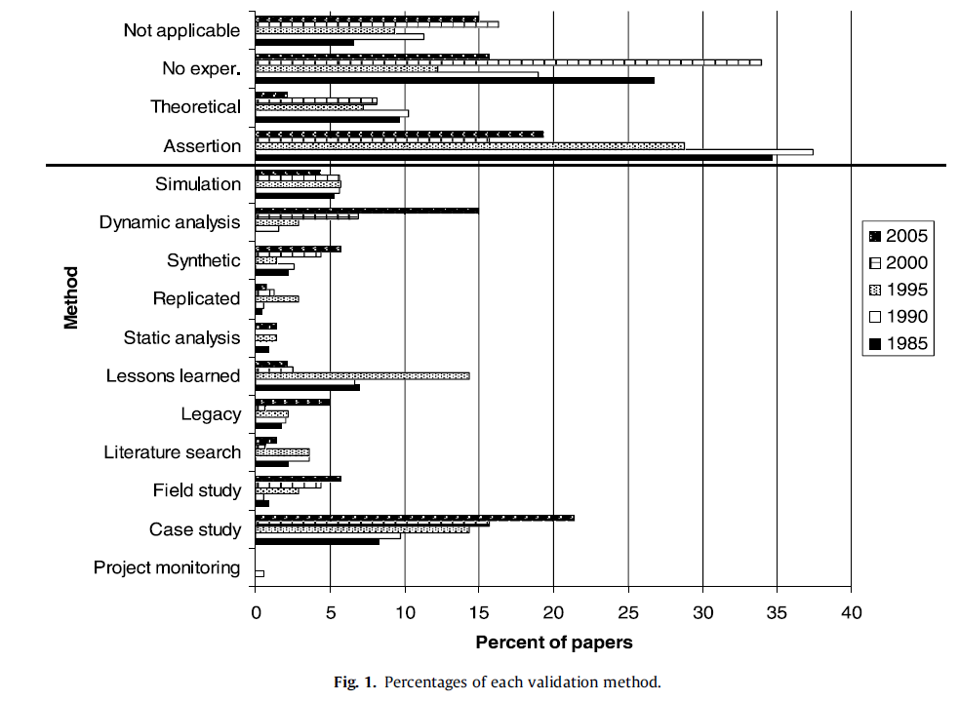
EMSE: What is it?
Source: Zelkowitz, M.V., An update to experimental models for validating computer technology, J. Syst. Software (2008), doi:10.1016/j.jss.2008.06.040

Slide 5
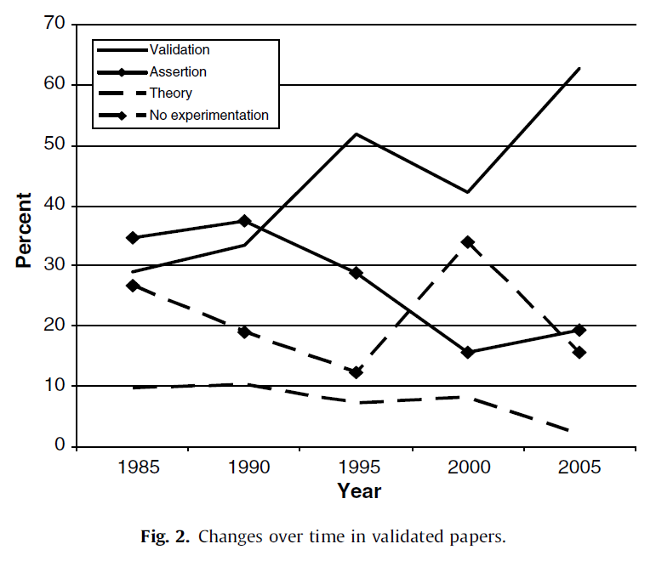
EMSE: Why Should I Care?
Zelkowitz’ data:
  Strong trend over time that an increasing % of software engineering papers have an empirical component
Source: Zelkowitz, M.V., An update to experimental models for validating computer technology, J. Syst. Software (2008), doi:10.1016/j.jss.2008.06.040

Slide 6
Agents for adaptive business intelligence
Quality
(e.g.
PRED(30))
mode #2
mode #1
learn
mode #3
learn
break
down
break
down
learn
Data collected over time

Slide 7
Agents for adaptive business intelligence
Quality
(e.g.
PRED(30))
mode #2
mode #1
learn
mode #3
learn
break
down
break
down
learn
Data collected over time
What is different here?
  Not “apply data mining to build a predictor”
  But add monitor and repair tools to recognize and handle the breakdown of old predictors
  Trust = data mining + monitor + repair

Slide 8
If crowd sourcing
Quality
(e.g.
PRED(30))
mode #2
mode #1
Company#1
mode #3
Quality
(e.g.
PRED(30))
mode #5
Company #2
mode #4
mode #6
Quality
(e.g.
PRED(30))
mode #8
mode #7
Company #3
mode #9
With DM, we could recognize that e.g. 1=4=7
i.e. when some “new” situation has happened before
So we’d know what experience base to exploit

Slide 9
Research Questions.
How to handle….
Anonymization
  Make data public, without revealing private data
Volume of data
  Especially if working from “raw” project artifacts
  Especially if crowd sourcing
Explanation : of complex patterns
Noise: from dad data collection
Mode recognition
  Is when new is stuff is new, or a a repeat of old stuff
Trust : you did not collect the data
  Must surround the learners with assessment agents
    Anomaly detectors
    Repair

Slide 10
Prototypes
Bits and pieces

Slide 11
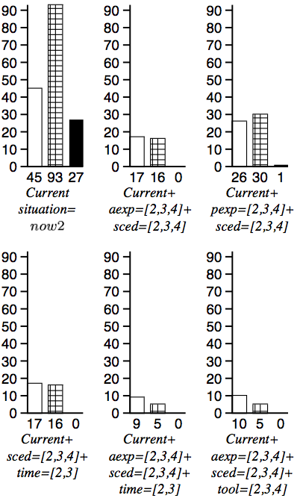
Contrast set learning
Minimal contrast set learning = diagnosis &planning
A decision tree with weighted leaves
  Treatment = decisions that prune branches
    Culls bad weights
    Keeps good weights
E.g. Simulator + C4.5 + 10-way
  10 * 1000 node trees
  TAR1: tiny rules: decision on 4 ranges
Why so small?
  Higher decisions prune more branches
    touch fewer nodes

Slide 12
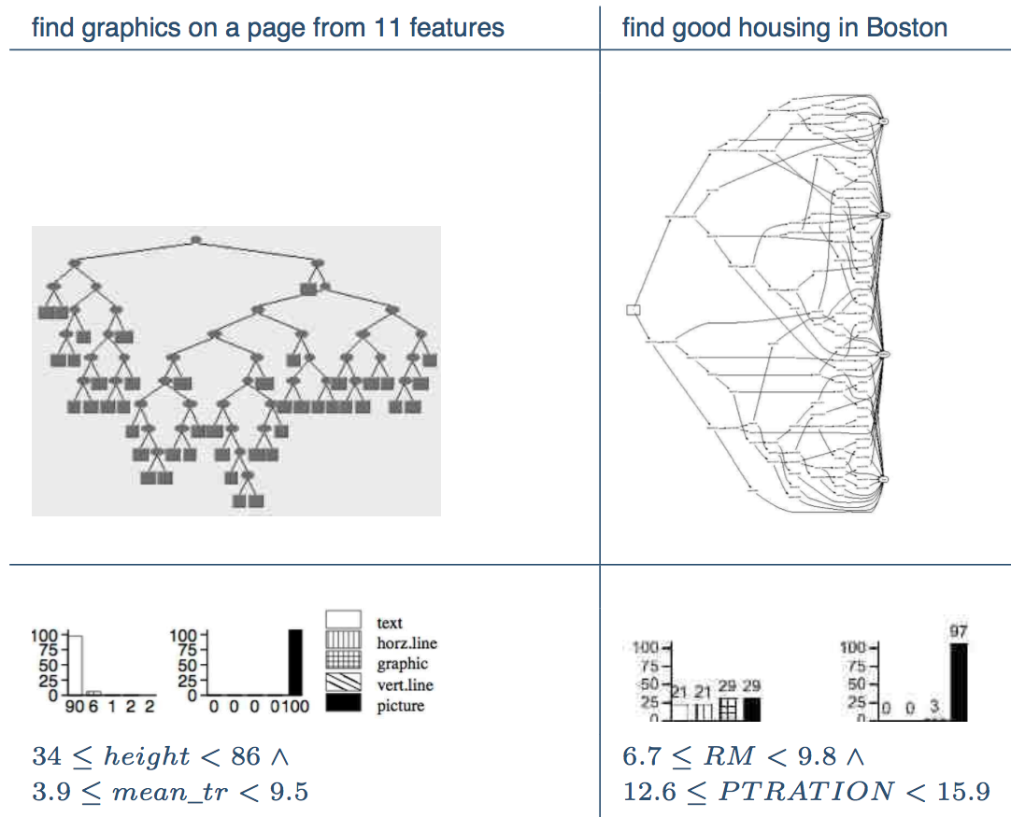
Contrast Set Learning ➔
Succinct Explanations

Slide 13
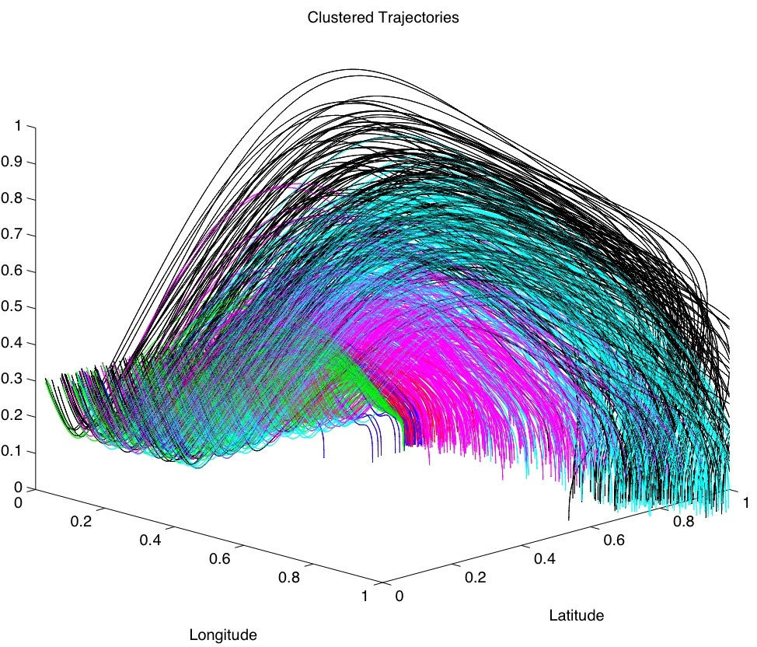
Contrast Set Learning
(10 years later)
No longer a post-processor to a decision tree learner
  TAR3: Branch pruning operators applied directly to discretized data
Summer’09
  Shoot ‘em up at NASA AMES
  State-of-the-art numerical optimizer
  TAR3
    Ran 40 times faster
    Generated better solutions
Powerful succinct explanation tool

Slide 14
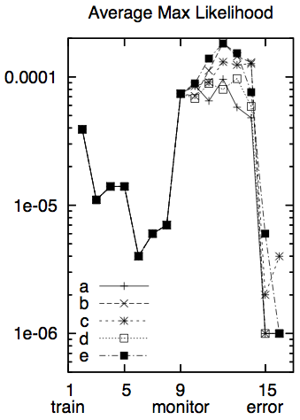
Contrast Set Learning ➔ Anomaly Detection
Recognize when old ideas
are now out-dated
SAWTOOTH:
  read data in “eras” of 100 instances
  Classify all examples as “seen it”
SAWTOOTH1:
  Report average likelihood of examples belong to “seen it”
  Alert if that likelihood drops
SAWTOOTH2:
  Back-end to TAR3
  Track frequency of contrast sets
  Some uniformity between contrast sets and anomaly detection

Slide 15
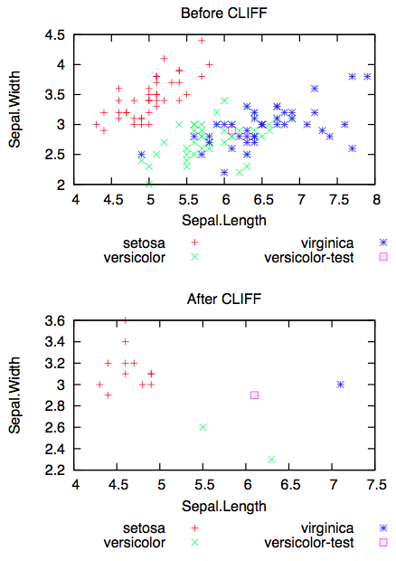
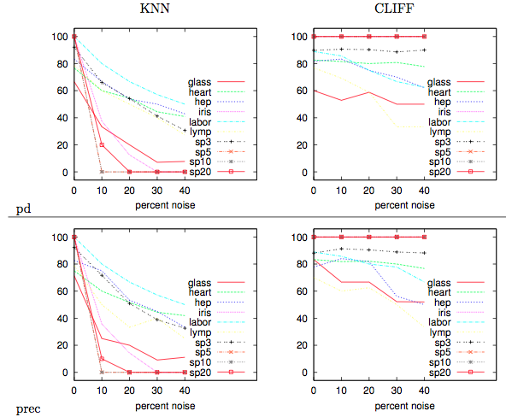
Contrast sets ➔ noise management
CLIFF: post-processor to TAR3
  Linear time instance selector
Finds the attribute ranges that change classification
Delete all instances that lack the “power ranges”

Slide 16
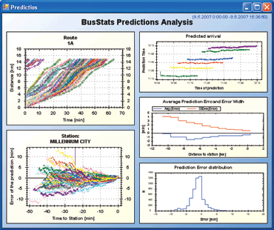


The (Industrial) State of the Art
If data collected, then usually forgotten
Dashboards : visualizations for feature
extraction; intelligence left the user
MapReduce, Hadoop et. al : systems
support for massive, parallel execution.
  http://hadoop.apache.org
  Implements the bus, but no bus drivers
Many SE data mining publications
  e.g. Bird, Nagappan, Zimmermann
  and last slide
  But, no agents that recognize when
  old models are no longer relevant,
  Or to repair old models using new data

Slide 17
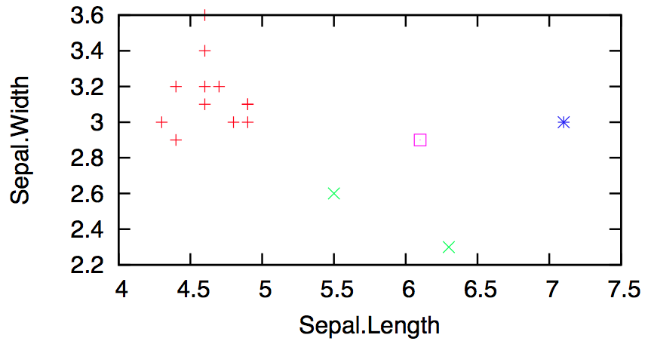
Contrast Sets ➔ CLIFF ➔
Active Learning
Many examples, too few labels
Reduce the time required for business users to offer judgment on business cases
Explore the reduced space generated by CLIFF.
    Randomly ample the instances half-way between different classes
Fast (in the reduced space)

Slide 18
Contrast sets ➔ CLIFF ➔ Statistical databases
Anonymize the data: Preserving its distributions
For KNN, that means keep the boundaries between classes
  Which we get from CLIFF
Also, CLIFF empties out the instance space
  Leaving us space to synthesize new instances

