Slide 1
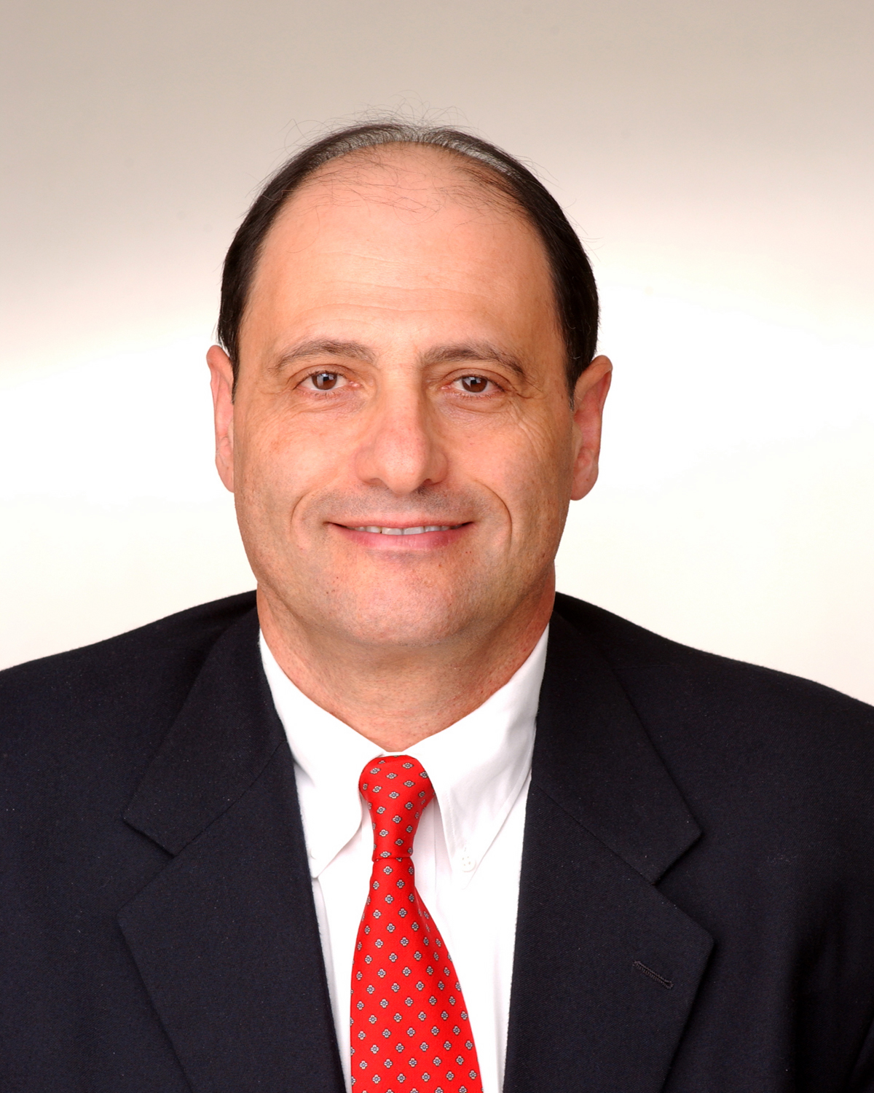
Acquisition Perspectives on the
Incremental Commitment Model
Integrating Systems and Software Engineering 2007
Dr. Peter Hantos
Senior Engineering Specialist
The Aerospace Corporation
© 2007. The Aerospace Corporation. All Rights Reserved.

Slide 2
Acknowledgements
This work would not have been possible without the following:
  Reviewers
    Suellen Eslinger, Software Engineering Subdivision
    Dr. Leslie J. Holloway, Software Acquisition and Process Department
    Mary A. Rich, Software Engineering Subdivision
  Sponsor
    Michael Zambrana, USAF Space and Missile Systems Center, Engineering & Architecture Directorate
  Funding source
    Mission-Oriented Investigation and Experimentation (MOIE) Research Program (Software Acquisition Task)

Slide 3
Agenda
Objectives
Incremental Commitment Model (ICM) – The 10,000 Foot View
ICM and DOD (Department of Defense) Acquisition Life Cycle Model Phases
Evolutionary Acquisition
Selected Evolutionary Acquisition and Spiral Development Challenges
Renaming Anchor Points in ICM
Conclusions
Acronyms
References

Slide 4
Objectives
Identify strengths and weaknesses of the new Incremental Commitment Model
Explore to what extent the new model will mitigate known problems of the defense acquisition system

Slide 5
ICM - The 10,000-Foot View*
Based on and inherits most characteristics of the Spiral Model
  Risk-driven spiral planning is the most significant element
The uncoiled spiral metaphor replaces spiral
  Every spiral cycle maps into a life cycle phase
  For depicting concurrency, builds on the well-known IBM/RUP® diagram of core process work flows
Major emphasis on formalized stakeholder commitment
  Anchor Point (AP) reviews are renamed to Commitment Reviews (CR)
  The new Commitment Reviews emphasize life cycle phase-entry instead of phase-exit
Most CRs are aligned with DOD 5000.2 Acquisition Life Cycle Milestones (See next slide)
____________________
* Discussion is based on [Pew 2007]
® RUP is registered in the U.S. Patent and Trademark Office by IBM/Rational Corporation

Slide 6
ICM and DOD Acquisition Life Cycle Model Phases
Pre-Systems Acquisition
Systems Acquisition
Sustainment
DODI 5000.2.2 (12 May 2003)
Concept
Refinement
Technology
Development
System Development
&
Demonstration
Production & Deployment
Operations &
Support
A
B
C
IOC
FOC
Concept Decision
Technology
Development
Approval
System
Development &
Demonstration
Approval
Design Readiness
Review
Low-Rate
Initial Prod
Approval
Full Rate
Production
Approval
Initial
Operational
Capability
Final
Operational
Capability
DCR
DCR
…
ECR
VCR
ACR
DCR
OCR₁
OCR₂
Exploration
Commitment
Review
Valuation
Commitment
Review
Architecture
Commitment
Review
Development
Commitment
Review
Operations
Commitment
Review
Development₁ Architecting₂
Operations₁
Development₂
Architecting₃
Operations₂
Development₃
Architecting₄
Exploration
Valuation
Architecting
ICM
Notes:
Acronyms
DOD Department of Defense
DoDI Department of Defense Instruction
ICM Incremental Commitment Model

Slide 7
Evolutionary Acquisition
Current DOD direction embraces Evolutionary Acquisition (EA) and Spiral Development (SD)
  EA is an acquisition strategy, and SD is a development process
    Note that unique life cycle models are associated with both
  Per DOD 5000.2, SD is preferred because (supposedly) it supports EA
Current state
  EA is well understood and widely practiced
  SD is still not well understood, sporadically practiced, and many times misrepresented
The following discussion is highly relevant, since ICM is a successor of the Spiral Model

Slide 8
Selected EA-SD Challenges
Uncoiling the spiral and mapping it into DOD 5000.2 phases have been a concern from the beginning
  Common interpretation is that spiral increments are mapped into DOD 5000.2 phases
    This notion is reinforced by the fact that DOD 5000.2 requires risk-identification and risk-reduction activities in every phase

Slide 9
Spiraling After Milestone B is Problematic
After Milestone B, system requirements must be agreed to; this is needed to secure funding for the first acquisition increment. Spending of funds is highly constrained.
____________________
Legend: JROC: Joint Requirements Oversight Council
PPBE: Planning, Programming, Budgeting, and Execution. For details see [DODP 2003]

Slide 10
Bogeyman – The Nunn-McCurdy Breach
Reporting Thresholds | “Significant” | “Critical”
Current Baseline Estimate Is exceeded by | +15% | +25%
Original Baseline Estimate Is exceeded by | +30% | +50%
Congress is very closely monitoring cost growth. Program re-baselining cannot be taken lightly.

Slide 11
“Conventional” Risk Management vs. Risk-driven Spiral Planning in ICM Spirals
Conventional risk management (required by DOD 5000.2)
  Fundamental characteristics
    Assigns a likelihood and impact value to the risk to facilitate prioritization
    Simple monitoring is an acceptable way of handling risks
    Most of the time a risk “burn-down” plan is put in place for risk mitigation
  In all cases the contractor is supposed to have the costs associated with risk mitigation in the baseline
    Alternative development paths and experiments might be chosen to deal with risks, but the contracted cost and schedule must not be impacted
Risk-driven spiral planning
  All parameters of upcoming increments are “up for grab”
  Number of spirals should not be administratively limited
    In fact, spinning-off iterations with engineering objectives, even without delivering any additional, useful functionality is an essential characteristic of iterative development
Iteration represents a sensible engineering approach, but might be incompatible with the overarching acquisition structure.

Slide 12
The Previously Shown Spiral Mapping Does Not Support EA
The previously shown mapping of spiral increments has nothing to do with EA; those spirals are localized, internal matters of a single acquisition increment
Spirals shown in the earlier mapping are far removed from the upgrade decision that triggers the creation of the new acquisition increment
A more reasonable interpretation is as follows:

Slide 13
Renaming Anchor Points to Commitment Reviews in ICM
CR equivalents of key Anchor Points
  LCO (Life Cycle Objectives) → ACR (Architecture Commitment Review)
  LCA (Life Cycle Architecture) → DCR (Development Commitment Review)
  IOC (Initial Operational Capability) → OCR (Operations Commitment Review)
The new naming conventions emphasize the importance of stakeholder commitment at the entry to the next phase
  Pros and cons:
    The positive impact is the reinforcement and codification of the principles that were used to create the Win-Win extension of the Spiral Model
    The negative impact is that – inadvertedly – the Anchor Point objectives got deemphasized

Slide 14
Conclusions
Strengths:
  ICM is a promising, new, development life cycle model
  Recent ICM publications do contribute to the better understanding of spiral development principles
  In ICM the original spiral graphical metaphor has been replaced with the uncoiled spiral, making the model’s use easier for project managers
  ICM emphasizes the importance of gaining stakeholder commitment before progressing to the next life cycle phase
Weaknesses:
  The renaming of APs to CRs deemphasized the earlier, important notion in the Spiral Model that all activities in a spiral increment are focusing on the satisfaction of the objectives of the upcoming Anchor Point
  The mapping of ICM Anchor Points into the DOD 5000.2 milestones is artificial and not supportive of either the DOD 5000.2 Instruction in general, or its preferred, Evolutionary Acquisition strategy in particular

Slide 15
Acronyms

Slide 16
References

Slide 17
Contact Information
Peter Hantos
The Aerospace Corporation
P.O. Box 92957-M1/112
Los Angeles, CA 90009-2957
Phone: (310) 336-1802
Email: peter.hantos@aero.org

Slide 18
All trademarks, service marks, and trade names are the property of their respective owners

