Slide 1

Value Changes Everything
Tim Menzies (tim@menzies.us)‏
Phillip Green II,
Steve Williams
Oussama Elwaras
Wednesday, May 19, 2009

Slide 2
Sound bites
Value-based SE:
  not even wrong?
  Does it change anything?
Data drought leading to conclusion uncertainty
  Seek stability over samples
On sampling some systems, we see
  Value radically changes the conclusions we reach regarding project organization
What works best THERE may not work best HERE
  Needs better ways to find local best

Slide 3
Value-based
Software Engineering
The future of SE?

Slide 4
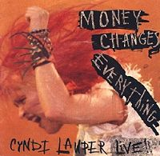
Thesis: value changes everything!
Q: what is SE
  A: The application of science and mathematics by which the properties of software are made useful to people
Most SE techniques are
“value-neutral”
  Boehm, ASE 2004
  Euphuism for “useless”?
Value-based SE makes a difference
  Yeah? Really?

Slide 5

The History of Computing Naturally Leads to Value-based SE

Slide 6
Risk Exposure (RE)
= Software Quality Investment RE (REq)
+ Market Share Erosion RE (REm)‏
Software Quality
Investment RE
Market Share
Erosion RE
Many defects and/or
Critical defects
Many rivals and/or
Strong rivals
Sweet
Spot
RE =REq + REm
Few rivals and/or
Weak rivals
Few defects and/or
minor defects
Time to Ship (amount of testing)‏

Slide 7
Value-based SE
Not even wrong?

Slide 8
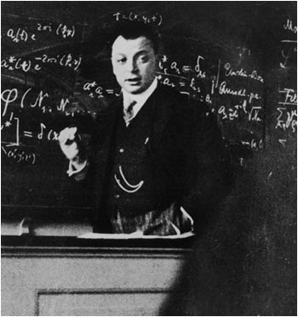
Is the value-thesis not even wrong?
Wolfgang Pauli
The "conscience of physics",
  the critic to whom his colleagues were accountable.
Scathing in his dismissal of poor theories
  often labeling it ganz falsch, utterly false.
But “ganz falsch” was not his most severe criticism,
  He hated theories so unclearly presented as to be
    untestable
    unevaluatable
  Worse than wrong because they could not be proven wrong.
  Not properly belonging within the realm of science
    even though posing as such.
  Famously, he wrote of a such unclear paper:
    ”That’s not right. It’s not even wrong."

Slide 9
So is the value thesis refutable?
(defun energy ()‏
"Calculates energy based on cocomo pm, tdev, coqualmo defects,
Madachy’s risk."
(let* ((npm (calc-normalized-pm))‏
(ntdev (calc-normalized-tdev))‏
(ndefects (calc-normalized-defects))‏
(nrisk (calc-normalized-risk))‏
(pm-weight 1)‏
(tdev-weight 1)‏
(defects-weight (+ 1 (expt 1.8 (- (xomo-rating? 'rely) 3))))‏
(risk-weight 1))‏
(/ (sqrt (+ (expt (* npm pm-weight) 2)‏
(expt (* ntdev tdev-weight) 2)‏
(expt (* ndefects defects-weight) 2)‏
(expt (* nrisk risk-weight) 2)))‏
(sqrt (+ pm-weight tdev-weight
defects-weight risk-weight)))))‏
Find a domain general “value” proposition
  Menzies, Boehm, Madachy, Hihn, et al, [ASE 2007]
  Reduce effort, defects, schedule
  “energy”
Find a local value proposition
  A variant of USC Ph.D. thesis
    [Huang 2006]: Software Quality Analysis: a Value-Based Approach
  “value”
Use them in a what-if scenario
Any difference in the conclusions?
(defun risk-exposure ()‏
“Calculates risk exposure based on rely”
(let* ((pm (calc-pm))‏
(size-coefficient (calc-size-coefficient '(rely)))‏
(defects (calc-defects))‏
(defects_vl (calc-defects-with-vl-rely))‏
(loss-probability (/ defects defects_vl))‏
(loss-size (* (expt 3 (/ (- (xomo-rating? 'cplx) 3) 2) )‏
size-coefficient
pm))‏
(software-quality-re (* loss-probability loss-size))‏
(market-coefficient (calc-market-coefficient '(rely)))‏
(market-erosion-re (* market-coefficient pm))‏
(+ software-quality-investment-re
market-erosion-re)))‏

Slide 10

Aside
Not really [Huang06]
  But some variant Huang06
Had to use some “engineering judgment”
  a.k.a. guesses
Apologies to Dr. Huang

Slide 11
Tools
Four USC models
  COCOMO effort prediction: staff months
  COCOMO schedule predictor: calendar months
  COQUALMO defect predictor: defects/KLOC
Monte Carlo simulator
AI search engine
  Search for the least number of project changes …
  … that most improves the “target”
  “Target” is either
    [Ase07]’s “energy” function
    [Huang06]’s “XPOS” proposition (risk exposure)

Slide 12
“Energy” [Ase07]
Euclidean Distance to lowest everything
Energy = sqrt( a * square( normalized ( Time )) +
b * square( normalized( Effort )) +
c * square( normalized( Defects ))
)
/ sqrt(a+b+c)

Slide 13
Xpos [Huang06]
Value based evaluation method designed to minimize risk exposure based on 'rely'
Balances beating everyone to market with more/worse bugs and being last to market with few/minor bugs.
Based on NASA/USC Inspector SCRover project described in [Huang06]
  XPOS
  Risk Exposure (RE)
  = Software Quality Investment RE (REq)
  + Market Share Erosion RE (REm)‏

Slide 14
Software Quality Investment = Pq(L) * Sq(L)
Pq(L):
  [Huang06] calculated from COQUALMO estimates of delivered defect density
  To incorporate COQUALMO model: defects/defects-with-vl-rely
Sq(L)
  [Huang06] used based values from a Pareto distribution and modified it with a coefficient based on a factor depending if a project was for early startup (1/3) commercial (1), high finance(3)
  We used the same values for the distribution but instead of defining 3 different functions, we used a function base don cplx to determine the coefficient 3^((cplx-3)/2)) (range is [0.3333 .. 5.196]

Slide 15
Market Share Erosion
Risk Exposure (REm)‏
[Huang06]
  used a simple exponential distribution for Rem
  REm was normalized
We weight it with PM

Slide 16
The details
Using AI to find stable conclusions
in a space of options

Slide 17

Problem: local tuning
Problem
  Models need calibration
  Calibration needs data
  Usually, data incomplete (the “data drought”)
Our thesis :
  Precise tunings not required
  Space of possible tunings is well-defined
  Find and set the collars
    Reveal policies that reduce effort/ defects months
    That are stable across the entire space

Slide 18
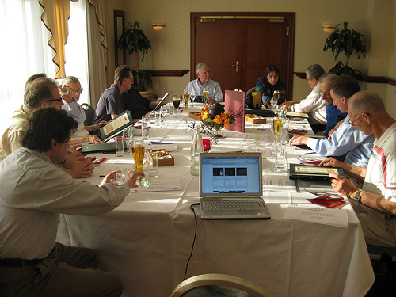
Experts disagree
Target application picked
  A mission critical,
  real-time system;
  Built by contractors
  (not in-house)
  That has an operational life of 5 to 10 years (since have invested much effort into a mission critical system, an organization is most likely to use it for many years to come).
For each COCOMO input variable
  Boehm defines each variable
  5 minutes “open comments”
  Vote. Record majority view
No majority view

Slide 19
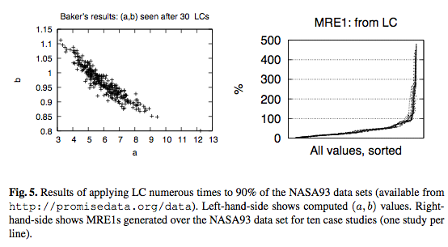
The tuning instability problem
If some method DOUBLED productivity, you might miss it if tunings randomly jumps 9 to 4.5.

Slide 20
Dodging tuning instability
Estimate = model( project, tunings)
Twiddle project
Let tunings roam free
Can still control the estimate (if project dominates estimate)
Project details are the dominate influence on estimate for the USC models.

Slide 21
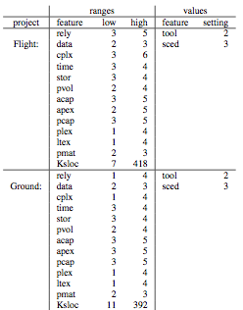

Sampling
E.g. effort = mx + b
Two kinds of unknowns
  • Unknowns in project ranges
    E.g. range of “x”
  • Unknowns in internal ranges
    E.g. range of {“m”, “b”}
Standard practice:
  Use historical data
  to constrain {“m”,”b”}
Here: Monte Carlo over
range of { “x” , “m”, “b” }
  Learn values for “x” that reduce
  effort
  As a side-effect, reduce variance
  Not need for tuning data
1.3
1.2
1.1
1.0
0.9
0.8
0.7
effort
1 2 3 4 5 6
X
vl
l
n
h
vh
xh

Slide 22
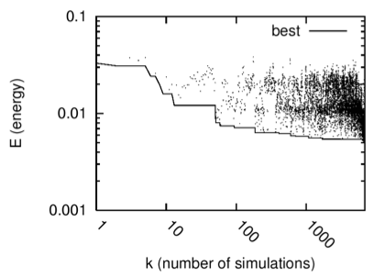
Search for stable conclusions
Using simulated annealing, Monte Carlo simulated annealing across intersection of
  A particular project type
  Space of possible tunings
Rank options by frequency in good, not bad
For r options
  Try setting the 1 ≤ x ≤ R top ranked options
  Simulate (100 times) to check the effect of options 1 .. x
Smile if
  Reduced median and variance in defects/ efforts/ time/ threats
Bad
Good
Sample run
(after 10,000 runs, little improvement)‏

Slide 23
Other search methods
A-star
MaxWalkSat
Isamp
Etc

Slide 24
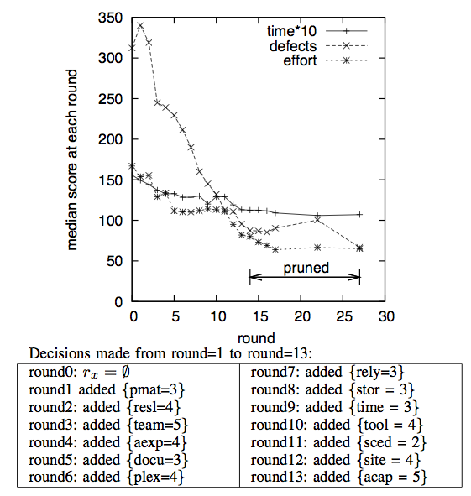

Slide 25
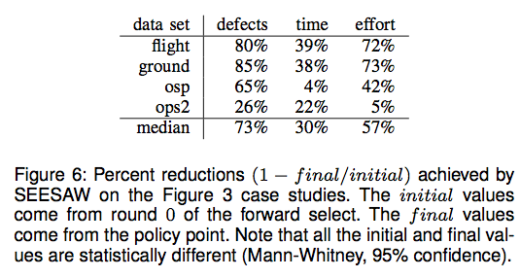
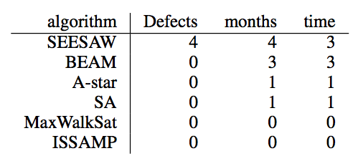
What works best?
A little domain knowledge goes a long way
Standard methods not best
Best methods very effective

Slide 26
Results
And the winner is…
…. no one in particular

Slide 27
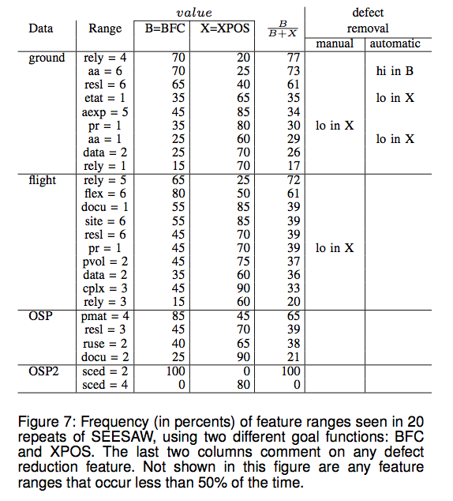
tea
aa 1 aexp 1 cplx 1 data 2 docu 1 etat 1 flex 1 pmat 1
Pr 2
pvol 1
ruse 1 rely 2
resl 2 sced 1 site 1
MIA: prec, team, acap, ltex, pcap, pcon,stor, time,tool

Slide 28
Conclusion
So what?

Slide 29
Conclusion
Is value-based SE “ganz falsch”? (not even wrong)
  Hard to tell, if we have a data drought
  So seek stability in samples of the possibilities
On sample, using 4 case studies and 2 value functions:
  Many seemingly important factors weren’t (important)
  The most important ones change from project to project
  For any project, changes to value changes everything

Slide 30
Conclusions
Value-based SE:
  Not “not even wrong”
  Value change everything
Data drought leading to conclusion uncertainty
  Seek stability over samples
On sampling some systems, we see
  Value radically changes the conclusions we reach regarding project organization
What works best THERE may not work best HERE
  Needs better ways to find local best

