Slide 1



Can We Build Software Faster and Better and Cheaper?
Tim Menzies, Oussama El-Rawas (WVU) Jairus Hihn (JPL)
Barry Boehm (USC)
PROMISE’09
A: yes…
(nearly)

Slide 2
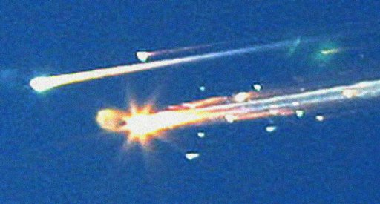
“Faster, Better, Cheaper?
Pick any Two”
1980s: very expensive NASA missions
  BFC= management directive to diversify mission portfolio
Mission costs
  Before BFC: $935M (Viking)
  After: $270M (Mars pathfinder)
High profile failures
    NASA: Mars Climate Orbiter
    and Polar Lander
    UK: Beagle2
    Columbia shuttle disaster
Yet many successes (136/148)

Slide 3
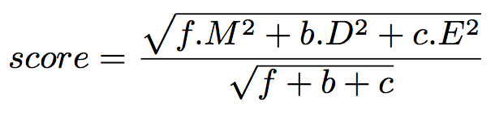
G = goal
Goal = minimize score
Default: BFC
  b=f=c=1
Cheaper, Faster
  b=0 (ignore defects)
Better, Faster
  c= 0 (ignore development effort)
Cheaper, better
  f=0 (ignore development time)

Slide 4
A different kind of PROMISE paper
If data mining: data = lots; experts= not
then (e.g.) decision trees
  Learn model from data
If data = lots; experts = lots then (e.g.) Bayes nets
  Initialize using expert
  Tune with data
  Audit with experts
If data=no and experts = yes then (e.g.) STAR
  Reuse model, replace uncertain point with ranges
  Monte across ranges
  AI search seeks stable
  conclusions across simulations
PROMISE:
2005 - 2009
PROMISE:
2010 and
Afterwards?

Slide 5
Need 5 things for this to work
Gomprots: <G, M, P, T, S>
G = A goal function to guide the search
M = model
P= Project options
T= Tuning options
S= A search engine to explore subsets p of P

Slide 6
<G, M, P, T, S>
G = goal
Goal = minimize score
Default: BFC
  b=f=c=1
Cheaper, Faster
  b=0 (ignore defects)
Better, Faster
  c= 0 (ignore development effort)
Cheaper, better
  f=0 (ignore development time)

Slide 7
<G, M,P, T, S>
M= model
COCOMO
  Total development effort
  Development months
  E.g. 4 people, 1 year then effort =48 and months = 12
COQUALMO
  Defects / KLOC
Should work for other models where
  project options, not tuning options, are the dominant effect on estimates

Slide 8
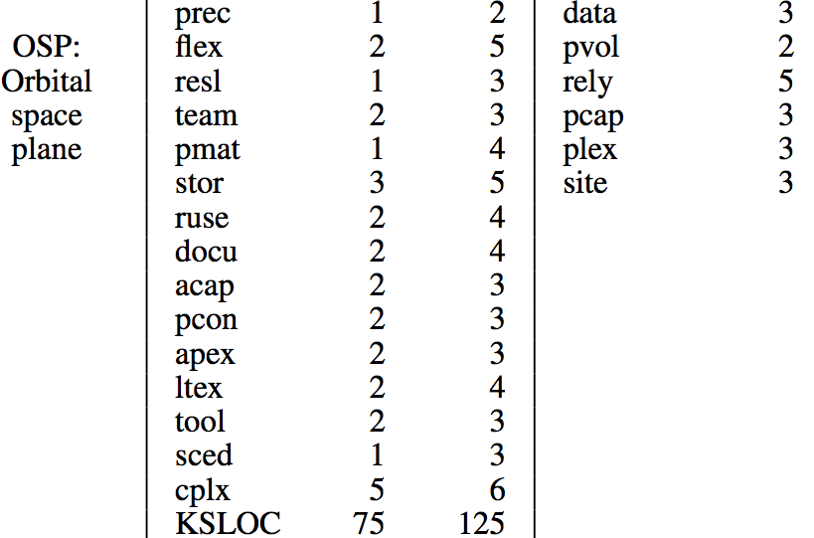
<G, M, P, T, S>
P= project options
AI searches min .. max
As project grow, they
grow less flexible
OSP2 < OSP < flight
  Flight: general description
  OSP: orbital space plan
  OSP2: OSP v2.
ranges: min max | fixed
Notes:
unreadable

Slide 9
<G, M, P, T, S>
T= tuning options
COCOMO effort estimation
  Effort multipliers are straight (ish) lines
  when EM = 3 = nominal , multiple effort by one (I.e. nothing)
  i.e. they pass through the point {3,1};
Similarly for scale factors (and COQUALMO)
Increase effort
decrease effort
cplx, data, docu
pvol, rely, ruse,
stor, time
acap, apex, ltex, pcap,
pcon, plex, sced,
site, tool

Slide 10
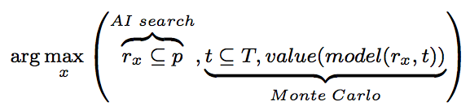
<G, M, P, T, S>
S = search
Which search engine?
  This paper:
    simulated annealing + a Bayesian ranking method
And many others

Slide 11
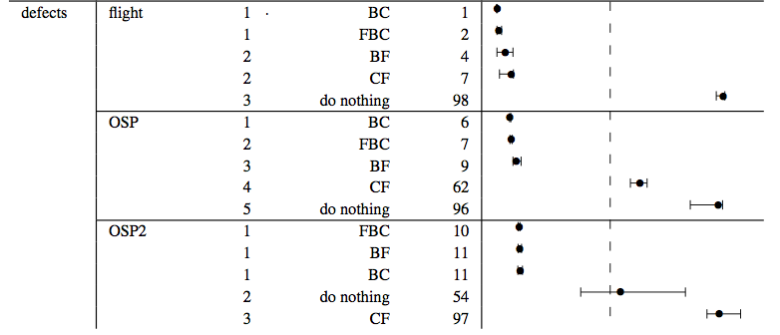
Results: defects
#1: Large defect reductions are possible.
#2: CF’s defects much larger than any of (BC,BF, BFC)
#3: FBC not best (lowest defects). But very close to best.
Notes:
Note that B are always best

Slide 12
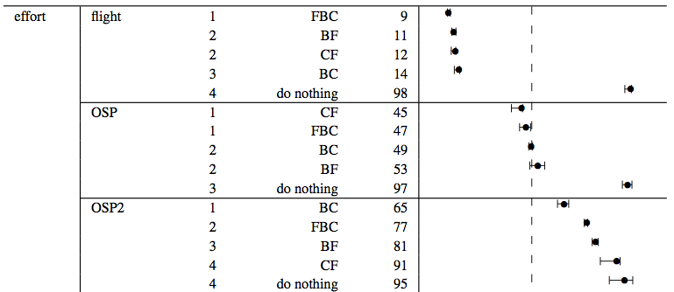
Results: effort
#3, again: FBC very close to best (least effort) except for OSP2
#4: Largest reductions arise when we can change most options

Slide 13
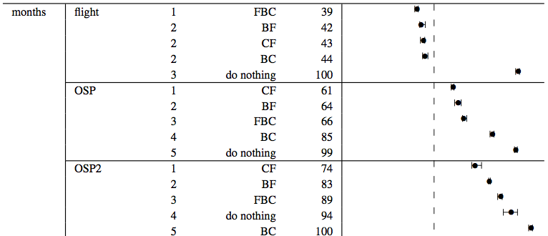
Results: months
#3, again: FBC very close to best (least effort) except for OSP2
#4, again: largest reductions arise when we can change most options

Slide 14
Validity
Internal validity
  Results stable across space of tunings
External Validity
  Conclusions based on one search engine
    Active area of exploration
  Conclusions based on COCOMO/COQUALMO
    28 years of active development review
  Assumes estimates can be controlled by controlling project options,, not tunings
    Which is true for COCOMO/COQUALMO [Menzies, Boehm, Madachy, El-waras, et al ICSP 2008]
Construct validity
  Is BFC captures by settings to <b,f,c>?

Slide 15
Related Work
Other work in this framework
  Ranking different process changes [ICSE’09]
  With Orrego [ICSP’09]: studying reuse
  Submitted to [ASE’09]: ranking different search algorithms
Uncertainty in software engineering often Bayesian; eg.
  E.g., Pendharkar et al. [TSE’05]
  E.g. Fenton and Neil et al [Many places, including PROMISE’07]
  Not combinations of defect, effort, time
Search-Based Software Engineering (SBSE) [Harmon et al]
  e.g. simulated annealing , genetic algorithms, tabu search
AI search algorithms
  Integer programming, BDDs, constraint satisfaction , etc etc
Numeric optimization
  Gradient descent
Variance reduction
  Feature subset selection
  Instance-based learning
  Collect more data

Slide 16
Discussion
Expected: BFC? Pick any two
Observed: FBC can be achieved with minimal compromises on individual criteria
Historically, FBC usually, worked.
  Successful/partially successful in 136/146 FBC era projects
  Nevertheless, some largely publicized failures.
  That is, FBC was mostly a technical success, but a PR failure.
Speculation:
  Sometimes, large failures resulted from CF masquerading as BFC
  Ignore “B” at your peril
  CF had up to nines times as many defects as any other goal
Next generation of PROMISE paper.
  Don’t just build models,
  But also report tricks on how to best use them

Slide 17
Questions,
Comments?

Slide 18
Need tools for data droughts
Norman Fenton
  “....much of the current software metrics research is inherently irrelevant to the industrial mix ... any software metrics program that depends on some extensive metrics collection is doomed to failure.”
Barry Boehm
  After 26 years of COCOMO: less than 200 projects.
Kitchenham & Mendes & Travassos, (TSE’07)
  Literature unclear if it is wise to use estimation data from other companies
  But some results ay “NO!” very clearly (Mendes & Dinakaran & Mosley www2007)
Exception: Turhan, Menzies, Bener et al (ESE’09)
  Special case of defect prediction
  Their data can build good defect predictor for us
Notes:
Need external validity, need this one in the the conc

Slide 19
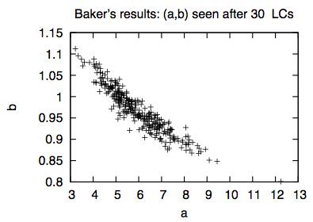
Estimate= model( Project, Tunings)
in 100 LCs
E.g. COCOMO
  <processMaturity, analystCapability> = project options
    If “analysts not too bad” then acap = nominal or high
  <a,b> = tuning options
    100* { learn from 90% of data }
Normal practice: use local data to constrain tuning options
  Augment with feature subset selection, outlier removal, etc
Here: AI search over project options
  Leave tunings unconstrained
  Return conclusions that are stable across space of all tunings
  No need for data
Assumes Project, not tunings, are the dominant influence on estimate
  Which is true for COCMO/COQUALMO [Menzies, Boehm, Madachy, El-waras, et al ICSP 2008]

