Slide 1



How to Avoid Drastic Software Process Change (using Stochastic Stability)
Tim Menzies, Steve Williams, Oussama El-Rawas (WVU)
Jairus Hihn (JPL)
Barry Boehm (USC)
ICSE’09

Slide 2
Stochastic stability
“For all is but a woven web of guesses.”
  -- Xenophanes (570 – 480 BCE)
Seek what holds true over the space of all guesses.
  Surprisingly, happily, such stable conclusions exist.
Bad idea for:
  The safety-critical guidance system of a manned rocket.
Good idea for:
  Exploring the myriad space of possibilities associated with software project manager.

Slide 3

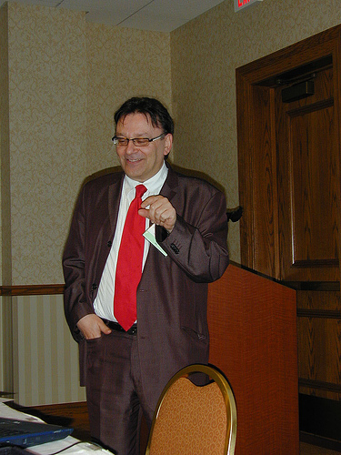
The process
“data drought”
Yet another drought victim
Fenton07: “....much of the current software metrics research is inherently irrelevant to the industrial mix ... any software metrics program that depends on some extensive metrics collection is doomed to failure.”
e.g. After 26 years, Boehm collected less than 200 sample projects for the COCOMO effort database

Slide 4
A different kind of learning
If data mining: data = lots; experts= not
then (e.g.) decision trees
  Learn model from data
If data = lots; experts = lots then (e.g.) Bayes nets
  Initialize using expert
  Tune with data
  Audit with experts
If data=no and experts = yes then (e.g.) STAR
  Reuse model, replace uncertain point with ranges
  Monte Carlo across ranges
  AI search seeks stable
  conclusions across simulations
Past
Future?

Slide 5
This talk
A stochastic stability study of
“internal” vs “drastic” project changes
Managers have more
options than they think

Slide 6
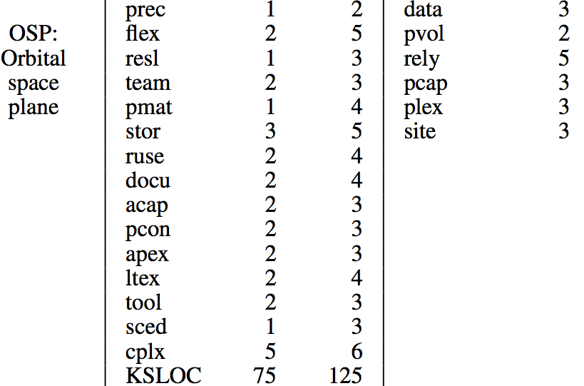
Internal change
(twiddle current project)
Project options
  Search within (Min .. Max)
ranges: min max | fixed
Controllability
assumption
Notes:
unreadable

Slide 7
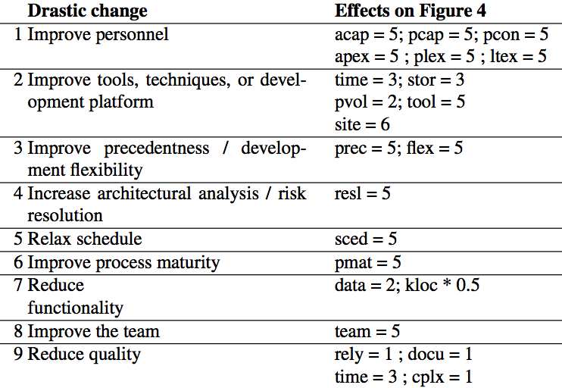
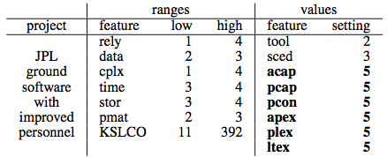
Drastic change
(massive project reorganization)
From Hoh Peter In
And Barry Boehm, 1999
(not all drastic changes,
just a sample)

Slide 8
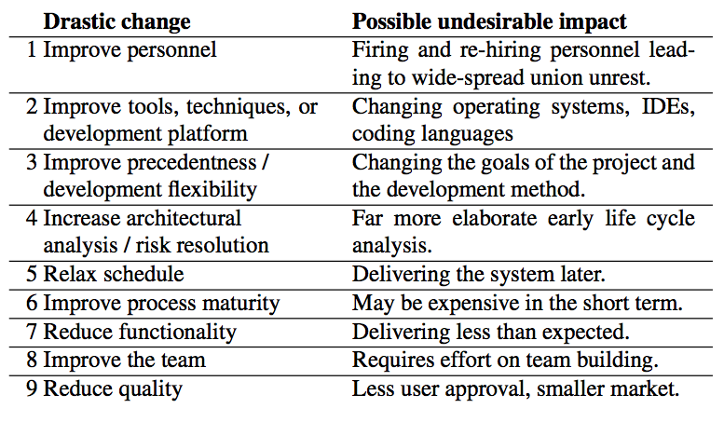
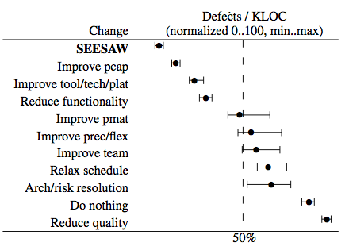
Drastic changes can be pretty drastic
Q: can we do better than drastic
change via internal changes?
A: in many cases, yes

Slide 9
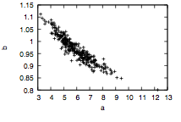
How to check if internal beats drastic
Easy! (not)
  Conduct what-if queries across process models
  Cloud computing, overnight run, try everything!
Problems
  How to get models
  people trust?
  How to avoid mountains of irrelevant data?
  How to tune those models to local conditions?
Estimate = a * loc ^{b} * stuff
  Repeat: find <a,b> in 90% of data
“Tuning variance” not tamed by
  outlier removal,
  feature selection,
  more data collection,
  better statistical analysis…
b
a

Slide 10
Need 5 things for this to work
<G, M, P, T, S>
G = A goal function to guide the search
M = model
P= Project options
T= Tuning options
S= A search engine to explore subsets p of P

Slide 11
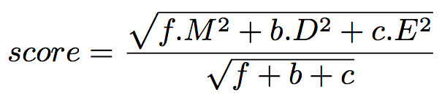
<G, M, P, T, S>
G = goal
Goal = minimize score
M: development months (calendar)
D: development effort (total staff assigned)
E: effort

Slide 12
<G, M,P, T, S>
M= model
COCOMO
  Total development effort
  Development months
  E.g. 4 people, 1 year then effort =48 and months = 12
COQUALMO
  Defects / KLOC
Should work for other models where
  project options, not tuning options, are the dominant effect on estimates

Slide 13
<G, M, P, T, S>
P= project options
AI searches (Min .. Max)
As project grow, they
grow less flexible
OSP2 < OSP < ( flight, ground)
  Flight: general description
  OSP: orbital space plan
  OSP2: OSP v2.
ranges: min max | fixed
Controllability
assumption
Notes:
unreadable

Slide 14
<G, M, P, T, S>
T= tuning options
COCOMO effort estimation
  Effort multipliers are straight (ish) lines
  when EM = 3 = nominal , multiple effort by one (I.e. nothing)
  i.e. they pass through the point {3,1};
Similarly for scale factors (and COQUALMO)
Increase effort
decrease effort
cplx, data, docu
pvol, rely, ruse,
stor, time
acap, apex, ltex, pcap,
pcon, plex, sced,
site, tool

Slide 15
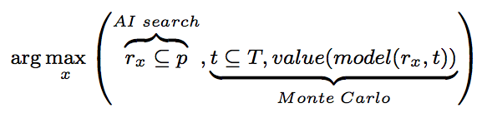
<G, M, P, T, S>
S = search
Which search engine?
  This paper:
    a constraint satisfaction method (a variant of MaxWalkSat)
And many others

Slide 16
Results

Slide 17
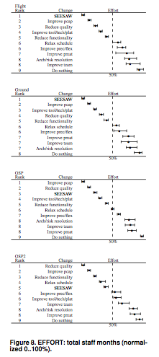
Results normalized min=0 to max=100
50% percentile
Notes:
Note that B are always best

Slide 18
Treatment
25% to 75% range
50% (median)
Notes:
Note that B are always best

Slide 19
Internal change
Mann-Whitney results (95% confidence)
Notes:
Note that B are always best

Slide 20
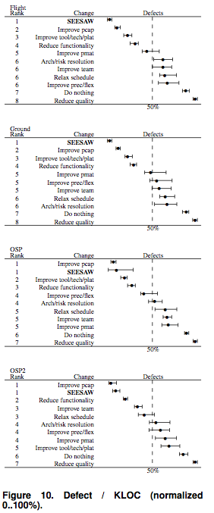
Defect predictions after SEESAW
Always first, or ties with first
Notes:
Note that B are always best

Slide 21
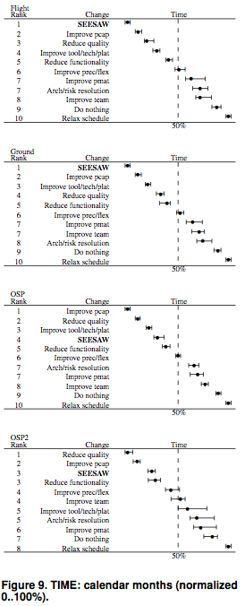
Development Time predictions after SEESAW
Flight= first
Ground = first
OSP = fourth (beaten by reduce quality, improve pcap)
OSP2= third (beaten by reduce quality, improve pcap)
Notes:
Note that B are always best

Slide 22
Effort predictions after SEESAW
Flight= first
Ground = first
OSP = third (beaten by reduce quality, improve pcap)
OSP2 = fifth (but still in bottom half)
Notes:
Note that B are always best

Slide 23
12 case studies
(flight, ground, OSP,OSP2) * (effort, defect, time)
Usually (8/12):
  SEESAW ties for first rank
In the remaining (3/4):
  beaten by reducing quality, pcap changes
Always(12/12):
  better than at least half the others
Usually (10/12):
  in bottom quarter
Worst results with OSP2

Slide 24
Validity
Internal validity
  Results stable across space of tunings
External Validity
  Conclusions based on one search engine
    Active area of exploration
  Conclusions based on COCOMO/COQUALMO
    28 years of active development review
  Assumes estimates can be controlled by controlling project options,, not tunings
    Which is true for COCOMO/COQUALMO [Menzies, Boehm, Madachy, El-waras, et al ICSP 2008]
Construct validity
  The change cost issue
  Results are “estimates”, not “actuals”
    Estimates as odd as the underlying model
Relative impact above lowest value

Slide 25
Related Work
Other work in this framework
  Studying the effects of changing weights in goal function [Promise’09]
  With Orrego [ICSP’09]: studying reuse
  Submitted to [ASE’09]: ranking different search algorithms
Uncertainty in software engineering often Bayesian; eg.
  E.g., Pendharkar et al. [TSE’05]
  E.g. Fenton and Neil et al [Many places, including PROMISE’07]
  Not combinations of defect, effort, time
Search-Based Software Engineering (SBSE) [Harmon et al]
  e.g. simulated annealing , genetic algorithms, tabu search
AI search algorithms
  Integer programming, BDDs, constraint satisfaction , etc etc
Numeric optimization
  Gradient descent
Variance reduction
  Feature subset selection
  Instance-based learning
  Collect more data
b
a

Slide 26
Summary
Drastic changes are disruptive.
  Can we avoid them?
Problem:
  What –if queries over process models complicated by tuning variance
Solution:
  Use models where project effects dominate tuning effects
  E.g. USC COCOMO suite
SEESAW
  AI searches project options
  Each option assessed by Monte Carlo over randomly selected tuning options
Using SEESAW:
  Usually, internal changes are as good, or better, as drastic
Next generation of empirical SE
  Don’t just build models,
  But also report tricks on how to best use them

Slide 27

Questions,
Comments?

