Slide 1
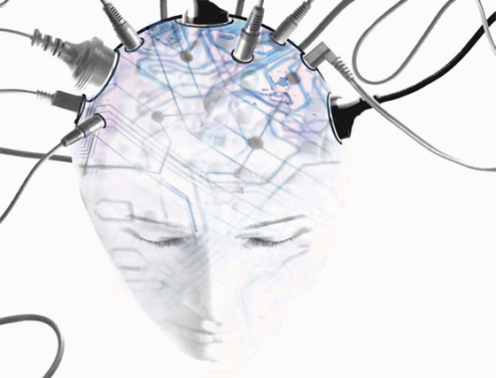
Q: Can a machine think?
Tim Menzies
tim@menzies.us
LCSEE, WVU
Oct-8-10

Slide 2
A1: no, they only think they can

Slide 3
A machine can never…
Do “X” like a human can
  Cause I am human
  Cause only humans can do “X” like me
Look at the person next too you
  Are you sure that they are thinking “just like you”?
  And if they were: what a dull world it would be

Slide 4
A2: depends what you think “thinking” means

Slide 5
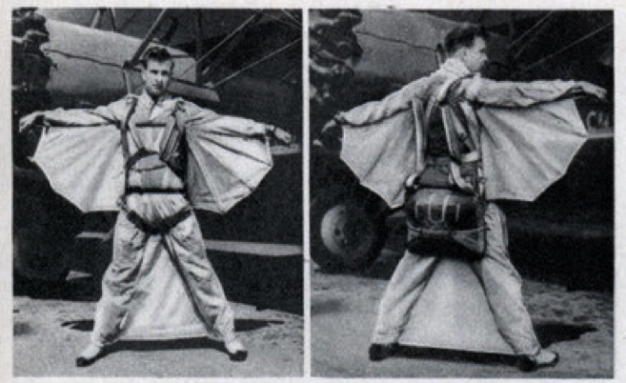
Aeroplanes can’t fly
Cause birds fly
And birds flap their wings
And aeroplanes don’t
flap their wings
So they don’t fly

Slide 6
Abstract ideas, implementation independent
Every computer scientist knows this to be true:
  There are computational properties, independent of processor the algorithm runs on, or the implementation language.
  The idea is different to the substrate
  “computer science is no more about computers than astronomy is about telescopes”
    Dijkstra (and he could have been talking about AI)

Slide 7
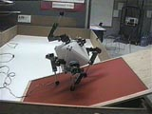
The Platonic Beast
Thinking about thinking is hard
Lets do something simpler- like walking
Should a robot could/should walk like us? (see http://people.cs.ubc.ca/~pai/movies/beast.mpg)
  walks by throwing a spare limb over its head
  Such a move would tear us apart
  but it’s natural for that kind of walking thing.

Slide 8
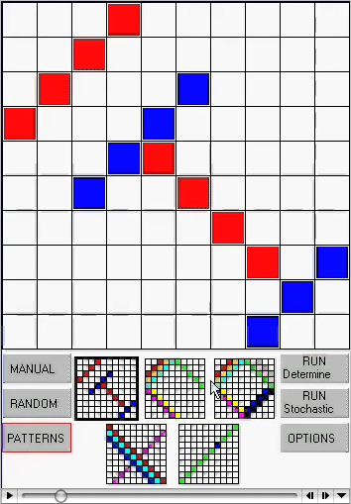
Stochastic search
“Latin's square”: no 2 same colors on the same row or column
  Method 1: deterministic exhaustive theorem proving
  Method 2: stochastic: makes an initial guess, then refines that guess based on local feedback.
  http://menzies.us/csx72/img/latin.mov
  Stochastic kills deterministic
You would not expect a human to think using stochastic search (too much CPU twiddling).
  But for a computer, stochastics are useful since each local twiddle can be done very quickly
  An AI may think wildly different to a human

Slide 9

Prediction
The more we turn to computers,
  The more we’ll get answers which
    Work
    But which we don’t understand
Welcome to the 21st century

Slide 10
Questions?
Comments?

