Slide 1

Quarterly Report
WVU/Grammatech STTR
Tim Menzies tim@menzies.us,
Andrew Butcher abutcher@afrolegs.com
Ekrem Kocagüneli kocaguneli@gmail.com
Kel Cecil kelcecil@praisechaos.com
April 10, 2011

Slide 2
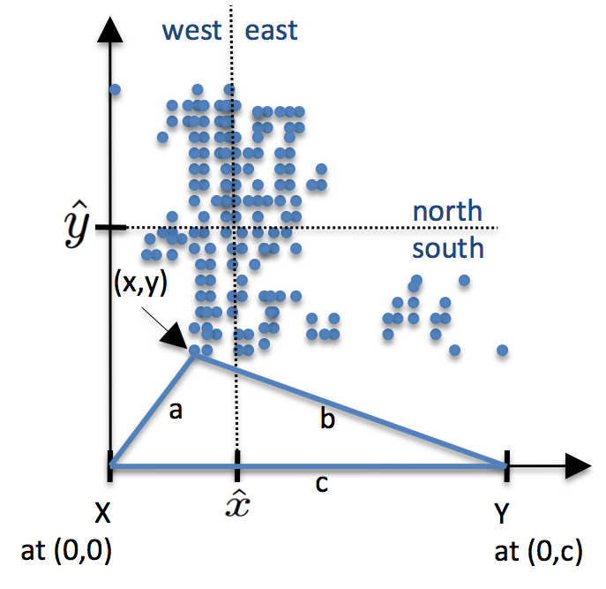

IDEA: Background
IDEA= iterative dichotomization on every attribute
  novel multi-dimensional clustering and visualization algorithm.
Using the FastMap heuristic,
  IDEA finds top 2dimensions of greatest variance in a data set,
  Let X ,Y be the two most distant points,
  seperated by distance “c”
  All other points have distance “a”, “b” to X,Y
  Map points to a 2-D grid based on “a,b,c”
Partition data into four quadrants (NW, NE, SW, SE) using the median point on each
  Recurse on each quadrant
  Stop when #instances = sqrt{total instances}.
Clusters are generated by combining neighbouring leaf quadrants with similar densities.
  The median score of dependent variables in each quadrant is then displayed.
NW
NE
SW
SE
Algorithm recurses on each quadrant NW, NE, SW, SE

Slide 3
IDEA: Example
For example, in the following figure, each dot is a 24-dimensional project description
  colours denote the median time for project development within each cluster.
a) initial 2 dimensions (b) after recursion (c) showing clusters,
with median scores
When applied for decision support systems, IDEA provides a framework for analysts to interactively explore complex multi-dimensional data
  e.g. Active learning = sample the boundary between neighboring clusters with very different median scores. For example:

Slide 4
Current status

Slide 5
Summary of Work
This quarter
Next quarter
0. Porting work
  Assisting Grammatech with commissioning our algorithms at their site
1. Data collection
  Menzies has organized going on-site at Microsoft in July for a month to look for data at that site.
2. Scalability studies
  Trying algorithms on larger data sets
  Summary: Scales very well (linear time)
  For more details, see “How Fast?” Below
3. Documentation work
  Defining algorithms
  Writing tutorials on our methods
  Current status: see “Descriptions, Below”
4. Understanding active learning
  Puzzle: Standard active learning methods fail of our defect data sets
  Question: What is different about our data?
  Answer: We can now characterize topologies of the data that do, do not support active learning (see below: “Inside the data”)
0. More porting work
1. Data collection
2. Exploiting our optimizations
  Given these fast algorithms…
  … are their other opportunities for analysis?
  Not “just” active learning
3. Documentation work
  Need an extensive tutorial document
4. Better active learning
  Given the findings (at left), check if defect data does/does not have the topology that supports active learning.
  If so, then write a new active learner for that topology

Slide 6
Details
Data collection
Optimization studies
Documentation work
Understanding active learning

Slide 7

1. Data Collection
Given that
  We have a working integration of IDEA and CodeSurfer/CodeSonar
  We can resolve licensing issues
Menzies goes to Microsoft in July, hunting for data

Slide 8
Details
Data collection
Scalability studies
Documentation work
Understanding active learning

Slide 9
2a. IDEA is fast
Inference and classification
  executes on a 2-D space, inferred after a recursive division of the attribute space according to the dimensions of greatest variance
Without IDEA:
  classification requires inference over all attributes
With IDEA:
  classification requires inference over 2 attributes
  Dramatically faster (see the “ratio” plot on next slide: 10 to 100 times faster)
The times shown on next slide includes:
  Time required to find the clusters
  Time required to move test instances down the tree of clusters,
  Time required to apply NaiveBayes within the selected cluster.

Slide 10
2b: IDEA is fast
Runtimes on different data sets: CM1, KC2, MW1, KC3, PC1, KC1
Same data,
log scale
Ratio IDEA to classification using all dimensions

Slide 11
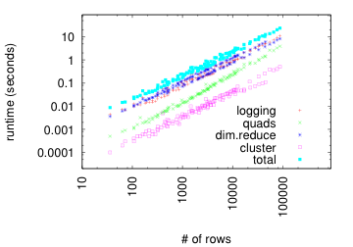
2c. Scalability studies
How well does IDEA scale to larger data sets?
For Data in ManyDataSets do
  Train[0] = copy(Data)
  Run analysis
  For i= 1 to 3 do
    Train[i] = Train[i-1], copied twice
    Run IDEA on Train[i]
Results (shown at right)
  All sub-routines of IDEA are linear on #rows (instances)
Conclusion: IDEA scales to very large data sets

Slide 12
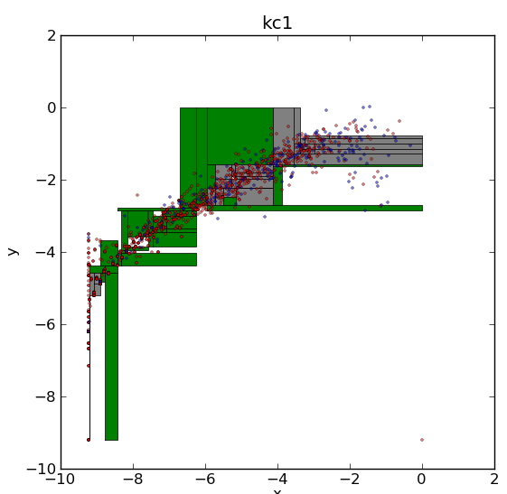
2d. Digression: is faster stupider?
Defect estimation data
Treatment1:
  Generate a hold-out set
  Learn from all the data, minus the hold-out
  Test on the hold-out
Treatment2:
  Generate a hold-out set
  Build clusters on all data, minus the hold-out
  Learn one theory per cluster
  Test by (first) finding nearest cluster then (second) apply the theory from each cluster
Results:
  No statistical difference
  between treatments
  So our faster is not stupider.

Slide 13
2e. Implications
Given IDEA is so fast,
  Should we restrict it to just active learning?
Hypothesis
  IDEA is a general, scalable, decision support tool for exploring multi-dimensional data
To test that hypothesis
  Take some general statement of “information needs” of software project managers
    E.g R. Buse and T. Zimmermann, Information Needs for Software Development Analytics, MSR-TR-2011-8, 30 January 2011. http://goo.gl/LPrJN
  Ask the question “what support does IDEA give to these information needs”?

Slide 14
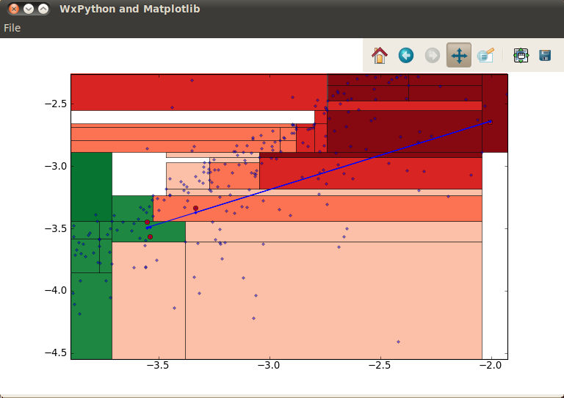
2f. Implications for “trending”
For example, one Buse/Zimmermann “information need” is trending;
  i.e. what are the patterns of changes in projects
In IDEA, trending can be implemented as follows:
  Given a project data from N times points (e.g. the red dots, below)
  Trend = your trajectory in instance space
  i.e. a spline fitted to those points

Slide 15
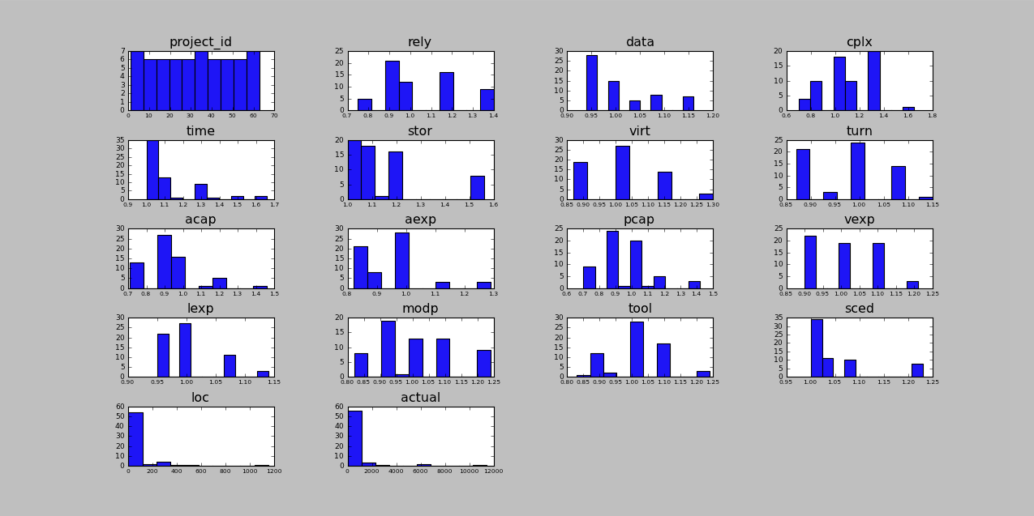
2g. Implications for “forecasting”
For example, one Buse/Zimmermann “information need” is forecasting;
  i.e. what is expected about the current project
In IDEA, forecast can be implemented as follows
  Cluster data
  Find cluster of “current project”
  Forecast = data distributions in that cluster

Slide 16
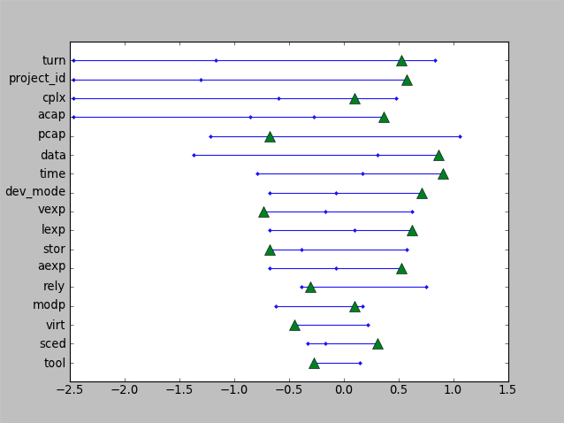
2h. Implications for “summarization”
For example, one Buse/Zimmermann “information need” is summerization;
  i.e. what are the essential features of the historical data
In IDEA, summarization is a post-processor to forecast
  For a cluster “C”
  Summarization = how different are forecasts between “C” and all other clusters
In this figure, “
  All data divided into 10 bins
  “0” means bin’s distribution as elsewhere,
  “>0” means “more frequent” in
  this cluster than elsewhere
  Green triangles = current project
Selects for “change”
Selects for “status quo”
Most important
to preserve
Biggest opportunity
for major change

Slide 17
2i. Digression: one small detail
Question:
  How are the range values calculated for the previous slide?
Answer: Log(OddsRatio):
  Discrete every feature: say, (max – min) / 10
  For all pairs of target / other of size C1, C2 count frequency of range N1, N2 in each class
  Log(odds ratio)
    log((N1/C1) / (N2/C2))
    Greater than 0 if more frequent in target
  Možina, M., Demšar, J., Kattan, M., and Zupan, B. 2004. Nomograms for visualization of naive Bayesian classifier. In Proceedings of the 8th European Conference on Principles and Practice of Knowledge Discovery in Databases (Pisa, Italy, September 20 - 24, 2004)

Slide 18
2j . Other implications
Buse/Zimmermann list 9 information needs.
  The previous slides show how IDEA can handle 3 of them:
    “trending”,
    “forecasting”,
    “summarization”
  We are working on the other 6
    Summary: IDEA offers linear time support for 8 of 9 of the Buse/Zimmermann information needs
    We are working on heuristics to optimize the final nineth item
More generally
  IDEA began as an “active learning”
  Turns out, it can do much more.

Slide 19
Details
Data collection
Scalability studies
Documentation work
Understanding active learning

Slide 20
3a. Documentation work
IDEA is now an elaborate prototype
Needs better documentation and tutorial work
This is a work in progress:
  expect a decent document early May.
Samples from that work follow

Slide 21
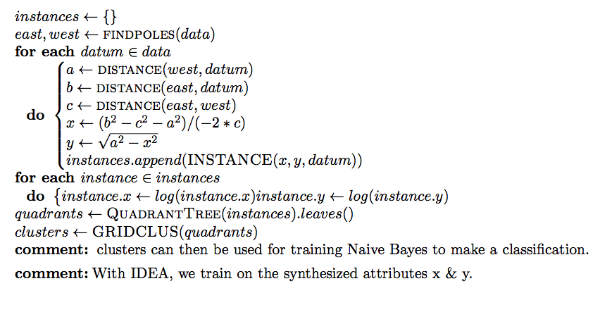
3b: main algorithm
(see next slides for sub-routines)

Slide 22
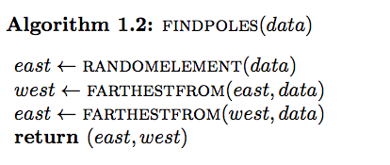
3c: FindPoles

Slide 23
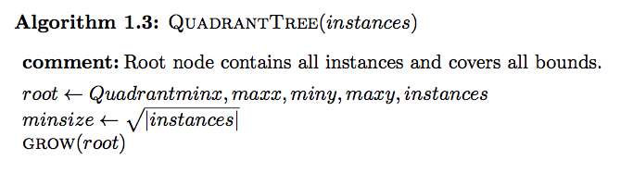
3d: QuadrantTrees

Slide 24
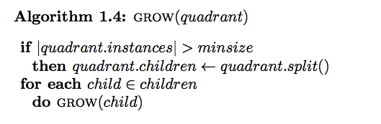
3e: Grow

Slide 25
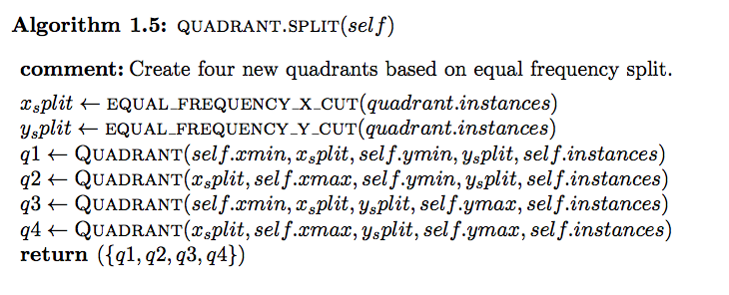
3f: Split

Slide 26
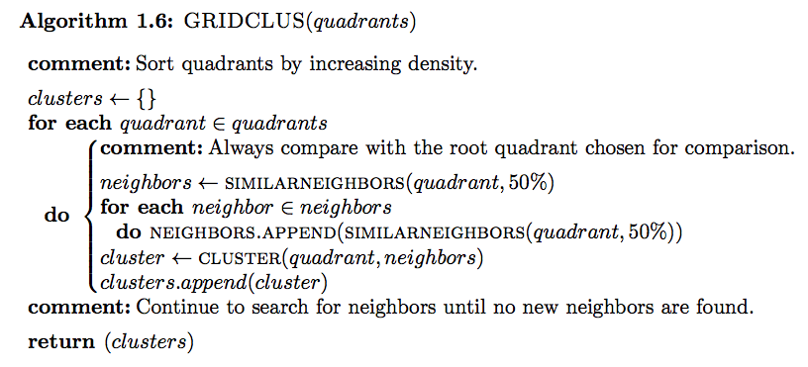
3g: GridClus
Comment: GridClus is needed since QuadrantTrees tends to over-split the data. GridClus
Fixes this by re-connecting neighbors with similar densities.

Slide 27
Details
Data collection
Scalability studies
Documentation work
Understanding active learning

Slide 28
4a: Active Learning
IDEA’s original plan was to be an “active learner”
  Find the most informative region within which to collect the next data sample
Active learning loop
  Take current knowledge
  Find region(s) where that knowledge is most brittle
  Explore those regions
  E.g. collect more data here, but not here

Slide 29

4b: Strange Results
In theory, active learning lets us learn from less data
  Don’t chase uninformative information
  Just collect the minimum
In practice, for the defect data sets, active learning is ineffective
  Theory performance changes as we learn from more data
  Performance changes indistinguishable between
    Selecting new data randomly
    Selecting new data via active learning

Slide 30
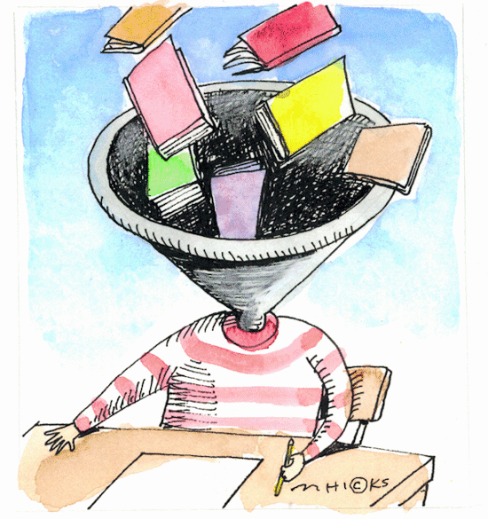
4c: What is going on?
Research approach
  Find a class of data where active learning does not work
  Find a class of data where it does
  Find the difference between (1), (2)
We already have (1):
  our defect data sets
Can we find (2)?

Slide 31
4d: E(k) matrices
E(k) matrix: static analysis of instance space.
  Everyone’s k-th nearest matrix
E(k)[i,j] is true if “j” appears in the k nearest neighbors of “i”
We ignore the trivial case where i=j
  i.e. an instance’s nearest neighbor does not include themselves
E(1) describes just the single nearest neighbor
Define “popularity” of instance “x’” to be Σ_{j} E(1)[x,j]
  i.e. how often is “x” someone else’s nearest neighbor

Slide 32
4e: Observation: many instances are unpopular
Effort estimation data sets
Ratio of instances with Σ_{j} E(1)[x,j] > 0
Observation:
  Up to half the data is unpopular Σ_{j} E(1)[x,j] = 0
Speculation:
  Popularity offers an active learning algorithm
  Sort instances descending by their popularity
  Label instances in that sort order
  Compare results
    after labeling “N” instances (active learning)
    After labeling all instances (passive learning)

Slide 33
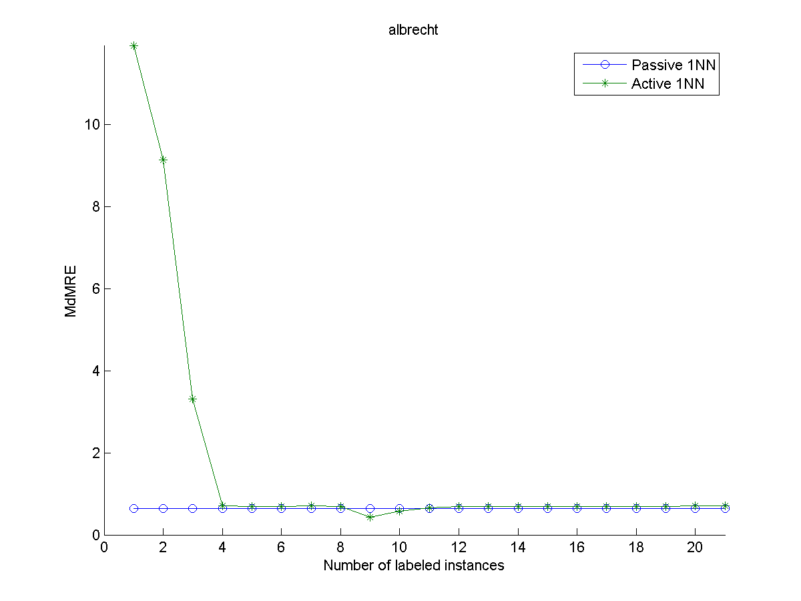
4f: results
4 labels are enough
Y-axis:
Prediction
Error (less
Is better)
Effort
Estimation
data

Slide 34
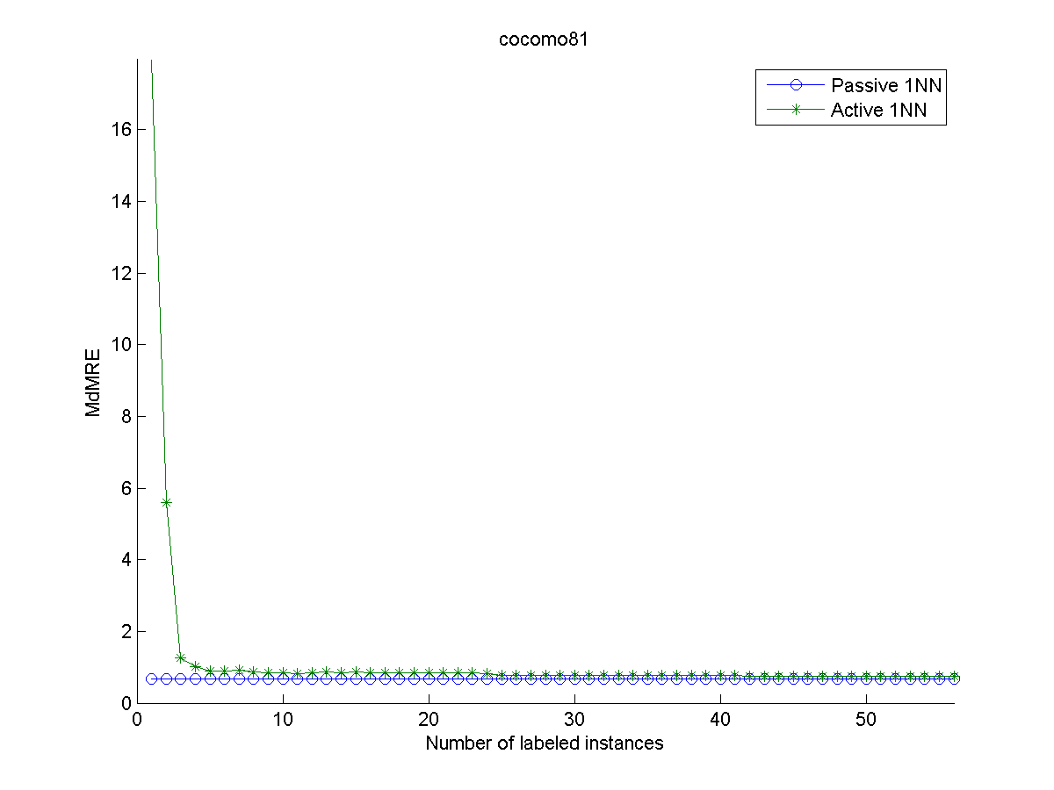
4g: results, different data
3 labels are enough
Y-axis:
Prediction
Error (less
Is better)
Effort
Estimation
data

Slide 35
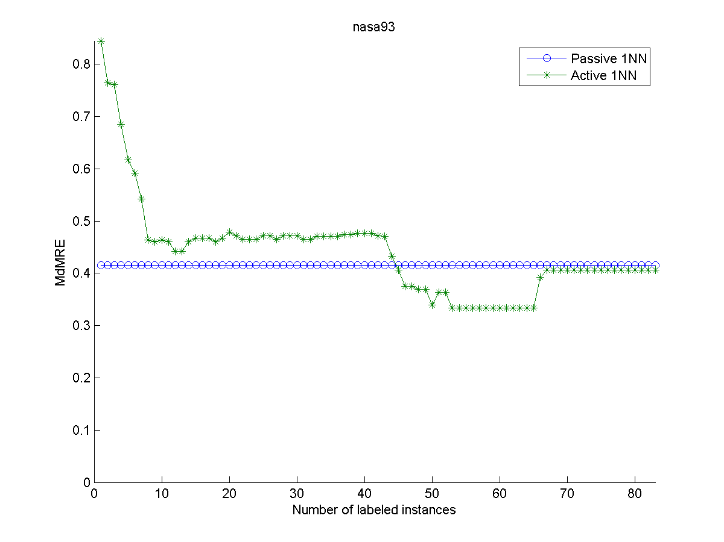
4h: results, different data
9 labels are enough
Y-axis:
Prediction
Error (less
Is better)
Effort
Estimation
data

Slide 36
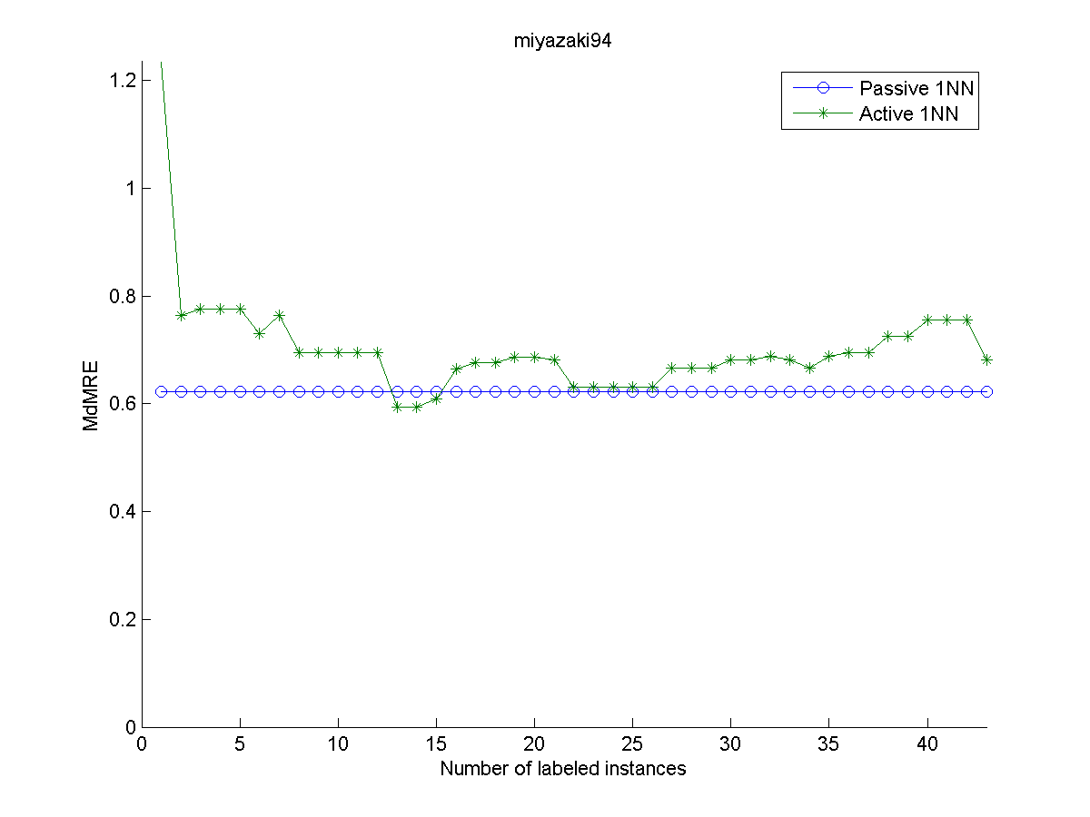
4i: results, different data
9 labels are enough
Y-axis:
Prediction
Error (less
Is better)
Effort
Estimation
data

Slide 37
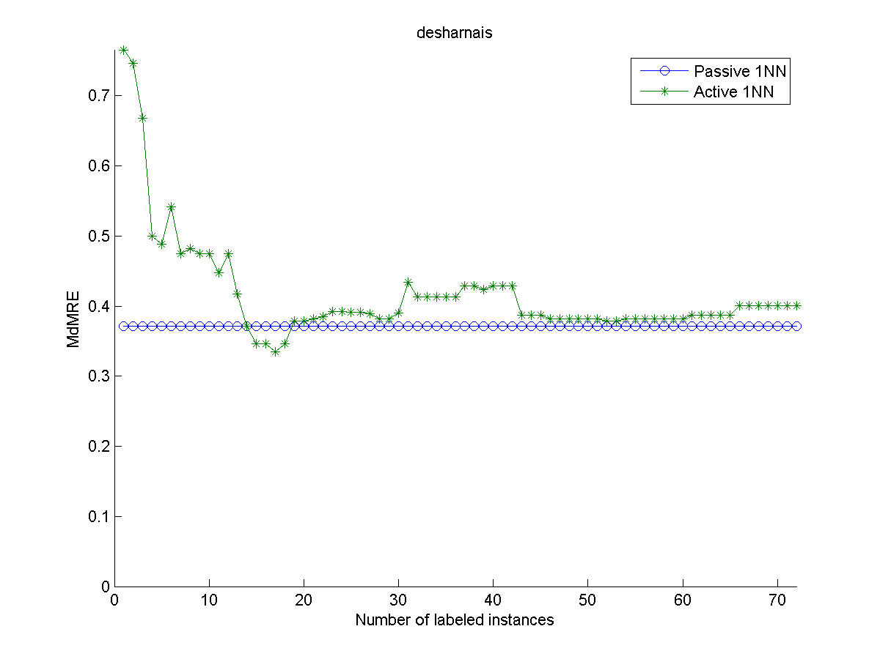
4j: results, different data
13 labels are enough
Y-axis:
Prediction
Error (less
Is better)
Effort
Estimation
data

Slide 38
4k: across all datasets
Strong active learning result
Around a dozen, or fewer, labels are enough
  Specifically: 3,4,9,9,13
Effort
Estimation
data

Slide 39

4l: Next steps
Recall our research approach
  Find a class of data where active learning does not work
  Find a class of data where it does
  Find the difference between (1), (2)
We have (1):
  our defect data sets
We have (2):
  The above effort estimation data sets
Next quarter
  Can we do (3)?
  Perhaps E(k) matrices will let us predict if a data set supports active learning?

