Slide 1
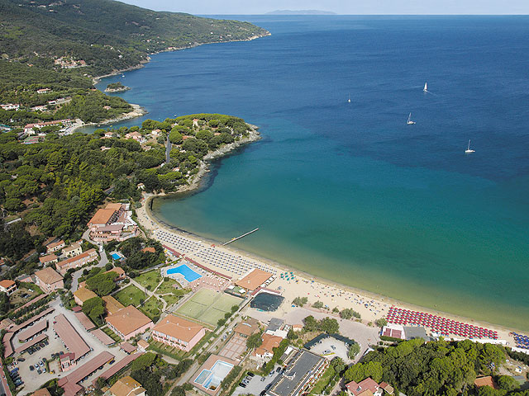
Empirical Software Engineering (Version 2.0) and Data Mining
Laser summer school ,Empirical SE
Sept 5-11, 2010, ElBA Island, Italy
Tim Menzies,
WVU, USA, tim@menzies.us, http://menzies.us
Download from http://unbox.org/wisp/var/timm/10/laser
Version history
V1: Aug18 ’10
V1a: Aug28 ’10
V1b: Sept02 ’10
V1c: Sept11’10

Slide 2
Road map
Data mining & SE (overview)
Data mining tools (guided tour of “WEKA”)
Data “carving” (core operators of DM)
Generality (or not)
Bias (is your friend)
Evaluation (does it really work?)

Slide 3
Change log
Version 1: Aug 18, 2010
  Version 1a: Aug 28, 2010
      2 more slides on “why empirical SE v2.0”
  Version 1b: Sept 2: minor edits
  Version 1c: minor edits
  Version 1d: mew conclusion

Slide 4
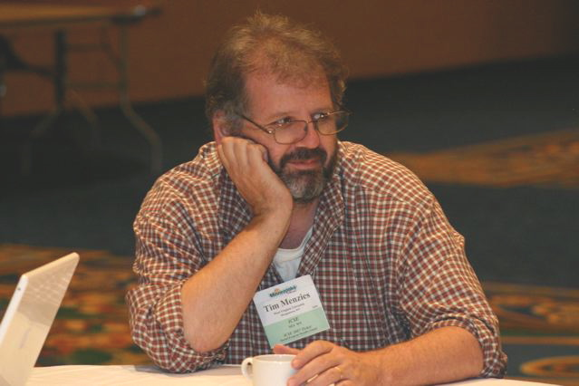
About the author
Dr. Tim Menzies (tim@menzies.us) has worked on advanced modeling + AI since 1986.
  PhD from Uni. New South Wales, Sydney, Oz
  Assoc/prof at WVU CS &EE
Former research chair for NASA
Author of190 refereed papers: http://menzies.us/papers.php
Co-founder and organizer of the PROMISE conferences on repeatable experiments in SE
For more, see http://menzies.us

Slide 5
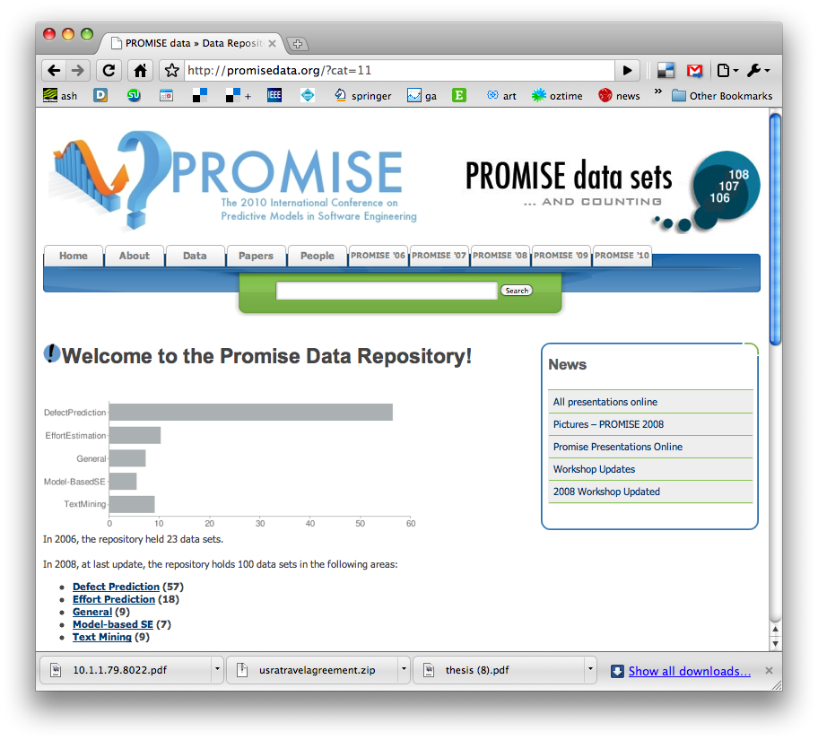
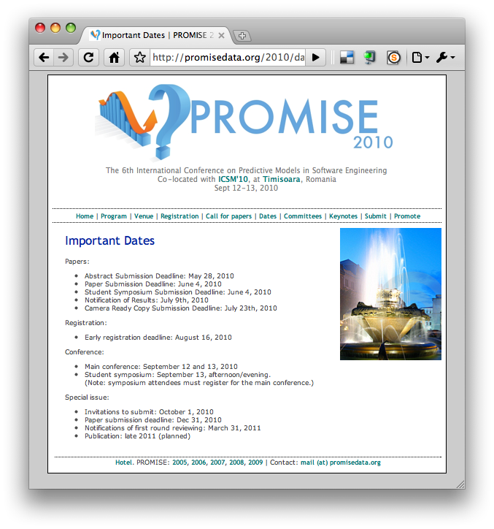
http://promisedata.org/data
Repository + annual
conference.
See you there?

Slide 6
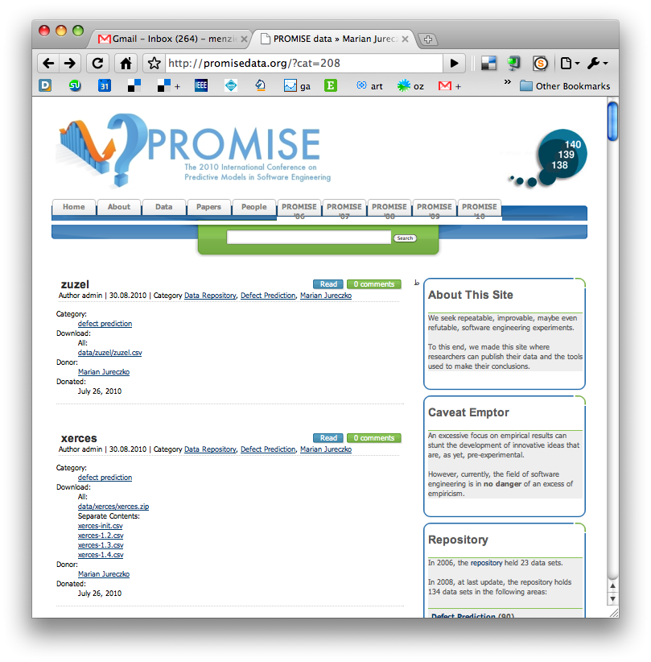
New trend
Ph.D. students, finishing up their studies, using PROMISE to archive their data
  E.g. 30 new OO data sets from Marian Jureczko
Are you next?

Slide 7


Digressions
References and further reading:
  shown in blue.
The following material has more Barry Boehm references than Victor Basili
  Only cause I’ve been working with Barry on effort estimation & value-based SE.
  To redress that imbalance, see
    Forrest Shull, Carolyn Seaman, Marvin Zelkowitz, "Victor R. Basili's Contributions to Software Quality," IEEE Software, vol. 23, no. 1, pp. 16-18, Jan./Feb. 2006,
    Or

Slide 8
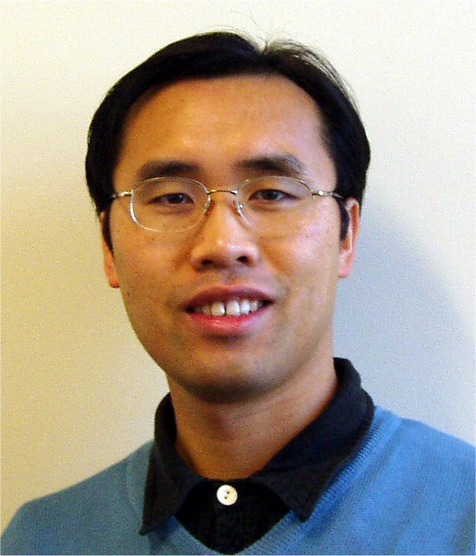

For other view on DM + SE
ICSE 2010 Tutorial T18 Tuesday, 4 May 2010 (afternoon)
Mining Software Engineering Data
  Ahmed E. Hassan: Queen's University, Canada
  Tao Xie: North Carolina State University, USA
Tutorial Slides:
  https://sites.google.com/site/asergrp/dmse/dmse-icse08-tutorial.ppt?attredirects=0

Slide 9
Data MINING & SE
(overview)

Slide 10
Road map
Data mining & SE (overview)
Data mining tools (guided tour of “WEKA”)
Data “carving” (core operators of DM)
Generality (or not)
Bias (is your friend)
Evaluation (does it really work?)

Slide 11
Definition
Finding patterns in (lots of) data
  Diamonds in the dust
Combines statistics, AI, visualization, ….
Synonyms
  Machine learning
  Business intelligence
  Predictive analytics
The art of the approximate scalable analysis
  Bigger is better
Used for… anything
  The review of current beliefs w.r.t. new data is the hallmark of human rationality.
  It is irrational NOT to data mine.

Slide 12
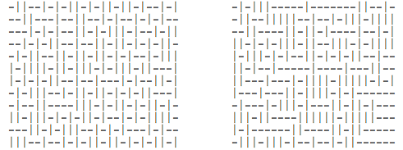
Exercise #1
One these these things is not like the other
  One was generating by selecting “-” or “|”
  at random, 300 times.
Which one?

Slide 13
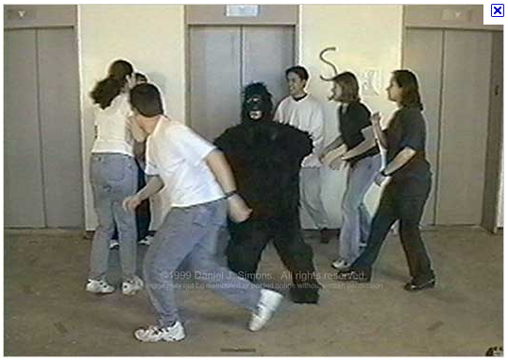
Exercise #2
A little experiment from http://www.youtube.com/v/vJG698U2Mvo&hl=en_US&fs=1&rel=0
Rules
  No one talks for the next 4 minutes
  If you know what is about to happen, see (1)
This is a selective
attention test
  Count the number
  of times the team
  with the white
  shirt passes the ball.

Slide 14
What have we learned?
Lesson #1:
  Algorithms can be pretty dumb
  If they don’t focus on X, they see any Y, at random.
Lesson #2:
  Humans can be pretty dumb
  If they mono-focus on X, you can miss Y
Maybe, any induction process is a guess
  And while guessing can be useful
  Guesses can also be wrong
Lets us a create community of agents,
each with novel insights and limitations
  Data miners working with humans
  Maybe in combination, we can see more that separately
Wikipedia:
List of cognitive biases
http://en.wikipedia.org/wiki/ List_of_cognitive_biases
• 38 decision making biases
• 30 biases in probability
• 18 social biases,
• 10 memory biases

Slide 15
Applications
Effort estimation
Defect prediction
Optimization of discrete systems
Test case generation
Fault localization
Text mining
Temporal sequence mining
  Learning software processes
  Learning APIs
Etc
Welcome to Empirical SE, Version 2.0

Slide 16
Applications
Effort estimation
Defect prediction
Optimization of discrete systems
Test case generation
Fault localization
Text mining
Temporal sequence mining
  Learning software processes
  Learning APIs
Etc
Welcome to Empirical SE, Version 2.0
Data mining applications
explored by me since 2007.
A career in data mining is a very diverse career, indeed

Slide 17
Application: Effort estimation
Can we predict development effort (time * staff)?
E.g. using linear regression; effort = a*KLOC^{b} c
  Boehm, B. W. 1981 Software Engineering Economics
  Boehm, B. W., Clark, Horowitz, Brown, Reifer, Chulani, Madachy, R., and Steece, B. 2000 Software Cost Estimation with Cocomo II
  Sunita Chulani, Barry W. Boehm, Bert Steece: Bayesian Analysis of Empirical Software Engineering Cost Models IEEE Trans. Software Eng. 25(4): 573-583 (1999)
E.g. using analogy
  Describe past projects according to N dimensions
  Float all known projects in an N-dimensional space
  To estimate a project, insert into that space; query its nearest neighbors
  For the classic estimation via analogy, see
    Martin J. Shepperd, Chris Schofield: Estimating Software Project Effort Using Analogies IEEE Trans. Software Eng. 23(11): 736-743 (1997)
  For 12,000+ variants to that process, see
    Fig1 of http://menzies.us/pdf/10stable.pdf
E.g. using other methods:
  See 154 variants in http://menzies.us/pdf/10stable.pdf

Slide 18
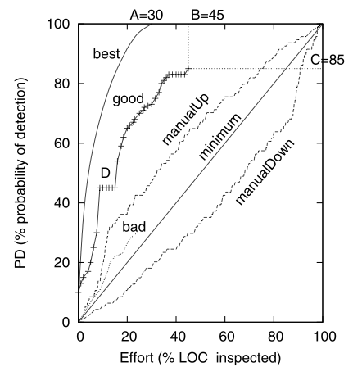
Application: Defect Prediction
Limited QA budgets, can’t check everything.
  Where should we place our inspection effort?
For a review, see Section Two of
  http://menzies.us/pdf/10which.pdf
Practical value:
  How to inspect less, and find more bugs

Slide 19
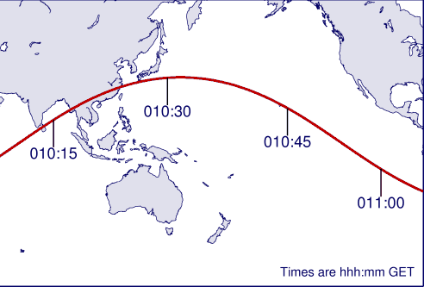
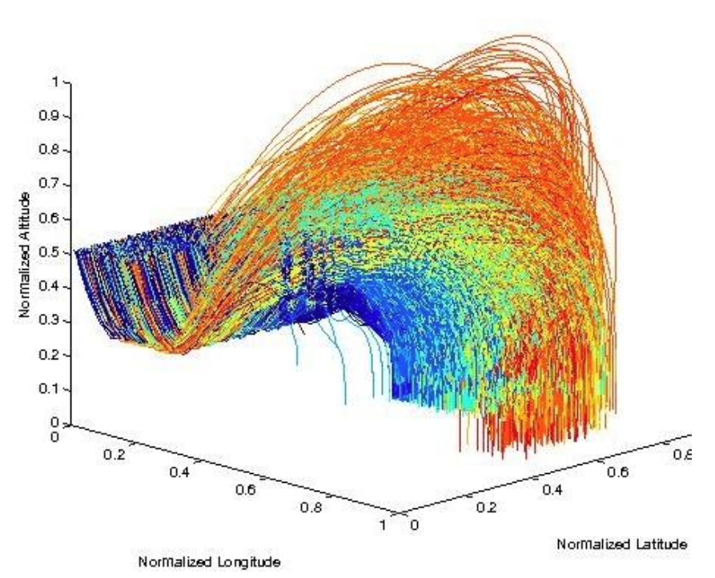
Application:
Optimizations of discrete systems
Standard numeric optimizers assume continuous, possibly even linear, equations
Data miners much happier to work in discrete spaces.
What factors predict for landing closest to the target?
    State-of-the-art optimizer
    Simulated annealing
    the TAR3 data miner
    TAR3 45 times faster, found better solutions
http://menzies.us/pdf/10keys.pdf

Slide 20
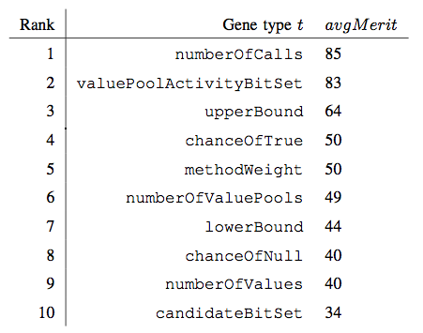
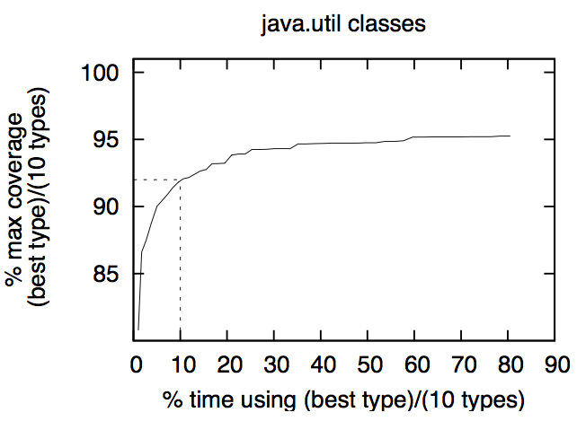
Application: Test Case Generation
NIGHTHAWK: A genetic algorithm that mutates sequences of method calls in order to maximize code coverage.
RELIEF: a data mining technique to find “interesting features”
    Same attribute same values in all classes?
      Boring
    Same Attribute, different values in different classes?
      Interesting
RELIEF found that 90% of NIGHTHAWK’s mutators were “boring”
  Order of magnitude speed up in test generation
James H. Andrews, Tim Menzies, Felix C.H. Li, "Genetic Algorithms for Randomized Unit Testing," IEEE Transactions on Software Engineering, 25 Mar. 2010.

Slide 21
Application: Fault Localization
100,000 JAVA methods
  In a matrix T*D
  T = “terms” = all the method calls in each method
  D = “documents” = all the methods
Bug report
  Replace text with just the method calls it mentions
  Add edited report as row D+one in the matrix
  Compute similarity of D+one to other rows (cosine similarity)
  The actual buggy method is in the closest 100 methods
  Use relevancy feedback to narrow down the search
Gregory Gay, Sonia Haiduc, Andrian Marcus Tim Menzies: On the use of relevance feedback in IR-based concept location ICSM 2009: 351-360

Slide 22
Application: Text Mining
80% of data in organizations is unstructured
  Not in databases, or XML schemas
  But in the natural language of (say) Word documents
Given enough of these seemingly unstructured documents, structures can be discovered
E.g.
  Thousands of natural language bug reports from NASA
  Used “feature reduction” to find the top 100 most important words
  Used standard data mining to learn predictors for defect severity from that top-100
  Tim Menzies, Andrian Marcus: Automated severity assessment of software defect reports. ICSM 2008: 346-355

Slide 23
Application:
Temporal Sequence Mining
Learning software process descriptions
  No more prescriptions of what we think goes on inside software projects
  Lets look at see at what actually happens
    Li, Mingshu and Boehm, Barry and Osterweil, Leon and Jensen, Chris and Scacchi, Walt “Experiences in Discovering, Modeling, and Reenacting Open Source Software Development Processes”, Unifying the Software Process Spectrum, Lecture Notes in Computer Science, 2006, page 449 to 462
Learning APIs from method sequence calls
  Tao Xie and Jian Pei. MAPO: Mining API Usages from Open Source Repositories. In Proceedings of the 3rd International Workshop on Mining Software Repositories (MSR 2006), Shanghai, China, pp. 54-57, May 2006
Learning patches from method sequence calls
  Suresh Thummalapenta and Tao Xie. Mining exception-handling rules as sequence association rules. In ICSE ’09: Proceedings of the 31st International Conference on Software Engineering, pages 496– 506, Washington, DC, USA, 2009. IEEE Computer Society.
Obtaining sequence miners:
  https://illimine.cs.uiuc.edu/
  Another tool set is at http://himalaya-tools.sourceforge.net/
  See more tools at https://sites.google.com/site/asergrp/dmse/resources

Slide 24
Application: etc etc etc
Data mining + SE a very active area
  PROMISE conference
  Mining Software Repository conference
See also
  ESEM conference
  Search-based software engineering
Hint: to get ahead of the curve…
  … learn sequence mining
Welcome to Empirical SE, version 2.0

Slide 25
Empirical SE, Version 2.0
Open Science movement
  Open Data
    Everyone places their data on-line, all the time
  Open Access publishing
    Death to subscription-based services
Shneiderman, B. (2008) "Science 2.0" Science 319(5868):1349-50
  Science meets web 2.0
  International team of researchers posting and analyzing data
  Research at internet speed
Anda, Markus et al (*) distinguish between
  Case studies: that collect new context variables from project data
  Experiments: that explore case study data
  Currently, very few case studies generating publicly available data
    But very many researchers wanting to experiment on that data
    Perfect setting for data mining
(*) Bente Anda Audris Mockus and Dag I.K. Sjoberg. Experiences from replicating a case study to investigate reproducibility of software development. In First International Workshop on Replication in Empirical Software Engineering Research, ICSE’09,

Slide 26
Q: Why Empirical SE 2.0?
A: Case study results may not generalize
What is true at one site,
  May not be true for another
  E.g. local sites have different goals, different biases, that changes what is “best” for that site
    II, P. G., Menzies, T., Williams, S., and El-Rawas, O. 2009. Understanding the Value of Software Engineering Technologies. In Proceedings of the 2009 IEEE/ACM international Conference on Automated Software Engineering(November 16 - 20, 2009)
  E.g. general policies perform worse than locally generated policies
    .
    Menzies, T., Williams, S., Boehm, B., and Hihn, J. 2009. How to avoid drastic software process change (using stochastic stability). In Proceedings of the 31st international Conference on Software Engineering (May 16 - 24, 2009
So we need to audit the conclusions of one case study w.r.t. to data taken from other sites.
Data mining is one technology that can (at least partially) automate that audit process

Slide 27
Q: Why Empirical SE 2.0?
A: Sharing is a good thing
WC= Within- company data
  Locally collected, locally applied
CC= Cross- company data
  Collected elsewhere, applied here.
Filtered CC works nearly as well as WC
  Turhan, B., Menzies, T., Bener, A. B., and Di Stefano, J. 2009. On the relative value of cross-company and within-company data for defect prediction. Empirical Softw. Engg. 14, 5 (Oct. 2009), 540-578
  Ekrem Kocaguneli, Gregory Gay, Tim Menzies, Ye Yang, Jacky Keung, When to Use Data from Other Projects for Effort Estimation, IEEE ASE 2010
So if ever you are doing new work,
  and lack local data,
  you can apply other people’s data
But only if it is available
  Open data !!!

Slide 28
Q: Why Empirical SE 2.0
A: Changing nature of data
In the 21st century
  we can access more data collected by others than we can ever can collect by ourselves.
In the 20th century,
  research was focused on case studies where researchers collected special purpose data sets for their particular questions.
In the 21st century,
  much research is devoted to experimentation with the data generated by the case studies,
  possibly investigating hypotheses not originally considered when the data was collected.
  Data mining is one way to experiment with data.

Slide 29
Q: Why Empirical SE 2.0?
A: Increasing pace of change
New developments are radically changing SE: open source toolkits, agile development, cloud-based computing, etc.
20th century Empirical SE used “big science”
  Research questions, data collection, analysis took years
  Big science is too slow to keep up with changes to contemporary SE. e.g.
    Increasing pace of organization change at NASA was fatal to the “big science” approach of Victor Basili’s Software Engineering Laboratory (*)
    V. Basili, F. McGarry, R. Pajerski, and M. Zelkowitz. Lessons learned from 25 years of process improvement: The rise and fall of the NASA software engineering laboratory. In Proceedings of the 24th International Conference on Software Engineering (ICSE) 2002, Orlando, Florida, 2002.
Data mining is one response to the open and urgent issue of
  how to reason faster about SE data.

Slide 30
Q: Why Empirical SE 2.0?
A: Changing nature of SE theories
20th century SE: the struggle for the single theory
  E.g. Boehm’s COCOMO effort estimation project
  E.g. SEI capability maturity model [130];
21st century: faster pace = more diversity
  Less likely that there exists a single over-arching grand theory of SE
Recent reports [1,2,3,4,5] say that while such generality may elude us, we can still find the special lessons that work best on the local projects
    Rombach A. Endres, H.D. A Handbook of Software and Systems Engineering: Empirical Observa- tions, Laws and Theories. Addison Wesley, 2003.
    B. Kitchenham D. Budgen, P. Brereton. Is evidence based software engineering mature enough for practice & policy? In 33rd Annual IEEE Software Engineering Workshop 2009 (SEW-33), Skvde, Sweden, 2009.
    B. A. Kitchenham, E. Mendes, and G. H. Travassos. Cross- vs. within-company cost estimation studies: A systematic review. IEEE Transactions on Software Engineering, pages 316–329, May 2007.
    Tim Menzies and Forrest Shull. The quest for convincing evidence. In A. Oram and G. Wilson, editors, Making Software: What Really Works, and Why We Believe It. O’Reilly, 2010.
    H. Gall E. Giger T. Zimmermann, N. Nagappan and B. Murphy. Cross-project defect prediction. In ESEC/FSE’09, August 2009.
Data mining is one way to rapidly find and verify the special practices that best work on the local projects.

Slide 31
Q: Why Empirical SE 2.0?
A: Changing nature of data analysis
A contemporary empirical SE paper might explore gigabytes of core dumps looking for the method calls that lead to a crash.
Faced with such large and complex data, analysis methods are becoming more intricate; e.g.
  Model trees for multi-model data
  Latent Dirichlet allocation (LDA) for document clustering
  Mining sequences to learn exception handling rules
It is now possible to ﬁnd new insights in old data, just by applying a new analysis method.
  E.g. see later, the “W” tool

Slide 32
Why Data Mining for SE?
Natural tool to help a community:
  racing to keep up with the pace of change in SE;
  while ﬁnding and verifying the special theories that work best on local projects …
  … from a new kind data sources …
  … using a large menagerie of new data analysis tools.

Slide 33

Empirical Science 2.0 adjusts its questions to the available data
The questions you
want to ask
The answers anyone else cares about
The questions the data can support (which, BTW, you won’t know till you look).
Are you here?

Slide 34
Coming next…
Enough generalities
Details of using a data mining tool suite
  The “WEKA”

Slide 35
Digression #1

Slide 36
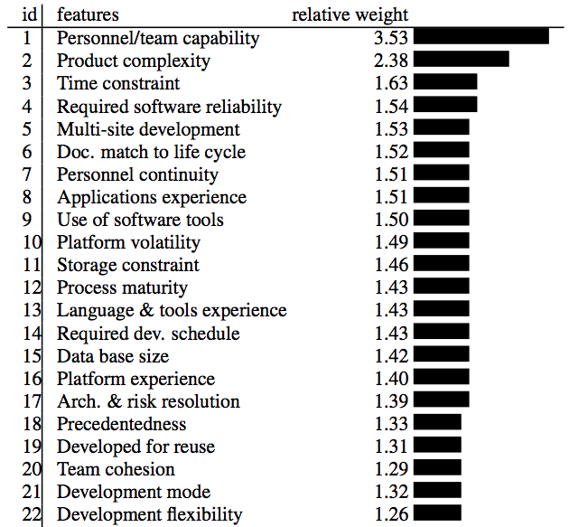
Are we spending our time on things that matter?
Objects,
Aspects,
Pair programming,
Design patterns
….
Source: Boehm 2000.
Regression results from
161 projects.

Slide 37
Are we spending our time on things that matter?
Objects,
Aspects,
Pair programming,
Design patterns
….
Source: Boehm 2000.
Regression results from
161 projects.

Slide 38
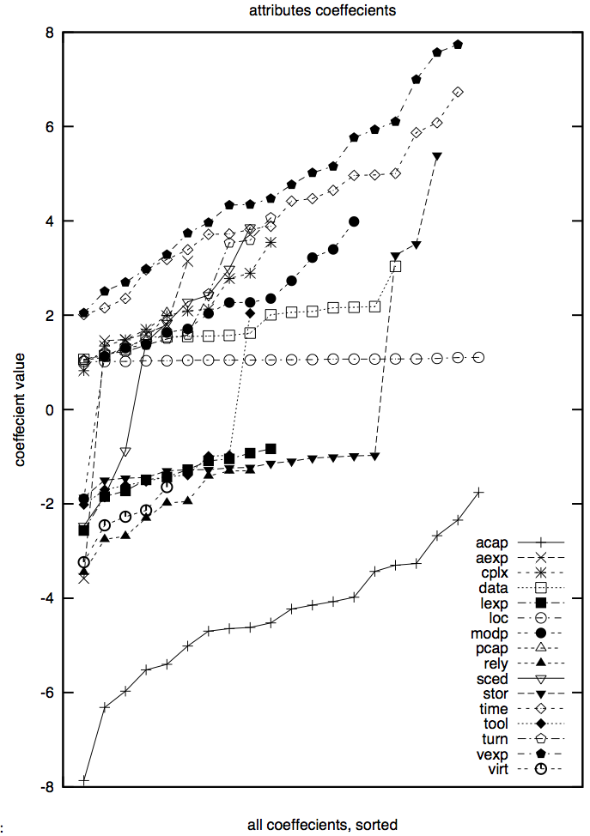
Once is not enough:
Stability studies: 20 * 90% samples
20 experiments, using 66% of the data (selected at random)
Linear regression:
  Effort = b₀ + sum of b_{i *} x_{i}
  Followed by a greedy back-select to prune dull variables
Results
  LOC influence stable
  Some variables pruned away half the time
  Large ranges (max – min)
  Nine attributes even change the sign on their coefficients

Slide 39
Data mining tools (guided tour of “WEKA”)

Slide 40
Road map
Data mining & SE (overview)
Data mining tools (guided tour of “WEKA”)
Data “carving” (core operators of DM)
Generality (or not)
Bias (is your friend)
Evaluation (does it really work?)

Slide 41

WEKA
Machine learning/data mining software written in Java
  Used for research, education, and applications
  Complements Data Mining: Practical Machine Learning Tools and Techniques (Second Edition) Ian H. Witten, Eibe Frank, Morgan Kaufmann June 2005 525 pages ISBN 0-12-088407-0
Main features
  Comprehensive set of data pre-processing tools, learning algorithms and evaluation methods
  Graphical user interfaces (incl. data visualization)
  Environment for comparing learning algorithms

Slide 42
Access
WEKA is available at
http://www.cs.waikato.ac.nz/ml/weka
Also has a list of projects based on WEKA
WEKA contributors:
Abdelaziz Mahoui, Alexander K. Seewald, Ashraf M. Kibriya, Bernhard Pfahringer , Brent Martin, Peter Flach, Eibe Frank ,Gabi Schmidberger ,Ian H. Witten , J. Lindgren, Janice Boughton, Jason Wells, Len Trigg, Lucio de Souza Coelho, Malcolm Ware, Mark Hall ,Remco Bouckaert , Richard Kirkby, Shane Butler, Shane Legg, Stuart Inglis, Sylvain Roy, Tony Voyle, Xin Xu, Yong Wang, Zhihai Wang

Slide 43
Data Files
@relation heart-disease-simplified
@attribute age numeric
@attribute sex { female, male}
@attribute chest_pain_type { typ_angina, asympt, non_anginal, atyp_angina}
@attribute cholesterol numeric
@attribute exercise_induced_angina { no, yes}
@attribute class { present, not_present}
@data
63,male,typ_angina,233,no,not_present
67,male,asympt,286,yes,present
67,male,asympt,229,yes,present
38,female,non_anginal,?,no,not_present
...
numeric attribute
nominal attribute
Flat file in
ARFF format

Slide 44
Explorer: pre-processing
Source
  Data can be imported from a file in various formats: ARFF, CSV, C4.5, binary
  Data can also be read from a URL or from an SQL database (using JDBC)
Pre-processing tools
  Called “filters”
  Discretization, normalization, resampling, attribute selection, transforming and combining attributes, …

Slide 45
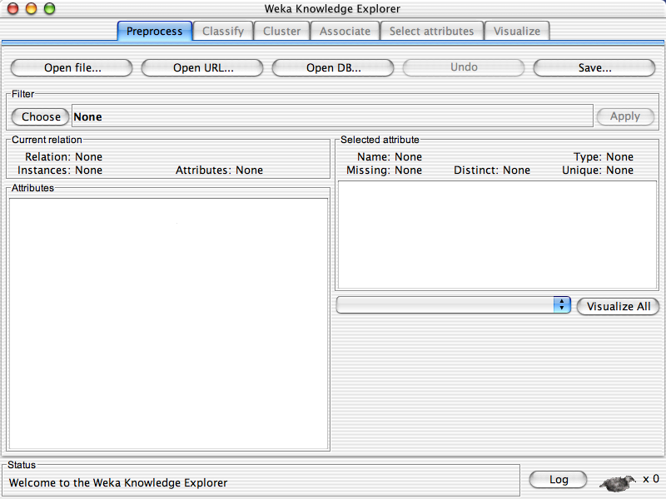

Slide 47
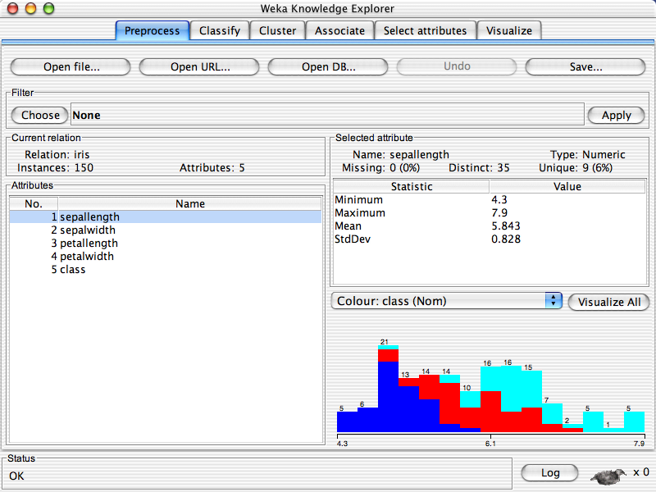

Slide 49
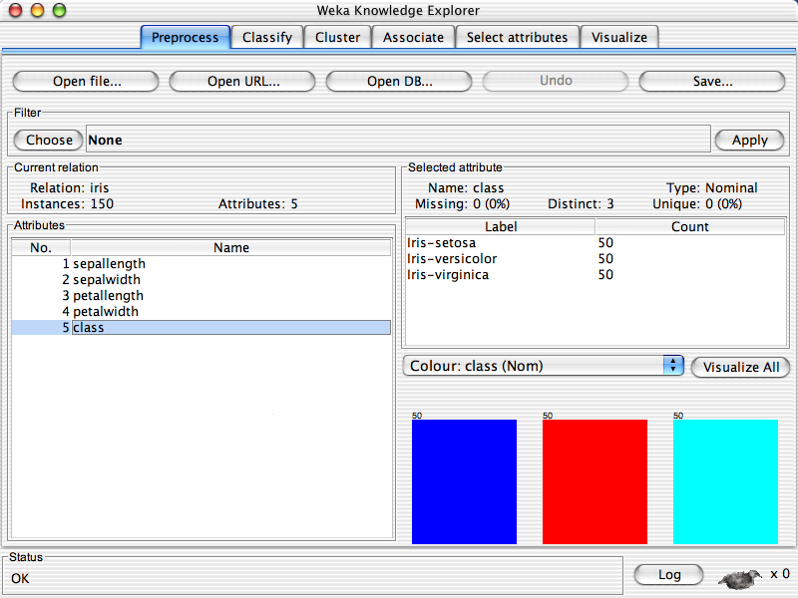

Slide 51
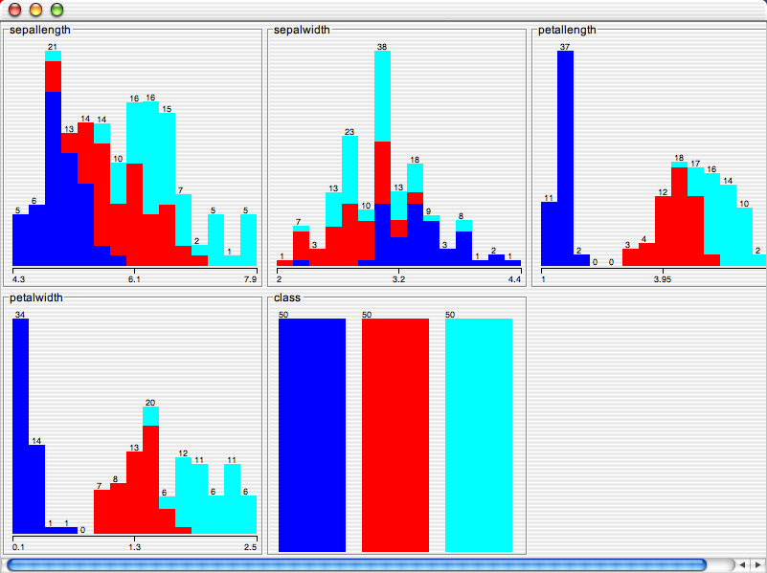

Slide 52
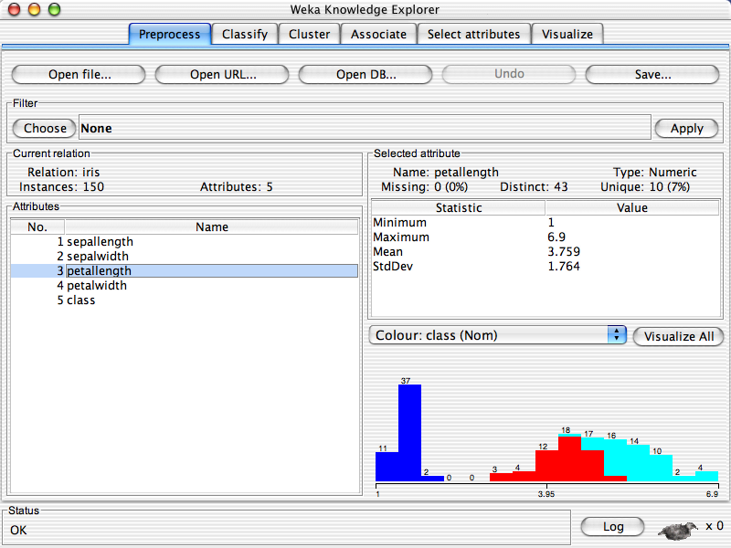

Slide 54
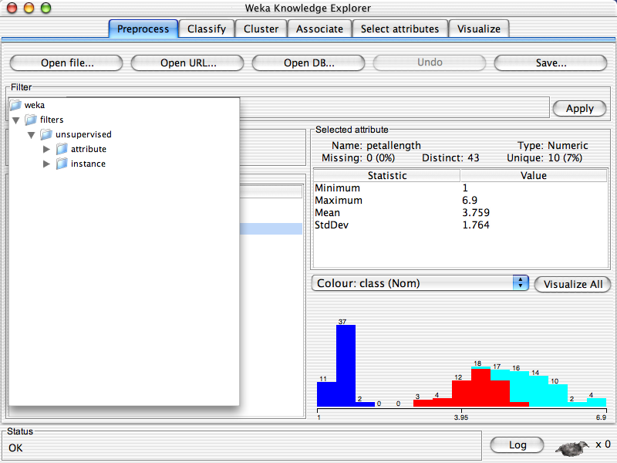

Slide 56
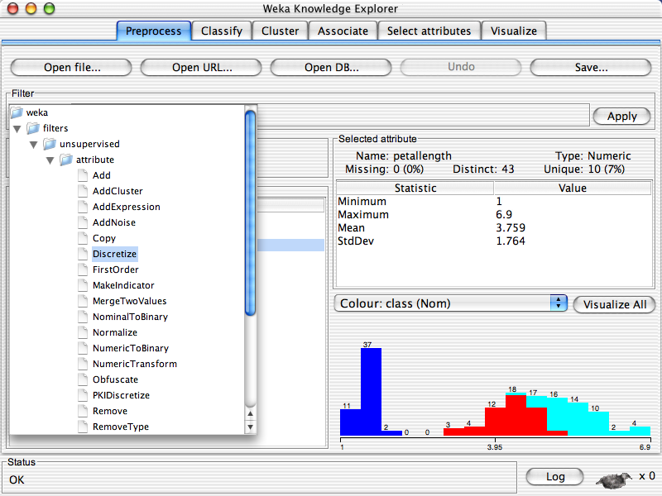

Slide 57
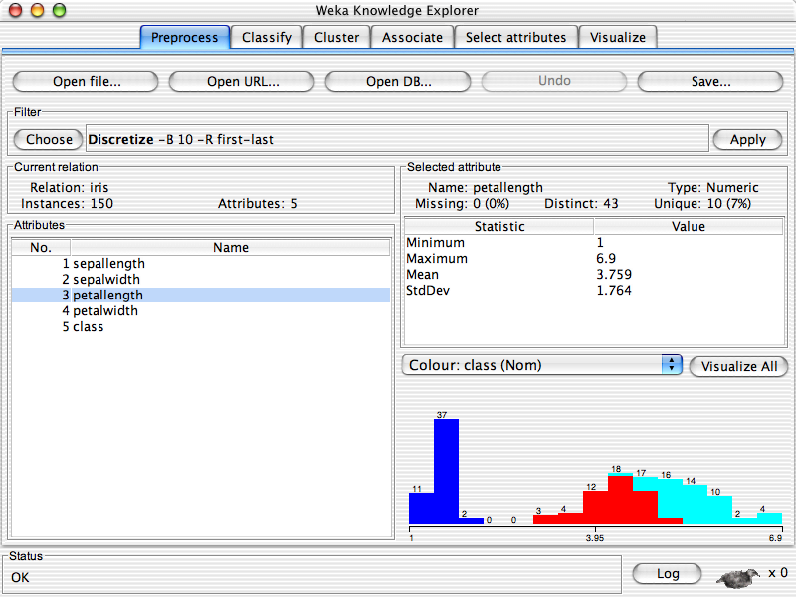

Slide 59
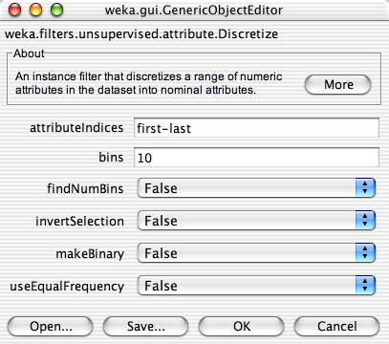

Slide 61
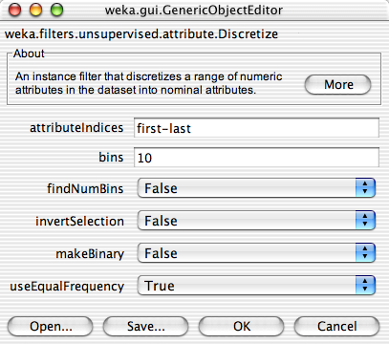

Slide 63


Slide 65
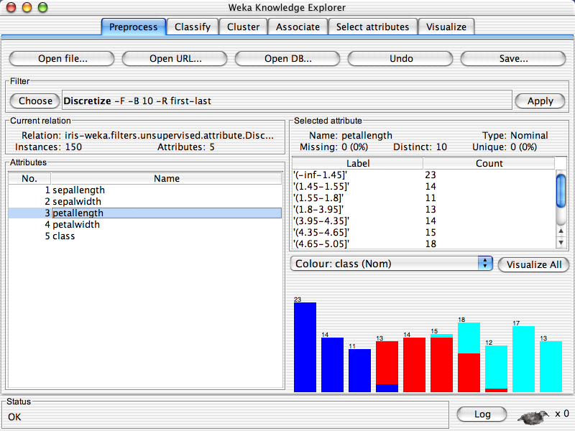

Slide 66
Explorer: building “classifiers”
Classifiers in WEKA are models for predicting nominal or numeric quantities
Implemented learning schemes include:
  Decision trees and lists, instance-based classifiers, support vector machines, multi-layer perceptrons, logistic regression, Bayes’ nets, …
“Meta”-classifiers include:
  Bagging, boosting, stacking, error-correcting output codes, locally weighted learning, …

Slide 67
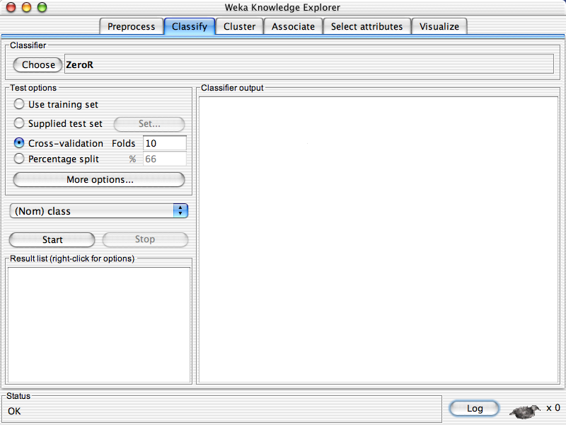

Slide 69
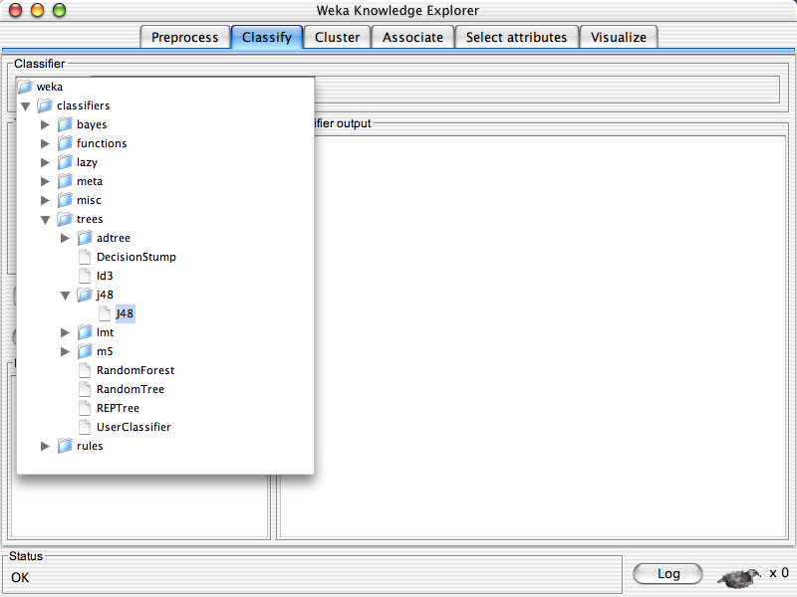

Slide 70
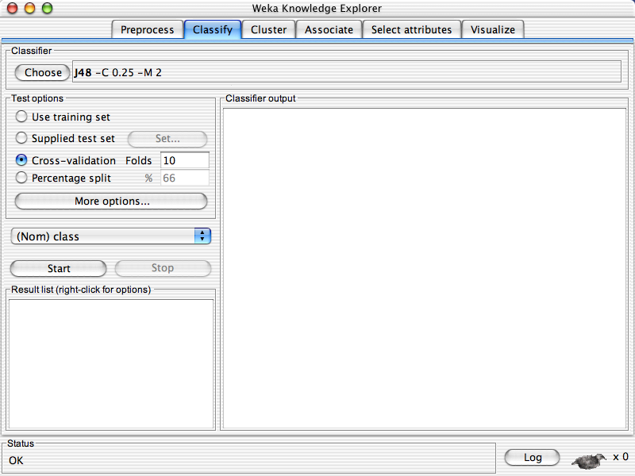

Slide 72
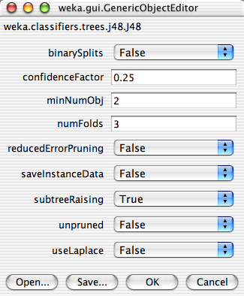

Slide 76
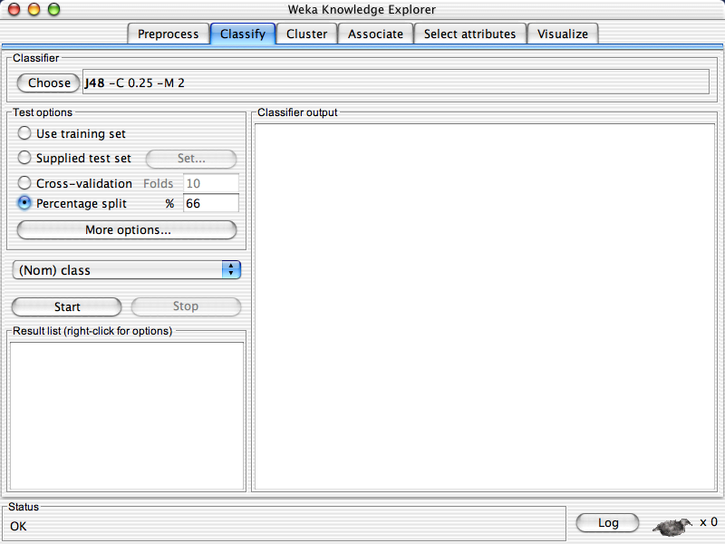

Slide 78
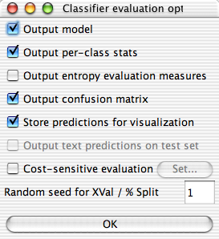

Slide 82
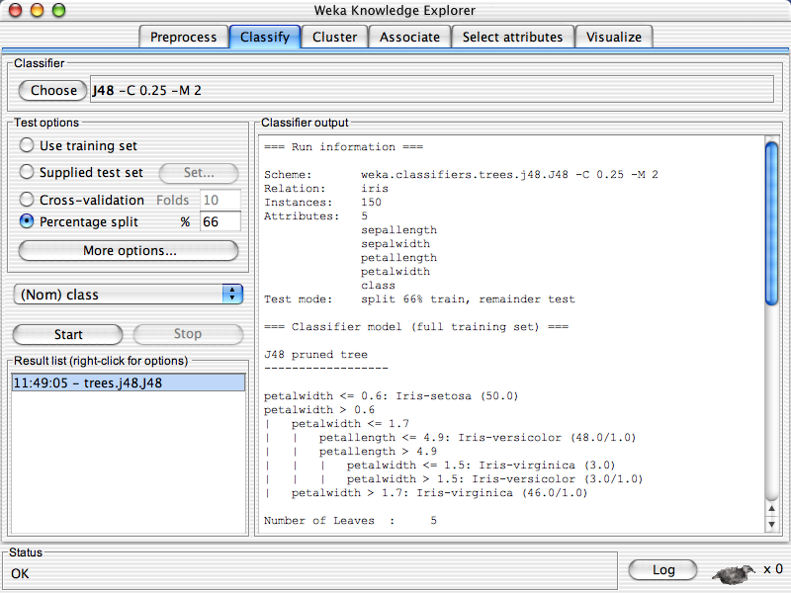

Slide 85
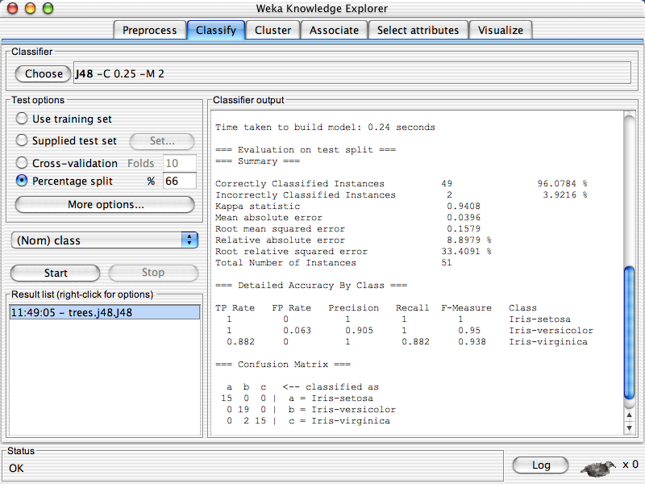

Slide 88
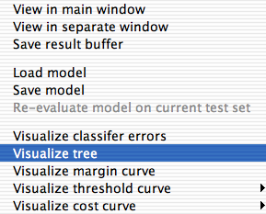

Slide 89
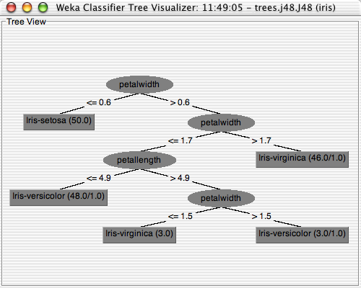

Slide 90
Explorer: clustering data
WEKA contains “clusterers” for finding groups of similar instances in a dataset
Implemented schemes are:
  k-Means, EM, Cobweb, X-means, FarthestFirst
Clusters can be visualized and compared to “true” clusters (if given)
Evaluation based on loglikelihood if clustering scheme produces a probability distribution

Slide 91
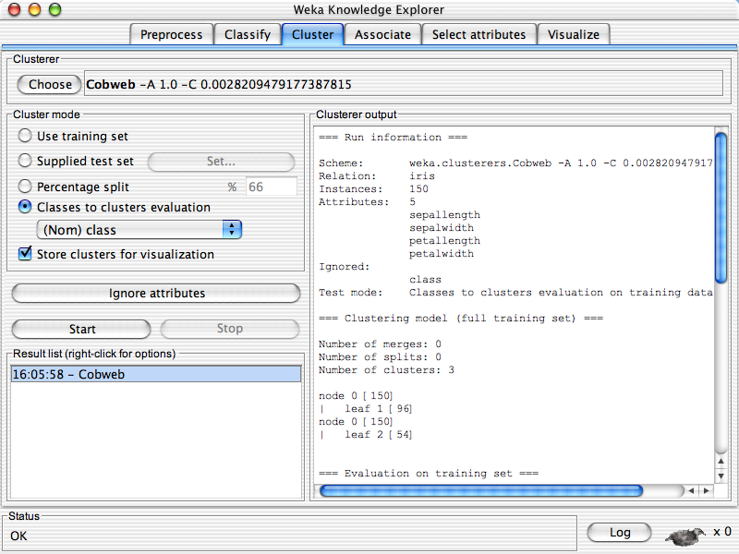

Slide 92
Explorer: finding associations
WEKA contains an implementation of the Apriori algorithm for learning association rules
  Works only with discrete data
Can identify statistical dependencies between groups of attributes:
  milk, butter ⇒ bread, eggs (with confidence 0.9 and support 2000)
Apriori can compute all rules that have a given minimum support and exceed a given confidence

Slide 93
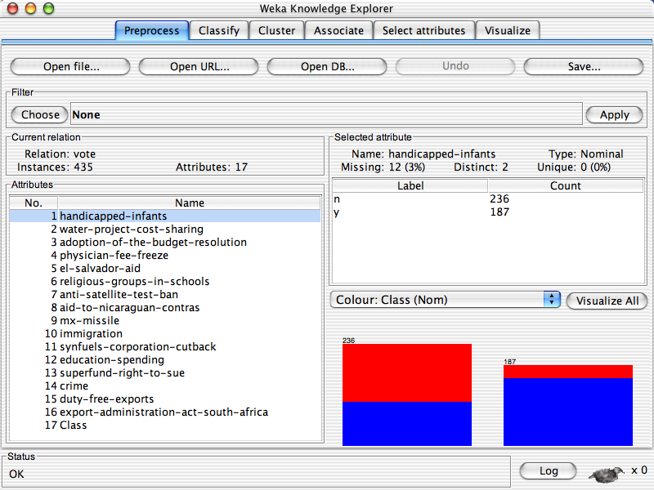

Slide 94
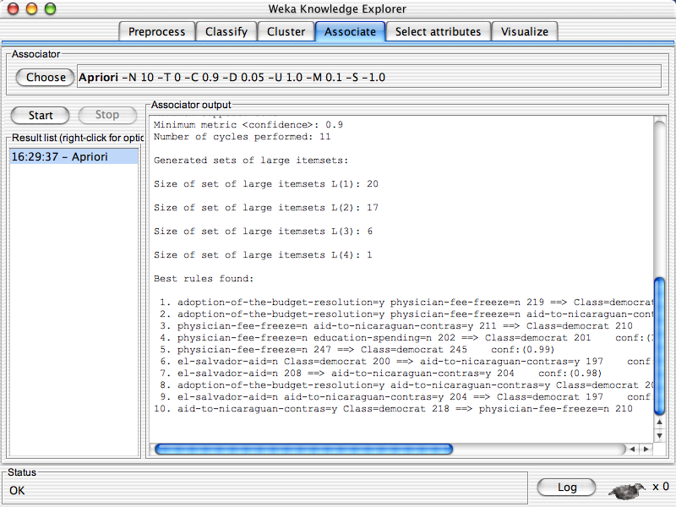

Slide 95
Explorer: attribute selection
Panel that can be used to investigate which (subsets of) attributes are the most predictive ones
Attribute selection methods contain two parts:
  A search method: best-first, forward selection, random, exhaustive, genetic algorithm, ranking
  An evaluation method: correlation-based, wrapper, information gain, chi-squared, …
Very flexible: WEKA allows (almost) arbitrary combinations of these two

Slide 96
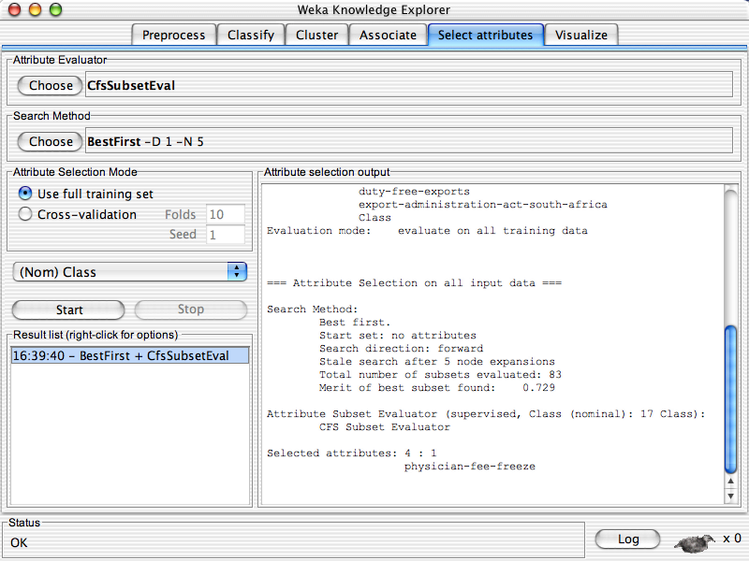

Slide 98
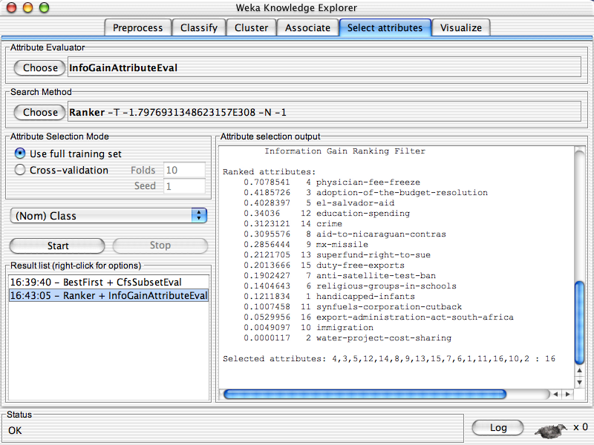

Slide 100
Which attribute selector?
Best: WRAPPER
  Slow: O(2^N) search through all attribute combinations
  The “wrapped” learner called to assess each combination
  Some heuristics to prune the search; but does not scale
If not WRAPPER
  Use InfoGain / OneR for very big datasets
  Use CFS otherwise
Don’t use PCA
  This is an unsupervised selector
  So it is uninformed on how dimensions help classification

Slide 101
Limitations
Loads all data into ram prior to learning
  Problem for large data sets
Not good for complex experiments
IMHO, discourages experimentation with new learners
  The “WEKA effect”
    Try every learner till something works
Still, very useful for
  Initial investigations
  Learning data mining
  Or as a sub-routine of other systems

Slide 102
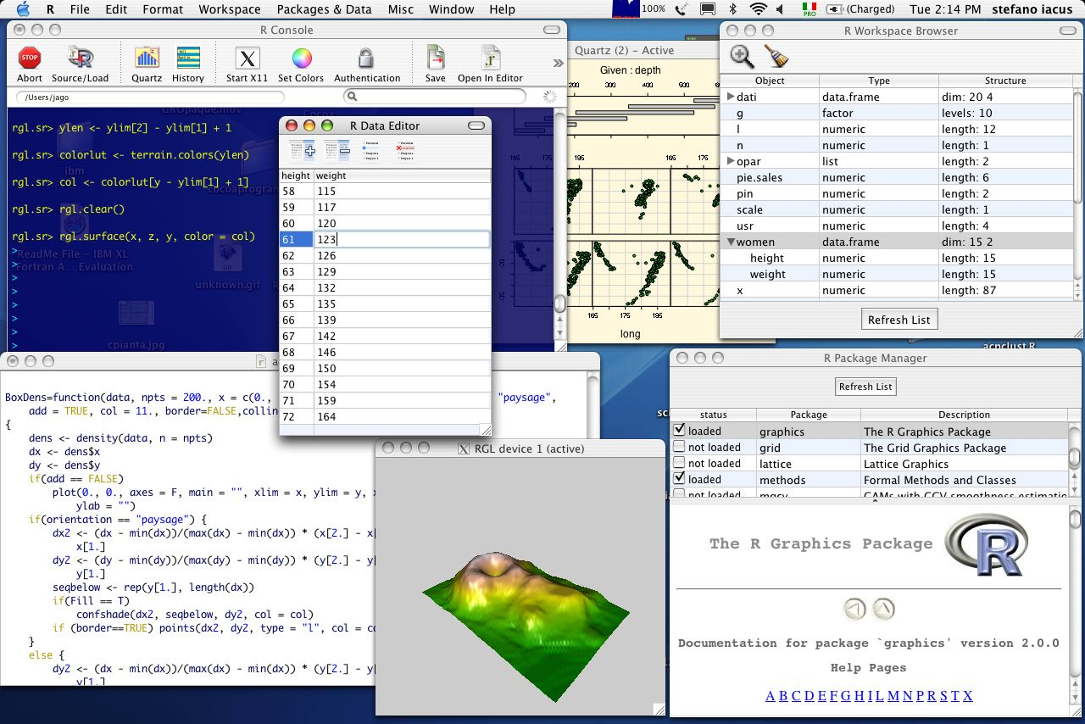
Alternate tools: “R”
Leading open-source system for statistical computing and graphics,
http://www.r-project.org/

Slide 103
Alternate tools: Matlab
For me: just say no
Open science, open tools

Slide 104
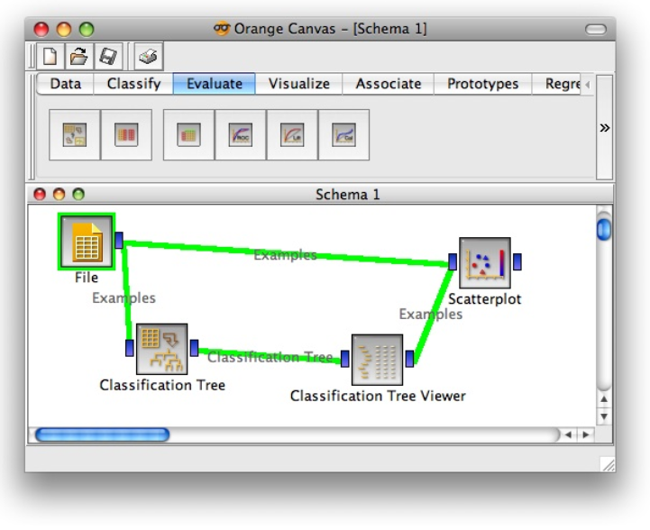
Alternate tools: Orange
Written in Python
Simpler specification (but see WEKA’s KnowledgeFlow
Environment).
Also, less community support/debugging. So sometimes
frustrated by random bugs

Slide 105
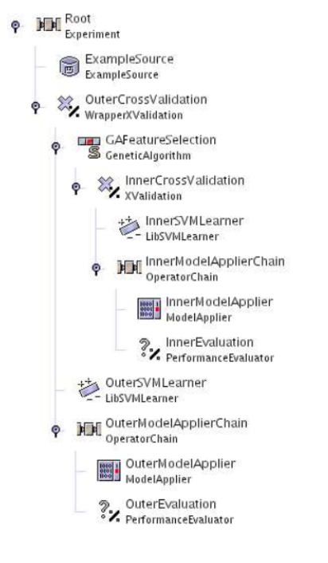
Alternate tools: RapidMiner
Experiments specified in an XML tree syntax
In theory, possible to share experimental descriptions

Slide 106
Alternate tools: OurMine
Forget the visuals.
Make WEKA a sub-routine
inside Bash script
Now you can mix WEKA’s JAVA with learners written in your
favorite language.
But how do you find the magic
command strings?
Java=$Base/lib/java
Weka="java -Xmx2048M -cp $Java/weka.jar ”
Clusterers="java -Xmx1024M -jar $Java/Clusterers.jar ”
Reducers="java -Xmx1024M -jar $Java/Reduce.jar ”
nb() {
local learner=weka.classifiers.bayes.NaiveBayes
$Weka $learner -p 0 -t $1 -T $2
}
nb10() {
local learner=weka.classifiers.bayes.NaiveBayes
$Weka $learner -i -t $1
}
j48() {
local learner=weka.classifiers.trees.J48
$Weka $learner -p 0 -C 0.25 -M 2 -t $1 -T $2
}
Adam Nelson, Tim Menzies, Gregory Gay,
Sharing Experiments Using Open Source Software,
Softw. Pract. Exper. 2011

Slide 108
Why go to all that trouble?
analysis1(){
local origdata=$1
local outstats=$2
local nattrs="2 4 6 8 10 12 14 16 18 20"
local learners="nb10 j4810 zeror10 oner10 adtree10"
local reducers="infogain chisquared oneR"
local tmpred=$Tmp/red
echo "n,reducer,learner,accuracy" > $outstats
for n in $nattrs; do
for reducer in $reducers; do
$reducer $origdata $n $tmpred
for learner in $learners; do
accur=`$learner $tmpred.arff | acc
out="$n,$reducer,$learner,$accur"
blabln $out
echo $out >> $outstats
done
done
done
}
Complex experiments, specified succinctly.
Experiments can now be reviewed, audited, by others.
Also, in 12 months time when Reviewer2 wants a tiny extension to the old paper, you don’t have to remember all that clicking you did: just rerun the script.

Slide 109
Coming next…
Enough details
So many tools in WEKA, R, Rapid-Miner, Orange, OURMINE…
The great secret
  All those “different” tools do the same thing.
    Carve up vector space.

Slide 110
Data CARVING
(The core operators of DM)

Slide 111
Road map
Data mining & SE (overview)
Data mining tools (guided tour of “WEKA”)
Data “carving” (core operators of DM)
Generality (or not)
Bias (is your friend)
Evaluation (does it really work?)

Slide 112

“Data Carving”:
A geometric view of data mining
Data is like a block of marble,
  waiting for a sculptor (that’s you)
  to find the shape within
So “data mining” is really “data carving”
  chipping away the irrelevancies
  To find what lies beneath.

Slide 113
Four operators of data carving
Each example is a row in a table
What can can we do change the table geometry?
Clump
Select
columns
Select
rows
Rotate
(add new
columns)
Clump columns
@attribute outlook {sunny, overcast, rainy}
@attribute temperature real
@attribute humidity real
@attribute windy {TRUE, FALSE}
@attribute play {yes, no}
@data
sunny, 85,85,FALSE, no
sunny, 80,90,TRUE, no
overcast, 83,86,FALSE, yes
rainy, 70,96,FALSE, no
rainy, 68,80,FALSE, yes
rainy, 65,70,TRUE, no
overcast, 64,65,TRUE, yes
sunny, 72,95,FALSE, no
sunny, 69,70,FALSE, yes
rainy, 75,80,FALSE, yes
sunny, 75,70,TRUE, yes
overcast, 72,90,TRUE, yes
overcast, 81,75,FALSE, yes
rainy, 71,91,TRUE, no

Slide 114
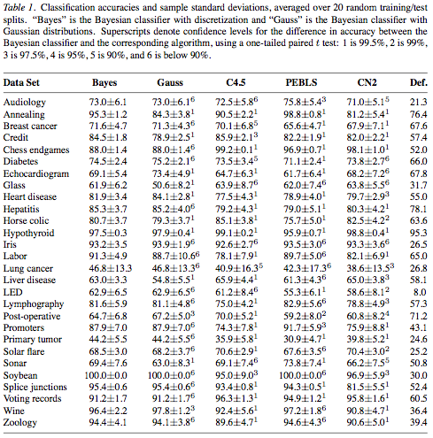
The field is called “data mining”, not “algorithm mining”
To understand data mining, look at the data, not the algorithms
Why? We do data mining not to study algorithms.
  But to study data
Our results should be insights about data,
  not trivia about (say) decision tree algorithms
Besides, the thing that most predicts for performance is the data, not the algorithm,
  Pedro Domingos and Michael J. Pazzani, On the Optimality of the Simple Bayesian Classifier under Zero-One Loss, Machine Learning, Volume 29, number 2-3, pages 103-130, 1997

Slide 115
The rest of this hour
1. Clump
2. Select
columns
3. Select
rows
4. Rotate
(add new
columns)
5. Clump columns

Slide 116
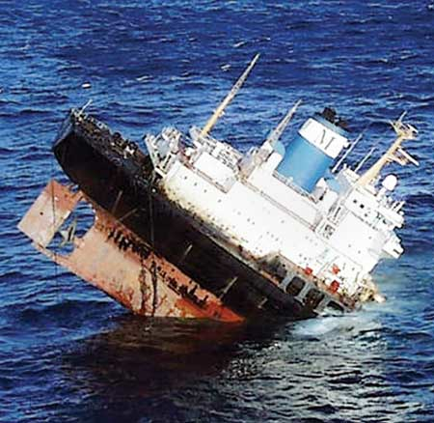
Carving can be dangerous
While carving the training data is recommended
  It is a methodological error to carve the test data
Whatever is learned from the training data
  Should be assessed on “raw” (i.e. uncarved) test data

Slide 117
Clumping column data
(a.k.a. discretization)
Learning = compression
  Take a target concept that is spread out across all the data
  Squeeze it together till it is dense enough to be visible.
Discretization: clump together observations taken over a continuous range
  into a small number of regions.
E.g. "toddlers” If age =1,2,3
Discretization improves the performance of a learner
  Gives a learner a smaller space to reason about,
  With more examples in each part of the space
overcast, 64,65,TRUE, yes
Rainy, 65,70,TRUE, no
sunny, 69,70,FALSE,yes
sunny, 75,70,TRUE, yes
overcast, 81,75,FALSE,yes
rainy, 68,80,FALSE,yes
rainy, 75,80,FALSE,yes
sunny, 85,85,FALSE,no
overcast, 83,86,FALSE,yes
overcast, 72,90,TRUE, yes
sunny, 80,90,TRUE, no
rainy, 71,91,TRUE, no
sunny, 72,95,FALSE,no
rainy, 70,96,FALSE,no

Slide 118
Supervised
Discretization
Standard method:
  Find a break that most reduces class diversity either side of the break
  Recurse on data:
    above break,
    below break
  Fayyad and Irani, Multi-Interval Discretization of Continuous-Valued Attributes for Classification Learning IJCAI’93, pp1022-1027
overcast, 64,65,TRUE, yes
Rainy, 65,70,TRUE, no
sunny, 69,70,FALSE,yes
sunny, 75,70,TRUE, yes
overcast, 81,75,FALSE,yes
rainy, 68,80,FALSE,yes
rainy, 75,80,FALSE,yes
sunny, 85,85,FALSE,no
overcast, 83,86,FALSE,yes
overcast, 72,90,TRUE, yes
sunny, 80,90,TRUE, no
rainy, 71,91,TRUE, no
sunny, 72,95,FALSE,no
rainy, 70,96,FALSE,no

Slide 119
Unsupervised
Discretization
Divide into “B” bins
  (X – Min) / ((Max – Min )/ B)
  B=3 or 10 very common
Divide into P percentile groups
  Each bins contains (say) 25% of the rows
For Bayesian methods
  Divide into groups of N items
  Ying and Webb recommends N= sqrt(rows)
  Ying Yang and Geoff Webb, Weighted Proportional k-Interval Discretization of Naïve Bayes classifeirs, PAKADD’03, p501-512, 2003

Slide 120
Select columns
Occam's Razor - Entia non sunt multiplicanda praeter necessitatem.( "Entities should not be multiplied more than necessary").
  the fewer features used to explain something, the better
Log(OR):
  Discrete every feature. For all pairs of target / other of size C1, C2 count frequency of range N1, N2 in each class
  Log(odds ratio) = log((N1/C1) / (N2/C2)) > 0 if more frequent in target
  “Pivots” are the ranges with high Log (OR)
  Možina, M., Demšar, J., Kattan, M., and Zupan, B. 2004. Nomograms for visualization of naive Bayesian classifier. InProceedings of the 8th European Conference on Principles and Practice of Knowledge Discovery in Databases (Pisa, Italy, September 20 - 24, 2004)
InfoGain:
  Use Fayyad Irani trick: assses each column by how well it divides up the data
  Takes linear time : O(C)
Wrapper:
  Explore 2^{C} subsets of C columns: takes time O(2^{C})
  Call a learner on each subset
  Use the columns that maximize learner performance
  Not practical for large data sets
For more, see Hall, M. and Holmes, G. (2003). Benchmarking attribute selection techniques for discrete class data mining. IEEE Transactions on Knowledge and Data Engineering. 15(3), November/December 2003

Slide 121
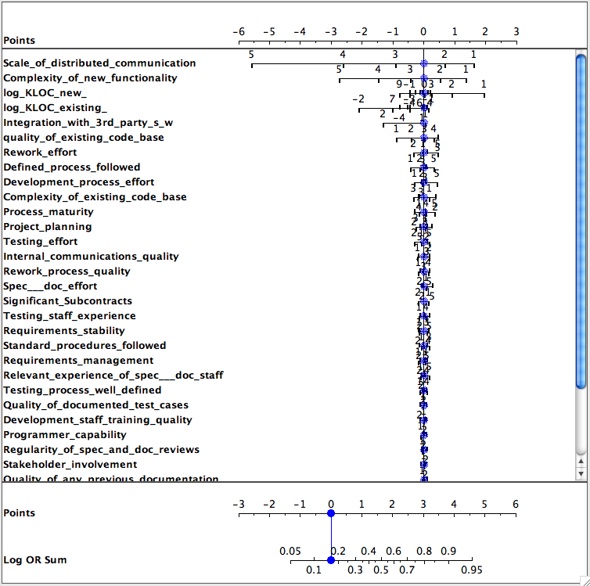
Select columns with log(OR)
Data from Norman Fenton’s Bayes Net
  Project Data Incorporating Qualitative Factors for Improved Software Defect Prediction Norman Fenton, Martin Neil, William Marsh, Peter Hearty, Lukasz Radlinski and Paul Krause., PROMISE 2008
Target class. worse defects
Only a few features matter
Only a few ranges of those features matter

Slide 122
Select columns with log(OR)
Data from Norman Fenton’s Bayes Net
  Project Data Incorporating Qualitative Factors for Improved Software Defect Prediction Norman Fenton, Martin Neil, William Marsh, Peter Hearty, Lukasz Radlinski and Paul Krause., PROMISE 2008
Target class. worse defects
Only a few features matter
Only a few ranges of those features matter
Pivotal if
Log(OR) >
0.2 * max of
Log(OR)

Slide 123
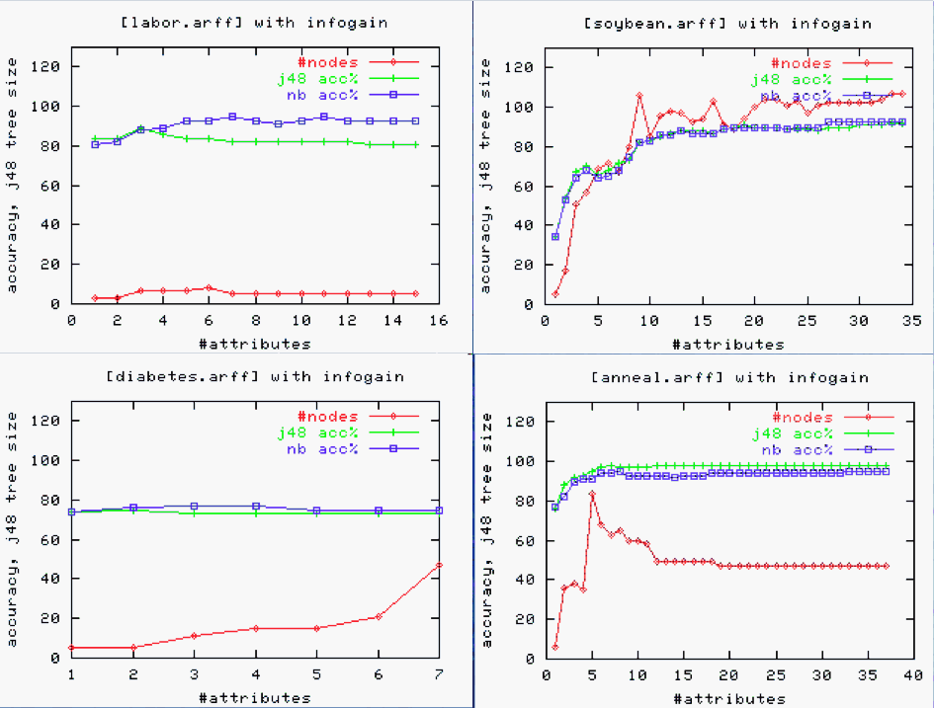
Select columns with InfoGain
X-axis
sorted by
sum(-p*log(p))
Simpler theories after column selection,
work just as well as using everything

Slide 124
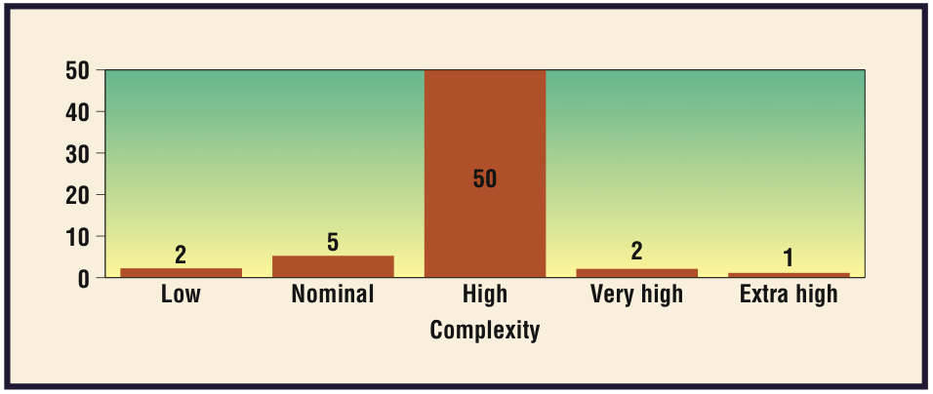
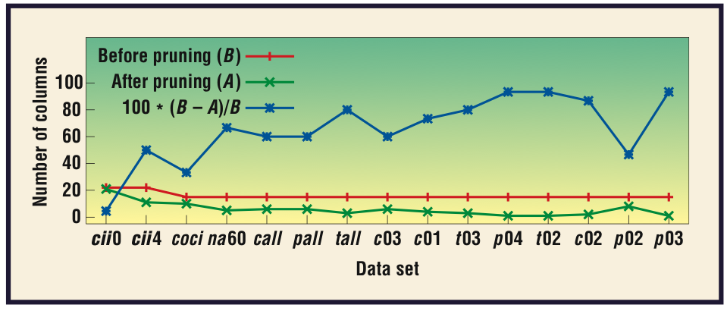

Select columns with WRAPPER
  Finding the Right Data for Software Cost Modeling Chen, Menzies, Port, Boehm, IEEE Software Nov/Dec 2005

Slide 125
Select rows
Replace N rows
  with M < N rows
  that best exemplify the data
Typical result:
  Can throw out 80 to 90% of the rows without lossing accuracy
  C. Chang, “Finding prototypes for nearest neighbor classiﬁers,” IEEE Trans. on Computers, pp. 1179–1185, 1974.
Benefits:
  Outlier removal
  Any downstream processing is faster
    E.g. any O(N²) process is 100 times faster on N/10 of the data
  Less errors in conclusions
    Instance learner: classify according to nearest neighbors
    If nearest neighbors further away, harder for data collection errors to cause wrong classifications
  Easier to visualize
    Fewer things to look at

Slide 126

Select rows
Exponential time
  Genetic algorithm to explore the 2^{R} subsets of rows.
    When more rows than columns, even slower than the WRAPPER’s O(2^{C}) search
    Y.Li, M.Xie, and T.Goh, “A study of project selection and feature weighting for analogy based software cost estimation,” Journal of Systems and Software, vol. 82, pp. 241–252, 2009.
Polynomial time: Greedy agglomerative clustering
  Push every instance to its closest neighbor.
  Build a synthetic example at each pair’s median
  Repeat for the synthetic points.
  Prototypes are all nodes at level X of GAC tree
  For R rows, O(R²)
TEAK = GAC plus …
  Prune sub-trees with large variance
  When to Use Data from Other Projects for Effort Estimation Ekrem
  Kocaguneli, Gregory Gay, Tim Menzies, Ye Yang, Jacky W. Keung , ASE 2010
Linear-time
  Rank ranges by frequency delta in different classes
  Discard all rows that do not have the top R pivots

Slide 127

Select rows
(with TEAK)
To effort estimate a test instance, start at root of GAC tree
  Move to nearest child
  Stop at leaf or when sub-tree variance greater than super-tree
  Estimate = median of instances in that sub-tree
Compared with
  linear regression,
  neural nets,
  analogy methods that use K=1,2,4 nearest neighbors (no variance pruning)
Compared using
  20 * {shuffle rows, 3-way cross-val)
  #wins - # losses (in a Wilcoxon, 95%)
  Count number of times ranked first by this procedure
Conclusion: row-selection using clustering + variance pruning is a good thing

Slide 128


Select rows
(with range pruning)
For K in Klasses
  Let NotK = Klasses – K
  Let N1, N2 be number of rows with K and NotK classes
  For C in columns
    For R in range of column C
      Let F1, F2 = frequency of C.R in K and NotK
      Let x = F1 / N1 and y = F2 / N2
      Let R.score = x² / (x + y)
      ;;; pivotal if R far more frequent in K than NotK
Remove all rows without the top five pivots
  If accuracy of reduced set decreases, then ABORT.
For each instance, find distance needed to
travel before a K=5 nearest neighbor
algorithm changes the classification.
  In the full data set
  In the reduced data set
Result:
  Much charger to change classification in reduced data set
Conclusion: if concerned about errors in
data collection, use row selection (and less classes)
3 class system
5 class system

Slide 129
Rotate
(add columns)
Sometimes, the data’s raw dimensions suffice for isolating the target concept..
But what if the target concept falls across,
and not along, the raw dimensions?
b
b
b
a
a
b
b
b
a
a
b
b
a
a
b
b
b
a
a
b
b
a
a
b
b
a
a
a
b
a
b
b
a
b
b
b
b
b
b
b
b
b
b
b
a
b
b
b
a
b
b
b
a
b
b
b
b
b
b
b
Theory 1:
if true, then “a”
Theory 2::
if x > 1, then “a”
Theory 3::
if x > 1, and y > 1 then “a”

Slide 130
Rotate
(add columns)
Synthesize a new dimension
that combines the raw
into something new
Apply single-valued decomposition (SVD) to
  the covariance matrix (principal component analysis, or PCA)
  or the data table (latent semantic indexing, or LSI)
PCA that produces a set of orthogonal “components”
  Transforms C correlated variables into fewer uncorrelated "components".
  Component[i] accounts for as much variability as possible.
  Component[i+1] accounts for as much of the remaining variability as possible.
Much easier to learn rules when dimensions match the data. E.g. a defect predictor:
if comp[1] ≤ 0.180
then NoDefects
else if comp[1] > 0.180
then if comp[1] ≤ 0.371 then NoDefects
else if com[1] > 0.371 then Defects
But it can be hard to explain that predictor:
Comp[1] = 0.236*v(g) +0.222*ev(g)+0.236*iv(g) +0.241*n +0.238*v -0.086*l +0.199*d +0.216*i +0.225*e +0.236*b +0.221*t +0.241*lOCode +0.179*lOComment +0.221*lOBlank +0.158*lOCodeAndComment +0.163*uniq_Op +0.234*uniq_Opnd
+0.241*total_Op +0.241*total_Opnd +0.236*branchCount

Slide 131



Rotate
(add columns)
Special transforms
Support vector
machines: construct
a hyper-plane that
separates classes

Slide 132
Clump rows
(a.k.a. generalize)
Ever notice that rows and rules have (nearly) the same syntax?
  Age=young and wealth=rich and iq=high and class=happy
  If age=old and wealth=rich and iq=high then happy
But when we write rules, we only do it for frequently occurring patterns in the other rows
“Clump rows” : replace them with a rule that covers many rows, but many only mention some of the columns
    If age=old and wealth=rich then happy
  If you do this after clumping columns and selecting good rows and selecting good columns and (maybe) adding in good columns
    Then the search space is very small
    The exploring can be heavily biased by the other steps (e.g. look at great rows before dull ones)
    And, hey presto, you’ve got a working data miner

Slide 133
Hints and tips (note: only my view)
Always try clumping with discretization
  So very simple
  So experiment with / without discretization
Always try column selection
  Usually, massive reduction in the columns
If the data won’t fit in RAM,
  try column selection first (use a linear-time approach)
  then you can explore row selection by (say)
    Era1: read first 1000 instances and apply row selection
    Era[i+1]: read next 1000 records and ignore instances that fall close to the instances selected at Era[i]
Try these last: PCA / Support vector machines
  Benefits of PCA often achieved, or beaten by other column selectors
    Hall, M. and Holmes, G. (2003). Benchmarking attribute selection techniques for discrete class data mining. IEEE Trans on Knowledge and Data Engineering. 15(3), November/December 2003
  The FASTMAP heuristic FASTMAP, can do what PCA does, faster, scalable.
    Faloutsos, C. and Lin, K. 1995. FastMap: a fast algorithm for indexing, data-mining and visualization of traditional and multimedia datasets. In Proceedings of the 1995 ACM SIGMOD international Conference on Management of Data
  For text mining (PCA / LDA) vs TF*IDF never benchmarked

Slide 134
Coming next…
Enough geeking
What have you learned, that is useful, at the business level?
  What can you say about how to do better SE?

Slide 135
Generality (or not)

Slide 136
Road map
Data mining & SE (overview)
Data mining tools (guided tour of “WEKA”)
Data “carving” (core operators of DM)
Generality (or not)
Bias (is your friend)
Evaluation (does it really work?)

Slide 137
This hour
Claim:
  Current SE empirical practice asks for conclusions that are are external valid
    apply to more than one domain
  So far, such external valid conclusions are illusive
    Despite decades of research.
Implications:
  The goal is wrong
  Seek not for general theories
    Only for the special lessons that work best on local projects.
“W”
  a baseline tool for generating those special lessons
  Case-Based Reasoning vs Parametric Models Software Quality Optimization, Adam Brady, Tim Menzies, PROMISE 2010

Slide 138
What general lessons have we learned from all this data mining?
Only a small minority of PROMISE papers (11/64) discuss results that repeated in data sets from multiple projects
E.g. Ostrand, Weyuker, Bell PROMISE ‘08, ‘09
  Same functional form
  Predicts defects for generations of AT&T software
E.g. Turhan, Menzies, Bener PROMISE ’08, ‘09
  10 projects
    Learn on 9
    Apply to the 10th
  Defect models learned from NASA projects work for Turkish white goods software
    Caveat: need to filter irrelevant training examples. See also
    When to Use Data from Other Projects for Effort Estimation Ekrem
    Kocaguneli, Gregory Gay, Tim Menzies, Ye Yang, Jacky W. Keung , ASE 2010
    B. Turhan, T. Menzies, A. Bener, and J. Distefano. On the relative value of cross-company and within- company data for defect prediction. Empirical Software Engineering, 68(2):278–290, 2009

Slide 139

What general lessons have we learned from all this data mining?
The usual conclusion is that we learn that we can learn very little
FSE’09: Zimmerman et al.
  Defect models
  not generalizable
    Learn “there”, apply
    “here” only works in 4%
    of their 600+ experiments
  Opposite to Turhan’09 results
    ?add relevancy filter
ASE’09: Green, Menzies et al.
  AI search for better software project options
  Conclusions highly dependent on local business value proposition
And others
  TSE ‘01, ’05: Shepperd et al
    Any conclusion regarding “best” effort estimator varies by data sets,
    performance criteria, random selection train/test set
  TSE’06: Menzies, Greenwald:
    attributes selected by column selection vary wildly across projects

Slide 140

The gods are angry
Fenton at PROMISE’ 07 (invited talk)
  "... much of the current software metrics research is inherently irrelevant to the industrial mix ...”
  "... any software metrics program that depends on some extensive metrics collection is doomed to failure ...”
Budgen & Kitchenham:
  “Is Evidence Based Software Engineering mature enough for Practice & Policy?
  Need for better reporting: more reviews.
  Empirical SE results too immature for making policy.
  B. Kitchenham D. Budgen, P. Brereton. Is evidence based software engineering mature enough for practice & policy? In 33rd Annual IEEE Software Engineering Workshop 2009 (SEW-33), Skvde, Sweden, 2009.
Basili : still far to go
  But we should celebrate the progress made over the last 30 years.
  And we are turning the corner

Slide 141

A new hope
(actually, quite old)
Experience factories
  Method for find the special lessons that work for the
  local projects
Basili’09 (pers. comm.):
  “All my papers have the same form.
  “For the project being studied, we find that changing X improved Y.”
Translation (mine):
  Even if we can’t find general models (which seem to be quite rare)….
  … we can still research general methods for finding the special lessons that work best on the local projects

Slide 142
“W” + CBR:
Preliminaries
“Query”
  What kind of project you want to analyze; e.g.
    Analysts not so clever,
    High reliability system
    Small KLOC
“Cases”
  Historical records, with their development effort
Output:
  A recommendation on how to change our projects in order to reduce development effort

Slide 143
Cases
Cases map features F to a utility
F= Controllables + others
train
test

Slide 144
Cases
Cases map features F to a utility
F= Controllables + others
train
test
(query ⊆ ranges)
k-NN
relevant

Slide 145
Cases
Cases map features F to a utility
F= Controllables + others
train
test
(query ⊆ ranges)
k-NN
Best
utilities
x
b = F(x | best) / F(best)
relevant
x
r = F(x | rest) / F(rest)
rest

Slide 146
Cases
Cases map features F to a utility
F= Controllables + others
train
test
(query ⊆ ranges)
S = all x sorted descending by score
k-NN
Best
utilities
x
b = F(x | best) / F(best)
if controllable(x) &&
b > r &&
b > min
then score(x) = b²/(b+r)
else score(x) = 0
fi
relevant
x
r = F(x | rest) / F(rest)
rest

Slide 147
Cases
Cases map features F to a utility
F= Controllables + others
train
test
k-NN
query_{i}* =
query + ∪_{i}S_{i}
treated_{i}
(query ⊆ ranges)
S = all x sorted descending by score
k-NN
Best
utilities
x
b = F(x | best) / F(best)
if controllable(x) &&
b > r &&
b > min
then score(x) = b²/(b+r)
else score(x) = 0
fi
relevant
x
r = F(x | rest) / F(rest)
rest

Slide 148
Cases
Cases map features F to a utility
F= Controllables + others
utility
median
train
test
k-NN
query_{i}* =
query + ∪_{i}S_{i}
spread
i
treated_{i}
(query ⊆ ranges)
S = all x sorted descending by score
k-NN
Best
utilities
x
b = F(x | best) / F(best)
if controllable(x) &&
b > r &&
b > min
then score(x) = b²/(b+r)
else score(x) = 0
fi
relevant
x
r = F(x | rest) / F(rest)
rest

Slide 149
Cases
Cases map features F to a utility
F= Controllables + others
treatment
q₀*
q_{i}*
utility
median
train
test
k-NN
query_{i}* =
query + ∪_{i}S_{i}
spread
i
i
treated_{i}
As is
To be
(query ⊆ ranges)
S = all x sorted descending by score
k-NN
Best
utilities
x
b = F(x | best) / F(best)
if controllable(x) &&
b > r &&
b > min
then score(x) = b²/(b+r)
else score(x) = 0
fi
relevant
x
r = F(x | rest) / F(rest)
rest

Slide 150
Results (distribution of development efforts in q_{i}*)
 |  | X = as is |  | Y = to be |  | (X-Y) / X
cases | query | median | spread | median | spread | median | spread
nasa93 | ground | 162 | 349 | 99 | 80 | 61% | 23%
nasa93 | flight | 215 | 398 | 131 | 100 | 61% | 25%
nasa93 | osp | 117.6 | 396 | 68 | 79 | 58% | 20%
nasa93 | osp2 | 170 | 409 | 95 | 94 | 56% | 23%
coc81 | flight | 88 | 205 | 34 | 156 | 39% | 76%
coc81 | osp2 | 126 | 496 | 38 | 154 | 30% | 31%
coc81 | ground | 87 | 400 | 25 | 360 | 29% | 90%
coc81 | osp | 114 | 380 | 26 | 114 | 23% | 30%
Cases from promisedata.org/data
Median = 50% percentile
Spread = 75% - 25% percentile
Improvement = (X - Y) / X
X = as is
Y = to be
more is better
Usually:
spread reduced to 25% of “as is”
median reduction to 45% of “as is”

Slide 151
But that was so easy
And that’s the whole point
Yes, finding the special lessons that work best on the local projects need not be difficult
Strange to say…
  There are no references in the CBR effort estimation literature for anything else than estimate = nearest neighbors
  No steps beyond into planning , etc
  Even though that next steps is easy

Slide 152
What should change?
(q_{j}* - q_{o}*)
 |  | acap | apex | ltex | ltex | plex | pmat | pmat | sced | sced | stor | time | tool | # of
cases | query | 3 | 3 | 3 | 4 | 3 | 3 | 4 | 2 | 3 | 3 | 3 | 3 | Changes
nasa93 | ground |  |  |  |  | 100% | 55% |  |  |  | 85% |  |  | 3
nasa93 | flight |  |  |  |  | 95% | 70% |  |  |  | 100% |  |  | 3
nasa93 | osp | 95% | 90% |  |  |  |  |  |  |  |  |  | 100% | 3
nasa93 | osp2 |  |  |  | 100% |  |  | 80% | 85% |  |  |  |  | 3
coc81 | flight |  |  |  |  |  | 60% |  |  |  |  | 65% |  | 2
coc81 | osp2 |  |  | 55% | 55% |  | 65% |  |  | 100% |  |  |  | 4
coc81 | ground |  |  |  |  |  | 80% |  |  |  |  | 100% |  | 2
coc81 | osp |  |  |  |  |  | 65% |  |  | 65% |  |  |  | 2
Overall: |  | 12% | 11% | 7% | 19% | 24% | 49% | 10% | 11% | 21% | 23% | 21% | 13%

Slide 153
Good news: improving estimates requires very few changes
 |  | acap | apex | ltex | ltex | plex | pmat | pmat | sced | sced | stor | time | tool | # of
cases | query | 3 | 3 | 3 | 4 | 3 | 3 | 4 | 2 | 3 | 3 | 3 | 3 | Changes
nasa93 | ground |  |  |  |  | 100% | 55% |  |  |  | 85% |  |  | 3
nasa93 | flight |  |  |  |  | 95% | 70% |  |  |  | 100% |  |  | 3
nasa93 | osp | 95% | 90% |  |  |  |  |  |  |  |  |  | 100% | 3
nasa93 | osp2 |  |  |  | 100% |  |  | 80% | 85% |  |  |  |  | 3
coc81 | flight |  |  |  |  |  | 60% |  |  |  |  | 65% |  | 2
coc81 | osp2 |  |  | 55% | 55% |  | 65% |  |  | 100% |  |  |  | 4
coc81 | ground |  |  |  |  |  | 80% |  |  |  |  | 100% |  | 2
coc81 | osp |  |  |  |  |  | 65% |  |  | 65% |  |  |  | 2
Overall: |  | 12% | 11% | 7% | 19% | 24% | 49% | 10% | 11% | 21% | 23% | 21% | 13%

Slide 154
Not-so-good news: special lessons very local
 |  | acap | apex | ltex | ltex | plex | pmat | pmat | sced | sced | stor | time | tool | # of
cases | query | 3 | 3 | 3 | 4 | 3 | 3 | 4 | 2 | 3 | 3 | 3 | 3 | Changes
nasa93 | ground |  |  |  |  | 100% | 55% |  |  |  | 85% |  |  | 3
nasa93 | flight |  |  |  |  | 95% | 70% |  |  |  | 100% |  |  | 3
nasa93 | osp | 95% | 90% |  |  |  |  |  |  |  |  |  | 100% | 3
nasa93 | osp2 |  |  |  | 100% |  |  | 80% | 85% |  |  |  |  | 3
coc81 | flight |  |  |  |  |  | 60% |  |  |  |  | 65% |  | 2
coc81 | osp2 |  |  | 55% | 55% |  | 65% |  |  | 100% |  |  |  | 4
coc81 | ground |  |  |  |  |  | 80% |  |  |  |  | 100% |  | 2
coc81 | osp |  |  |  |  |  | 65% |  |  | 65% |  |  |  | 2
Overall: |  | 12% | 11% | 7% | 19% | 24% | 49% | 10% | 11% | 21% | 23% | 21% | 13%

Slide 155
Better than model-based approach
(conclusion instability problem)
20 experiments, using 66% of the data (selected at random)
Linear regression:
  Effort = b₀ + sum of b_{i *} x_{i}
  Followed by a greedy back-select to prune dull variables
Results
  LOC influence stable
  Some variables pruned away half the time
  Large ranges (max – min)
  Nine attributes even change the sign on their coefficients

Slide 156

Q: Can we do better than “W”?
A: Most certainly!
“W” contains at least a dozen arbitrary design decisions
  Which is best?
But the algorithm is so simple
  It should least be a baseline tool
  Against which we compare supposedly more sophisticated methods.
  The straw man
Methodological advice
  Before getting complex, get simple
  Warning: often: my straw men don’t burn

Slide 157
Certainly, we should always strive for generality
But don’t be alarmed if you can’t find it.
The experience to date is that,
  with rare exceptions,
  SE research does not lead to general models
But that’s ok
  Very few others have found general models (in SE)
  E.g. Turhan, Menzies, Ayse ESE journal ’09
    B. Turhan, T. Menzies, A. Bener, and J. Distefano. On the relative value of cross-company and within- company data for defect prediction. Empirical Software Engineering, 68(2):278–290, 2009
  E.g. Menzies et al ASE conference, 2010
    When to Use Data from Other Projects for Effort Estimation Ekrem Kocaguneli, Gregory Gay, Tim Menzies, Ye Yang, Jacky W. Keung , ASE 2010
Anyway
  If there are few general results, there may be general methods to find the special lessons that work best on the local projects
    Seek not “models as products”
    But general “models to generate products”

Slide 158
Two definitions of “model”
A hypothetical description of a complex entity or process.
  Model as output from research machine
  The “product” of research
A plan to create, according to a model or models
  Model of the research machine
  The “generator” of products
“W” is a general model generator.

Slide 159
If we can’t find general models, is it science?
Popper ’60: Everything is a “hypothesis”
  And the good ones have weathered the most attack
  SE “theories” aren’t even “hypotheses”
  Karl Popper, Conjectures and Refutations, London: Routledge and Keagan Paul, 1963
Endres & Rombach ’03: Distinguish “observations”, “laws”, “theory”
  Laws predict repeatable observations
  Theories explain laws
  Laws are either hypotheses (tentatively accepted) or conjectures (guesses)
  Rombach A. Endres, H.D. A Handbook of Software and Systems Engineering: Empirical Observa- tions, Laws and Theories. Addison Wesley, 2003.
Sjoberg ’08 : 5 types of “theory”:
  Building Theories in Software Engineering Dag I. K. Sjøberg, Tore Dyba Bente C. D. Anda and Jo E. Hannay, GUIDE TO ADVANCED EMPIRICAL SOFTWARE ENGINEERING2008,
  Analysis (e.g. ontologies, taxonomies)
  Explanation (but it is hard to explain “explanation”)
  Prediction (some predictors do not explain)
  Explanation and prediction
  “models” for design + action
    Don’t have to be “right”
    Just “useful”
    A.k.a. Endres & Rombach’s “laws”?

Slide 160

Btw, constantly (re)building the special local models is a general model
Case-based reasoning
Kolodner’s theory of
reconstructive memory
  Janet Kolodner, "Reconstructive Memory:
  A Computer Model," Cognitive Science 7 (1983)
The Yale group
  Shank & Riesbeck et al.
    Riesbeck, Christopher, and Roger Schank.
    Inside Case-based Reasoning.
    Northvale, NJ: Erlbaum, 1989.
  Memory, not models
  Don’t “think”, remember

Slide 161

Kludges: they work
Ask some good old fashioned AI types
Minsky’86: “Society of Mind”
The brain is a set of 1000+ kludges
  Minsky, Marvin The Society of Mind, Simon and Schuster, New York. 1988.
Feigenbaum’83
Don't take your heart attack
to the Maths Dept.
  Were they will diagnose and treat you using first principles
Instead, go to the E.R room
  Staffed by doctors who spent decades learning the quirks of drugs, organs, diseases, people, etc
  Edward Feigenbaum and Pamela McCorduckThe Fifth Generation: Artificial Intelligence and Japan's Computer Challenge to the World, Addison-Wesley (1983)
Seek out those that study kludges.
You'll be treated faster
You'll live longer

Slide 162
Disagree with me?
Want to find some general conclusions on SE?
Need to go somewhere to get a lot of data from different projects?

Slide 163
http://promisedata.org/data
Repository + annual conference. See you there?

Slide 164
Coming next…
If all SE conclusions are biased by local conditions….
  … Is this an enormous problem?
  … Or a way to generate new insights?

Slide 165
Bias (is your friend)

Slide 166
Road map
Data mining & SE (overview)
Data mining tools (guided tour of “WEKA”)
Data “carving” (core operators of DM)
Generality (or not)
Bias (is your friend)
Evaluation (does it really work?)

Slide 167


Q: What is the “best” programming language?
A1: Eiffel! (of course)
A2: Depends on the bias

Slide 168


Bias is unavoidable
Without bias
  we can’t assess relevance / irrelevance
Without irrelevance,
  we can’t prune the data
Without pruning,
  we can’t summarize
Without summarization,
  we can’t generalize
Without generalizing past experience
  we can’t predict the future
So bias makes us blind (to some things)
  But also, it lets us see (the future)

Slide 169

Sources of bias
Sampling:
  what data do you select in the pre-process?
Language
  E.g. if propositional, can’t learn linear equations
Search
  When growing a model, what do you look at next?
Over-fitting avoidance
  When pruning a model, what is chopped first?
Evaluation
  Do you seek high accuracy? high support? What?
e.g. language bias. Hard to describe a circle if your language Is restricted to “Z op Value”

Slide 170

Different learners use different biases
48 learners, 320 combinations of biases
  48/320 = 15%
Separate-and-conquer rule learningJ. FurnkranzArtificial Intelligence Review, 13, pages 3--54, 1999. http://citeseerx.ist.psu.edu/viewdoc/summary?doi=10.1.1.33.4894

Slide 171
Bias can change conclusions
Every data miner has its own bias
Same data, different data miners, different conclusions
  Changing biases changes what we best believe
So, relativistic soup?
  No basis to make policies, to plan for the future?
  Data mining is a pack of lies?
    No more than any other inductive generalization process

Slide 172
Nothing is “right”, but some things are “useful”
Sure, one data set supports many theories.
  But there are many many more theories that are unsupported.
No model is right, but some things are useful
    (perform well on test data)
    George Box
And many many many more ideas are useless
    Can’t make predictions
    Not defined enough to support (possible) refutation

Slide 173

Embrace bias
When reporting a conclusion, report the biases that generated it.
Make it a first class modeling construct
Example #1: “W”
  Recall the sampling bias of “W”
  Different biases (the query “q”) lead to different conclusions
  Case-Based Reasoning vs Parametric Models Software Quality Optimization, Adam Brady, Tim Menzies, PROMISE 2010
Example #2: “WHICH”
Defect prediction from static code features: current results, limitations, new approaches. Tim Menzies, Zach Milton, Burak Turhan, Bojan Cukic, Yue Jiang and Ayşe Bener Automated Software Engineering (2010) 17: 375-407, July 23, 2010. http://menzies.us/pdf/10which.pdf

Slide 174
Evaluation Bias #1 : AUC(Pd,Pf)
Much research
Little recent improvement:
  Lessmann, S., Baesens, B., Mues, C., Pietsch, S.: Benchmarking classiﬁcation models for software defect prediction: a proposed framework and novel ﬁndings. IEEE Trans. Softw. Eng. (2008)
A shallow well?
  And we’ve reached the bottom?

Slide 175

Evaluation Bias #2 : AUC(Pd,effort)
Inspect fewest LOC to find the most bugs.
Arisholm and Briand[2006]
  E. Arisholm and L. Briand. Predicting fault-prone components in a java legacy system. In 5th ACM-IEEE International Symposium on Empirical Software Engineering (ISESE), Rio de Janeiro, Brazil, September 21-22, 2006. Available from http://simula.no/research/engineering/publications/Arisholm.2006.4.
  For a budget-conscious team,
  if X% of modules predicted to be faulty
  But they contain ≤X% of the defects,
  Then that defect predictor is not useful
  i.e. their bias is pd>eﬀort
Operationalizing their bias:
  Find modules triggered by the learner
  Sort them in ascending order of size
  Assume human inspectors ﬁnd ∆ of the defects in the triggered modules
  Use ratoos of “best” eﬀort-vs-pd curve
    “best”only triggers on defective modules
    Note: ∆ cancels out

Slide 176
Implementing a bias-specific learner
All learners have an search bias S and an evaluation bias E . e.g. C4.5:
  S = infogain
  E = pd, pf, accuracy, etc
Note: usually, not(S = E)
Question: What if we make S = E ?
  Answer: “WHICH”

Slide 177

Implementing a bias-specific learner (more)
Fuzzy beam search
Discretize all numeric features.
Sort all ranges using E on to a stack
Pick any 2 items near top-of-stack
Combine items, score them with E, insert them into the sorted stack.
Goto 3
Note: no S and E is customizable
But when to stop? (Use 200 picks)

Slide 178

Results:
10 random orderings * 3-way cross-val
10 sets of static code features from NASA, Turkish whitegoods
“Rank” computed using Mann-Whitney U test (95%)
E = AUC(effort, pd)
Micro20: training on 20 defective + 20 non-defective
WHICH destroys classic learners
  Which were built to optimize accuracy
  So bias changes everything
BTW, once again a shallow well
  we do not need much data to do it (40 examples).

Slide 179
Discussion
Bias changes everything
But this is not a problem
  It is a research opportunity
What biases are current in industrial SE?
  How do they effect our conclusions?

Slide 180
Coming up…
Let’s focus on one particular bias
  Evaluation

Slide 181
Evaluation
(Does it really work?)

Slide 182
Road map
Data mining & SE (overview)
Data mining tools (guided tour of “WEKA”)
Data “carving” (core operators of DM)
Generality (or not)
Bias (is your friend)
Evaluation (does it really work?)

Slide 183

Wolfgang Pauli: the conscience of physics
The critic to whom his colleagues were accountable.
Scathing in his dismissal of poor theories
  often labeling it ganz falsch, utterly false.
But “ganz falsch” was not his most severe criticism,
  He hated theories so unclearly presented as to be
    untestable
    unevaluatable,
  Worse than wrong
    because they could not be proven wrong.
  Not properly belonging within the realm of science,
    even though posing as such.
  Famously, he wrote of of such unclear paper:
    ”This paper is right. It is not even wrong."
Lesson: evaluation is important

Slide 184
So evaluation is important
We saw above how “evaluation” actually became “the learning algorithm”
  The “WHICH” experiment
So evaluation is not some post hoc bolt,
  Only to be explored as an after-thought once the work is done
  Rather, it is an integral part of the work
  Best to be get continual feedback from your algorithms as you go along
BTW: to fail at a data mining Ph.D.
  Plan to start evaluation in year3
Lesson: build the evaluation rig FIRST

Slide 185
Performance measures for continuous classes
Absolute residual = AR = (actual – predicted)
Relative error = RE = AR/actual
Magnitude of relative error = MRE = abs(RE)
  Can be surprisingly large (see next slide)
MER = AR / predicted
Median MRE, Median MER
Mean MRE (severely deprecated)
  Tron Foss, Erik Stensrud, Barbara Kitchenham, Ingunn Myrtveit, "A Simulation Study of the Model Evaluation Criterion MMRE," IEEE Transactions on Software Engineering, vol. 29, no. 11, pp. 985-995, Nov. 2003
Pred(X) = percents of RE within X% of actual
  E.g. if 80% of the predictions are with 30% of actual then Pred(30) = 80
  Note Pred will not notice if a small number of predictions are really bad

Slide 186

Performance measures
for discrete classes
Collect separately for each class.
Repeat 10 times (re-ordering data) * 10-way
Repeat for each learner * discretizer * x * y * ….

Slide 187




Instability and Precision
Tim Menzies, Alex Dekhtyar, Justin S. Di Stefano, Jeremy Greenwald: Problems with Precision: A Response to "Comments on 'Data Mining Static Code Attributes to Learn Defect Predors", IEEE Transactions on Software Engineering, Volume 33, Number 9, September 2007
Lesson: avoid precision when target class is rare

Slide 188
Strange tales of performance measures
Truth
0 1
Detector 0 A B
1 C D
Prec = D/(C+D) Acc = (A+D) / (A+B+C+D)
PD = D/(B+D) PF = C / (A+C)
PF = PD = 1 (so detection does not preclude
bad false alarm rates)
Acc = 85% (so when target is comparatively
PD = 33% rare, Acc does not predict for PD)
Acc = 100% (so highly accurate predictors can
PD = 0 miss everything)
PD = 80% (so PD does not predict
Prec = 44% for precision)
0 0
10 10
Detector 0
1
80 15
0 5
Detector 0
1
100 0
0 0
Detector 0
1
0 10
50 40
Detector 0
1
Lesson: avoid Accuracy; consider both PD and Pf

Slide 189
Evaluation is time-consuming
analysis1(){
local origdata=$1
local outstats=$2
local nattrs="2 4 6 8 10 12 14 16 18 20"
local learners="nb10 j4810 zeror10 oner10 adtree10"
local reducers="infogain chisquared oneR"
local tmpred=$Tmp/red
echo "n,reducer,learner,accuracy" > $outstats
for n in $nattrs; do
for reducer in $reducers; do
$reducer $origdata $n $tmpred
for learner in $learners; do
accur=`$learner $tmpred.arff | acc
out="$n,$reducer,$learner,$accur"
blabln $out
echo $out >> $outstats
done
done
done
}
Learners * data sets * pre-processors
Repeated 30 – 100 times
for statistical validity
Time to run experiments
• Hours to days (first time)
Then comes the “oh dear moment”
• Do it all again
1 masters = 20 days of CPU (for evaluation)
Lesson: start your evaluations ASAP

Slide 190
Variance problems (more)
"Simple Software Cost Estimation: Safe or Unsafe?" by Tim Menzies and Zhihao Chen and Dan Port and Jairus Hihn. Proceedings, PROMISE workshop, ICSE 2005 2005 . Available fromhttp://menzies.us/pdf/05safewhen.pdf .
20 experiments, using 66% of the data (selected at random)
Linear regression:
  Effort = b₀ + sum of b_{i *} x_{i}
  Followed by a greedy back-select to prune dull variables
Results
  LOC influence stable
  Some variables pruned away half the time
  Large ranges (max – min)
  Nine attributes even change the sign on their coefficients
Lesson: check the stability of the learned model
Lesson: avoid Accuracy; consider both PD and Pf

Slide 191

Evaluation (using hypothesis testing) is contentious
Statistical significance tests of the form (H0 vs H1) are a ‘potent but sterile intellectual rake who leaves . . . no viable scientiﬁc offspring’.
    Cohen J. 1988. The earth is round (p < .05). American Psychologist 49: 997 – 1003.
Consider one study showing that, using signiﬁcance testing, estimates from multiple sources are no better than those from a single source.
How to explain 31 other studies where multiple sources out-performed single source by 3.4 to 23.4% (average = 12.5%).
Odds of that happening at random?
  2^31 < less than a billionth
  Armstrong JS. 2007. Signiﬁcance tests harm progress in forecasting. International Journal of Forecasting 23: 21 – 327.
Lesson: Don’t base conclusions on just hypothesis testing

Slide 192
Evaluation is humbling
All that clever programming, then…
  Then simpler ideas do as well, or better, than the more sophisticated
Example
  E.g. “Bayes”= simple correlation unaware learner
  C4.5 = more sophisticated method, correlation aware
  And no evidence here that the added complexity of C4.5 is better than dumb Bayes
  Pedro Domingos and Michael J. Pazzani, On the Optimality of the Simple Bayesian Classifier under Zero-One Loss, Machine Learning, Volume 29, number 2-3, pages 103-130, 1997
Lesson: baseline your new method against a simpler alternative

Slide 193

Evaluation is humbling (2)
90 data miners
  9 learners with
  10 pre-processors
20 datasets
(Win – Loss) results when one miner is compared to 89 others.
Sum of five different performance measures
And most miners perform about the same
Lesson: beware “ceiling effects”

Slide 194

Evaluation is humbling (3)
Left:
  Y. Jiang, B. Cukic, and T. Menzies. Fault prediction using early lifecycle data. In ISSRE’07, 2007. Available from http://menzies.us/pdf/07issre.pdf.
Right:
  Lessmann, S., Baesens, B., Mues, C., Pietsch, S.: Benchmarking classiﬁcation models for software defect prediction: a proposed framework and novel ﬁndings. IEEE Trans. Softw. Eng. (2008)
Lesson: most “improvements”, aren’t

Slide 195

No consensus on the
“best” evaluation
No global standard
Advice:
  Study evaluation methods in current state-of-the-art papers
      Copy them
  Avoid t-tests and their simplistic Gaussian assumptions
  Don’t bother with results that report a (say) 4% improvement
  Be prepared to change the evaluation to make the reviewers happy
  Favor informative visualizations,
      Use statistical tests as sanity checks on the conclusions form the visualization
Janez Demsar: Statistical Comparisons of Classifiers over Multiple Data Sets.
Journal of Machine Learning Research 7: 1-30 (2006)

Slide 196
Visualizations need not be elaborate
== PERCENTILES ===
Rank Treatment 0% 50% 100% 10 30 50 70 90
==== ========= == === ==== == == == == ==
1 (M 3 K 3) | | --- *| 81 88 94 100 100
1 (M 3 K 2) | | ------ *| 76 88 94 100 100
1 (M 3 K 1) | | --- *| 76 82 94 100 100
1 (M 3 K 0) | | --- *| 81 88 94 100 100
1 (M 2 K 3) | | *| 81 82 94 100 100
1 (M 2 K 2) | | ------ *| 76 88 94 100 100
1 (M 2 K 1) | | --- *| 76 82 94 100 100
1 (M 1 K 3) | | ------ *| 76 88 94 100 100
1 (M 1 K 2) | | ------ *| 76 88 94 100 100
1 (M 1 K 1) | | ---- *| 76 85 94 100 100
1 (M 1 K 0) | | ------ *| 76 88 94 100 100
1 (M 2 K 0) | | ---- * | 76 85 88 100 100
2 (M 0 K 0) | --- | * | 41 49 65 100 100
3 (M 0 K 3) | -------| * | 35 50 59 100 100
4 (M 0 K 2) | ------| * | 38 50 59 100 100
5 (M 0 K 1) | ------ | * | 35 47 59 100 100
M,K: two magic params inside a NaiveBayes classifier handling low frequency counts
PD measurements in a 10*3 cross-val on IRIS
Rank set by a Mann-Whintey (95%( comparing each row to proceeding rows of the same rank

Slide 197
What have We Learned?
tim@menzies.us

Slide 198
Fatal flaws in data mining for SE?
Barbara Kitchenham et al, ESE journal, 2008
  Replications can replicate stupid errors
Vic Basili, LASER, 2010
  If we give people our data, they can make stupid mistakes, cause they don’t understand our context
Well get back to this….

Slide 199
Data mining = a diverse and lucrative career
Effort estimation
Defect prediction
Optimization of discrete systems
Test case generation
Fault localization
Text mining
Temporal sequence mining
  Learning software processes
  Learning APIs
Etc
Data mining applications
explored by me since 2007.
A career in data mining is a very diverse career, indeed

Slide 200
We need help
A little experiment from http://www.youtube.com/v/vJG698U2Mvo&hl=en_US&fs=1&rel=0
Rules
  No one talks for the next 4 minutes
  If you know what is about to happen, see (1)
This is a selective
attention test
  Count the number
  of times the team
  with the white
  shirt passes the ball.

Slide 201

Data analysis deserves
(much) more than zero pages
Easterbrook et al. (2007)
9 pages: selecting methods
3 pages: research questions
2 pages: empirical validity
2 pages: different forms of "empirical truth"
1 page: role of theory building
1 page: conclusions
1 page: data collection techniques
0 pages: data analysis
  and then a miracle happens

Slide 202
Don’t just do data mining
Be of the empirical research community
  Go to LASER, ICSE, etc
  Talk
Find current hypothesis that of interest
  E.g. max AUC(effort,pdf)
  E.g. cross-vs-within data
  E.g. TOE
  E.g. text mining for structured reviews
    Juristo, Menzies, 2011

Slide 203

Don’t do data mining once
Continuous process monitoring
  Learn expectations
  Stale smell policy: when good ideas go bad
  Repair policies: how to modify old ideas (more mining)
  Escalation policy: recognize when you need to call for help
Bt the way,
  1,2,3,4 can all be implemented by data miners.
Welcome to TOE

Slide 204
Other Do-s and Don’ts
Do learn about data mining
  People make mistakes
  Need communities of agents (human and otherwise)
  New algorithms, old data, new insights
Don’t used dumb data mining:
  correlation, PCA??
  Forgettaboutit
Don’t quote old dumb studies:
  E.g. Mccabe
Do study stability:
  20 * 66% of the data
Do model bias
  Bias is where the business meets the learning

Slide 205

Exploit the crowd source advantage
Crowd source
  Join the community of people studying the data
  Be there for them
Lead, follow, or get out of the way
  What’s fair got to do with it? Its going to happen
  Wolfgang Grieskamp from Microsoft, at Dagstuhl 2010

Slide 206

Open data initiatives
Open source? That’ll never work
Menzies = bazaar!
Are you the high priest in a cathedral?

Slide 207
Lighten up!
Do put data on the web
Do collect data with “sunset clauses” (when it can go public)
  The COCOMO experience
Do collect data that joins
  performance indicators
  with things you can change
Much inaccessible empirical data:
  Data from the 152/ 154 MSR papers
  ISERN 2007, ISERN 2008, ISERN 200
  COCOMO-II
  SEL
  CeBase.org
No propriety software
  Static pages (no code that needs maintaining)
  Password free sites (after the sunset)

Slide 208
Generate better results, faster
Empirical SE results greatly lag the pace of innovation in the field.
In too many cases
  A trusted body of empirical results….
  …Only appears after the innovative is already well on their way to obsolescence or standard practice.
The generality of a result from any one case study is highly questioned. We urgently need:
  Faster ways to learn local lessons
  Faster ways to study data from multiple sources
Can’t always afford N people* Y years
  Managers need answers yesterday
  Funding bodies want progress
Every time someone says “it depends”…
  A grad student dies.

Slide 209

If a tree falls in a forest….
Pooh and Piglet were walking together in the Thousand Acre Wood.
The wind was blowing ferociously and the treetops were swaying.
Somewhat disconcerted, Piglet asked Pooh, "What if a tree falls on us?”
Pooh considered for a moment, before replying "What if it doesn’t?”
Barbara Kitchenham et al, ESEj, 2008
  Replications can replicate stupid errors
  Me: and sometimes, they don’t
Vic Basili, LASER, 2010
  If we give people our data, they can make stupid mistakes, cause they don’t understand the context
  Me: and sometimes, they won’t

Slide 210

Dude! Chill out!

Slide 211




By the way….
I am happy to report that there is no book called “data mining for dummies”

