Slide 1
MSR favorites
MSR summer school (tim@menzies.us)

Slide 2
Kitchenham et al. 2007, TSE
Cross- vs. Within-Company Cost Estimation Studies: A Systematic Review
  Barbara A. KITCHENHAM
  Emilia MENDES
  Guilherme H. TRAVASSOS
Generalities
  Complaint against current SOTA
  Wake-up call
    Defining the right question is key
    Not too detailed
  Re-Structuring abstracts (make them easier to search)
    Structured abstracts
  Systematic reviews
    Massive, focuses, literature reviews
Specifics:
  A specific question “Can I use their data to make decisions here?”
  Cross-company vs within-company data.
    Their paper: effort estimation
    But generalizes to other fields
  Their conclusion:
    Maybe yes,
    Maybe no
Methodology
  Defines a general problem
    Of clear industrial benefit
    Data collection is expensive!
  Documents an open problem
    Feeling challenged?
  Detailed documentation of existing approaches

Slide 3
Structured abstracts
OBJECTIVE
  The objective of this paper is to determine under what circumstances individual organisations would be able to rely on cross-company-based estimation models.
METHOD
  We performed a systematic review of studies that compared predictions from cross-company models with predictions from within-company models based on analysis of project data.
RESULTS
  Ten papers compared cross- and within-company estimation models, however, only seven presented independent results. Of those seven, three found that cross-company models were not significantly different to within- company models; four found that cross-company models were significantly worse than within-company models. Experimental procedures used by the studies differed making it impossible to undertake formal meta-analysis of the results. The main trend distinguishing study results was that studies with small within-company data sets (i.e. <20 projects) that used leave-one-out cross-validation all found that the within-company model was significantly different (better) to the cross-company model.
CONCLUSIONS
  The results of this review are inconclusive. It is clear that some organisations would be ill-served by cross-company models whereas others would benefit. Further studies are needed, but they must be independent (i.e. based on different data bases or at least different single company data sets) and should address specific hypotheses concerning the conditions that would favour cross-company or within-company models. In addition, experimenters need to standardise their experimental procedures to enable formal meta-analysis, and recommendations are made in part III.

Slide 4
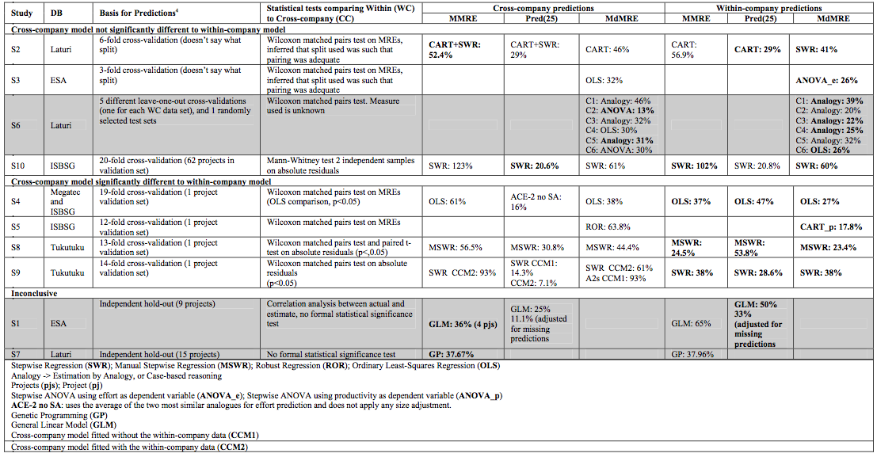
Details on prior analysis

Slide 5
Relevancy filtering
Using cross-company data often not useful
  E.g. Zimmermann et al, FSE, 2009
Opposite to “within” learning
  Using within-company data
    Using 90% of the local data from training
    Testing on 10% of the remaining
Relevancy filtering:
  Find subset of their data that is relevant to test set
    E.g. K=10 nearest neighbors for each test set
  Training only on the relevant data
  Good news: now cross-company data works as well as here data
    E.g Defect prediction:
      Turhan, Menzies et al. ESE journal, 2009
    E.g. Effort estimation:
      Kocaguneli, Menzies et al. ASE conference, 2010
  Bad news: for process planning
    Tremendous variance in the recommended solutions
    Despite relevancy filtering

Slide 6
Critical issues and Future Directions
MSR summer school (tim@menzies.us)

