Slide 1
Learning local
Lessons
IN SOFTWARE
ENGINEERING
Tim Menzies, WVU, USA,
tim@menzies.us

Slide 2
Today’s talk
Claim:
  Current SE empirical practice asks for conclusions that are are external valid
    apply to more than one domain
  So far, such external valid conclusions are illusive
    Despite decades of research.
Implications:
  The goal is wrong
  Seek not for general theories
    Only for local lessons.
“W”
  a baseline tool for generating local lessons

Slide 3
Two definitions of “model”
A hypothetical description of a complex entity or process.
  Model as output from research machine
  The “product” of research
A plan to create, according to a model or models
  Model of the research machine
  The “generator” of products
“W” is a general model generator.

Slide 4
If we can’t find general models, is it science?
Popper ’60: Everything is a “hypothesis”
  And the good ones have weathered the most attack
  SE “theories” aren’t even “hypotheses”
Endres & Rombach ’03: Distinguish “observations”, “laws”, “theory”
  Laws predict repeatable observations
  Theories explain laws
  Laws are either hypotheses (tentatively accepted) or conjectures (guesses)
Gregor’06 : 5 types of “theory”:
  Analysis (e.g. ontologies, taxonomies)
  Explanation (but it is hard to explain “explanation”)
  Prediction (some predictors do not explain)
  Explanation and prediction
  “models” for design + action
    Don’t have to be “right”
    Just “useful”
    A.k.a. Endres & Rombach’s “laws”?

Slide 5
Disagree with me?
Want to find some general conclusions on SE?
Need to go somewhere to get a lot of data from different projects?

Slide 6
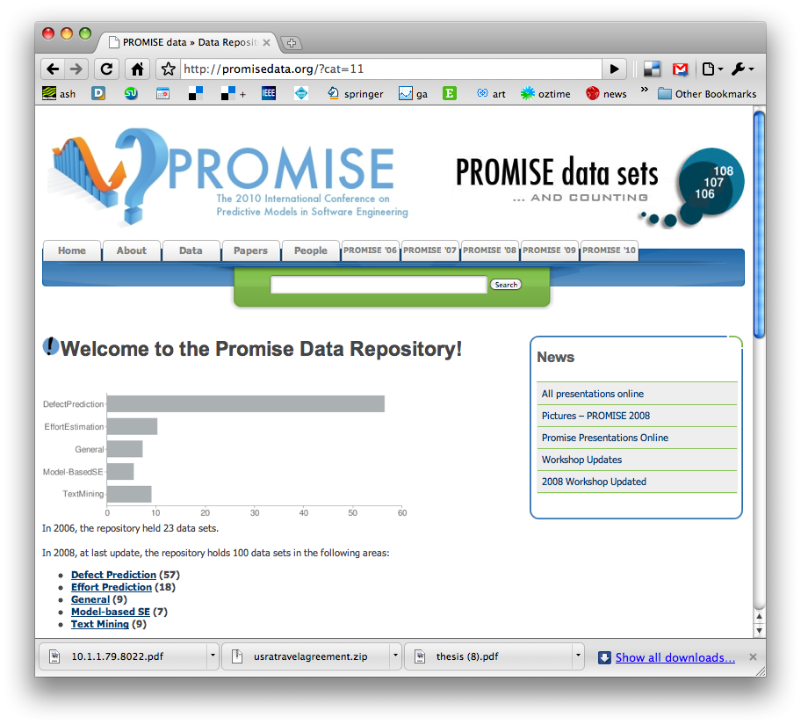
http://promisedata.org/data
Repository + annual conference. See you there?

Slide 7
A warm up exercise

Slide 8
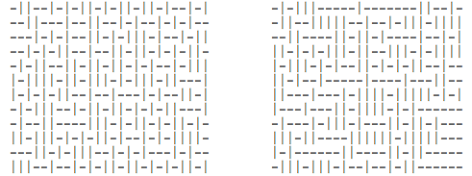
Exercise #1
One these these things is not like the other
  One was generating by selecting “-” or “|”
  at random, 300 times.
Which one?

Slide 9
Exercise #2
A little experiment
Rules
  No one talks for the next 4 minutes
  If you know what is about to happen, see (1)
This will is a selective attention test
  Count the number of times the team with the white shirt passes the ball.
  http://www.youtube.com/v/vJG698U2Mvo&hl=en_US&fs=1&rel=0

Slide 10
What have we learned?
Lesson #1:
  Algorithms can be pretty dumb
  If they don’t focus on X, they see any Y, at random.
Lesson #2:
  Humans can be pretty dumb
  If they mono-focus on X, you can miss Y
Maybe, any induction process is a guess
  And while guessing can be useful
  Guesses can also be wrong
Lets us a create community of agents,
each with novel insights and limitations
  Data miners working with humans
  Maybe in combination, we can see more that separately
Wikipedia:
List of cognitive biases
• 38 decision making biases
• 30 biases in probability
• 18 social biases,
• 10 memory biases

Slide 11

The (Very Weak)
State of the Art in Empirical SE

Slide 12

  Nature of Empirical SE has changed
Ground swell of complaint against empirical SE
  DOD funding ends, 2002 (exception: SEI)
  Zanier, ICSE, 2006
  http://www.semat.org, 2009
  NSF funding, 2010
  Robles, MSR 2010
  Shull & Menzies, 2010, O’Reilly
Data collection is different
  20th century:
    design data collection around targeted questions
  21st century:
    Science 2.0, more data on the web from other sites than you can ever collect yourself.
Data analysis is different
  20th century:
    2 populations of 10 experts, 20 questions.
    Check for differences using chi-squared
  21st century:
    Explore 3 gigabytes of core dumps; search for frequent sequences of method calls that lead to a crash.
    Use a multitude of rapidly changing methods to find patterns: LDA, frequent sequence mining, model trees, etc
  More re-analysis of old data using new techniques

Slide 13
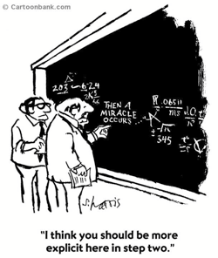
Standard practice, empirical SE
Easterbrook et al. (2007)
9 pages: selecting methods
3 pages: research questions
2 pages: empirical validity
2 pages: different forms of "empirical truth"
1 page: role of theory building
1 page: conclusions
1 page: data collection techniques
0 pages: data analysis
  and then a miracle happens
Data analysis needs more than 0 pages
  Properly done, data analysis replaces, not augments, standard empirical methods

Slide 14
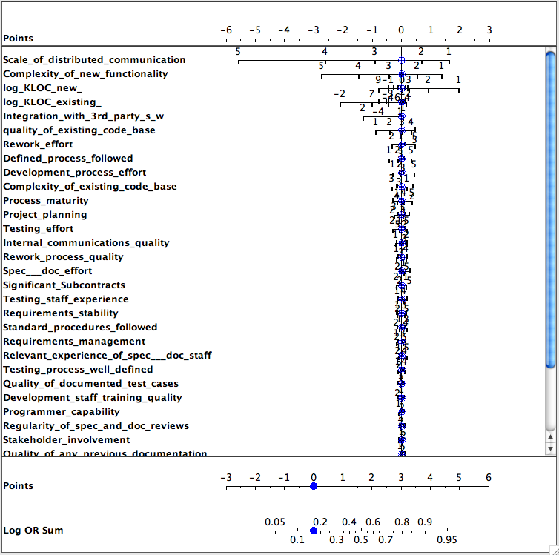
Is the data is deaf to your question?
Effect of 35 things on defects?
Data from Norman Fenton’s Bayes Net
Classes=
  round(log2(defects/KLOC))/2)
Target class = max(class)
  I.e. worse defects
Only a few features matter
Only a few ranges of those features matter

Slide 15
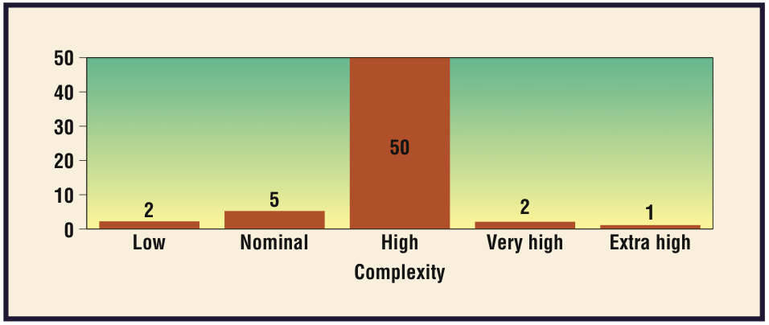
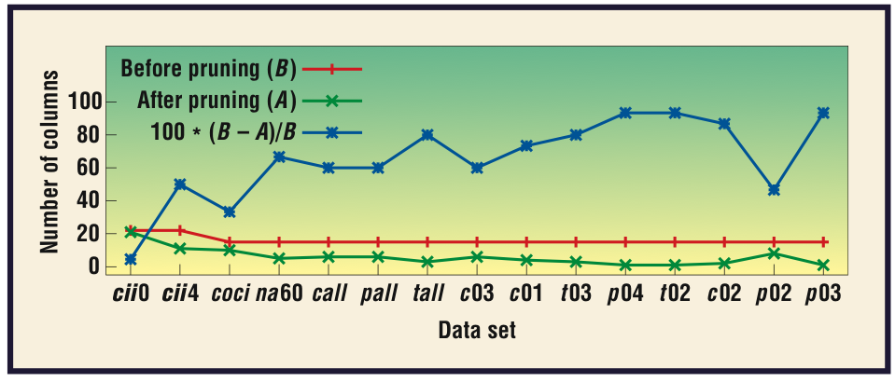
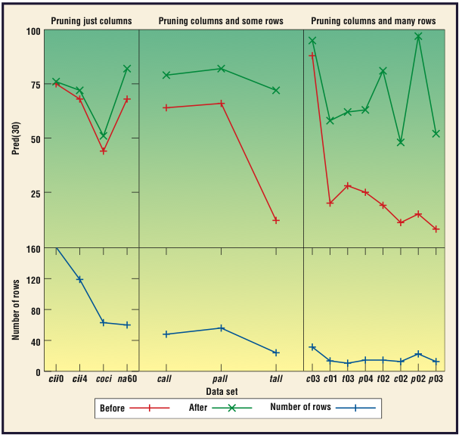
Is the data is deaf to your question? (2)
Effect of complexity on effort?
  Finding the Right Data for Software Cost Modeling
  Chen, Menzies, Port, Boehm,
  IEEE Software Nov/Dec 2005

Slide 16

What to explore?
The questions you
want to ask
The answers anyone else cares about
The questions the data can support (which, BTW, you won’t know till you look).
Are you here?

Slide 17
More on standard practice
In Basili’s Goal/Question/Metric (GQM), data collection is designed as follows:
  Conceptual level (goal): Defined w.r.t. models of quality, from various points of view and relative to a particular environment.
  Operational level (question): Define questions and models to focus on objects that characterize the assessment of that goal.
  Quantitative level (metric): Define metrics, based on models, for every question in order to collect answers in a measurable way.
GQM is an example of “the
positivist” tradition.
  Problem statement
  State research objective, context
  Experiment (goals, materials, tasks, hypotheses, design)
  Collection, hypothesis testing
  Etc
Release the Ph.D. students
  Wait N years
  Do it once, then celebrate

Slide 18
Time to change standard practice?
Does the pace of change in modern software engineering make GQM impractical?
  Researchers need rapid adaptation methods to keep up with this faster pace. Otherwise…
Basili’s SEL’s learning organization experiment lasted ten years (from 1984 to 1994) during a period of relative stability within the NASA organization.
Starting in 1995, the pace of change within NASA increased dramatically.
  New projects were often outsourced
  SEL became less the driver and more the observer, less proactive and more reactive.
  Each project could adopt its own structure.
  SEL-style experimentation became difficult: no longer a central model to build on.
NASA also tried some pretty radical development methods
  ‘Faster, Better, Cheaper” lead led to certain high profile errors which were attributed to production haste, poor communications, and mistakes in engineering management.
  When ‘Faster, Better, Cheaper’ ended, NASA changed, again, their development practices.
This constant pace of change proved fatal to the SEL.
  Basili el al. [24] describe the period 1995-2001 as one of ‘retrenchment’ at the SEL.

Slide 19
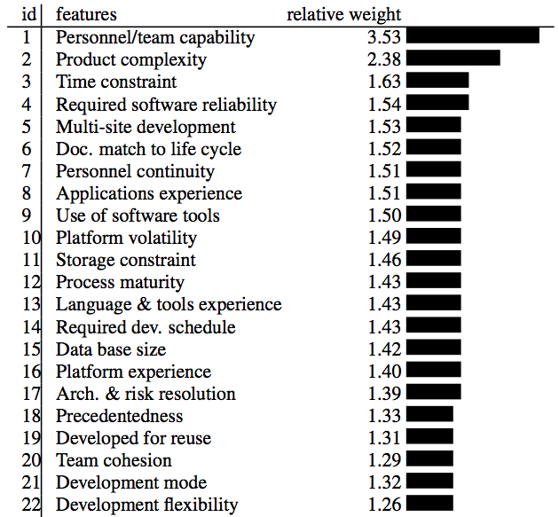
What have we learned from standard practice (1)?
We spend an awful lot of time debating things that don’t matter:
  Objects,
  aspects,
  types,
  etc etc
Source: Boehm 2000.
Regression results from
161 projects.

Slide 20
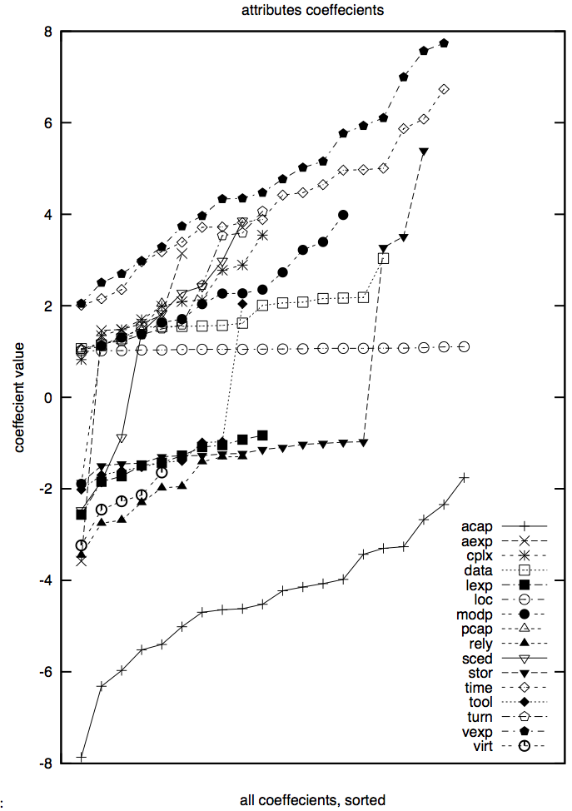
(But don’t take treat those numbers too precisely)
20 experiments, using 66% of the data (selected at random)
Linear regression:
  Effort = b₀ + sum of b_{i *} x_{i}
  Followed by a greedy back-select to prune dull variables
Results
  LOC influence stable
  Some variables pruned away half the time
  Large ranges (max – min)
  Nine attributes even change the sign on their coefficients

Slide 21
What have we learned from standard practice (2)?
PROMISE 2005 … 2009 :
  64 presentations
48 papers
  tried a new analysis on old data (repeatability is a GOOD thing)
  Or reported a new method that worked once for one project.
4 papers
  argued against model generality
9 papers
  found issues that challenged the validity of prior results
  (re-assessment is a GOOD thing)
  E.g. Menzies et al. Promise 2006
    The variance study described above

Slide 22
What have we learned from standard practice (2, cont.)?
Only a small minority of PROMISE papers (11/64) discuss results that repeated in data sets from multiple projects
E.g. Ostrand, Weyuker, Bell ‘08, ‘09
  Same functional form
  Predicts defects for generations of AT&T software
E.g. Turhan, Menzies, Bener ’08, ‘09
  10 projects
    Learn on 9
    Apply to the 10th
  Defect models learned from NASA projects work for Turkish whitegoods software
    Caveat: need to filter irrelevant training examples

Slide 23
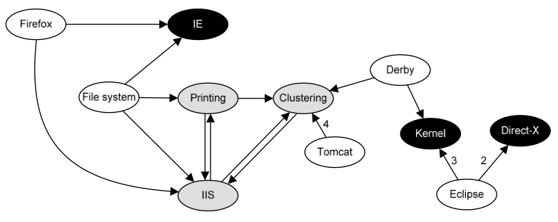
What have we learned from standard practice (3)?
The usual conclusion is that we learn that we can learn very little
FSE’09: Zimmerman et al.
  Defect models
  not generalizable
    Learn “there”, apply
    “here” only works in 4%
    of their 600+ experiments
  Opposite to Turhan’09 results
    ?add relevancy filter
ASE’09: Green, Menzies et al.
  AI search for better software project options
  Conclusions highly dependent on
  local business value proposition
And others
  TSE ‘01, ’05: Shepperd et al
    Any conclusion regarding “best” effort estimator varies by data sets,
    performance criteria, random selection train/test set
  TSE’06: Menzies, Greenwald:
    attributes selected by FSS vary wildly across projects
  Zannier et al ICSE’06:
    picked 5% (at random) ICSE claiming to be “empirical,”
    very few of them (2%) compare methods from multiple researchers

Slide 24
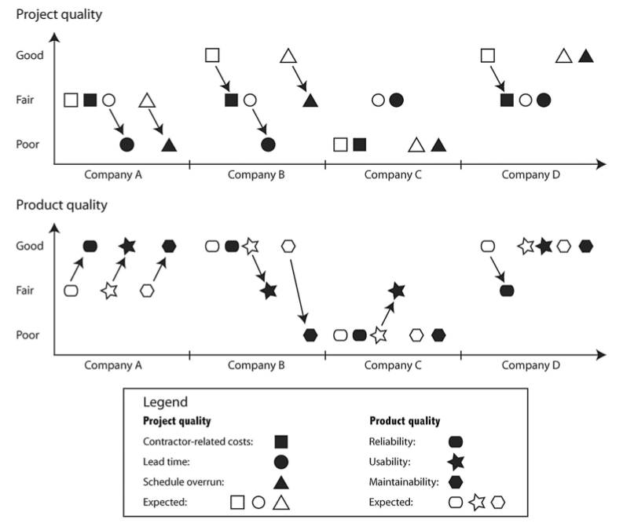
Same task, 4 implementations from 4 companies
Anda, Bente, Mockus,
IEEE TSE May 2009
Usual case: predicted not actual

Slide 25

The gods are angry
Fenton at PROMISE’ 07
  "... much of the current software metrics research is inherently irrelevant to the industrial mix ...”
  "... any software metrics program that depends on some extensive metrics collection is doomed to failure ...”
Budgen & Kitchenham:
  “Is Evidence Based Software Engineering mature enough for Practice & Policy? ”
  Need for better reporting: more reviews.
  Empirical SE results too immature for making policy.
Basili : still far to go
  But we should celebrate the progress made over the last 30 years.
  And we are turning the corner

Slide 26

A new hope
(actually, quite old)
Experience factories
  Method for find local lessons
Basili’09 (pers. comm.):
  “All my papers have the same form.
  “For the project being studied, we find that changing X improved Y.”
Translation (mine):
  Even if we can’t find general models (which seem to be quite rare)….
  … we can still research general methods for finding local lessons learned

Slide 27
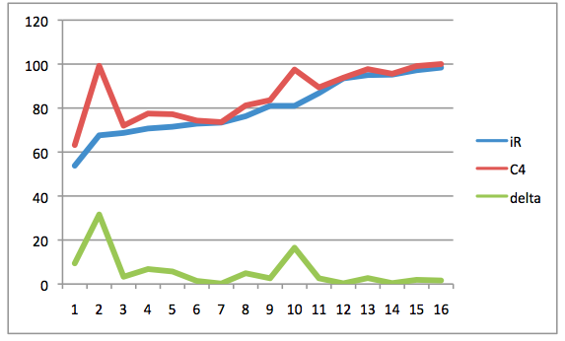
The rest of this talk: “W”
(a “local lessons” finder)
27/46
Bayesian case-based
contrast-set learner
  uses greedy search
  illustrates the “local lessons” effect
  offers functionality missing in
  the effort-estimation literature
Fast generator of baseline results
  There are too few baseline results
  And baseline results can be very interesting (humbling).
A very (very) simple algorithm
  Should add it to your toolkit
  At least, as the “one to beat”
accuracy
Holte’93
• C4: builds decision trees “N” deep
• 1R: builds decision trees “1” deep
• For datasets with 2 classes, 1R ≈ C4

Slide 28
Rest of this talk
Not TAR
Can achieve same effect
  Tiny rules
Using a much simpler approach
  A greedy search based on Bayesian range selection heuristic

Slide 29
Contrast set learning with “W”

Slide 30

“W”= Simple (Bayesian) Contrast Set Learning (in linear time)
Mozini: KDD ‘04
“best” = target class (e.g. “survive”)
“rest” = other classes
x = any range (e.g. “sex=female”)
f(x|c) = frequency of x in class c
b = f( x | best ) / F(best)
r = f( x | rest ) / F(rest)
LOR= log(odds ratio) = log(b/r)
  ? normalize 0 to max = 1 to 100
s = sum of LORs
  e = 2.7183 …
  p = F(B) / (F(B) + F(R))
  P(B) = 1 / (1 + e^(-1*ln(p/(1 - p)) - s ))

Slide 31
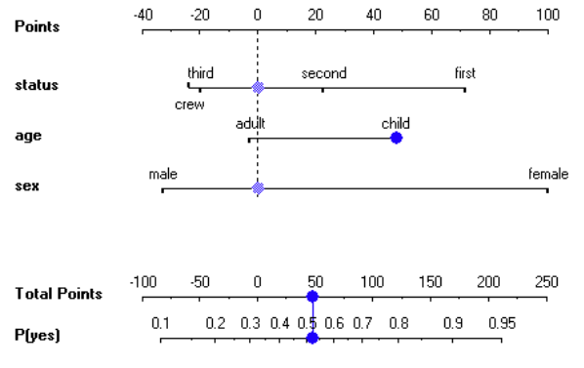
“W”= Simple (Bayesian) Contrast Set Learning (in linear time)
Mozini: KDD ‘04
“best” = target class (e.g. “survive”)
“rest” = other classes
x = any range (e.g. “sex=female”)
f(x|c) = frequency of x in class c
b = f( x | best ) / F(best)
r = f( x | rest ) / F(rest)
LOR= log(odds ratio) = log(b/r)
  ? normalize 0 to max = 1 to 100
s = sum of LORs
  e = 2.7183 …
  p = F(B) / (F(B) + F(R))
  P(B) = 1 / (1 + e^(-1*ln(p/(1 - p)) - s ))

Slide 32
“W”= Simple (Bayesian) Contrast Set Learning (in linear time)
Mozini: KDD ‘04
“best” = target class (e.g. “survive”)
“rest” = other classes
x = any range (e.g. “sex=female”)
f(x|c) = frequency of x in class c
b = f( x | best ) / F(best)
r = f( x | rest ) / F(rest)
LOR= log(odds ratio) = log(b/r)
  ? normalize 0 to max = 1 to 100
s = sum of LORs
  e = 2.7183 …
  p = F(B) / (F(B) + F(R))
  P(B) = 1 / (1 + e^(-1*ln(p/(1 - p)) - s ))
“W”:
Discretize data and outcomes
Count frequencies of ranges in classes
Sort ranges by LOR
4) Greedy search on top ranked ranges

Slide 33
LOR and Defect Prediction
Data from Norman Fenton’s Bayes Net
Classes=
  round(log2(defects/KLOC))/2)
Target class = max(class)
  I.e. worse defects
Only a few features matter
Only a few ranges of those features matter

Slide 34
“W” + CBR:
Preliminaries
“Query”
  What kind of project you want to analyze; e.g.
    Analysts not so clever,
    High reliability system
    Small KLOC
“Cases”
  Historical records, with their development effort
Output:
  A recommendation on how to change our projects in order to reduce development effort

Slide 35
Cases
Cases map features F to a utility
F= Controllables + others
train
test

Slide 36
Cases
Cases map features F to a utility
F= Controllables + others
train
test
(query ⊆ ranges)
k-NN
relevant

Slide 37
Cases
Cases map features F to a utility
F= Controllables + others
train
test
(query ⊆ ranges)
k-NN
Best
utilities
x
b = F(x | best) / F(best)
relevant
x
r = F(x | rest) / F(rest)
rest

Slide 38
Cases
Cases map features F to a utility
F= Controllables + others
train
test
(query ⊆ ranges)
S = all x sorted descending by score
k-NN
Best
utilities
x
b = F(x | best) / F(best)
if controllable(x) &&
b > r &&
b > min
then score(x) = log(b/r)
else score(x) = 0
fi
relevant
x
r = F(x | rest) / F(rest)
rest

Slide 39
Cases
Cases map features F to a utility
F= Controllables + others
train
test
k-NN
query_{i}* =
query + ∪_{i}S_{i}
treated_{i}
(query ⊆ ranges)
S = all x sorted descending by score
k-NN
Best
utilities
x
b = F(x | best) / F(best)
if controllable(x) &&
b > r &&
b > min
then score(x) = log(b/r)
else score(x) = 0
fi
relevant
x
r = F(x | rest) / F(rest)
rest

Slide 40
Cases
Cases map features F to a utility
F= Controllables + others
utility
median
train
test
k-NN
query_{i}* =
query + ∪_{i}S_{i}
spread
i
treated_{i}
(query ⊆ ranges)
S = all x sorted descending by score
k-NN
Best
utilities
x
b = F(x | best) / F(best)
if controllable(x) &&
b > r &&
b > min
then score(x) = log(b/r)
else score(x) = 0
fi
relevant
x
r = F(x | rest) / F(rest)
rest

Slide 41
Cases
Cases map features F to a utility
F= Controllables + others
treatment
q₀*
q_{i}*
utility
median
train
test
k-NN
query_{i}* =
query + ∪_{i}S_{i}
spread
i
i
treated_{i}
As is
To be
(query ⊆ ranges)
S = all x sorted descending by score
k-NN
Best
utilities
x
b = F(x | best) / F(best)
if controllable(x) &&
b > r &&
b > min
then score(x) = log(b/r)
else score(x) = 0
fi
relevant
x
r = F(x | rest) / F(rest)
rest

Slide 42

#1: Brooks’s Law

Slide 43
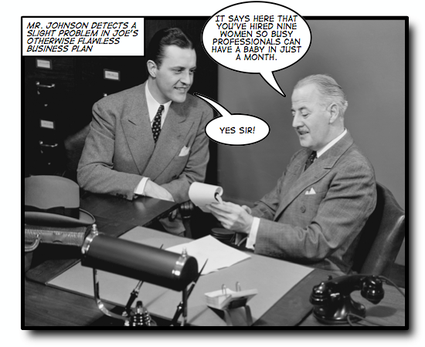
Some tasks have
inherent temporal constraints

Slide 44

Brooks’s Law (1975)
“Adding manpower (sic) to a late project makes it later”.
Inexperience of new comers
  • Extra communication overhead
  • Slower progress

Slide 45
“W”, CBR, & Brooks’s law
Can we mitigate for decreased
experience?
Data:
  Nasa93.arff
  (from promisedata.org)
Query:
  Applications Experience
    “aexp=1” : under 2 months
  Platform Experience
    “plex=1” : under 2 months
  Language and tool experience
    “ltex = 1” : under 2 months
For nasa93, inexperience does not always delay the project
  if you can reign in the DB requirements.
So generalities may be false
  in specific circumstances
Need ways to quickly build and maintain domain- specific SE models

Slide 46
#2 , #3,…. #13

Slide 47
Results (distribution of development efforts in q_{i}*)
 |  | X = as is |  | Y = to be |  | (X-Y) / X
cases | query | median | spread | median | spread | median | spread
nasa93 | ground | 162 | 349 | 99 | 80 | 61% | 23%
nasa93 | flight | 215 | 398 | 131 | 100 | 61% | 25%
nasa93 | osp | 117.6 | 396 | 68 | 79 | 58% | 20%
nasa93 | osp2 | 170 | 409 | 95 | 94 | 56% | 23%
coc81 | flight | 88 | 205 | 34 | 156 | 39% | 76%
coc81 | osp2 | 126 | 496 | 38 | 154 | 30% | 31%
coc81 | ground | 87 | 400 | 25 | 360 | 29% | 90%
coc81 | osp | 114 | 380 | 26 | 114 | 23% | 30%
Cases from promisedata.org/data
Median = 50% percentile
Spread = 75% - 25% percentile
Improvement = (X - Y) / X
X = as is
Y = to be
more is better
Usually:
spread reduced to 25% of “as is”
median reduction to 45% of “as is”

Slide 48
But that was so easy
And that’s the whole point
Yes, finding local lessons learned need not be difficult
Strange to say…
  There are no references in the CBR effort estimation literature for anything else than estimate = nearest neighbors
  No steps beyond into planning , etc
  Even though that next steps is easy

Slide 49
What should change?
(q_{j}* - q_{o}*)
 |  | acap | apex | ltex | ltex | plex | pmat | pmat | sced | sced | stor | time | tool | # of
cases | query | 3 | 3 | 3 | 4 | 3 | 3 | 4 | 2 | 3 | 3 | 3 | 3 | Changes
nasa93 | ground |  |  |  |  | 100% | 55% |  |  |  | 85% |  |  | 3
nasa93 | flight |  |  |  |  | 95% | 70% |  |  |  | 100% |  |  | 3
nasa93 | osp | 95% | 90% |  |  |  |  |  |  |  |  |  | 100% | 3
nasa93 | osp2 |  |  |  | 100% |  |  | 80% | 85% |  |  |  |  | 3
coc81 | flight |  |  |  |  |  | 60% |  |  |  |  | 65% |  | 2
coc81 | osp2 |  |  | 55% | 55% |  | 65% |  |  | 100% |  |  |  | 4
coc81 | ground |  |  |  |  |  | 80% |  |  |  |  | 100% |  | 2
coc81 | osp |  |  |  |  |  | 65% |  |  | 65% |  |  |  | 2
Overall: |  | 12% | 11% | 7% | 19% | 24% | 49% | 10% | 11% | 21% | 23% | 21% | 13%

Slide 50
Good news: improving estimates requires very few changes
 |  | acap | apex | ltex | ltex | plex | pmat | pmat | sced | sced | stor | time | tool | # of
cases | query | 3 | 3 | 3 | 4 | 3 | 3 | 4 | 2 | 3 | 3 | 3 | 3 | Changes
nasa93 | ground |  |  |  |  | 100% | 55% |  |  |  | 85% |  |  | 3
nasa93 | flight |  |  |  |  | 95% | 70% |  |  |  | 100% |  |  | 3
nasa93 | osp | 95% | 90% |  |  |  |  |  |  |  |  |  | 100% | 3
nasa93 | osp2 |  |  |  | 100% |  |  | 80% | 85% |  |  |  |  | 3
coc81 | flight |  |  |  |  |  | 60% |  |  |  |  | 65% |  | 2
coc81 | osp2 |  |  | 55% | 55% |  | 65% |  |  | 100% |  |  |  | 4
coc81 | ground |  |  |  |  |  | 80% |  |  |  |  | 100% |  | 2
coc81 | osp |  |  |  |  |  | 65% |  |  | 65% |  |  |  | 2
Overall: |  | 12% | 11% | 7% | 19% | 24% | 49% | 10% | 11% | 21% | 23% | 21% | 13%

Slide 51
Not-so-good news: local lessons very local
 |  | acap | apex | ltex | ltex | plex | pmat | pmat | sced | sced | stor | time | tool | # of
cases | query | 3 | 3 | 3 | 4 | 3 | 3 | 4 | 2 | 3 | 3 | 3 | 3 | Changes
nasa93 | ground |  |  |  |  | 100% | 55% |  |  |  | 85% |  |  | 3
nasa93 | flight |  |  |  |  | 95% | 70% |  |  |  | 100% |  |  | 3
nasa93 | osp | 95% | 90% |  |  |  |  |  |  |  |  |  | 100% | 3
nasa93 | osp2 |  |  |  | 100% |  |  | 80% | 85% |  |  |  |  | 3
coc81 | flight |  |  |  |  |  | 60% |  |  |  |  | 65% |  | 2
coc81 | osp2 |  |  | 55% | 55% |  | 65% |  |  | 100% |  |  |  | 4
coc81 | ground |  |  |  |  |  | 80% |  |  |  |  | 100% |  | 2
coc81 | osp |  |  |  |  |  | 65% |  |  | 65% |  |  |  | 2
Overall: |  | 12% | 11% | 7% | 19% | 24% | 49% | 10% | 11% | 21% | 23% | 21% | 13%

Slide 52

Q: Can we do better than “W”?
A: Most certainly!
“W” contains at least a dozen arbitrary design decisions
  Which is best?
But the algorithm is so simple
  It should least be a baseline tool
  Against which we compare supposedly more sophisticated methods.
  The straw man
Methodological advice
  Before getting complex, get simple
  Warning: often: my straw men don’t burn

Slide 53
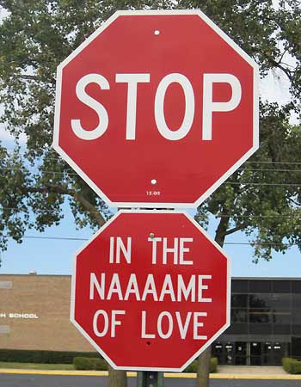
In conclusion …

Slide 54
Certainly, we should always strive for generality
But don’t be alarmed if you can’t find it.
The experience to date is that,
  with rare exceptions,
  SE research does not lead to general models
But that’s ok
  Very few others have found general models (in SE)
  E.g. Turhan, Menzies, Ayse ESE journal ’09
  E.g. Menzies et al ASE conference, 2010
Anyway
  If there are few general results, there may be general methods to find local results
    Seek not “models as products”
    But general models to generate products

Slide 55
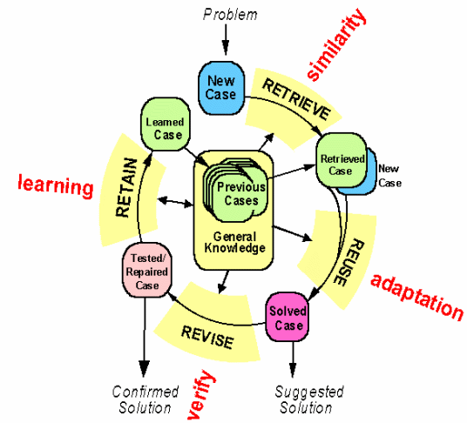
Btw, constantly (re)building local models is a general model
Case-based reasoning
Kolodner’s theory of
reconstructive memory
The Yale group
  Shank & Riesbeck et al.
  Memory, not models
  Don’t “think”, remember

Slide 56
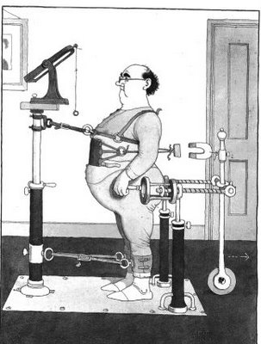
Kludges: they work
Ask some good old fashioned AI types
Minsky’86: “Society of Mind”
The brain is a set of 1000+ kludges
Feigenbaum'78
Don't take your heart attack
to the Maths Dept.
  Were they will diagnose and treat you using first principles
Instead, go to the E.R room
  Staffed by doctors who spent decades learning the quirks of drugs, organs, diseases, people, etc
Seek out those that study kludges.
You'll be treated faster
You'll live longer

Slide 57
Disagree with me?
Want to find some general conclusions on SE?
Need to go somewhere to get a lot of data from different projects?

Slide 58
http://promisedata.org/data
Repository + annual conference. See you there?

Slide 59
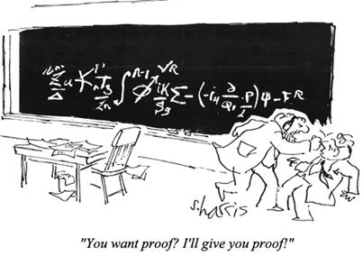
Questions?
Comments?
“You want proof? I’ll give you proof!”

Slide 60
Additional Slides

Slide 61
Digression:
Finding KEY factors is easy

Slide 62
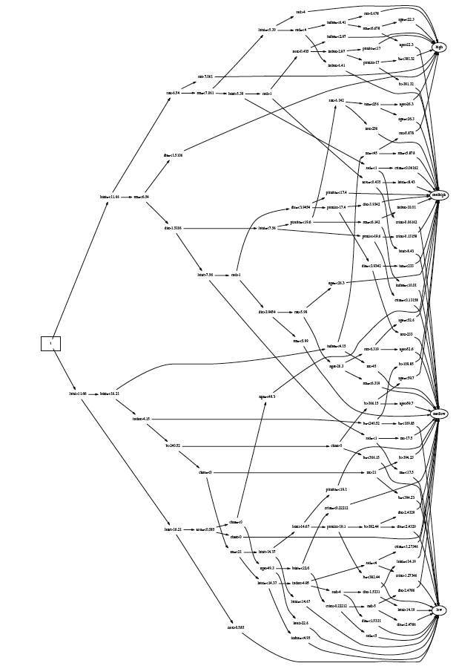
TARZAN
good
ok
Good branches go to good goals
Bad branches go to bad goals
Select decisions that select for
  Most good
  Least bad
TARZAN:
  swings through the trees
  Post-processor to C4.5
worse
worst

Slide 63
TARZAN
good
ok
Good branches go to good goals
Bad branches go to bad goals
Select decisions that select for
  Most good
  Least bad
TARZAN:
  swings through the trees
  Post-processor to C4.5
worse
worst

Slide 64
TARZAN
good
ok
Good branches go to good goals
Bad branches go to bad goals
Select decisions that select for
  Most good
  Least bad
TARZAN:
  swings through the trees
  Post-processor to C4.5
worse
worst

Slide 65
Comment
good
ok
Higher decisions prune more
branches
#nodes at level I much
smaller than level I+1.
So tree pruning often yields
very small sets of recommendations
worse
worst

Slide 66
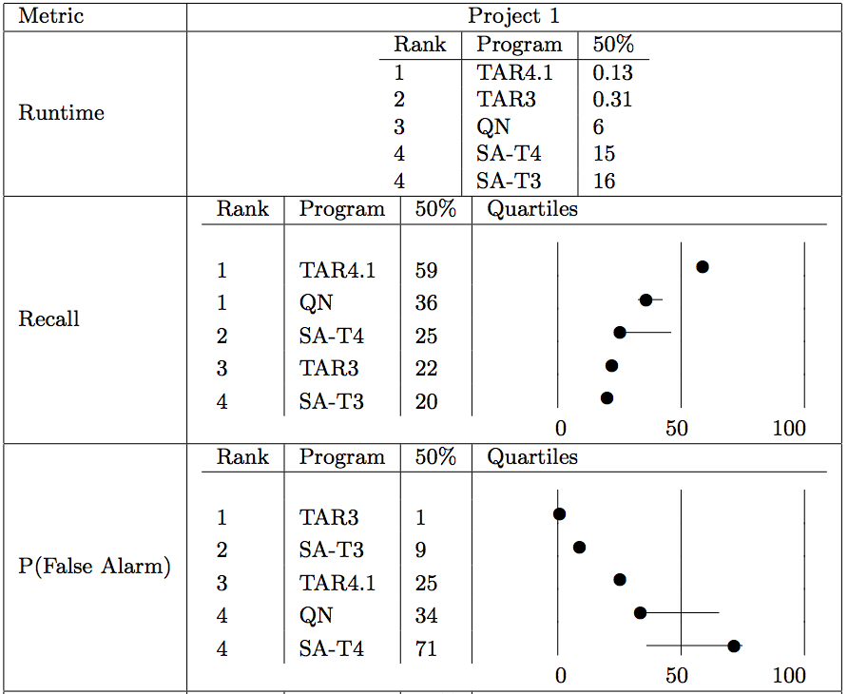
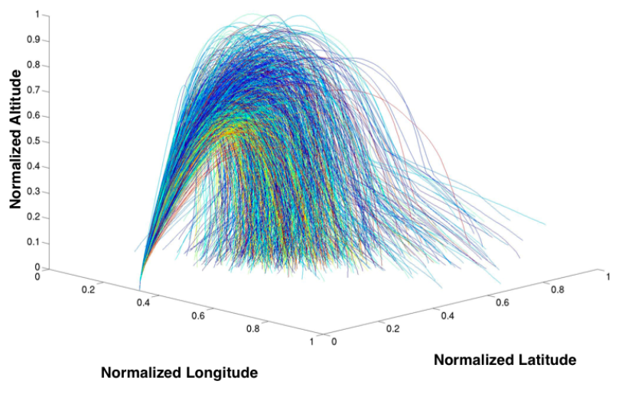
9 years later:
TARZAN ➔ TAR2, TAR3, TAR4.1
TARZAN is no longer a post-processor
  Branch queries performed directly on discretized data
    thanks David Poole
  Stochastic sampling
  for rule generation
Benchmarked against state-of-the-art numerical optimizers for GNC control
Still generating tiny rules
(very easy to read, explain, audit, implement)

