Slide 1
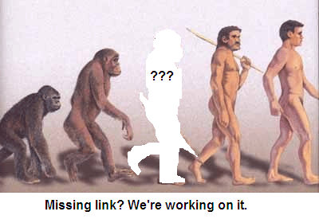
Data Mining: the Missing Link in Empirical Software Engineering
Tim Menzies
WVU, USA,
tim@menzies.us

Slide 2
Today’s talk
Question:
  How does data mining change the nature of empirical software engineering?
Answers:
  not general theories, but local lessons.
  not “models as products” but “models to generators”

Slide 3
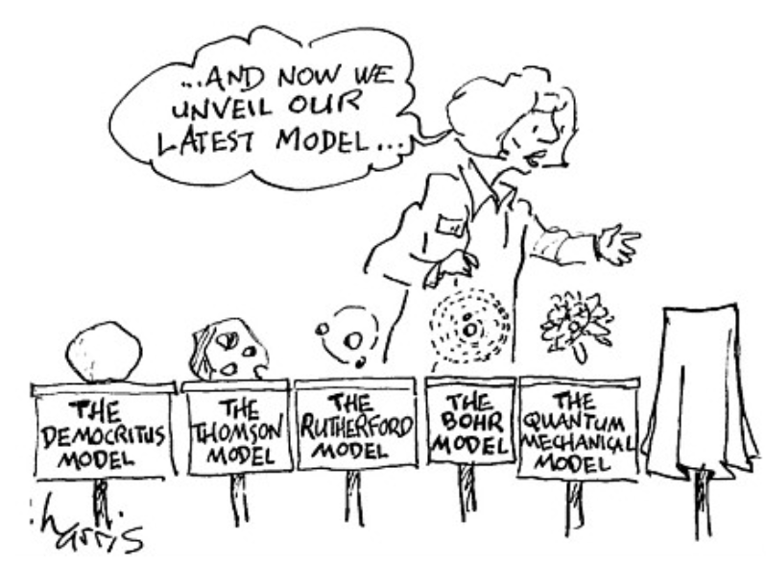
Something wrong with current practice
Few generalized results. Which is damaging our reputation, our funding.
Solution1: blame the statistics
Solution2: relevancy filtering (patch current practice)
Solution3; SAIL (replace, not patch)
  Forget objectivism
  Pick up your microscope (your data miner)
  Go look at the data, pre-defined hypothesis optional, see what you can see
    Runs the risk of making spurious conclusions
    Any report is a tentative hypothesis, needing monitoring&constant re-evaluation
    And that is different to other scientific theories, how?

Slide 4
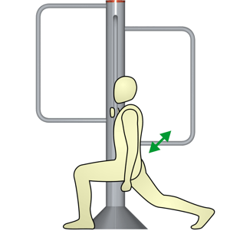
Time to warm up
To begin….

Slide 5
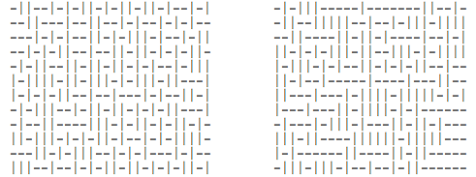
Exercise #1
One these these things is not like the other
  One was generating by selecting “-” or “|”
  at random, 300 times.
Which one?

Slide 6
Exercise #2
A little experiment
Rules
  No one talks for the next 4 minutes
  If you know what is about to happen, see (1)
This will is a selective attention test
  Count the number of times the team with the white shirt passes the ball.
  http://www.youtube.com/v/vJG698U2Mvo&hl=en_US&fs=1&rel=0

Slide 7
What have we learned?
Lesson #1:
  Algorithms can be pretty dumb
  If they don’t focus on X, they see any Y, at random.
Lesson #2:
  Humans can be pretty dumb
  If they mono-focus on X, you can miss Y
Maybe, any induction process is a guess
  And while guessing can be useful
  Guesses can also be wrong
Lets us a create community of agents,
each with novel insights and limitations
  Maybe in combination, we can see more that separately
Wikipedia:
List of cognitive biases
• 38 decision making biases
• 30 biases in probability
• 18 social biases,
• 10 memory biases

Slide 8

State of the Art
(Not so strong)
But why demand a change?

Slide 9

What to explore?
The questions you
want to ask
The answers anyone else cares about
The questions the data can support (which, BTW, you won’t know till you look).
Are you here?

Slide 10
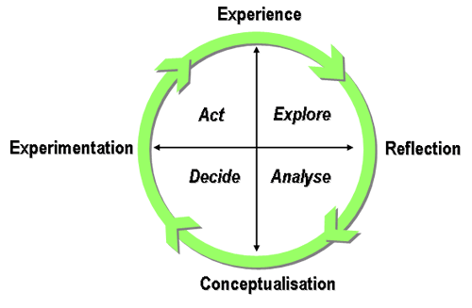
SAIL = surprise-driven research
“The only interesting answers are those which destroy the questions. -- Susan Sontag
You can start with whatever questions you like
  But the data may only hold answers to other questions.
So starting with questions (version 1.0)
Study data. If quirks, then chase the quirks
  Now explore questions (version 2.0)

Slide 11
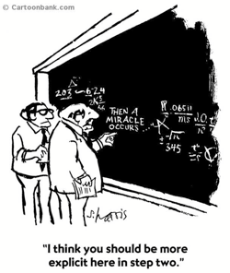
Using feedback to change the study is NOT standard practice
Easterboork et al. (2007)
9 pages: selecting methods
3 pages: research questions
2 pages: empirical validity
2 pages: different forms of "empirical truth"
1 page: role of theory building
1 page: conclusions
1 page: data collection techniques
0 pages: data analysis
  and then a miracle happens
Data analysis needs more than 0 pages
  Properly done, data analysis replaces, not augments, standard empirical methods

Slide 12
More on standard practice
In Basili’s Goal/Question/Metric (GQM), data collection is designed as follows:
  Conceptual level (goal): Defined w.r.t. models of quality, from various points of view and relative to a particular environment.
  Operational level (question): Define questions and models to focus on objects that characterize the assessment of that goal.
  Quantitative level (metric): Define metrics, based on models, for every question in order to collect answers in a measurable way.
GQM is an example of “the
positivist” tradition.
  Problem statement
  State research objective, context
  Experiment (goals, materials, tasks, hypotheses, design)
  Collection, hypothesis testing
  Etc
Release the Ph.D. students
  Wait N years
  Do it once, then celebrate

Slide 13
Time to change standard practice?
Does the pace of change in modern software engineering make GQM impractical?
  Researchers need rapid adaptation methods to keep up with this faster pace. Otherwise…
Basili’s SEL’s learning organization experiment lasted ten years (from 1984 to 1994) during a period of relative stability within the NASA organization.
Starting in 1995, the pace of change within NASA increased dramatically.
  New projects were often outsourced
  SEL became less the driver and more the observer, less proactive and more reactive.
  Each project could adopt its own structure.
  SEL-style experimentation became difficult: no longer a central model to build on.
NASA also tried some pretty radical development methods
  ‘Faster, Better, Cheaper” lead led to certain high profile errors which were attributed to production haste, poor communications, and mistakes in engineering management.
  When ‘Faster, Better, Cheaper’ ended, NASA changed, again, their development practices.
This constant pace of change proved fatal to the SEL.
  Basili el al. [24] describe the period 1995-2001 as one of ‘retrenchment’ at the SEL.

Slide 14
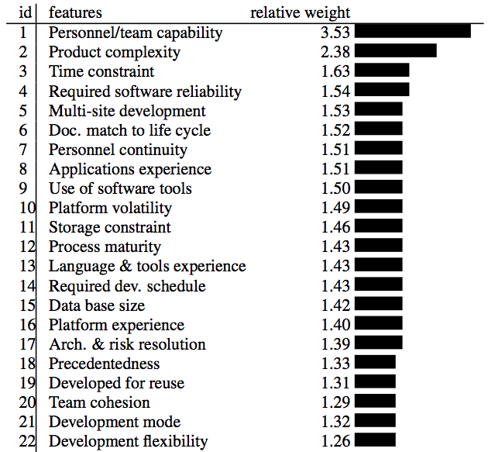
What have we learned from standard practice (1)?
We spend an awful lot of time debating things that don’t matter:
  Objects,
  aspects,
  types,
  etc etc
Source: Boehm 2000.
Regression results from
161 projects.

Slide 15
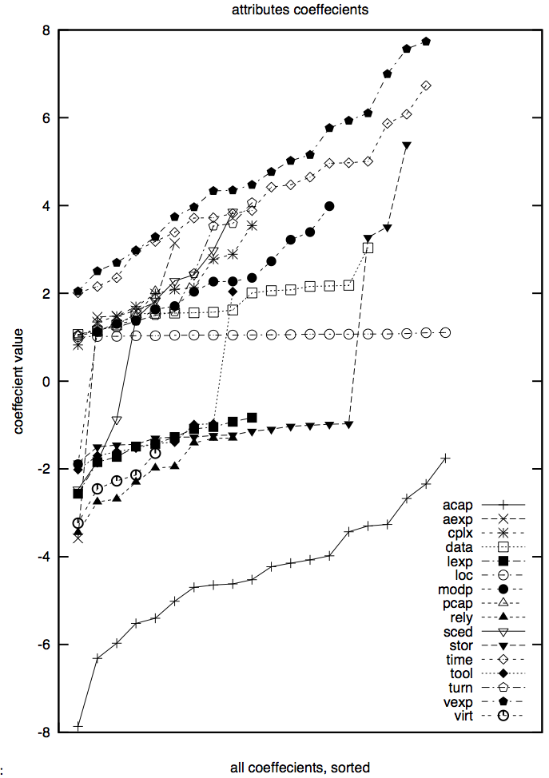
Cautionary tale
But don’t treat those numbers too precisely
20 experiments, using 66% of the data (selected at random)
Linear regression:
  Effort = b₀ + sum of b_{i *} x_{i}
  Followed by a greedy back-select to prune dull variables
Results
  LOC influence stable
  Some variables pruned away half the time
  Large ranges (max – min)
  Nine attributes even change the sign on their coefficients

Slide 16
What have we learned from standard practice (2)?
  Consider two “methods”:
    software tools, process changes, whatever,
    Anything that we might do to “improve”
    (in some way) a project.
For a list of such methods, see
  IEEE-1012 : the V&V
  “Handbook on software and systems engineering”: Endres and Rombach, 2003
Consider any pair of method1/ method2
  Any studies that comparatively assess them?

Slide 17
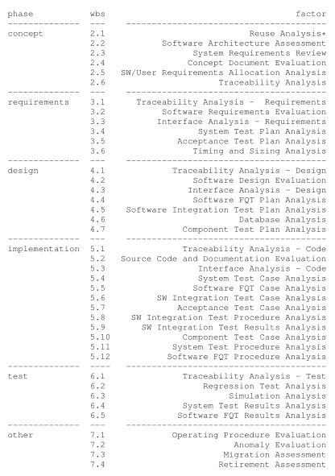
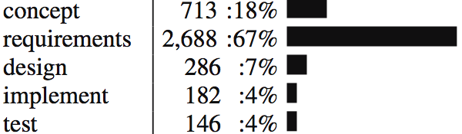
NASA IV&V data
Less is best
109
63
90
11
2
5
131
210
81
4
85
?
  From http://menzies.us/pdf/07ivv.pdf
Step1: Find the phase that saw the most high severity errors, with least IV&V cost
In that phase do the least effort thing first
  frequency of doing “it” times the number of times you did “it”
  If no data, write “?”
An “heroic” study
  Lots of business users doing lots of joins on databases never designed for inter-operative
  Lots of “engineering judgment” on how to align terminology
Not a reproducible study:
  Just the best I have yet to offer
  Has anyone else done better?
    Nope
220
134
23
250
7
22
?
283
545
268
30
61
?
?
?
?
?
202
?
63
?
54
202
?
?
?
?
?

Slide 18
What have we learned from standard practice (3)?
PROMISE 2005 … 2009 :
  64 presentations
48 papers
  tried a new analysis on old data (repeatability is a GOOD thing)
  Or reported a new method that worked once for one project.
4 papers
  argued against model generality
9 papers
  found issues that challenged the validity of prior results
  (re-assessment is a GOOD thing)
  E.g. Menzies et al. Promise 2006
    The variance study described above

Slide 19
What have we learned from standard practice (3, cont.)?
Only a small minority of PROMISE papers (11/64) discuss results that repeated in data sets from multiple projects
E.g. Ostrand, Weyuker, Bell ‘08, ‘09
  Same functional form
  Predicts defects for generations of AT&T software
E.g. Turhan, Menzies, Bener ’08, ‘09
  10 projects
    Learn on 9
    Apply to the 10th
  Defect models learned from NASA projects work for Turkish whitegoods software
    Caveat: need to filter irrelevant training examples

Slide 20
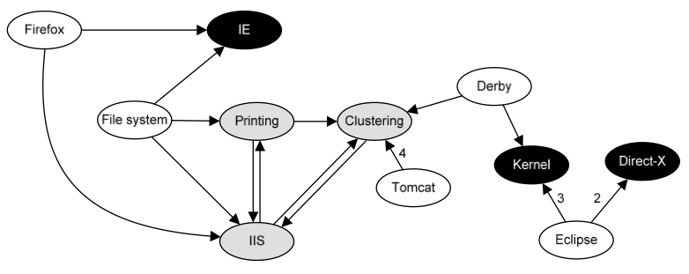
What have we learned from standard practice (4)?
The usual conclusion is that we learn that we can learn very little
FSE’09: Zimmerman et al.
  Defect models
  not generalizable
    Learn “there”, apply
    “here” only works in 4%
    of their 600+ experiments
  Opposite to Turhan’09 results
    ?add relevancy filter
ASE’09: Green, Menzies et al.
  AI search for better software project options
  Conclusions highly dependent on
  local business value proposition
And others
  TSE ‘01, ’05: Shepperd et al
    Any conclusion regarding “best” effort estimator varies by data sets,
    performance criteria, random selection train/test set
  TSE’06: Menzies, Greenwald:
    attributes selected by FSS vary wildly across projects
  Zannier et al ICSE’06:
    picked 5% (at random) ICSE claiming to be “empirical,”
    very few of them (2%) compare methods from multiple researchers

Slide 21

The gods are angry
Fenton at PROMISE’ 07
  "... much of the current software metrics research is inherently irrelevant to the industrial mix ...”
  "... any software metrics program that depends on some extensive metrics collection is doomed to failure ...”
Budgen & Kitchenham:
  “Is Evidence Based Software Engineering mature enough for Practice & Policy? ”
  Need for better reporting: more reviews.
  Empirical SE results too immature for making policy.
Basili : still far to go
  But we should celebrate the progress made over the last 30 years.
  And we are turning the corner

Slide 22

A new hope
Experience factories
  Method for find local lessons
Basili’09 (pers. comm.):
  “All my papers have the same form.
  “For the project being studied, we find that changing X improved Y.”
Translation (mine):
  Even if we can’t find general models (which seem to be quite rare)….
  … we can still research general methods for finding local lessons learned

Slide 23
If we can’t find general models, is it science?
Popper ‘60
  Everything is a “hypothesis”
  And the good ones have weathered the most attack
  SE “theories” aren’t even “hypotheses”
Endres & Rombach ‘03
  Distinguish “observations”,
  “laws”, “theory”
  Laws predict repeatable observations
  Theories explain laws
  Laws are either hypotheses (tentatively accepted) or conjectures (guesses)
Gregor’06 : 5 types of “theory”:
  Analysis (e.g. ontologies, taxonomies)
  Explanation (but it is hard to explain “explanation”)
  Prediction (some predictors do not explain)
  Explanation and prediction
  “models” for design + action
    Don’t have to be “right”
    Just “useful”
    A.k.a. Endres & Rombach’s “laws”?

Slide 24
Two definitions of “model”
A hypothetical description of a complex entity or process.
  Model as output from research machine
  The “product” of research
A plan to create, according to a model or models
  Model of the research machine
  The “generator” of products
“W” is a general model generator.

Slide 25
Contrast set learning with “W”
CBR…

Slide 26
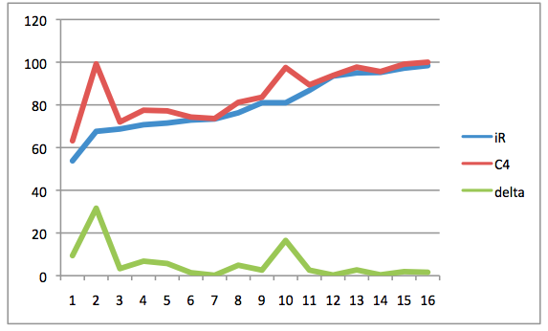
The rest of this talk: “W”
(a “local lessons” finder)
26/46
Bayesian case-based
contrast-set learner
  uses greedy search
  illustrates the “local lessons” effect
  offers functionality missing in
  the effort-estimation literature
Fast generator of baseline results
  There are too few baseline results
  And baseline results can be very interesting (humbling).
A very (very) simple algorithm
  Should add it to your toolkit
  At least, as the “one to beat”
accuracy
Holte’93
• C4: builds decision trees “N” deep
• 1R: builds decision trees “1” deep
• For datasets with 2 classes, 1R ≈ C4

Slide 27

“W”= Simple (Bayesian) Contrast Set Learning (in linear time)
Moziai: KDD ‘04
“best” = target class (e.g. “survive”)
“rest” = other classes
x = any range (e.g. “sex=female”)
f(x|c) = frequency of x in class c
b = f( x | best ) / F(best)
r = f( x | rest ) / F(rest)
LOR= log(odds ratio) = log(b/r)
  ? normalize 0 to max = 1 to 100
s = sum of LORs
  e = 2.7183 …
  p = F(B) / (F(B) + F(R))
  P(B) = 1 / (1 + e^(-1*ln(p/(1 - p)) - s ))

Slide 28
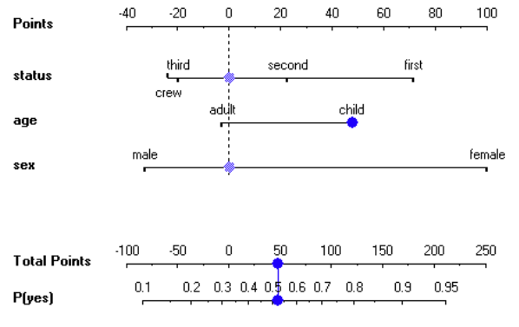
“W”= Simple (Bayesian) Contrast Set Learning (in linear time)
Moziai: KDD ‘04
“best” = target class (e.g. “survive”)
“rest” = other classes
x = any range (e.g. “sex=female”)
f(x|c) = frequency of x in class c
b = f( x | best ) / F(best)
r = f( x | rest ) / F(rest)
LOR= log(odds ratio) = log(b/r)
  ? normalize 0 to max = 1 to 100
s = sum of LORs
  e = 2.7183 …
  p = F(B) / (F(B) + F(R))
  P(B) = 1 / (1 + e^(-1*ln(p/(1 - p)) - s ))

Slide 29
“W”= Simple (Bayesian) Contrast Set Learning (in linear time)
Mozini: KDD ‘04
“best” = target class (e.g. “survive”)
“rest” = other classes
x = any range (e.g. “sex=female”)
f(x|c) = frequency of x in class c
b = f( x | best ) / F(best)
r = f( x | rest ) / F(rest)
LOR= log(odds ratio) = log(b/r)
  ? normalize 0 to max = 1 to 100
s = sum of LORs
  e = 2.7183 …
  p = F(B) / (F(B) + F(R))
  P(B) = 1 / (1 + e^(-1*ln(p/(1 - p)) - s ))

Slide 30
“W”= Simple (Bayesian) Contrast Set Learning (in linear time)
Mozini: KDD ‘04
“best” = target class (e.g. “survive”)
“rest” = other classes
x = any range (e.g. “sex=female”)
f(x|c) = frequency of x in class c
b = f( x | best ) / F(best)
r = f( x | rest ) / F(rest)
LOR= log(odds ratio) = log(b/r)
  ? normalize 0 to max = 1 to 100
s = sum of LORs
  e = 2.7183 …
  p = F(B) / (F(B) + F(R))
  P(B) = 1 / (1 + e^(-1*ln(p/(1 - p)) - s ))
“W”:
Discretize data and outcomes
Count frequencies of ranges in classes
Sort ranges by LOR
4) Greedy search on top ranked ranges

Slide 31
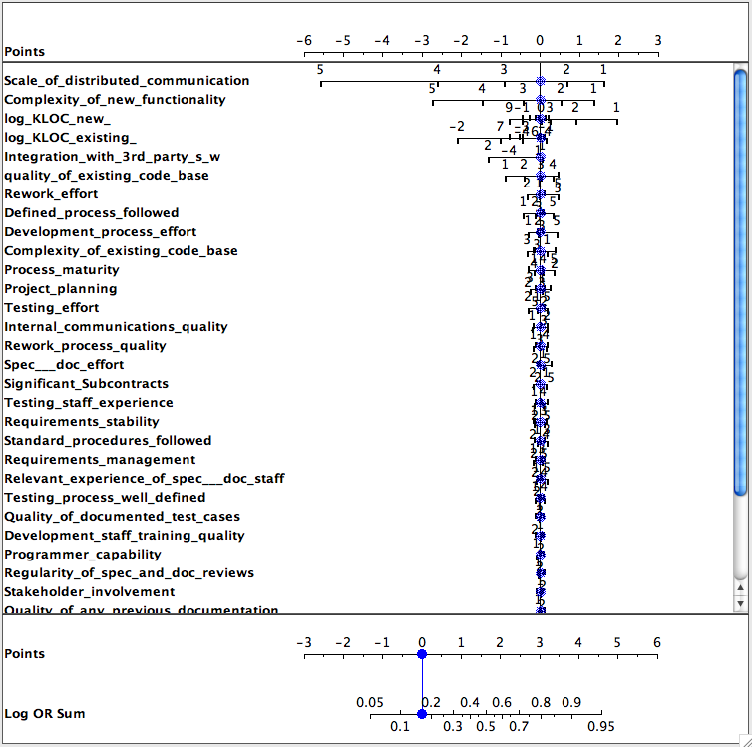
LOR and Defect Prediction
Data from Norman Fenton’s Bayes Net
Classes=
  round(log2(defects/KLOC))/2)
Target class = max(class)
  I.e. worse defects
Only a few features matter
Only a few ranges of those features matter

Slide 32
“W” + CBR:
Preliminaries
“Query”
  What kind of project you want to analyze; e.g.
    Analysts not so clever,
    High reliability system
    Small KLOC
“Cases”
  Historical records, with their development effort
Output:
  A recommendation on how to change our projects in order to reduce development effort

Slide 33
Cases
Cases map features F to a utility
F= Controllables + others
train
test

Slide 34
Cases
Cases map features F to a utility
F= Controllables + others
train
test
(query ⊆ ranges)
k-NN
relevant

Slide 35
Cases
Cases map features F to a utility
F= Controllables + others
train
test
(query ⊆ ranges)
k-NN
Best
utilities
x
b = F(x | best) / F(best)
relevant
x
r = F(x | rest) / F(rest)
rest

Slide 36
Cases
Cases map features F to a utility
F= Controllables + others
train
test
(query ⊆ ranges)
S = all x sorted descending by score
k-NN
Best
utilities
x
b = F(x | best) / F(best)
if controllable(x) &&
b > r &&
b > min
then score(x) = log(b/r)
else score(x) = 0
fi
relevant
x
r = F(x | rest) / F(rest)
rest

Slide 37
Cases
Cases map features F to a utility
F= Controllables + others
train
test
k-NN
query_{i}* =
query + ∪_{i}S_{i}
treated_{i}
(query ⊆ ranges)
S = all x sorted descending by score
k-NN
Best
utilities
x
b = F(x | best) / F(best)
if controllable(x) &&
b > r &&
b > min
then score(x) = log(b/r)
else score(x) = 0
fi
relevant
x
r = F(x | rest) / F(rest)
rest

Slide 38
Cases
Cases map features F to a utility
F= Controllables + others
utility
median
train
test
k-NN
query_{i}* =
query + ∪_{i}S_{i}
spread
i
treated_{i}
(query ⊆ ranges)
S = all x sorted descending by score
k-NN
Best
utilities
x
b = F(x | best) / F(best)
if controllable(x) &&
b > r &&
b > min
then score(x) = log(b/r)
else score(x) = 0
fi
relevant
x
r = F(x | rest) / F(rest)
rest

Slide 39
Cases
Cases map features F to a utility
F= Controllables + others
treatment
q₀*
q_{i}*
utility
median
train
test
k-NN
query_{i}* =
query + ∪_{i}S_{i}
spread
i
i
treated_{i}
As is
To be
(query ⊆ ranges)
S = all x sorted descending by score
k-NN
Best
utilities
x
b = F(x | best) / F(best)
if controllable(x) &&
b > r &&
b > min
then score(x) = log(b/r)
else score(x) = 0
fi
relevant
x
r = F(x | rest) / F(rest)
rest

Slide 40

#1: Brooks’s Law

Slide 41
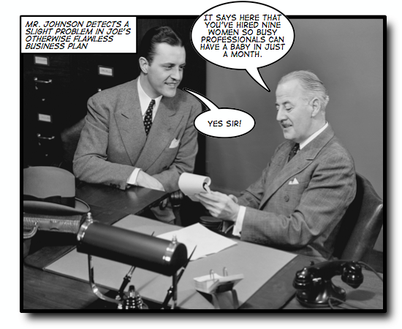
Some tasks have
inherent temporal constraints

Slide 42

Brooks’s Law (1975)
“Adding manpower (sic) to a late project makes it later”.
Inexperience of new comers
  • Extra communication overhead
  • Slower progress

Slide 43
“W”, CBR, & Brooks’s law
Can we mitigate for decreased
experience?
Data:
  Nasa93.arff
  (from promisedata.org)
Query:
  Applications Experience
    “aexp=1” : under 2 months
  Platform Experience
    “plex=1” : under 2 months
  Language and tool experience
    “ltex = 1” : under 2 months
For nasa93, inexperience does not always delay the project
  if you can reign in the DB requirements.
So generalities may be false
  in specific circumstances
Need ways to quickly build and maintain domain- specific SE models

Slide 44
#2 , #3,…. #13

Slide 45
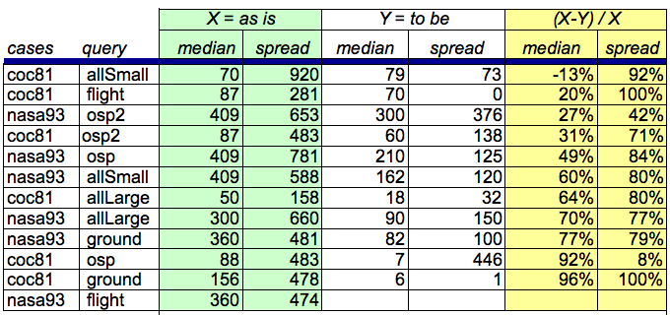
Results (distribution of development efforts in q_{i}*)
Cases from promisedata.org/data
Median = 50% percentile
Spread = 75% - 25% percentile
Improvement = (X - Y) / X
X = as is
Y = to be
more is better
Usually:
spread ≥ 75% improvement
median ≥ 60% improvement

Slide 46
But that was so easy
And that’s the whole point
Yes, finding local lessons learned need not be difficult
Strange to say…
  There are no references in the CBR effort estimation literature for anything else than estimate = nearest neighbors
  No steps beyond into planning , etc
  Even though that next steps is easy

Slide 47
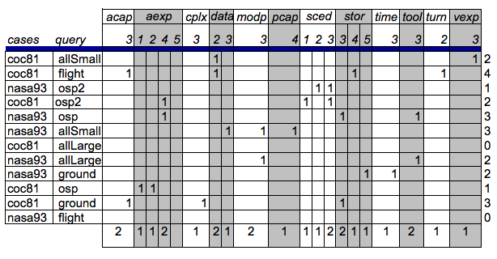
What should change?
(q_{j}* - q_{o}*)

Slide 48
Good news: improving estimates requires very few changes

Slide 49
Not-so-good news: local lessons very local

Slide 50

Q: Can we do better than “W”?
A: Most certainly!
“W” contains at least a dozen arbitrary design decisions
  Which is best?
But the algorithm is so simple
  It should least be a baseline tool
  Against which we compare supposedly more sophisticated methods.
  The straw man
Methodological advice
  Before getting complex, get simple
  Warning: often: my straw men don’t burn

Slide 51
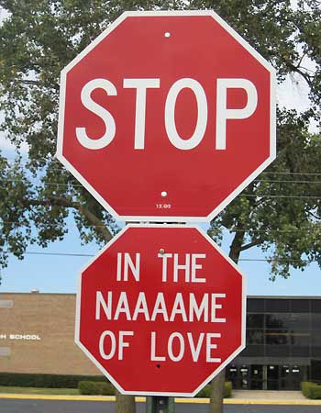
In conclusion …

Slide 52
Certainly, we should always strive for generality
But don’t be alarmed if you can’t find it.
The experience to date is that,
  with rare exceptions,
  SAILing does not lead to general theories
But that’s ok
  Very few others have found general models (in SE)
  E.g. Turhan, Menzies, Ayse’09
Anyway
  If there are few general results, there may be general methods to find local results

Slide 53
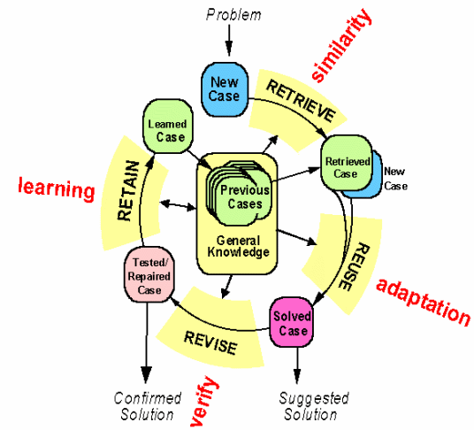
Btw, constantly (re)building local models is a general model
Case-based reasoning
Kolodner’s theory of
reconstructive memory
The Yale group
  Shank & Riesbeck et al.
  Memory, not models
  Don’t “think”, remember

Slide 54
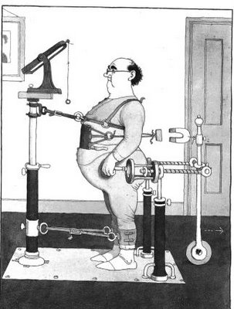
Kludges: they work
Ask some good old fashoned AI types
Minsky’86: “Society of Mind”
The brain is a set of 1000+ kludges
Feigenbaum'78
Don't take your heart attack
to the Maths Dept.
  Were they will diagnose and treat you using first principles
Instead, go to the E.R room
  Staffed by doctors who spent decades learning the quirks of drugs, organs, diseases, people, etc
Seek out those that study kludges.
You'll be treated faster
You'll live longer

Slide 55
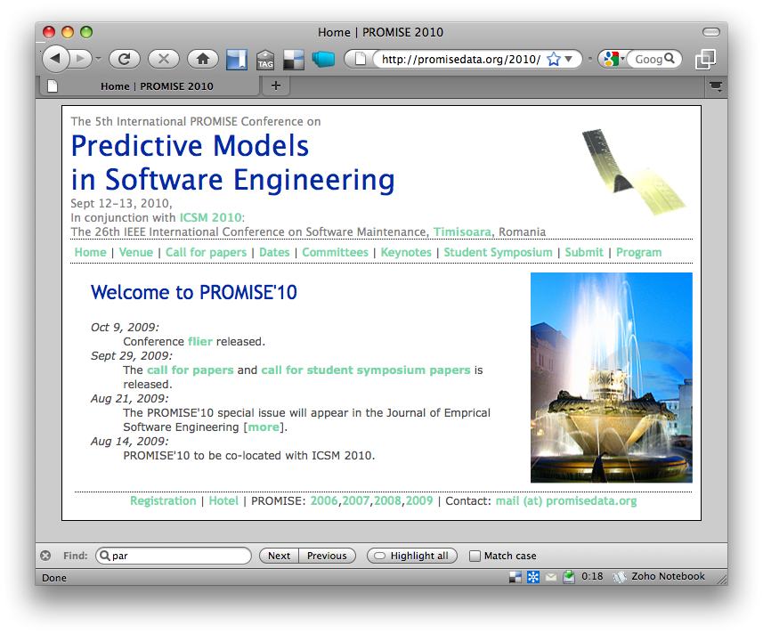
See you at PROMISE’10?
http://promisedata.org/2010

Slide 56
Supplemental slides

Slide 57
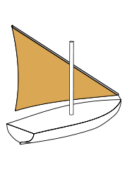




Contact details
We know where you live.
tim@menzies.us
http://menzies.us
http://twitter.com/timmenzies
http://www.facebook.com/tim.menzies

Slide 58
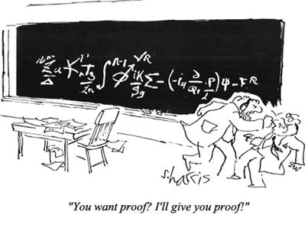
Questions?
Comments?
“You want proof? I’ll give you proof!”

Slide 59

Future work
What’s next?
Better than Bgreedy?
  While staying simple?
Incremental anomaly detection and lesson revision
  Not discussed here
  Turns out, that may be very simple (see me later)

Slide 60

A little primer: DM for SE
Summary: easier than you think
(#include standardCaveat.h)

Slide 61
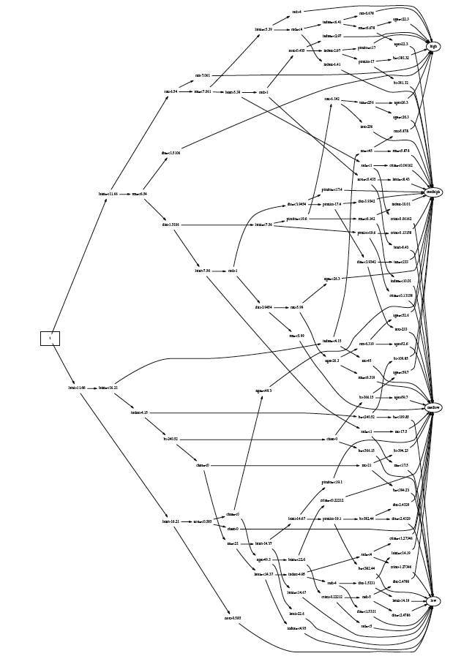
Monte Carlo + Decision Tree Learning
Menzies: ASE’00
Process models
  Input: project details
  Output: (effort, risk)
Increase #simulations
  till error minimizes
Learn decision trees
Repeat 10 times

Slide 62
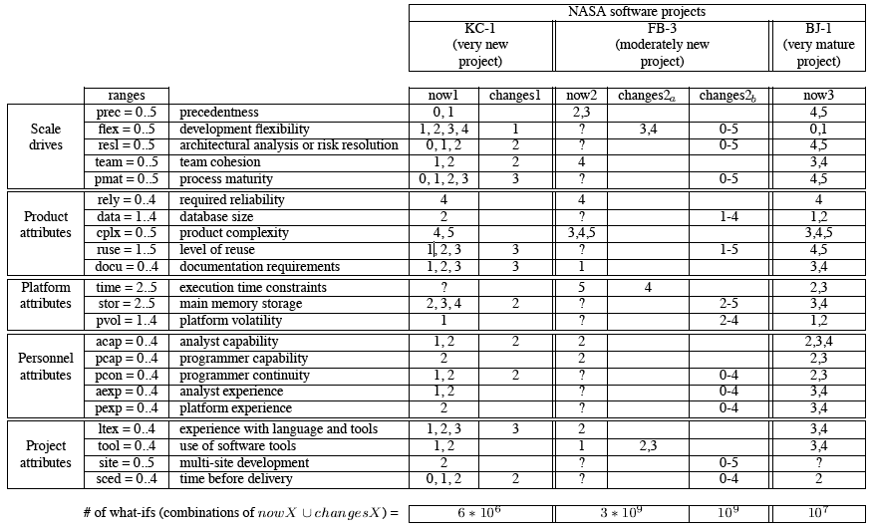
Software Management
Given now_{i} which subsets of changes_{i} is most effective?

Slide 63
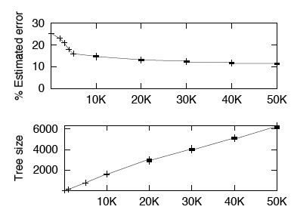
Problem
Too much information

Slide 64

The “keys” effect: usually, a few variables set the rest
SAILing is easy
So the complexity of the whole depends on just a small part
Empirical evidence:
  Feature subset selection: Kohavi’97
  Few pathways: Bieman’92, Harrold’98
  Mutation testing & rapid saturation: Budd’80, Wong’95, Michael’97
  Surprisingly few internal states: Drezdel’94, Colomb’00, Menzies’99
  Success of stochastic theorem provers: Crawford’94, Williams & Selman’03
Theoretical evidence:
  Menzies & Singh ‘03
Easy to find these keys
  Score the outputs
  Look for ranges more frequent in “best” than “rest”
  A useful short-cut to data mining, model-based reasoning

Slide 65
Tree Pruning
good
Can you see the big picture?
ok
Good branches go to good goals
Bad branches go to bad goals
Select decisions that select for
  Most good
  Least bad
TARZAN:
  swings through the trees
  Post-processor to C4.5
worse
worst

Slide 66
Tree Pruning
good
Can you see the big picture?
ok
Good branches go to good goals
Bad branches go to bad goals
Select decisions that select for
  Most good
  Least bad
TARZAN:
  swings through the trees
  Post-processor to C4.5
worse
worst

Slide 67
Tree Pruning
good
Can you see the big picture?
ok
Good branches go to good goals
Bad branches go to bad goals
Select decisions that select for
  Most good
  Least bad
TARZAN:
  swings through the trees
  Post-processor to C4.5
worse
worst

Slide 68
Comment
good
Less is best
ok
Higher decisions prune more
branches
#nodes at level I much
smaller than level I+1.
So tree pruning often yields
very small sets of recommendations
worse
worst

Slide 69

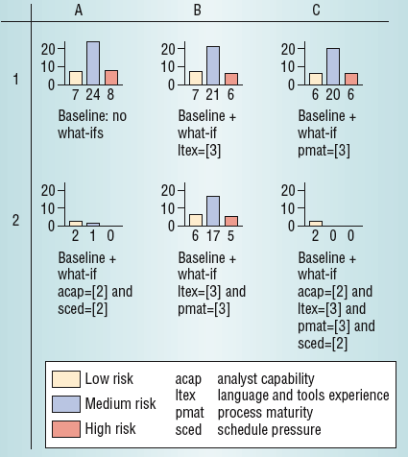
Don’t bury me in data
Don’t show me “what is”; just tell what “to do”

Slide 70
Given the size of the search space, the small number of decision points was very surprising

Slide 71
SAIL: auto-monitor SE projects
S imple, semi-automated
A gent
I ncremental, instantaneous
L essons learned, librarian
Real-time, anytime monitoring alert/repair on organizational data
  Do it all the time, every time, there is new data
Partnership between humans and data miners
  Both propose hypotheses
  Both check each others hypotheses
  Data miners track and score the current set of active hypotheses

Slide 72
Not global lessons
But local lessons
Continually adjusted as new information arrives

Slide 73

Issues with statistical methods
#include standardComment.h

Slide 74
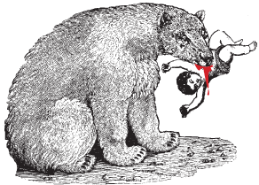
The usual slide at this point
Statistics- take care

Slide 75
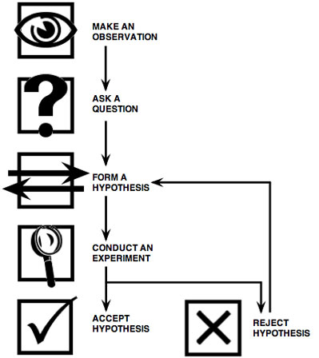
The slavish application of statistical hypothesis testing is a very bad idea
Ask anyone from any field who has been
doing this stuff longer than us.
Psychologists: e.g. Cohen, 1988: “The earth is flat (p < .05)”
  Significance hypothesis testing of H0 P versus H1 is a ‘potent but sterile intellectual rake who leaves . . . no viable scientific offspring’.
Marketing; e.g. Armstrong, 2007, Significance
tests harm progress in forecasting:
  Revises one study that, using significance testing, concludes that estimates generated from multiple sources do no better than those generated from a single source.
  Lists 31 studies: multiple source prediction consistently out-performs single source prediction by 3% to 23% (average = 12.5%).
  These improvements, in all study are the exact opposite of what would be predicted from the significance test results.
Worse, we don’t know how to apply hypothesis testing

Slide 76
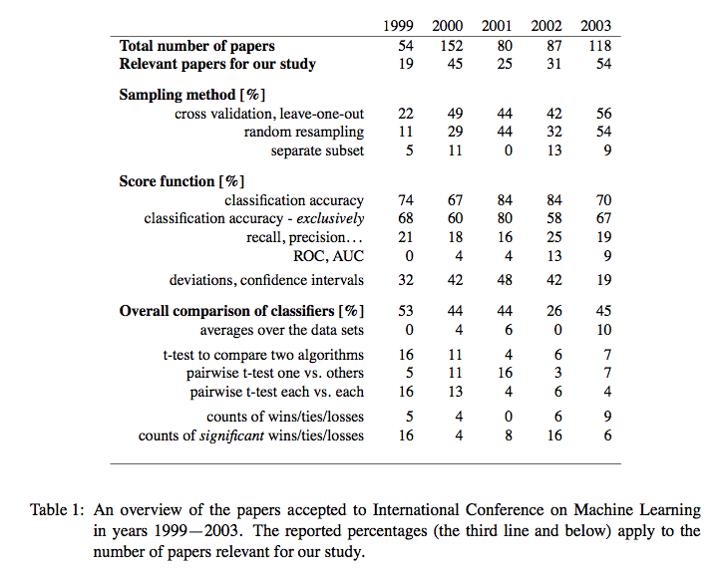
Janez Demsar : Statistical Comparisons of Classifiers over Multiple Data Sets
Journal of Machine Learning Research 7 (2006) 1–30
Statistical methods in our field are in disarray.
Demsar proposes a fix:
  Friedman, Nemenyi tests
  But not widely accepted.
Best to
  Make sure you are reporting BIG effects- not some 3% delta (yawn)
  Minimize use of stats (use them as a sanity check to conform an intuition gained via, say, some visualization
  Use the statistical methods that bother reviewers the least

Slide 77
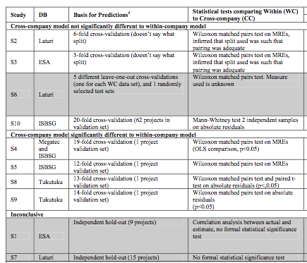
Kitchenham et al. TSE, 2007

Slide 78
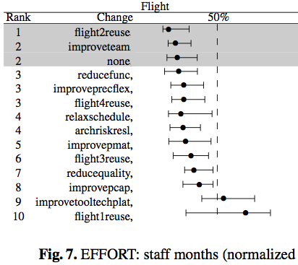
Example “ranked quartiles” from http://menzies.us/pdf/09reuse.pdf
Non-parametric analysis
  Means = no
  Standard deviations = don’t do it
Indicate median and variability around the mean (here, 25-75% percentile range)
Show baselines against something else.
Stats are secondary
BTW
  Death to t-tests
    At least Mann-whitney, Wilcoxon. At most, see Demsar 2006
  Accuracy and prevision very bad when target class rare: http://menzies.us/pdf/07precision.pdf
When not to use ranked quartiles
  When there is not enough space in the paper
  When reviewers want something lese
  When your co-authors want something else

Slide 79
Damned if you do, damned if you don’t
But worse that over-relying on stats
  Is using no stats at all
How to get a paper rejected
  Only report deltas between mean values
Every paper that performs repeated trials must analyze
  the central tendency
    e.g. the 50th percentile
  as well as the deviations around that tendency, of the results
    e.g. the 75-25th percentile

Slide 80
Variance reduction
Here’s an idea…

Slide 81
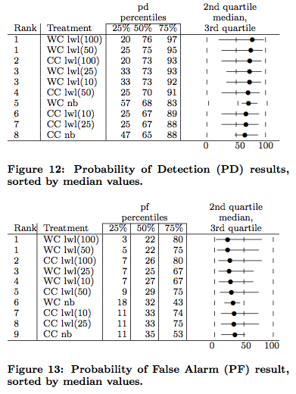
Results variance: http://menzies.us/09ourmine.pdf
10 times repeat
  Randomized order of data
  Conduct a 10-way cross val
    LWL= local weighted Naive Bayes (uses a nearest neighbor pre-processor)
    NB= Naïve Bayes
    WC= train and test on local data
    CC = train on other data sets, test locally
Note that large variance in the 75-25th percentile results seen in a 10-by-10 way
Such large variances make a nonsense of reports of (e.g.) a 4% different in performance
So, as a pre-cursor to any search for repeatable results, perform variance reduction

Slide 82
Column Selection
(a.k.a. feature subset selection)
  If y = b₀ + b_{1 *} x₁ + b_{2 *} x₂ + b_{3 *} x₃ + …
And if variance in x₁ contribute to variance to y
  Then if we discard some “x” variables…
  … then the variance in “y” decreases
If lower variance, easier for learner to find better theories.
This effect is particularly marked for smaller data sets

Slide 83
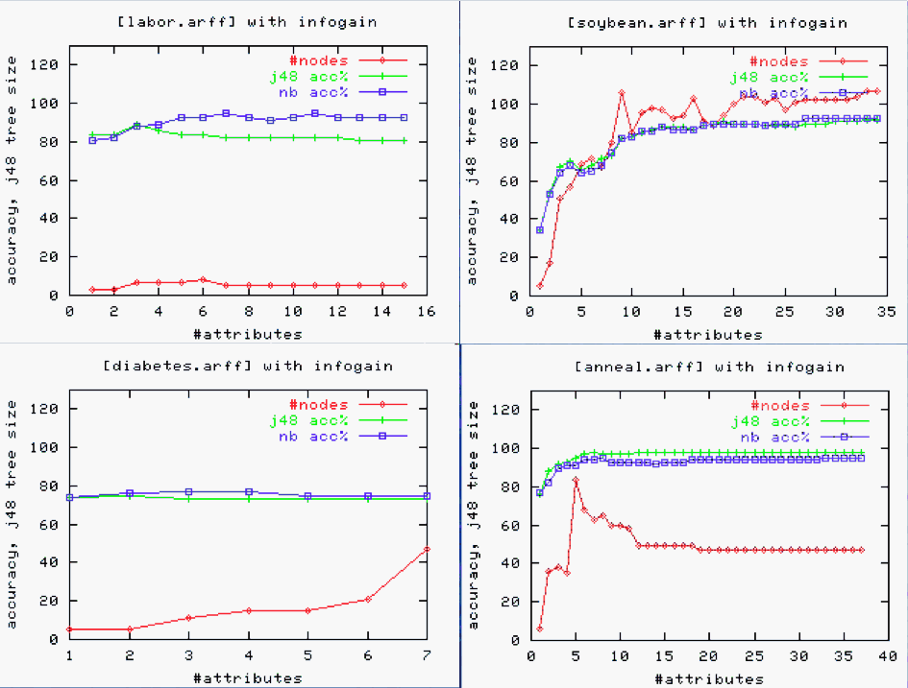
Often, can prune most attributes, with no loss to performance
Why? : the “small treatment” effect (STE)

Slide 84
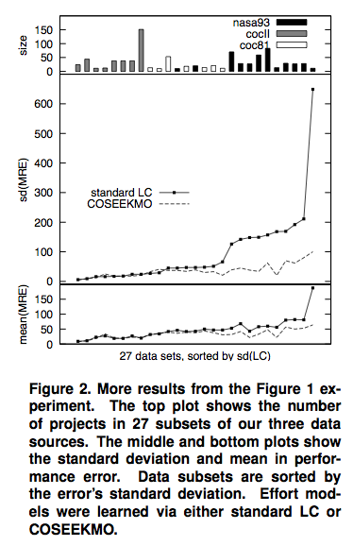
Effort estimation and row pruning
From http://menzies.us/pdf/06deviations.pdf
COSEEKMO: prunes, if possible.
Note how database size does not predict for variance
  But row pruning does
Sadly, “less” is still “lots”
  MRE = 50 +/- 50

Slide 85
Row Selection
(a.k.a. prototype generation)
Repeated result
  Removing most features does not degrade performance
    Sometimes, can improve it
    Often, reduces the variance in the performance
Similarly…
  Removing most rows does not degrade performance
    Sometimes, can improve it.
    Often, reduces the variance in the performance
Prototype methods ﬁnd, or generate, a set of representative examples that replace the train- ing cases. Typically, prototype generation removes most of the training data. For example, Chang’s prototype generators [25] replaced training sets of size T = (514, 150, 66) with prototypes of size N = (34, 14, 6) (respectively). That is, prototypes may be as few as N T = (7, 9, 9)% of the original data.
Chang, Finding prototypes for nearest neighbor classiﬁers”, 1974
  Instance selection works well for ESE ,ASE journal

Slide 86
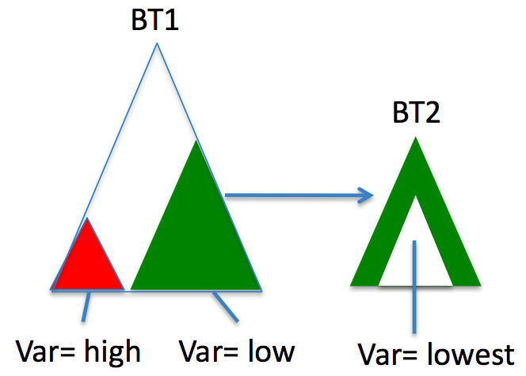
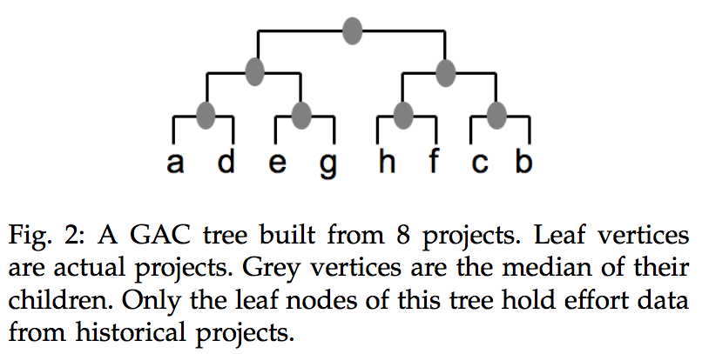
Variance pruning

Slide 87
This talk
“W” (pronounced “wubya”): the decider
  Baseline implementation of SAIL
  Evidence against global SE theory
      The locality effect
But before that…
  Why change our empirical practices?
  An assessment of the current SOA

Slide 88
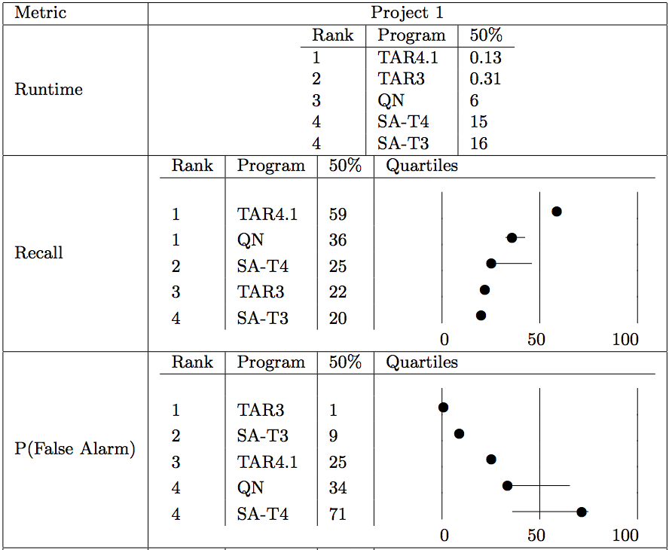
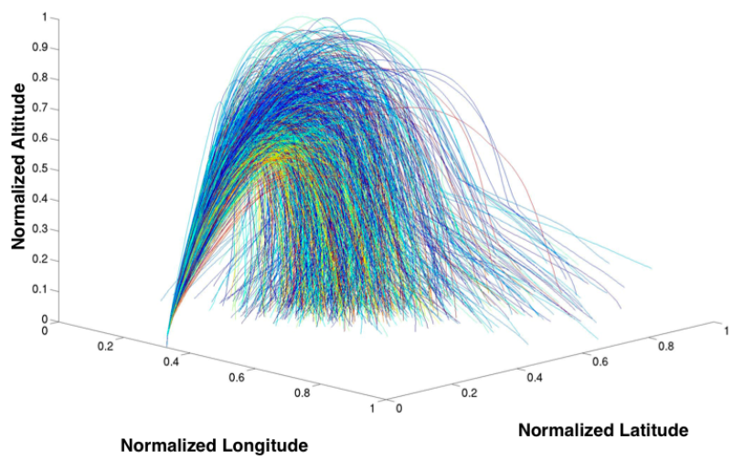
Treatment learning:
9 years later
Gay, Menzies et al.’ 09
TARZAN is no longer a post-processor
  Branch queries performed directly
  on discretized data
    thanks David Poole
  Stochastic sampling
  for rule generation
Benchmarked against state-of-the-art
numerical optimizers for GNC control
Still generating tiny rules
(very easy to read, explain, audit, implement)

