Slide 1
Learning local
Lessons
Tim Menzies, WVU, USA, tim@menzies.us

Slide 2
Today’s talk
Claim:
  Current SE empirical practice asks for conclusions that are are external valid
    apply to more than one domain
  So far, such external valid conclusions are illusive
    Despite decades of research.
Implications:
  The goal is wrong
  Seek not for general theories
    Only for local lessons but local lessons.
“W”
  a baseline tool for generating local lessons

Slide 3
Two definitions of “model”
A hypothetical description of a complex entity or process.
  Model as output from research machine
  The “product” of research
A plan to create, according to a model or models
  Model of the research machine
  The “generator” of products
“W” is a general model generator.

Slide 4
Disagree with me?
Want to find some general conclusions on SE?
Need to go somewhere to get a lot of data from different projects?

Slide 5
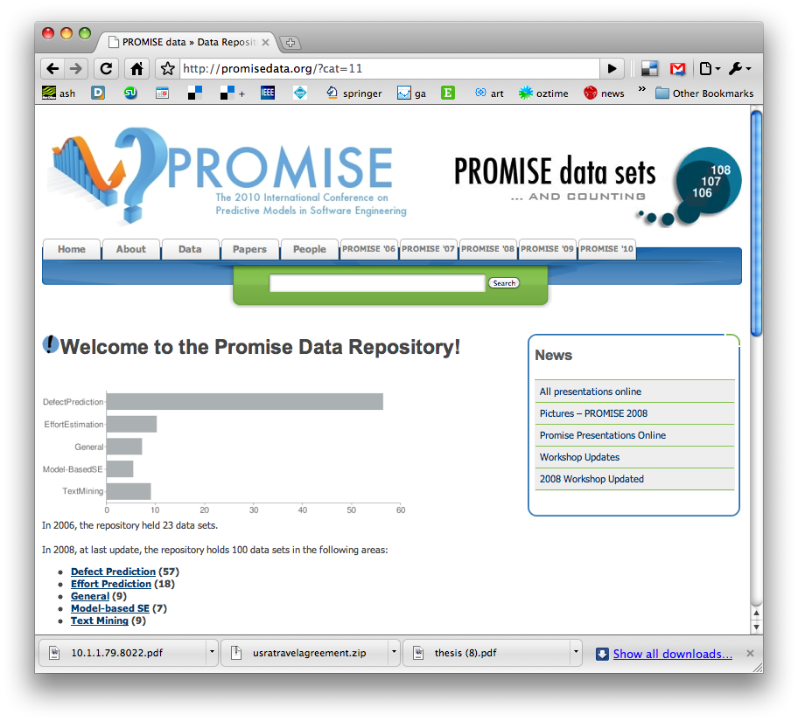
http://promisedata.org/data
Repository + annual conference. See you there?

Slide 6
A warm up exercise

Slide 7
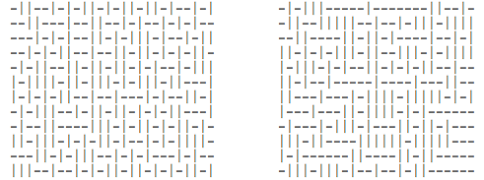
Exercise #1
One these these things is not like the other
  One was generating by selecting “-” or “|”
  at random, 300 times.
Which one?

Slide 8
Exercise #2
A little experiment
Rules
  No one talks for the next 4 minutes
  If you know what is about to happen, see (1)
This will is a selective attention test
  Count the number of times the team with the white shirt passes the ball.
  http://www.youtube.com/v/vJG698U2Mvo&hl=en_US&fs=1&rel=0

Slide 9
What have we learned?
Lesson #1:
  Algorithms can be pretty dumb
  If they don’t focus on X, they see any Y, at random.
Lesson #2:
  Humans can be pretty dumb
  If they mono-focus on X, you can miss Y
Maybe, any induction process is a guess
  And while guessing can be useful
  Guesses can also be wrong
Lets us a create community of agents,
each with novel insights and limitations
  Data miners working with humans
  Maybe in combination, we can see more that separately
Wikipedia:
List of cognitive biases
• 38 decision making biases
• 30 biases in probability
• 18 social biases,
• 10 memory biases

Slide 10

The (Very Weak)
State of the Art in Empirical SE

Slide 11
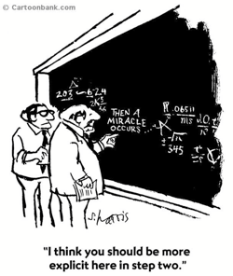
Standard practice, empirical SE
Easterboork et al. (2007)
9 pages: selecting methods
3 pages: research questions
2 pages: empirical validity
2 pages: different forms of "empirical truth"
1 page: role of theory building
1 page: conclusions
1 page: data collection techniques
0 pages: data analysis
  and then a miracle happens
Data analysis needs more than 0 pages
  Properly done, data analysis replaces, not augments, standard empirical methods

Slide 12
More on standard practice
In Basili’s Goal/Question/Metric (GQM), data collection is designed as follows:
  Conceptual level (goal): Defined w.r.t. models of quality, from various points of view and relative to a particular environment.
  Operational level (question): Define questions and models to focus on objects that characterize the assessment of that goal.
  Quantitative level (metric): Define metrics, based on models, for every question in order to collect answers in a measurable way.
GQM is an example of “the
positivist” tradition.
  Problem statement
  State research objective, context
  Experiment (goals, materials, tasks, hypotheses, design)
  Collection, hypothesis testing
  Etc
Release the Ph.D. students
  Wait N years
  Do it once, then celebrate

Slide 13
Time to change standard practice?
Does the pace of change in modern software engineering make GQM impractical?
  Researchers need rapid adaptation methods to keep up with this faster pace. Otherwise…
Basili’s SEL’s learning organization experiment lasted ten years (from 1984 to 1994) during a period of relative stability within the NASA organization.
Starting in 1995, the pace of change within NASA increased dramatically.
  New projects were often outsourced
  SEL became less the driver and more the observer, less proactive and more reactive.
  Each project could adopt its own structure.
  SEL-style experimentation became difficult: no longer a central model to build on.
NASA also tried some pretty radical development methods
  ‘Faster, Better, Cheaper” lead led to certain high profile errors which were attributed to production haste, poor communications, and mistakes in engineering management.
  When ‘Faster, Better, Cheaper’ ended, NASA changed, again, their development practices.
This constant pace of change proved fatal to the SEL.
  Basili el al. [24] describe the period 1995-2001 as one of ‘retrenchment’ at the SEL.

Slide 14
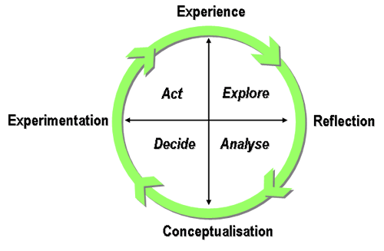
  Done properly, data analysis replaces, not augments, standard empirical methods
“The only interesting answers are those which destroy the questions. -- Susan Sontag
You can start with whatever questions you like
  But the data may only hold answers to other questions.
So starting with questions (version 1.0)
Study data. If quirks, then chase the quirks
  Now explore questions (version 2.0)

Slide 15

What to explore?
The questions you
want to ask
The answers anyone else cares about
The questions the data can support (which, BTW, you won’t know till you look).
Are you here?

Slide 16
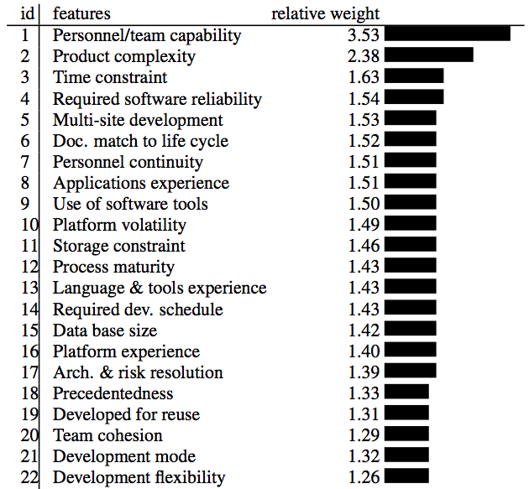
What have we learned from standard practice (1)?
We spend an awful lot of time debating things that don’t matter:
  Objects,
  aspects,
  types,
  etc etc
Source: Boehm 2000.
Regression results from
161 projects.

Slide 17
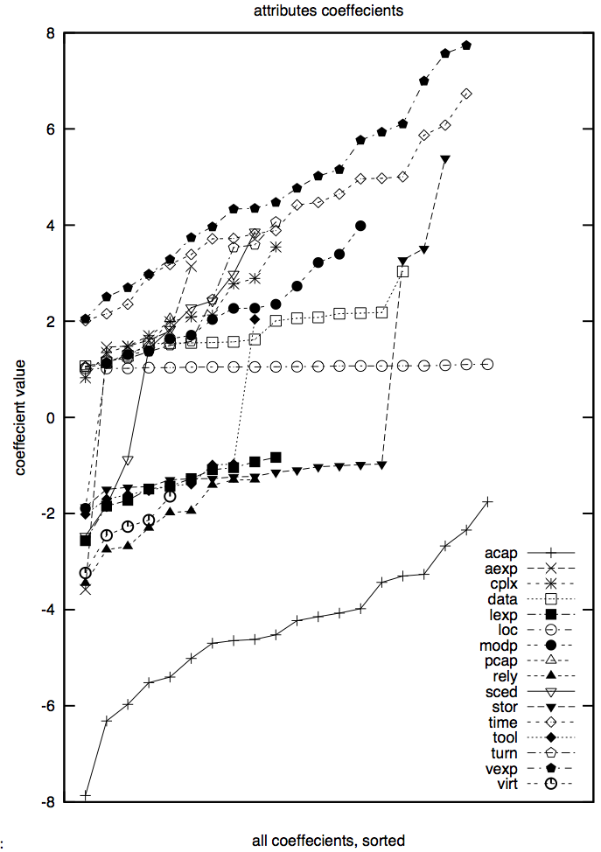
(But don’t take treat those numbers too precisely)
20 experiments, using 66% of the data (selected at random)
Linear regression:
  Effort = b₀ + sum of b_{i *} x_{i}
  Followed by a greedy back-select to prune dull variables
Results
  LOC influence stable
  Some variables pruned away half the time
  Large ranges (max – min)
  Nine attributes even change the sign on their coefficients

Slide 18
What have we learned from standard practice (2)?
  Consider two “methods”:
    software tools, process changes, whatever,
    Anything that we might do to “improve”
    (in some way) a project.
For a list of such methods, see
  IEEE-1012 : the V&V
  “Handbook on software and systems engineering”: Endres and Rombach, 2003
Consider any pair of method1/ method2
  Any studies that comparatively assess them?

Slide 19
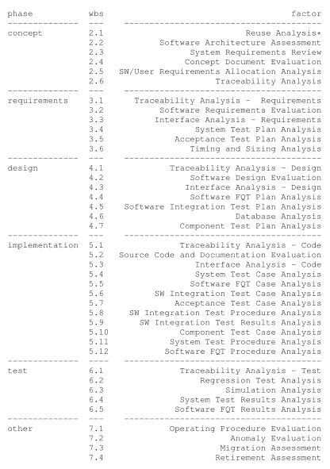
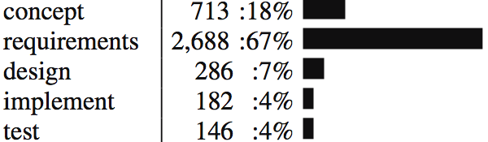
NASA IV&V data
Less is best
109
63
90
11
2
5
131
210
81
4
85
?
  From http://menzies.us/pdf/07ivv.pdf
Step1: Find the phase that saw the most high severity errors, with least IV&V cost
In that phase do the least effort thing first
  frequency of doing “it” times the number of times you did “it”
  If no data, write “?”
An “heroic” study
  Lots of business users doing lots of joins on databases never designed for inter-operative
  Lots of “engineering judgment” on how to align terminology
Not a reproducible study:
  Just the best I have yet to offer
  Has anyone else done better?
    Nope
220
134
23
250
7
22
?
283
545
268
30
61
?
?
?
?
?
202
?
63
?
54
202
?
?
?
?
?

Slide 20
What have we learned from standard practice (3)?
PROMISE 2005 … 2009 :
  64 presentations
48 papers
  tried a new analysis on old data (repeatability is a GOOD thing)
  Or reported a new method that worked once for one project.
4 papers
  argued against model generality
9 papers
  found issues that challenged the validity of prior results
  (re-assessment is a GOOD thing)
  E.g. Menzies et al. Promise 2006
    The variance study described above

Slide 21
What have we learned from standard practice (3, cont.)?
Only a small minority of PROMISE papers (11/64) discuss results that repeated in data sets from multiple projects
E.g. Ostrand, Weyuker, Bell ‘08, ‘09
  Same functional form
  Predicts defects for generations of AT&T software
E.g. Turhan, Menzies, Bener ’08, ‘09
  10 projects
    Learn on 9
    Apply to the 10th
  Defect models learned from NASA projects work for Turkish whitegoods software
    Caveat: need to filter irrelevant training examples

Slide 22
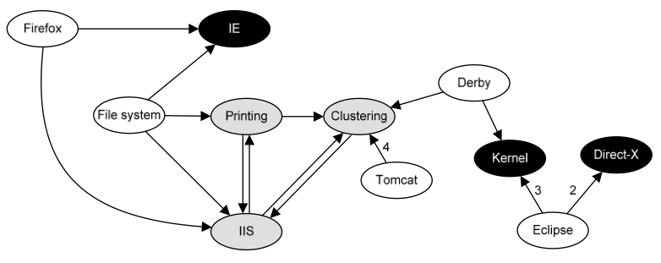
What have we learned from standard practice (4)?
The usual conclusion is that we learn that we can learn very little
FSE’09: Zimmerman et al.
  Defect models
  not generalizable
    Learn “there”, apply
    “here” only works in 4%
    of their 600+ experiments
  Opposite to Turhan’09 results
    ?add relevancy filter
ASE’09: Green, Menzies et al.
  AI search for better software project options
  Conclusions highly dependent on
  local business value proposition
And others
  TSE ‘01, ’05: Shepperd et al
    Any conclusion regarding “best” effort estimator varies by data sets,
    performance criteria, random selection train/test set
  TSE’06: Menzies, Greenwald:
    attributes selected by FSS vary wildly across projects
  Zannier et al ICSE’06:
    picked 5% (at random) ICSE claiming to be “empirical,”
    very few of them (2%) compare methods from multiple researchers

Slide 23

The gods are angry
Fenton at PROMISE’ 07
  "... much of the current software metrics research is inherently irrelevant to the industrial mix ...”
  "... any software metrics program that depends on some extensive metrics collection is doomed to failure ...”
Budgen & Kitchenham:
  “Is Evidence Based Software Engineering mature enough for Practice & Policy? ”
  Need for better reporting: more reviews.
  Empirical SE results too immature for making policy.
Basili : still far to go
  But we should celebrate the progress made over the last 30 years.
  And we are turning the corner

Slide 24

A new hope
(actually, quite old)
Experience factories
  Method for find local lessons
Basili’09 (pers. comm.):
  “All my papers have the same form.
  “For the project being studied, we find that changing X improved Y.”
Translation (mine):
  Even if we can’t find general models (which seem to be quite rare)….
  … we can still research general methods for finding local lessons learned

Slide 25
If we can’t find general models, is it science?
Popper ’60: Everything is a “hypothesis”
  And the good ones have weathered the most attack
  SE “theories” aren’t even “hypotheses”
Endres & Rombach ’03: Distinguish “observations”, “laws”, “theory”
  Laws predict repeatable observations
  Theories explain laws
  Laws are either hypotheses (tentatively accepted) or conjectures (guesses)
Gregor’06 : 5 types of “theory”:
  Analysis (e.g. ontologies, taxonomies)
  Explanation (but it is hard to explain “explanation”)
  Prediction (some predictors do not explain)
  Explanation and prediction
  “models” for design + action
    Don’t have to be “right”
    Just “useful”
    A.k.a. Endres & Rombach’s “laws”?

Slide 26
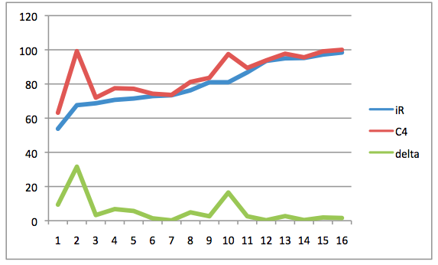
The rest of this talk: “W”
(a “local lessons” finder)
26/46
Bayesian case-based
contrast-set learner
  uses greedy search
  illustrates the “local lessons” effect
  offers functionality missing in
  the effort-estimation literature
Fast generator of baseline results
  There are too few baseline results
  And baseline results can be very interesting (humbling).
A very (very) simple algorithm
  Should add it to your toolkit
  At least, as the “one to beat”
accuracy
Holte’93
• C4: builds decision trees “N” deep
• 1R: builds decision trees “1” deep
• For datasets with 2 classes, 1R ≈ C4

Slide 27
Contrast set learning with “W”

Slide 28
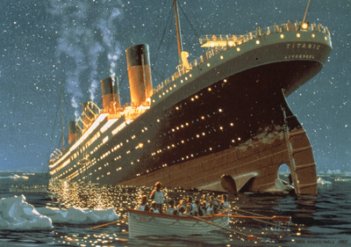
“W”= Simple (Bayesian) Contrast Set Learning (in linear time)
Mozini: KDD ‘04
“best” = target class (e.g. “survive”)
“rest” = other classes
x = any range (e.g. “sex=female”)
f(x|c) = frequency of x in class c
b = f( x | best ) / F(best)
r = f( x | rest ) / F(rest)
LOR= log(odds ratio) = log(b/r)
  ? normalize 0 to max = 1 to 100
s = sum of LORs
  e = 2.7183 …
  p = F(B) / (F(B) + F(R))
  P(B) = 1 / (1 + e^(-1*ln(p/(1 - p)) - s ))

Slide 29
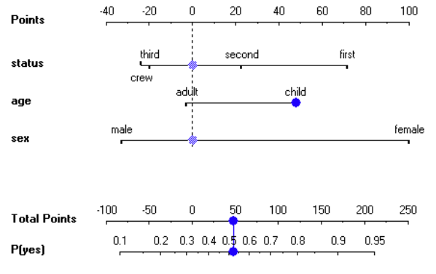
“W”= Simple (Bayesian) Contrast Set Learning (in linear time)
Mozini: KDD ‘04
“best” = target class (e.g. “survive”)
“rest” = other classes
x = any range (e.g. “sex=female”)
f(x|c) = frequency of x in class c
b = f( x | best ) / F(best)
r = f( x | rest ) / F(rest)
LOR= log(odds ratio) = log(b/r)
  ? normalize 0 to max = 1 to 100
s = sum of LORs
  e = 2.7183 …
  p = F(B) / (F(B) + F(R))
  P(B) = 1 / (1 + e^(-1*ln(p/(1 - p)) - s ))

Slide 30
“W”= Simple (Bayesian) Contrast Set Learning (in linear time)
Mozini: KDD ‘04
“best” = target class (e.g. “survive”)
“rest” = other classes
x = any range (e.g. “sex=female”)
f(x|c) = frequency of x in class c
b = f( x | best ) / F(best)
r = f( x | rest ) / F(rest)
LOR= log(odds ratio) = log(b/r)
  ? normalize 0 to max = 1 to 100
s = sum of LORs
  e = 2.7183 …
  p = F(B) / (F(B) + F(R))
  P(B) = 1 / (1 + e^(-1*ln(p/(1 - p)) - s ))
“W”:
Discretize data and outcomes
Count frequencies of ranges in classes
Sort ranges by LOR
4) Greedy search on top ranked ranges

Slide 31
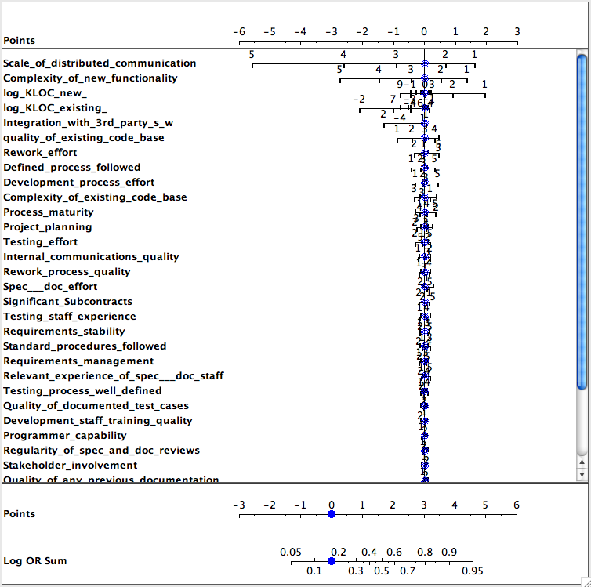
LOR and Defect Prediction
Data from Norman Fenton’s Bayes Net
Classes=
  round(log2(defects/KLOC))/2)
Target class = max(class)
  I.e. worse defects
Only a few features matter
Only a few ranges of those features matter

Slide 32
“W” + CBR:
Preliminaries
“Query”
  What kind of project you want to analyze; e.g.
    Analysts not so clever,
    High reliability system
    Small KLOC
“Cases”
  Historical records, with their development effort
Output:
  A recommendation on how to change our projects in order to reduce development effort

Slide 33
Cases
Cases map features F to a utility
F= Controllables + others
train
test

Slide 34
Cases
Cases map features F to a utility
F= Controllables + others
train
test
(query ⊆ ranges)
k-NN
relevant

Slide 35
Cases
Cases map features F to a utility
F= Controllables + others
train
test
(query ⊆ ranges)
k-NN
Best
utilities
x
b = F(x | best) / F(best)
relevant
x
r = F(x | rest) / F(rest)
rest

Slide 36
Cases
Cases map features F to a utility
F= Controllables + others
train
test
(query ⊆ ranges)
S = all x sorted descending by score
k-NN
Best
utilities
x
b = F(x | best) / F(best)
if controllable(x) &&
b > r &&
b > min
then score(x) = log(b/r)
else score(x) = 0
fi
relevant
x
r = F(x | rest) / F(rest)
rest

Slide 37
Cases
Cases map features F to a utility
F= Controllables + others
train
test
k-NN
query_{i}* =
query + ∪_{i}S_{i}
treated_{i}
(query ⊆ ranges)
S = all x sorted descending by score
k-NN
Best
utilities
x
b = F(x | best) / F(best)
if controllable(x) &&
b > r &&
b > min
then score(x) = log(b/r)
else score(x) = 0
fi
relevant
x
r = F(x | rest) / F(rest)
rest

Slide 38
Cases
Cases map features F to a utility
F= Controllables + others
utility
median
train
test
k-NN
query_{i}* =
query + ∪_{i}S_{i}
spread
i
treated_{i}
(query ⊆ ranges)
S = all x sorted descending by score
k-NN
Best
utilities
x
b = F(x | best) / F(best)
if controllable(x) &&
b > r &&
b > min
then score(x) = log(b/r)
else score(x) = 0
fi
relevant
x
r = F(x | rest) / F(rest)
rest

Slide 39
Cases
Cases map features F to a utility
F= Controllables + others
treatment
q₀*
q_{i}*
utility
median
train
test
k-NN
query_{i}* =
query + ∪_{i}S_{i}
spread
i
i
treated_{i}
As is
To be
(query ⊆ ranges)
S = all x sorted descending by score
k-NN
Best
utilities
x
b = F(x | best) / F(best)
if controllable(x) &&
b > r &&
b > min
then score(x) = log(b/r)
else score(x) = 0
fi
relevant
x
r = F(x | rest) / F(rest)
rest

Slide 40

#1: Brooks’s Law

Slide 41
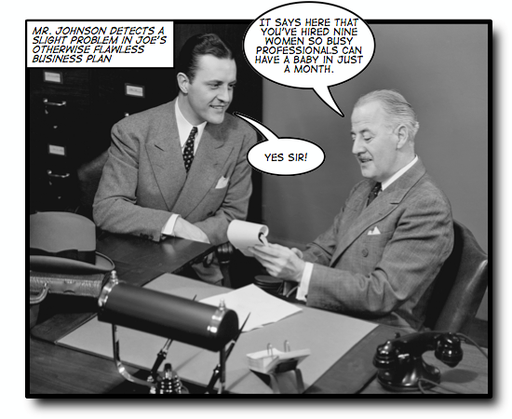
Some tasks have
inherent temporal constraints

Slide 42

Brooks’s Law (1975)
“Adding manpower (sic) to a late project makes it later”.
Inexperience of new comers
  • Extra communication overhead
  • Slower progress

Slide 43
“W”, CBR, & Brooks’s law
Can we mitigate for decreased
experience?
Data:
  Nasa93.arff
  (from promisedata.org)
Query:
  Applications Experience
    “aexp=1” : under 2 months
  Platform Experience
    “plex=1” : under 2 months
  Language and tool experience
    “ltex = 1” : under 2 months
For nasa93, inexperience does not always delay the project
  if you can reign in the DB requirements.
So generalities may be false
  in specific circumstances
Need ways to quickly build and maintain domain- specific SE models

Slide 44
#2 , #3,…. #13

Slide 45
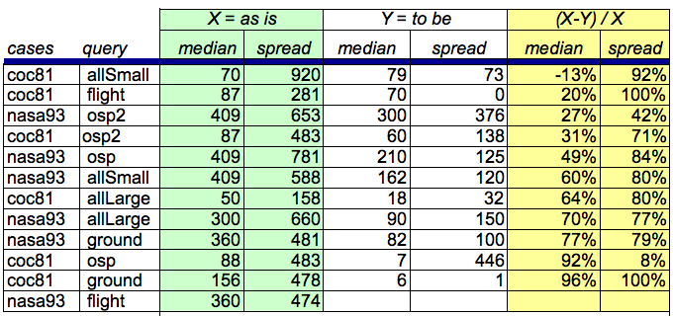
Results (distribution of development efforts in q_{i}*)
Cases from promisedata.org/data
Median = 50% percentile
Spread = 75% - 25% percentile
Improvement = (X - Y) / X
X = as is
Y = to be
more is better
Usually:
spread ≥ 75% improvement
median ≥ 60% improvement

Slide 46
But that was so easy
And that’s the whole point
Yes, finding local lessons learned need not be difficult
Strange to say…
  There are no references in the CBR effort estimation literature for anything else than estimate = nearest neighbors
  No steps beyond into planning , etc
  Even though that next steps is easy

Slide 47
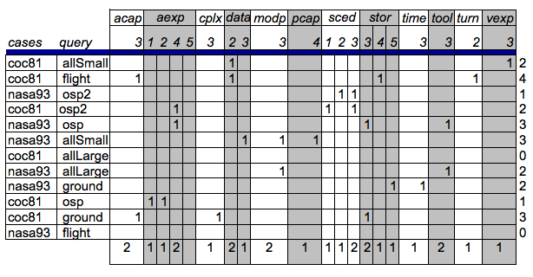
What should change?
(q_{j}* - q_{o}*)

Slide 48
Good news: improving estimates requires very few changes

Slide 49
Not-so-good news: local lessons very local

Slide 50

Q: Can we do better than “W”?
A: Most certainly!
“W” contains at least a dozen arbitrary design decisions
  Which is best?
But the algorithm is so simple
  It should least be a baseline tool
  Against which we compare supposedly more sophisticated methods.
  The straw man
Methodological advice
  Before getting complex, get simple
  Warning: often: my straw men don’t burn

Slide 51
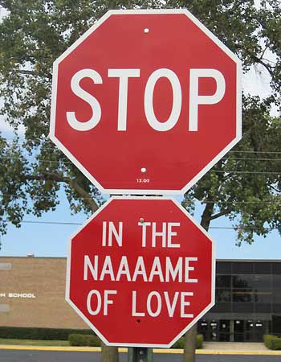
In conclusion …

Slide 52
Certainly, we should always strive for generality
But don’t be alarmed if you can’t find it.
The experience to date is that,
  with rare exceptions,
  SE does not lead to general models
But that’s ok
  Very few others have found general models (in SE)
  E.g. Turhan, Menzies, Ayse’09
Anyway
  If there are few general results, there may be general methods to find local results
    Seek not “models as products”
    But general models to generate products

Slide 53
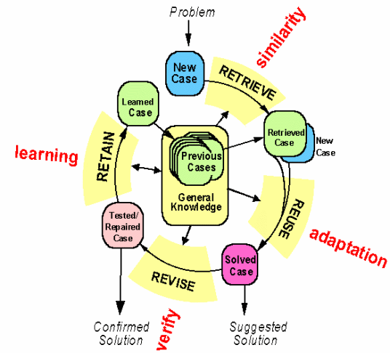
Btw, constantly (re)building local models is a general model
Case-based reasoning
Kolodner’s theory of
reconstructive memory
The Yale group
  Shank & Riesbeck et al.
  Memory, not models
  Don’t “think”, remember

Slide 54
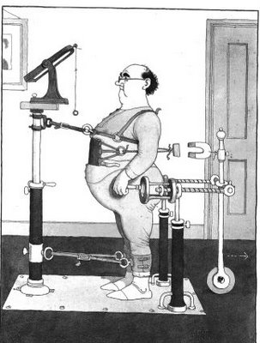
Kludges: they work
Ask some good old fashioned AI types
Minsky’86: “Society of Mind”
The brain is a set of 1000+ kludges
Feigenbaum'78
Don't take your heart attack
to the Maths Dept.
  Were they will diagnose and treat you using first principles
Instead, go to the E.R room
  Staffed by doctors who spent decades learning the quirks of drugs, organs, diseases, people, etc
Seek out those that study kludges.
You'll be treated faster
You'll live longer

Slide 55
Disagree with me?
Want to find some general conclusions on SE?
Need to go somewhere to get a lot of data from different projects?

Slide 56
http://promisedata.org/data
Repository + annual conference. See you there?

Slide 57
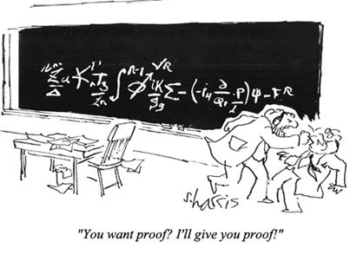
Questions?
Comments?
“You want proof? I’ll give you proof!”

