Slide 1

Issues with statistical methods
#include standardComment.h

Slide 2
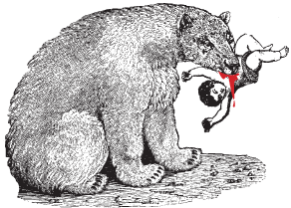
The usual slide at this point
Statistics- take care

Slide 3
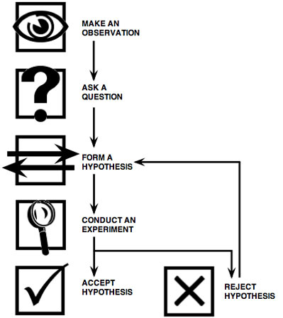
The slavish application of statistical hypothesis testing is a very bad idea
Ask anyone from any field who has been
doing this stuff longer than us.
Psychologists: e.g. Cohen, 1988: “The earth is flat (p < .05)”
  Significance hypothesis testing of H0 P versus H1 is a ‘potent but sterile intellectual rake who leaves . . . no viable scientific offspring’.
Marketing; e.g. Armstrong, 2007, Significance
tests harm progress in forecasting:
  Revises one study that, using significance testing, concludes that estimates generated from multiple sources do no better than those generated from a single source.
  Lists 31 studies: multiple source prediction consistently out-performs single source prediction by 3% to 23% (average = 12.5%).
  These improvements, in all study are the exact opposite of what would be predicted from the significance test results.
Worse, we don’t know how to apply hypothesis testing

Slide 4
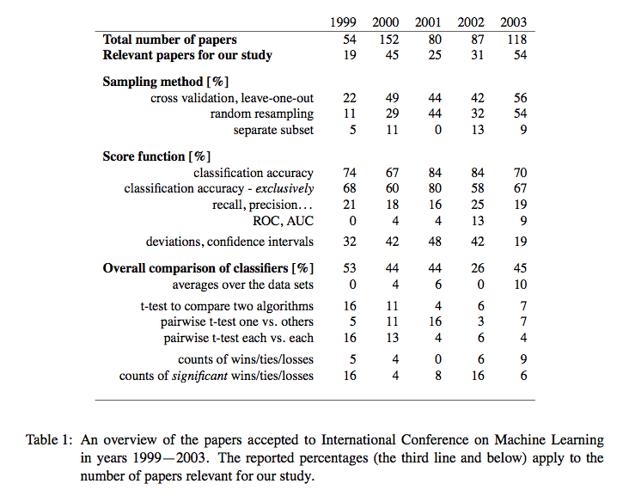
Janez Demsar : Statistical Comparisons of Classifiers over Multiple Data Sets
Journal of Machine Learning Research 7 (2006) 1–30
Statistical methods in our field are in disarray.
Demsar proposes a fix:
  Friedman, Nemenyi tests
  But not widely accepted.
Best to
  Make sure you are reporting BIG effects- not some 3% delta (yawn)
  Minimize use of stats (use them as a sanity check to conform an intuition gained via, say, some visualization
  Use the statistical methods that bother reviewers the least

Slide 5
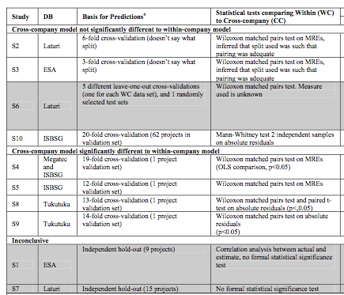
Kitchenham et al. TSE, 2007

Slide 6
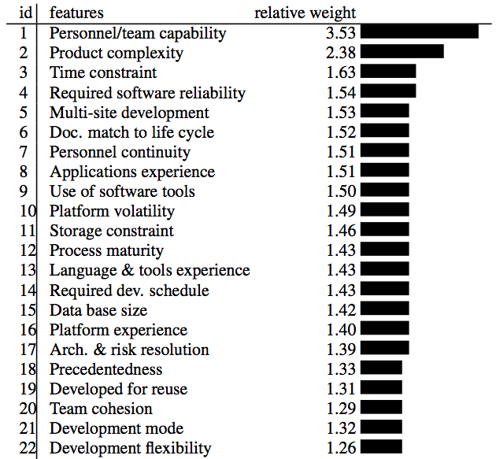
Consider using simple visuals rather than complex stats
Boehm, 2000
Where are automated software engineering methods?
  How good are they compared to other ways to change a project?
Source: Boehm 2000.
Regression results from
161 projects.

Slide 7
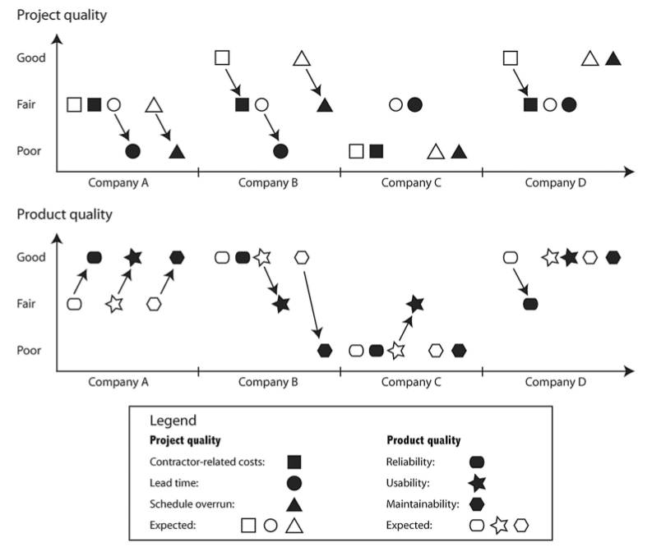
Same task, 4 implementations from 4 companies
Anda, Bente, Mockus,
IEEE TSE May 2009
Usual case: predicted not actual
You’ll never see this figure in any stats text

Slide 8
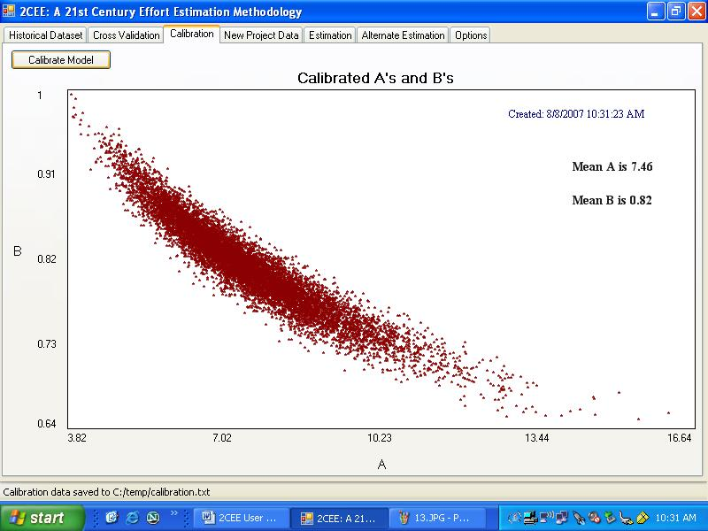
A simple visualization to make a point about instability.
“Local calibration” to learn (a,b) for
  effort=a.LOC^{b}.c
Repeated 1000 times for 90% of some NASA data
By the way:
  Officially,
  a=2.9, b=0.91,

Slide 9
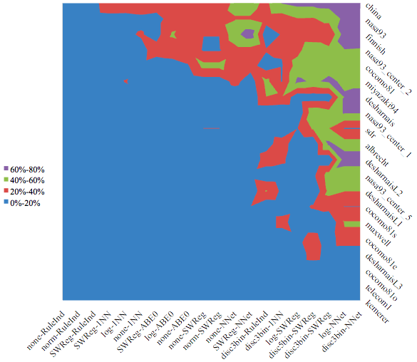
More simple visualizations
(and we spent days getting here)
Seven different performance criteria
20 effort estimation data sets
20 estimation methods
Percentage of losses of one method vs 20 other methods
Wilcoxon, 95% confidence).
If Blue then < 20
Mostly blue
  Which explains the “conclusion instability” problem

Slide 10
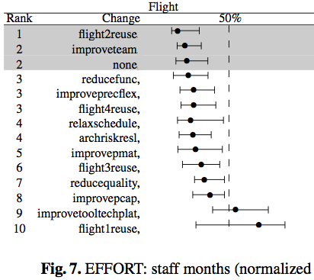
Example “ranked quartiles” from http://menzies.us/pdf/09reuse.pdf
Non-parametric analysis
  Means = no
  Standard deviations = don’t do it
Indicate median and variability around the mean (here, 25-75% percentile range)
Show baselines against something else.
Stats are secondary
BTW
  Death to t-tests
    At least Mann-whitney, Wilcoxon. At most, see Demsar 2006
  Accuracy and prevision very bad when target class rare: http://menzies.us/pdf/07precision.pdf
When not to use ranked quartiles
  When there is not enough space in the paper
  When reviewers want something lese
  When your co-authors want something else

Slide 11
Damned if you do, damned if you don’t
But worse that over-relying on stats
  Is using no stats at all
How to get a paper rejected
  Only report deltas between mean values
Every paper that performs repeated trials must analyze
  the central tendency
    e.g. the 50th percentile
  as well as the deviations around that tendency, of the results
    e.g. the 75-25th percentile

