Slide 1


Case-Based Reasoning vs Parametric Models for Software Quality Optimization
Adam Brady : adam.m.brady@gmail.com
Tim Menzies : tim@menzies.us
Lane Dept. of Computer Science and Electrical Engineering
West Virginia University, USA

Slide 2
Is “effort estimation” the wrong question?
Don’t tell me what is, tell me what to change.”
  -- An irate business user, May’00
After prediction…
  Comes the planning that improves that prediction
SQO= software quality optimization
  adjusting a software project to improve attributes e.g.
    defects (number of delivered defects),
    months (calendar time to delivery)
    effort (staff time, in person months, required for that delivery).

Slide 3
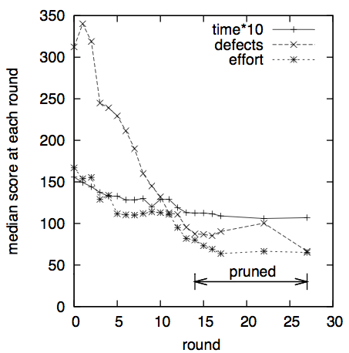
“Model-based” SQO
Use a predictive model (e.g. COCOMO) as a
sub-routine in a what-if analysis
  Guide the what-if analysis with some AI algorithm
    A*,
    Beam,
    simulated annealing,
    ISAMP,
    MaxWalkSat,
    …
  As done by Menzies et al. in ASE’07, ICSP’08,
  ICSE’09, PROMISE’09, SPIP 2009, ASE’09
Repeat 1000 times
  p = a possible project
  t = a possible model tuning
  Out = value( model(p, t) )
Search for ranges in p that maximize Out
Test those ranges by calling the model again

Slide 4

This talk: “case-based” SQO?
“W”
  “dubya”: the decider
  a very greedy algorithm
  Meant to have been a straw-man baseline tool
    But it out-performs ASE’07, ICSP’08, ICSE’09,
    PROMISE’09, SPIP 2009, ASE’09
No need for a process model
  embarrassingly simple

Slide 5
Definitions
Model-based, Case-based Reasoning

Slide 6
Case-based, model-based reasoning
Model-based
Training data + learner ➔ model
Test case + model ➔ prediction
Most of current PROMISE papers
Case-based
Test case + Training data ➔ neighbors
Neighbors ➔ prediction

Slide 7
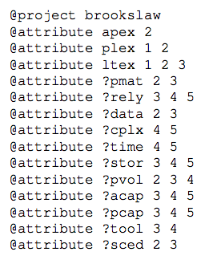

Slide 8
1
A membership function
returning 0 to 14

Slide 9
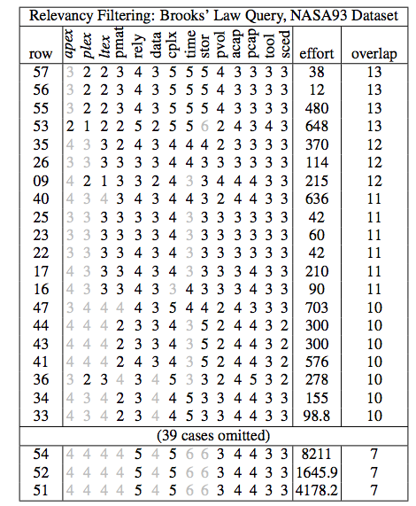
1
A membership function
returning 0 to 14
2

Slide 10
1
A membership function
returning 0 to 14
3
2

Slide 11
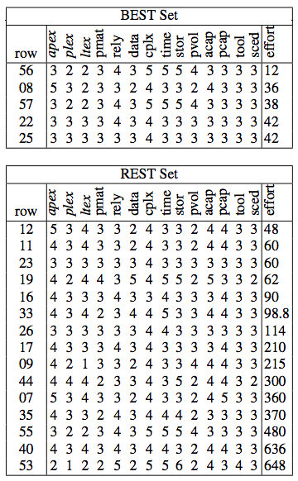
1
A membership function
returning 0 to 14
3
2
4a
4b

Slide 12
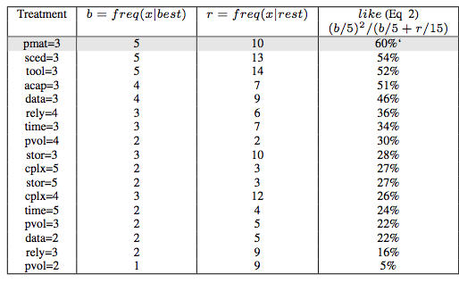
1
A membership function
returning 0 to 14
3
5
2
4a
4b

Slide 13
1
A membership function
returning 0 to 14
3
5
2
4a
4b
6

Slide 14
1
A membership function
returning 0 to 14
3
5
2
4a
4b
6
Repeat 20 times

Slide 15
1
Simplest case of the KEYS2: see Gay, Menzies et al ASE journal, Dec’10
A membership function
returning 0 to 14
3
5
2
4a
4b
6
Repeat 20 times

Slide 16
“W” = CBR + query adaption
Standard CBR = “what is”
“W” = “what to change”
Q= query
C= cases
Predict = adapt(Q ∧C)
Q0 = query
N times repeat
  C = Cases = Train + Prune
  Predict0 = adapt(Q0 ∧Train)
  Q1 = Q0 + treatment
  Predict1 = adapt(Q1 ∧Prune)
Best treatment:
  maximizes Predict1/Predict0
  And is stable across the repeats
Q: Why just “Prune”
  And not “Prune” and “Test”?
  A: Some very small data sets

Slide 17
Experimental Comparisons
Model-based vs CBR

Slide 18
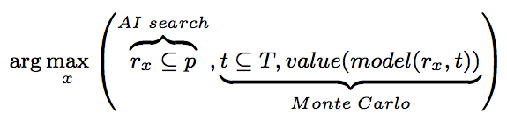
Is “W” beaten by other methods?
STAR, NOVA:
  model-based what-if exploration of software process models
  Oracle = COCOMO (effort); COQUALMO (defects)
  ASE’07, ICSP’08, ICSE’09, PROMISE’09, SPIP 2009, ASE’09
STAR:
  Simulated annealing (SA) to explore project options
  Tuning options (T) sampled Monte Carlo
  SA explored project options (p) looking for changes
    That caused stable outputs
    Despite tuning uncertainties
NOVA:
  SA, beam, issamp, keys, maxwalksat, A*, SEESAW,….

Slide 19
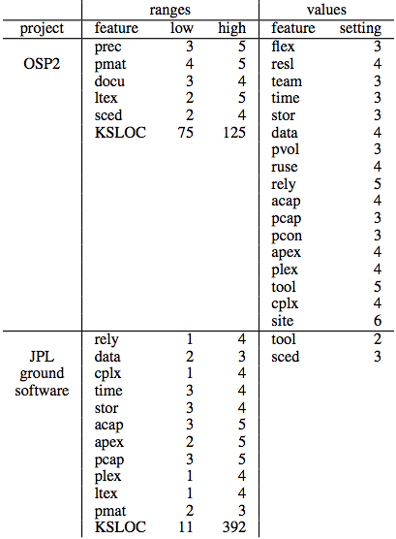
“W” vs NOVA
NOVA’s best search method
  SEESAW (ASE’09)
Project descriptions from NASA
  Flight, ground systems
  Two flight guidance system:
  OSP, OSP2
Case study data = NASA93
  50 times,
    divided into “train” and “test”
    (66% / 33%)

Slide 20
Testing the treatments
  Query= NASA project descriptions
  Learn a treatment
Testing:
  Sort test data by overlap with Query + Treatment
  Look at up to 20 cases with greatest overlap
  (In practice, Query+Treatment selects for less than 20 test cases).
Treatment1: CBR (“W”)
  Learn treatment1 with “W” from “train”, assuming query
  Assess on “test”
Treatment2: model-based (SEESAW)
  Constrain inputs to just the query
  Learn treatment2 with NOVA
  Assess on “test”

Slide 21
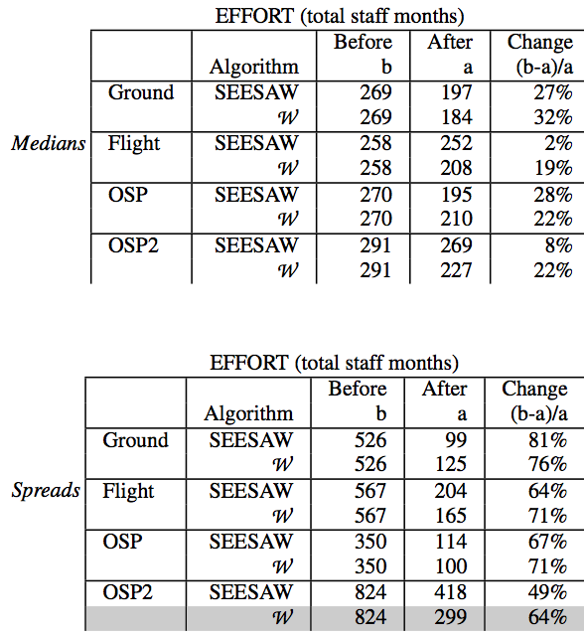
Results
Learner= (SEESAW or W)
Project= (Flight, ground, OSP, or OSP2)
Goal= (defects, months, or effort)
Report= (median or spread)
  Median = 50th percentile
  Spread = (75-25)th percentile
Finding1:
  In 94% of runs, reductions observed
  So SQO works

Slide 22
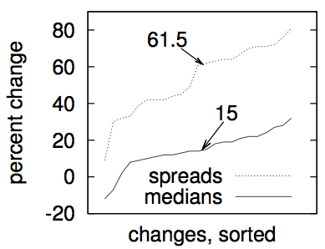
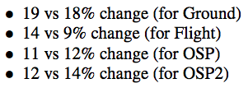

Results (more)
Finding2:
  SEESAW’s / W’s recommendations
  reduced the spread
  So SQO increases certainty
Finding3:
  In absolute terms …
  Improvements seen by SEESAW/W very similar
Finding4:
  In relative terms …
  W wins a little more: Mann-Whitney, 95%

Slide 23
Other observations
Simple to code: 200 lines of AWK vs 5000 lines of LISP
Faster to run: less than second (in awk!!!)
Simpler to maintain
  in CBR, “maintenance” = “add more cases”
No use of an underlying model
  Free of any (possibly wrong) assumptions of parametric modeling.
  Can be quickly applied to more data sets.
    E.g. our older implementations required data in COCOMO format
    W has been applied to numerous other formats

Slide 24
Discussion

Slide 25
Case-based vs model-based SQP
“W”
  finds similar or better optimizations than more complex model-based approaches
Simpler to code
Faster to run
Easier to maintain
No model assumptions
No restrictions arising from model ontology

Slide 26

  Is simple sufficient?
SE data is a shallow well?
  Seemingly sophisticated algorithms can be no
  better than simpler alternatives
  See also, Lessmann et al TSE’08 , Menzies et al. ASEJ,10
Bias in our field: always go for the more complex
  Ant algorithms to find best splits for model trees
  Cloud computing to try 10,000 variants of a machine learner
  …
Estimation data = small
  misguided to spend
  day of CPU time
  to analyze only a handful
  of instances

Slide 27
Scope of these conclusions
Do all CBR methods are better than all model-based method?
Nope
  Here, just SQO
But this result should motivate more exploration of CBR for SE data

Slide 28
Questions or comments?

