Slide 1


Case-Based Reasoning vs Parametric Models for Software Quality Optimization
Adam Brady : adam.m.brady@gmail.com
Tim Menzies : tim@menzies.us
LCSEE,
WVU, USA

Slide 2
Road map
Motivation
Implementation
Optimization
Applications
Implications

Slide 3
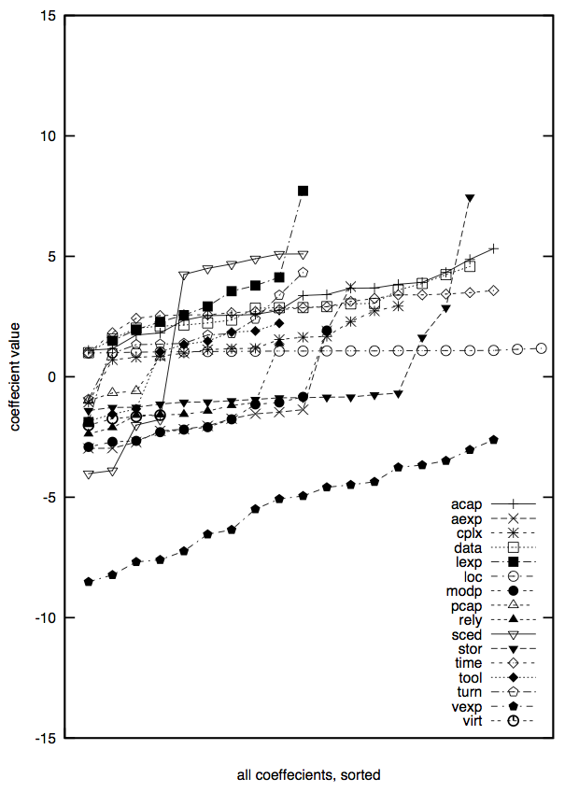
Motivation 1 : Model-based methods on SE data are “brittle”
Are “models” the best way to reason about software projects?
  Training data + learner ➔ model
  Test case + model ➔ prediction
  Predictions unstable if models “brittle”
  Widely-used models are very brittle
What about instance-based learning?
  Test case + Training data ➔ neighbors
  Neighbors ➔ prediction
20 repeats of linear regression on 66% of some COCOMO data to learn effort = b₀ + b_{i}x_{i} using 20.
From PROMISE’05.

Slide 4
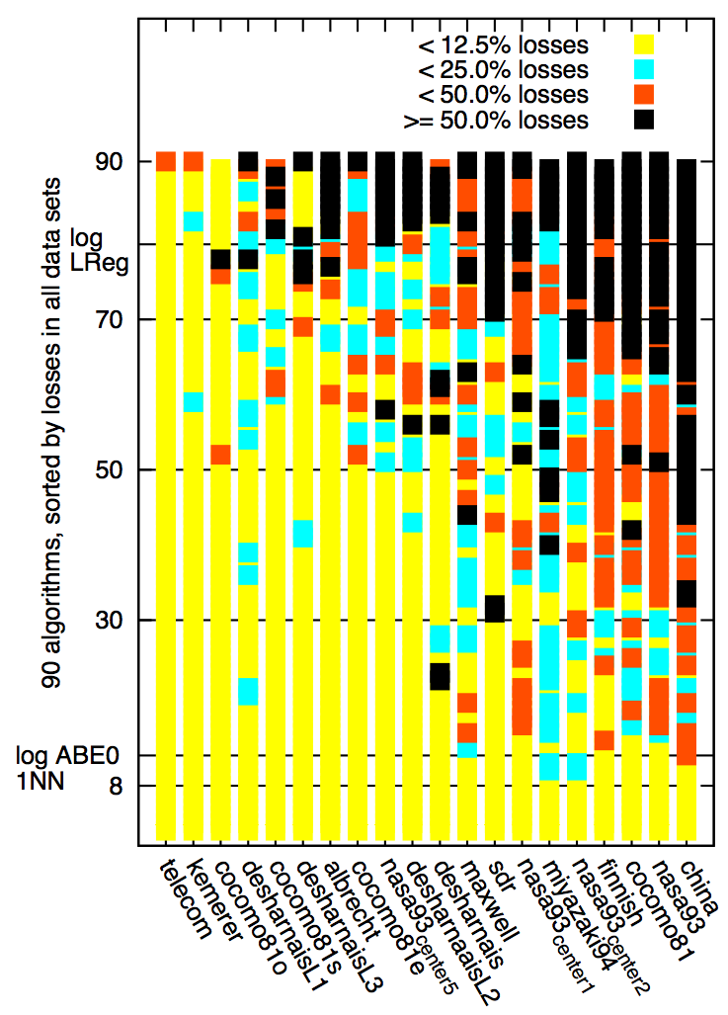
Motivation 2: Estimation research is crowding a (mostly) flat space
Something wrong with current research into effort estimation
  Endless stream of results trying new learner X on some data
Thesis: the world is flat
  Most estimation are indistinguishable
  Easy to get fooled that you’ve found a “better” method
    When really, your just standing on random dust in flat land
623 comparisons, Wilcoxon (one learner vs 89 others using MRE, PRED(25), MMRE, MdMRE, MER, AR, MIBRE).
Leave-one-out experiments

Slide 5
Motivation 3:
Mere estimation is not enough
Even if we can estimate, so what?
  Is the issue “how long”
  or “how to improve”?
SQO= software quality optimization
  adjusting a software project to improve attributes e.g.
    defects (number of delivered defects),
    months (calendar time to delivery)
    effort (staff time, in person months, required for that delivery).
SQO is non-linear problem: improving goal1 can harm goal2
  If management rushes completion, then months=down but defects=up
  If elaborate QA then defects=down but effort=up.

Slide 6
Motivation 4:
Must react to local conditions
20th century SE: the struggle for the single theory
  E.g. Boehm’s COCOMO effort estimation project
  E.g. SEI capability maturity model [130];
21st century: faster pace = more diversity
  Less likely that there exists a single over-arching grand theory of SE
  Very few reports of models that work on N projects
    Ostrand, Weyuker, Bell PROMISE ‘08, ‘09
    When to Use Data from Other Projects for Effort Estimation Ekrem
    Kocaguneli, Gregory Gay, Tim Menzies, Ye Yang, Jacky W. Keung , ASE 2010
    B. Turhan, T. Menzies, A. Bener, and J. Distefano. On the relative value of cross-company and within- company data for defect prediction. Empirical Software Engineering, 68(2):278–290, 2009
The majority view [1,2,3,4,5] is that while generality may elude us, we can still find the special lessons that work best on the local projects
    Rombach A. Endres, H.D. A Handbook of Software and Systems Engineering: Empirical Observa- tions, Laws and Theories. Addison Wesley, 2003.
    B. Kitchenham D. Budgen, P. Brereton. Is evidence based software engineering mature enough for practice & policy? In 33rd Annual IEEE Software Engineering Workshop 2009 (SEW-33), Skvde, Sweden, 2009.
    B. A. Kitchenham, E. Mendes, and G. H. Travassos. Cross- vs. within-company cost estimation studies: A systematic review. IEEE Transactions on Software Engineering, pages 316–329, May 2007.
    Tim Menzies and Forrest Shull. The quest for convincing evidence. In A. Oram and G. Wilson, editors, Making Software: What Really Works, and Why We Believe It. O’Reilly, 2010.
    H. Gall E. Giger T. Zimmermann, N. Nagappan and B. Murphy. Cross-project defect prediction. In ESEC/FSE’09, August 2009.
Seek a learner that returns different conclusions,
based on the context of the problem at hand

Slide 7
Road map
Motivation
Implementation
Certification
Applications
Implications

Slide 8
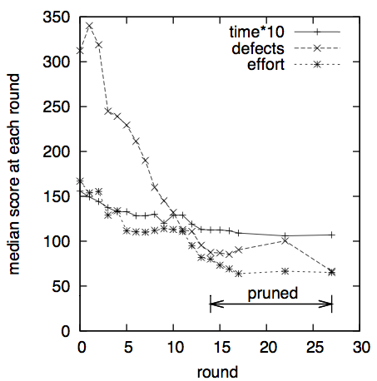
Implementation (#1: model-based)
Standard SE process models
  COCOMO effort, months predictor
  COQUALMO defect predictor
  Parameterize regions internal uncertainty
STAR, NOVA
  Monte Carlo random picks in uncertain regions
  AI algorithms found inputs to minimize outputs
    Despite those internal uncertainties
    A*, Beam, ISAMP, SA, MaxWalkSat, SEESAW
ASE’07, ICSP’08, ICSE’09, PROMISE’09, SPIP 2009, ASE’09
  New algorithm, SEESAW, better than usual suspects
  Found project options to minimize outputs
  Only needed to make a few project changes
  Local data useful, but can make decisions without it
  “Best” decisions specific to local projects and goals

Slide 9
Implementation (#2: instance-based)
“W” (dubya, the decider)
  Project constraints = a query Q0
  Data= 66% train, 33%prune (at random)
  Q0 + training data ➔ relevant subset
  Sort subset from best to rest
  Rank attribute ranges by relative frequency in best/rest
  Apply Rank1, Rank2… to prune
    stop when improvement at RankN
Rx= treatment = what to change
    (and rank1 rank2 … rankN)
  Q1 = Q0 + Rx
    Selects for other projects than Q0
    Projects with better desired properties
Repeat 20 times to check stability
“W”: 100Ks of AWK, linear-time processing,
  1 sec runtime
  Requires no model
  Hence, can take data sets using any column names
  “Maintenance” = easy
    Just add more cases
NOVA: 1000Ks of LISP
  Minutes to hours to run
  Critically dependent on COCOMO
  Restricted use to just COCOMO-style data
  “Maintenance” = hard
    develop, validate new model

Slide 10
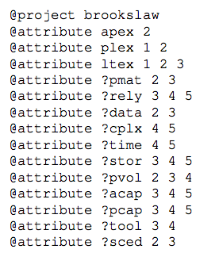
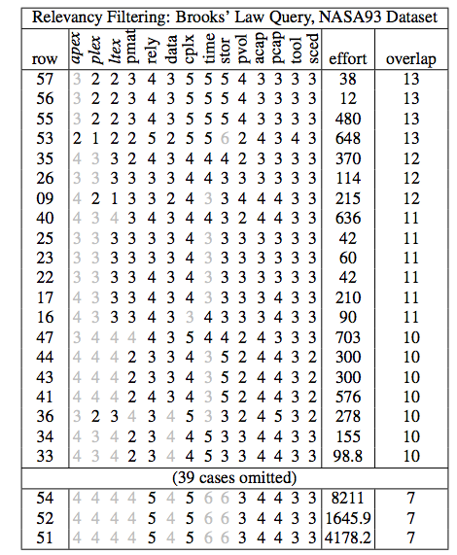
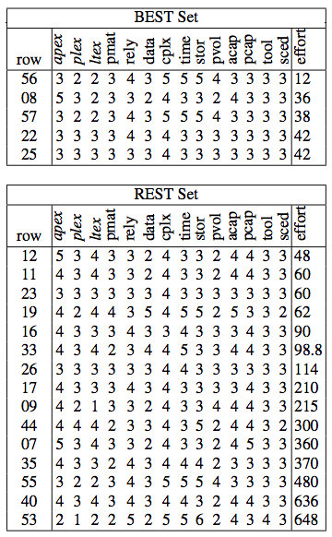
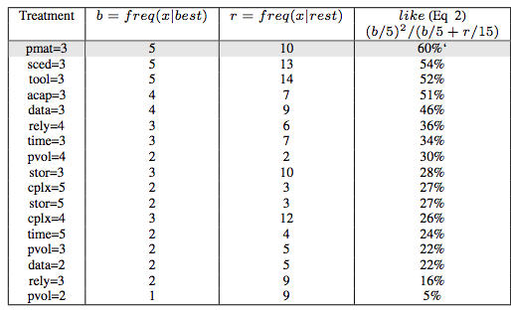
1
Q0 = a query. Defines ranges of interest
Rank training data by overlap with Q0
Relevant = 20 examples with most overlap
Divide relevant into a) best and b) rest
Rank ranges by how often in best/rest
Search in rank order
3
2
5
4a
4b
Simplest case of the KEYS2: see Gay, Menzies et al ASE journal, Dec’10

Slide 11
Road map
Motivation
Implementation
Certification
Applications
Implications

Slide 12
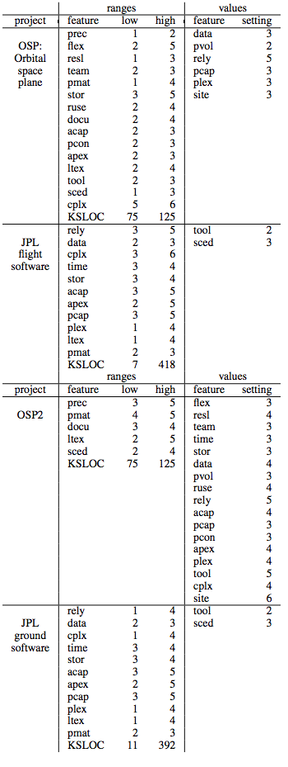
Certification
“W” is a simple++ algorithm
  Better than a search-based
  model-based approach?
Performance measure:
  effort, defect, months
  Median values before and after treatment
  (75-25)% band before and after treatment
Historical cases
  Nasa93, coc81 from promisedata.org/data
An objective function
  sum(defects, effort, months), normalized to 0..1
Queries:
  flight/ground systems from JPL
  Two flight guidance systems: OSP, OSP2

Slide 13
Results
Software quality optimization works:
  in 49 of 52 experiments,
  W and SEESAW reduced effort/defects/ months
In no case did “W” do worse than SEESAW. E.g. months change:
  19 vs 18% change (for Ground)
  14 vs 9% change (for Flight)
  11 vs 12% change (for OSP)
  12 vs 14% change (for OSP2)
In some cases, “W” did much better than SEESAW
  Mann-whitney comparisons
    17 ties
    6/1 wins/losses for W over SEESAW.
Some times, SEESAW did much worse that “W”
  OSP2 defects
    SEESAW’s recommendations increased defects by over 300%
    While “W” decreased defects by 17%
SUMMARY: on these data sets, for SQO, the added sophistication and implementation complexity of the model-based tool is not justified

Slide 14
Road map
Motivation
Implementation
Certification
Applications
Implications

Slide 15
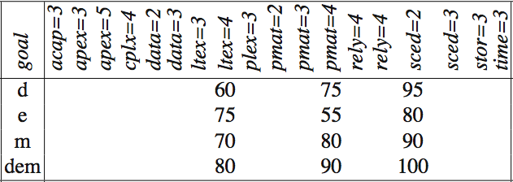
Stable conclusions
Recall experiment from introduction
  20 repeats on 66% of data
  Coefficients from linear regression varied insanely
Same experiment with “W”
  Count how many times a treatment has a range
  In 20 repeats on 66% of the data
  Data set = nasa93, query = OSP2
  Percentage occurrence of a range when
  optimizing for defects (e) effort (e) months (m)
  or all (dem)
  Note the conclusion stability.

Slide 16
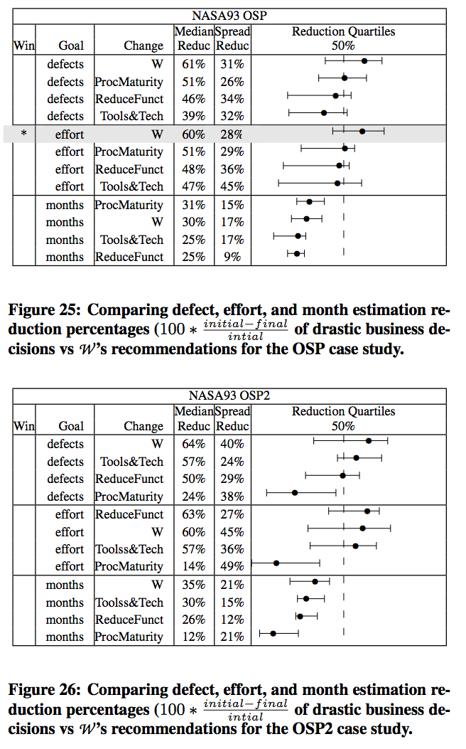
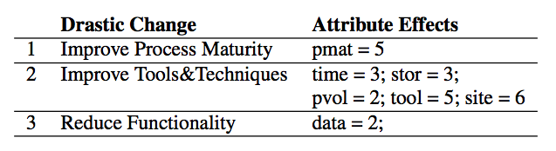
Assessing global vs local policies
Your CIO encourages:
  Tools & Tech: infusing all projects with the latest gadgets
  ProcMaturity: climbing the CMM scale
For some projects, she even likes
  ReduceFunct: savagely pruning the requirements
Q1: Which, if any, of the above are useful for your current project?
Q2: Are there better things to do for your local project than the above?
A: ask “W”

Slide 17
Road map
Motivation
Implementation
Certification
Applications
Implications

Slide 18
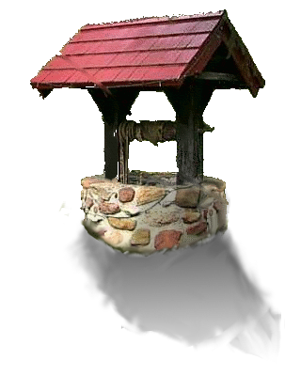
  SE project data is a “shallow well”?
Seemingly sophisticated algorithms do no better than the most simple?
In this case, for SQO, on these data sets
  An embarrassingly simple algorithm
    Performed as well as a seemingly state-of-the-art SBSE tool
    Measured in terms of reducing effort , defects, months
And, on other measures, “W” out-performs “NOVA”
  No requirement for a software process model
  Can be adapted quickly to new data sets with different attributes
  Much simpler to code
  Much simpler maintenance: just add more cases
  Faster to run than other LISP version (1 second, or less, not minutes)
  Simple enough for rigorous analysis;
    e.g. all routines of “W” are O(N)

Slide 19
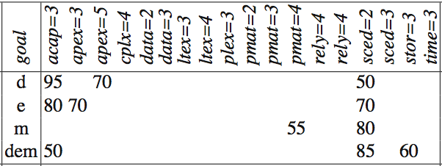
Generality
The “best” treatment varies
  From project to project,
  From query to query
  From goal to goal
Good news:
  “W” can find those best
  treatments
Bad news:
  Don’t expect them to
  generalize beyond the
  project at hand
Data=NASA93, query=OSP2
Data=NASA93, query=OSP

Slide 20
What kind of models do we need for SE?
Popper ’60: Everything is a “hypothesis”
  And the good ones have weathered the most attack
  SE “theories” aren’t even “hypotheses”
  Karl Popper, Conjectures and Refutations, London: Routledge and Keagan Paul, 1963
Endres & Rombach ’03: Distinguish “observations”, “laws”, “theory”
  Laws predict repeatable observations
  Theories explain laws
  Laws are either hypotheses (tentatively accepted) or conjectures (guesses)
  Rombach A. Endres, H.D. A Handbook of Software and Systems Engineering: Empirical Observa- tions, Laws and Theories. Addison Wesley, 2003.
Sjoberg ’07 : 5 types of “theory”:
  Building Theories in Software Engineering Dag I. K. Sjøberg, Tore Dyba Bente C. D. Anda and Jo E. Hannay, GUIDE TO ADVANCED EMPIRICAL SOFTWARE ENGINEERING2008,
  Analysis (e.g. ontologies, taxonomies)
  Explanation (but it is hard to explain “explanation”)
  Prediction (some predictors do not explain)
  Explanation and prediction
  “models” for design + action
  Don’t have to be “right”
    Just “useful”
    A.k.a. Endres & Rombach’s “laws”?

Slide 21
Two definitions of “model”
A hypothetical description of a complex entity or process.
    The product of a research plan
    model-based learning
A plan to create, according to a model or models.
    A method to create products
    Instance-based learner
Clearly, “W” is more the latter
  A way to find the best local lessons
  But no general model

Slide 22
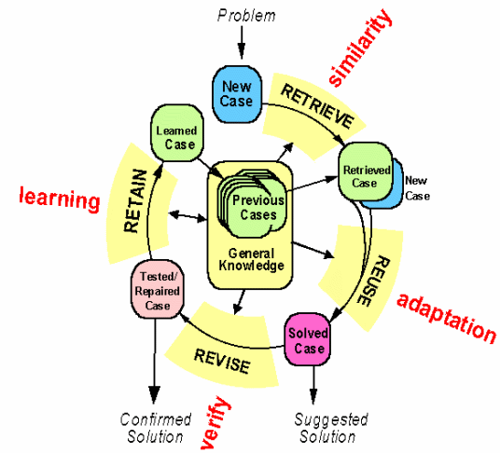
Btw, constantly (re)building the special local models is a general model
Case-based reasoning
Kolodner’s theory of
reconstructive memory
  Janet Kolodner, "Reconstructive Memory:
  A Computer Model," Cognitive Science 7 (1983)
The Yale group
  Shank & Riesbeck et al.
    Riesbeck, Christopher, and Roger Schank.
    Inside Case-based Reasoning.
    Northvale, NJ: Erlbaum, 1989.
  Memory, not models
  Don’t “think”, remember

Slide 23
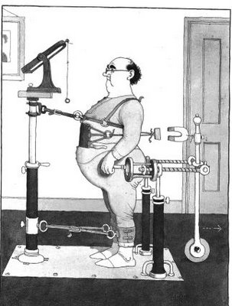
Kludges: they work
Ask some good old fashioned AI types.
Minsky’86: “Society of Mind”
The brain is a set of 1000+ kludges
  Minsky, Marvin The Society of Mind, Simon and Schuster, New York. 1988.
Feigenbaum’83
Don't take your heart attack
to the Maths Dept.
  Were they will diagnose and treat you using first principles
Instead, go to the E.R room
  Staffed by doctors who spent decades learning the quirks of drugs, organs, diseases, people, etc
  Edward Feigenbaum and Pamela McCorduckThe Fifth Generation: Artificial Intelligence and Japan's Computer Challenge to the World, Addison-Wesley (1983)
Seek out those that study kludges.
You'll be treated faster
You'll live longer

Slide 24
Questions or comments?

