Slide 1
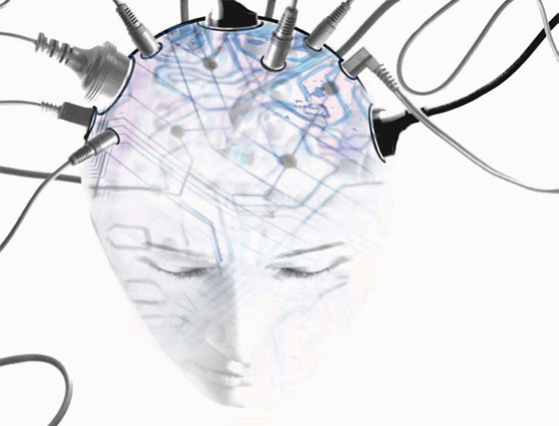
Welcome to the Singularity?
Tim Menzies
tim@menzies.us
LCSEE, WVU
Oct-8-10

Slide 2
Outline
There’s this “thing”
  Called the singularity
That some people think will happen real soon
That others think is a load of cr*p
Which I think is already here (ish).

Slide 3
What is the singularity?

Slide 4
Leading experts predict…
The singularity
  An event, around 2060, where history will fundamentally change
  After which, we lose our ability to make any further predictions.
Which experts, you ask?

Slide 5
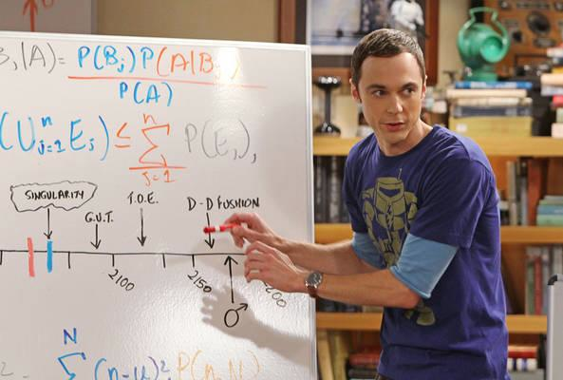
Sheldon Cooper (Ph.D.) CalTech
2060: “The earliest estimate of the Singularity, when man will be able to transfer his consciousness into machines and achieve immortality.”
– S. Cooper

Slide 6
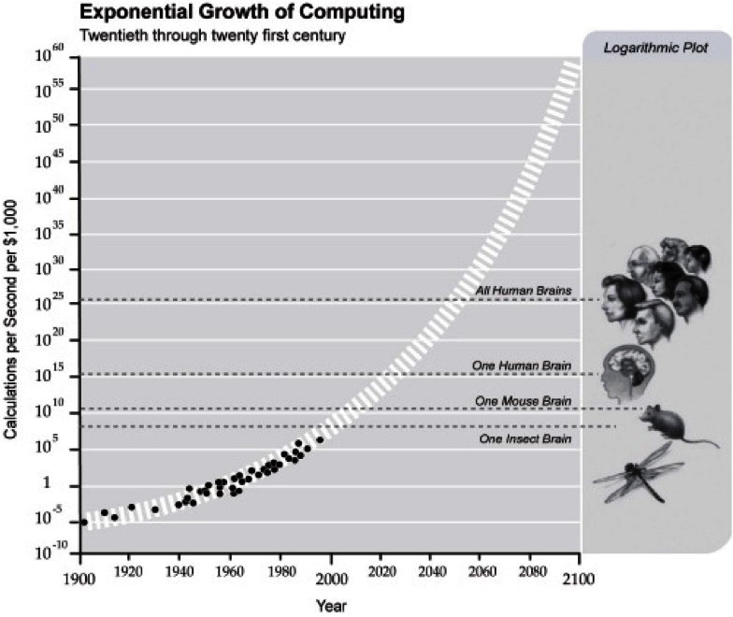
Dr. Cooper is not totally correct
More precisely, the singularity is when
  Technological progress becomes so extremely rapid, due to positive feedback
Assumes extrapolation
of current trends
  Is that valid?
  A point we will return too
One common prediction a singularity event:
  The creation of smarter-than-human intelligence
  Human’s would lose their ability to model/ predict/ control the future.
  Since AIs can enhance their minds faster than humans.
  And humans can’t predict actions of more intelligent entities

Slide 7
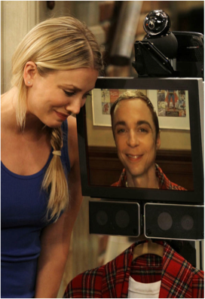
So, soon something may be thinking faster than you or me
  But it may not be Sheldon

Slide 8
Evidence for the singularity

Slide 9
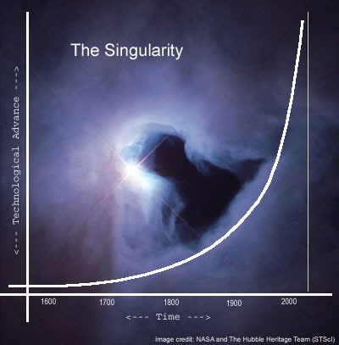
Exponential trends

Slide 10
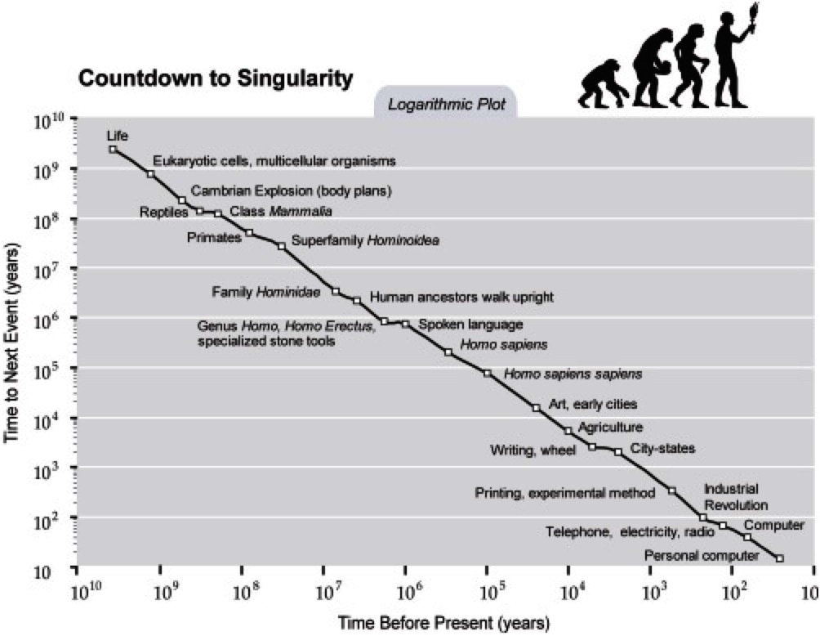
Complaint: selection bias in the points that Kurzweil chooses to use. For example, biologist PZ Myers points out that many of the early evolutionary "events" were picked arbitrarily

Slide 11
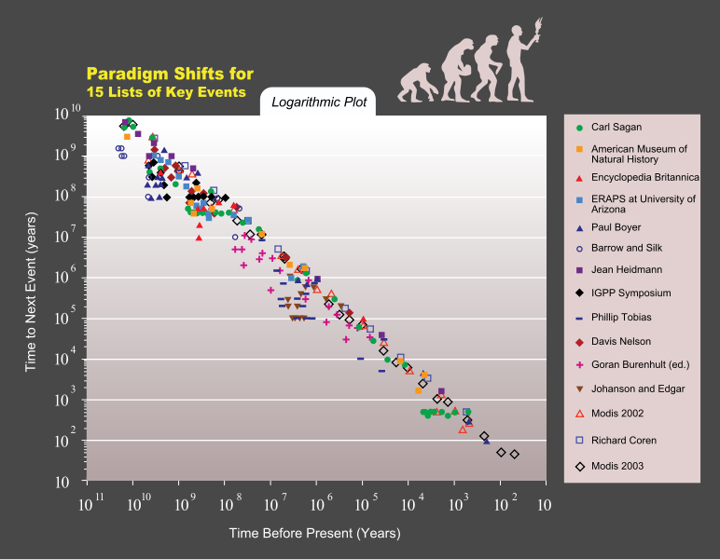
5 lists of paradigm shifts for key historic events shows an exponential trend. The lists' compilers include Carl Sagan, Paul D. Boyer, Encyclopædia Britannica, American Museum of Natural History, and University of Arizona.

Slide 12
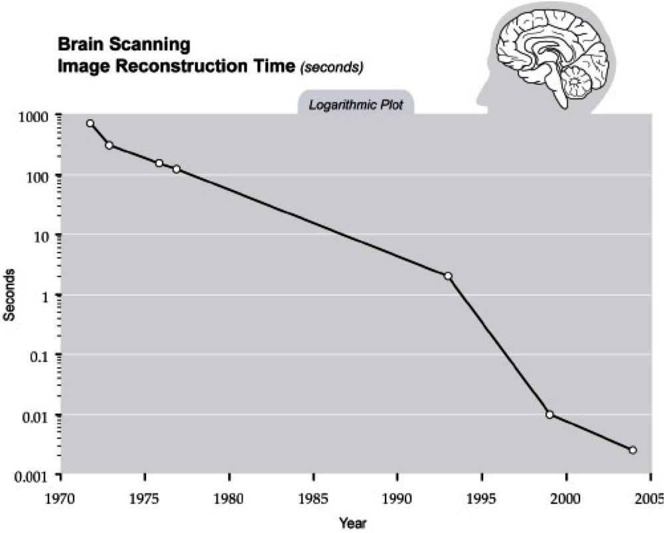
Exponential trends

Slide 13
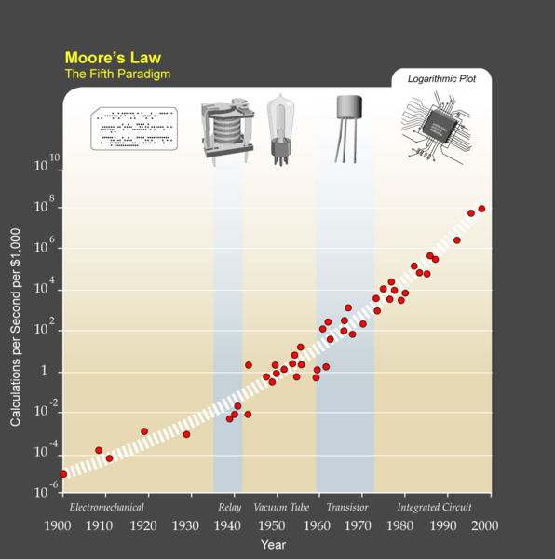
Exponential trends

Slide 14
Evidence against the singularity

Slide 15
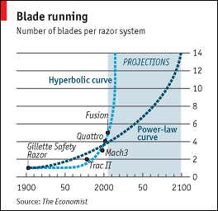
Extrapolating is bogus? e.g. number of razor blades per razor
http://www.economist.com/node/5624861?story_id=5624861

Slide 16
Steven Pinker, 2008
"(...) There is not the slightest reason to believe in a coming singularity. “
“The fact that you can visualize a future in your imagination is not evidence that it is likely or even possible. “
“Look at domed cities, jet-pack commuting, underwater cities, mile-high buildings, and nuclear-powered automobiles — all staples of futuristic fantasies when I was a child that have never arrived.”
“Sheer processing power is not a pixie dust that magically solves all your problems. (...)"

Slide 17
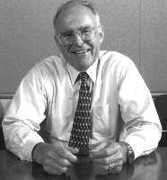
Some trends are nearly over: e.g. Moore's Law is dead, according to Gordon Moore, its inventor
13 April 2005
"In terms of size [of transistor] you can see that we're approaching the size of atoms which is a fundamental barrier, “
“We have another 10 to 20 years before we reach a fundamental limit. By then they'll be able to make bigger chips and have transistor budgets in the billions."

Slide 18
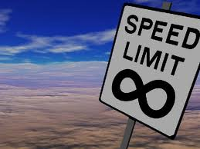
Ways through the limits?
Quantum computing
  More bits per bit
Robert Yung (CTO) Tessera,
  separating out processing
  to several cores
  "scaling out" as opposed
  to scaling down.
EUV extreme ultraviolet lithography
  Ordinary lithography uses ultraviolet light, wavelength = 193 nm
  EUV uses wavelengths of about 14 nanometers.
  Open issue: will the manufacturing costs get so high, that the value of their lifetime productivity can never justify it.

Slide 19
But lets go back to the AI
Some critics go so far as to assert that no computer or machine will ever achieve human intelligence,
While others hold that the definition of intelligence is irrelevant if the net result is the same
  Who cares if it is “human intelligence”
  Smart is smart

Slide 20
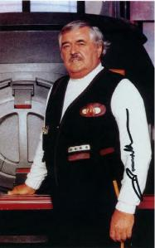
Machines don’t think like we do
There is a abstract notion of flying/thinking that is independent of birds/humans.
  "Intelligence does not require bulk, Mr. Scott”
  – Spock
“Intelligence" could be coded any number of ways (biological, mechanical, a collection of wind-powered beer cans, whatever)

Slide 21
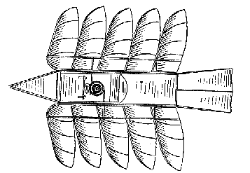
Do you object?
“The only thing that can be rational like me is another person”?
  That’s like saying airplanes don’t really fly (no wing flapping)
Every computer scientist knows this to be true:
  There are computational properties, independent of processor the algorithm runs on, or the implementation language.
  The idea is different to the substrate
  “computer science is no more about computers than astronomy is about telescopes”
    Dijkstra (and he could have been talking about AI)

Slide 22
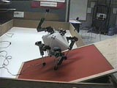
The Platonic Beast
Thinking about thinking is hard
Lets do something simpler- like walking
Should a robot could/should walk like us? (see http://people.cs.ubc.ca/~pai/movies/beast.mpg)
  walks by throwing a spare limb over its head
  Such a move would tear us apart
  but it’s natural for that kind of walking thing.

Slide 23
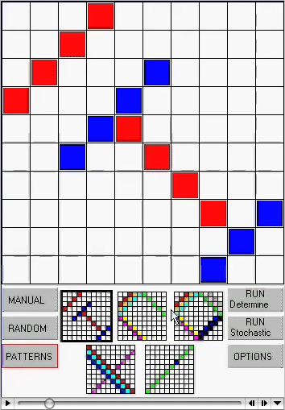
Stochastic search
“Latin's square”: no 2 same colors on the same row or column
  Method 1: deterministic exhaustive theorem proving
  Method 2: stochastic: makes an initial guess, then refines that guess based on local feedback.
  http://menzies.us/csx72/img/latin.mov
  Stochastic kills deterministic
You would not expect a human to think using stochastic search (too much CPU twiddling).
  But for a computer, stochastics are useful since each local twiddle can be done very quickly
  An AI may think wildly different to a human

Slide 24

Prediction
The more we turn to computers,
  The more we’ll get answers which
    Work
    But which we don’t understand

Slide 25
Is the AI singularity already here?

Slide 26
When is the AI singularity?
Does the AI singularity:
  Require decades of improvement in processor speed?
Or have we already arrived at the AI singularity?

Slide 27
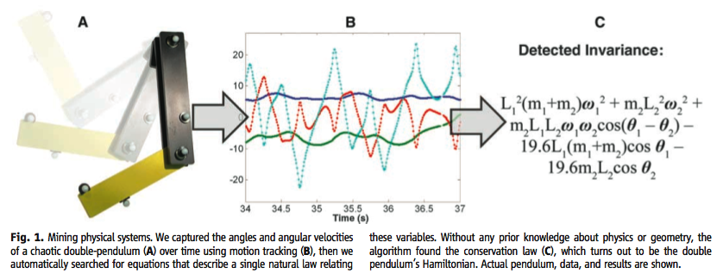
The Eureqa Machine
Distilling Free-Form Natural Laws from Experimental Data
  Michael Schmidt and Hod Lipson
  SCIENCE VOL 324 3 APRIL 2009

Slide 28
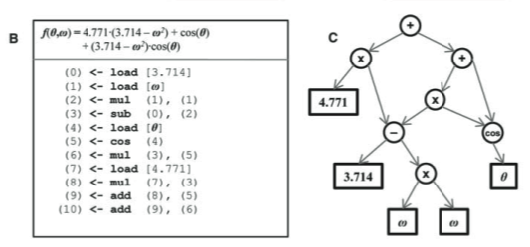
Searches the space of possible equations

Slide 29
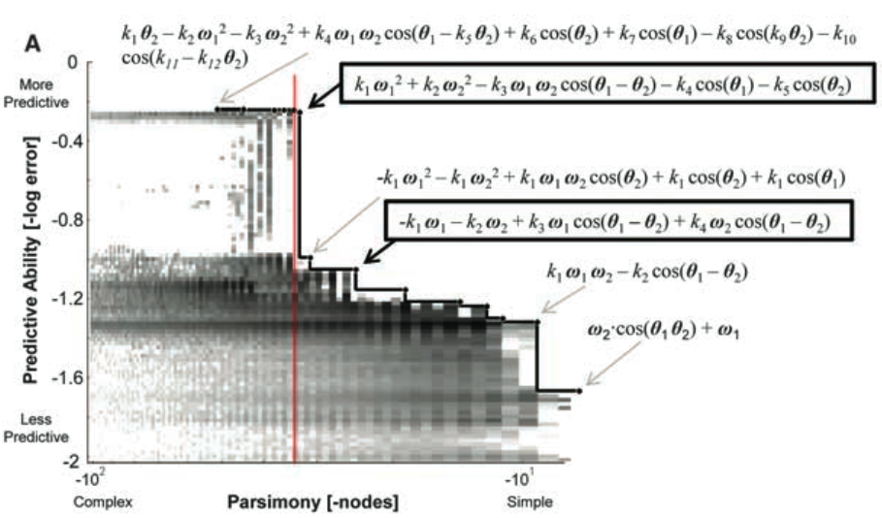
Trades off parsimony and predictive ability

Slide 30
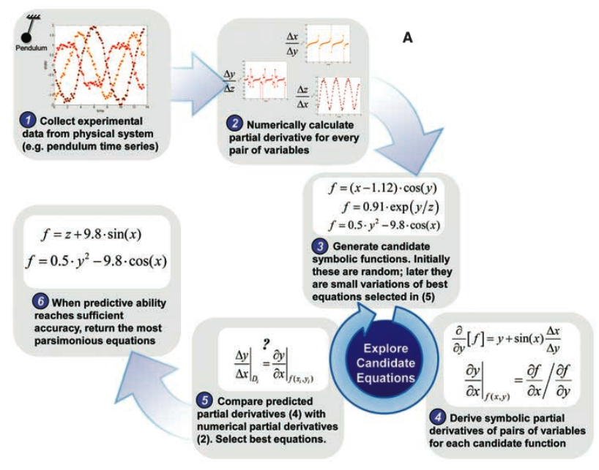
Limits to the Eureqa machine
Watches numeric data
Infers error in
partial differentials.
Can’t invent
calculus.
So Newton
can’t be replaced.
Yet

Slide 31
Limits to belief
Eureqa and biology
Unpublishable
  Single cell dynamics (bacteria):
    how nutrients increase and decrease
  Crazy complex quilt of intra-cellular feedback
    1000s of effects
  Eureqa found two equations
    Equations match data not used in training
    Predicted results when tested on new data
Don’t know what the equations mean
  Got the answer , but not the insight
The more we turn to computers,
  The more we’ll get answers we don’t understand

Slide 32
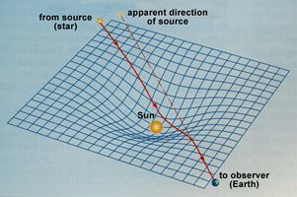
Should we use laws that we can’t explain?
Gravity
1846, rival astronomers John Adams (in England) and Urbain Leverrier (in France) raced to ﬁnd a previously unseen planet that was disturbing the orbit of Uranus.
Neptune was ﬁrst sighted by Adams, then Leverrier, after both men pointed their telescopes at the precise point in the sky indicated by Newton’s equations.
But for 100s of years, there was no explanation for gravity
Not till relativity and space-time curvature
  1600s till 1900s

Slide 33
Five types of theories
(Gregor ’06)
Lists of what is: taxonomies, ontologies
Explainers: e.g. case studies on historical data
  No test on data not used in the analysis
Predictors
  And may not don’t explain why
  (Neural nets, Naïve Bayes)
Explain & predict
    Learn a model: Decision tree learners, linear regression
    Apply the model to predict
    Browse the model to explain the predictions
Convincing models: on some domain-specific criteria
  E.g. “goto considered harmful”
Post-singularity,
expect these

Slide 34
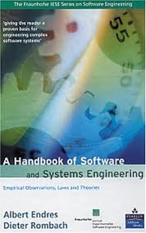
Three kinds of statements
(Endres & Rombach’03)
Observations: what you see
Laws:
  predict observation B given observation A
Theories:
  explanations of laws
Laws predict repeatable observations
Theories explain laws
Laws are either hypotheses (tentatively accepted) or conjectures (guesses)
100+ laws
  No theories

Slide 35
Research into defect prediction
Useful to (say) organize testing resources
  Assumes that you don’t have the resources to test everything 100% rigorously
If something looks like its going to be bad
  Allocate more resources to it
Method: data mining on logs of prior defects
  What predicts for defects?

Slide 36
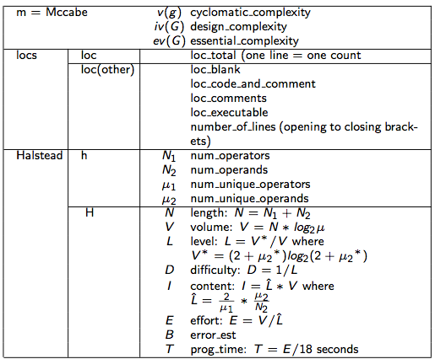
Which of these most predict for software defects?

Slide 37
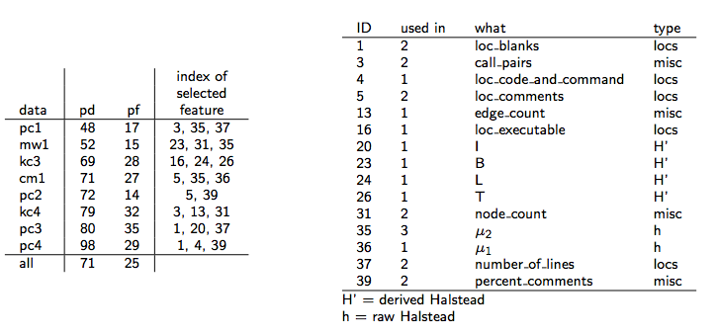
No common pattern
pd, pf = prob.detection, prob.falseAlarm
Data sets = pc1, mw1m kc3,cm1, pc2, kc4, pc4,pc4
Learner = Naïve Bayes
Attribute selection = WRAPPER

Slide 38
Managing Software Development Projects
Take a project described by
  Task complexity
  Skill of the analysts
  Schedule pressure
  Etc
Assume partial partial control of some of these features
Find changes that most
  Reduce development time
  Reduce defects
  Reduce required staff
Method: AI search algorithms
  Model-based, instance-based

Slide 39
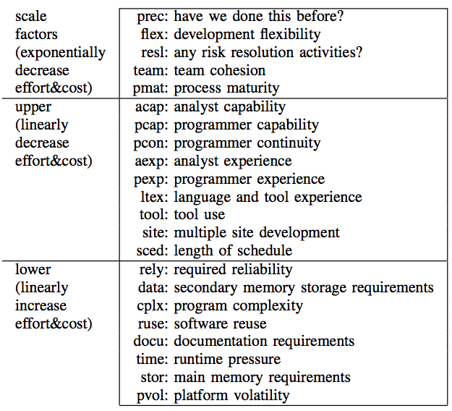
Which of these most predict for software development problems?

Slide 40
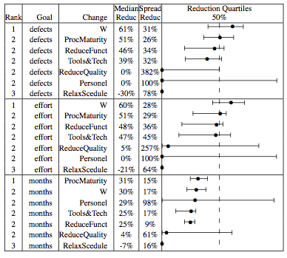
Instance-based planner to reduce defects, effort, months
NASA data
W :
  instance-based planner
Other:
  standard changes
Median = 50th %
Spread = (75-25)^{th} %
Reduction
= (init-final)/init

Slide 41
But again, no common pattern
 |  | acap | apex | ltex | ltex | plex | pmat | pmat | sced | sced | stor | time | tool | # of
cases | query | 3 | 3 | 3 | 4 | 3 | 3 | 4 | 2 | 3 | 3 | 3 | 3 | Changes
nasa93 | ground |  |  |  |  | 100% | 55% |  |  |  | 85% |  |  | 3
nasa93 | flight |  |  |  |  | 95% | 70% |  |  |  | 100% |  |  | 3
nasa93 | osp | 95% | 90% |  |  |  |  |  |  |  |  |  | 100% | 3
nasa93 | osp2 |  |  |  | 100% |  |  | 80% | 85% |  |  |  |  | 3
coc81 | flight |  |  |  |  |  | 60% |  |  |  |  | 65% |  | 2
coc81 | osp2 |  |  | 55% | 55% |  | 65% |  |  | 100% |  |  |  | 4
coc81 | ground |  |  |  |  |  | 80% |  |  |  |  | 100% |  | 2
coc81 | osp |  |  |  |  |  | 65% |  |  | 65% |  |  |  | 2
Overall: |  | 12% | 11% | 7% | 19% | 24% | 49% | 10% | 11% | 21% | 23% | 21% | 13%
20 repeats over 2:1 split to train:test
Learner = the “W” instance-based planner
Only shows ranges found in > 50% of the repeats

Slide 42
In all these SE experiments
Can generate useful predictions
  Defect prediction
  Software process planning
But no general pattern
  Performance, but no insight
  These AI tools “just” work
  And we don’t understand why

Slide 43
And so…

Slide 44
Outline
There’s this “thing”
  Called the singularity
That some people think will happen real soon
That others think is a load of cr*p
Which I think is already here (ish).

Slide 45
When is the AI singularity?
Does the AI singularity:
  Require decades of improvement in processor speed?
Or have we already arrived at the AI singularity?

Slide 46
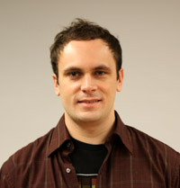
Michael Schmidt, Cornell U.
Creator of Eureqa
“We’ve have this window in human history when we could not just know things but actually understand them.
“That is, we could you know why they were true and not just know but to know why.
“And that’s a beautiful moment in human history.
“But I feel like it may only be a moment.”

Slide 47
My results
My AI tools are producing theories that:
  Work
  But offer no insight why they work
Or is this the shape of things to come?
  The more we turn to computers,
    The more we’ll get answers which
      Work
      But which we don’t understand

Slide 48
Questions?
Comments?

