Slide 1

Empirical Software Engineering, Version 2.0
Tim Menzies (WVU, USA)
Forrest Shull (Fraunhofer , USA)
John Grundy (Swinburne, Oz)
Jan27-2011

Slide 2
Summary
We need to do more “data mining”
  Not just on different projects
  But again and again on the same project
And by “data Mining” we really mean
  Automated agents that implement
    prediction
    monitoring
    diagnosis,
    Planning
    Adaptive business intelligence

Slide 3
This talk
A plea for industrial partners to aid in this research

Slide 4
Science 2.0

Slide 5
Ben Shneiderman, Mar’08
The growth of the World Wide Web ... continues to reorder whole disciplines and industries. ...
It is time for researchers in science to take network collaboration to the next phase and reap the potential intellectual and societal payoffs.
  -B. Shneiderman.
  Science 2.0.
  Science, 319(7):1349–1350, March 2008

Slide 6
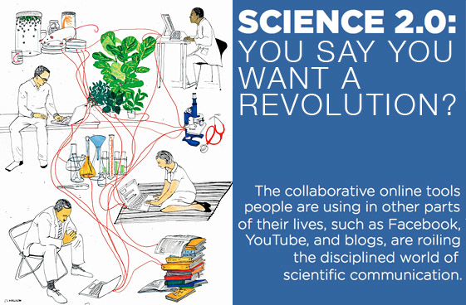
Science 2.0

Slide 7
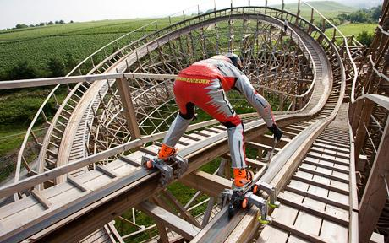
A proposal
Add roller skates to software engineering
Always use DM (data mining) on SE data

Slide 8
What can DM do
(for software engineering?)
Process data
  Input: Developer skills, platform stability
  Output: effort estimation
Social data
  Input: e.g. which tester do you most respect?
  Output: predictions of what bugs gets fixed first
Product data
  Input: static code descriptions
  Output: defect predictors
Trace data
  Input: what calls what?
  Output: call sequences that lead to a core dump
Usage data
  Input: what is everyone using?
  Output: recommendations on where to browse next
Any textual form
  Input: text of any artifact
  Output: e.g. fault localization

Slide 9
DM: extends research methods
SE research v1.0
SE research v2.0
Case studies
  Watch, don’t touch
Experiments
  Vary a few conditions in a project
Simple analysis
  A little ANOVA, regression, maybe a t-test
Data generators
  Case studies
  Experiments
Data analysis
  10,000 of possible
  data miners
Crowd-sourcing
  10,000 of possible analysts

Slide 10
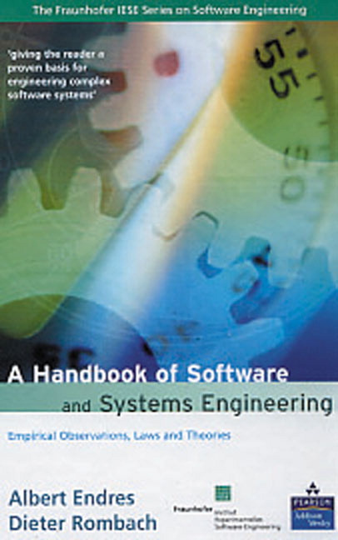
DM patches problems with
Case-Study Research
Case studies: powerful for defining problems, highlighting open issues
Has documented 100s of candidate methods for improving SE development
e.g. Kitchenham et. Al IEEE TSE, 2007,
  Cross versus Within-Company Cost Estimation
  Spawned a sub-culture of researchers
    checking if what works here also works there.

Slide 11

Case-Study Research: Has Limits
Too slow
  Years to produce conclusions
  Meanwhile, technology base changes
Too many candidate methods
  No guidance on what methods to apply to particular projects
Little generality
  Zimmermann et. al, FSE 2009
    662 times : learn here, test there
    Worked in 4% of pairs
  Many similar no-generality results
    Chpt1, Menzies & Shull

Slide 12
Case-studies + DM =
Better Research
Propose a partnership between
  case study research
  And data mining
Data mining is stupid
  Syntactic, no business knowledge
Case studies are too slow
  And to check for generality? Even slower
Case study research (on one project) to raise questions
Data mining (on many projects) to check the answers

Slide 13
Adaptive Agents

Slide 14
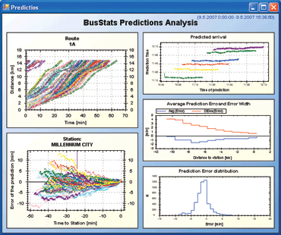


Current research: not adaptive
If data collected, then usually forgotten
Dashboards : visualizations for feature
extraction; intelligence left the user
MapReduce, Hadoop et. al : systems
support for massive, parallel execution.
  http://hadoop.apache.org
  Implements the bus, but no bus drivers
Many SE data mining publications
  e.g. Bird, Nagappan, Zimmermann
  and last slide
  But, no agents that recognize when
  old models are no longer relevant,
  Or to repair old models using new data

Slide 15
Need for adaptive agents
No general rules in SE
  But general methods to find the local rules
Issues:
  How quickly can we learn the local models?
  How to check when local models start failing?
  How to repair local models?
An adaptive agent watching a stream of data, learning and relearning as appropriate

Slide 16
Agents for adaptive business intelligence
Quality
(e.g.
PRED(30))
mode #2
mode #1
learn
mode #3
learn
break
down
break
down
learn
Data collected over time

Slide 17
Agents for adaptive business intelligence
Quality
(e.g.
PRED(30))
mode #2
mode #1
learn
mode #3
learn
break
down
break
down
learn
Data collected over time
Adaptive business intelligence
  Via incremental data mining
  Technology: incremental discretization + incremental clustering and classification

Slide 18
Agents for adaptive business intelligence
Quality
(e.g.
PRED(30))
mode #2
mode #1
learn
mode #3
learn
break
down
break
down
learn
Data collected over time
What is different here?
  Not “apply data mining to build a predictor”
  But add monitor and repair tools to recognize and handle the breakdown of old predictors
  Trust = data mining + monitor + repair

Slide 19
Most of the technology required for this approach can be implemented via data mining

Slide 20
The
Details

Slide 21
Agents for adaptive business intelligence
Quality
(e.g.
PRED(30))
mode #2
mode #1
learn
mode #3
learn
break
down
break
down
learn
Data collected over time
Q1: How to learn faster?
  Technology: active learning: reflect on examples to date to ask most informative next question
Q2: How to recognize breakdown?
  Technology: bayesian anomaly detection

Slide 22
Agents for adaptive business intelligence
Quality
(e.g.
PRED(30))
mode #2
mode #1
learn
mode #3
learn
break
down
break
down
learn
Data collected over time
Q3: How to classify mode?
  Recognize if you’ve arrived at a mode seen before
  Technology: Bayes classifier
Q4: How to make predictions?
  Using the norms of a mode, report expected behavior
  Technology: table look-up of data inside Bayes classifier

Slide 23
Agents for adaptive business intelligence
Quality
(e.g.
PRED(30))
mode #2
mode #1
learn
mode #3
learn
break
down
break
down
learn
Data collected over time
Q5: What went wrong? (diagnosis)
  Delta between current and prior, better, mode
Q6: What to do? (planning)
  Delta between current and other, better, mode
Technology: contrast set learning

Slide 24
Agents for adaptive business intelligence
Quality
(e.g.
PRED(30))
mode #2
mode #1
learn
mode #3
learn
break
down
break
down
learn
Data collected over time
Q7: How to understand a mode (explanation)
  Presentation of essential features of a mode
Technology: Dimensionality reduction, feature selection

Slide 25
Agents for adaptive business intelligence
Quality
(e.g.
PRED(30))
mode #2
mode #1
learn
mode #3
learn
break
down
break
down
learn
Data collected over time
Q8: How to start?
All the above can be based on a matrix P*T:
  Products (P) described using a set of terms (T)
  Probably a sparse matrix

Slide 26
Agents for adaptive business intelligence
Quality
(e.g.
PRED(30))
mode #2
mode #1
learn
mode #3
learn
break
down
break
down
learn
Data collected over time
Q9: What terms to collect?
A: Everything
  Assign all project artifacts and unique ID
  Place all project artifacts in (say) a wiki
  Use text mining to generate the P*T matrix
  Add a join key that maps artifacts to some quality measure (defects, effort, whatever is important and monitored at your site)

Slide 27
Organizing the artifacts

Slide 28
Visual Wiki (“Viki”) concept

Slide 29
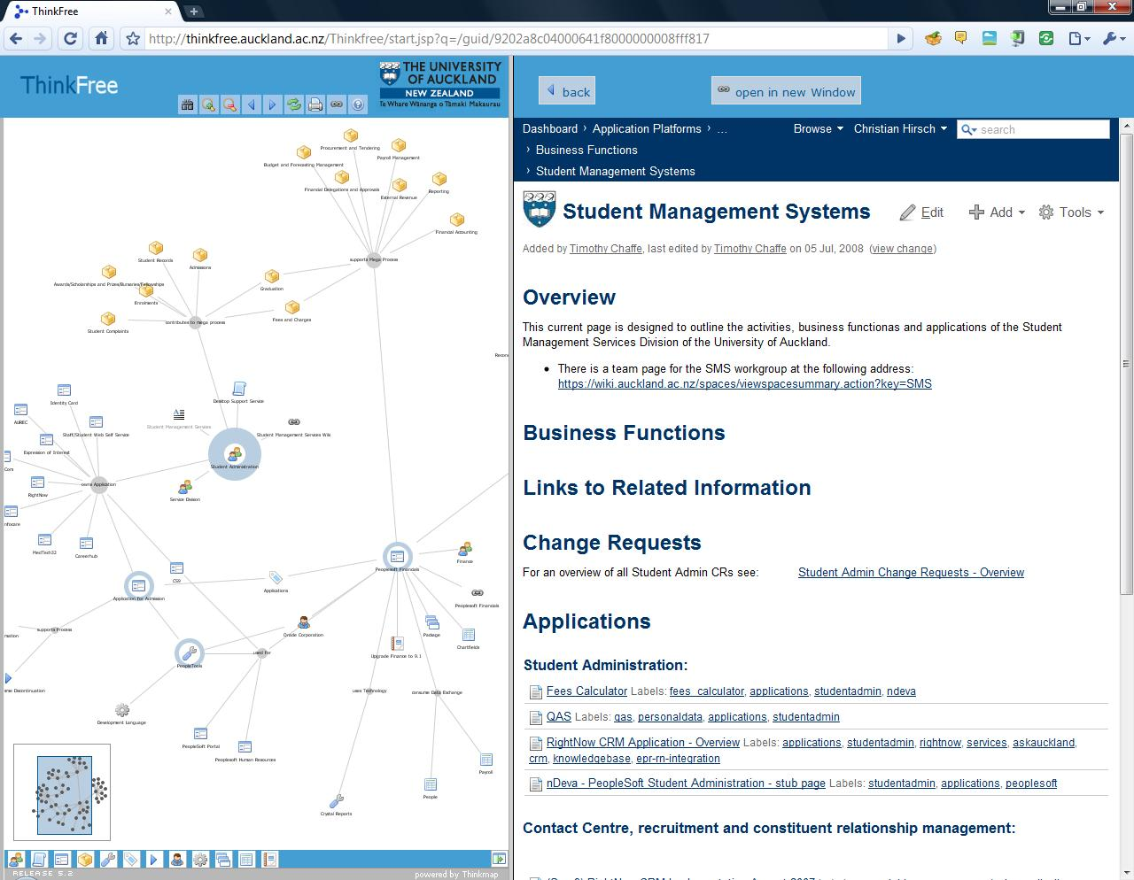
Enterprise Artifacts example
Add documents; organize; search; navigate
Edit properties, documents, add links, extract links

Slide 30
Various Vikis
Bottom left: business process descriptions

Slide 31
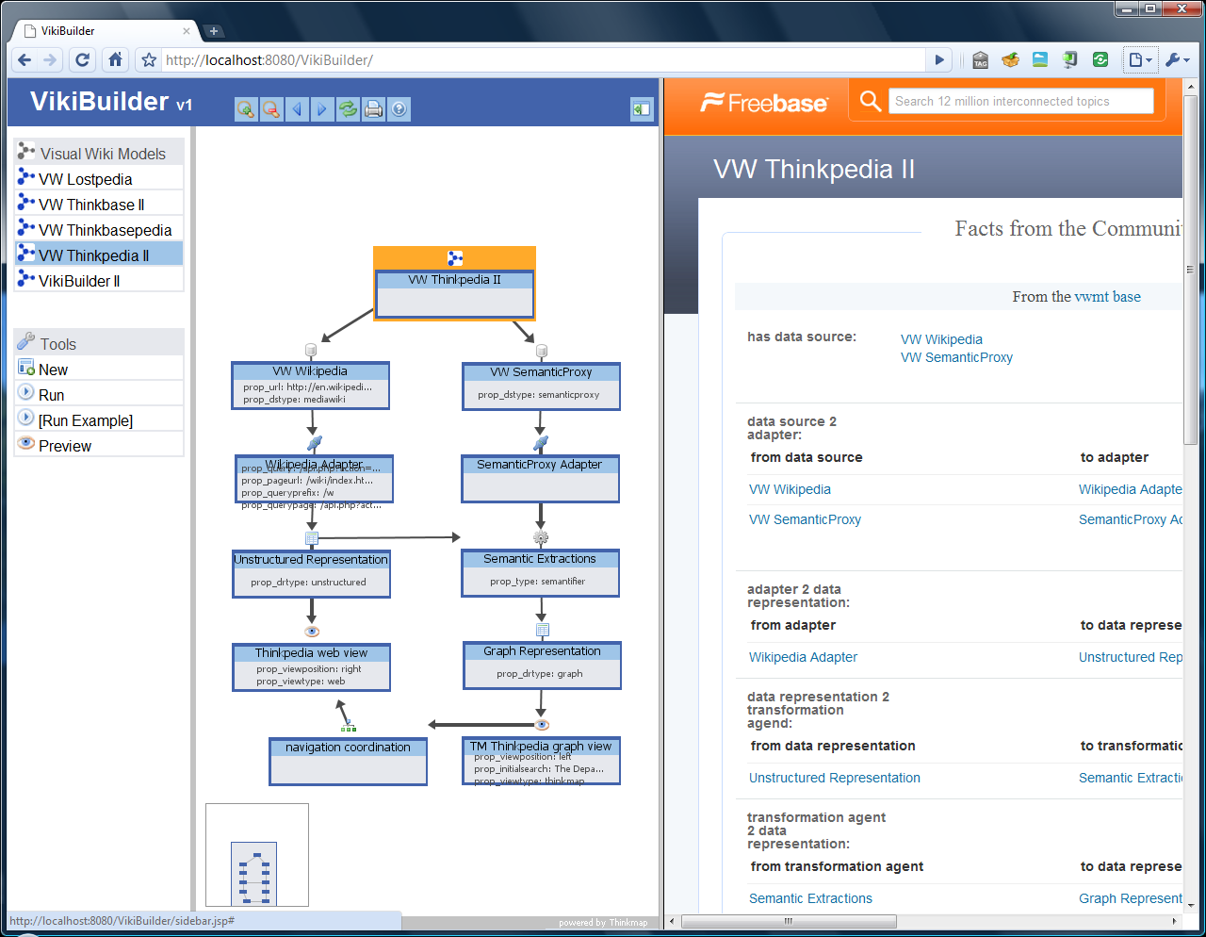
VikiBuilder – generating Vikis

Slide 32
Finding the controllables

Slide 33
What are the control points?
Problem
Solution
Most certainly,
  Our initial data collection will be incomplete
If we add all products to a wiki
  We still might miss the process options that can change a project
Domain interviews
  When modes identified
  Conduct structured interviews with managers …
  … on the delta of this mode to others…
  … to indentify the process actions or the market forces that resulted in a mode
Some of these actions/forces will be controllable
  Augment T with these new actions/forces

Slide 34
And so…

Slide 35
We seek industrial partners
That will place textual versions of their products in a wiki
That will offer joins of those products to quality measures
That will suffer us interviewing their managers, from time to time, to learn the control points.
(Note: 1,2 can be behind your firewalls.)

Slide 36
In return, we offer
Agents for
  automatic, adaptive, business intelligence
  that tunes itself to your local domain

Slide 37
Questions?
Comments?

Slide 38
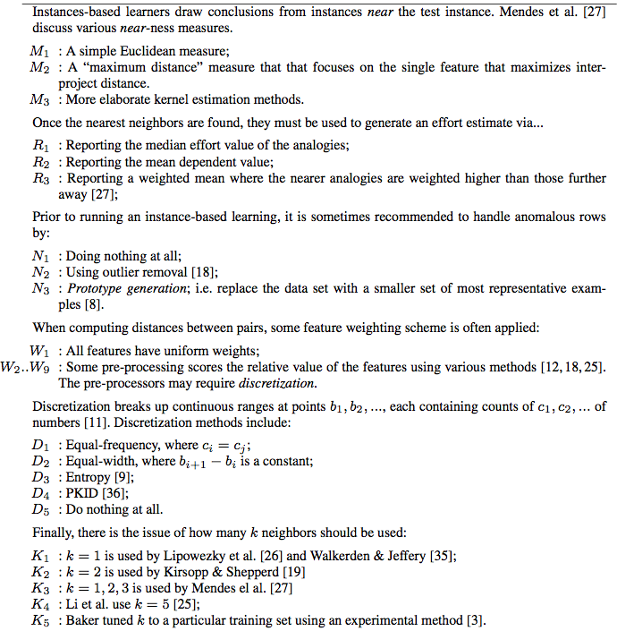
Aside: many data miners
E.g. Analogy-based
effort estimation.
3 distance measures
3 ways to summarize
neighbors
3 row selectors
9 column selectors
5 discretizers
5 different
neighborhood sizes
6,000+ options

Slide 39
Related Work

Slide 40
Researchers
  Data collection teams get
    Comparisons of their data to data from other sites
    Data analysis via crowd sourcing
  Data mining teams get
    Fuel for their analysis

Slide 41
Industrial Standards Bodies
20th century SE
  Prescriptions of how we think it should be
21st century SE
  Descriptions of how it is
  Massive data collection
  Comparisons across different sites
  Recognitions of common patterns
    Good smells: patterns to be propagated
    Bad smells: patterns to be avoided

Slide 42
Industrial practitioners
Analysts-in-a-box
  Rapid and automated analysis
Learn best practices
  Learn when other people’s best practices do not apply to you
Get more data from other sites
  So, if using a technology that is new to you
  But has been explored at other site
  Then you can still determine (say)
    Expected defect rates
    Expected development effort

Slide 43
Details

Slide 44
Agents for adaptive business intelligence
Quality
(e.g.
PRED(30))
mode #2
mode #1
learn
mode #3
learn
break
down
break
down
learn
Data collected over time

Slide 45
Agents for adaptive business intelligence
Quality
(e.g.
PRED(30))
mode #2
mode #1
learn
mode #3
learn
break
down
break
down
learn
Data collected over time
Adaptive business intelligence
  Via incremental data mining
  Technology: incremental discretization + incremental clustering and classification

Slide 46
Agents for adaptive business intelligence
Quality
(e.g.
PRED(30))
mode #2
mode #1
learn
mode #3
learn
break
down
break
down
learn
Data collected over time
What is different here?
  Not “apply data mining to build a predictor”
  But add monitor and repair tools to recognize and handle the breakdown of old predictors
  Trust = data mining + monitor + repair

