Slide 1

Empirical Software Engineering (Version 2.0) and Data Mining
Nov 24, 2010
Tim Menzies,
WVU, USA, tim@menzies.us, http://menzies.us
Download: http://unbox.org/wisp/var/timm/10/swinburne
Version history
V1: Aug18 ’10
V1a: Aug28 ’10
V1b: Sept02 ’10
V1c: Sept11’10
V2: Nov23’10

Slide 2
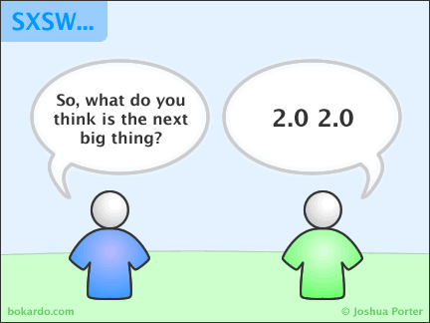

Slide 3
Road map
Data mining & SE (overview)
Data mining tools (guided tour of “WEKA”)
Data “carving” (core operators of DM)
Generality (or not)
Bias (is your friend)
Evaluation (does it really work?)

Slide 4
Change log
Version 1: Aug 18, 2010
  Version 1a: Aug 28, 2010
      2 more slides on “why empirical SE v2.0”
  Version 1b: Sept 2: minor edits
  Version 1c: minor edits
  Version 1d: new conclusion
Version 2: Nov 21, 2010
  Shorter version for Swinburne

Slide 5
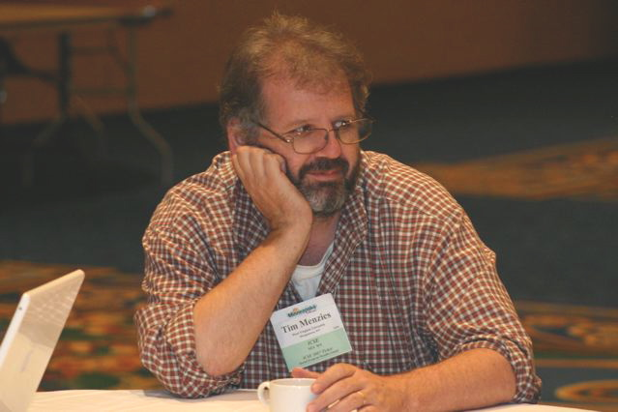
About the author
Dr. Tim Menzies (tim@menzies.us) has worked on advanced modeling + AI since 1986.
  PhD from Uni. New South Wales, Sydney, Oz
  Assoc/prof at WVU CS &EE
Former research chair for NASA
Author of 200 refereed papers: http://menzies.us/papers.php
Co-founder and organizer of the PROMISE conferences on repeatable experiments in SE
For more, see http://menzies.us

Slide 6
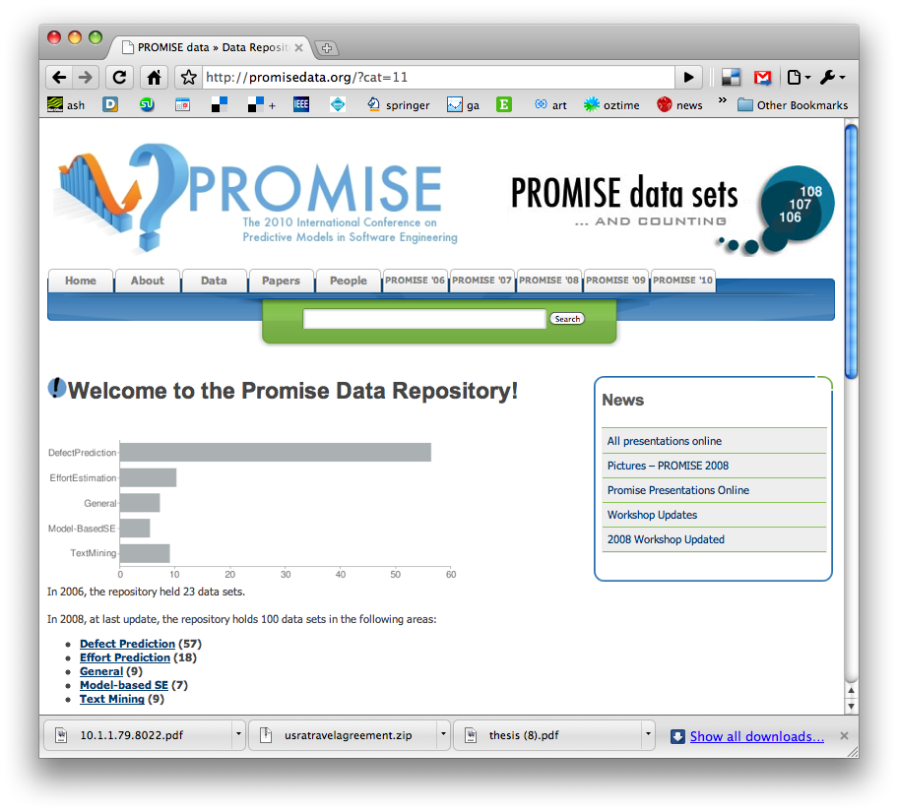
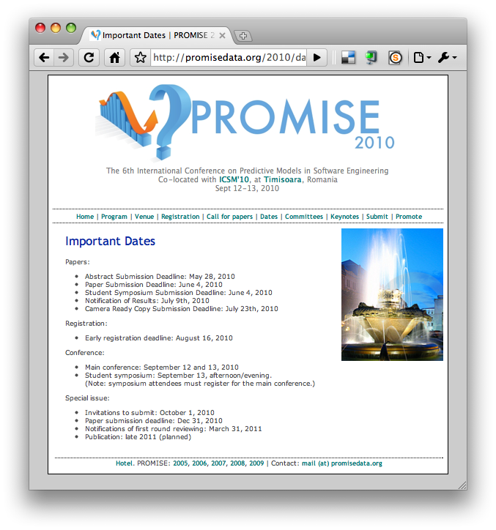
http://promisedata.org/data
Repository + annual
conference.
See you there?

Slide 7
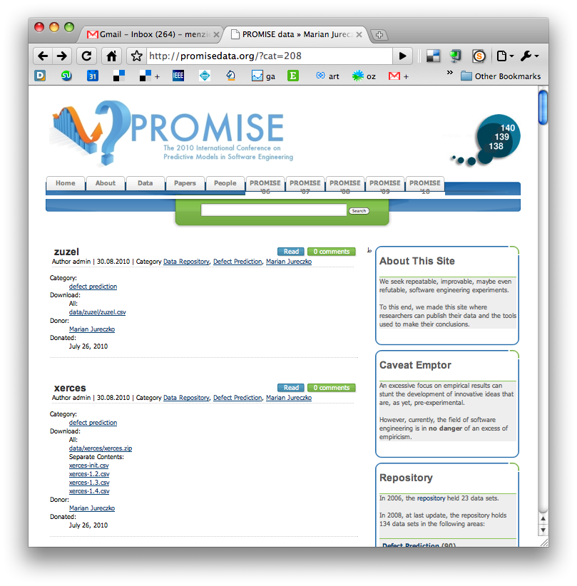
New trend
Ph.D. students, finishing up their studies, using PROMISE to archive their data
  E.g. 30 new OO data sets from Marian Jureczko
Are you next?

Slide 8
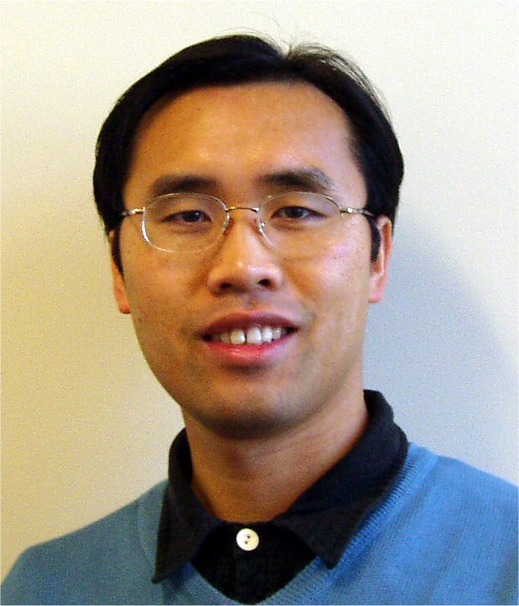

For other view on DM + SE
ICSE 2010 Tutorial T18 Tuesday, 4 May 2010 (afternoon)
Mining Software Engineering Data
  Ahmed E. Hassan: Queen's University, Canada
  Tao Xie: North Carolina State University, USA
Tutorial Slides:
  https://sites.google.com/site/asergrp/dmse/dmse-icse08-tutorial.ppt?attredirects=0

Slide 9
Data MINING & SE
(overview)

Slide 10
Road map
Data mining & SE (overview)
Data mining tools (guided tour of “WEKA”)
Data “carving” (core operators of DM)

Slide 11
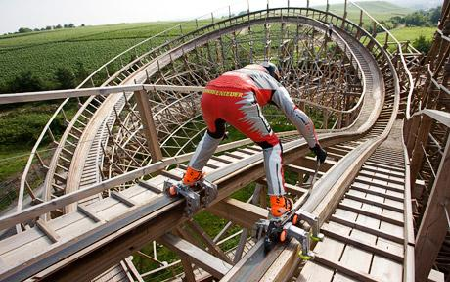
A proposal
Add roller skates to scientific analysis
Always use data mining on SE data

Slide 12
Data Mining: definition
Finding patterns in (lots of) data
  Diamonds in the dust
Combines statistics, AI, visualization, ….
Synonyms
  Machine learning
  Business intelligence
  Predictive analytics
The art of the approximate scalable analysis
  Bigger is better
Used for… anything
  The review of current beliefs w.r.t. new data is the hallmark of human rationality.
  It is irrational NOT to data mine.

Slide 13
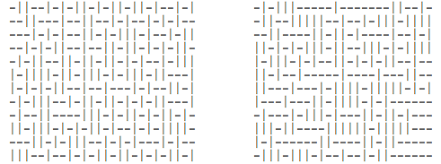
Exercise #1
One these these things is not like the other
  One was generating by selecting “-” or “|”
  at random, 300 times.
Which one?

Slide 14
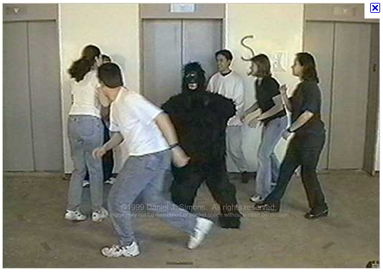
Exercise #2
A little experiment from http://www.youtube.com/v/vJG698U2Mvo&hl=en_US&fs=1&rel=0
Rules
  No one talks for the next 4 minutes
  If you know what is about to happen, see (1)
This is a selective
attention test
  Count the number
  of times the team
  with the white
  shirt passes the ball.

Slide 15
What have we learned?
Lesson #1:
  Algorithms can be pretty dumb
  If they don’t focus on X, they see any Y, at random.
Lesson #2:
  Humans can be pretty dumb
  If they mono-focus on X, you can miss Y
Maybe, any induction process is a guess
  And while guessing can be useful
  Guesses can also be wrong
Lets us a create community of agents,
each with novel insights and limitations
  Data miners working with humans
  Maybe in combination, we can see more that separately
Wikipedia:
List of cognitive biases
http://en.wikipedia.org/wiki/ List_of_cognitive_biases
• 38 decision making biases
• 30 biases in probability
• 18 social biases,
• 10 memory biases

Slide 16
Applications
Effort estimation
Defect prediction
Optimization of discrete systems
Test case generation
Fault localization
Text mining
Temporal sequence mining
  Learning software processes
  Learning APIs
Etc
Welcome to Empirical SE, Version 2.0

Slide 17
Applications
Effort estimation
Defect prediction
Optimization of discrete systems
Test case generation
Fault localization
Text mining
Temporal sequence mining
  Learning software processes
  Learning APIs
Etc
Welcome to Empirical SE, Version 2.0
Data mining applications
explored by me since 2007.
A career in data mining is a very diverse career, indeed

Slide 18
Application: Effort estimation
Can we predict development effort (time * staff)?
E.g. using linear regression; effort = a*KLOC^{b} c
  Boehm, B. W. 1981 Software Engineering Economics
  Boehm, B. W., Clark, Horowitz, Brown, Reifer, Chulani, Madachy, R., and Steece, B. 2000 Software Cost Estimation with Cocomo II
  Sunita Chulani, Barry W. Boehm, Bert Steece: Bayesian Analysis of Empirical Software Engineering Cost Models IEEE Trans. Software Eng. 25(4): 573-583 (1999)
E.g. using analogy
  Describe past projects according to N dimensions
  Float all known projects in an N-dimensional space
  To estimate a project, insert into that space; query its nearest neighbors
  For the classic estimation via analogy, see
    Martin J. Shepperd, Chris Schofield: Estimating Software Project Effort Using Analogies IEEE Trans. Software Eng. 23(11): 736-743 (1997)
  For 12,000+ variants to that process, see
    Fig1 of http://menzies.us/pdf/10stable.pdf
E.g. using other methods:
  See 154 variants in http://menzies.us/pdf/10stable.pdf

Slide 19
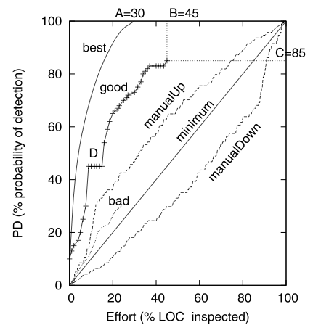
Application: Defect Prediction
Limited QA budgets, can’t check everything.
  Where should we place our inspection effort?
For a review, see Section Two of
  http://menzies.us/pdf/10which.pdf
Practical value:
  How to inspect less, and find more bugs

Slide 20
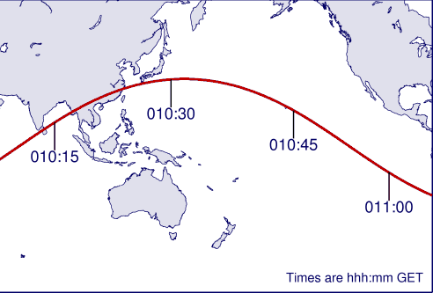
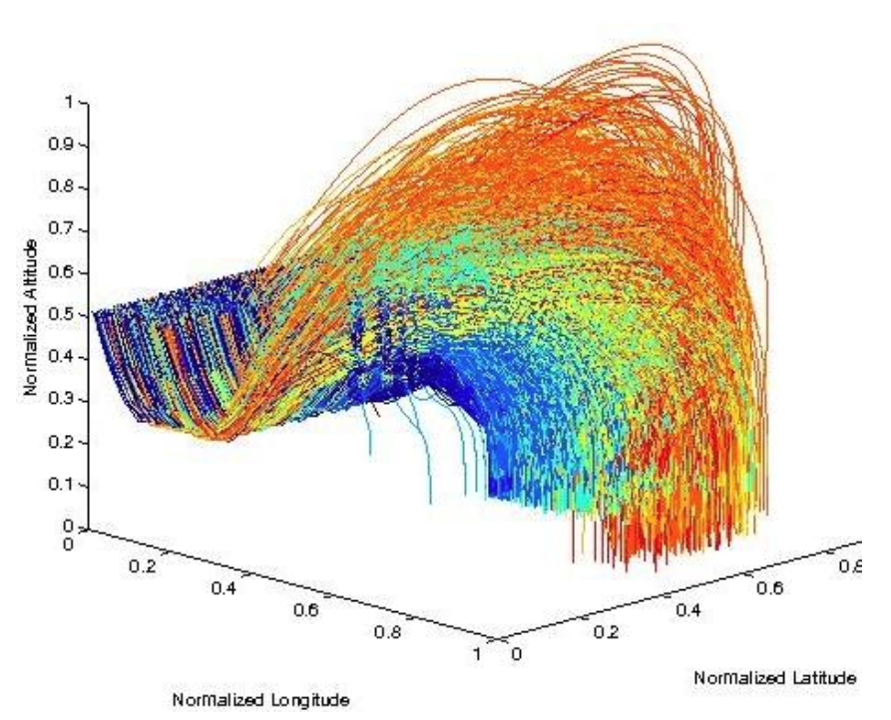
Application:
Optimizations of discrete systems
Standard numeric optimizers assume continuous, possibly even linear, equations
Data miners much happier to work in discrete spaces.
What factors predict for landing closest to the target?
    State-of-the-art optimizer
    Simulated annealing
    the TAR3 data miner
    TAR3 45 times faster, found better solutions
http://menzies.us/pdf/10keys.pdf

Slide 21
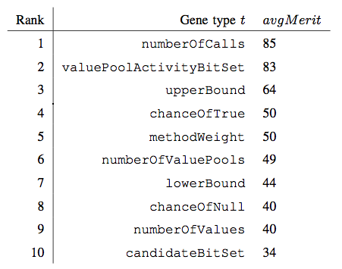
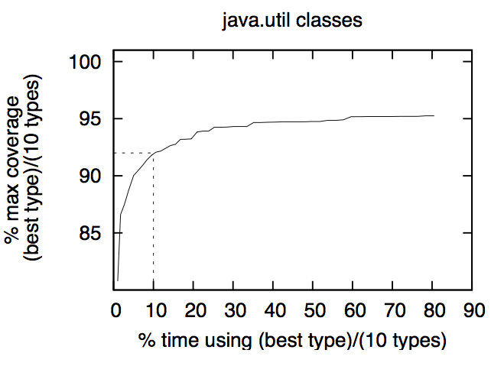
Application: Test Case Generation
NIGHTHAWK: A genetic algorithm that mutates sequences of method calls in order to maximize code coverage.
RELIEF: a data mining technique to find “interesting features”
    Same attribute same values in all classes?
      Boring
    Same Attribute, different values in different classes?
      Interesting
RELIEF found that 90% of NIGHTHAWK’s mutators were “boring”
  Order of magnitude speed up in test generation
James H. Andrews, Tim Menzies, Felix C.H. Li, "Genetic Algorithms for Randomized Unit Testing," IEEE Transactions on Software Engineering, 25 Mar. 2010.

Slide 22
Application: Fault Localization
100,000 JAVA methods
  In a matrix T*D
  T = “terms” = all the method calls in each method
  D = “documents” = all the methods
Bug report
  Replace text with just the method calls it mentions
  Add edited report as row D+one in the matrix
  Compute similarity of D+one to other rows (cosine similarity)
  The actual buggy method is in the closest 100 methods
  Use relevancy feedback to narrow down the search
Gregory Gay, Sonia Haiduc, Andrian Marcus Tim Menzies: On the use of relevance feedback in IR-based concept location ICSM 2009: 351-360

Slide 23
Application: Text Mining
80% of data in organizations is unstructured
  Not in databases, or XML schemas
  But in the natural language of (say) Word documents
Given enough of these seemingly unstructured documents, structures can be discovered
E.g.
  Thousands of natural language bug reports from NASA
  Used “feature reduction” to find the top 100 most important words
  Used standard data mining to learn predictors for defect severity from that top-100
  Tim Menzies, Andrian Marcus: Automated severity assessment of software defect reports. ICSM 2008: 346-355

Slide 24
Application:
Temporal Sequence Mining
Learning software process descriptions
  No more prescriptions of what we think goes on inside software projects
  Lets look at see at what actually happens
    Li, Mingshu and Boehm, Barry and Osterweil, Leon and Jensen, Chris and Scacchi, Walt “Experiences in Discovering, Modeling, and Reenacting Open Source Software Development Processes”, Unifying the Software Process Spectrum, Lecture Notes in Computer Science, 2006, page 449 to 462
Learning APIs from method sequence calls
  Tao Xie and Jian Pei. MAPO: Mining API Usages from Open Source Repositories. In Proceedings of the 3rd International Workshop on Mining Software Repositories (MSR 2006), Shanghai, China, pp. 54-57, May 2006
Learning patches from method sequence calls
  Suresh Thummalapenta and Tao Xie. Mining exception-handling rules as sequence association rules. In ICSE ’09: Proceedings of the 31st International Conference on Software Engineering, pages 496– 506, Washington, DC, USA, 2009. IEEE Computer Society.
Obtaining sequence miners:
  https://illimine.cs.uiuc.edu/
  Another tool set is at http://himalaya-tools.sourceforge.net/
  See more tools at https://sites.google.com/site/asergrp/dmse/resources

Slide 25
Application: etc etc etc
Data mining + SE a very active area
  PROMISE conference
  Mining Software Repository conference
See also
  ESEM conference
  Search-based software engineering
Hint: to get ahead of the curve…
  … learn sequence mining
Welcome to Empirical SE, version 2.0

Slide 26
Empirical SE, Version 2.0
Open Science movement
  Open Data
    Everyone places their data on-line, all the time
  Open Access publishing
    Death to subscription-based services
Shneiderman, B. (2008) "Science 2.0" Science 319(5868):1349-50
  Science meets web 2.0
  International team of researchers posting and analyzing data
  Research at internet speed
Anda, Markus et al (*) distinguish between
  Case studies: that collect new context variables from project data
  Experiments: that explore case study data
  Currently, very few case studies generating publicly available data
    But very many researchers wanting to experiment on that data
    Perfect setting for data mining
(*) Bente Anda Audris Mockus and Dag I.K. Sjoberg. Experiences from replicating a case study to investigate reproducibility of software development. In First International Workshop on Replication in Empirical Software Engineering Research, ICSE’09,

Slide 27

Empirical Science 2.0 adjusts its questions to the available data
The questions you
want to ask
The answers anyone else cares about
The questions the data can support (which, BTW, you won’t know till you look).
Are you here?

Slide 28
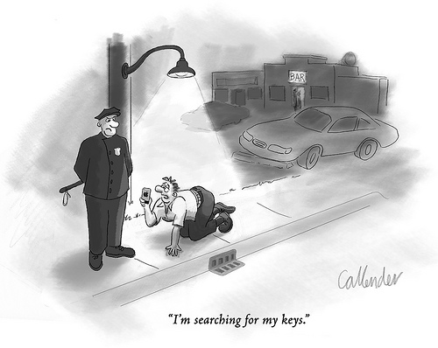
The lamppost objection
Where did you lose your keys?
  Over by the car.
So why are you looking here?
  Cause the light is better
Traditional view
  Frame the question
  Then collect the data
  Then explore data w.r.t. that question
  Assumes control of data collection

Slide 29
The lamppost objection (more)
Where did you lose your keys?
  Over by the car.
So why are you looking here?
  Cause the light is better
Another view
  Study the SE literature looking for open questions
  Study the SE data looking for what answers they support
  When answers intersect with questions, then report
E.g. Kitchenham TSE 2007: use cross-vs-within company data
E.g. Shepperd TSE 2002, 2005: stability of ranking of estimation methods

Slide 30
Does it work?
Any general conclusions?
Only a small minority of PROMISE papers (11/64) discuss results that repeated in data sets from multiple projects
E.g. Ostrand, Weyuker, Bell PROMISE ‘08, ‘09
  Same functional form
  Predicts defects for generations of AT&T software
E.g. Turhan, Menzies, Bener PROMISE ’08, ‘09
  10 projects
    Learn on 9
    Apply to the 10th
  Defect models learned from NASA projects work for Turkish white goods software
    Caveat: need to filter irrelevant training examples. See also
    When to Use Data from Other Projects for Effort Estimation Ekrem
    Kocaguneli, Gregory Gay, Tim Menzies, Ye Yang, Jacky W. Keung , ASE 2010
    B. Turhan, T. Menzies, A. Bener, and J. Distefano. On the relative value of cross-company and within- company data for defect prediction. Empirical Software Engineering, 68(2):278–290, 2009

Slide 31
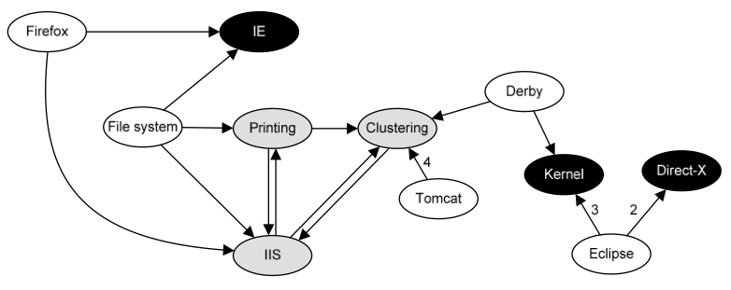
General conclusions: very rare
The usual conclusion is that we learn that we can learn very little
FSE’09: Zimmerman et al.
  Defect models
  not generalizable
    Learn “there”, apply
    “here” only works in 4%
    of their 600+ experiments
  Opposite to Turhan’09 results
    ?add relevancy filter
ASE’09: Green, Menzies et al.
  AI search for better software project options
  Conclusions highly dependent on local business value proposition
And others
  TSE ‘01, ’05: Shepperd et al
    Any conclusion regarding “best” effort estimator varies by data sets,
    performance criteria, random selection train/test set
  TSE’06: Menzies, Greenwald:
    attributes selected by column selection vary wildly across projects

Slide 32
The local lesson hypothesis
Software construction is a very varied process
General principles may not hold at local sites
Need methods for quickly finding those local lessons
Enter data mining

Slide 33
Q: Why Empirical SE 2.0?
A: Case study results may not generalize
What is true at one site,
  May not be true for another
  E.g. local sites have different goals, different biases, that changes what is “best” for that site
    II, P. G., Menzies, T., Williams, S., and El-Rawas, O. 2009. Understanding the Value of Software Engineering Technologies. In Proceedings of the 2009 IEEE/ACM international Conference on Automated Software Engineering(November 16 - 20, 2009)
  E.g. general policies perform worse than locally generated policies
    .
    Menzies, T., Williams, S., Boehm, B., and Hihn, J. 2009. How to avoid drastic software process change (using stochastic stability). In Proceedings of the 31st international Conference on Software Engineering (May 16 - 24, 2009
So we need to audit the conclusions of one case study w.r.t. to data taken from other sites.
Data mining is one technology that can (at least partially) automate that audit process

Slide 34
Q: Why Empirical SE 2.0?
A: Sharing is a good thing
WC= Within- company data
  Locally collected, locally applied
CC= Cross- company data
  Collected elsewhere, applied here.
Filtered CC works nearly as well as WC
  Turhan, B., Menzies, T., Bener, A. B., and Di Stefano, J. 2009. On the relative value of cross-company and within-company data for defect prediction. Empirical Softw. Engg. 14, 5 (Oct. 2009), 540-578
  Ekrem Kocaguneli, Gregory Gay, Tim Menzies, Ye Yang, Jacky Keung, When to Use Data from Other Projects for Effort Estimation, IEEE ASE 2010
So if ever you are doing new work,
  and lack local data,
  you can apply other people’s data
But only if it is available
  Open data !!!

Slide 35
Q: Why Empirical SE 2.0?
A: Like it or not, here it comes
Everyone has access to this technology
  In three minutes, on your machine, I can install
    200 data miners * pre-processors * meta-learners
    http://www.cs.waikato.ac.nz/ml/weka/index_downloading.html
We must explore how communities can responsibly use that technology
Otherwise, we run the risk of
  Inexperienced analysts hiding in a corner,
  Making private conclusions
  Which they don’t share

Slide 36
Q: Why Empirical SE 2.0
A: Changing nature of data
In the 21st century
  we can access more data collected by others than we can ever can collect by ourselves.
In the 20th century,
  research was focused on case studies where researchers collected special purpose data sets for their particular questions.
In the 21st century,
  much research is devoted to experimentation with the data generated by the case studies,
  possibly investigating hypotheses not originally considered when the data was collected.
  Data mining is one way to experiment with data.

Slide 37
Q: Why Empirical SE 2.0?
A: Increasing pace of change
New developments are radically changing SE: open source toolkits, agile development, cloud-based computing, etc.
20th century Empirical SE used “big science”
  Research questions, data collection, analysis took years
  Big science is too slow to keep up with changes to contemporary SE. e.g.
    Increasing pace of organization change at NASA was fatal to the “big science” approach of Victor Basili’s Software Engineering Laboratory (*)
    V. Basili, F. McGarry, R. Pajerski, and M. Zelkowitz. Lessons learned from 25 years of process improvement: The rise and fall of the NASA software engineering laboratory. In Proceedings of the 24th International Conference on Software Engineering (ICSE) 2002, Orlando, Florida, 2002.
Data mining is one response to the open and urgent issue of
  how to reason faster about SE data.

Slide 38
Q: Why Empirical SE 2.0?
A: Changing nature of SE theories
20th century SE: the struggle for the single theory
  E.g. Boehm’s COCOMO effort estimation project
  E.g. SEI capability maturity model [130];
21st century: faster pace = more diversity
  Less likely that there exists a single over-arching grand theory of SE
Recent reports [1,2,3,4,5] say that while such generality may elude us, we can still find the special lessons that work best on the local projects
    Rombach A. Endres, H.D. A Handbook of Software and Systems Engineering: Empirical Observa- tions, Laws and Theories. Addison Wesley, 2003.
    B. Kitchenham D. Budgen, P. Brereton. Is evidence based software engineering mature enough for practice & policy? In 33rd Annual IEEE Software Engineering Workshop 2009 (SEW-33), Skvde, Sweden, 2009.
    B. A. Kitchenham, E. Mendes, and G. H. Travassos. Cross- vs. within-company cost estimation studies: A systematic review. IEEE Transactions on Software Engineering, pages 316–329, May 2007.
    Tim Menzies and Forrest Shull. The quest for convincing evidence. In A. Oram and G. Wilson, editors, Making Software: What Really Works, and Why We Believe It. O’Reilly, 2010.
    H. Gall E. Giger T. Zimmermann, N. Nagappan and B. Murphy. Cross-project defect prediction. In ESEC/FSE’09, August 2009.
Data mining is one way to rapidly find and verify the special practices that best work on the local projects.

Slide 39
Q: Why Empirical SE 2.0?
A: Changing nature of data analysis
A contemporary empirical SE paper might explore gigabytes of core dumps looking for the method calls that lead to a crash.
Faced with such large and complex data, analysis methods are becoming more intricate; e.g.
  Model trees for multi-model data
  Latent Dirichlet allocation (LDA) for document clustering
  Mining sequences to learn exception handling rules
It is now possible to ﬁnd new insights in old data, just by applying a new analysis method.
  E.g. see later, the “W” tool

Slide 40
Why Data Mining for SE?
Natural tool to help a community:
  racing to keep up with the pace of change in SE;
  while ﬁnding and verifying the special theories that work best on local projects …
  … from a new kind data sources …
  … using a large menagerie of new data analysis tools.

Slide 41
Coming next…
Enough generalities
Details of using a data mining tool suite
  The “WEKA”

Slide 42
Data mining tools (guided tour of “WEKA”)

Slide 43
Road map
Data mining & SE (overview)
Data mining tools (guided tour of “WEKA”)
Data “carving” (core operators of DM)

Slide 44
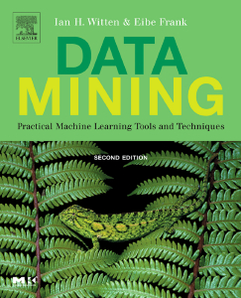
WEKA
Machine learning/data mining software written in Java
  Used for research, education, and applications
  Complements Data Mining: Practical Machine Learning Tools and Techniques (Second Edition) Ian H. Witten, Eibe Frank, Morgan Kaufmann June 2005 525 pages ISBN 0-12-088407-0
Main features
  Comprehensive set of data pre-processing tools, learning algorithms and evaluation methods
  Graphical user interfaces (incl. data visualization)
  Environment for comparing learning algorithms

Slide 45
Access
WEKA is available at
http://www.cs.waikato.ac.nz/ml/weka
Also has a list of projects based on WEKA
WEKA contributors:
Abdelaziz Mahoui, Alexander K. Seewald, Ashraf M. Kibriya, Bernhard Pfahringer , Brent Martin, Peter Flach, Eibe Frank ,Gabi Schmidberger ,Ian H. Witten , J. Lindgren, Janice Boughton, Jason Wells, Len Trigg, Lucio de Souza Coelho, Malcolm Ware, Mark Hall ,Remco Bouckaert , Richard Kirkby, Shane Butler, Shane Legg, Stuart Inglis, Sylvain Roy, Tony Voyle, Xin Xu, Yong Wang, Zhihai Wang

Slide 46
Data Files
@relation heart-disease-simplified
@attribute age numeric
@attribute sex { female, male}
@attribute chest_pain_type { typ_angina, asympt, non_anginal, atyp_angina}
@attribute cholesterol numeric
@attribute exercise_induced_angina { no, yes}
@attribute class { present, not_present}
@data
63,male,typ_angina,233,no,not_present
67,male,asympt,286,yes,present
67,male,asympt,229,yes,present
38,female,non_anginal,?,no,not_present
...
numeric attribute
nominal attribute
Flat file in
ARFF format

Slide 47
Explorer: pre-processing
Source
  Data can be imported from a file in various formats: ARFF, CSV, C4.5, binary
  Data can also be read from a URL or from an SQL database (using JDBC)
Pre-processing tools
  Called “filters”
  Discretization, normalization, resampling, attribute selection, transforming and combining attributes, …

Slide 48
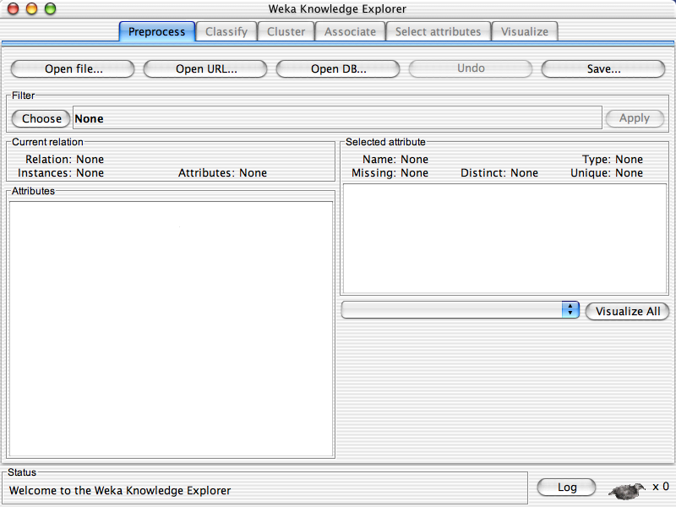

Slide 50
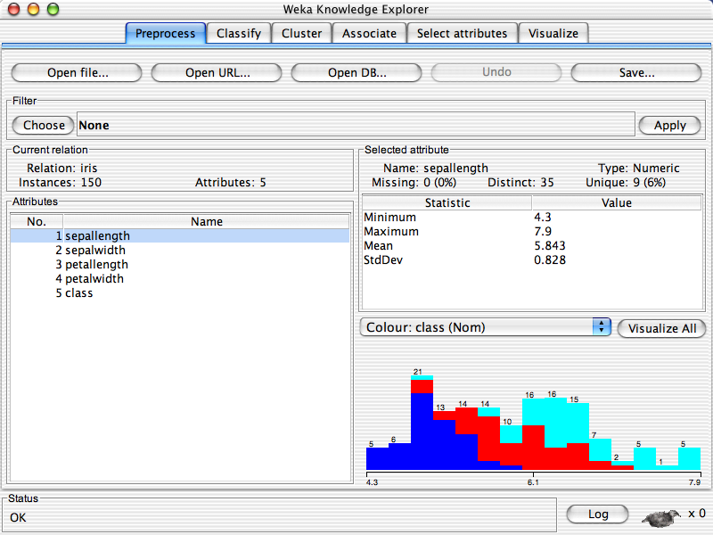

Slide 52
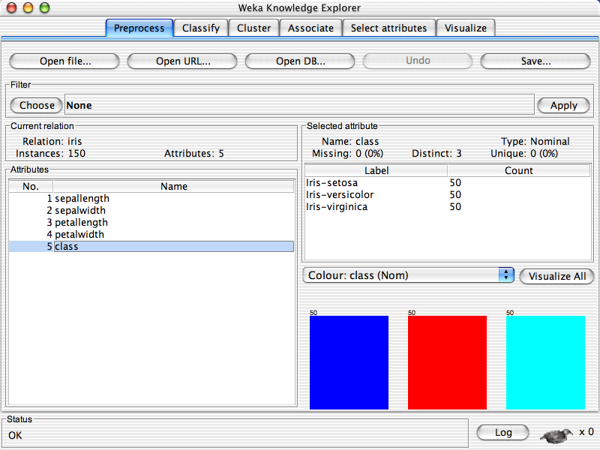

Slide 54
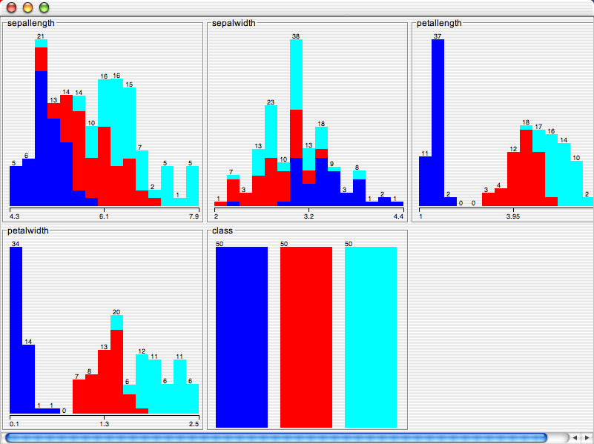

Slide 55
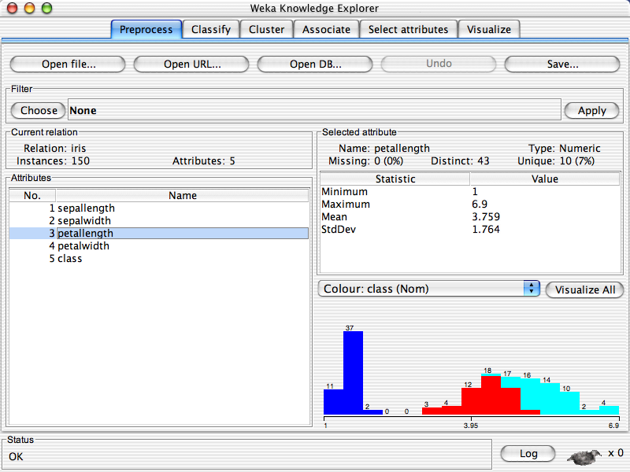

Slide 57
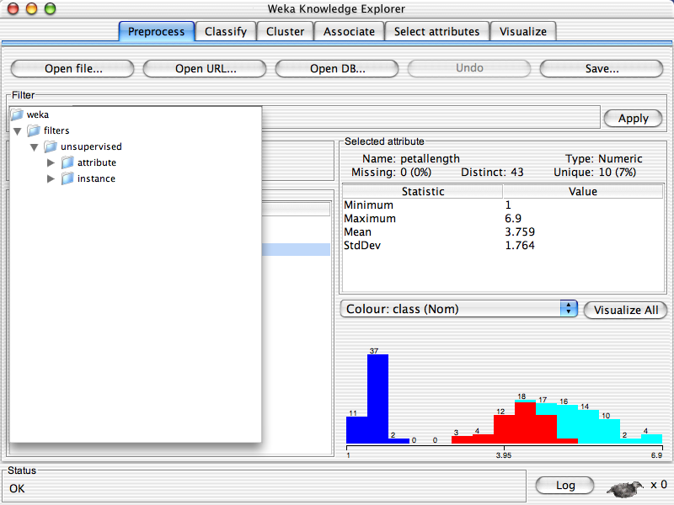

Slide 59
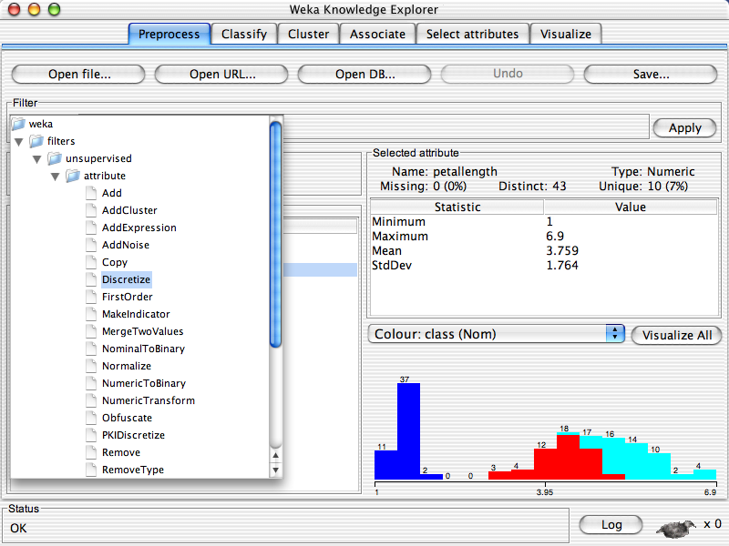

Slide 60
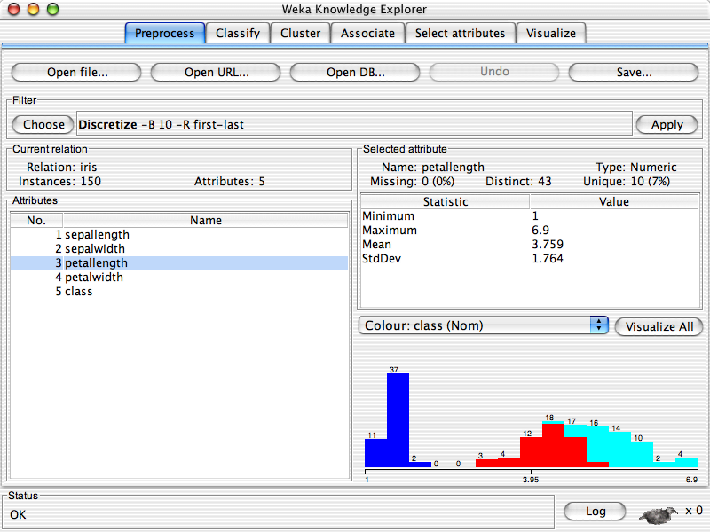

Slide 62
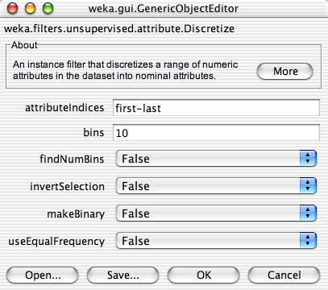

Slide 64
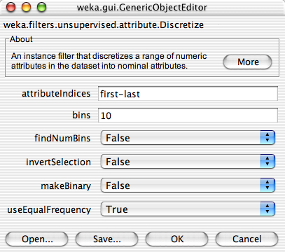

Slide 66


Slide 68
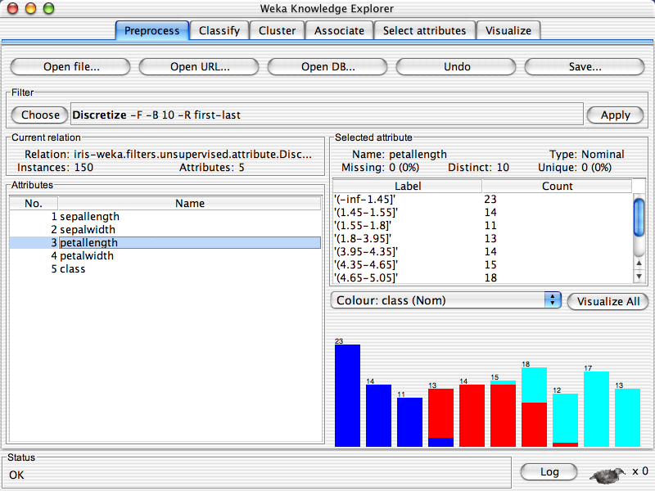

Slide 69
Explorer: building “classifiers”
Classifiers in WEKA are models for predicting nominal or numeric quantities
Implemented learning schemes include:
  Decision trees and lists, instance-based classifiers, support vector machines, multi-layer perceptrons, logistic regression, Bayes’ nets, …
“Meta”-classifiers include:
  Bagging, boosting, stacking, error-correcting output codes, locally weighted learning, …

Slide 70
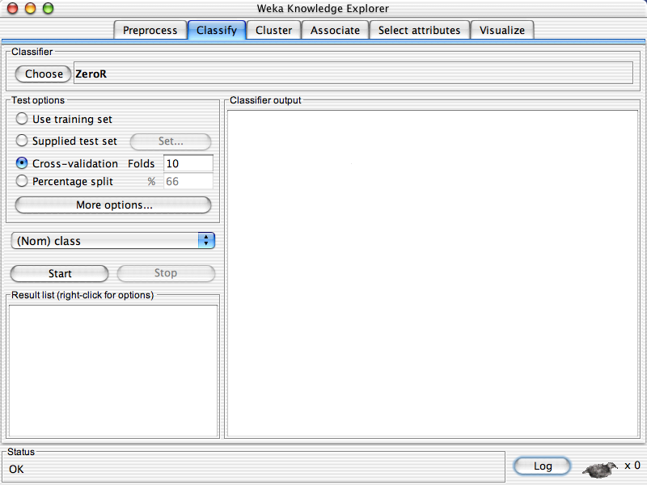

Slide 72
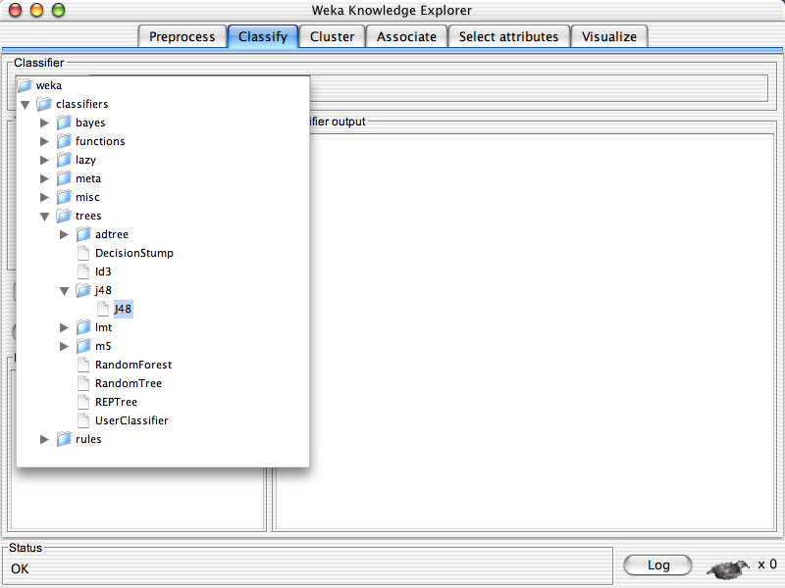

Slide 73
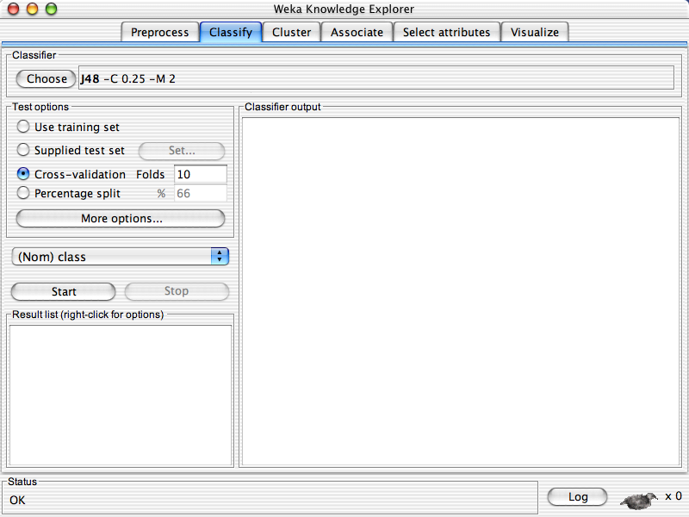

Slide 75
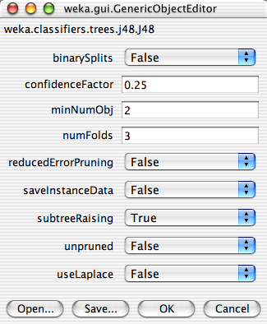

Slide 79
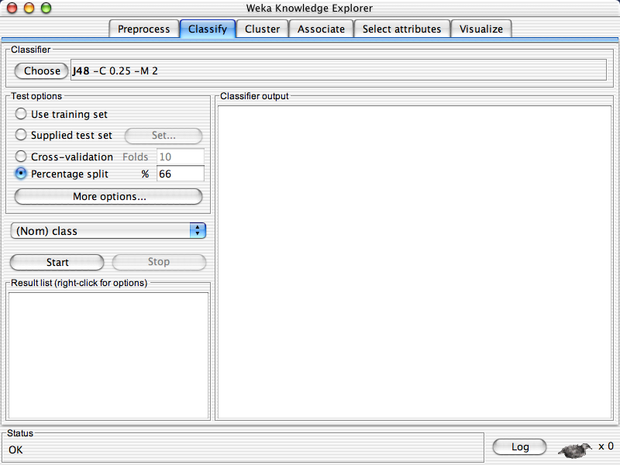

Slide 81
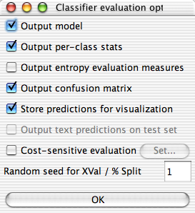

Slide 85
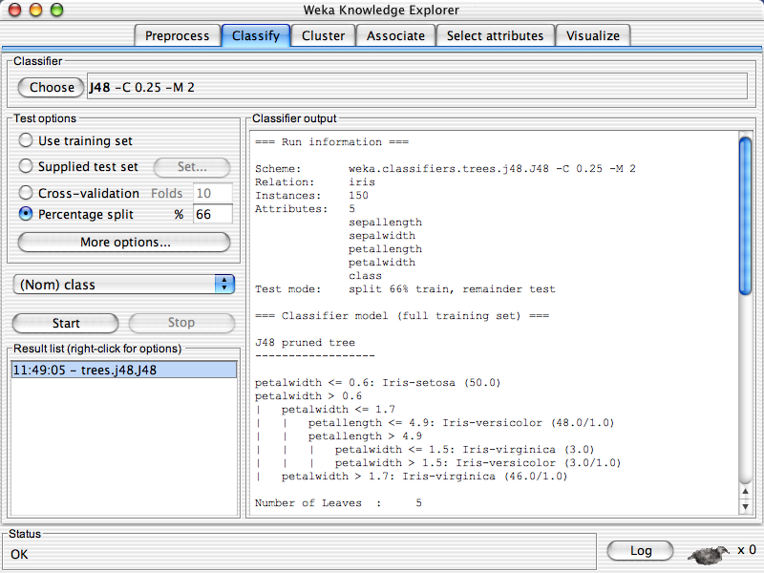

Slide 88
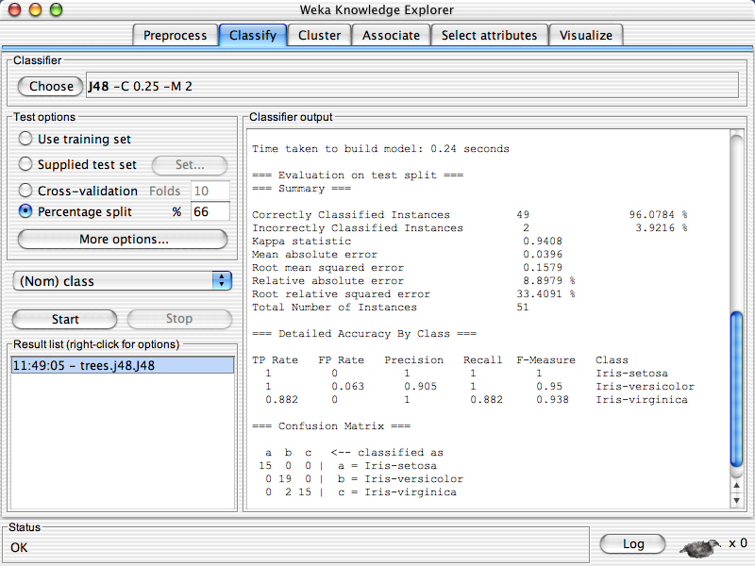

Slide 91
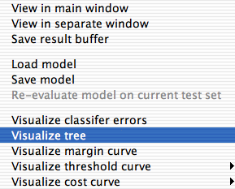

Slide 92
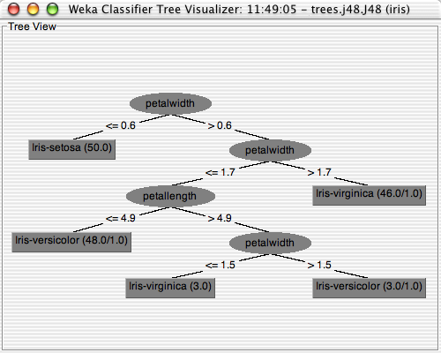

Slide 93
Explorer: clustering data
WEKA contains “clusterers” for finding groups of similar instances in a dataset
Implemented schemes are:
  k-Means, EM, Cobweb, X-means, FarthestFirst
Clusters can be visualized and compared to “true” clusters (if given)
Evaluation based on loglikelihood if clustering scheme produces a probability distribution

Slide 94
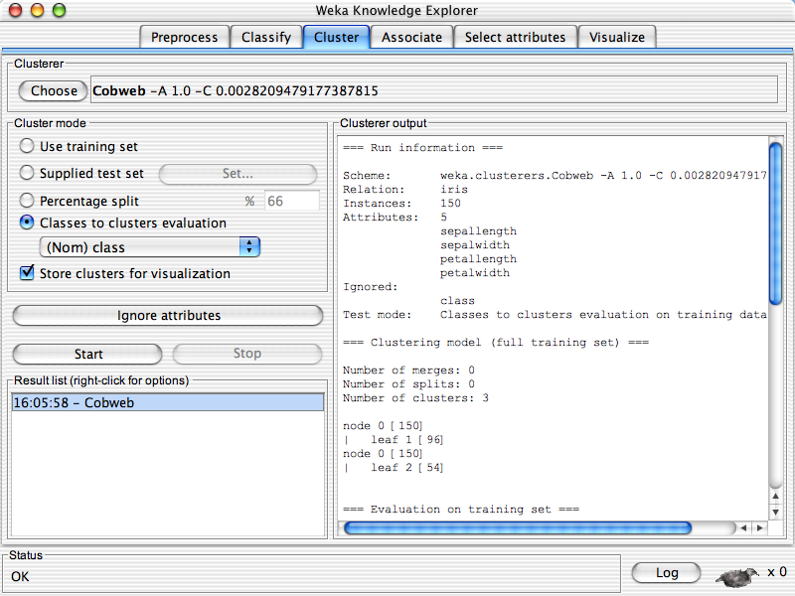

Slide 95
Explorer: finding associations
WEKA contains an implementation of the Apriori algorithm for learning association rules
  Works only with discrete data
Can identify statistical dependencies between groups of attributes:
  milk, butter ⇒ bread, eggs (with confidence 0.9 and support 2000)
Apriori can compute all rules that have a given minimum support and exceed a given confidence

Slide 96
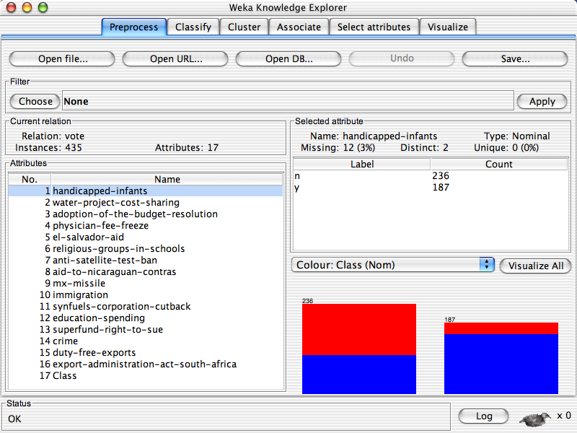

Slide 97
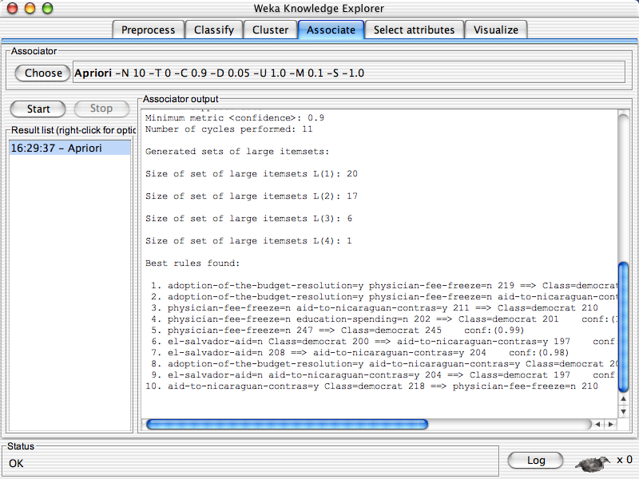

Slide 98
Explorer: attribute selection
Panel that can be used to investigate which (subsets of) attributes are the most predictive ones
Attribute selection methods contain two parts:
  A search method: best-first, forward selection, random, exhaustive, genetic algorithm, ranking
  An evaluation method: correlation-based, wrapper, information gain, chi-squared, …
Very flexible: WEKA allows (almost) arbitrary combinations of these two

Slide 99
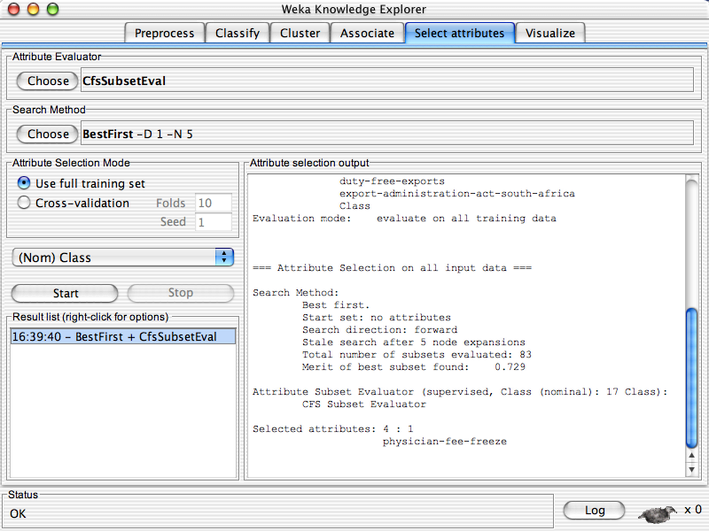

Slide 101
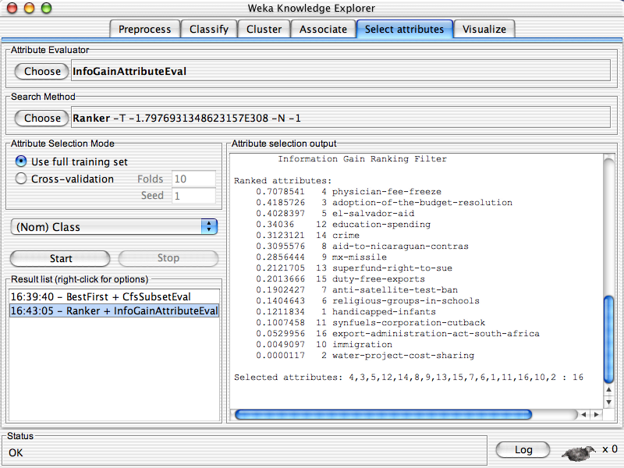

Slide 103
Which attribute selector?
Best: WRAPPER
  Slow: O(2^N) search through all attribute combinations
  The “wrapped” learner called to assess each combination
  Some heuristics to prune the search; but does not scale
If not WRAPPER
  Use InfoGain / OneR for very big datasets
  Use CFS otherwise
Don’t use PCA
  This is an unsupervised selector
  So it is uninformed on how dimensions help classification

Slide 104
Limitations
Loads all data into ram prior to learning
  Problem for large data sets
Not good for complex experiments
IMHO, discourages experimentation with new learners
  The “WEKA effect”
    Try every learner till something works
Still, very useful for
  Initial investigations
  Learning data mining
  Or as a sub-routine of other systems

Slide 105
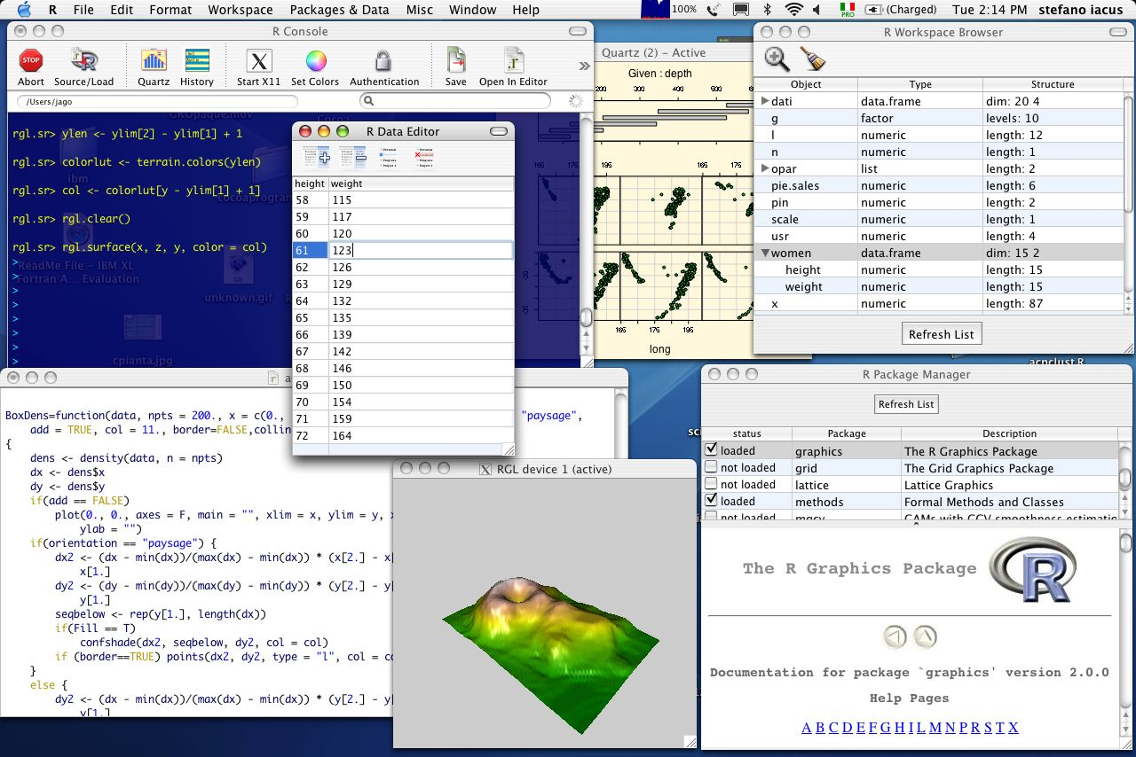
Alternate tools: “R”
Leading open-source system for statistical computing and graphics,
http://www.r-project.org/

Slide 106
Alternate tools: Matlab
For me: just say no
Open science, open tools

Slide 107
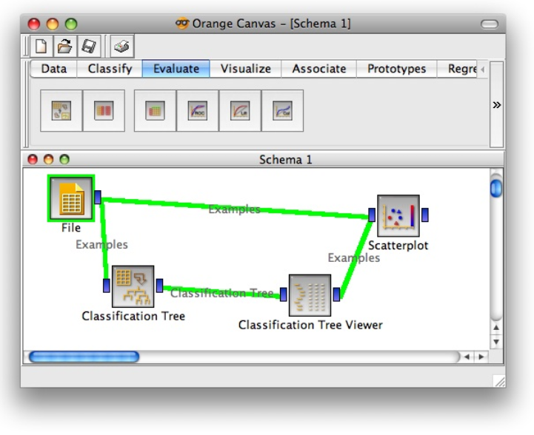
Alternate tools: Orange
Written in Python
Simpler specification (but see WEKA’s KnowledgeFlow
Environment).
Also, less community support/debugging. So sometimes
frustrated by random bugs

Slide 108
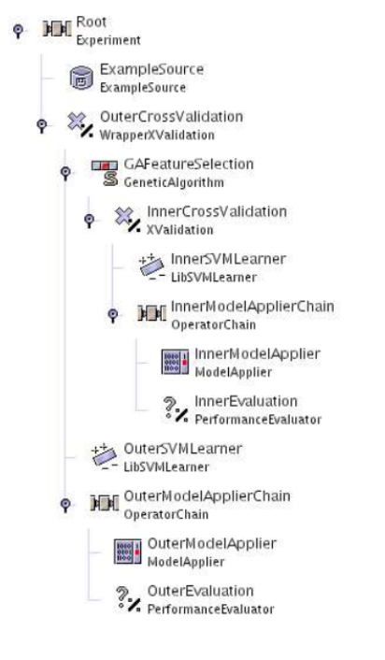
Alternate tools: RapidMiner
Experiments specified in an XML tree syntax
In theory, possible to share experimental descriptions

Slide 109
Alternate tools: OurMine
Forget the visuals.
Make WEKA a sub-routine
inside Bash script
Now you can mix WEKA’s JAVA with learners written in your
favorite language.
But how do you find the magic
command strings?
Java=$Base/lib/java
Weka="java -Xmx2048M -cp $Java/weka.jar ”
Clusterers="java -Xmx1024M -jar $Java/Clusterers.jar ”
Reducers="java -Xmx1024M -jar $Java/Reduce.jar ”
nb() {
local learner=weka.classifiers.bayes.NaiveBayes
$Weka $learner -p 0 -t $1 -T $2
}
nb10() {
local learner=weka.classifiers.bayes.NaiveBayes
$Weka $learner -i -t $1
}
j48() {
local learner=weka.classifiers.trees.J48
$Weka $learner -p 0 -C 0.25 -M 2 -t $1 -T $2
}
Adam Nelson, Tim Menzies, Gregory Gay,
Sharing Experiments Using Open Source Software,
Softw. Pract. Exper. 2011

Slide 111
Why go to all that trouble?
analysis1(){
local origdata=$1
local outstats=$2
local nattrs="2 4 6 8 10 12 14 16 18 20"
local learners="nb10 j4810 zeror10 oner10 adtree10"
local reducers="infogain chisquared oneR"
local tmpred=$Tmp/red
echo "n,reducer,learner,accuracy" > $outstats
for n in $nattrs; do
for reducer in $reducers; do
$reducer $origdata $n $tmpred
for learner in $learners; do
accur=`$learner $tmpred.arff | acc
out="$n,$reducer,$learner,$accur"
blabln $out
echo $out >> $outstats
done
done
done
}
Complex experiments, specified succinctly.
Experiments can now be reviewed, audited, by others.
Also, in 12 months time when Reviewer2 wants a tiny extension to the old paper, you don’t have to remember all that clicking you did: just rerun the script.

Slide 112
Coming next…
Enough details
So many tools in WEKA, R, Rapid-Miner, Orange, OURMINE…
The great secret
  All those “different” tools do the same thing.
    Carve up vector space.

Slide 113
Data CARVING
(The core operators of DM)

Slide 114
Road map
Data mining & SE (overview)
Data mining tools (guided tour of “WEKA”)
Data “carving” (core operators of DM)

Slide 115

“Data Carving”:
A geometric view of data mining
Data is like a block of marble,
  waiting for a sculptor (that’s you)
  to find the shape within
So “data mining” is really “data carving”
  chipping away the irrelevancies
  To find what lies beneath.

Slide 116
Four operators of data carving
Each example is a row in a table
What can can we do change the table geometry?
Clump
Select
columns
Select
rows
Rotate
(add new
columns)
Clump columns
@attribute outlook {sunny, overcast, rainy}
@attribute temperature real
@attribute humidity real
@attribute windy {TRUE, FALSE}
@attribute play {yes, no}
@data
sunny, 85,85,FALSE, no
sunny, 80,90,TRUE, no
overcast, 83,86,FALSE, yes
rainy, 70,96,FALSE, no
rainy, 68,80,FALSE, yes
rainy, 65,70,TRUE, no
overcast, 64,65,TRUE, yes
sunny, 72,95,FALSE, no
sunny, 69,70,FALSE, yes
rainy, 75,80,FALSE, yes
sunny, 75,70,TRUE, yes
overcast, 72,90,TRUE, yes
overcast, 81,75,FALSE, yes
rainy, 71,91,TRUE, no

Slide 117
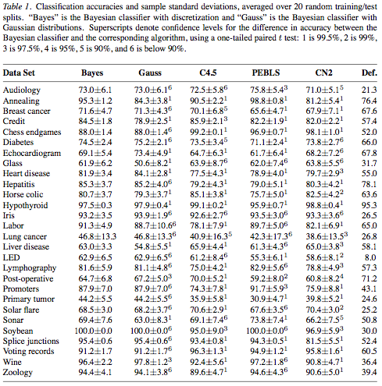
The field is called “data mining”, not “algorithm mining”
To understand data mining, look at the data, not the algorithms
Why? We do data mining not to study algorithms.
  But to study data
Our results should be insights about data,
  not trivia about (say) decision tree algorithms
Besides, the thing that most predicts for performance is the data, not the algorithm,
  Pedro Domingos and Michael J. Pazzani, On the Optimality of the Simple Bayesian Classifier under Zero-One Loss, Machine Learning, Volume 29, number 2-3, pages 103-130, 1997

Slide 118
The rest of this hour
1. Clump
2. Select
columns
3. Select
rows
4. Rotate
(add new
columns)
5. Clump columns

Slide 119
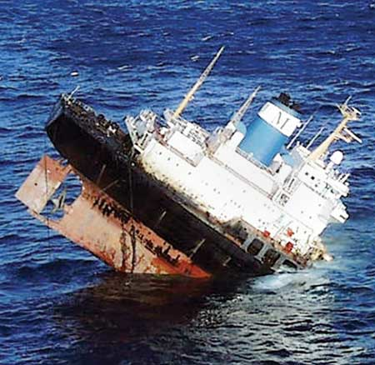
Carving can be dangerous
While carving the training data is recommended
  It is a methodological error to carve the test data
Whatever is learned from the training data
  Should be assessed on “raw” (i.e. uncarved) test data

Slide 120
Clumping column data
(a.k.a. discretization)
Learning = compression
  Take a target concept that is spread out across all the data
  Squeeze it together till it is dense enough to be visible.
Discretization: clump together observations taken over a continuous range
  into a small number of regions.
E.g. "toddlers” If age =1,2,3
Discretization improves the performance of a learner
  Gives a learner a smaller space to reason about,
  With more examples in each part of the space
overcast, 64,65,TRUE, yes
Rainy, 65,70,TRUE, no
sunny, 69,70,FALSE,yes
sunny, 75,70,TRUE, yes
overcast, 81,75,FALSE,yes
rainy, 68,80,FALSE,yes
rainy, 75,80,FALSE,yes
sunny, 85,85,FALSE,no
overcast, 83,86,FALSE,yes
overcast, 72,90,TRUE, yes
sunny, 80,90,TRUE, no
rainy, 71,91,TRUE, no
sunny, 72,95,FALSE,no
rainy, 70,96,FALSE,no

Slide 121
Supervised
Discretization
Standard method:
  Find a break that most reduces class diversity either side of the break
  Recurse on data:
    above break,
    below break
  Fayyad and Irani, Multi-Interval Discretization of Continuous-Valued Attributes for Classification Learning IJCAI’93, pp1022-1027
overcast, 64,65,TRUE, yes
Rainy, 65,70,TRUE, no
sunny, 69,70,FALSE,yes
sunny, 75,70,TRUE, yes
overcast, 81,75,FALSE,yes
rainy, 68,80,FALSE,yes
rainy, 75,80,FALSE,yes
sunny, 85,85,FALSE,no
overcast, 83,86,FALSE,yes
overcast, 72,90,TRUE, yes
sunny, 80,90,TRUE, no
rainy, 71,91,TRUE, no
sunny, 72,95,FALSE,no
rainy, 70,96,FALSE,no

Slide 122
Unsupervised
Discretization
Divide into “B” bins
  (X – Min) / ((Max – Min )/ B)
  B=3 or 10 very common
Divide into P percentile groups
  Each bins contains (say) 25% of the rows
For Bayesian methods
  Divide into groups of N items
  Ying and Webb recommends N= sqrt(rows)
  Ying Yang and Geoff Webb, Weighted Proportional k-Interval Discretization of Naïve Bayes classifeirs, PAKADD’03, p501-512, 2003

Slide 123
Select columns
Occam's Razor - Entia non sunt multiplicanda praeter necessitatem.( "Entities should not be multiplied more than necessary").
  the fewer features used to explain something, the better
Log(OR):
  Discrete every feature. For all pairs of target / other of size C1, C2 count frequency of range N1, N2 in each class
  Log(odds ratio) = log((N1/C1) / (N2/C2)) > 0 if more frequent in target
  “Pivots” are the ranges with high Log (OR)
  Možina, M., Demšar, J., Kattan, M., and Zupan, B. 2004. Nomograms for visualization of naive Bayesian classifier. InProceedings of the 8th European Conference on Principles and Practice of Knowledge Discovery in Databases (Pisa, Italy, September 20 - 24, 2004)
InfoGain:
  Use Fayyad Irani trick: assses each column by how well it divides up the data
  Takes linear time : O(C)
Wrapper:
  Explore 2^{C} subsets of C columns: takes time O(2^{C})
  Call a learner on each subset
  Use the columns that maximize learner performance
  Not practical for large data sets
For more, see Hall, M. and Holmes, G. (2003). Benchmarking attribute selection techniques for discrete class data mining. IEEE Transactions on Knowledge and Data Engineering. 15(3), November/December 2003

Slide 124
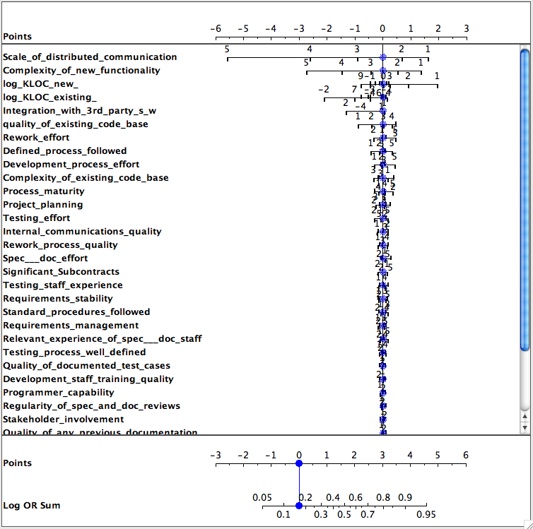
Select columns with log(OR)
Data from Norman Fenton’s Bayes Net
  Project Data Incorporating Qualitative Factors for Improved Software Defect Prediction Norman Fenton, Martin Neil, William Marsh, Peter Hearty, Lukasz Radlinski and Paul Krause., PROMISE 2008
Target class. worse defects
Only a few features matter
Only a few ranges of those features matter

Slide 125
Select columns with log(OR)
Data from Norman Fenton’s Bayes Net
  Project Data Incorporating Qualitative Factors for Improved Software Defect Prediction Norman Fenton, Martin Neil, William Marsh, Peter Hearty, Lukasz Radlinski and Paul Krause., PROMISE 2008
Target class. worse defects
Only a few features matter
Only a few ranges of those features matter
Pivotal if
Log(OR) >
0.2 * max of
Log(OR)

Slide 126
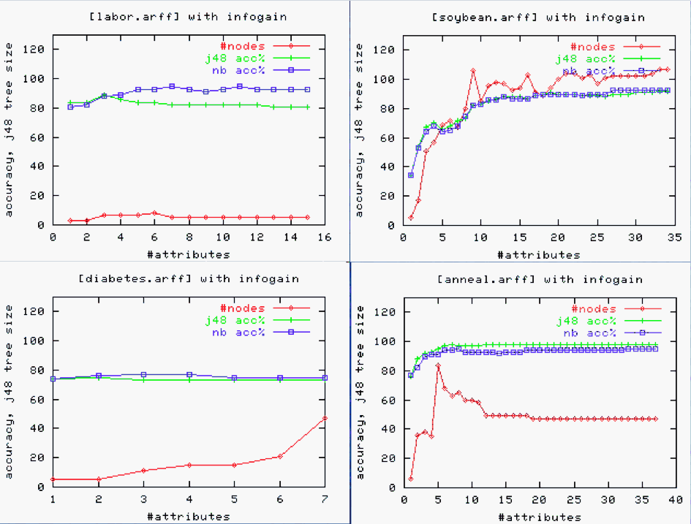
Select columns with InfoGain
X-axis
sorted by
sum(-p*log(p))
Simpler theories after column selection,
work just as well as using everything

Slide 127



Select columns with WRAPPER
  Finding the Right Data for Software Cost Modeling Chen, Menzies, Port, Boehm, IEEE Software Nov/Dec 2005

Slide 128
Select rows
Replace N rows
  with M < N rows
  that best exemplify the data
Typical result:
  Can throw out 80 to 90% of the rows without lossing accuracy
  C. Chang, “Finding prototypes for nearest neighbor classiﬁers,” IEEE Trans. on Computers, pp. 1179–1185, 1974.
Benefits:
  Outlier removal
  Any downstream processing is faster
    E.g. any O(N²) process is 100 times faster on N/10 of the data
  Less errors in conclusions
    Instance learner: classify according to nearest neighbors
    If nearest neighbors further away, harder for data collection errors to cause wrong classifications
  Easier to visualize
    Fewer things to look at

Slide 129

Select rows
Exponential time
  Genetic algorithm to explore the 2^{R} subsets of rows.
    When more rows than columns, even slower than the WRAPPER’s O(2^{C}) search
    Y.Li, M.Xie, and T.Goh, “A study of project selection and feature weighting for analogy based software cost estimation,” Journal of Systems and Software, vol. 82, pp. 241–252, 2009.
Polynomial time: Greedy agglomerative clustering
  Push every instance to its closest neighbor.
  Build a synthetic example at each pair’s median
  Repeat for the synthetic points.
  Prototypes are all nodes at level X of GAC tree
  For R rows, O(R²)
TEAK = GAC plus …
  Prune sub-trees with large variance
  When to Use Data from Other Projects for Effort Estimation Ekrem
  Kocaguneli, Gregory Gay, Tim Menzies, Ye Yang, Jacky W. Keung , ASE 2010
Linear-time
  Rank ranges by frequency delta in different classes
  Discard all rows that do not have the top R pivots

Slide 130

Select rows
(with TEAK)
To effort estimate a test instance, start at root of GAC tree
  Move to nearest child
  Stop at leaf or when sub-tree variance greater than super-tree
  Estimate = median of instances in that sub-tree
Compared with
  linear regression,
  neural nets,
  analogy methods that use K=1,2,4 nearest neighbors (no variance pruning)
Compared using
  20 * {shuffle rows, 3-way cross-val)
  #wins - # losses (in a Wilcoxon, 95%)
  Count number of times ranked first by this procedure
Conclusion: row-selection using clustering + variance pruning is a good thing

Slide 131

Select rows
(with range pruning)
For class in classes
  Rank attribute ranges by how often they appear in class vs notClass
For each attribute
  Find its range with top rank
Sort attributes by top ranked range
Remove rows that do not have the top range of the top N ranked attribute
Linear time (much faster than any other instance selector)
ProbDefections not harmed
As noise added to data, this method’s PF changes the least)
5 class system

Slide 132
Rotate
(add columns)
Sometimes, the data’s raw dimensions suffice for isolating the target concept..
But what if the target concept falls across,
and not along, the raw dimensions?
b
b
b
a
a
b
b
b
a
a
b
b
a
a
b
b
b
a
a
b
b
a
a
b
b
a
a
a
b
a
b
b
a
b
b
b
b
b
b
b
b
b
b
b
a
b
b
b
a
b
b
b
a
b
b
b
b
b
b
b
Theory 1:
if true, then “a”
Theory 2::
if x > 1, then “a”
Theory 3::
if x > 1, and y > 1 then “a”

Slide 133
Rotate
(add columns)
Synthesize a new dimension
that combines the raw
into something new
Apply single-valued decomposition (SVD) to
  the covariance matrix (principal component analysis, or PCA)
  or the data table (latent semantic indexing, or LSI)
PCA that produces a set of orthogonal “components”
  Transforms C correlated variables into fewer uncorrelated "components".
  Component[i] accounts for as much variability as possible.
  Component[i+1] accounts for as much of the remaining variability as possible.
Much easier to learn rules when dimensions match the data. E.g. a defect predictor:
if comp[1] ≤ 0.180
then NoDefects
else if comp[1] > 0.180
then if comp[1] ≤ 0.371 then NoDefects
else if com[1] > 0.371 then Defects
But it can be hard to explain that predictor:
Comp[1] = 0.236*v(g) +0.222*ev(g)+0.236*iv(g) +0.241*n +0.238*v -0.086*l +0.199*d +0.216*i +0.225*e +0.236*b +0.221*t +0.241*lOCode +0.179*lOComment +0.221*lOBlank +0.158*lOCodeAndComment +0.163*uniq_Op +0.234*uniq_Opnd
+0.241*total_Op +0.241*total_Opnd +0.236*branchCount

Slide 134



Rotate
(add columns)
Special transforms
Support vector
machines: construct
a hyper-plane that
separates classes

Slide 135
Clump rows
(a.k.a. generalize)
Ever notice that rows and rules have (nearly) the same syntax?
  Age=young and wealth=rich and iq=high and class=happy
  If age=old and wealth=rich and iq=high then happy
But when we write rules, we only do it for frequently occurring patterns in the other rows
“Clump rows” : replace them with a rule that covers many rows, but many only mention some of the columns
    If age=old and wealth=rich then happy
  If you do this after clumping columns and selecting good rows and selecting good columns and (maybe) adding in good columns
    Then the search space is very small
    The exploring can be heavily biased by the other steps (e.g. look at great rows before dull ones)
    And, hey presto, you’ve got a working data miner

Slide 136
Hints and tips (note: only my view)
Always try clumping with discretization
  So very simple
  So experiment with / without discretization
Always try column selection
  Usually, massive reduction in the columns
If the data won’t fit in RAM,
  try column selection first (use a linear-time approach)
  then you can explore row selection by (say)
    Era1: read first 1000 instances and apply row selection
    Era[i+1]: read next 1000 records and ignore instances that fall close to the instances selected at Era[i]
Try these last: PCA / Support vector machines
  Benefits of PCA often achieved, or beaten by other column selectors
    Hall, M. and Holmes, G. (2003). Benchmarking attribute selection techniques for discrete class data mining. IEEE Trans on Knowledge and Data Engineering. 15(3), November/December 2003
  The FASTMAP heuristic FASTMAP, can do what PCA does, faster, scalable.
    Faloutsos, C. and Lin, K. 1995. FastMap: a fast algorithm for indexing, data-mining and visualization of traditional and multimedia datasets. In Proceedings of the 1995 ACM SIGMOD international Conference on Management of Data
  For text mining (PCA / LDA) vs TF*IDF never benchmarked

Slide 137
What have We Learned?
tim@menzies.us

Slide 138
Fatal flaws in data mining for SE?
Barbara Kitchenham et al, ESE journal, 2008
  Replications can replicate stupid errors
Vic Basili, LASER, 2010
  If we give people our data, they can make stupid mistakes, cause they don’t understand our context
Well get back to this….

Slide 139
Data mining = a diverse and lucrative career
Effort estimation
Defect prediction
Optimization of discrete systems
Test case generation
Fault localization
Text mining
Temporal sequence mining
  Learning software processes
  Learning APIs
Etc
Data mining applications
explored by me since 2007.
A career in data mining is a very diverse career, indeed

Slide 140
We need help
A little experiment from http://www.youtube.com/v/vJG698U2Mvo&hl=en_US&fs=1&rel=0
Rules
  No one talks for the next 4 minutes
  If you know what is about to happen, see (1)
This is a selective
attention test
  Count the number
  of times the team
  with the white
  shirt passes the ball.

Slide 141

Data analysis deserves
(much) more than zero pages
Easterbrook et al. (2007)
9 pages: selecting methods
3 pages: research questions
2 pages: empirical validity
2 pages: different forms of "empirical truth"
1 page: role of theory building
1 page: conclusions
1 page: data collection techniques
0 pages: data analysis
  and then a miracle happens

Slide 142
Don’t just do data mining
Be of the empirical research community
  Go to LASER, ICSE, etc
  Talk
Find current hypothesis that of interest
  E.g. max AUC(effort,pdf)
  E.g. cross-vs-within data
  E.g. TOE
  E.g. text mining for structured reviews
    Juristo, Menzies, 2011

Slide 143

Don’t do data mining once
Continuous process monitoring
  Learn expectations
  Stale smell policy: when good ideas go bad
  Repair policies: how to modify old ideas (more mining)
  Escalation policy: recognize when you need to call for help
Bt the way,
  1,2,3,4 can all be implemented by data miners.
Welcome to TOE

Slide 144
Other Do-s and Don’ts
Do learn about data mining
  People make mistakes
  Need communities of agents (human and otherwise)
  New algorithms, old data, new insights
Don’t used dumb data mining:
  correlation, PCA??
  Forgettaboutit
Don’t quote old dumb studies:
  E.g. Mccabe
Do study stability:
  20 * 66% of the data
Do model bias
  Bias is where the business meets the learning

Slide 145

Exploit the crowd source advantage
Crowd source
  Join the community of people studying the data
  Be there for them
Lead, follow, or get out of the way
  What’s fair got to do with it? Its going to happen
  Wolfgang Grieskamp from Microsoft, at Dagstuhl 2010

Slide 146

Open data initiatives
Open source? That’ll never work
Menzies = bazaar!
Are you the high priest in a cathedral?

Slide 147
Lighten up!
Do put data on the web
Do collect data with “sunset clauses” (when it can go public)
  The COCOMO experience
Do collect data that joins
  performance indicators
  with things you can change
Much inaccessible empirical data:
  Data from the 152/ 154 MSR papers
  ISERN 2007, ISERN 2008, ISERN 200
  COCOMO-II
  SEL
  CeBase.org
No propriety software
  Static pages (no code that needs maintaining)
  Password free sites (after the sunset)

Slide 148

Generate better results, faster
Empirical SE results greatly lag the pace of innovation in the field.
In too many cases
  A trusted body of empirical results….
  …Only appears after the innovative is already well on their way to obsolescence or standard practice.
The generality of a result from any one case study is highly questioned. We urgently need:
  Faster ways to learn local lessons
  Faster ways to study data from multiple sources
Can’t always afford N people* Y years
  Managers need answers yesterday
  Funding bodies want progress
Every time someone says “it depends”…
  A grad student dies.

Slide 149

If a tree falls in a forest….
Pooh and Piglet were walking together in the Thousand Acre Wood.
The wind was blowing ferociously and the treetops were swaying.
Somewhat disconcerted, Piglet asked Pooh, "What if a tree falls on us?”
Pooh considered for a moment, before replying "What if it doesn’t?”
Barbara Kitchenham et al, ESEj, 2008
  Replications can replicate stupid errors
  Me: and sometimes, they don’t
Vic Basili, LASER, 2010
  If we give people our data, they can make stupid mistakes, cause they don’t understand the context
  Me: and sometimes, they won’t

Slide 150

Dude! Chill out!

Slide 151




By the way….
I am happy to report that there is no book called “data mining for dummies”

